Slide 1
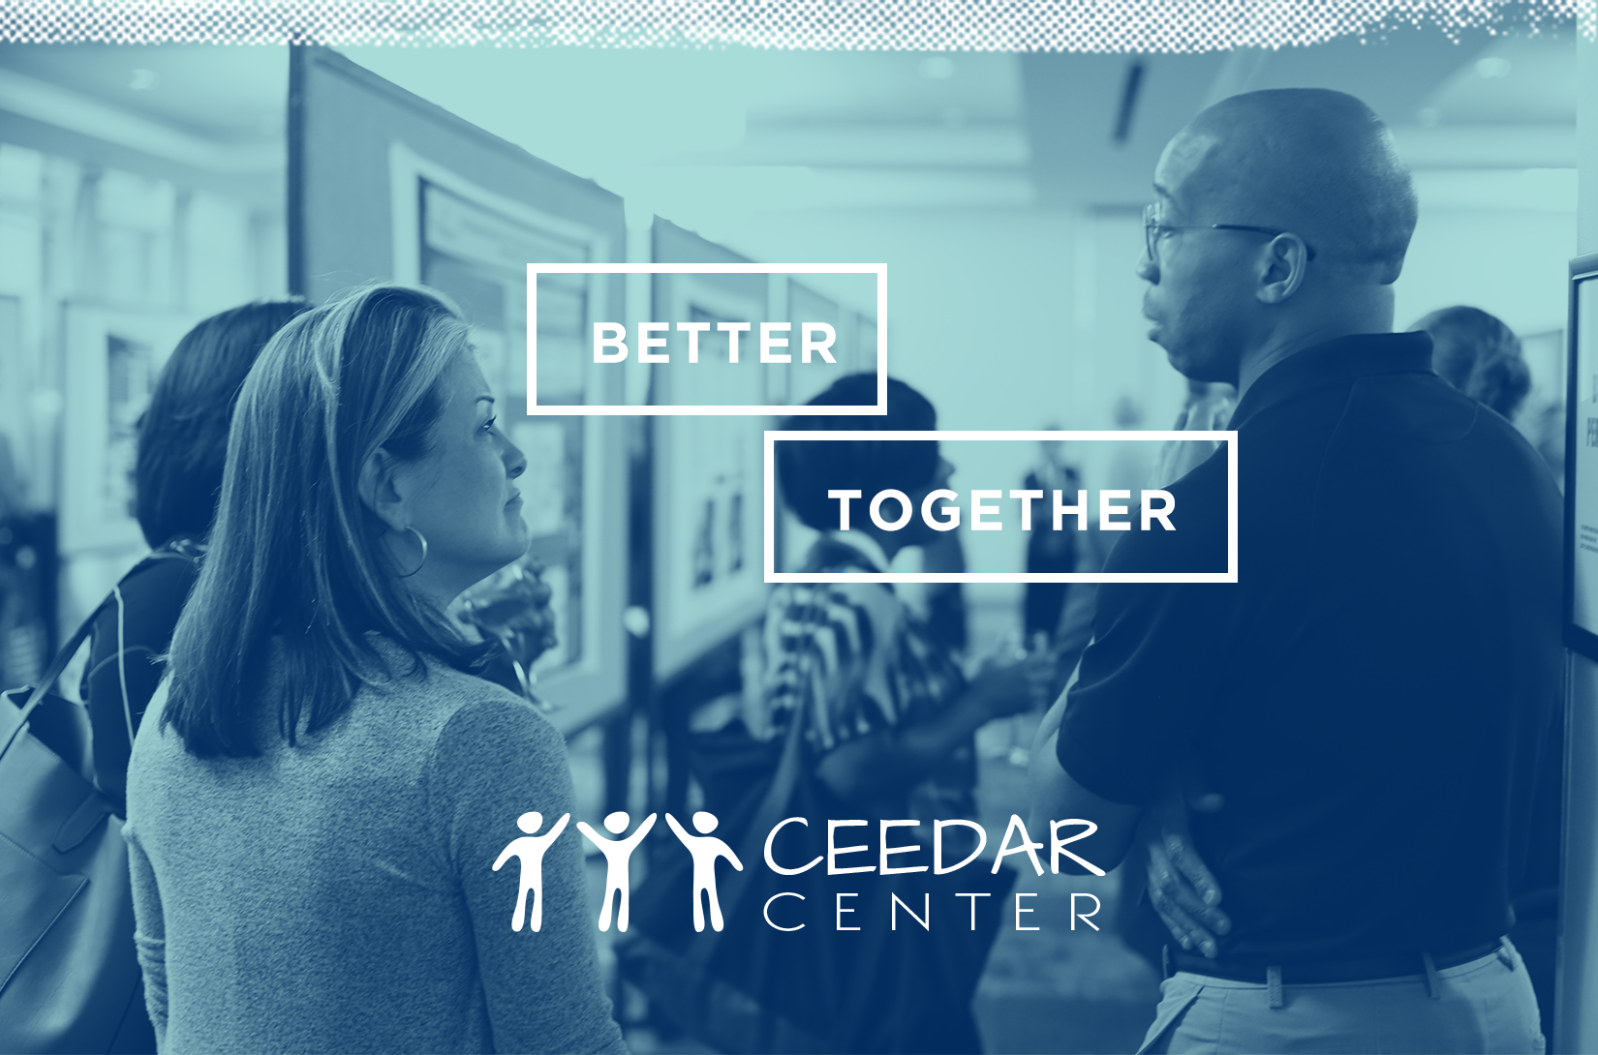
Culturally Relevant Education

Slide 2
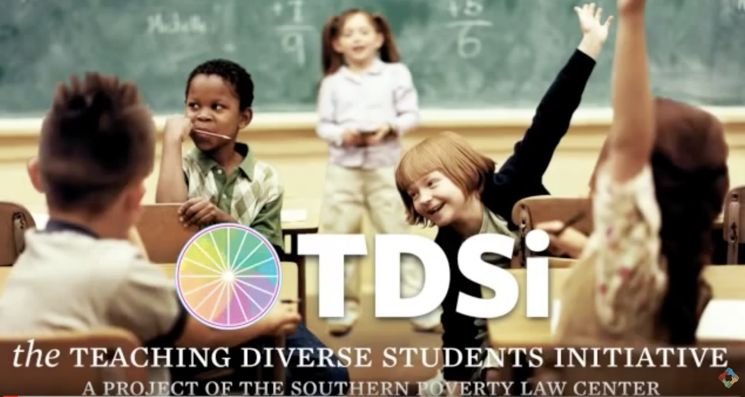
Culturally responsive & relevant pedagogy
Notes:
https://youtu.be/nGTVjJuRaZ8

Slide 3
Conceptions of Culture
Conceptions of Culture
(Hall, 1976; White, 1959)
A blueprint for perception, evaluation, behavior, feeling, thinking.
Culture is in us, around us, like the air we breathe.
What appears to be natural and “how things are.”
A framework that guides and bounds life practices — a set of possibilities from which to choose.

Slide 4
Culture is dynamic
Glenn (1989) warned that "we need an approach to education that takes seriously the lived culture of children and their families, not the fiestas and folklores that had meaning for their grandparents but are not part of the lives of families coming to terms with the losses and gains of immigration" (p. 779).
What does this statement suggest about how culture should be approached with students in the classroom?

Slide 5
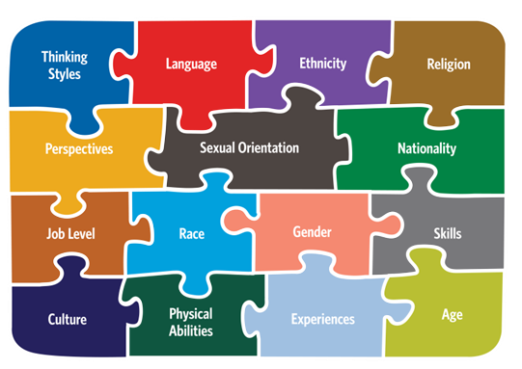
DIVERSITY
Notes:
The various backgrounds and races that comprise a community, nation, or other grouping. In many cases, the term diversity does not just acknowledge the existence of diversity of background, race, gender, religion, sexual orientation, and so on, but also implies an appreciation of these differences (The Aspen Institute).

Slide 6

CULTURALLY/LINGUISTICALLY DIVERSE (CLD):
Primarily refers to people of color who are not Caucasian or White but can also include people who are Caucasian or White yet are outside the mainstream of American culture, including immigrants from Europe who have limited English proficiency or people who live in impoverished conditions; also, used by the U.S. Department of Education to define students enrolled in education programs who are either non-English proficient (NEP) or limited-English proficient (LEP; (International Center for Leadership in Education, 2011).

Slide 7
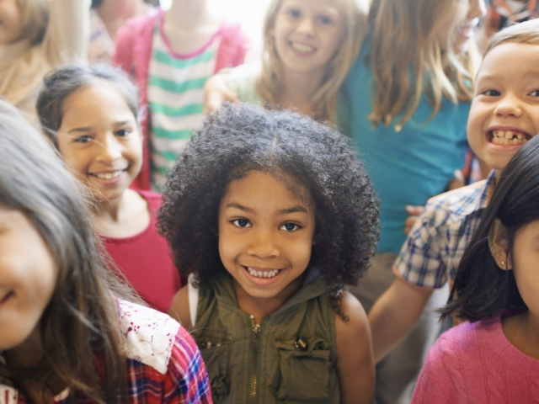
What’s the word on the street?
What are the “buzz” words/terms surrounding serving CLD students (and otherwise marginalized students) in your context?

Slide 8
The evolution of culturally relevant education
Culturally relevant pedagogy
Culturally responsive teaching
Culturally sustaining pedagogy

Slide 9
Educators enacting culturally relevant pedagogy do the following:
Emphasize preparing students for life-long learning through interactions that lead to individual and collective academic achievement and empowerment.
Develop sociopolitical consciousness, identify root causes of injustice, increase self-awareness, and incorporate these issues in instruction from an informed stance so that students are able to understand and critique systems and society.
(Howard 2012; Ladson-Billings, 1995)
Focus on cultural competence and equip students to navigate systems not designed to enable their success.

Slide 10
Culturally responsive teaching
Empower students socially and academically by setting high expectations and demonstrating commitment to students’ success.
Transform schools and societies through student-centered approaches to curriculum, instruction, and assessment.
Seek to see, acknowledge, and teach the whole child socially, emotionally, and politically.
Use students’ cultural capital and funds of knowledge to build on strengths to develop/enhance curricula and provide instruction.
Engage cultural knowledge, experiences, contributions, and perspectives.
Explicitly engage students in critical thinking, reflection, and action to spur emancipation and liberation for the community through the students.
(Gay 2002, 2010; Villegas & Lucas, 2002)

Slide 11
Culturally sustaining pedagogy
Educators enacting culturally sustaining pedagogy do the following:
Seek to “perpetuate and foster–to sustain–linguistic, literate, and cultural pluralism as part of the democratic project of schooling” (Paris, 2012, p. 93).
Seek to sustain “heritage and community” language, literacy, and cultural ways of knowing and being and offer “access to dominant cultural competence” (p. 95) while embracing the fluidity of culture and community.

Slide 12
Culturally relevant education
Captures the interconnectedness of culturally relevant pedagogy to inform culturally relevant teaching, delineating how “teaching affects competence and practice whereas pedagogy affects attitude and disposition” (Aronson & Laughter, 2016, p. 167).
Seeks to sustain cultural knowledge that students bring to the classroom, fostering cultural pluralism in all its fluidity.

Slide 13
DISCLAIMER
This content was produced under U.S. Department of Education, Office of Special Education Programs, Award No. H325A170003. David Guardino serves as the project officer. The views expressed herein do not necessarily represent the positions or polices of the U.S. Department of Education. No official endorsement by the U.S. Department of Education of any product, commodity, service, or enterprise mentioned in this website is intended or should be inferred.

