Slide 1
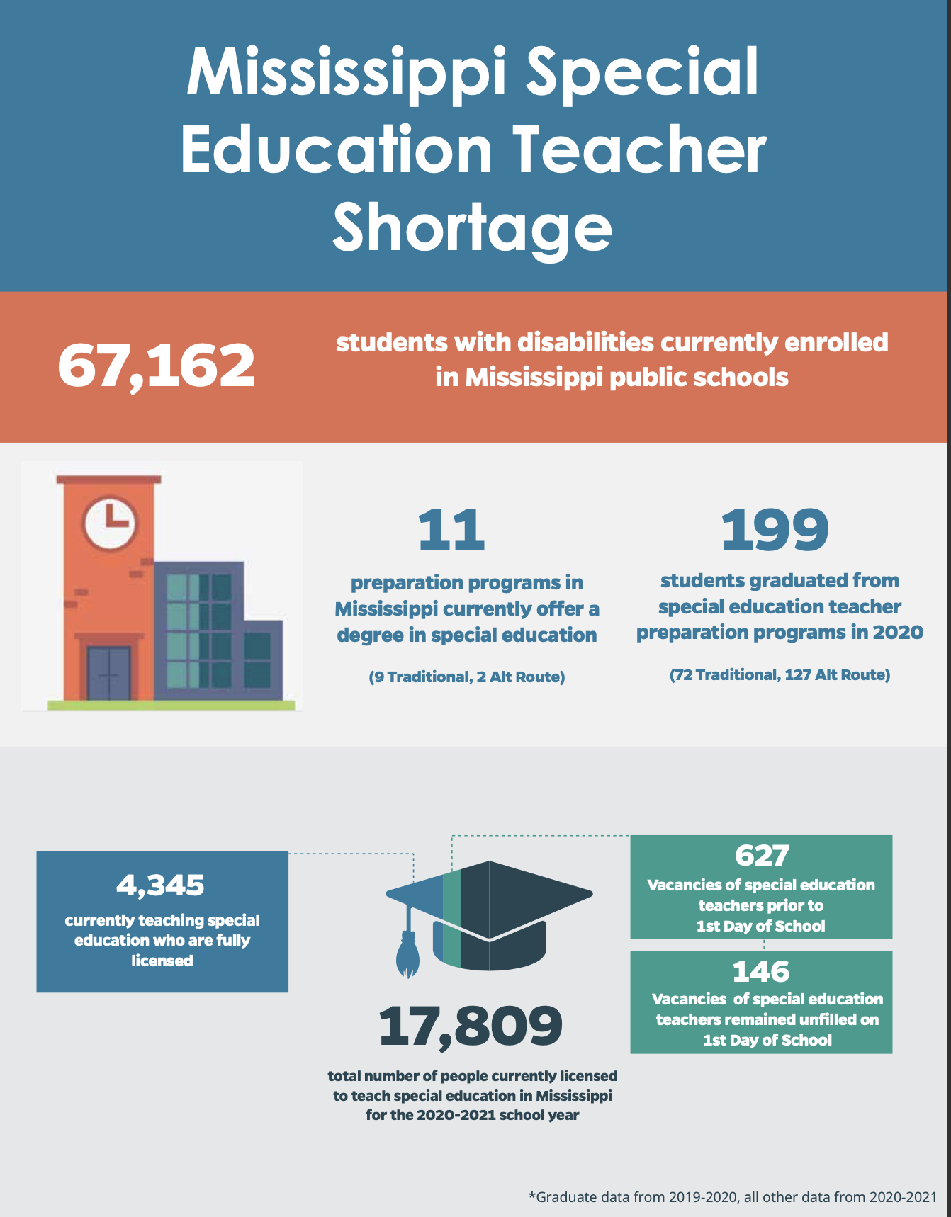
2020-2021 School Year

Slide 2
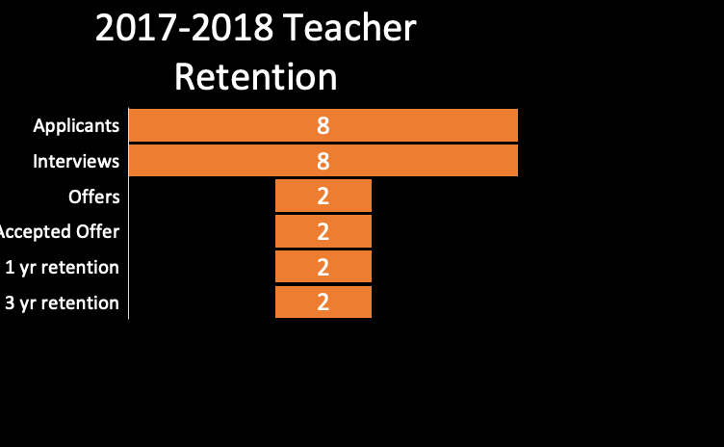
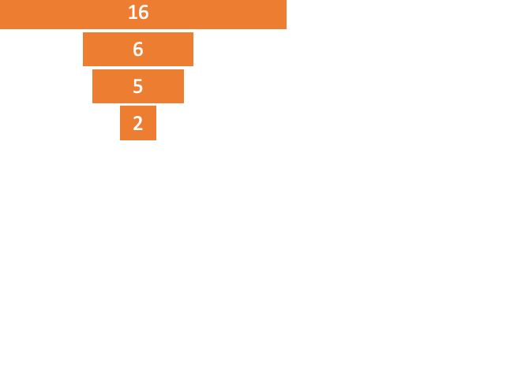
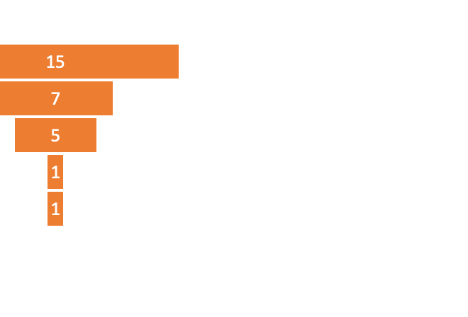
For these districts it “seems” there are enough applicants for open positions.
For the most part, retaining at year one, but not at three.
Why might that be?
Notes:
Elisa – data is also a little skewed --- how to create a system to capture accurate data

Slide 3
Teacher Exit Survey: What would have encouraged you to stay?
Development
37%
Supports
37%
Role
67%
Financial
50%
Additional induction and mentoring
More professional development opportunities
Opportunities for advancement
School culture that supports my roles and responsibilities
More supportive school administrators
Respect and consideration for my knowledge
More support from supervisors
Clear roles and responsibilities
Less paperwork
Respect for my time
More autonomy
Increase in pay (50%)
Notes:
Elisa

Slide 4
Principal Exit Survey – Why did your special educator leave?
Did not collaborate well with colleagues 12%
Moved/Retired 40%
Paperwork 20%
Did not support school culture 8%
Notes:
Elisa – perception is reality

Slide 5
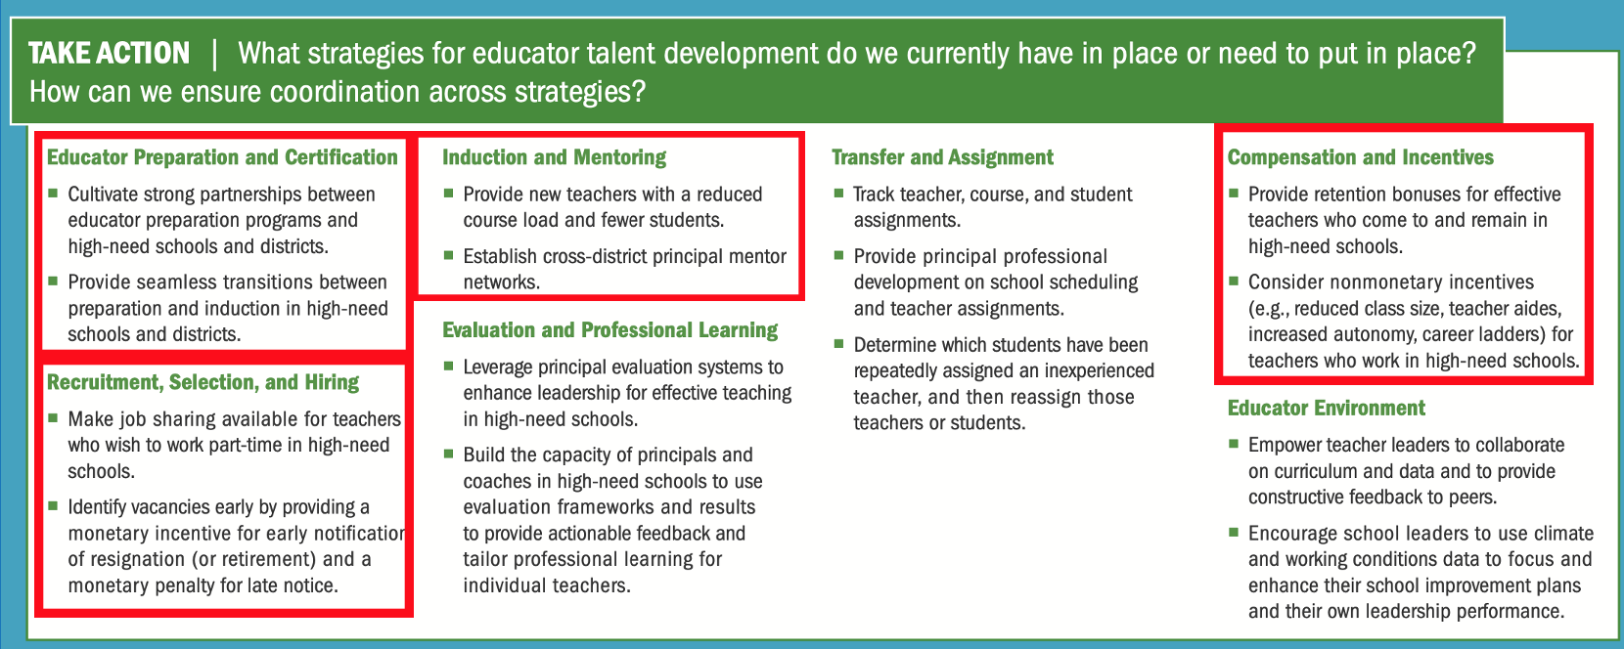
Potential target areas
Notes:
Elisa – coming to induction and mentoring – we can only change so much (not have access to change teacher prep) recruiting is good but need to have them stay

Slide 6

Strategy – Induction & Mentoring
Induction & Mentoring
Mentor Training & PD
New Teacher PD
District Administrator PD
Community of Practice – 3rd Year Teachers
Notes:
Lisa – bootcamps and checkins – let them work with eachother --- aligning all of these pieces to a HLP

Slide 7
Questions about the professional development
For New Teachers
Please rate your knowledge of HLPs Before and After you began the professional development.
Notes:
Lisa – used to collect data --- questions for new teachers (mid year)

Slide 8
HLP 4: Use multiple sources of information to develop a comprehensive understanding of a student’s strengths & needs
BEFORE PD
AFTER PD
Notes:
Lisa – had 20 teachers --- difficulty calculating response rate because who received it?

Slide 9
HLP 7: Establish a consistent, organized, & respectful learning environment
BEFORE PD
AFTER PD
Notes:
Lisa

Slide 10
HLP 8: (Social-emotional/behavioral practices) Provide positive & constructive feedback to guide students’ learning & behavior
BEFORE PD
AFTER PD
Notes:
Lisa

Slide 11
HLP 18: Use strategies to promote active student engagement
BEFORE PD
AFTER PD
Notes:
Lisa

Slide 12
HLP 22: (instructional) Provide positive & constructive feedback to guide students’ learning & behavior
BEFORE PD
AFTER PD
Notes:
Lisa

Slide 13
Please rate on a scale of 1 to 5 how the time you meet with your mentor(s) meets your needs with 1 being "does not meet my needs" to 5 "highly meets my needs."
Notes:
Elisa – specifically about Mentors – degree of support depends on if mentor is in building with teacher

Slide 14
What is something you need the most help with moving forward?
“I feel like I need more help with time management.”
“Writing IEPs”
“Connecting instruction between the IEP goal and what is going on in class.”
“Support when making decisions on high-profile students.”
Notes:
Elisa

Slide 15
How can external partners & district & school administrators better support you in your mentoring work? Constructive Feedback
“I think we all just need more time.”
“Make mentees aware of what is expected. Maybe have HLP training together (mentees & mentors).”
“Ask us how our mentoring experience is going. I don’t feel like my admin knew that I was a mentor this past year.”
“Everyone needs to meet at the beginning of the year to get on the same page.”
“My school administrators could be more cooperative with provided opportunities to focus time toward mentor work observations and such. My time is spread so thinly, I barely have time to do what I need to do.”
“Mentees should be in the same building as mentors.”
“It can be better by having a midway refresher bootcamp with administration.”
“External partners are excellent. School admin can support by lessening our ‘other jobs’ like janitorial work, etc. to focus on mentoring planning.”
Notes:
Elisa – effect of COVID – needing more time

Slide 16
Lessons Learned and moving forward
Beginning of the year orientation for mentors, mentees, & administrators
Mid-year check in with mentors, mentees, & administrators
MDE Initiative
Notes:
Lisa- Lessons learned ----we did not have a meeting with all (admin, teachers, mentors, etc)--- not a time for collective vision ----- do new teachers realize that mentoring is not “just another thing”

Slide 17
DISCLAIMER
This content was produced under U.S. Department of Education, Office of Special Education Programs, Award No. H325A170003. David Guardino serves as the project officer. The views expressed herein do not necessarily represent the positions or polices of the U.S. Department of Education. No official endorsement by the U.S. Department of Education of any product, commodity, service, or enterprise mentioned in this website is intended or should be inferred.

Slide 18


OUR PARTNERS

Slide 19
Breakouts
Lisa & Rachel – Mississippi in Main lobby (Group 1)
https://ceedarcenter.padlet.org/rsilva1/ml165ltas56mop16
Elisa –Mississippi (Group 2)
https://ceedarcenter.padlet.org/rsilva1/hpag2kjexmmahog7
Jennifer - Utah (Group 3)
https://ceedarcenter.padlet.org/tmdedc1/lkpnza3xs9wde1pq
Katie & Tim- Utah (Group 4)
https://ceedarcenter.padlet.org/tmdedc1/euq52sesxgwto4s3

Slide 20
Discussion
What is important to share with my team that helps my context, lessons learned, or things to avoid?
Who should I connect with later/ when and what should I follow up?

