Slide 1
Check In: Use the annotate tool to select which topics related to preparing candidates for online and hybrid instruction are you still interested in learning more about
Standards for Virtual/Hybrid Teaching
Teaching Methods & Curriculum
Practica/Field Experiences
Other (please indicate in chat)
Notes:
Keane please add here

Slide 2
Preparing Teacher Candidates for Online and Hybrid Instruction
Meeting 6: April 13, 2022
Dr. Sean J. Smith, PhD, CIDDL Center | Dr. Maya Israel, PhD, University of Florida |
Keane Alavi, CEEDAR Center | Rachel Silva, CEEDAR Center

Slide 3
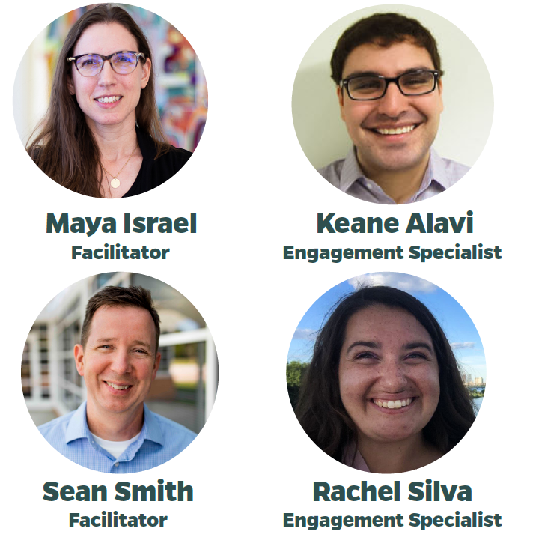
WHO WE ARE
Dr. Sean J. Smith, CIDDL Center
Dr. Maya Israel, University of Florida
Keane Alavi, CEEDAR Center
Rachel Silva, CEEDAR Center

Slide 4
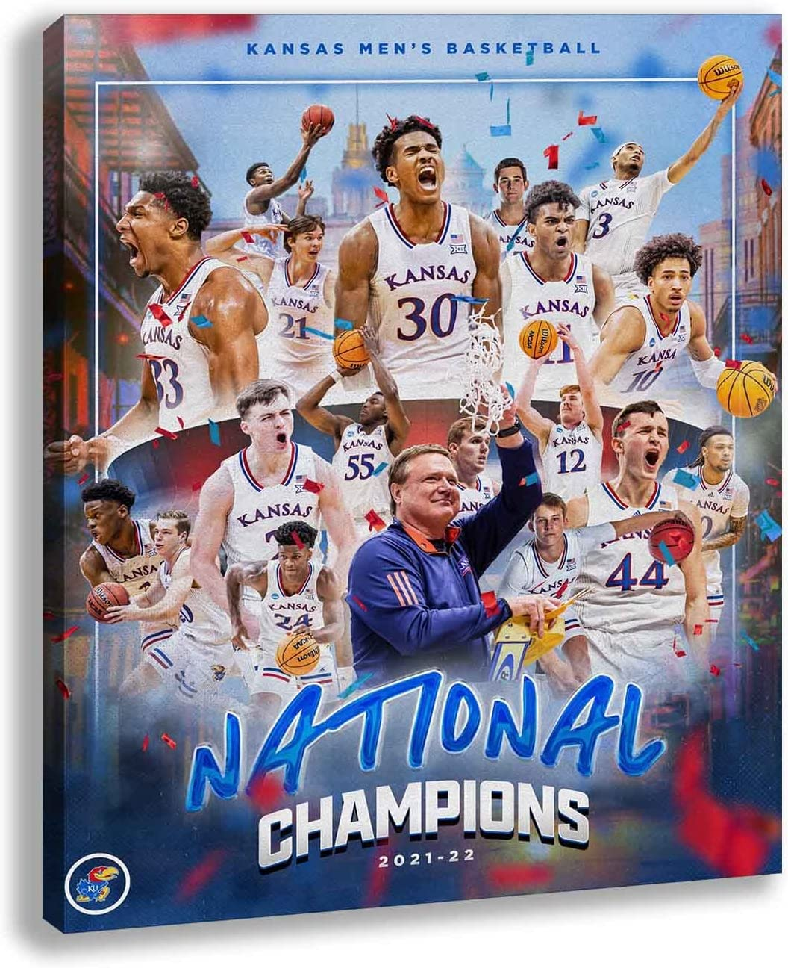

Slide 5
OUR PURPOSE
Is to engage with stakeholders interested in the preparation of personnel (e.g., preservice teachers) for the preK-12 hybrid or online classroom. Hope to discuss, learn, and address:
Issues related to such preparation and unpacking barriers.
Success stories
Tools, materials, and strategies to consider.
And so much more...
Notes:
Sean

Slide 6
Notes:
Keane

Slide 7
WHAT IS AN AG?
This is not a traditional “Webinar”
AG success is contingent on active participation!
Be ready to listen AND share
&
Notes:
Keane

Slide 8
March Affinity Group Overview
Discussion of how K-12 teaching exists within a variety of experiences (from in-person to virtual)
Preparation of teachers for these varied experiences
Changes to practicum experiences
Notes:
Maya
Practicum Field Experience Clinical Experience Internship
Mentor Teacher Collaborative Teacher Supervising Teacher Cooperative Teacher

Slide 9
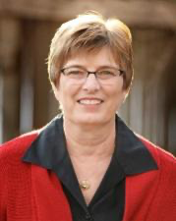
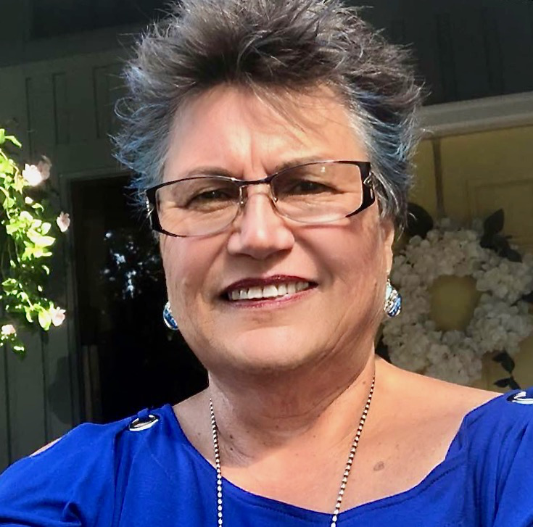
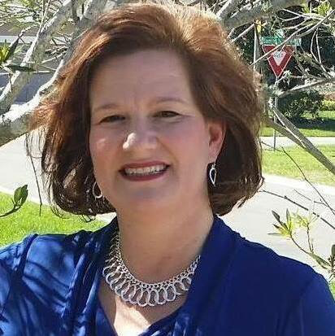
March Overview
Marti Elford
University of Kansas
Barbara Serianni
Georgia Southern University
Carolyn Rethwisch
Savannah Chatham eLearning Academy
Notes:
Maya
Marti: Supervision and Facilitating Practicums
Barb & Carolyn: Experiences Facilitating Practicum: Reflections from the Field

Slide 10
The Family

Slide 12
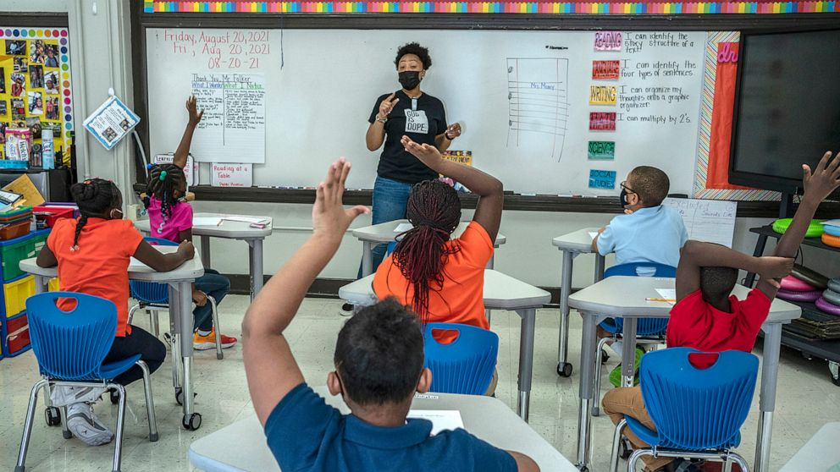
Collaborate - Learning Coach
“It Takes a Village to Raise a Child”
Pandemic - Resulted in Role Changes
Social Emotional Development
Executive Functioning Skills
Technologist
Master Communicator
What about the Parent/Family?

Slide 13
Learning Coach...
Empower parents/family members
Engage parents
Ensure the home can support/reinforce
Effective communication
....

Slide 14
Communicate - Teach Stakeholders
Strategies - In the Home
Strategies - Student Empowerment
Strategies - Engagement
Strategies - Social Emotional
Learning Coach 101

Slide 15
Why Communicate?
Direct/Support/Facilitate Instruction.
Support/Facilitate Learning.
Improve Learner Outcomes.
Engage and Empower (e.g., use of strategies).
Share Information, Resources, Knowledge, & More.
Problem solving.

Slide 16
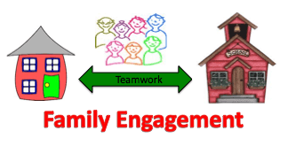
Why Communicate?
Hybrid
Virtual
Periodic F2F disruptions
Reinforcement on School-based learning
Online - extended learning
Online - Catch Up - Drill & Practice
Digital learning is here to STAY

Slide 17
Supporting Families +
https://www.pealcexnter.org/
Designated State Parent Training Center
Personalized to the Needs of PA
Experts in Family Engagement
Identified and proven strategies, processes, etc.
Understood’s - How to Use PTIs

Slide 18
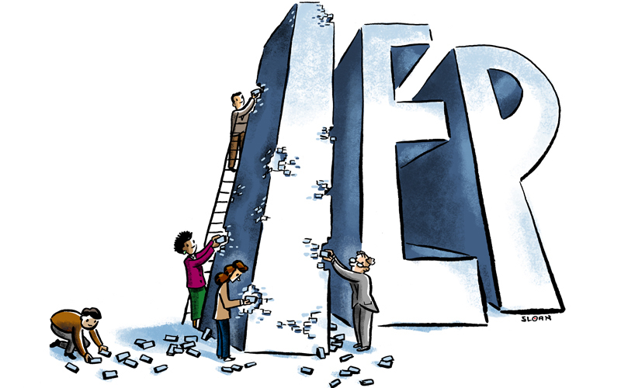
IEP Process
Use School’s Platform (LMS - Suite)
Send Meeting Announcements
Safe and Protected
Shared Information - Connecting Tools
It’s protected
It’s familiar
Cloud-based apps - Microsoft Teams - Etc.

Slide 19
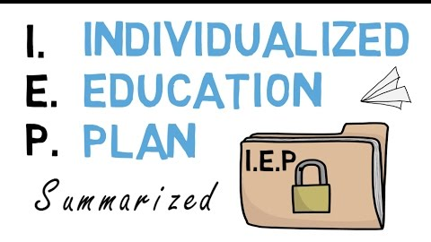
IEP Process
2. Consider varied web-conferencing tools (video, phone, organizing emails and communication)
3. Synchronize calendars (Google Calendar, Doodle, Outlook, etc.)
4. Create a Digital Agenda (organize the meeting, keep folks on track and informed)
5. Use confidentiality features of tech (e.g., email functions)

Slide 20
IEP Process
Maximize the power of Zoom
Master the tech features
Ensure accessibility
Use the various features
Be creative
Be collaborative

Slide 21
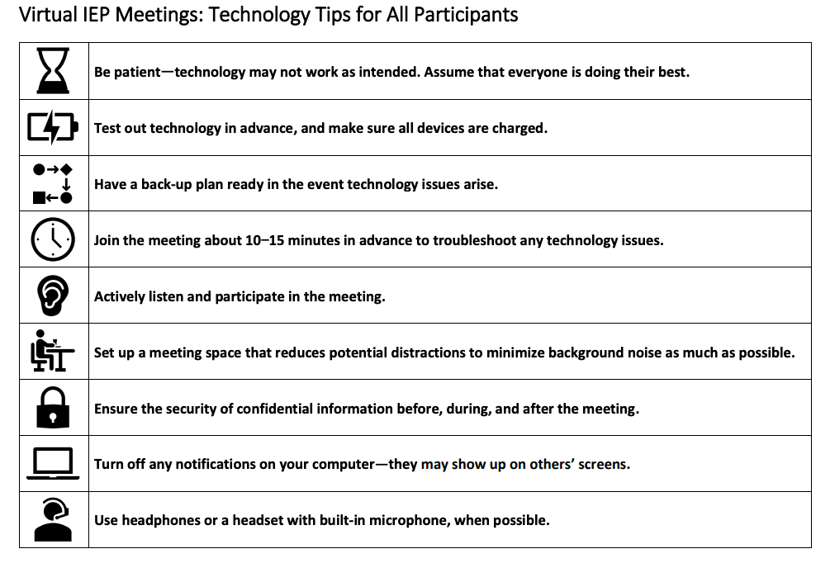
Have the Tech Work for You
WI’s Example

Slide 22
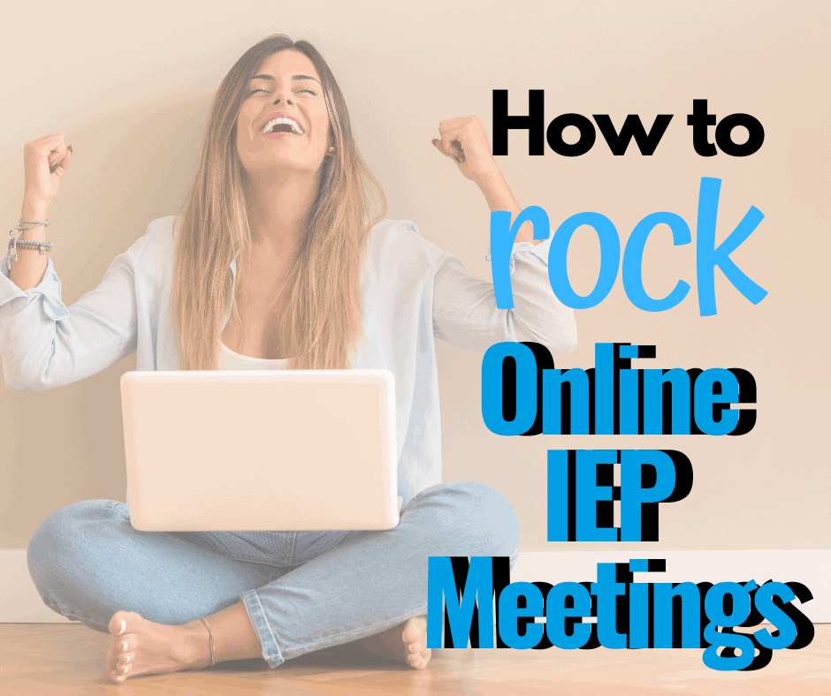
Virtual vs F2F - Future IEPs
Video Overview of Virtual IEP Tips - Special Education Teacher
Virtual IEP Meeting Suggestions - Tip Sheet
OSEP’s TIP Sheet
PATTAN’s Virtual Learning Resources
Podcast - How to Run a Virtual IEP Meeting

Slide 23
Communicate - Instruction +
Class Directions
Class Expectations
Strategy Applications - Student Empowerment
Tips & Strategies for the Home
Assessment - Determining Progress
Executive Functioning Skills
Social Emotional Supports

Slide 24
Communicate - Class Instruction
Explicit Directions
Step-by-Step Supports
Assignment/Instruction Expectations
How To Information
Instruction
Rinse & Repeat

Slide 25
Communicate - Class Instruction
Explicit Directions
Step-by-Step Supports
Assignment/Instruction Expectations
How To Information
Instruction
Rinse & Repeat
Tips for Teaching with Video
Top Tech Tools for Teachers
Best Screen Recorders - 2021
10 Ways to Use Video for Hybrid Instruction
Understood’s Video Tips

Slide 26
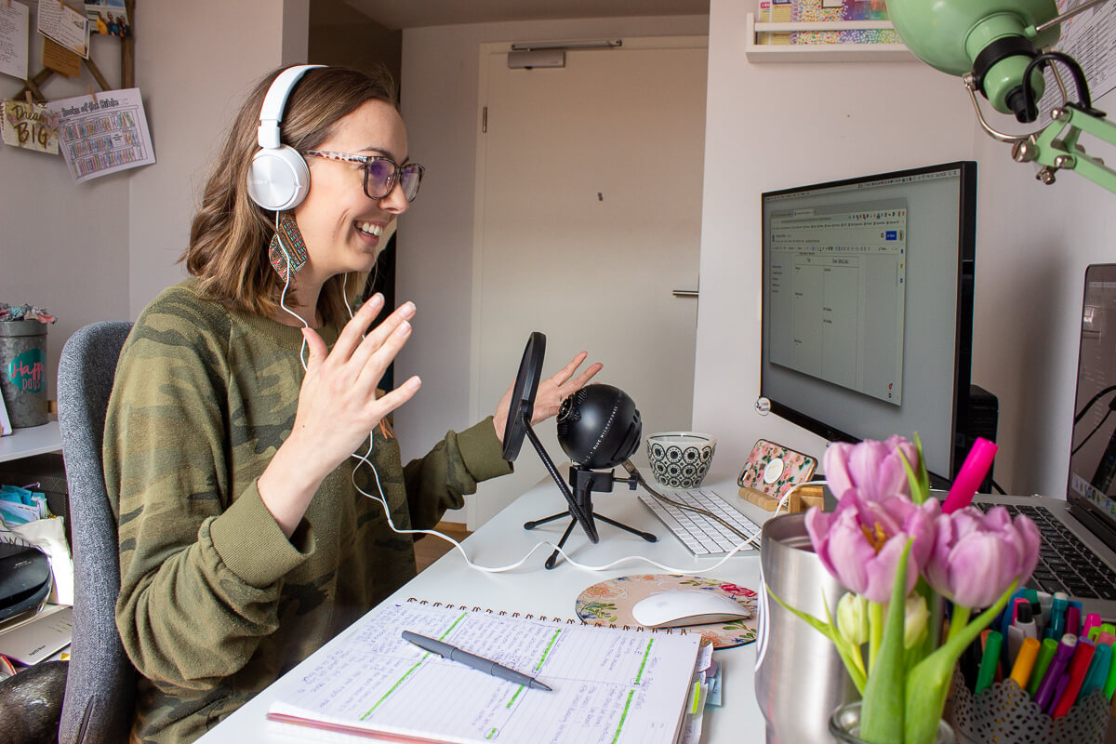
Communicate - Tech we will Use
Audio - Podcast & More
Step-by-Step Guide
Podcasts for Instruction
Video Modeling
Step-by-Step Guides
Video Modeling 101

Slide 27
Communicate - Podcasts for Teachers

Slide 28
Parent-Teacher Communication Tools
Best Family Communication Platforms - With Teachers
Teacher-Parent Communication Strategies
Best Classroom
Messaging Software
12 Ways to Use Social Media for Education
The Secret to Remote Learning Communication with Parents (Includes Podcast)
Webinar: Tips And Tricks For Communicating With Parents Remotely
Notes:
Bridgette find 2 more resources similar to what I have here..
Tools teachers can use to connect with families and parents

Slide 29
Resource Highlight: Parent University
Parent University: Created by Broward County Public Schools (FL) to help parents with transitioning to remote learning
Includes pre-recorded webinars and slide presentations for e-Learning strategies and best practices for parents, categorized by grade level
Closed captioning for the webinars is available in Spanish, Portuguese, Haitian-Creole, Arabic, Chinese and Vietnamese
Notes:
Bridget could u make this slide pretty
Add a link to Parent University
Find more school based guides that have been created by school districts to further engage and support parent-school interaction
Processes
toolkits

Slide 30
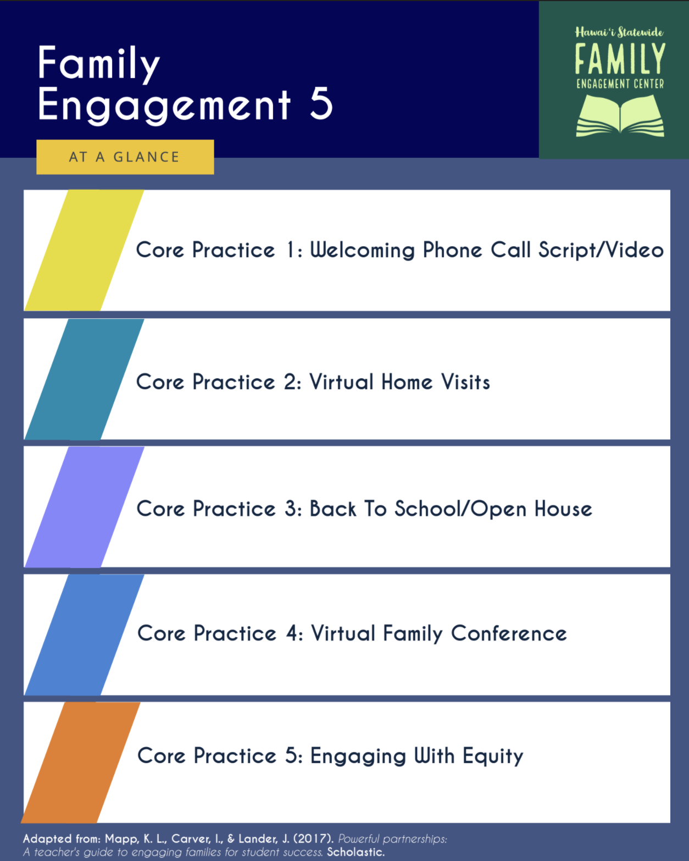
Resource Highlight: Remote Parent Engagement Strategies
Hawai'i Statewide Family Engagement Center: 5 Remote Family Engagement Strategies (Tips, Examples, and Step-By-Step Guides)
Online Tools for Parent Engagement: Resources from Education World, Edutopia, and Common Sense Education,
Creating Virtual Parent-Teacher Events: Resources from ParentSquare and Albert
Notes:
Bridget could u find other resources that suggest tools for parent and school communicate that

Slide 31
Parent-Teacher Communication Tools
Virtual Meeting Platforms
Social Media: Create Classroom Accounts/Pages
Direct, Individual Communication
Create Newsletters/Virtual Handouts

Slide 32
PADLET
Understanding families come from different backgrounds and have different experiences with technology, what types of experiences do teach candidates need to help to engage with parents more effectively within these spaces? Where in the teach preparation program does that fit? Should it fit?
Notes:
Rachel
Padlet: https://ceedarcenter.padlet.org/rsilva1/4jvadwtg9dbbvm3h

Slide 33
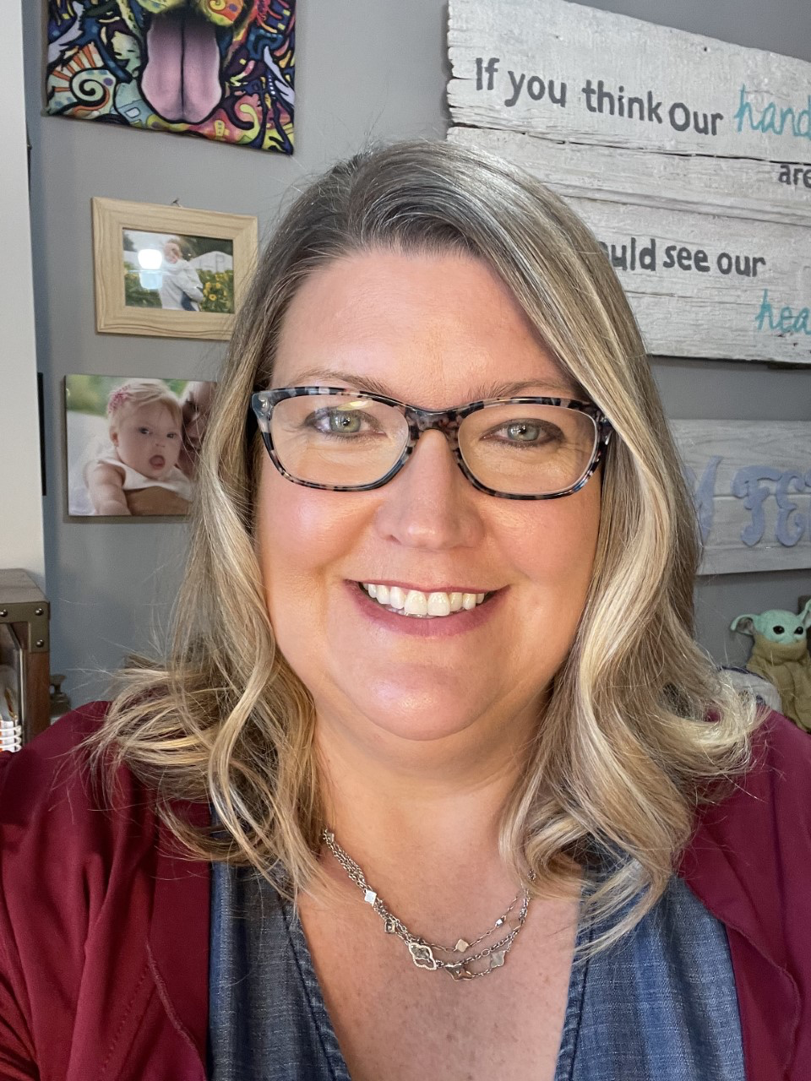
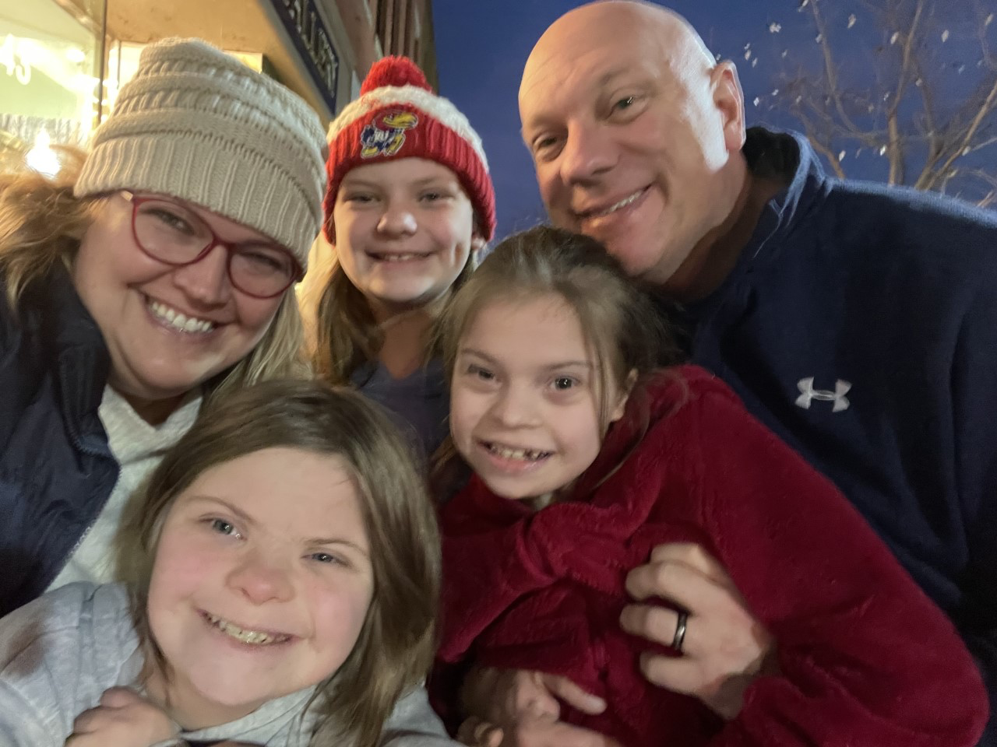
The Parent Perspective:
Jill Reffett

Slide 34
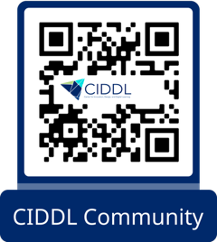
CIDDL PLN
Continue the conversation on our PLN "Teacher Preparation for Online/ Hybrid Instruction", where you can post follow-ups, reflections, questions, and inspirations related to this Affinity Group!
Join by scanning the QR code or visiting https://tinyurl.com/CIDDLNetwork

Slide 36
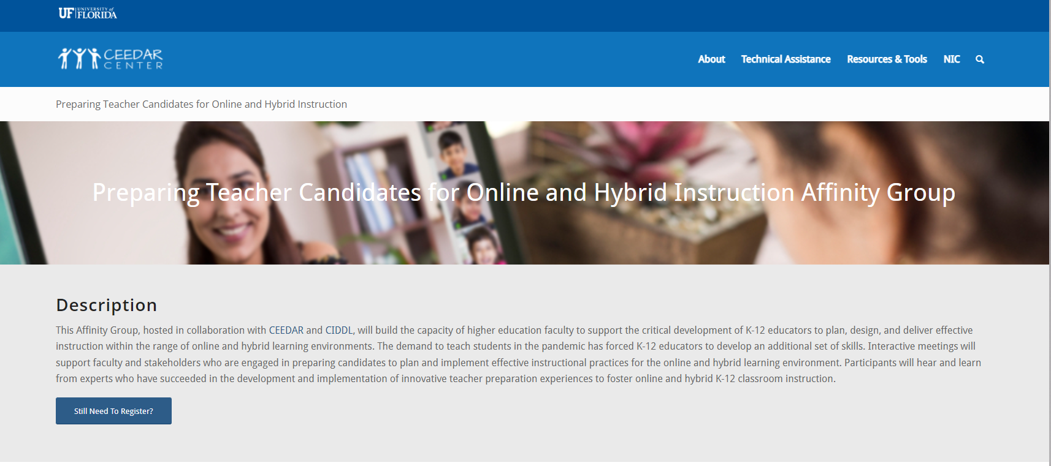
BEFORE YOU GO
Make sure you bookmark our Affinity Group archive site!
https://ceedar.education.ufl.edu/portfolio/preparing-teacher-candidates-for-online-and-hybrid-instruction/
Notes:
https://ceedar.education.ufl.edu/portfolio/preparing-teacher-candidates-for-online-and-hybrid-instruction/

