Slide 1
AS YOU ENTER, PLEASE USE THE ANNOTATE FEATURE TO IDENTIFY WHICH SEASON YOUR BIRTHDAY FALLS

Slide 2
Preparing Teacher Candidates for Online and Hybrid Instruction
Meeting 2: December 8, 2021
Dr. Sean J. Smith, PhD, CIDDL Center | Dr. Maya Israel, PhD, University of Florida |
Keane Alavi, CEEDAR Center | Rachel Silva, CEEDAR Center

Slide 3
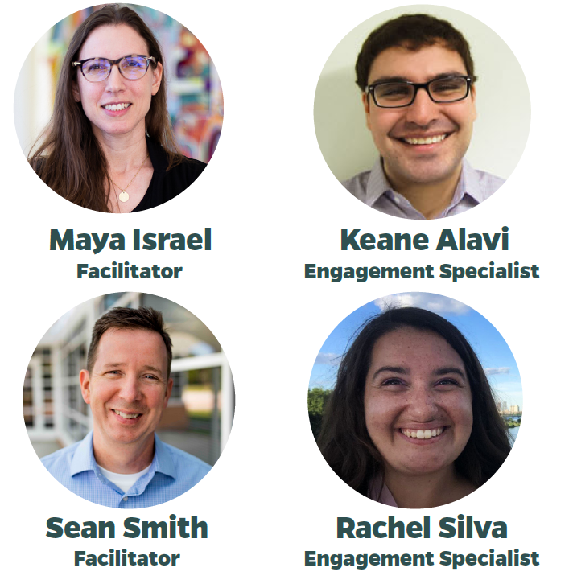
WHO WE ARE
Dr. Sean J. Smith, CIDDL Center
Dr. Maya Israel, University of Florida
Keane Alavi, CEEDAR Center
Rachel Silva, CEEDAR Center

Slide 4
OUR PURPOSE
Is to engage with stakeholders interested in the preparation of personnel (e.g., preservice teachers) for the preK-12 hybrid or online classroom. Hope to discuss, learn, and address:
Issues related to such preparation and unpacking barriers.
Success stories
Tools, materials, and strategies to consider.
And so much more...
Notes:
Sean

Slide 5
Notes:
Keane

Slide 6
WHAT IS AN AG?
This is not a traditional “Webinar”
AG success is contingent on active participation!
Be ready to listen AND share
&
Notes:
Keane

Slide 7
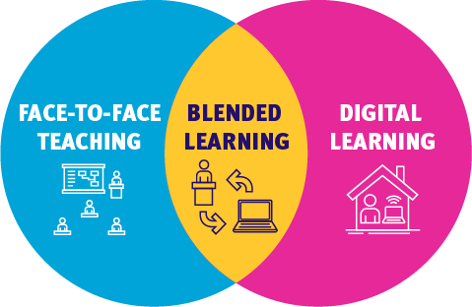
November’s Meeting:
Hybrid
Blended
Virtual
Online
Digital
Remote*
Center on Online Learning & Students with Disabilities
Notes:
Brief reminder of what we defined

Slide 8
Google Jamboard Activity
Findings Resources, Support, and Direction
Notes:
Rachel

Slide 9
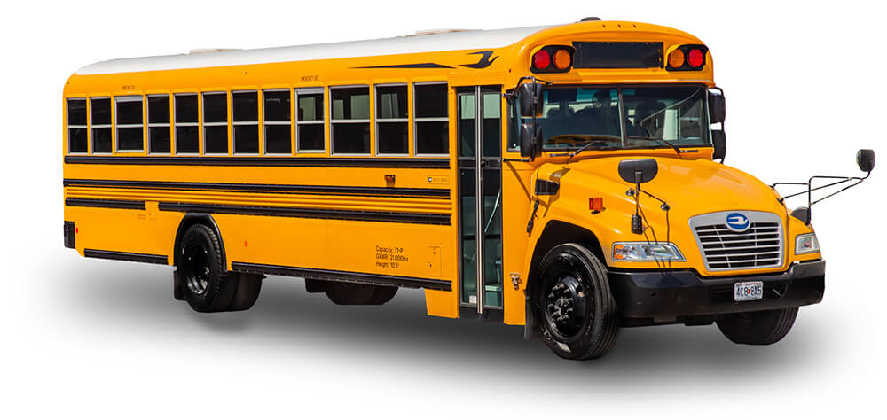
What/who drives our Teacher Preparation Efforts?
Accrediting Bodies
States
Standards
Professional Organizations
List goes on...

Slide 10
Practice-Based Standards for the Preparation of Special Educators
Initial -
5.2 Beginning special education professionals use technologies to support instructional assessment, planning, and delivery for individuals with exceptionalities.
5.3 - Beginning special education professionals are familiar with augmentative and alternative communication systems and a variety of assistive technologies to support the communication and learning of individuals with exceptionalities.
Advanced -
2.2 - Special educators continuously broaden and deepen their professional knowledge and expand their expertise with instructional technologies, curriculum standards, effective teaching strategies, and assistive technologies to support access to and learning of challenging content.
3.4 - Special education specialists use instructional and assistive technologies to improve programs, supports, and services for individuals with exceptionalities.

Slide 11
Other considerations...

Slide 12
But where are standards for K-12 Online Instruction???
Assistive Technology
AAC
Instructional
Support
Access

Slide 13
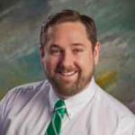
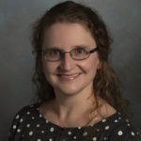
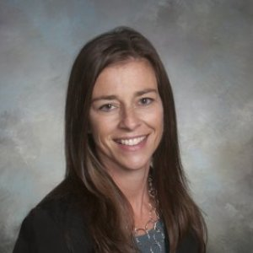
University of Mary Washington Colleagues
Kevin Good, Ph.D.
kgood@umw.edu
Melissa Jenkins, Ph.D.
mjenkin5@umw.edu
Jennifer Walker, Ph.D.
jwalker4@umw.edu

Slide 14
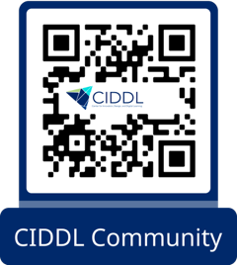
CIDDL PLN
Continue the conversation on our PLN "Teacher Preparation for Online/ Hybrid Instruction", where you can post follow-ups, reflections, questions, and inspirations related to this Affinity Group!
Join by scanning the QR code or visiting https://tinyurl.com/CIDDLNetwork

Slide 15
Next Affinity Group Session - January 12th
Topic: Teaching Methods and Curriculum
Wednesday, January 12th @ 2 pm ET

Slide 16
BEFORE YOU GO
Share in chat pod: What is one take-away you are leaving with after this meeting?
OR
What is one thing you will reflect on prior to the next meeting?

