Slide 1

Choosing the right metrics

Slide 2

Importance of Communication Plans
https://www.pexels.com/photo/person-holding-marker-1181537/

Slide 3
Align Your Communications Strategy
Mission
Tactics
Vision
Goals
Strategies
Broad
Single
Specific
Many

Slide 4
Initial Steps for An Integrated Communications Plan
Integrated Communication Plan
Research‐and Data‐Based Approach
Highlight Key Priorities
Describe Resources & Integration with Partners and Stakeholders
Measure & Optimize

Slide 5
Step 1: Research! Take a Data-Based Approach
Integrated Communication Plan
Research‐and Data‐Based Approach
Highlight Key Priorities
Describe Resources & Integration with Partners and Stakeholders
Measure & Optimize

Slide 6
Ask All of The Hard Questions
What are you trying to achieve this month / quarter?
Who do I want to reach?
Which programs/channels do I need to use to achieve my goals?
Which resources do I need to accomplish my tasks?
How can I determine which programs/channels worked?

Slide 7
In Other Words….
Goals
Define your key priorities
What are you trying to achieve
Audience(s)
Take a strategic approach to defining a narrow or target audience.
Who do I want to reach?
Tactics
What are the actions / programs that will be taken to achieve the goal?
What type of communications campaign would be best, omni-channel or multi-channel?
You can have multiple goals, but you should have them ranked in terms of importance to the mission.
Where do they typically ‘live’ (online, conferences, on social media, etc.
Resources
Plan and release content on a regular schedule.
What internal resources do I need to accomplish my tactics?
What external channels do I need to make sure are set in order for my tactics to work?
Measurement & Evolution
Define metrics or key performance indicators (KPIs) for success.
How can I determine which tactics or resources worked?

Slide 8
Take an Audit of Who, What, Where, Why & How
How have the current communications efforts performed?
What has worked in the past?
What is the current conversation?
What is the target audience saying about this topic?
Where are they having this conversation?
Who is the target audience and stakeholders?
Why is this important to the target audience(s)?
What in it for the target audience?
How many assets are already ready and available for you?
Who are the drivers of the conversation?
What are their interests?
What hasn’t worked in the past and why?
What is currently working?
What isn’t currently working and why?
Where do they live?
What languages they speak?
What stage of life they’re in (student, parent, retiree)?
What content do you already have produced?
Do you have webinars that can be repurposed?
Do you have printed material that is ready to use?
What is your elevator speech?
Why do they need this information?

Slide 9
Strategies for Building An Audience
Create personas: define as narrow an audience as possible.
The Five Why’s – ask why your audience needs this information five times until you get to the real stakes
Create content and release on a regular schedule to set a date with your audience and building anticipation
Pick one or two platforms to start, deliver consistently, and have patience (strategy, not volume, will help you meet goals)

Slide 10
Example of an Asset Audit
Digital Platform / Website
Interactive Tactics
Infrastructure
Analytics
Offline Tactics
Promotion
Community

Slide 11
Step 2: Set Priorities
Integrated Communication Plan
Research‐and Data‐Based Approach
Highlight Key Priorities
Describe Resources & Integration with Partners and Stakeholders
Measure & Optimize

Slide 12
Understand the Engagement Process
Research & Discovery
Evaluate
Grow
Engage
Validate
Use / Implement

Slide 13
Integrated Communications Planning Through the Engagement Process
Research & Discovery
Evaluate
Grow
Engage
Validate
Use / Implement
Marketing Strategy
What Tactics will I use?
Marketing Strategy
What tactics will I use?
Marketing Strategy
What tactics will I use?
Metrics,
KPIs & Optimization

Slide 14
Integrated Communications Planning Through the Engagement Process
Research & Discovery
Evaluate
Grow
Engage
Validate
Use / Implement
Marketing Strategy
What Tactics will I use?
Marketing Strategy
What tactics will I use?
Metrics,
KPIs & Optimization
Messaging & positioning
Website content
Blog
Newsletter
Training Webinar
PR Articles
Speaking engagements
Print guides / brochures
Watch videos
Download case studies
Conference registration
Attend an event
Research requests
Whitepapers
Webinar Training
PR Articles

Slide 15
Step 3: Resources
Integrated Communication Plan
Research‐and Data‐Based Approach
Highlight Key Priorities
Describe Resources & Integration with Partners and Stakeholders
Measure & Optimize

Slide 16
Map Your Resources to Target Audience, Key Partners and Stakeholders
Audience | Priority Message | Partners or Stakeholders | Assets and Resources | Timeline | Who’s Responsible
Families and Children | Career readiness Caring community Strong resources available | Teachers Counselors Clergy Coaches | Video Blog Webinar Social media content Website Resources | Priority in August to December January | Education Chair works with AIR
Deaf-Blind Community | Early Identification and Intervention Family Involvement Caring Community | Practitioners Regional Parent Centers State Coordinators | Success Stories Webinar Email Local Events Conferences | Year-round with focus on evergreen stories that can be used to supplement event promotion | Communications Staff

Slide 17
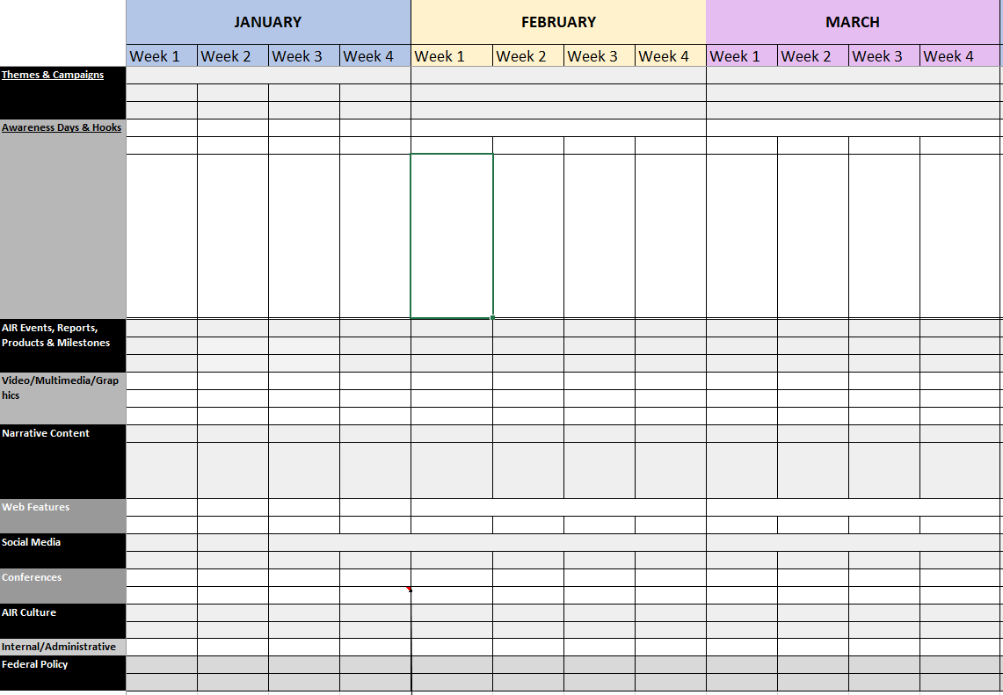
Get Organized with an Editorial Calendar

Slide 18
Step 4: Measure & Optimize
Integrated Communication Plan
Research‐and Data‐Based Approach
Highlight Key Priorities
Describe Resources & Integration with Partners and Stakeholders
Measure & Optimize

Slide 19
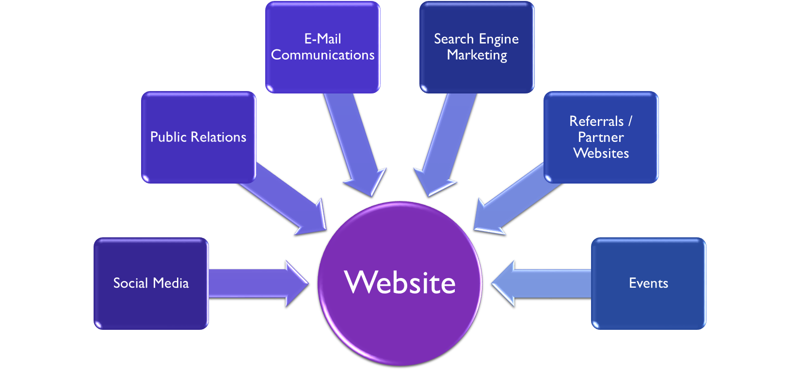
Why Measure?

Slide 20
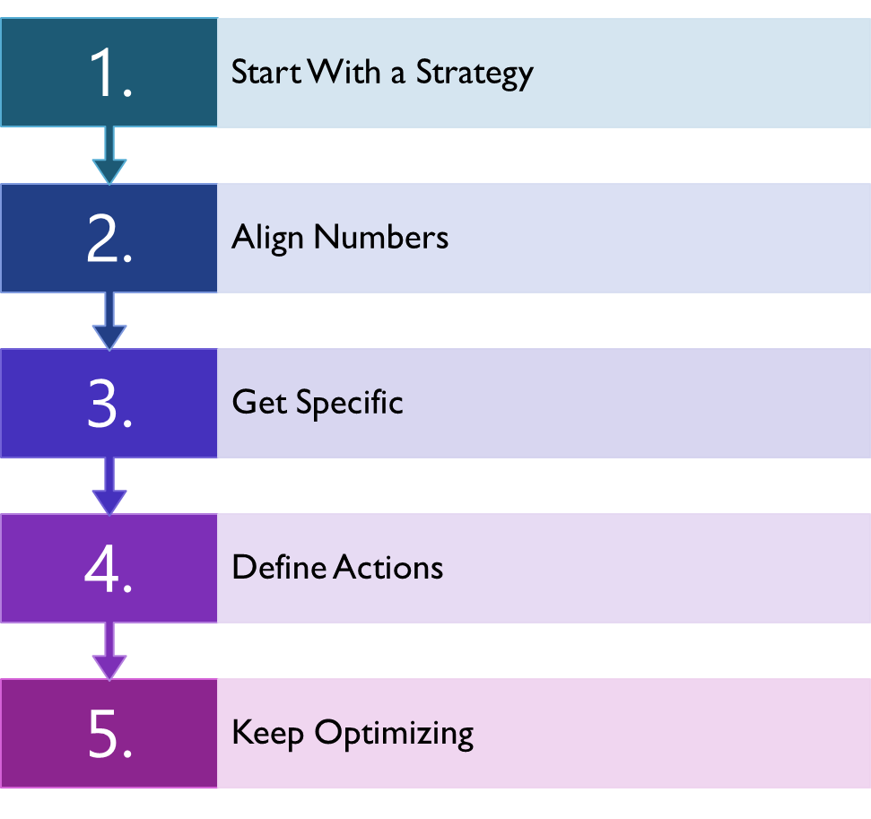
Create a Measurement Plan

Slide 21

Beware Of Vanity Metrics
Photo by Lukas from Pexels

Slide 22
A Smörgåsbord of Content Metrics
Basic Metrics
Engagement Metrics
Positioning Metrics
KPIs
Unique users
Pageviews
Bounce Rate
Average Session
Pages per Session
Clicks on Call to Actions
Pages per Source /Medium
How are you doing on search engines
Number of forms completed on gated content
Number of subscribe to emails
Number of completed registration for webinars or event

Slide 23
Yes! You can measure “Traditional Media”
Set some goals!
  X amount of unique visits to your website
  X amount of clicks to your resource page
  X amount of downloads
  X amount of sign-ups for an email list
  X amount of attendee to your event

Slide 24
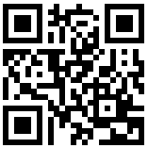
How Traditional Media Can Work and Be Measured
QR code offer its own URL to be linked to
Vanity URL for attribution
Special code for a download, webinar or event

Slide 25
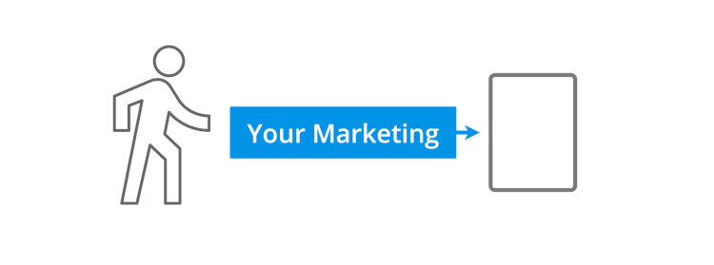
How to Track Using
Urchin Tracking Module (UTM) Tags

Slide 26

Using UTM Tags for Attribution
www.air.org/NGA_Conference
www.air.org/NGA_Conference?utm_source=print&utm_medium=meeting&utm_campaign=NGA%20Conference

Slide 27

Using UTM Tags for Attribution
https://www.jcrew.com/c/shops/stripesshop?srccode=OSMFCBK01728&utm_source=facebookorganic&utm_medium=social&utm_campaign=OSMFCBK01728&fbclid=IwAR3B2zoYbLbRyCShJkbpEGwt2Zl7juoOqVryL5Z8j6k4IPP8jjwjGsfhkPo

Slide 28
Last Thoughts…
An integrated platform of activity, not a “Chinese menu” of possibilities
Action happens both concurrent and consecutively
Build on successes, abandon those activities with limited ROI (measurement is key)
Biggest expense is time; does not require major $$ to do right

Slide 29
Example Outline of a Simple Integrated Communications Plan for an Executive
Executive Summary
Part 1: Background
  Communicate the organizations mission and vision.
  Discuss prior objectives, implementations and accomplishments.
Part 2: Today
  Examine the research (qualitative and quantitative).
  Review your SWOT analysis; strengths, weaknesses, opportunities and threats.
  Lay out new goals.

Slide 30
Example Outline of a Simple Integrated Communications Plan for an Executive
Part 3: Planning
  Audience segmentation
    Internal and external audiences
  Objectives for communication campaign(s)
    You will most likely have multiple objectives for the year.
    These should support the overall mission and vision of the organization.
  Strategies
    These are your very high-level tactics / activities that you would like to accomplish to meet the objectives.
  Measurement & Evaluation
    When the strategy calls for an engagement, like download or enrollment, list out the KPIs and other metrics for success.

Slide 31
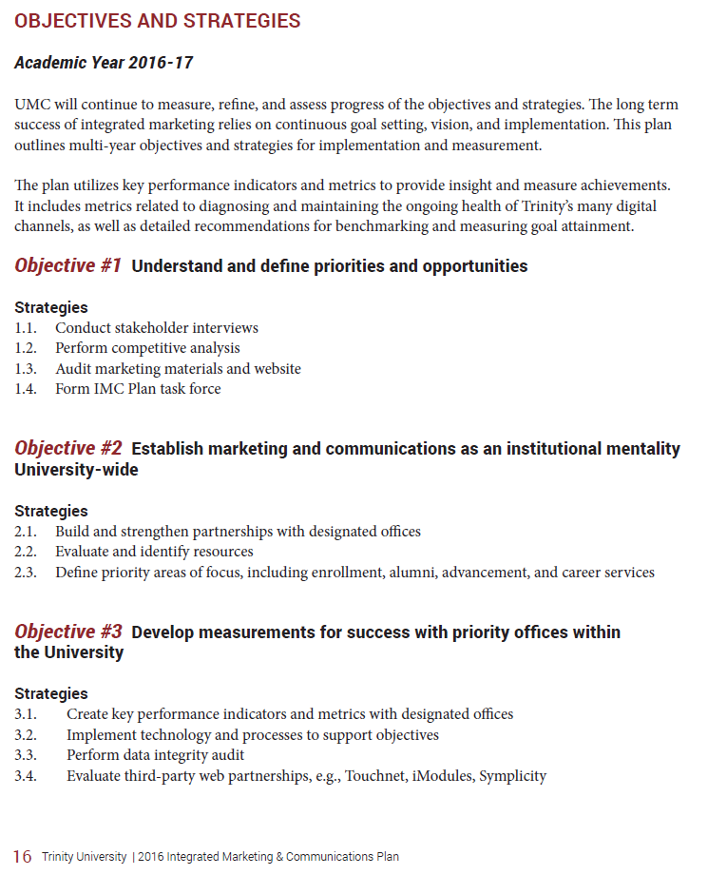
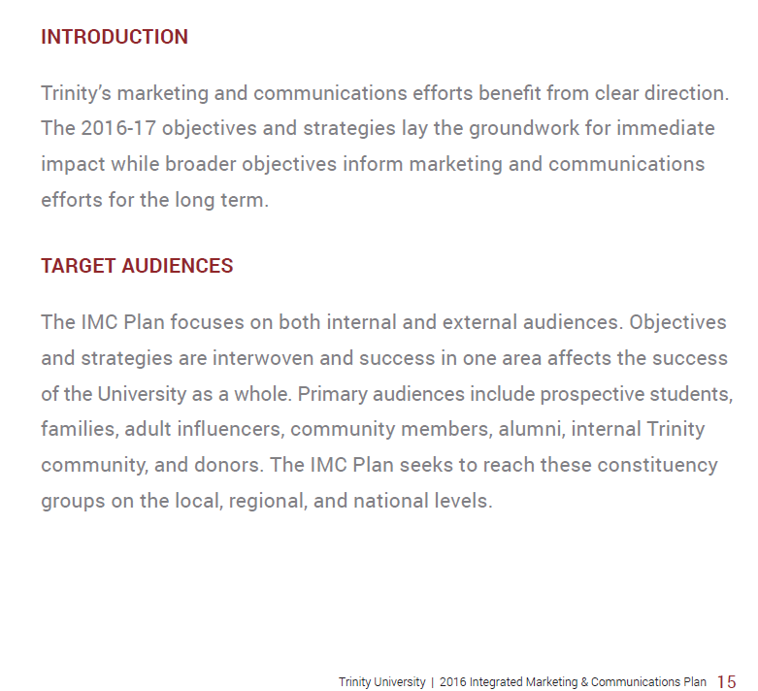
Example from Trinity University

Slide 32
Free Measurement Tools
Google Analytics https://analytics.google.com/
Google Surveys https://surveys.google.com/
Google Alerts https://www.google.com/alerts
Google Data Studio https://datastudio.google.com/navigation/reporting
Google Custom URL Builder
Tweetdeck
https://tweetdeck.twitter.com/
SproutSocial
https://sproutsocial.com/
Hootsuite
https://hootsuite.com/
Native Platform Analytics (Facebook, Twitter, LinkedIn, YouTube, etc.)
https://ga-dev-tools.appspot.com/campaign-url-builder/

Slide 33
Example Outline of a Detailed
Integrated Communications Plan
Executive Summary
Background Unique Proposition
Today, Identify the Organizations Objectives
Audience and Customer Personas
Key partners, and community and government relations
Message Development
Channels: digital, social media, print, direct mail, email
Important events and webinars
Measurement plan and goals
Editorial calendar for content planning
Measure and optimization frequency

Slide 34
DISCLAIMER
This content was produced under U.S. Department of Education, Office of Special Education Programs, Award No. H325A170003. David Guardino serves as the project officer. The views expressed herein do not necessarily represent the positions or polices of the U.S. Department of Education. No official endorsement by the U.S. Department of Education of any product, commodity, service, or enterprise mentioned in this website is intended or should be inferred.

