Slide 1
BUILDING POLICY THROUGH NETWORKING STRATEGIES NICK GILLON, TARA HASKINS, KERA ACKERMAN, TODD WHITNEY

Slide 2
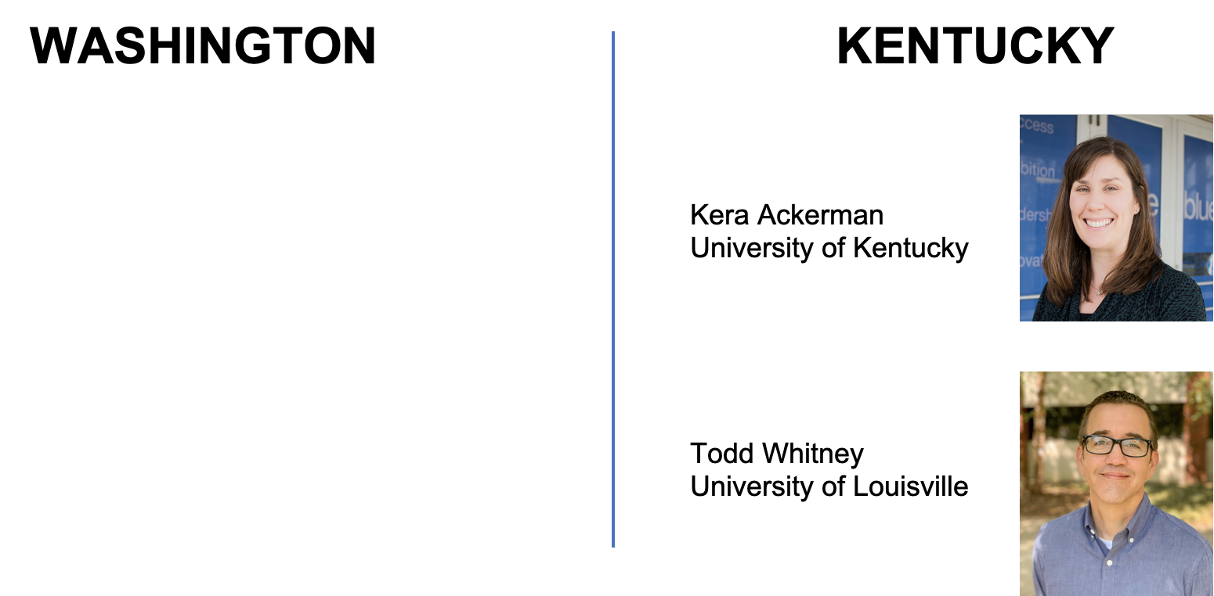
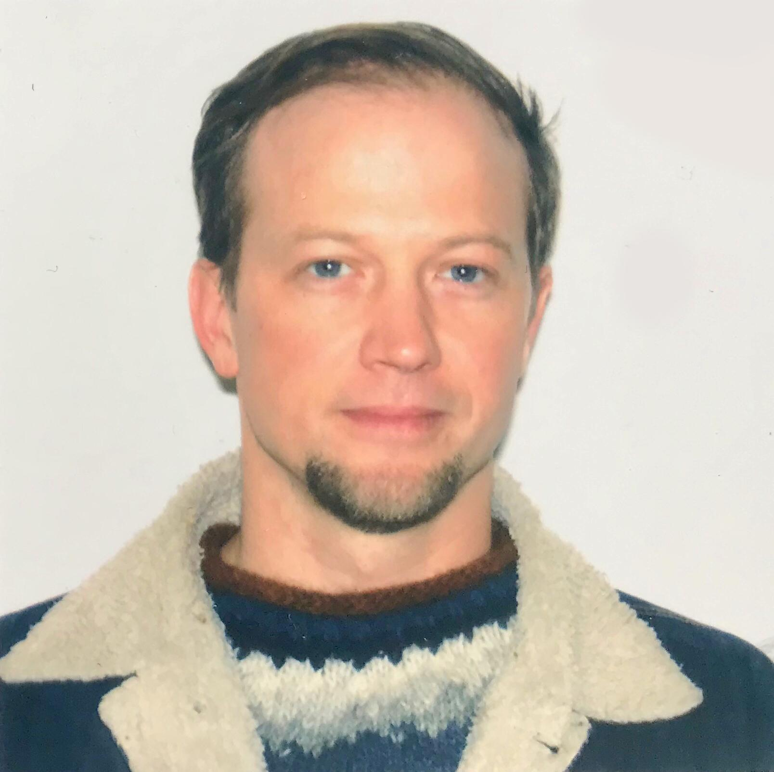
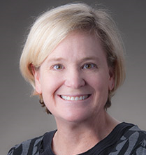
PRESENTER INTRODUCTIONS
Nicholas Gillon
Washington State Professional Educator Standards Board
Tara Haskins
Eastern Washington University

Slide 3
SESSION OBJECTIVES
•Participants will learn strategies for organizing change through a focus on policy levers that walk across the boundaries of the P-12 and educator preparation contexts.
Participants will be asked to consider and discuss their roles in initiating, convening, and sustaining momentum across education sectors such as local, intermediary, and statewide government, school districts, educator preparation programs, the educator workforce, and professional organizations.

Slide 4
TELL US WHAT YOU THINK… (padlet)
What are the advantages/disadvantages: Top down vs. bottom up
What is something you have done that you consider to be bottom up policy change?
What is something you have done that you consider to be top-down?
Notes:
padlet
https://ceedarcenter.padlet.org/nspalding1/wytcdu9gg8la9lri

Slide 5
WASHINGTON
The Washington team will share their exploration of the relationship between knowledge and skills standards for students with those of pre-service teachers.

Slide 8
Themes
Across three sets of applicable standards for teachers - inTASC, WA State SPED Endorsement, NAEYC - 7 themes emerged:
Family and communities
Formal assessment
Planning
Instruction calibrated by informal assessment
Differentiation and responsiveness
Professionalism
Subject matter content knowledge
Across two subject areas in one grade broad themes emerged:
Culturally normative
Developmentally normative
Decontextualized
Not inclusive of 6 of the 7 themes involved in standards for educators

Slide 9
KENTUCKY
Finding the Initiatives
Lorem 3
Lorem 1
Scaling the Message
Narrowing the Focus
Identifying key HLP that align to our mission.
Ensuring our mission compliments existing statewide initiatives.
Engaging key players to scale the work statewide.

Slide 10
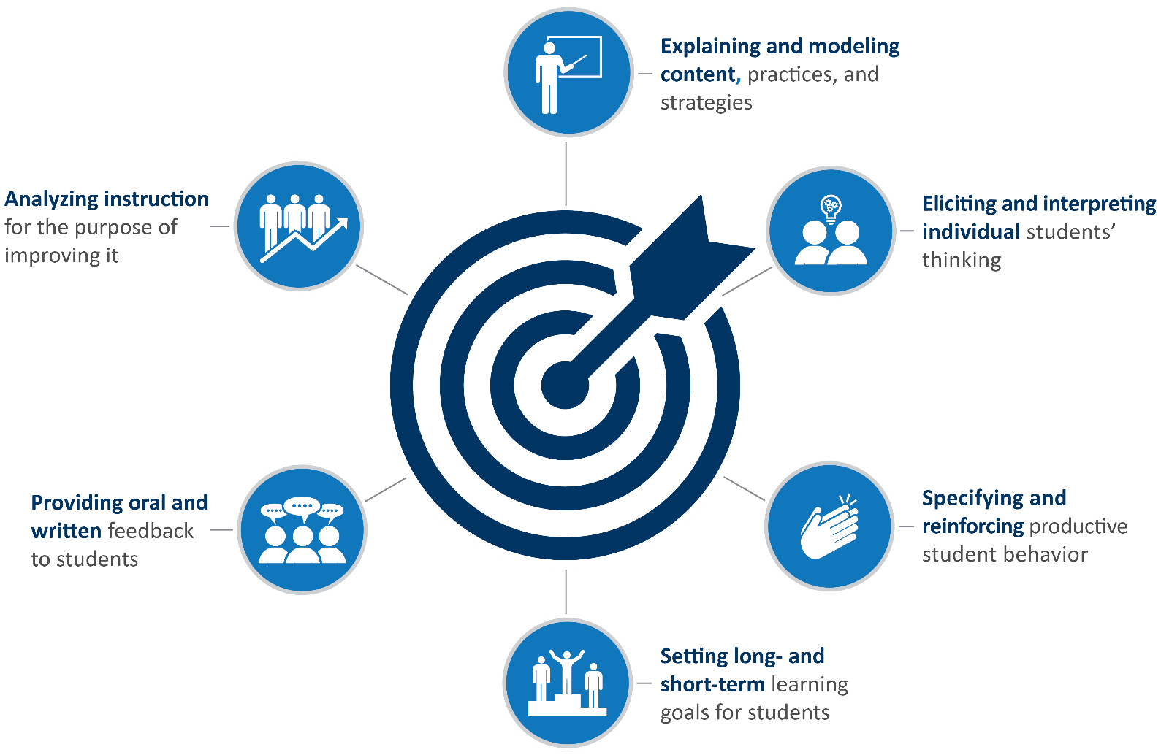
KEEP Purposeful Practices
Advancing Outcomes for All Learners

Slide 11
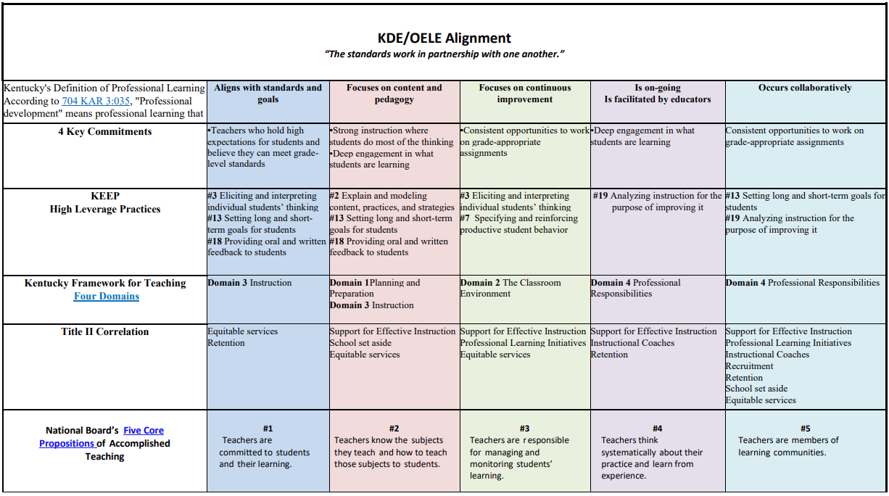

Slide 12
Key Players
Kentucky Department of Education, Office of Educator Licensure and Effectiveness
Teaching and Learning Pathways
Institutions of Higher Education
University of Louisville
University of Kentucky
Thomas More University
Western Kentucky University
State Level EPP Organizations
Kentucky Association of Teacher Educators
Special Education Consortium
KY Council for Exceptional Children, Teacher Education Division
Education Cooperatives

Slide 13
BREAKOUT SESSION:
GIVE US YOUR EXAMPLES (in padlet)
Are initiatives in your state more top-down or bottom-up?
What is working well in your state?
What are you challenged by?
Notes:
breakout session padlet:
https://ceedarcenter.padlet.org/nspalding1/svyy8o1hmpy2a4zv

