Slide 1
There's a Hole in my Bucket…
Utah and Learning Policy Institute
Leah Voorhies * Jennifer McKenzie * Steve Wojcikiewicz

Slide 2
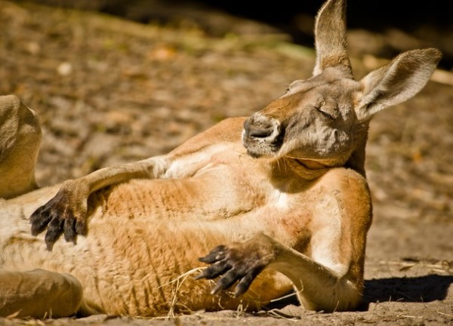
Check in… To what degree are shortages an issue on your context?
Who are WE… our current Role
CEEDAR Partners
SEA LEadership
LEA leadership
IHE Leadership
CEEDAR Staff

Slide 3
Utah’s challenges and efforts attraction, preparation, retention
Utah State Board of Education (USBE)
Leah Voorhies - Assistant Superintendent

Slide 4
Utah’s Beacon project
Southern Utah University (SUU)
Jennifer McKenzie

Slide 5
Relevant research and policy Crosswalk of the OSEP GTL/AIR LPI toolkits
Learning Policy Institute (LPI)
Steve Wojcikiewicz

Slide 6
Explore https://ceedar.education.ufl.edu/shortage-toolkit/ Share your experience and questions… What can LEAs do to keep good teachers in special education? What can IHEs and SEAs do to effectively support LEA retention efforts?
Breakout Groups Padlet link
https://ceedarcenter.padlet.org/tmdedc1/7cluq5xnj6kqhoxs

Slide 7
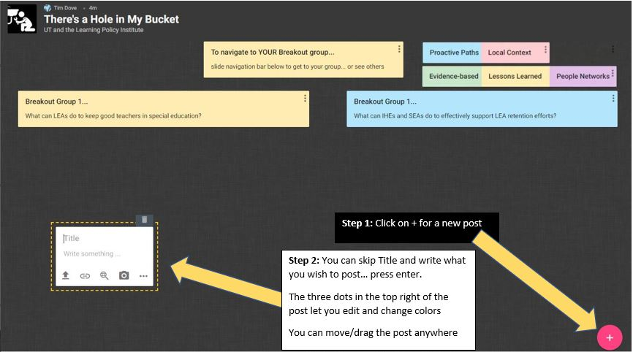
Six breakout groups… 25 minutes
Breakout Groups Padlet link
https://ceedarcenter.padlet.org/tmdedc1/7cluq5xnj6kqhoxs

Slide 8
Debrief… What can LEAs do to keep good teachers in special education? What can IHEs and SEAs do to effectively support LEA retention efforts?
Breakout Groups Padlet link
https://ceedarcenter.padlet.org/tmdedc1/7cluq5xnj6kqhoxs

Slide 9
Thank you!
Utah and Learning Policy Institute
Leah Voorhies Leah.Voorhies@schools.utah.gov
Jennifer McKenzie jennifermckenzie1@suu.edu
Steve Wojcikiewicz swojcikiewicz@learningpolicyinstitute.org

