Slide 1
State Commitment
The CEEDAR/Georgia partnership leverages the power of existing initiatives to develop teachers and leaders who can improve Georgia’s future by graduating ALL students who are ready to learn, ready to live and ready to lead.
Notes:
Georgia

Slide 2
Partnerships in Georgia
Notes:
Sheryl

Slide 3
State Focus
The CEEDAR GA project focuses on:
a) Improving teacher and leader preparation programs;
b) Revising licensure standards to align with such improvements;
c) Refining educator preparation program (EPP) evaluation systems; and
d) Aligning policy structures and professional learning systems.
Notes:
Georgia

Slide 4
Program Redesign at Georgia State University: Six years and counting
The Work:
MEd, EdS, and EdD programs
Context, intentionality, and hypervigilance
Relevance of content
Moving beyond legalities and data
Course redesigns
Equipping leaders to support induction level teachers and inclusive assessment
The Outcomes:
Model of inclusive leadership
Self assessment protocol
A journey, not a destination
Notes:
Sheryl

Slide 5
Another Example
University of West Georgia
UWG used a program-by-program approach to CEEDAR, starting with the Special Education program.
Year 1: SPED programs analyzed courses for program improvement (NIC).
Year 2: Reviewed/studied HLPs and continued to look for gaps.
Year 3: Strengthened alignment of the HLPs in Assessment, Collaboration, Methods, and Behavior Management courses
Year 4: Begin work on Dual Elementary/Special Education courses.
Educational Leadership Program
Year 3: Research/discussion of Inclusive Leadership with data analysis of standards and program to identify curriculum gaps
Year 4: Embedded Equity/Inclusive Leadership into Leadership programs (Tier 1, Tier 2, and EDSI)
Notes:
Georgia

Slide 6
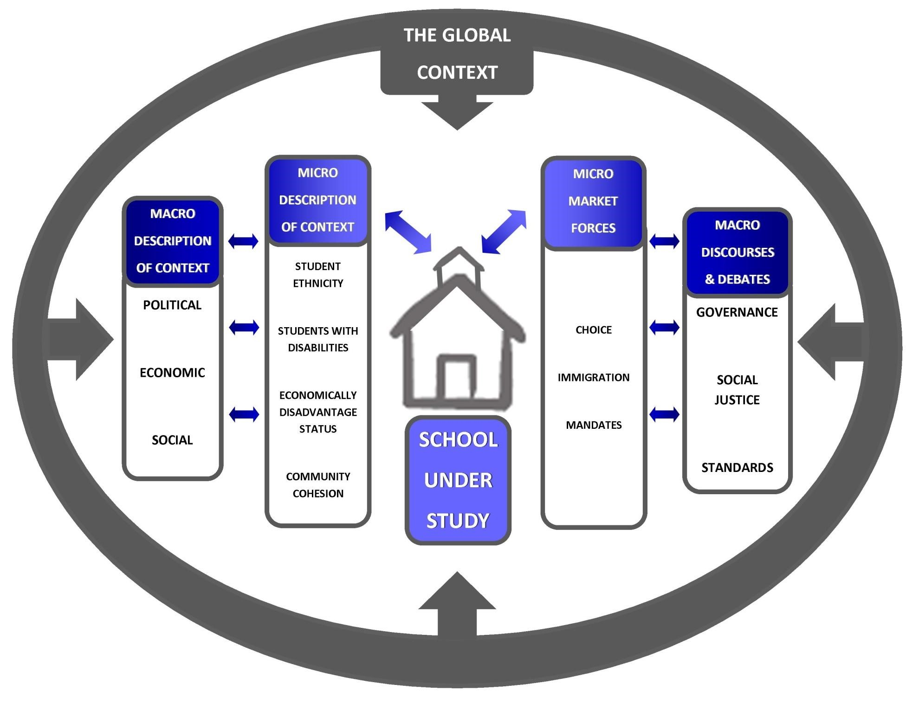
The ISLDN Network
Notes:
Sheryl This graphic shows how our work is impacted by forces that we do not control. We have to determine how to respond to this in ways that do not damage the integrity of the work.

Slide 7
Barriers, detours, and changes
State Level:
Recent focus on CRT (Critical Race Theory) among government entities, elected officials, and educational groups.
Resolutions denouncing CRT
Employees of state agencies are limited in their actions, statements, and the focus of their work.
Work of CEEDAR, AIPL, and Inclusion in Georgia is being impacted by this new direction in the state.
Local Level:
Local BOE’s in some districts are also denouncing CRT
Notes:
Georgia

Slide 8
Partnerships in Georgia – Focusing on the Work
Notes:
Sheryl

Slide 9
Moving Forward
“Not everything that I s faced can be changed, but nothing can be changed until it is faced.”
James Baldwin
Notes:
Georgia

