Slide 1
Mitigating Special Education Teacher Shortages: A Multi-pronged, Strategic, Statewide Approach
CEC 2019 Convention and Expo
Indianapolis, Indiana
Presenters:
Mary Brownell, Meg Kamman, & Paul Sindelar Lindsey Hayes & Lynn Holdheide
CEEDAR Center Center on Great Teachers and Leaders
University of Florida American Institutes for Research

Slide 3

Why should we Be Concerned?
Shortages in Special Education have been with us forever, but now they are reaching crisis proportions.

Slide 4
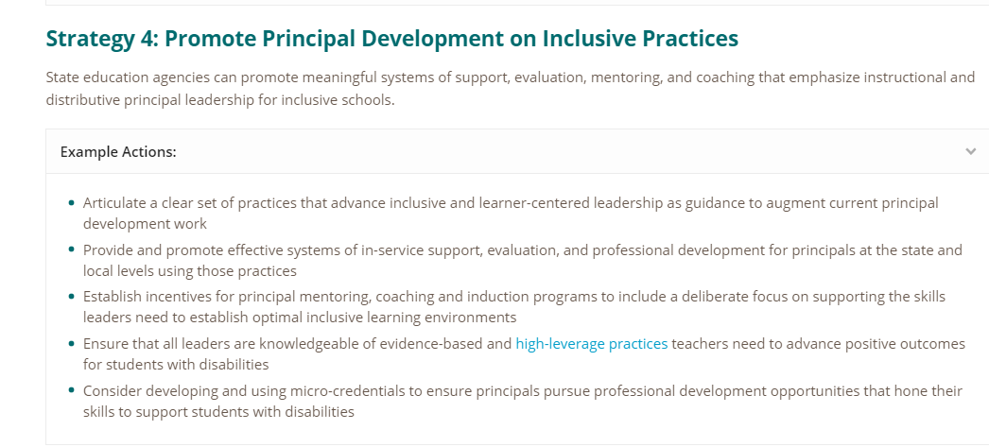

Slide 5

Professional Learning in Inclusive Leadership

Slide 6
What the Data Tells us
  48 states and the District of Columbia report shortages of special education teachers
  42 states report shortages of early intervention providers
        Council for Exceptional Children Issue Brief (2018)

Slide 7
Equity issues!

Slide 8
some students are impacted more than others
  Shortages of special educators from diverse backgrounds are the most dramatic
  Students served in special schools are more likely to have less prepared teachers
        Fall & Billingsley, 2011; Mason-Williams, Gagnon, & Bettini, 2017

Slide 9
Additionally. . .
The supply of teachers is dwindling
Council for Exceptional Children (2018); Dewey et al., in press

Slide 10
Problem with Short Term Solutions
They exacerbate quantity and quality shortages; creating a revolving door
Boe, Cook, & Sunderland, 2006; Feng & Sass, 2013; Ingersoll, Merrill, & May, 2014; Miller, Brownell

Slide 11
State responses to shortages
Nobody rises to low expectations!
Oklahoma and California have issued more emergency certificates
Arizona, Illinois, and Minnesota have lowered certification standards
Arizona gave local school administrators the power to determine teacher certification
New York has allowed charter schools to certify their own teachers with less rigorous preparation
West, J. (2018). Calling All Teachers, Flexing your Advocacy Muscles to Address Teacher Shortages. MSLD Rethinking Behavior

Slide 12

Reality
Reality is that districts are left with few choices and rely on “fast-track” and emergency certified teachers with little preparation and no classroom experience.
Policy changes and implementation, however, take time!

Slide 13
What should we do?

Slide 14
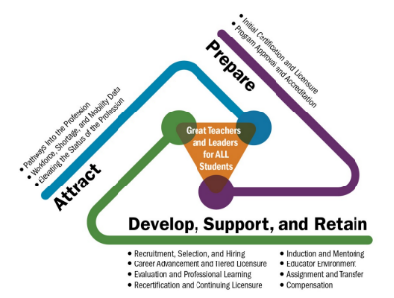
Educator Talent management
Need a talent
management framework
Looks across the career
continuum
Considers unique contexts
Clarifies partner roles
Educator Talent Management Framework:
Center on Great Teachers and Leaders

Slide 15


CEEDAR and GTL Center Tools
Combining short term solutions with long term strategies!

Slide 16



Existing Educator Shortage Resources
Talking About the Teacher Shortage with specific information for special education
  Summary of shortages in special education
How to Solve It – Evidence-based policy recommendations
  Service scholarships & student loan forgiveness
  Effective training & support for new teachers
  Teaching conditions & supportive leadership
  Competitive compensation
Latest News From Around the Country
https://teachershortage.solutiontoolkit.org/

Slide 17


Phase I: Short-Term Strategies
Just-in-time assistance to schools and districts forced to use less-than-fully-prepared teachers in classrooms.
Phase II: Long-Term Solutions
Systemic approaches that are specific to local contexts without compromising quality.
Facilitate strong networks with shared ownership, collective action, and joint accountability.
No two shortages are created equal. Strategies must address local context and needs.
Shortages can be addressed at any point along the educator career continuum.
Note: Districts must concurrently provide intensive support to these educators to get them prepared, while laying the foundation for longer-term solutions.

Slide 18
Phase I: Short Term Strategies
Strategy #1
Hiring the Best Possible Candidate
Previous experience with children
Previous experience with students/people with disabilities
Experience working in schools
Connection to the community
Mentoring & Induction
Professional Development
Pair with knowledgeable paraprofessional
Strategy #2
Intensive Supports
Notes:
In strategy 2- professional development, may take the form of connecting with an appropriate alternate route program, or microcredential in addition to more contextually specific PD or PD that may be embedded in induction. A bootcamp type of PD may be necessary depending on the credentials of the hire.
Also, the short term strategies will include considerations for long-term substitutes, often a population that gets forgotten or excluded from the above strategies, but is utilized by districts when shortages are evident.

Slide 19
How-to Guide
 | Role | Steps | Exemplars
What can the school leadership do?
What can the district do?
What can the Educator Preparation Program do?
What can the SEA do?
Decision Guidance
Are systems of professional learning and support available to less-than qualified teachers?
No
Establish Boot Camp Professional Development
Establish Mentoring and Induction

Slide 20










Strengthen collaborations across states, districts, and educator preparation programs by investing in local mentoring and induction programs that reinforce the content and skills that all teachers and leaders need to serve students with disabilities.
“A set of practices that are fundamental to support K-12 student learning, and that can be taught, learned, and implemented by those entering the profession.”
(Windschitl, Thompson, Braaten, & Stroupe, 2012, p.880)

Slide 21

Phase II: Comprehensive, systematic approach
Identification of strategies per the development of gaps across the career continuum
Smorgasbord/diversification of the portfolio
Targeted strategy selection per unique contexts

Slide 22

Phase ii: Strategy Selection Facilitation Process

Slide 23

Data Tool: Gap Analysis
Is it a production problem?
(Attract)
Is it an attrition problem?
(Prepare and Support)
Is it a distribution/equitable
access problem?
(Attract, Prepare, and Support)
Center on Great Teachers and Leaders Data Tool to Establish an Diverse, Effective Educator Workforce

Slide 24

Data Tool: Special Educator Shortages and Opportunity Gaps
Assess where special education shortages are corresponding with the greatest “opportunity gaps” for students with disabilities (as identified by the state’s ESSA accountability metrics).
Targeted on the schools and students that need the most help.
Strategies tailored toward local contexts and evaluated based upon impact where needed the most.
Center on Great Teachers and Leaders Data Tool to Establish an Diverse, Effective Educator Workforce

Slide 25
poll: Text your vote to 650 600 9016
Rate your response to the following: These tools could help my organization conduct data and root cause analysis to select specific strategies to address teacher shortages.
Strongly agree: 173089
Agree: 173090
Disagree: 173091
Strongly disagree: 173092
Not applicable to my organization: 173093

Slide 26
Multiple options based upon needs
Incentives and Loan Forgiveness
Five Year Preparation Programs with Practice-Based Opportunities
Grow Your Own Programs
National Board Certified Teachers
Sign-on Bonus
Paraprofessional Step Up Programs
Competitive Compensation
Teacher Leadership
Quality Professional Learning Systems

Slide 27
Poll 2: Text your vote to 650 600 9016
Rate your response to the following: This presentation increased my awareness and knowledge of strategies to address shortages of special education teachers.
Strongly agree: 173085
Agree: 173086
Disagree: 173087
Strongly disagree: 173088

Slide 28
DISCLAIMER
This content was produced under U.S. Department of Education, Office of Special Education Programs, Award No. H325A120003. Bonnie Jones and David Guardino serve as the project officers. The views expressed herein do not necessarily represent the positions or polices of the U.S. Department of Education. No official endorsement by the U.S. Department of Education of any product, commodity, service, or enterprise mentioned in this website is intended or should be inferred.

