Slide 1
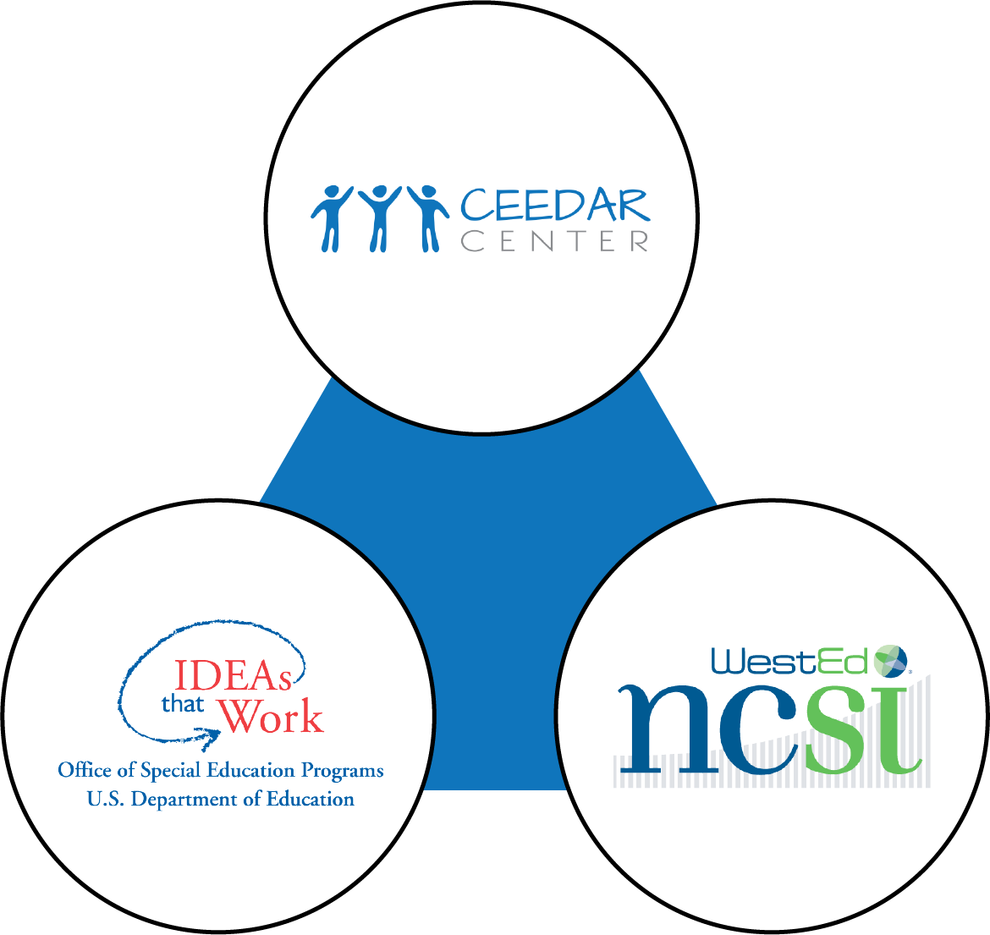

Effective practices for online professional collaboratives across special, general, and leadership education
Meg Kamman, CEEDAR
Lauren Artzi, CEEDAR/NCSI
Amy Peterson, NCSI
Notes:
Session Organization
Introductions (name and center affiliation) – 2 minutes
Learning Communities research - quick overview – 5 minutes
Overview of the learning networks represented in this session (CEEDAR, DaSy/ECTA, NCSI) – 5 minutes
Three sets of lessons learned
Launching – 10 minutes
Growing and sustaining – 10 minutes
Evaluating/measuring impact – 10 minutes
Discussion –

Slide 2
A Look at the Research
Communities of practice (CoP)
  Groups of people who share a concern or a passion for something they do and learn how to do it better as they interact regularly.
  Effective CoP comprise three areas
Domain/ Issue
Community/ Relationship
Practice/ Action
Cashman, J., Linehan, P., & Rosser, M. (2007). Communities of Practice: A new approach to complex educational problems. Alexandria, VA: National Association of State Directors of Special Education.
Wenger, E. (1998). Communities of practice: learning, meaning, and identity. New York: Cambridge University.
Notes:
Lauren
“Communities of Practice are groups of people who share expertise and passion about a topic and interact on an ongoing basis to further their learning in this domain. Communities of Practice members typical solve problems, discuss insights and share information. Communities of practice also develop tools and frameworks that become part of the common knowledge of the community . And over time, these mutual interactions and relationships build up a shared body of knowledge and sense of identity. “ Wenger, McDermott, & Synder, 2002

Slide 3
A Look at the Research (cont.)
Effective Networked Improvement Communities (NICs) are—
  Focused on a well-specified aim
  Guided by a deep understanding of the problem, the system that produces it, and a theory of improvement relative to it
  Disciplined by the rigor of improvement science
  Coordinated to accelerate the development, testing, and refinement of interventions and their effective integration into practice across varied educational contexts.
Learning to Improve: How America's Schools Can Get Better at Getting Better, edited by Bryk . S., Gomez L. M., Grunow A., and LeMahieu P. Harvard University Press, Cambridge, MA, 2015. 280 pp. ISBN‐10: 1612507913.
Notes:
Lauren

Slide 4
Trust in collaboratives
Organic Trust
Contractual Trust
Relational Trust
Notes:
Lauren
Bryk and Schneider (2002) discuss three kinds of social trust that are evident in education work collaboratives: organic, contractual, and relational trust. All three social trusts will be present in education-oriented teams, but the latter, relational trust, is of paramount importance to teams’ successful function—and relational trust is also the most difficult and time consuming kind of trust to promote. Like intrinsic motivation, relational trust can’t be given-- it must be cultivated through an atmosphere that promotes its evolution.

Slide 5
Ways to Establish Trust
Trust builds over time
Establishment of group norms helps promote trust in the beginning
Trust building loop:
  Forming expectations and identifying partners.
  Agreeing on collaboration aims.
  Managing risk.
  Addressing team dynamics and allowing for dynamics to shift as work progresses.
Notes:
Lauren

Slide 6

Learning Networks Featured Today
Affinity Groups
Topical Action Group
“Collaboratories”
Cross State Learning Collaboratives
Affinity Groups
Pop-ups
Notes:
Lauren

Slide 7
CEEDAR Cross-State Learning Groups
Affinity Groups
Introduction or exploration of topics of interest related to CEEDAR’s mission and state needs
Topical Action Groups
Deeper dive into selected topics related to blueprint or sustainability and scale-up goals
Collaboratories
Select groups engaged as Networked Improvement Communities with an inquiry focus on common topics of interest/problems of practice
Notes:
MEG

Slide 8
NCSI Learning Communities
Learning Collaboratives
Five Part B Collaboratives:
1. Grad/Post-School
2. Language & Literacy
3. Math
4. Results-Based Accountability
5. Systems Alignment Collaboratives
Four Part C Collaboratives:
1. Family Outcomes
2. Knowledge and Skills
3. Social and Emotional Outcomes
4. Results-Based Accountability
Affinity Groups
Sub-groups within a given learning collaborative.
Focused on issues that arise through the membership
Groups sustain over time or disband as problems are solved and/or sufficient capacity is built.
Example: Differentiating TA in response to local performance results within the Systems Alignment Collaborative
Pop-Up Groups
Similar to an Affinity Group but includes membership across two or more different Learning Collaboratives.
Formed ad hoc to meet short term needs.
Example: SSIP Writing Group operated from February to March 2018 to help states craft SSIP submissions.
Notes:
Amy

Slide 9
Turn and Talk
Think about a learning network or group that you have been a part of.
  What has worked well?
  What challenges have you faced?
Notes:
Amy

Slide 10




Launching, Growing/Sustaining/Measuring Impact, and Resources and ToolsLessons Learned
Lessons Learned
Notes:
(transition slide – 1 min - tbd)
Meg

Slide 11

Launching Learning Networks
Ensuring adequate virtual infrastructure
Identifying common problems of practice
Planning Supports
Getting Started
Will you use an existing platform or create a new space?
What are burning issues related to your mission?
How can you provide assistance to staff leading networks?
What strategies can we use to get started?
Lessons Learned
Notes:
Meg

Slide 12
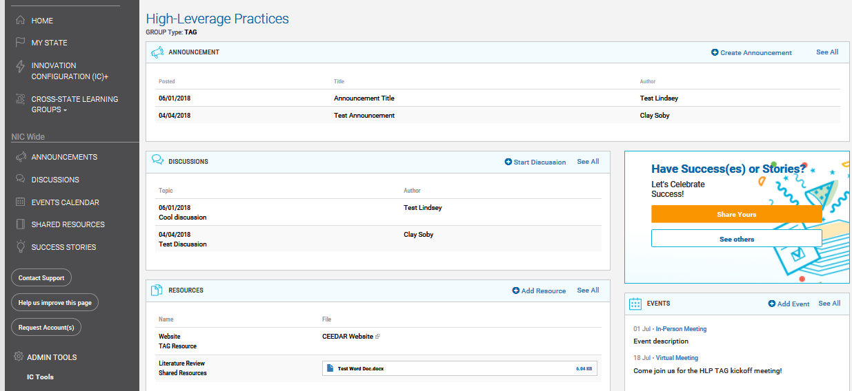
Launching Learning Networks:
Adequate Virtual Infrastructure
Ensuring adequate virtual infrastructure
Will you use an existing platform or create a new space?
Notes:
Meg

Slide 13
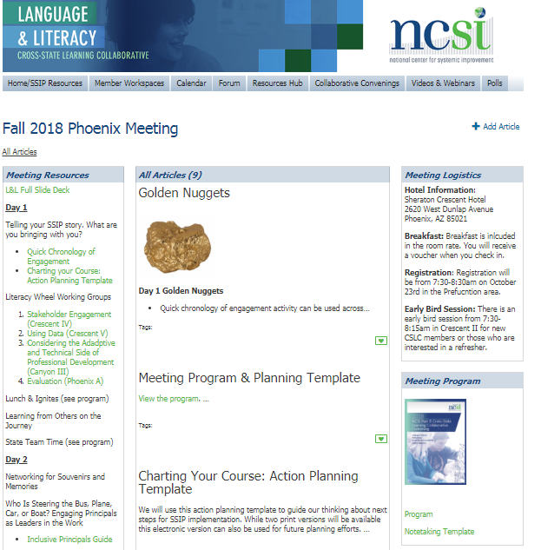
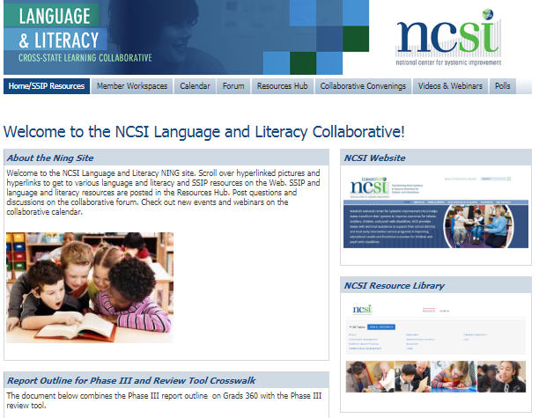
Launching Learning Networks:
Adequate Virtual Infrastructure (2)
Space for members to work in their teams
Calendar of Activities
Space for Resources & Materials
Space for Interactive Forums
Notes:
Amy

Slide 14




Launching Learning Networks:
Adequate Virtual Infrastructure (3)
Facilitating virtual meetings that enhance engagement
  Use of video
  Interactive polls
  Breakout rooms
Notes:
Amy

Slide 15
Launching Learning Networks:
Identifying Common Problems of Practice
Identifying common problems of practice
What are burning issues related to your mission?
Affinity groups:
  State leads submitted topics based on state interests and needs
  Compiled common areas to select 4 groups
    Dyslexia/literacy
    Licensure/ shortages
    Data/outcomes for preparation programs
  Added two groups in topics the center hopes to push the field in
    4. Inclusive Leadership
    5. Culturally Responsive Policy and Practice
Topical Action Groups:
  Selected topics aligned to common state blueprint goals
    High Leverage Practices, Inclusive Leadership, and Clinical Practice
Notes:
Lauren

Slide 16
Launching Learning Networks:
Identifying Common Problems of Practice (2)
Identifying common problems of practice
What are burning issues related to your mission?
Cross-State Learning Collaboratives:
  Start with SIMR focused topics
  Added additional topics focused on results-based accountability and systems alignment
    The systems alignment collaborative started as school turnaround but redefined based on state needs
  Within the overarching topic, states identify areas of focus
Pop-ups:
  State defined needs across collaboratives
    Writing pop-ups related to SSIP development, differentiated technical assistance
Notes:
Lauren

Slide 17
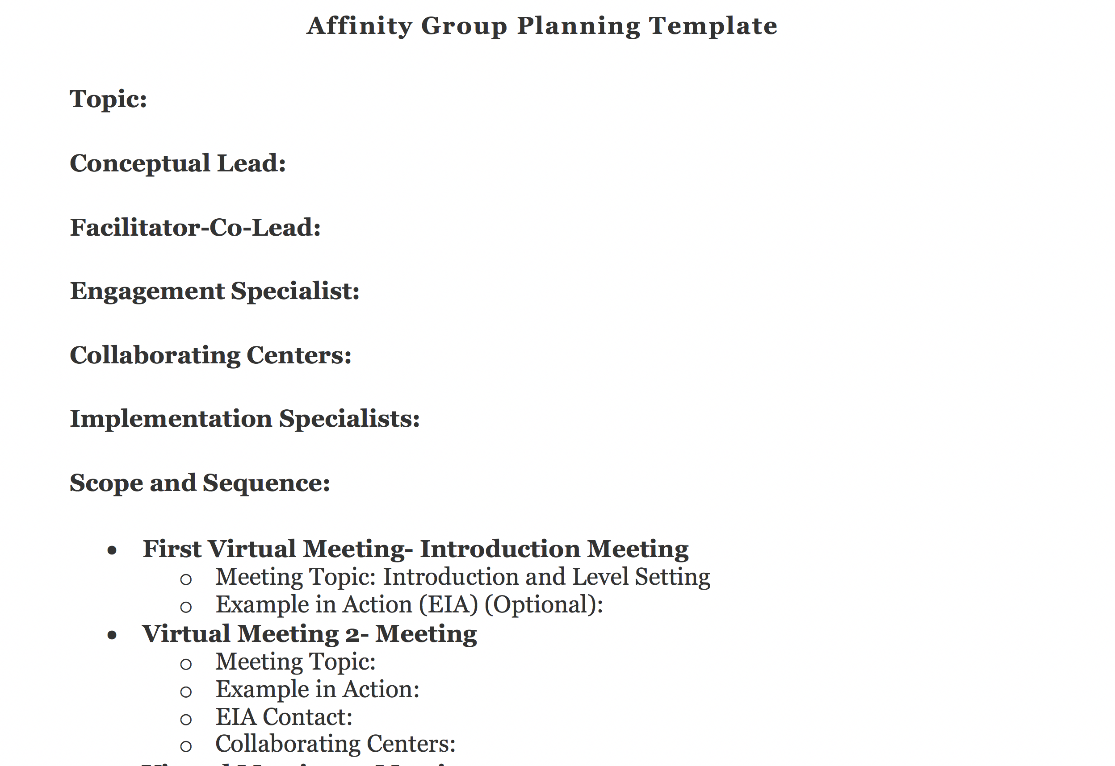
Launching Learning Networks:
Planning Supports
Planning Supports
How can you provide assistance to staff leading networks?
Templates for planning
  Scope and sequence
  Resources for synchronous engagement
  Resources for asynchronous engagement
  Engagement strategies (virtual and in person)
Notes:
Lauren

Slide 18


Synchronous vs. Asynchronous
Synchronous: Real-time communication & collaboration in “same time-different place”
Examples:
Audio, web, video conferencing
Chat/Instant messaging
White boards/application sharing
Asynchronous: Communication and collaboration over time in “different time-different place”
Examples:
Discussion boards/forums
Streaming audio/video
Document libraries
Notes:
Lauren

Slide 19
Launching Learning Networks:
Getting Started
Getting Started
What strategies can we use to get started?
Initial Activities
  Building Relationships
  Setting Group Norms
  Establishing a shared vision and goals
Notes:
Reference back to the trust slides at the start
I think we need to emphasize the importance of the relationship building at the start but the fact that it is a continuous aspect of the work as well.
Meg

Slide 20
Growing and Sustaining Learning Networks
Secure Commitment
Align work with ongoing efforts
Capacity Building Practices
Continuous Improvement
How will you clarify what participation means?
How will you support alignment of the work with ongoing efforts?
What “practices” will you use?
What data do you need to collect to ensure the community meets participants’ needs?
Share Impact
Who needs to know and how will you tell your story?
Lessons Learned
Notes:
Meg

Slide 21
Growing and Sustaining
Learning Networks continued
Secure Commitment
How will you clarify what participation means?
Application process
  Participants apply
  Selection criteria
Clearly articulate the activities and the expectations of participation in the learning network
  Cross-state
  Individualized action plan
  Evaluation expectations
Clearly articulate outcomes
Lessons Learned
Notes:
Meg

Slide 22
Growing and Sustaining
Learning Networks continued.
Align work with ongoing efforts
How will you support alignment of the work with ongoing efforts?
Ensure cross-state activities are driven by common needs
Action Plans should be based on data and connect with ongoing participant work
  Needs to be meaningful
Lessons Learned
Notes:
Amy
Connections with TA facilitators

Slide 23
Growing and Sustaining
Learning Networks continued..
Capacity Building Practices
What “practices” will you use?
TA providers should be using best practices to support participants in building capacity and making progress
Structure activities to maximize participant engagement and learning
  All participants bring important knowledge, but may need support in engaging in learning networks
Provide support for new members due to turnover
Lessons Learned
Notes:
Amy
Emphasize that collaboratives aim to both build capacity of individual states as well as the capacity of states to engage in the group.
Talk about growing state ownership
Also talk to turnover
We could talk to examples of how the staff participating in the collaboratives have changed a lot over time and there has been a need to balance moving forward with the new folks as well as supporting the newer folks with orientation calls and other supports.

Slide 24
Growing and Sustaining
Learning Networks continued…
Continuous Improvement
What data do you need to collect to ensure the community meets participants’ needs?
Gather data on an ongoing basis about the processes used within the learning network
  Are people actively engaging and sharing knowledge?
  Are people making progress and building capacity?
  If not, why not?
Be flexible with your approach and adapt based on the data and needs
Lessons Learned
Notes:
Amy

Slide 25
Growing and Sustaining
Learning Networks continued..
Share Impact
Who needs to know about impact and how will you share your story?
Identify meaningful data sources to share impact over time.
Lead with Qualitative data; bolster with quantitative data to support contextual understanding and nature of the systems change
Consider the message.
  Who is the message intended for?
  What do they care about?
  What format is best?
Lessons Learned
Notes:
Amy

Slide 26
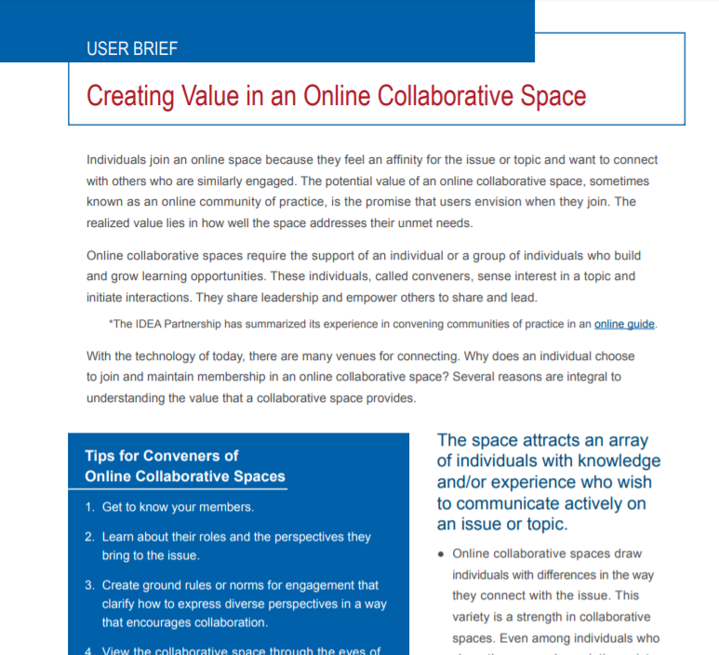
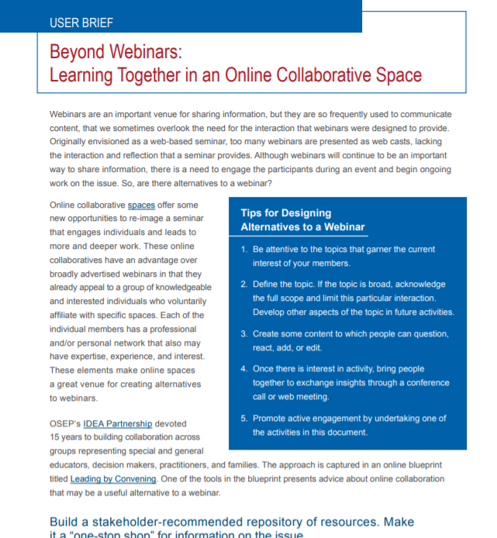
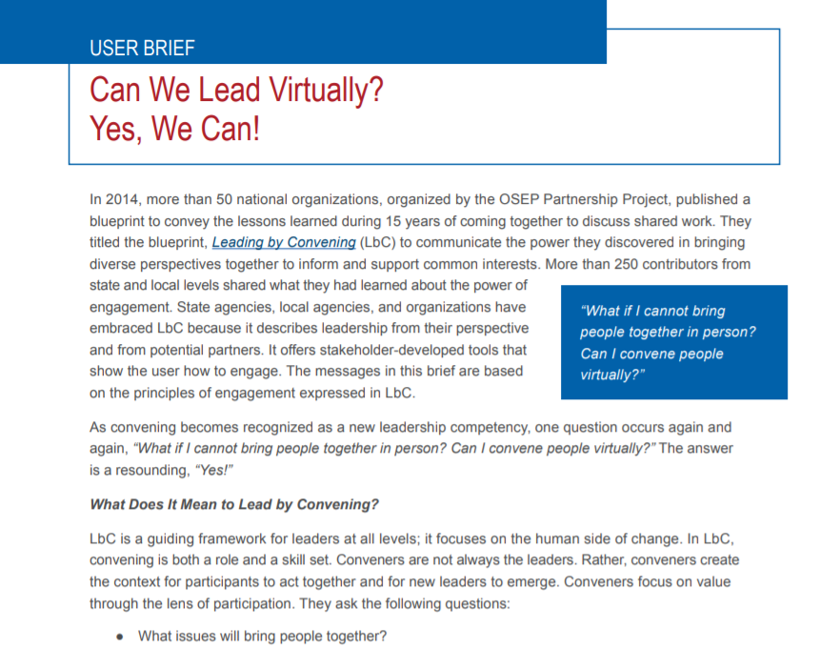
Resources and Tools
https://collab.osepideasthatwork.org/system/files/osepleadingconveningvirtually-508.pdf
https://collab.osepideasthatwork.org/system/files/itw-briefbeyondwebinars508_0.pdf
https://collab.osepideasthatwork.org/system/files/itw-briefonlncollabspce508_0.pdf
Find additional resources at https://collab.osepideasthatwork.org/content/guides1
Notes:
Lauren

Slide 27
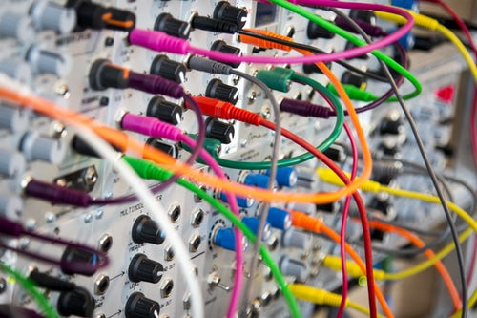
Let’s Talk

Slide 28
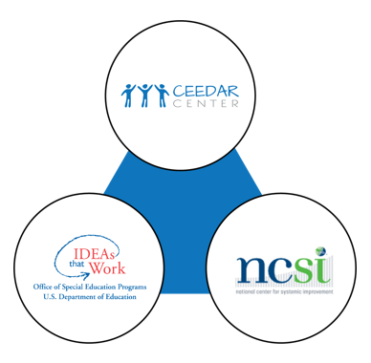
For more info or follow up…
Meg Kamman
mkamman@coe.ufl.edu
Lauren Artzi
lartzi@air.org
Amy Peterson
ampeterson@air.org

Slide 29
Thank you to our funders!
This content was produced under U.S. Department of Education, Office of Special Education Programs, Award Nos. H325A170003, HR326R140006
The views expressed herein do not necessarily represent the positions or polices of the U.S. Department of Education. No official endorsement by the U.S. Department of Education of any product, commodity, service, or enterprise mentioned in this content is intended or should be inferred.

