Slide 1
School and District Improvement Through
Inclusive Principal Leadership
Kathleen Airhart - CCSSO, Program Director Special Education Outcomes
Mary Brownell - CEEDAR, Executive Director
Lynn-Holdheide - AIR, Managing Technical Assistant Consultant
Zelphine Smith-Dixon – Georgia, State Director Special Education and Supports
NASDSE/CASE Joint Conference
October 27, 2019

Slide 2
Objectives - Participants will…
Understand CCSSO’s strategy to ensure each student benefits from college and career ready expectations through a lens of equity.
  Learn about NCIPL and the Advancing Inclusive Principal Leadership states initiative
Q&A
Hear from the Georgia Department of Education about strategies to integrate inclusive principal leadership into policy and practice
Q&A
Understand CEEDAR and other TA Center Supports and Resources

Slide 3

CCSSO Strategy
Kathleen Airhart

Slide 4

CCSSO Strategic Plan:
Students
Each student deserves an education that prepares them for lifelong learning and success in the world today.
Ensure each student benefits from college and career ready expectations through equitable access to rigorous courses, high-quality instruction, and appropriate supports.
Notes:
Each student deserves an education that prepares them for lifelong learning and success in the world today.

Slide 5

CCSSO:
States Leading for Equity
Leading for Equity, a series of commitments to help SEAs take action to achieve educational equity:
  Prioritize equity – set a vision
  Start from within – focus on the SEA
  Measure what matters – create accountability
  Go local – support LEAs
  Follow the money – allocate resources
  Start early – early childhood focus
  Engage deeply – equitable access to standards and assessment
  Value people – support teachers and leaders
  Improve conditions for learning – culture, climate, SEL
  Empower student options – parent choice
Educational Equity means that every student has access to the resources and educational rigor they need, at the right moment in their education across race, gender, ethnicity, language, disability, sexual orientation, family background, and/or family income.
Notes:
The inclusive leadership work is also grounded in states’ equity commitments - “to ensure that every student has access to the right resources and educational rigor they need, at the right moment in their education regardless of background or circumstance”.
In February 2017, Aspen Institute Education & Society Program and CCSSO released Leading for Equity, a series of commitments to help state education chiefs take action to achieve educational equity

Slide 6

Inclusive Principal Leadership:
PSEL standards
In January 2017, CCSSO and CEEDAR released a supplementary guidance document for students with learning differences
Outlines key steps every state can take to ensure all school principals are prepared and supported to lead learning environments that meet the needs of students with disabilities
Developed by an Advisory Group of principals, leaders from state and local education agencies, the higher education community, and professional associations
Notes:
January 2017, CCSSO in partnership with CEEDAR, released a guidance document - PSEL 2015 and Promoting Principal Leadership for the Success of Students with Disabilities.
To create the document, CCSSO and CEEDAR convened an Advisory Group of principals, SEA /LEA leaders, higher education, and principal professional associations. They identified the aspects for ensuring that struggling students, including SWDs, will have access to excellent teaching, appropriate supports, high-quality IEPs, and examples of inclusive principal leadership in practice

Slide 7
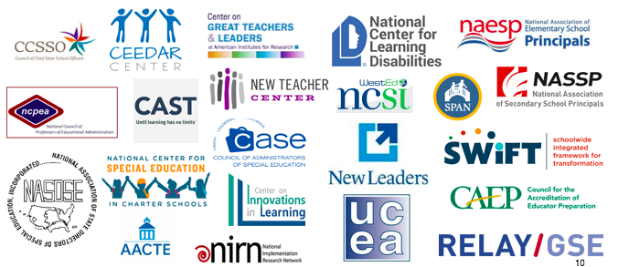
Inclusive Principal Leadership:
National Collaborative on Inclusive Principal Leadership (NCIPL)
Notes:
This group came together and made commitments for how they will move inclusive principal leadership forward in policy and practice by communicating and disseminating the resource, contributing to cross-organization collaboration and strategic-planning, and incorporating the work into their current work scopes.
In order to sustain and build upon this collective work, CCSSO launched the National Collaborative on Inclusive Principal Leadership (NCIPL) to support states’ efforts on advancing inclusive leadership in preparation and ongoing professional development, in partnership with CEEDAR and the Oak Foundation.

Slide 8

Inclusive Principal Leadership:
Supporting Inclusive Schools for the Success of Each Child
CCSSO released Supporting Inclusive Schools for the Success of Each Child (https://ccssoinclusiveprincipalsguide.org)
Notes:
In May 2018, after a year of convening and working with NCIPL partners, we released Supporting Inclusive Schools for the Success of Each Child (in partnership with the NCIPL, CEEDAR Center and Oak Foundation)—a microsite that provides 8 strategies with resources to support states in integrating inclusive principal leadership in policy and practice.
.

Slide 9
Inclusive Principal Leadership:
State Strategies Designed to Support
Supporting Inclusive Principal Leadership for the Success of Each Child contains 8 strategies for to support states in integrating inclusive principal leadership in policy and practice:
  Strategy 1: Set a Vision and Plan for Inclusive Principal Leadership
  Strategy 2: Cultivate Coherence and Collaboration
  Strategy 3: Transform Principal Preparation and Licensure
  Strategy 4: Promote Principal Development on Inclusive Practices
  Strategy 5: Provide Targeted Supports to Districts and Schools
  Strategy 6: Connect School Improvement and Principal Development Initiatives
  Strategy 7: Meaningfully Engage Stakeholders as Partners in the Work
  Strategy 8: Adopt Processes and Supports for Continuous Improvement
Notes:
These 8 strategies were identified by leaders in the field of inclusive education and represent their collected knowledge on how to ensure principals are prepared and supported to lead inclusive learning environments for students with disabilities and each and every child. Also included on the website are resources aligned to each strategy.

Slide 10

Advancing Inclusive Principal Leadership (AIPL):
Our Goal
Create and implement principal leadership plans focused on
improving outcomes for each and every student,
with a focus on students with disabilities.

Slide 11

Advancing Inclusive Principal Leadership (AIPL): Expected Outcomes
Four States in the AIPL State Initiative: Arkansas, Georgia, Mississippi, Ohio
Completed self-assessments and identified state-specific goals and objectives around: Recruit and Prepare; Support and Retain; and School Improvement and Targeted Supports
All states in the AIPL State Initiative have developed a plan that is designed to advance inclusive principal leadership in policy and practice.
By June 2020, all states in the AIPL will have made
measurable progress against two objectives.

Slide 12
Advancing Inclusive Principal Leadership (AIPL):
Common Areas of Focus
 | Adopt preparation guidelines aligned to PSEL and inclusive practices. | Revise professional development and leader evaluation systems focus on inclusive practices. | Implement professional learning opportunities focused on inclusive and high-leverage practices. . | Create guidance to LEAs to expand leader diversity. | Determine gaps and needs for inclusive principal leadership in targeted support schools. | Coordinate and collaborate across the SEA to implement targeted supports.
Arkansas |  | x | x
Georgia |  | x | x | x
Mississippi | x |  | x
Ohio |  |  | x |  | x | x

Slide 13



QUESTIONS, FEEDBACK AND IDEAS
Notes:
Lynn will moderate questions that come from the audience. If none, Lynn will use the following probes
Can you talk about how the SEAs involved have made connections between multiple efforts to support principal development?
What have been the challenges so far in ensuring this work aligns with other efforts to support leadership development?
Does CCSSO/CEEDAR intend to scale this work beyond the states listed on slide 12?
Ask participants:
How has your state or district aligned your efforts to prepare and support school leaders/principals? Is there a specific focus on principals within the SPDG? Is that work coordinated with school improvement?
Where can you see connections or opportunities to leverage the resources and lessons learned from this work in your efforts to support principals?

Slide 14

Georgia commitment to
Inclusive principal Leadership
Zelphine Smith-Dixon

Slide 15
2020 Vision Casting
Provide the necessary infrastructure and supports for leaders, teachers, and families to meet the whole child needs of each student and improve student outcomes and school climate resulting in increased quality of life and a workforce ready future.

Slide 16
Moving Forward 2020 Vision Link

Slide 17

Rationale
“If Every Student Succeeds, the commitment cannot be an Act. We must do what is right for the schoolhouse. All students matter! We must give each student the tools necessary to demonstrate readiness to learn, live and lead. We must offer high quality services and supports for teachers and leaders to address rigorous, diverse needs of students. We must prioritize an effective, engaging home-school partnership because families are partners in student success.

Slide 18
Theory of Action
IF we provide high quality services and supports for leaders, teachers, and families to meet the whole child needs of each student, THEN student outcomes and school climate will improve resulting in increased quality of life and a workforce ready future!

Slide 19

Students FIRST
Specially Designed Instruction, IEP Services and Supports & Self Determination Skills
As measured by: Improved results for students for disabilities (e.g., graduation, dropout, assessment proficiency rate, young children outcomes, etc.)
Data Fact: >25% of students with disabilities exit as dropouts each year.
We believe that students who have access to good instruction, IEP Services and self-determination skills will be ready to live, learn and lead!

Slide 20

Teachers FIRST
Equity, Efficacy & Excellence
As measured by: Increased teacher retention and improved high-quality services and supports (e.g., teacher shortage/retention rate, school climate data, etc.)
Data Fact: Georgia demonstrated a sped teacher shortage of 3,496 (3.1).
We believe that teachers who have equitable access to high quality services/supports and supportive leadership will create classroom conditions for student success, remain in the profession and motivate others to teach as a career of first choice.

Slide 21

Leaders FIRST
INTENTIONAL (Data-driven decision making) and INCLUSIVE
As measured by: Improved systems of continuous improvement and increased inclusive leadership
Data Fact: Council for Exceptional Children Teacher Survey Data indicated the following needs: Adequate resources to meet IEP requirements for students (831 responses); Smaller class sizes/caseloads (637 responses); and Administrators who support the IEP process (538 responses).
We believe that inclusive leaders who leverage the flexibility to make intentional decisions create school-wide conditions for student success.

Slide 22

Families FIRST
Engaging & Effective Home-School Partnerships
As measured by: Improved parent satisfaction and supports such as the Special Ed. Help Desk and Parent Mentor Partnership
Data Fact: Georgia Parent Mentor Partnership demonstrated 99,521 contacts with families during FY19.
We believe that home-school partnerships must prioritize communication, capacity-building and consensus decision making.

Slide 23
Keeping Georgia’s Students First

Slide 24

Leveraging National Resources for State and Local Impact

Slide 25
QUESTIONS, FEEDBACK AND IDEAS
Notes:
Lynn will moderate questions that come from the audience. If none, Lynn will use the following probes
What has been the response of leaders in focusing on inclusive principal leadership?
What competencies needed for inclusive leadership has been – or do you expect to be – the most challenging to build in existing leaders?
What strategies do you provide – or anticipate providing – to strengthen principals’ instructional leadership? Do you or do you anticipate training principal supervisors in strategies to support principals’ inclusive practices?
Ask participants:
Have any of your states taken on the preparation and support of leaders? How have you aligned initiatives with inclusive leadership?
From your role/perspective, do you feel that adding the task of establishing inclusive learning environments to the school principals place is much or should have already been an expectation?
In hearing about the NICPL and AIPL efforts, do you think this can be replicated in your states/districts?

Slide 26

Our Mission
CEEDAR (the Collaboration for Effective Educator Development, Accountability, and Reform) 2.0’s mission is to build the capacity of state personnel preparation systems to prepare teachers and leaders to implement evidence-based practices (EBPs) within multi-tiered systems of support (MTSS).
Notes:
The work that CCSSO is leading was a natural extension of the CEEDAR mission.

Slide 27
CEEDAR Realizes
Attempts to prepare highly effective general and special education teachers will be futile if they enter school environments that do not have the infrastructure or support system to facilitate shared ownership over all students’ learning and provide multiple opportunities to collaborate and leverage teacher strengths.
Notes:
OSEP and CEEDAR realized that efforts to prepare teachers would ultimately fail if these teachers did not enter schools that would enabled them to successfully enact what they learned about collaboration and effective practice in their teacher education programs.

Slide 28
School Principals are Essential to:
Developing the vision and capacity for inclusive practice
Fostering teacher collaboration and use of effective instruction
Retaining high quality teachers
Promoting student achievement and other critical outcomes
Notes:
To foster capacity, these leaders have to foster collaboration and use of effective instruction
Cannot foster collaboration and quality instruction if you cannot retain teachers. Student achievement is p

Slide 29
QUESTIONS, FEEDBACK AND IDEAS
Notes:
Lynn will moderate questions that come from the audience. If none, Lynn will use the following probes
What has been the response of leaders in focusing on inclusive principal leadership?
What competencies needed for inclusive leadership has been – or do you expect to be – the most challenging to build in existing leaders?
What strategies do you provide – or anticipate providing – to strengthen principals’ instructional leadership? Do you or do you anticipate training principal supervisors in strategies to support principals’ inclusive practices?
Ask participants:
Have any of your states taken on the preparation and support of leaders? How have you aligned initiatives with inclusive leadership?
From your role/perspective, do you feel that adding the task of establishing inclusive learning environments to the school principals place is much or should have already been an expectation?
In hearing about the NICPL and AIPL efforts, do you think this can be replicated in your states/districts?

Slide 30
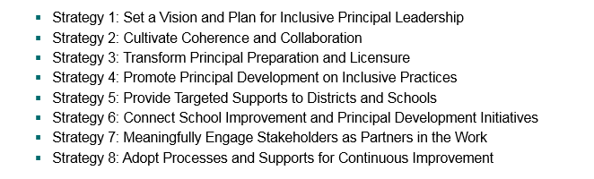
Questions, Feedback, and Ideas
How do you currently or how could you utilize these strategies in your SEA/Districts?

Slide 31
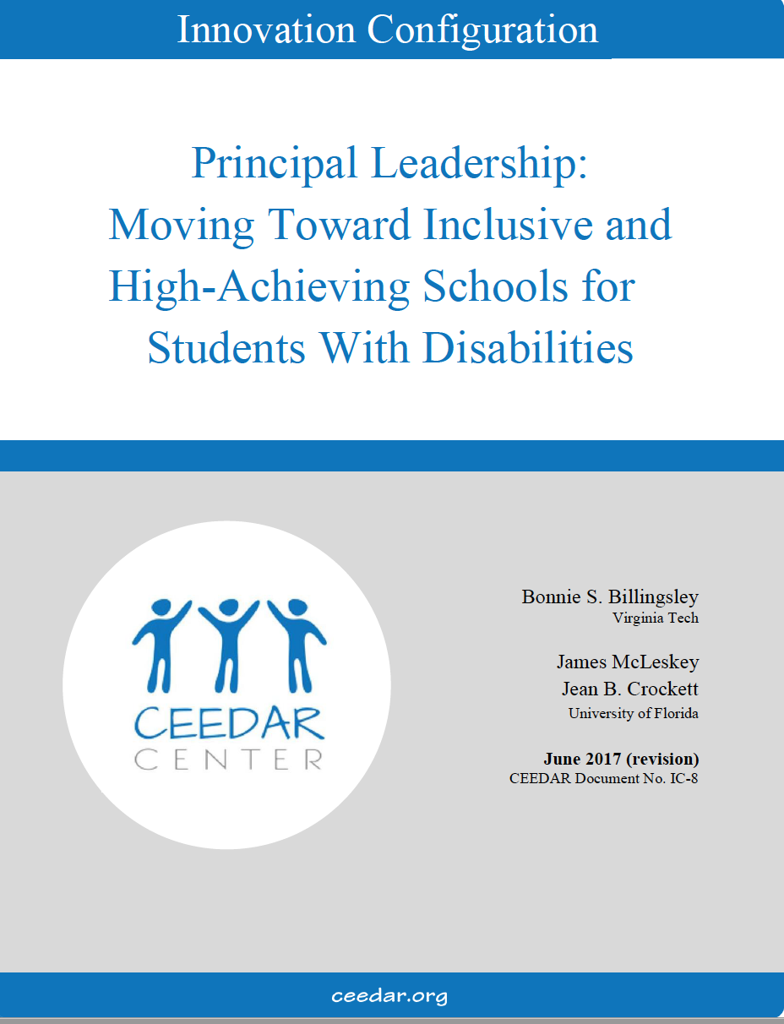
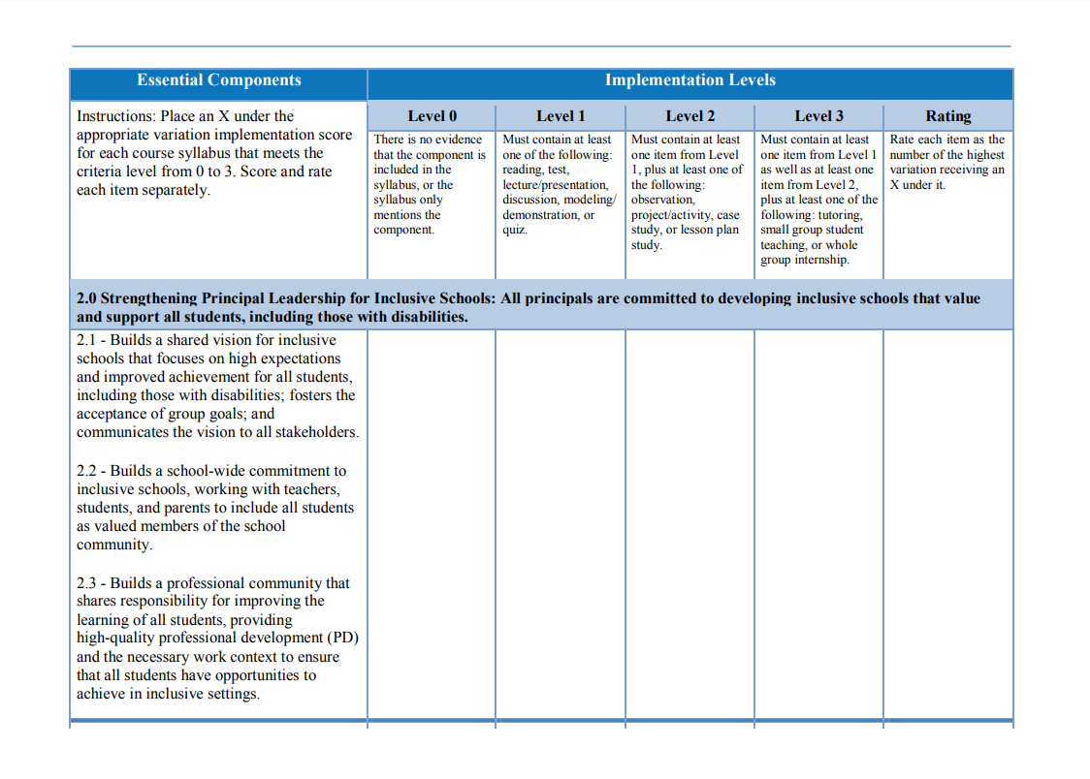

Competencies and Professional Learning
http://ceedar.education.ufl.edu/wp-content/uploads/2017/12/Principal-Leadership-IC-2017-Revision.pdf

Slide 32
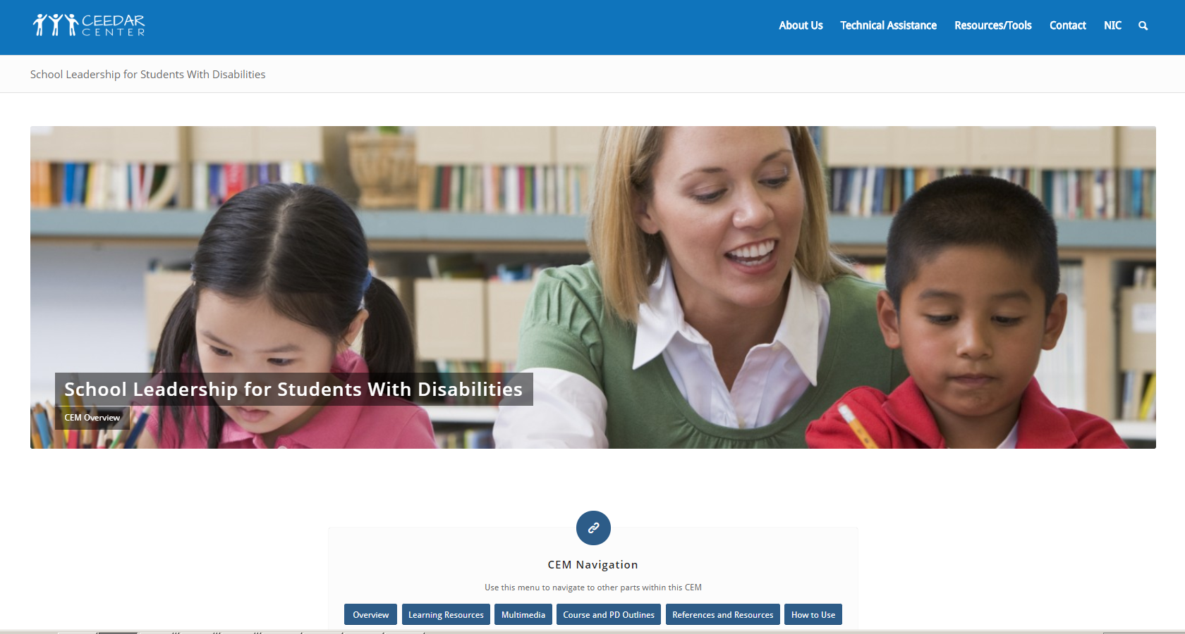
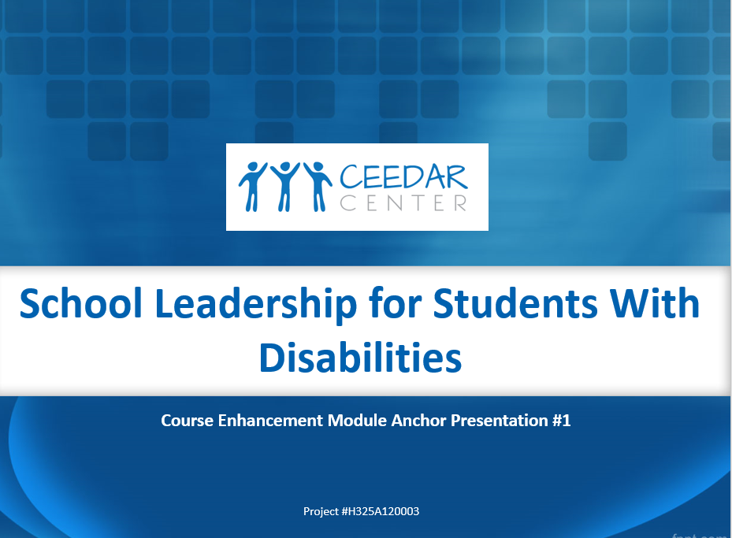
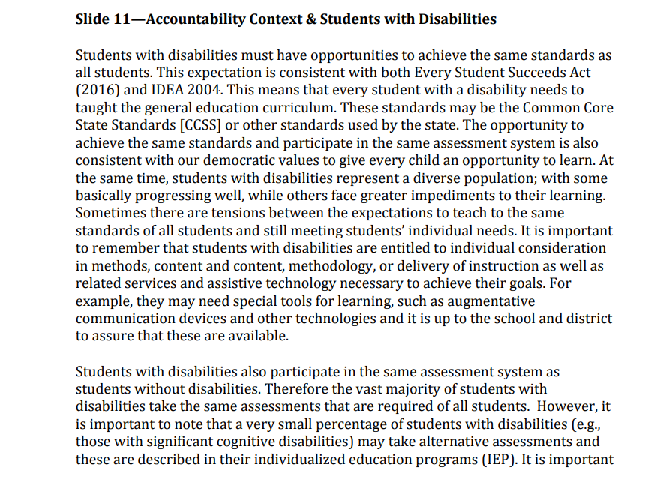
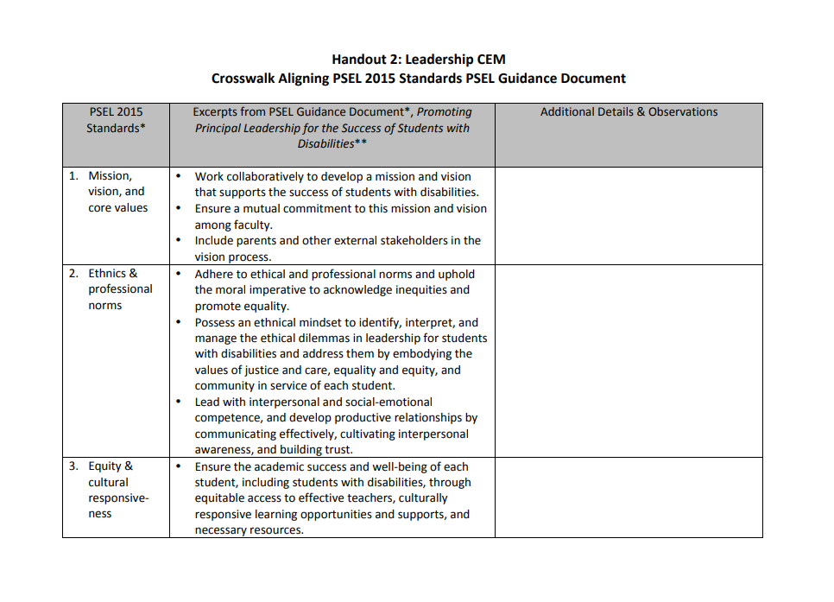
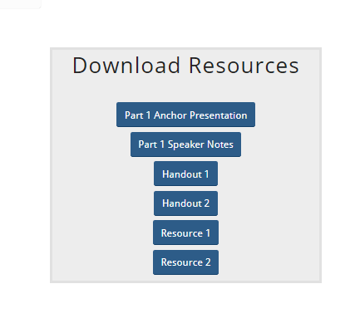
Competencies and Professional Learning
http://ceedar.education.ufl.edu/cems/leadership/

Slide 33
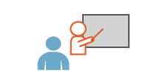
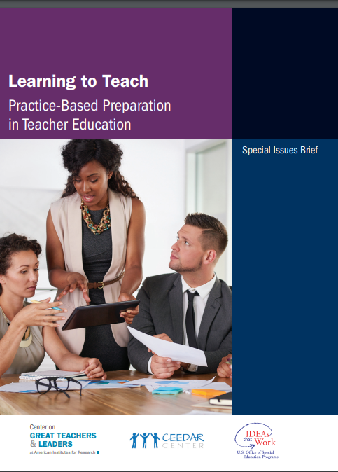
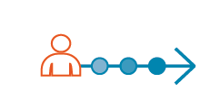
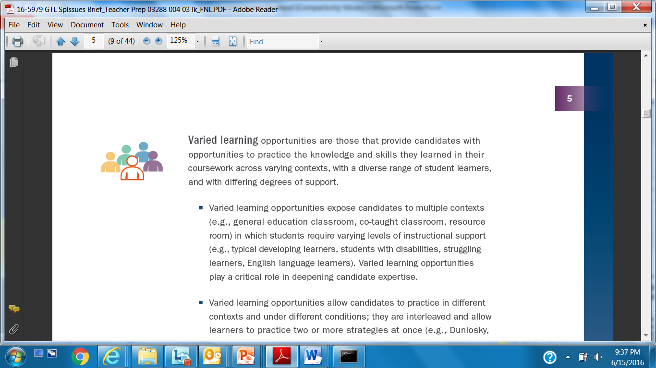
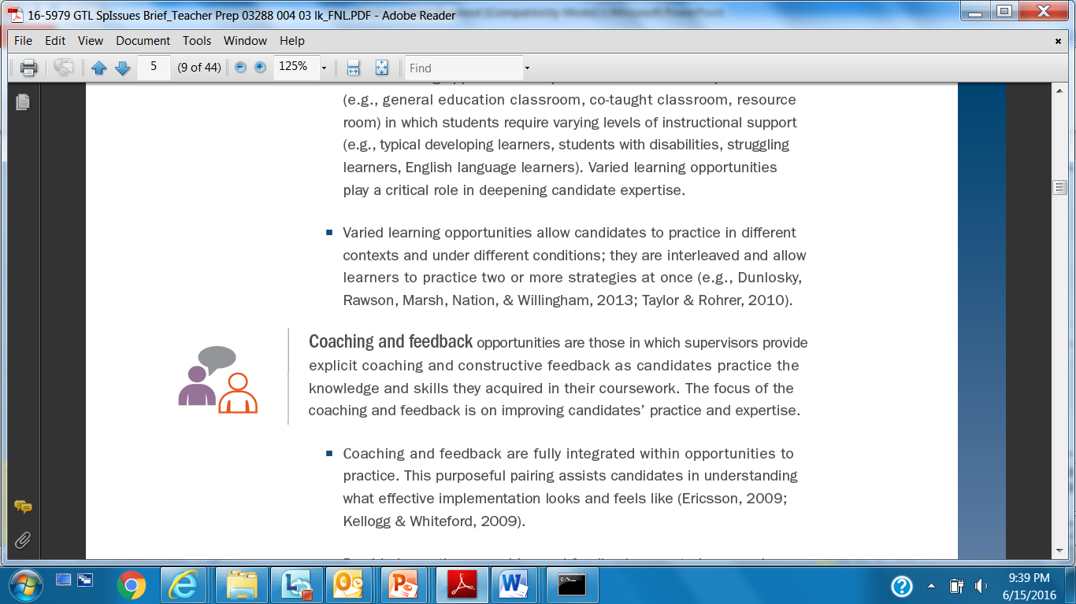
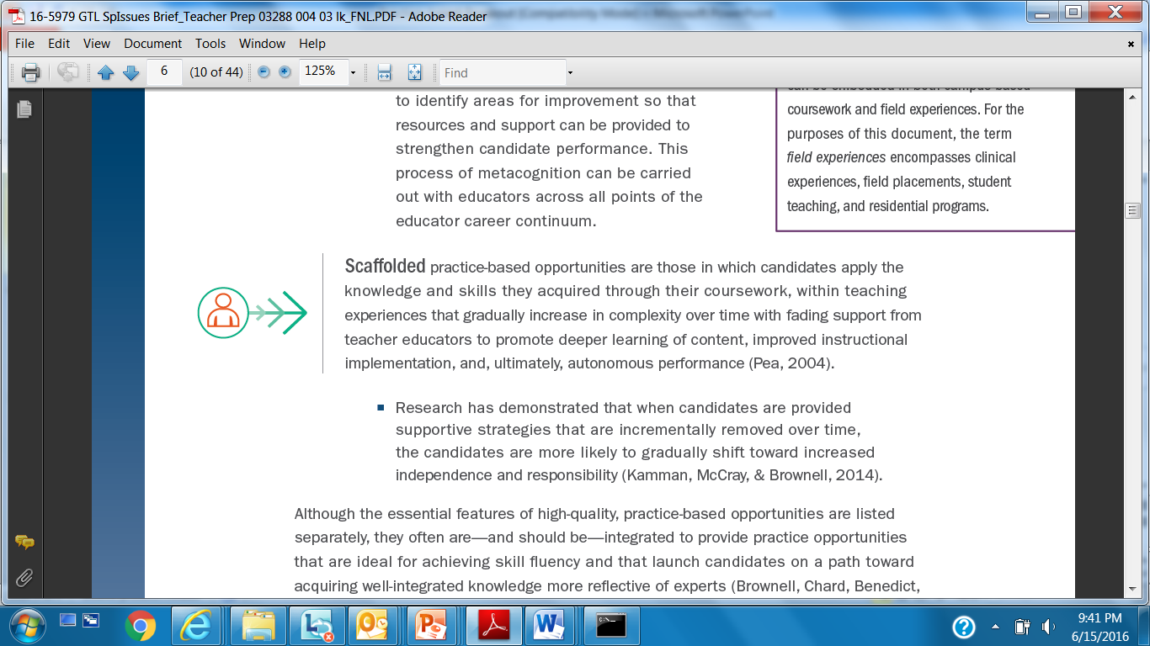
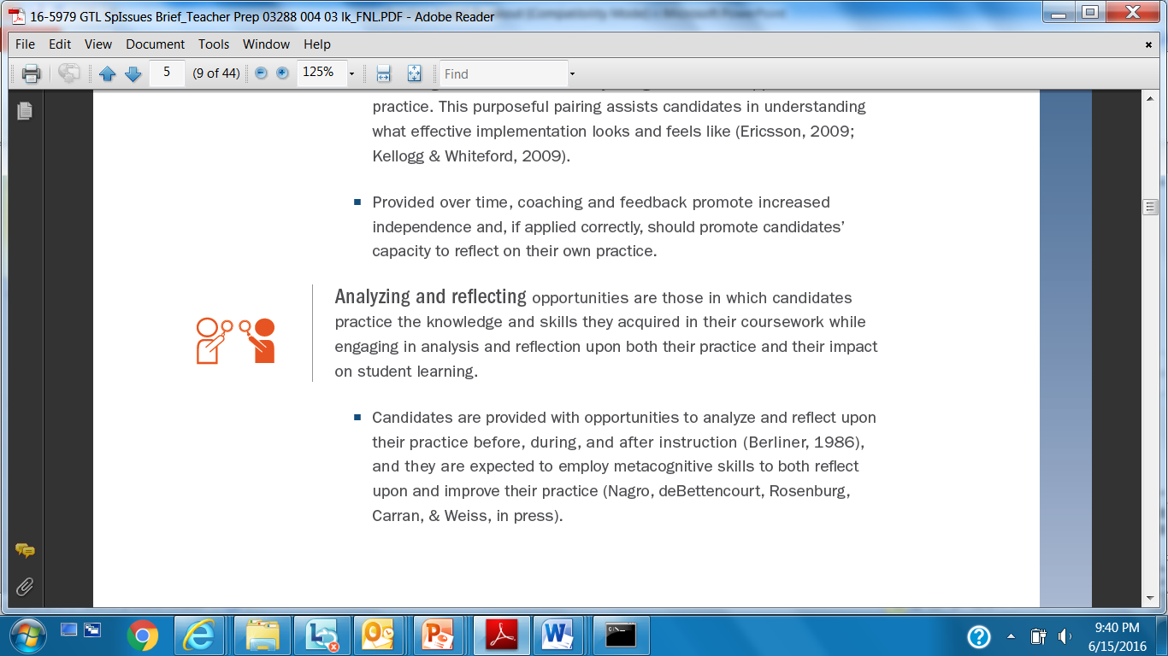
Competencies and Professional Learning
Modeling
Space Learning
Varied Learning
Coaching and Feedback
Analyzing and Reflecting
Scaffolded
http://ceedar.education.ufl.edu/wp-content/uploads/2016/07/Learning_To_Teach.pdf

Slide 34
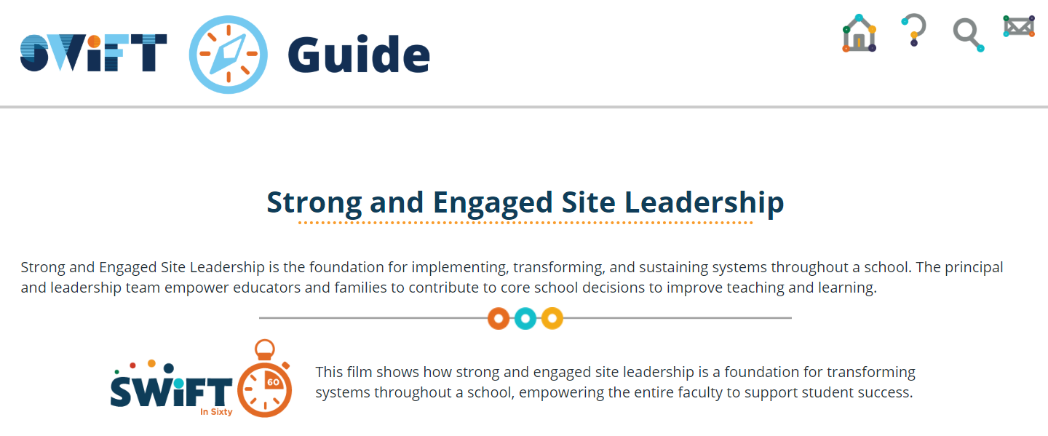
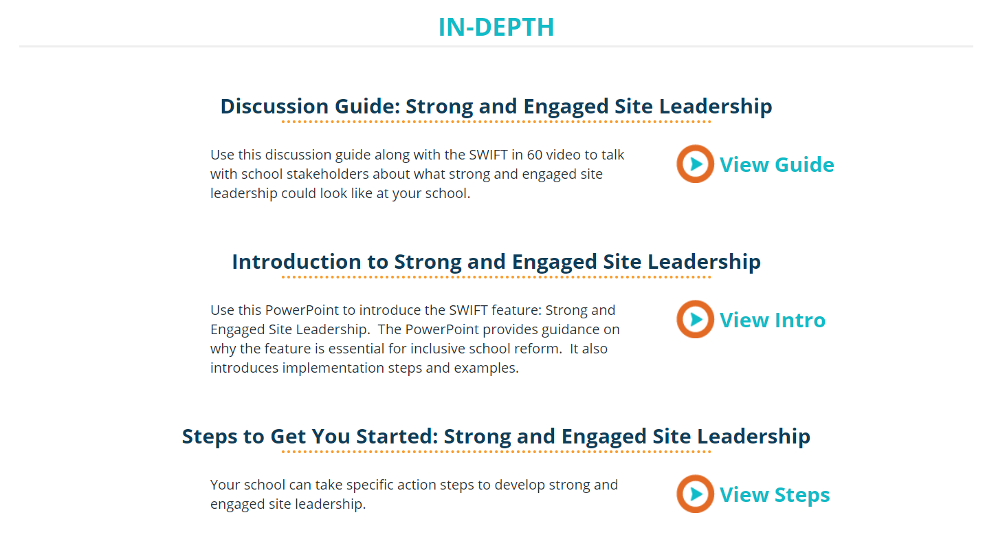
Competencies and Professional Learning

Slide 35

Every Student Succeeds Act (ESSA)
Allows state educational agencies (SEAs) to reserve up to three percent of the Title II subgrant funds (i.e., “set-aside” funding) to (Section 2101(c)(3))
Twenty-two states indicated they planned to leverage the three-percent funding option to provide professional learning support for principals (Education Commission of the States, 2017).
Nine states specifically mentioned Leadership Academies

Slide 36
Leadership Academies
Formal professional learning opportunities for leaders
Enroll cadre of principals typically engaged for 1 year
Uses a mix of learning methods by acquiring and applying knowledge:
  Weekend or week-long workshops
  Monthly webinars and online convenings
  Coaching
  Inquiry-based learning (i.e., to determine if changes in practice have the desired effects)
  Networked learning communities to exchange knowledge among peers
                -AIR Subject Matter Experts, 2019

Slide 37
Considerations
Align the content and focus on leadership academies to the inclusive principal leadership standards and competencies
Leverage the peer cohort approach to promote peer learning
Provide regular engagement with expert principals in establishing and maintaining inclusive buildings
Consider use of leadership academies to develop specialized practices, like inclusive leadership

Slide 38


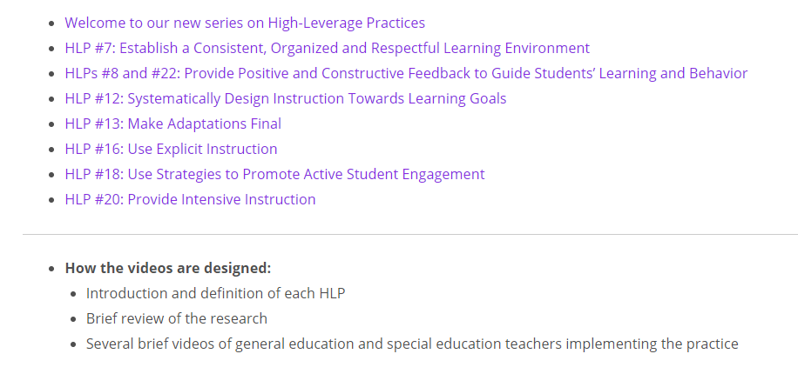
Instructional leadership
1. Getting to know HLPs
2. Sharing HLPs
3. Reflecting on HLPs
www.highleveragepractices.org

Slide 39
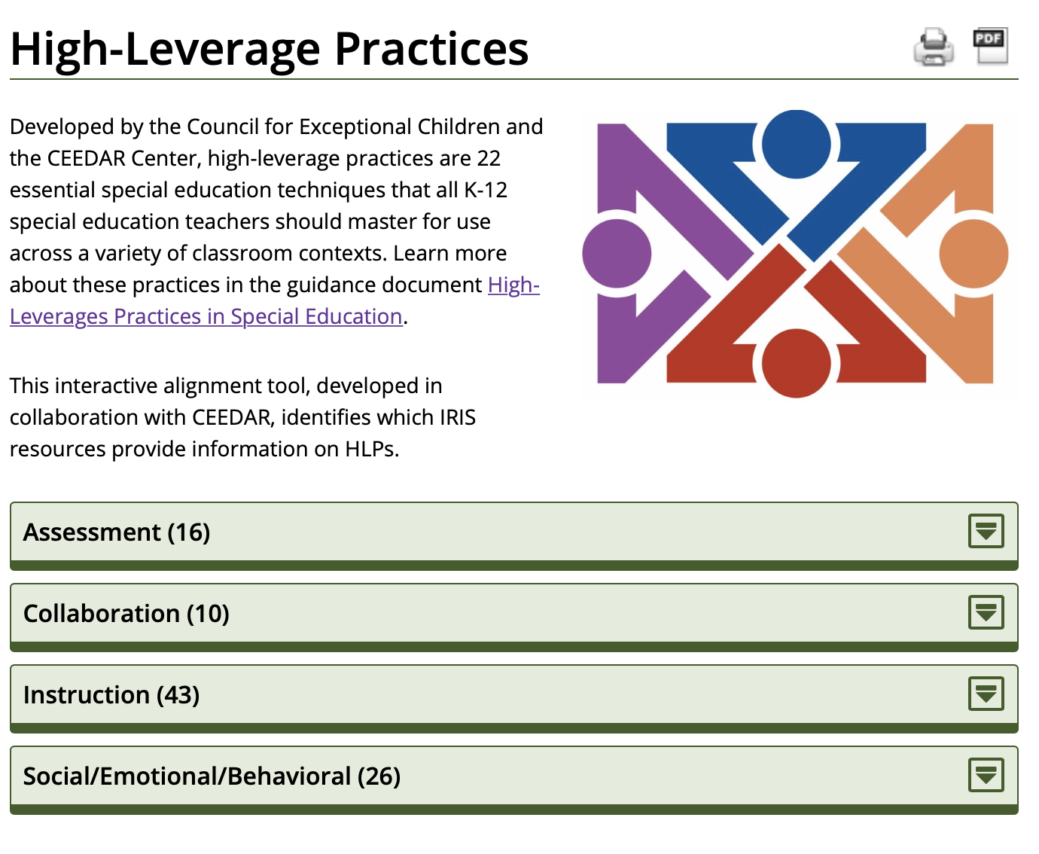
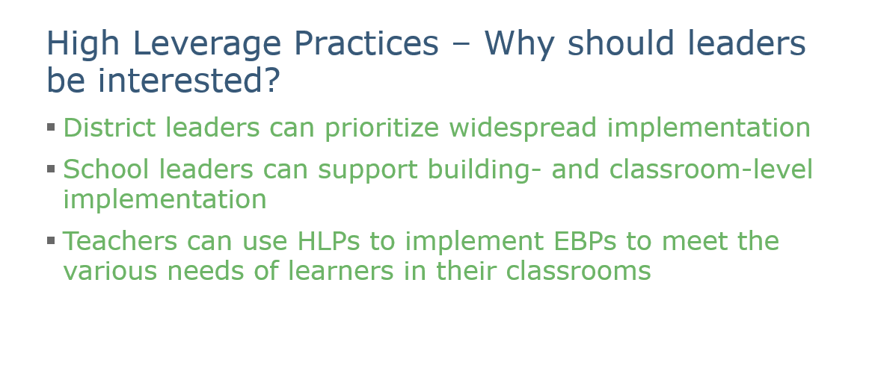
Instructional leadership
www.highleveragepractices.org

Slide 40
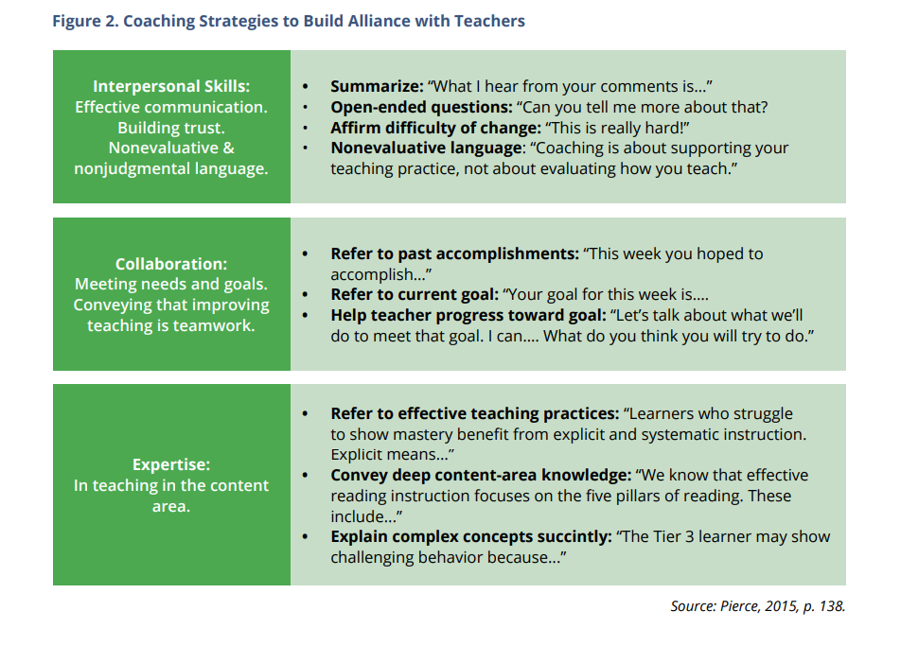
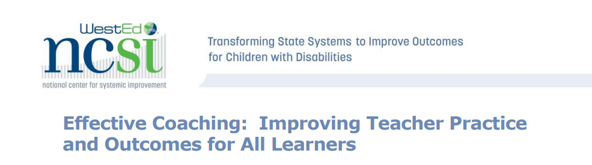
Instructional leadership
https://ncsi.wested.org/wp-content/uploads/2016/06/NCSIEffectiveCoachingBrief.pdf

Slide 41
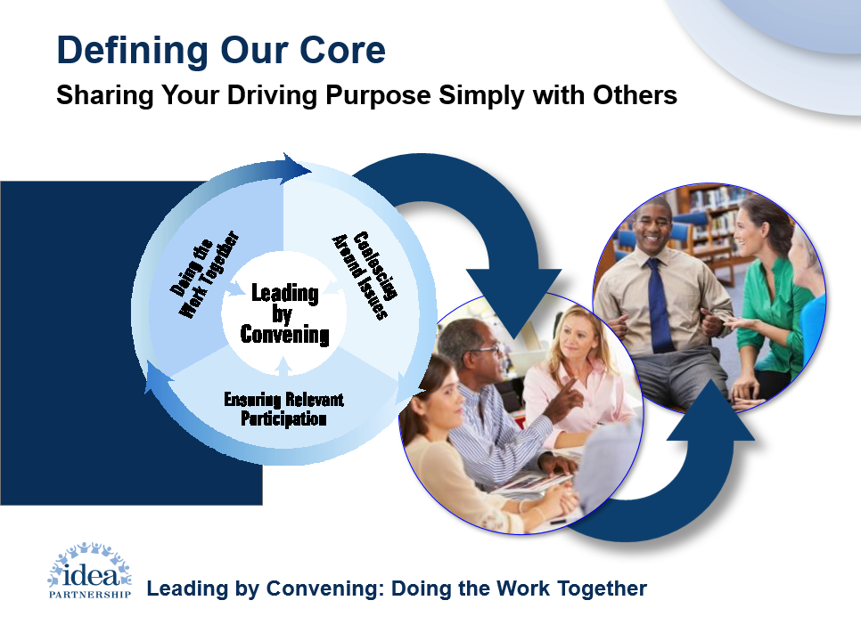
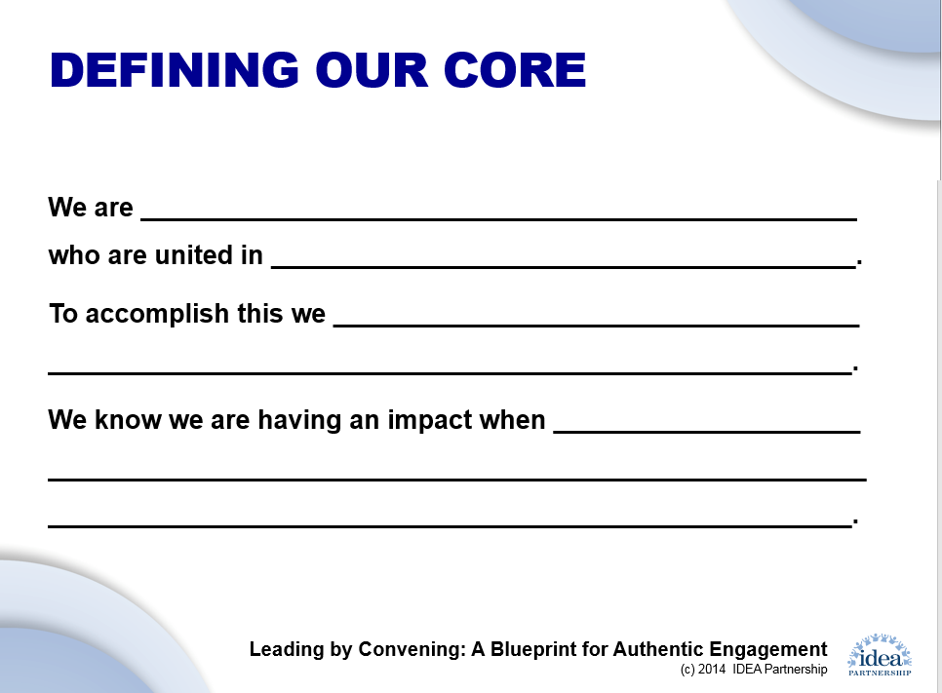
Establishing a vision

Slide 42
DISCLAIMER
This content was produced under U.S. Department of Education, Office of Special Education Programs, Award No. H325A170003. David Guardino serves as the project officer. The views expressed herein do not necessarily represent the positions or polices of the U.S. Department of Education. No official endorsement by the U.S. Department of Education of any product, commodity, service, or enterprise mentioned in this website is intended or should be inferred.

Slide 43


Professional Learning Modules
https://gtlcenter.org/technical-assistance/professional-learning-modules

Slide 44

National Governors Association
School Leadership Podcast
Episode 1: Principal Pipelines
Episode 2: Principal Turnover and Teacher Shortages
Episode 3: Research and Impact of Effective Principals
Episode 4: Principal Preparation
Episode 5: Policy Levers for Advancing School Leadership
Episode 6: Leveraging ESSA
Episode 7: Principal Professional Development
Episode 8: International Exemplars
https://www.nga.org/center/issues/education-issues/school-leadership-hot-topics-podcast/

Slide 45

Notes:
Introduce CCSSO – who we are and what we do
The Council of Chief State School Officers (CCSSO) is a nonprofit organization that supports public officials who head departments of elementary and secondary education.
CCSSO has had a longstanding partnership with the CEEDAR Center, funded by the US Department of Education’s Office of Special Education Programs, that works to strengthen teacher and leader preparation for the success of students with disabilities.
I am here today to share about work we are partnering on with CEEDAR related to the principal’s role in ensuring high-quality IEP implementation through the establishment of inclusive learning environments for each child

