Slide 1

Mathematics assessments through mtss
Notes:
Melinda

Slide 2
Mathematics Assessment within MTSS
Notes:
Kat 9:00-9:15

Slide 3
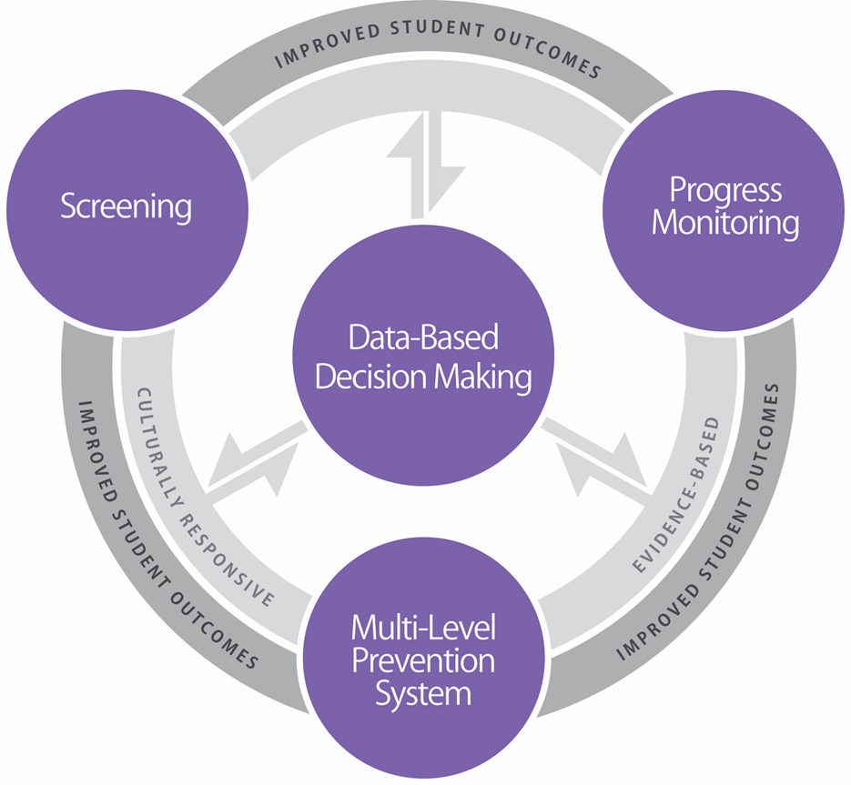
Essential Components of
MTSS Framework
Notes:
Multi-Tiered Systems of Support (MTSS) is a preventative framework for school improvement made up of four essential components. The four components are screening, the multilevel prevention system, progress monitoring, and data-based decision making. MTSS also encompasses features such as culturally responsive instruction, family engagement, and evidence-based instruction. As you’ll notice in the graphic, each of the components and features contribute to improved student outcomes.

Slide 4
Characteristics of Instruction Across the Tiers
 | Primary (T1) | Secondary (T2) | Intensive (T3)
Instruction/ Intervention Approach | Comprehensive, research-based curriculum | Standardized, targeted small-group instruction | Individualized, based on student data
Group Size | Classwide (with some small-group instruction) | 3–7 students | No more than 3 students
Monitor Progress | Once per term | At least once per month | Weekly
Population Served | All students | At-risk students | Significant and persistent learning needs
DBI is an approach to intensive intervention.

Slide 5
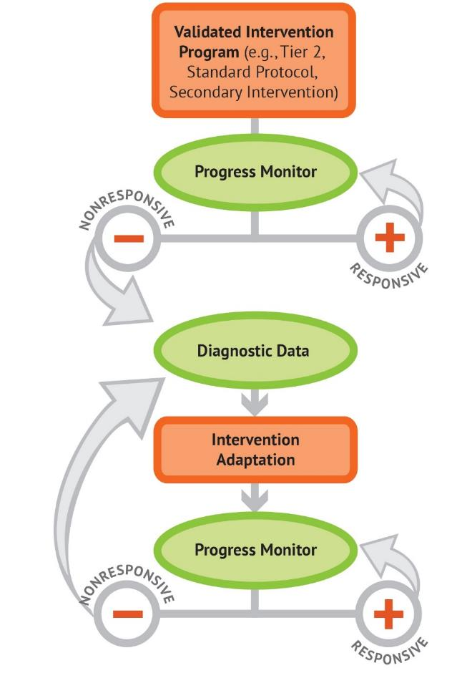
Five DBI Steps
Secondary intervention program, delivered with greater intensity
Progress monitoring
Informal diagnostic assessment
Adaptation
Continued progress monitoring, with adaptations occurring whenever needed to ensure adequate progress
Notes:
For students needing more intensive intervention, National Center for Intensive Intervention, NCII have developed Data-based Individualization to further highlight the process to help students. As we have discussed on previous calls, many schools are using a universal screener to identify students in need of Tier 2 and have progress monitoring tools, but then are challenged in identifying why some students are not responding.

Slide 6
Diagnostic Data
As the model shows, for students not responding teachers need to collect further diagnostic data. This might include:
  Work samples
  Additional assessments
  Analysis of assessment data- moving beyond just the score, but error analysis
  Clinical interviews

Slide 7
What is a Clinical Interview?
A way to explore student thinking.
A complement to other diagnostic data.
A respectful, flexible way to understand student’s present performance and WHY the student may be performing as observed.
Notes:
One way to gather further diagnostic data is through the use of clinical interviews.
In short, clinical interviews are a way for teachers and interventionists to gauge a student’s present and potential knowledge. Using interviews can help teachers uncover how students think about and solve problems and gain further insight into student’s thought processes.
They are deliberately nonstandard and give teachers a respectful, flexible tools to get at the ‘why’ behind what we observe on paper and pencil assessments or analysis of errors alone.

Slide 8
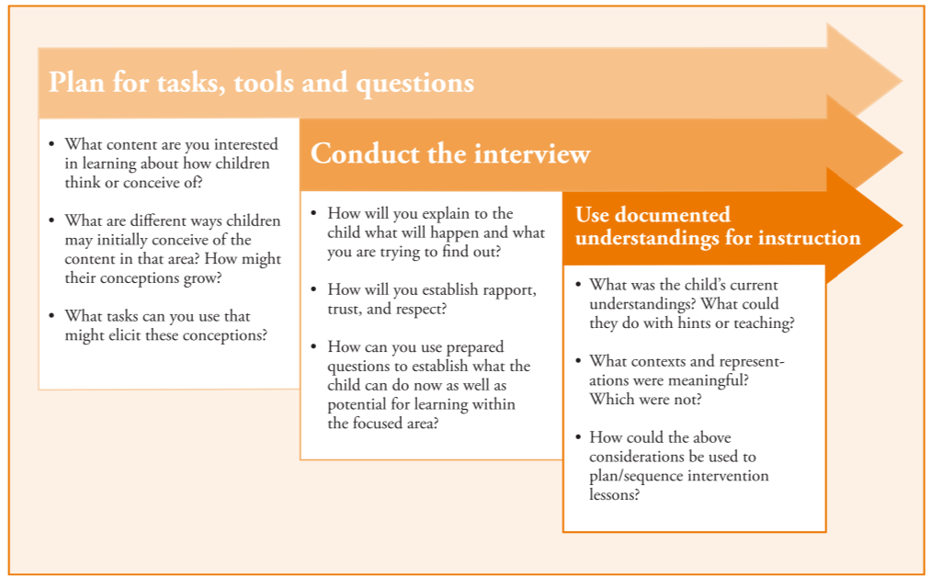
Planning for a Clinical Interview
1
2
3
Notes:
Clinical interviews typically include the following features:
Problem tasks, mathematical tools students can use, and questions to use to gain insight into students’ thinking of a specific mathematics content area;
A flexible plan for implementation - That is, a way to listen to students’ thinking, probe the meaning of their responses, and a way to alter questions on the fly to fully understand thinking in the moment; and
A way in which to use what was found out about how the student thinking to guide the planning of instruction.
Let’s look at each of these areas in a little more depth.

Slide 9
Tasks, Tool, and Questions
1. What content area you interested in learning more about how students think?
2. How might thinking develop over time or relate to other content?
3. What tasks can you use that might elicit students’ ideas about the content?
Intervention content
Foundational content
Curriculum standards
Progressions documents
Accessible
Worthwhile; familiar to students
Notes:
Choosing tasks for the clinical interview is the first step. To do that, consider the content you are interested in learning more about. Often times, this may be the intervention content students are working within or a concept or skill that is foundational to the intervention.
In this way, it is often helpful to examine content that stretches across years to get a holistic sense of what we might look for in terms of children’s understanding within a developmental progression. Curriculum, content standards, or progressions documents can help teachers think about these questions and identify content they’d like to address in the clinical interview.
Once teachers identify resources that yield a picture of how children’s thinking looks differently over time, they can prepare clear and specific problem tasks to use during the interview. Tasks should be worthwhile to students, be placed in familiar and accessible contexts, and be wide enough to elicit their thinking. Many teachers use modifications of tasks that appeared within an intervention or lesson. Other times, teachers design new tasks that have many ways students may solve them to further explore students’ reasoning.

Slide 10
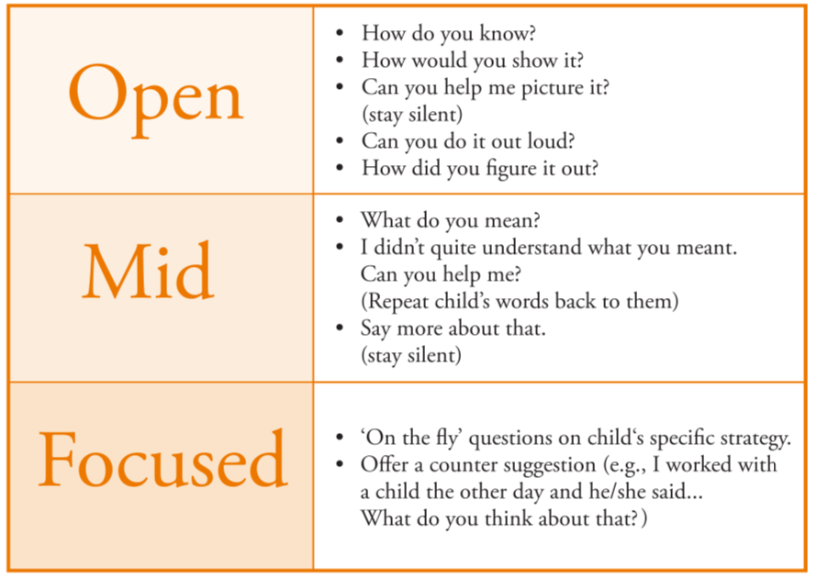
Tasks, Tool, and Questions
Have tools available for students to use as they solve problems.
  Students choose how to solve.
Prepare questions to use with tasks to probe or explore students’ thinking.
Linking Cubes
Whiteboards, paper
Notes:
Have mathematical tools, such as linking cubes, counters, or other tangible objects available for children to use, if they elect, to show their thinking. The child’s actions on the objects along with gestures, other nonverbal communication, and drawings are windows into their understanding.
Questions are prepared to accompany tasks and encourage the child to elaborate and provide full explanation of their thoughts. Prepare open-ended and focused questions to accompany each task, progressing from open-ended toward more specific questions. Sometimes repeating back a child’s words to them encourages them to say more. The figure on the screen provides gives ideas of open-ended and more specific questions to consider when planning a clinical interview, with the more open-ended ones variations of the essential question, “How did you solve it?”

Slide 11
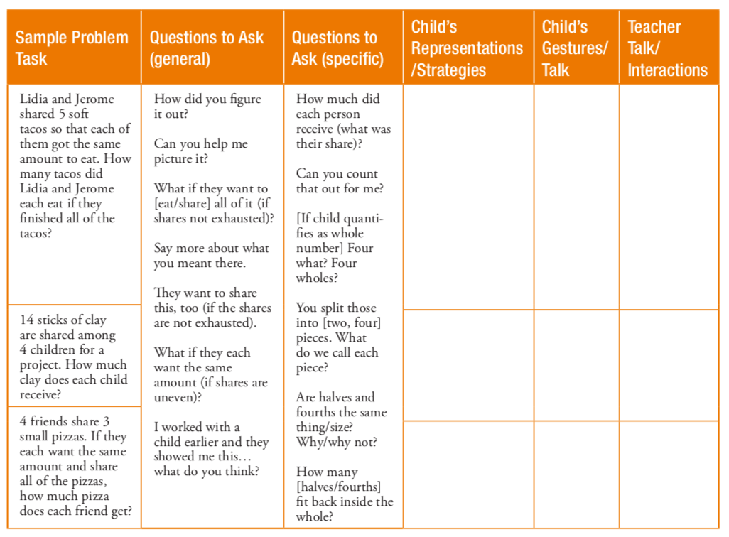
Tasks, Tool, and Questions
Notes:
A tool such as this can help you organize your tasks and questions and give you a way to record what happens during the interview.

Slide 12
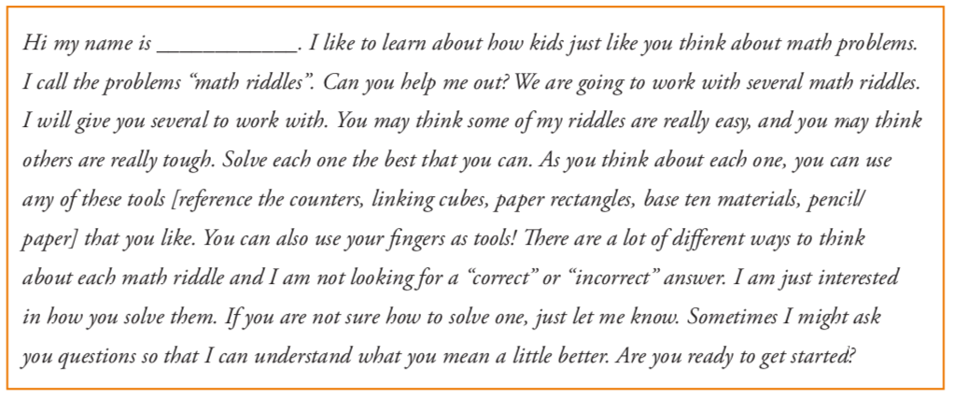
Conduct the interview
Explain to the student what will happen and why it is important.
Notes:
When tasks, tools and questions are ready, it is time to conduct the interview. Teachers can begin by explaining to the student what will happen in the interview and why it is important.
The best way to do this is to state, simply and honestly, the purpose for the interview. Getting any student, especially those who may struggle to understand mathematics, to show you their thinking can be difficult. For instance, students might believe that it is not their role to show their thinking in mathematics. These perceptions could affect the way in which the student initially interacts with the mathematics tasks and with the educator. An example of how to begin interviews is supplied on the screen.

Slide 13
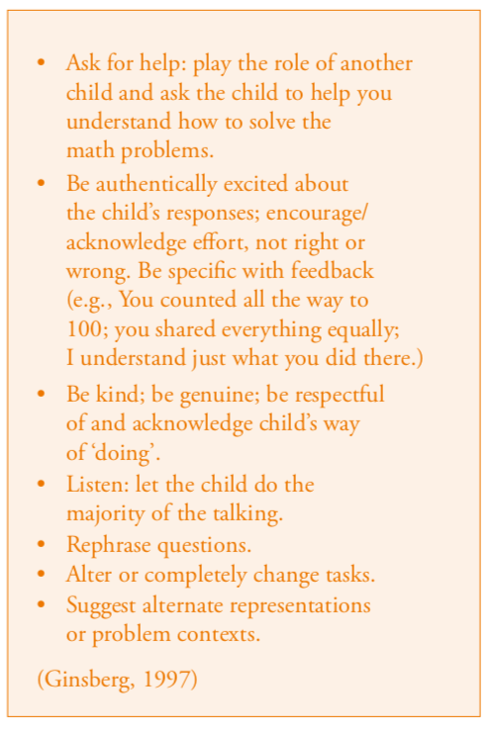
Conduct the interview
Determine the child’s current understanding.
Determine learning potential.
Less talk
More talk
Notes:
The questions prepared for the clinical interview are used during implementation to determine the child’s current understanding. It is best during this time not to interject in a way that could lead the student- it is OK to engage students in productive struggle. If students are reluctant to show their thinking, consider asking for help or playing the role of another student. Be authentic - encourage effort as opposed to ‘right answers’ – and specific with feedback as students solve problems. Most importantly, be kind and acknowledge the student’s way of doing and try your best to understand what, from the student’s frame of reference, makes sense.
Often, teachers also wish to also assess learning potential in addition to determining the student’s current understanding. In these instances, teachers can use multiple ways to clarify or even push children’s understanding and see what they do.
We found that if children did not respond to a rephrasing of a question or a change in representation, we could plan for hints In the provides example, a hint may be something like, “What do you know about soft tacos? What’s your favorite kind? Can you picture them on a plate in front of you? Would you want to leave that leftover taco on the plate if you were really hungry or would you want to eat it, too? How about your friend, if they wanted to share it with you?” Hints do not give away answers, but they do scaffold the question to make it more real for the child. In other instances, a simple change of representation or context opened access to the tasks for children who other appeared to not know how to solve the problem.
Another way to determine learning potential is to provide brief instruction within the interview to see how the child responds. If their propensity to explain and justify their thinking increases, this shows the child’s potential to learn with guidance. For example, one child we worked with used an effective problem solving strategy with some types of sharing problems but not with others. Drawing her attention toward the effective strategy in the new problems was helpful.

Slide 14
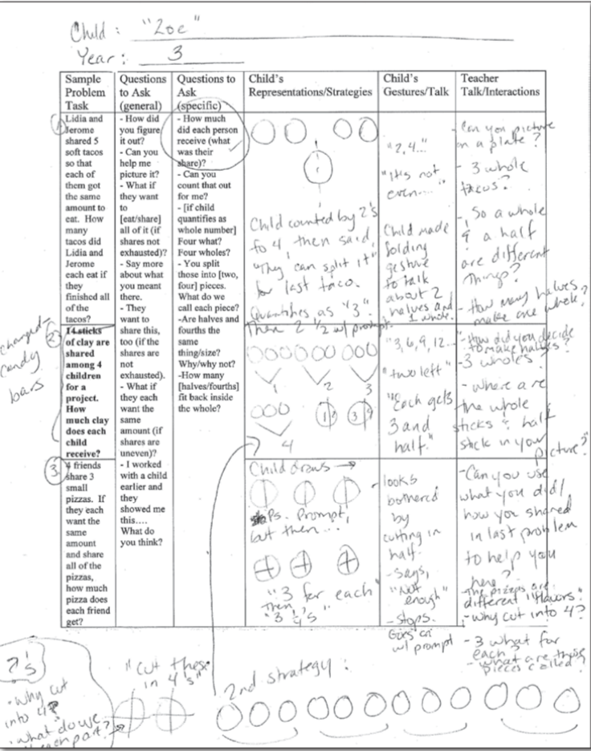
Using the Data
Notes:
Using the data from interviews involves a “report” of sorts on the part of the teacher – to themselves. Teachers should consider what the student’s current understandings were? What could he or she do with hints? Without hints? What contexts and representations were meaningful for this content? Which were not? Finally, how cold the information be used to better interventions being used to support the student’s performance?
From our clinical interviews, we obtained a rich insight into student’s thinking, both what they could conceive of currently (with and without changes in context or representations, hints, or short instructional interactions) as well as where learning could potentially go. This information helped us to suggest instruction for this student that used meaningful tasks both within and beyond the confines of her current intervention as well as contexts that were meaningful and rich for the student. We provide an example of completed interview notes here for one student.
In intensive intervention, our assessment tasks should help us to further understand the presenting instructional concerns, monitor student progress, and summarize the outcomes for a specific period of time (e.g., length of intervention, grading period, annual progress, etc.). We can use this to identify a specific area of potential learning. Through our interactions with our students, especially students who are struggling in mathematics, we are clarifying, defining, and seeking to understand their specific knowledge, thinking, and conceptual understandings to provide better instruction.
Utilizing clinical interviews in these ways gives teachers an additional means in which to richly understand children’s present and potential understandings.

Slide 15
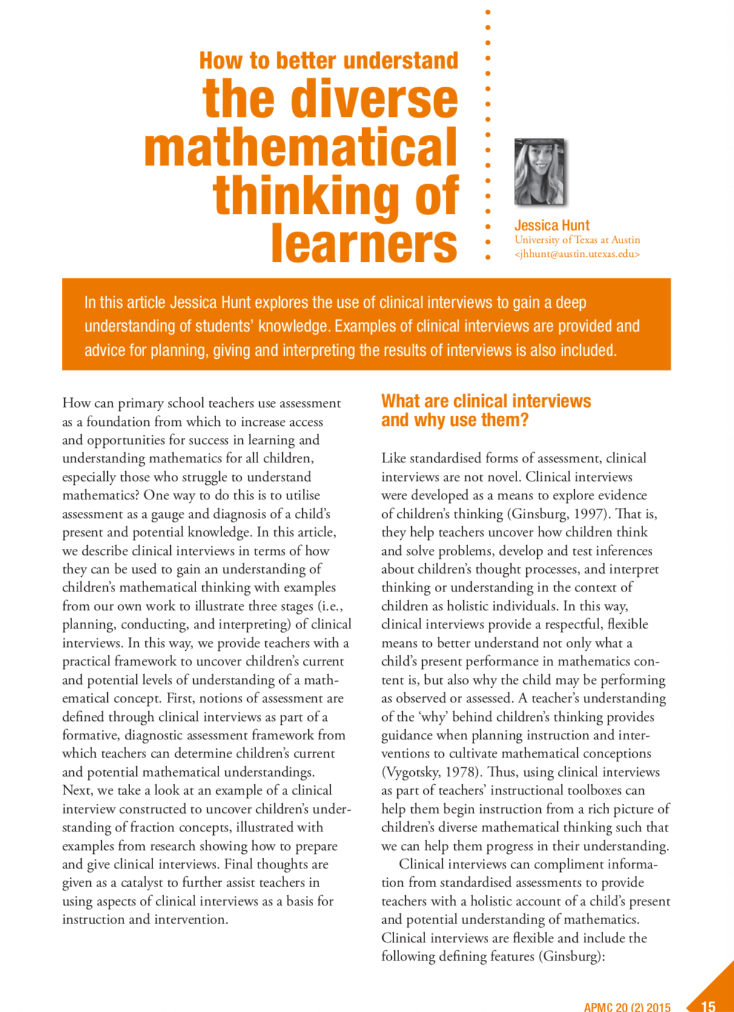
More information?
Hunt, J.H. (2015). How to better understand the diverse mathematical thinking of learners. Australian Primary Mathematics Classroom, 20(2), 15-21.
jhunt5@ncsu.edu
Free!→ https://files.eric.ed.gov/fulltext/EJ1093255.pdf
Notes:
Would you like more information? Feel free to contact me anytime, or read my paper found free at this link, to learn more. Thank you!

Slide 16

DISCLAIMER
This content was produced under U.S. Department of Education, Office of Special Education Programs, Award No. H325A170003. David Guardino serves as the project officer. The views expressed herein do not necessarily represent the positions or polices of the U.S. Department of Education. No official endorsement by the U.S. Department of Education of any product, commodity, service, or enterprise mentioned in this website is intended or should be inferred.

