Slide 1

Instructional level coaching of math ebps & hlps
Notes:
Melinda

Slide 2
Understanding Instructional Level Coaching
Notes:
Kat 9:00-9:15

Slide 3
Synthesis of Coaching Research
Variety of individuals serve as coaches.
  Experienced teachers, student teachers (peer coaching), researchers, university personnel, administrators
Lack of formal preparation opportunities for coaches.
Formal job descriptions are typically ambitious but do not emphasize the core duties/behaviors of the coach.
  Creates confusion as to purpose, definition, and desired outcomes of coaching.

Slide 4
Synthesis of Coaching Research
Regardless of who coaches, the content/subject area in which coaching occurs, specific practices hold links to improved teaching and student learning.
These specific practices should be clearly articulated and communicated across the system.

Slide 5
Effective Coaching Practices
Observe
Model
Performance Feedback
(Kretlow & Bartholomew, 2010; Wehby, Partin, Maggin, & Robertson, 2012; Pierce & Buysse, 2016)

Slide 6
The Logic of Coaching: Example
Does research suggest we can expect this?
Does research suggest we can expect this?
What kind? What exactly will the coach do?
If we provide coaching…
then teachers will improve their use of EBPs….
Leading to improved outcomes among students with disabilities.
Source: file:///G:/AIR%20Projects/Conferences/OSEP%20July%202018/ModelsOfSuprt-MatricDiscussGuide-FINAL_(1tp).pdf
Notes:
What do I mean by unpacking the logic? We’re all pretty familiar with spelling out our logic. For example: if coaching occurs, then what will happen? I suggest you go deeper than this, however, and really spell out what coaching will look like and what you can expect. You could use the content to more clearly message your coaching model to stakeholders.
Source:

Slide 7

Provision of Services
Service | Site 1 - CA | Site 2 - TN
Core Mathematics | Basic Mathematics/Co-teaching Math teacher + Sped teacher | General Math Inclusion Math teacher + Sped teacher
Intervention | (Only available in grade 6 for somewhat at-risk students) | RtI Math Class (meant to be temporary)
Resource room (SPED) |  | Math SPED Lab
Note: Blue highlighted cells designate the setting for which this project is being implemented at both sites.
Notes:
Discuss provision of services at both sites: Co-Teaching across core classes at both sites where students with IEPs are taught Core
Site 1
3 teachers at site 1: mathematics teacher for grades 6, 7, 8; sped teacher for grades 6,7 and sped teacher for grade 8
Basic Math is a lower tracked math class – Site 1
Because the core math is tracked, students do not receive additional mathematics in SPED. There is a Math opportunities class for 6th – but that teacher is not participating in the study
Site 2
Inclusion is not a tracked class – it is grade-level students with students with IEPs included
We plan to work in the Intervention setting and Resource Room setting at Site 2, rather than Core
Sped Math teacher for each grade level will be included + RTI Math teacher who provides services to all grade levels (4 teachers in all)
Sped Math teachers are in resource room for one period and inclusion for the other 3 periods

Slide 8
Unique Features: Instructional Research Group
Focus only on students with IEPs and those requiring intervention (or low track mathematics).
Adjust and understand school context which varies at the two sites.
Use two evidence-based interventions for promoting algebraic reasoning (TransMath Level 2 and Level 3 and Fraction Face-Off!)… Stress coherence.
Less coaching, more teacher planning; emerged at both sites.

Slide 9
Coaching
Coaching provided to special and general educators
Feedback includes
  15-minute calls
  Identified strengths and weaknesses
Coaching has led to resistance from teachers

Slide 10
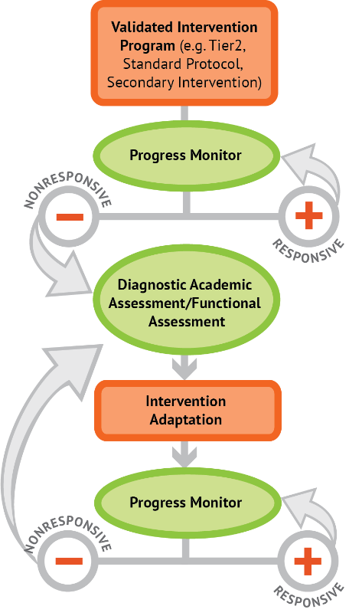

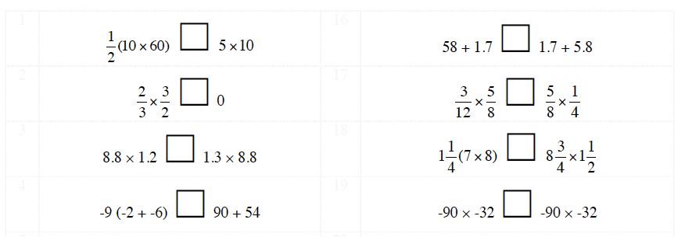
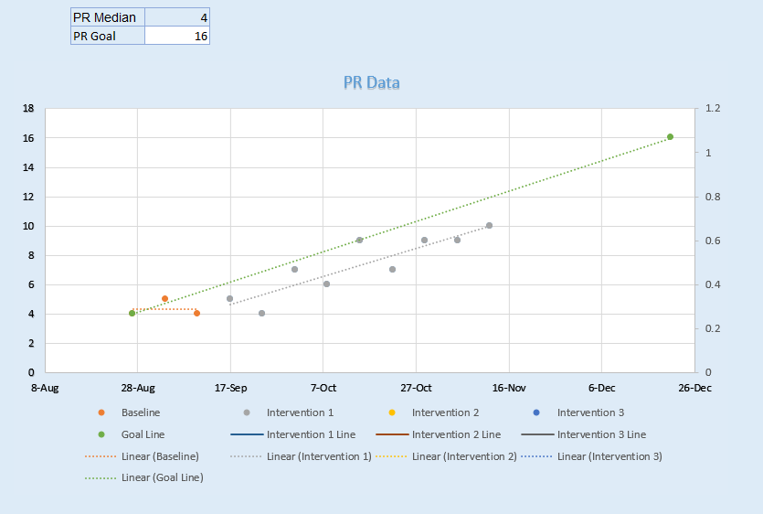
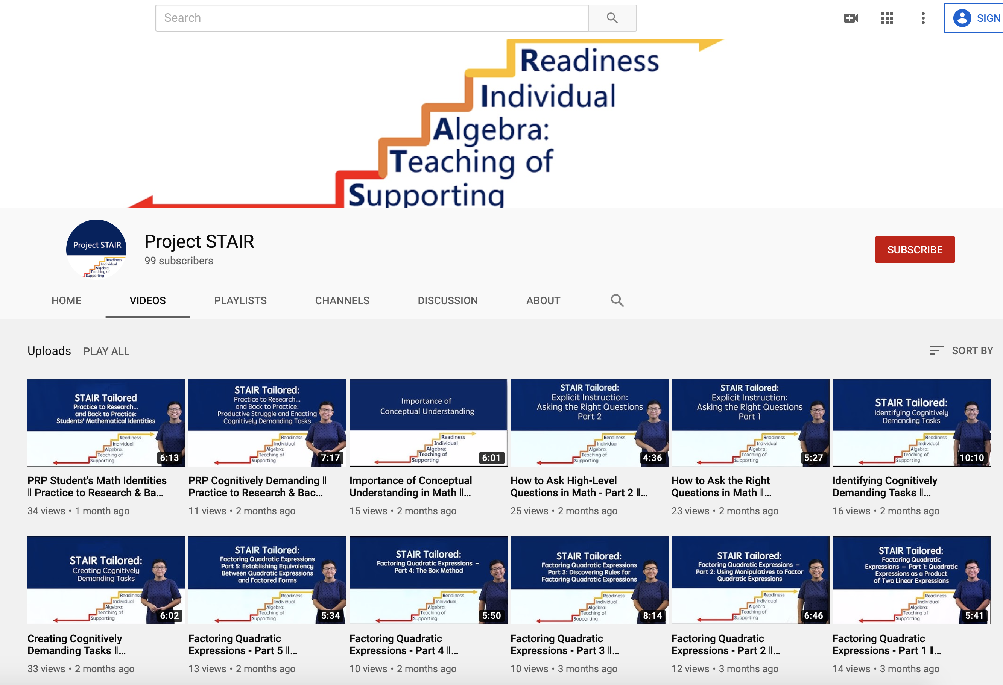
STAIR Intensive Flowchart
Diagnostic Data (DOMA)
STAIR Intensive
Progress Monitoring (ARPM)
Coaching
Graphing program
After STAIR Core, teachers implement DBI with their students
And we used STAIR Tailored to improve teaching practices for students
STAIR Tailored
Tailored PD (STAIR youtube)
Notes:
Flowchart for DBI
Intensive PD-train all teachers on DBI
Assess—decide which students are eligible for DBI
Assess—Collect baseline PM and diagnostic data
PD—Intensive PD: Train teachers on data and intervention design
Coach—tailored PD and Coaching—interpret data and change instruction

Slide 11
Coaching Resources
Notes:
Kat

Slide 12
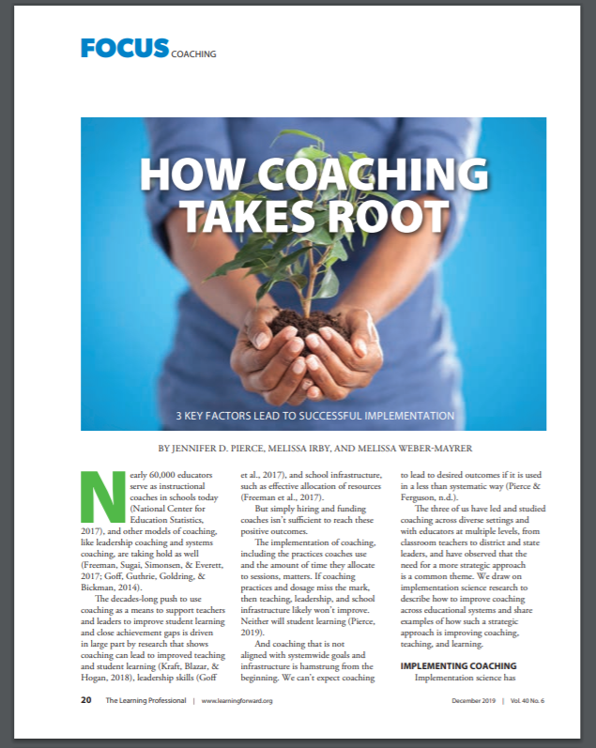

Recent Publications
Source:http://www.ascd.org/publications/educational-leadership/nov19/vol77/num03/How-Good-Coaches-Build-Alliance-with-Teachers.aspx
Source:https://lerningforward.org/wp-content/uploads/2019/12/the-learning-professional-december2019.pdf
Notes:
Both 11:50-12:00

Slide 13
Teacher Coaching
Module, Brief, and Infographic:
  https://docs.google.com/viewerng/viewer?url=https://ncsi-library.wested.org/system/resources/documents/000/000/057/original/NCSI_Effective-Coaching-Brief-508_1_.pdf?1490127749
  https://docs.google.com/viewerng/viewer?url=https://ncsi-library.wested.org/system/resources/documents/000/000/188/original/NCSI_Coaching_Infographic5.pdf?1497294857
  http://airhsdlearning.airws.org/ncsi-effectivecoaching/11-15/story_flash.html
Fidelity of Coaching (Module, rubric, worksheet, & completed sample):
  https://ncsi-library.wested.org/resources/247
  https://docs.google.com/viewerng/viewer?url=https://ncsi-library.wested.org/system/resources/documents/000/000/059/original/NCSI_Coaching-Fidelity-Tool_Rubric-508_1_.pdf?1490204815
  https://docs.google.com/viewerng/viewer?url=https://ncsi-library.wested.org/system/resources/documents/000/000/058/original/NCSI_Coaching-Fidelity-Tool_Worksheet-508_1_.pdf?1490127910
  https://docs.google.com/viewerng/viewer?url=https://ncsi-library.wested.org/system/resources/documents/000/000/189/original/NCSI_Coaching-Fidelity-Tool_Worksheet_completed-sample-508_(2).pdf?1497294973
National Council for Supervisors of Mathematics: Coaching Corner
  https://www.mathedleadership.org/coaching/
Notes:
You may find it helpful to access the full suite of effective coaching resources listed here, all of which are posted on the NCSI website as well as AIR’s website.

Slide 14

DISCLAIMER
This content was produced under U.S. Department of Education, Office of Special Education Programs, Award No. H325A170003. David Guardino serves as the project officer. The views expressed herein do not necessarily represent the positions or polices of the U.S. Department of Education. No official endorsement by the U.S. Department of Education of any product, commodity, service, or enterprise mentioned in this website is intended or should be inferred.

