Slide 1

Notes:
Melinda

Slide 2
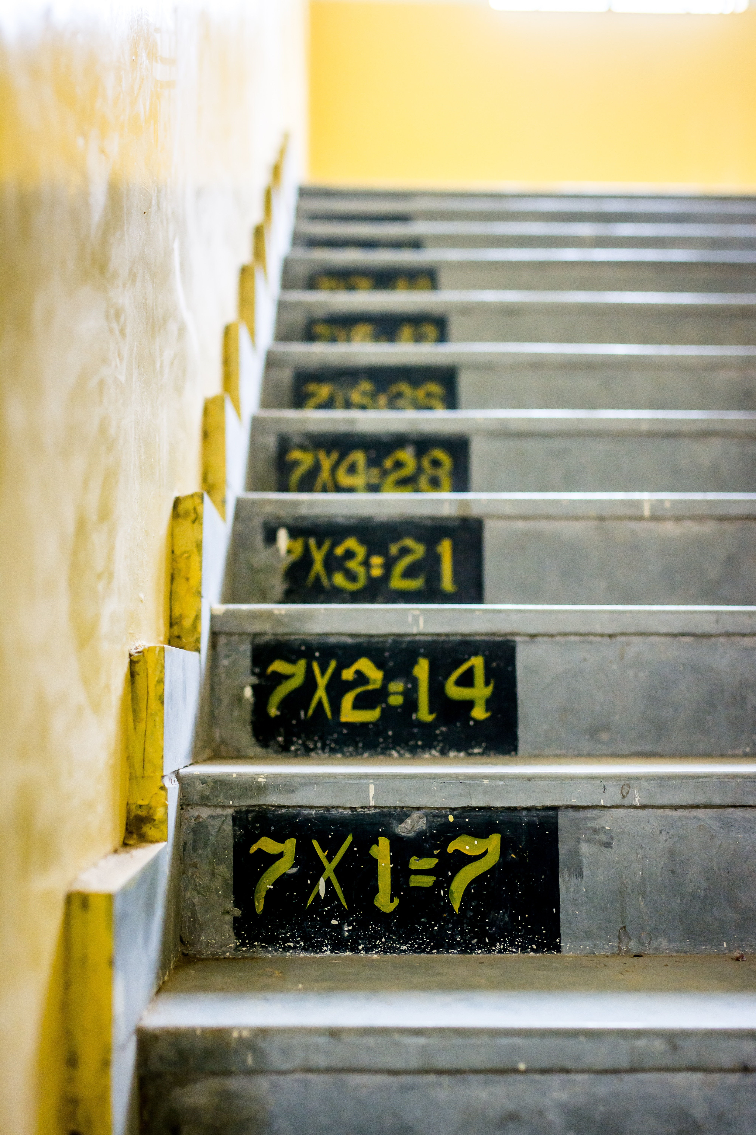
Evidence-based Practices & High-Leverage Practices
Photo by Gayatri Malhotra on Unsplash
Notes:
Kat

Slide 3
Evidence-based math practices (math & special education)
High-leverage instructional practices
Increased student conceptual understanding
Notes:
Kat

Slide 4

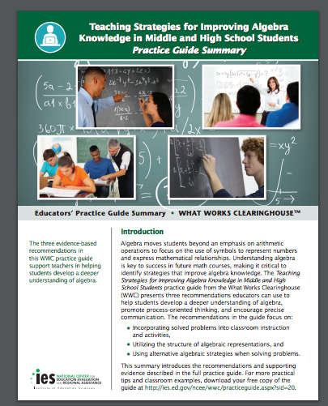
Evidence-based Math Practices
Instructional practices that have been shown to be effective at increasing
  Student understanding
  Procedural fluency
  Motivation
Need to be paired with HLPs;
meaning that specific EBPs for
math be coupled with HLPs in
order to lead to student success
Notes:
Kat

Slide 5
Mathematics Evidence-Based Practices
Working solved problems
Using multiple representations (CRA)
Understanding cognitive strategy instruction
Choosing and applying efficient strategies
Including motivation strategies
Classroom Discourse
Star, J. R., et al. (2015); Gersten et al. (2008). Retrieved from the NCEE website: http://whatworks.ed.gov
Notes:
Kat

Slide 6
High-Leverage Practices (HLPs) in Special Education
Practices that can be used to leverage student learning across different content areas, grade levels, and student abilities and disabilities.
HLPs should be combined with evidence-based practices such as
    Explicit instruction in math skills and vocabulary instruction
    Practice opportunities and multiple representations
Foundation of good teaching for both general and special educators.
Provide and embed explicit, systematic instruction
Utlize data-based individualization and mutliple data sources
Collaborate between special & general education
Provide positive and constructive feedback to students
https://highleveragepractices.org/
Notes:
Kat

Slide 7

Why the Struggle?
Why do students struggle in math?
Why do teachers struggle to teach math?
Why are parents unable to help their child?
Photo by Logan Fisher on Unsplash
Notes:
Kat

Slide 8
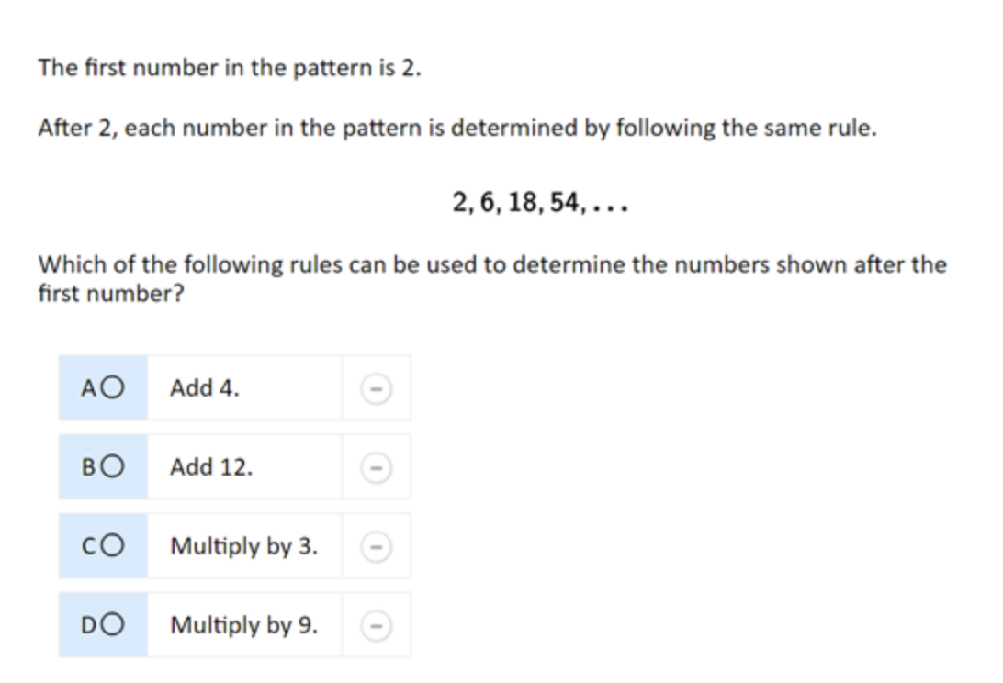
Practice
What makes this problem challenging?
What math vocabulary is needed in order to solve?
How could you use manipulatives/pictures to solve?
Notes:
Kat

Slide 9
CEEDAR Resources
Notes:
Kat

Slide 10
CEEDAR Resources
Innovation Configurations (https://ceedar.education.ufl.edu/innovation-configurations/)
  Evidence-Based Mathematics Instruction Innovation Configuration
  Innovation Configuration for Mathematics
Course Enhancement Module: MTSS for Mathematics
  https://ceedar.education.ufl.edu/cems/math/

Slide 11
DISCLAIMER
This content was produced under U.S. Department of Education, Office of Special Education Programs, Award No. H325A170003. David Guardino serves as the project officer. The views expressed herein do not necessarily represent the positions or polices of the U.S. Department of Education. No official endorsement by the U.S. Department of Education of any product, commodity, service, or enterprise mentioned in this website is intended or should be inferred.

