Slide 1
Putting HLPs into practice: Strategies, partnerships, and evaluation

Slide 2
Panel Members
Kennesaw State University | Melissa Kypraios Driver Kate Zimmer
University of Massachusetts at Boston | Kristin Murphy
University of Kentucky | Kera Ackerman
University of Louisville | Amy Lingo Todd Whitney
University of Florida | Mary Brownell Amber Benedict
University of Wisconsin Madison | Melinda Leko
Kent State University | Brian Barber
California State University at Long Beach | Cara Richards-Tutor

Slide 3
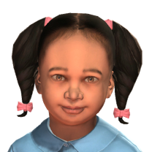
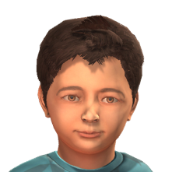
Using Mixed-reality Simulation to teach High leverage practices
CEC 2019, Indianapolis
Dr. Melissa K. Driver, Dr. Kate Zimmer, & Dr. Kristin Murphy
Kennesaw State University * University of Massachusetts Boston
Notes:
Melissa

Slide 4
Agenda
Providing Purposeful Practice for HLPs
Mixed Reality Simulations
  What, Why, How
Examples of Use
Tools and Strategies to Consider
Closing Questions
Notes:
Melissa

Slide 5
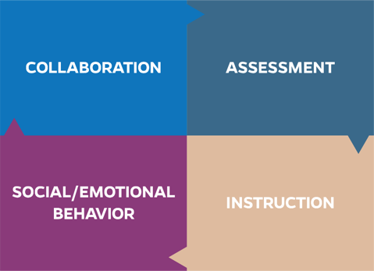
High Leverage Practices
HLPs are identified as specific teacher practices that are likely to result in improved student outcomes.
Notes:
Melissa: As a reminder, high leverage practices, or HLPs as they are commonly referred to, are identified teacher practices likely to result in improved student outcomes. HLPs are comprised of evidence-based strategies backed by decades of research. They are based on the premise that our students need teachers who are well-equipped in each of the areas of collaboration, assessment, social/emotional/behavior support, and instruction. <CLICK>

Slide 6
What to Consider
Is it introduced?
Is it practiced?
Is it applied in the field?
How do pre- and inservice teachers demonstrate their knowledge, skills, and dispositions?
Notes:
Melissa – As we dive into these HLPs, we want you to think about this material in your own context, whether you are an educator preparation provider, a classroom teacher, teacher leader, school/district administrator, or policy maker. Regardless of your role, consider what must happen as pre- and in-service teachers learn new knowledge and skills. First, the content must be presented in a meaningful and authentic way. Next, pre- and in-teachers should practice in a safe context with feedback. We believe that this practice should occur before practicing in the field with students. This step often gets skipped, however, incorporating this practice helps ensure that our students are getting the best version of their teacher’s new skill when it is applied in the field. And this is the final step, taking what candidates have learned and practiced then putting it into action where it counts. <CLICK>

Slide 7
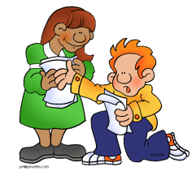
Providing Practice
Teacher candidates need opportunities to practice their craft in structured, scaffolded, and supervised experiences (Leko, Brownell, Sindelar, & Kiely, 2015).
In your experience, what are the pros & cons of role plays?
Notes:
Melissa

Slide 8


Issues of Time & Feedback
Notes:
MELISSA

Slide 9
Simulated Practice
Simulations allow individuals to learn and master new skills in an environment that does not put others (e.g., students) or relationships at risk (Dieker et al., 2014).
Simulations enable candidates to practice decision-making and receive feedback on decisions through virtual responses and peer observers (Brown, 2000).
Notes:
MELISSA

Slide 10
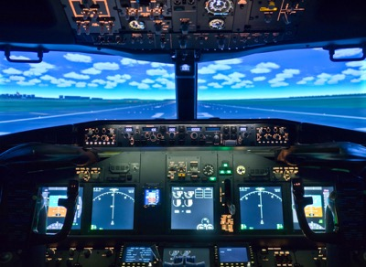
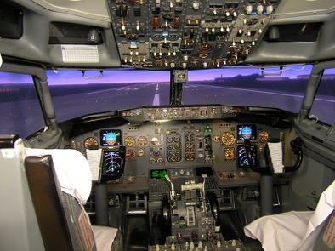

Simulated Practice
The use of simulations is a well-validated approach for students in fields outside of education such as military and medical training (McGaghie, Issenberg, Petrusa, & Scalese, 2010).

Slide 11
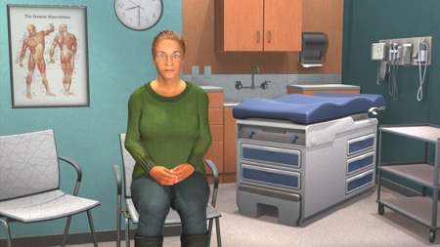
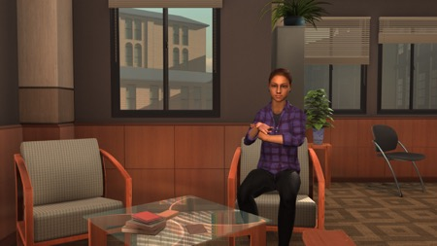
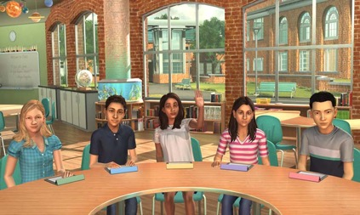
Mixed Reality Simulations
Similar to flight simulator training used for pilots before they fly an actual airplane
Bridge: Intermediary step to practice new skills with avatars (students and adults, e.g., co-teachers, parents, administrators…) before or alongside implementing in the field – never a replacement
Practice complex social interactionsssroom teaching above and beyond traditional methods of teacher preparation (Straub et al., 2015).
Notes:
Kristin

Slide 12

How does it work? How is this different from virtual reality? MRS is powered by a blend of . . .
Artificial Intelligence
Human Intelligence
+
“Human-in-the-loop” paradigm
Simulation specialists orchestrate the verbal and nonverbal interactions between avatar-based characters and the trainee during the simulation.
More authentic interactions than virtual reality
  Activates the neural pathways required to turn new skills into daily routines​
  Provides a safe environment for feedback and coaching​
Notes:
Kristin
This blending provides the realism needed to make experiences that involve intense human-to-human interaction impactful. The “human in the loop” is supported by the AI and is trained in the psychological behaviors of their characters.

Slide 13
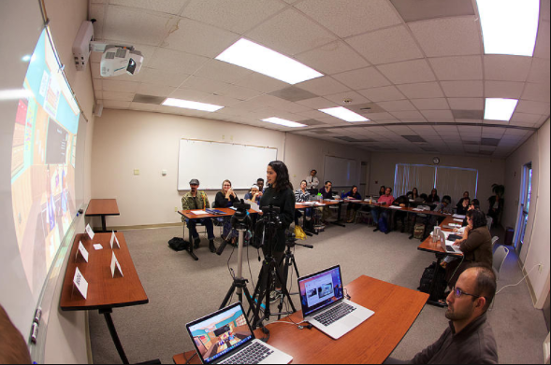
Notes:
Kristin

Slide 14
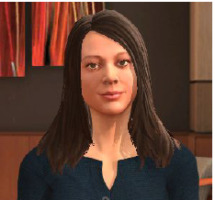
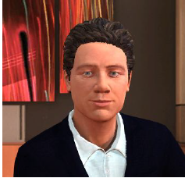
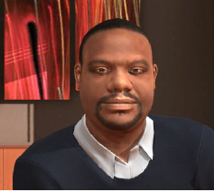
Meet the Adults
Notes:
Kate

Slide 15
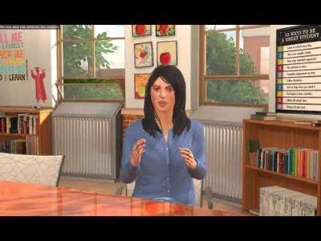
Meet Dani
Mixed-Simulation Partner: Mursion®
Notes:
Kate

Slide 16
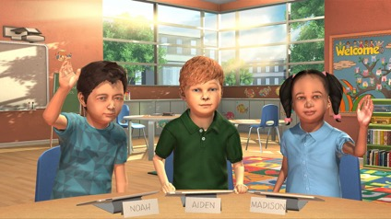

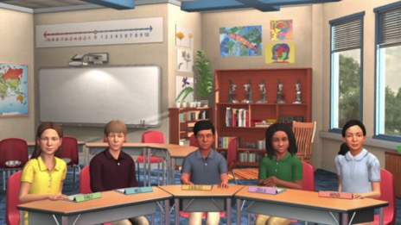
Meet the Students
Notes:
Kate

Slide 17
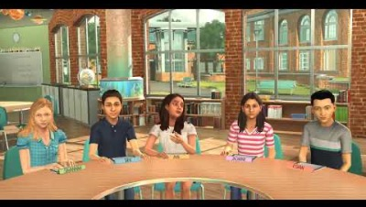
What makes a good teacher?
Notes:
Kate

Slide 18

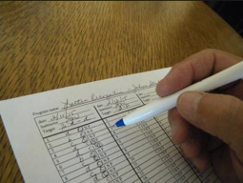


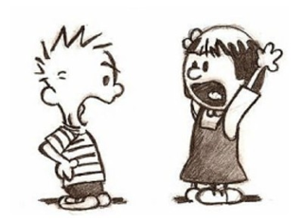
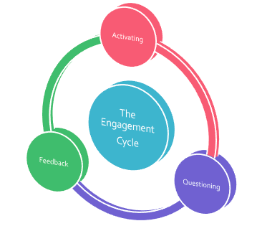
Practicing HLPs
Notes:
Melissa & Kate

Slide 19

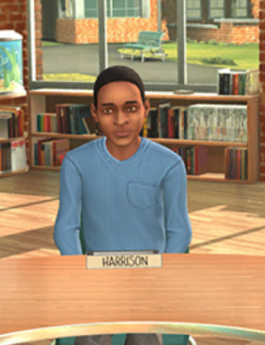
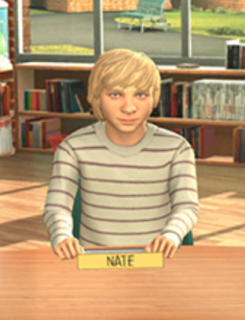
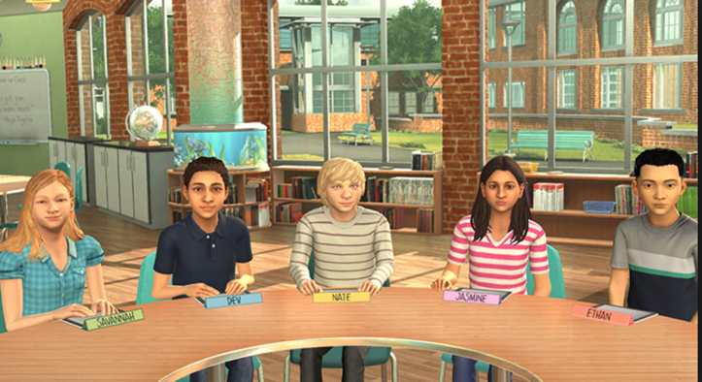
Avatars with diverse learning needs
Performance-based assessments
  Gateway assessments
Notes:
Kristin

Slide 20
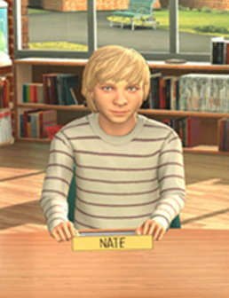
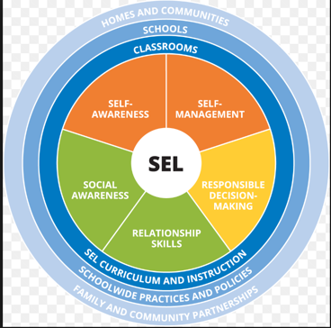
In today’s session, you will be transitioning the class from an independent drawing activity to a class discussion about the concept of Social Awareness, one of the five core competencies of Social and Emotional Learning from CASEL.
Performance objectives: You have up to 12 minutes to complete this activity.
1. Transition all 5 students away from writing activity in an engaging and positive way within the first 3 minutes.
2. Introduce the concept and definition of Social Awareness in an engaging and easy to understand way. Lead a discussion with all 5 students. Two to three of the students, including Nate, should provide at least one appropriate personal example of a time when they showed, or could have shown, social awareness.
Notes:
Kristin

Slide 21
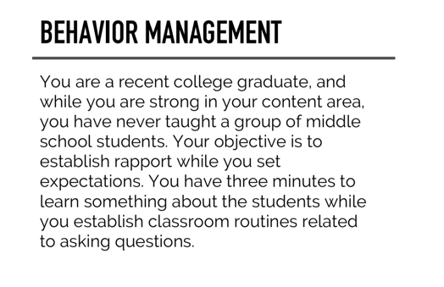
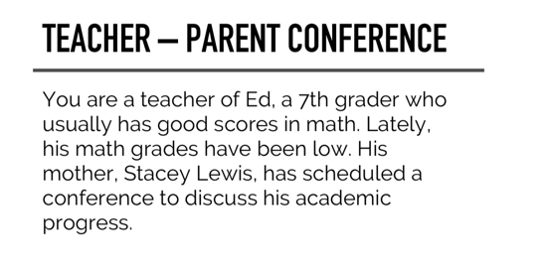
How to create a scenario
Identify Target Learning Objectives (1-2)
  Identify Session Outcomes
  Key Learning Experiences
  Deciding Context
  Planning to Provide Feedback
No more than 7-10 minutes in length
Always run an “orientation” session prior to conducting the actual simulations
Notes:
Kristin

Slide 22





Tools and strategies to consider when planning for embedding mixed reality into your courses
Notes:
All

Slide 23
Reflections from students
Mixed reality nerves
  I cannot speak for everyone but I also felt nervous and anxious because I could not predict how the meeting would operate with Stacey. On the other hand, this was a good stress, because I am sure that experienced educators already in the field experience this level of anxiety before an important meeting
Notes:
Kristin

Slide 24
Reflections from students
Increased confidence during a new experience
  I loved the idea of being able to tag someone in. I felt confident in the moment knowing that if I needed to someone could jump in. This allowed me to be engaged with the parent.
  I liked the idea of working with a team, because when you are in an IEP meeting you are working with a team. It let you get the experience of how you can work with your team members.
Notes:
Kristin

Slide 25
Reflections from the professors (us)
Avatars give us common characters and shared experience “in the field” to anchor our discussion to during simulations…and beyond
Strength and trajectory of conversation and feedback during the “pause” and “feedback” sessions
Allows us to tap into disposition of our students in the classroom prior to practicum
Time and $$
Notes:
Kristin

Slide 26

Notes:
Kate – our site license

Slide 27

Contact us
Melissa Driver and Kate Zimmer
  Kennesaw State University
  mdriver6@kennesaw.edu and
  kzimme10@kennesaw.edu
Kristin Murphy
  UMass Boston
  kristin.murphy@umb.edu
Notes:
Melissa

Slide 28

Building collaborative EPP partnerships to enhance educator quality:
An example from Kentucky
Kera Ackerman, Ph.D.
Amy Lingo, Ed.D.
Todd Whitney, Ph.D.

Slide 29

Initial Effort
University of Louisville
University of Kentucky
Thomas More University

Slide 30
Building Collaborative Partnerships Statewide:
Kentucky Excellence in Educator Preparation

Slide 31
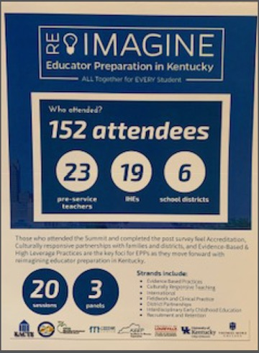
KEEP SUMMIT
Evidence-Based Practices
High-Leverage Practices
Fieldwork & Clinical Practice-based Experiences
Culturally Responsive Teaching & Equity
Family Engagement
District Partnerships
Recruitment & Retention of High Quality Teachers
Accreditation & Program Improvement

Slide 34
Next Steps:
Blueprint for Growth

Slide 35

Leveraging Resources
KEEP Summit – Identified needs:
  Common message
  University workgroups (within & between)
  Greater participation from all EPPs
K-KEEP research group within KACTE
  Means to engage additional EPPs

Slide 36


Existing State Structures
IHE Special Education Consortium

Slide 37
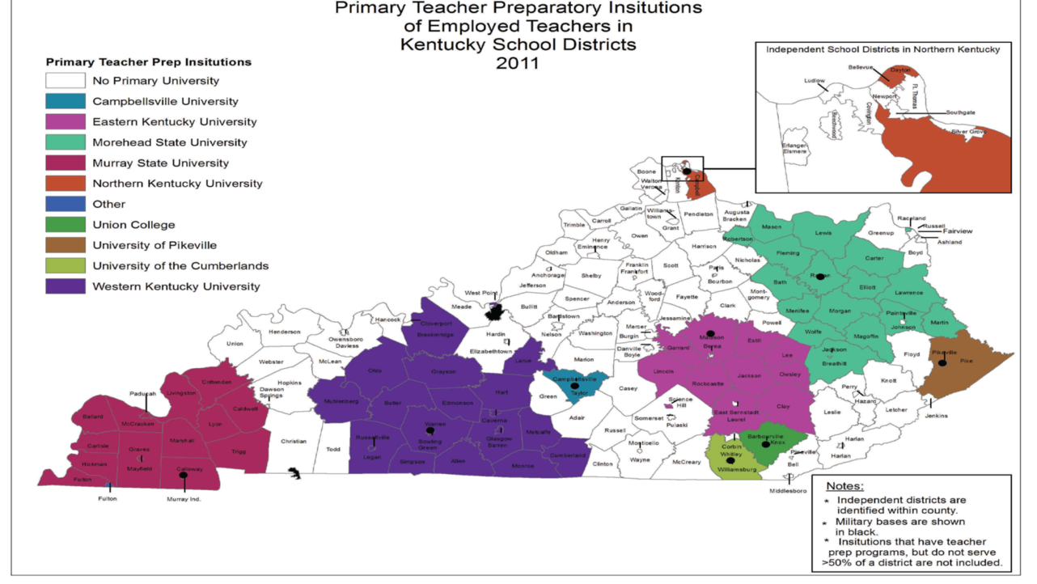

Slide 38
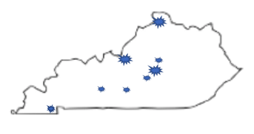
Building Capacity
Murray State University: Enhance Culturally Responsive Teaching through practice based opportunities & increase understanding of HLP & EBP through aligning curricula
Western Kentucky University: Enhance clinical partnerships through PDs on HLP
Campbellsville University: Enhance HLP & EBP through practice based opportunities, observation guides, lesson studies, video analysis, and tutoring
Asbury University: Enhance Culturally Responsive Teaching through practice based opportunities in rural and urban districts
Georgetown College: Enhance HLP & EBP through video observation

Slide 39

Improving teacher preparation from within: Using data to validate and improve practice-based preparation opportunities

Slide 40
Presenters
Mary T. Brownell, CEEDAR Director, University of Florida
Amber Benedict, University of Florida
Melinda Leko, Chair, University of Wisconsin Madison
Cara Richards-Tutor, California State University at Long Beach
Brian R. Barber, Kent State University

Slide 41

DISCLAIMER
This content was produced under U.S. Department of Education, Office of Special Education Programs, Award No. H325A120003. Bonnie Jones and David Guardino serve as the project officers. The views expressed herein do not necessarily represent the positions or polices of the U.S. Department of Education. No official endorsement by the U.S. Department of Education of any product, commodity, service, or enterprise mentioned in this website is intended or should be inferred.

Slide 42
Practice-based Teacher Preparation
High leverage practices (HLPs) and select evidence-based practices (EBPs) serve as the curriculum
Practice based preparation allows for the thoughtful implementation of HLPs and EBPs

Slide 43
Practice-based preparation
Involves a cohesive and carefully curated set of practice opportunities designed to help preservice candidates acquire the curriculum.

Slide 44
Individual Features of the opportunities
Modeling
Feedback
Analysis
Interleaving

Slide 45
Overarching features
Scaffolded
Duration
Cohesion

Slide 46
Although practice-based preparation is generating enthusiasm, we still do not have programmatic evidence of its impact (Brownell, Benedict, Leko, Peyton, Pua, & Richards-Tutor, under review).
And, we do not have systematic ways of collecting data that can be used to improve it!

Slide 47
Improvement Science Approach
To guide their efforts, teacher educators need ways of collecting data to design, implement, and improve their practice-based approaches
And, to demonstrate that these approaches are having the desired impact

Slide 48
CSU Long Beach
Dr. Cara Richards-TuTor

Slide 49
CSU Long Beach
Urban Dual Credential Program
Two year clinical residency-like program
Earn both elementary and education specialist credential
Undergraduate and post-bac options
Grounded in MTSS Framework
Strong Partnerships with school districts and schools
Notes:
Here would be a good place to discuss how school district partners use MTSS and that it is a mutual beneficial partnership.

Slide 50
HLPs Addressed
HLP #1: Collaborate with professionals to increase student success
HLP #6: Use student assessment data, analyze instructional practices, and make necessary adjustments that improve student learning
HLP #12: Systematically design instruction toward a specific learning goal
HLP #16: Use explicit instruction
HLP #20: Provide intensive instruction
HLP #22: Provide positive and constructive feedback to guide students’ learning and behavior

Slide 51
Example of One Practice Based Opportunity:
Tier 2/Tier 3 Intervention
Year 1, Semester 1 (Clinical Practice Rounds) | Year 1, Semester 2 (Clinical Practice Rounds) | Year 2, Semester 3 (Student Teaching) | Year 2, Semester 4 (Student Teaching)
Collaboratively develop two tier 1 lessons with input from classroom teachers and faculty using lesson study approach Teach lessons and receive feedback | Coursework in assessment and literacy (intervention) Collaboratively plan with “grade level team” small group intervention instruction for tiers 2/3 | Coursework in Mathematics Collaboratively plan with “grade level team” small group intervention instruction for tiers 2/3 | High leverage practices checklist for student teaching Apply intervention in ”true context”, not for a course assignment
First lesson: Basic comprehension skill, e.g., main idea Second lesson: More complex comprehension skill, e.g., compare and contrast | Critical Content: Reading (PA, phonics, fluency, vocabulary or comprehension) Critical Pedagogy: data-driven decision decision making; intervention—direct instruction, corrective feedback | Critical Content: Mathematics (number sense, word problems, algebra) Critical Pedagogy: data-driven decision decision making; intervention—direct instruction, corrective feedback

Slide 52
Data Collected to inform revisions

Slide 53
Fidelity Data: 2 years
Observation Protocol: modeling, many opportunities to respond, praise, corrective feedback
Observed at least 20% of lessons
Average fidelity scores from first intervention experience=93% Year 1: 82%-100%, Year 2: 71%-100%
Almost all candidates improved to 100% by end of first intervention practice opportunity (4 weeks, 8 intervention lessons)
Notes:
getting higher fidelity as intervention moved on; area of difficulty was corrective feedback and opportunities to respond; candidates who were working with more complex skills like vocabulary and comprehension struggled more with corrective feedback
Component
Stated the objective for the activity.
Gave clear directions.
Modeled each activity prior to guided practice.
Activities were broken down into steps for students.
Provided corrective feedback using staircase.
Provided verbal praise for correct responses.
Students had many opportunities to respond.

Slide 54
K-5 Student data
88 percent of K-5 students in intervention made growth on at least one target skill from DIBELS assessments (reading).
Younger students (K-1) made more growth than older students (2-5).
Notes:
Still need to analyze difference between student in special education and general education.

Slide 55
Candidate Interviews
  Data helped individualize intervention
  Collaborating with classmates helped get ideas to use for my students
  Individualizing the intervention allowed me to meet students’ needs
  Conducting the intervention helped us to feel we were making a difference and helping students succeed
Notes:
Candidates felt empowered that they could create change and be effective
Collecting baseline data: What was helpful about this step of the intervention process? Why? What was challenging? Why?
How did you feel about collaborating with your classmates in discussing data and designing intervention? Challenges? Benefits? What do you think the impact of this was on your intervention and ultimately your students?
Did the data you collected before and during intervention help you plan intervention? How so? Do you think you would use data like this in the future?
What do you believe were the key elements to delivering your intervention?
In class we discussed the following key components of intervention: Which did you find we fairly easy to implement? Which were difficult?
What was your overall take away from this process of implementing intervention

Slide 56
Revisions Made During and After Implementation
Observations showed that ”corrective feedback” was used infrequently…focused on this element as a class and modeled it again. Individual candidates had it modeled as they delivered intervention.
Candidate interviews showed focus on individualizing instruction was helpful (yay!); thus, we better aligned the assessment and intervention courses to strengthen candidates’ ability to improve instruction.
K-5 data indicated older students grew less. We decided to spend additional time on higher level decoding and reading comprehension interventions
Candidate interviews resulted in more structured opportunities in assement and intervention courses to collaborate.

Slide 57
Further Considerations for Program Improvement
Consider collecting same data for math intervention, but there are issues.
Consider reliability across master teachers and university faculty related to intervention for the purpose of professional consensus and feedback
Develop/use a data guide to more strategically help candidates make decisions about instruction during collaborative team time (if school site uses one that directly aligns).
Notes:
While collect data in student teaching on HLPs (one being intervention) do not focus on this level of details in regards to intervention, how can we also collect this data…not overwhelm university supervisors and master teachers
…are we in agreement regarding what we see and therefore guide candidates similarly.

Slide 58
KENT STATE UNIVERSITY
Dr. BRIAN R. BARBER

Slide 59

School-University Partnership to Promote Training in Effective Classroom Management
Project funded by the Ohio Dean’s Compact on Exceptional Children
Establish partnerships as contexts for mutually beneficial learning, or “simultaneous renewal” ¹
Used district priorities, HLPs, low-intensity CM strategies as guiding frameworks
Practice activities related to analysis of P-12 student behavioral outcomes
¹ Goodlad (1994)

Slide 60
HLPs IN Practice
HLP Addressed | Strategy Taught
1. Collaborate with Professionals to Increase Success in the General Education Curriculum (Collaboration) | OIP within Teacher-Based Teams Communication Skills
5. Communicate Assessment Information with Stakeholders to Collaboratively Design Educational Programs (Assessment) | Using Terminology with Assessment Data Interpretation
Use Assessment Continuously to Design, Evaluate, and Adjust Instruction that is Responsive to Students’ Needs (Assessment) | Setting Assessment Purpose Designing Data Collection Protocol Using Dara to Monitor Student Progress Adjusting Instruction Based on Data Using Technology for Data Collection
8. Provide Appropriate Rates of Positive and Constructive Feedback to Guide Students’ Learning and Behavior (Social-Behavioral) | Behavior-Specific Praise Pre-Correction Instructional Feedback High-p Requests Behavior Contracts (Tier II)
18. Use Strategies to Promote Active Student Engagement (Instructional) | Opportunities to Respond Active Supervision Incorporating Choice
19. Use Assistive and Instructional Technologies (Instructional) | Self-monitoring with Mobile Applications (Tier II)

Slide 61
Engagement Structure
  Student pairs rotate across pods/grade levels to cooperating teacher “strategy experts” every 3 weeks
    Per teacher – 2 CM strategies
    6 total CM strategies (5 preventive, 1 responsive)
  Teacher & faculty set time for weekly data review meetings
  Faculty available on-site during practice sessions for observations & consultation
  Students receive, in total, immersive instruction and practice across grade levels with 6 universal, low-intensity CM strategies, while practicing skills associated with 6 HLPs
Notes:
You could simply say we spent a lot of time thinking about how to engage the teachers and teacher candidates and this is the structure we ultimately used to improve the learning of both.

Slide 62
Pilot results: Candidates’ use of practices
Candidates assessed use of practices and associated change in instances of off-task behavior
Percentage decrease in classroom off-task behaviors by strategy (aggregated across 16 candidates):
  Pre correction 7.9%
  Opportunities to Respond 21.7%
  High Probability Request Sequences 10.6%
  Actionable Feedback 23.1%
  Behavior Specific Praise 11.3%

Slide 63
Pilot results: Teacher & Candidates’ ratings of practices
Teachers and candidates completed Usage Rating Profile-Intervention (UPR-1)¹ after learning each practice and at semester’s end
Three factors assessed for each practice [“Strongly disagree” (1) to “Strongly Agree” (6)]:
  Understanding: T (M=5.9); C (M=5.7)
  Acceptability: T (M=5.3); C (M=5.9)
  Feasibility: T (M=4.8); C (M=5.2)
¹ Chafouleas, Briesch, Riley-Tillman, & McCoach (2009)

Slide 64
Pilot Results: Teacher / Candidate
Focus Groups
Teachers: should be a dedicated course – allow for more time for observation and getting acclimated to students and the content.
  “If I had a recommendation, I think this should be done in a student teaching or some sort of long term experience so they can one, know the teacher, two, know the students, three, know the content”
Candidates also noted [it] would be better as a dedicated field experience course.
  “….because we don’t have a class on classroom management I feel more equipped now to go into Field II and student teaching.”
  “I feel like all in all this field experience was like a much needed one especially since like behavior issues in the classroom is like the number one thing to make teachers not to be teachers anymore”

Slide 65
Data Based revisions
Instructional Foci By Year |  | Learning Objectives | Practice-Based Activities
Y1 | School Systems, Instructional Planning & Delivery Models | Professional Problem Solving & Collaboration, Content Knowledge | Teaming, Co-teaching, Peer Tutoring
Y2 | Universal Instruction and Supports | Evidence-based & High Leverage Practices | Classroom Management, Whole Group Instruction
Y3 | Selected Instruction and Supports | Data Literacy, Risk Assessment, Early Warning Signs | Small Group Instruction
Y4 | Intensive Instruction and Supports | Data-based Individualization | Evaluation Team Reports/Individualized Education Programs, 1:1 Instruction
Notes:
Brian, I don’t think it is necessary to go through all of this. I think you could simply say that you partnered with the district to identify priorities for teacher education/professional development that were important to both of you

Slide 66
Data-based revisions
Strategies selected by pods based on data review, re-evaluated each semester
Student work with participating pod in two 4-week cycles (three strategies per cycle)
Each cycle involves:
  Observation of teachers using specific classroom management strategies
  Planning and teaching a brief lesson with team to incorporate the strategy
  Collecting peer data during teaching demonstration (using app)
  Working with teachers to analyze collected data
  Completing online activities using PowerschoolTM LMS

Slide 67
In summary
Programs were clear about the instructional practices (EBPs and HLPs) they wanted teacher candidates to demonstrate
Had clear theories about how those practices would develop; the theories were research based
Constructed data collection to better understand how teachers were understanding and using practices
Used data to refine program

Slide 68
Challenge across the three panels
This is intellectually demanding and logistically challenging work.

Slide 69
Some questions to Ponder
Are you and your colleagues incorporating HLPs combined with carefully crafted practice opportunities into your programs? How are you doing this?
What supports would your EPP or LEA need to engage in this work?
What are ways to reach LEAs that may not have direct partnerships with universities due to location?
How do we ensure that the work we are doing has merit, is rigorous, and advances our knowledge base in teacher education?

