Slide 1
High-Leverage Practices in Special Education
A Professional Development Guide for School Leaders

Slide 2
Improving Instructional Practice
Requires a laser-like focus on the critical features of effective performance
Notes:
https://www.fredzoller.com/3-ways-surpass-competition/laser-like-focus/

Slide 3
But, special educators play. . .
so many different roles and teach so many different types of learners.
And, they need to know so many different evidence-based practices.
Notes:
https://www.huffpost.com/entry/how-to-avoid-information-overload_n_5859540ee4b03904470ab9ab

Slide 4
CEC & CEEDAR
Put a stake in the ground. We felt that if we were going to improve practice, we had to define those practices that were most fundamental to good teaching and providing students with disabilities FAPE
Notes:
The picture shows a stake dug in the ground. It compliments the text on the slide.

Slide 5
Finally finished. . .
What Every Special Educator Needs to Know Day 1
22 High-Leverage Practices for special educators
Collaboration
Assessment
Social/emotional/behavioral
Instruction

Slide 6
22 High-Leverage Practices
Notes:
A foundation of skills to build on in becoming a highly effective SPE teacher. CEC HLPs focus on developing SPE teacher who is data based problem solver. Use data to improve instruction.

Slide 7
A foundation is insufficient without
Opportunities to Practice

Slide 8
Practice opportunities must
Feedback
Modeling
Self-analysis
Notes:
http://www.watchmelearn.com/video-modeling/in-the-classroom
https://www.google.com/search?biw=1622&bih=709&tbm=isch&sa=1&ei=0xBGXO2CBMi-ggfz7p_ACA&q=Feedback&oq=Feedback&gs_l=img.3..0l10.110267.113494..113856...1.0..0.72.560.9......1....1..gws-wiz-img.......0i67j0i10i24.SpNBLL7vWYU#imgrc=6kFFmQjvam7MWM:
https://www.google.com/search?tbm=isch&source=hp&biw=1622&bih=709&ei=lRFGXL2ED4rmsAX_-7jwBA&q=Self+analysis&oq=Self+analysis&gs_l=img.3..0l10.3461.6631..6889...0.0..0.305.1288.10j2j0j1......2....1..gws-wiz-img.....0.li5_YQXzOzU#imgrc=Iht4eWiY73LciM:

Slide 9
Need examples of HLPs in action
High Leverage Practices for Inclusive Classrooms - Co-published, CEC & Routledge

Slide 10
Need examples of HLPs in action
Teaching Exceptional Children Special HLP Edition – “Putting HLPs into Practice” – March/April 2018

Slide 11
High-Leverage Practices Videos
Video Library
Introduction Video
HLPs #8 and #22: Feedback
HLP #12: Systematically Design Instruction
HLP #16: Use Explicit Instruction
HLP #18: Student Engagement
HLP #7: Learning Environment

Slide 12
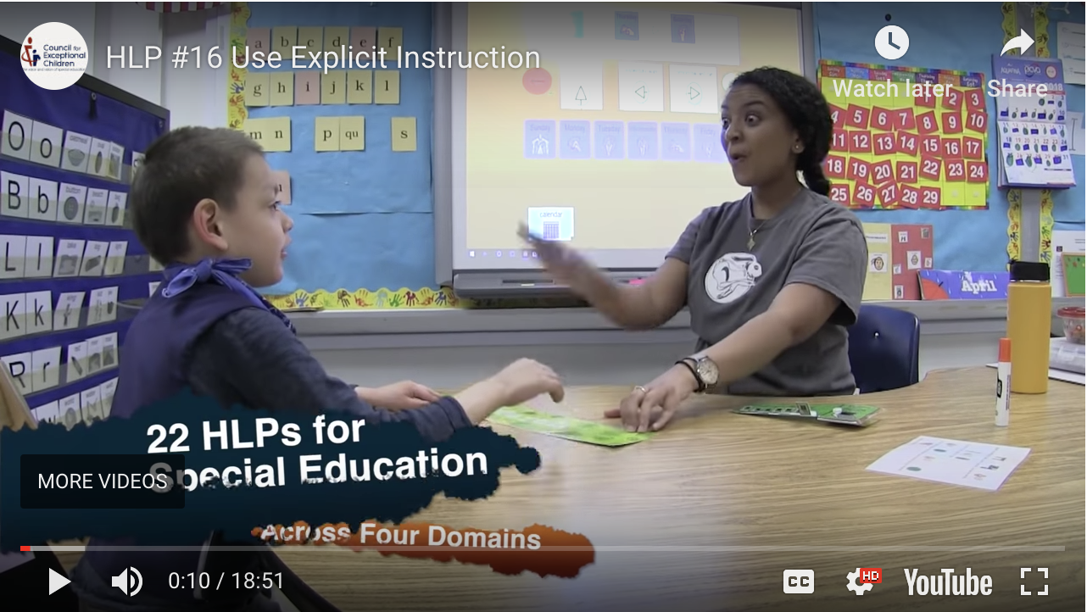
Explicit Instruction
https://highleveragepractices.org/701-2/
Notes:
:31 seconds is the general introduction to the HLP
1:20: Introduce and define explicit instruction; reference research used.
4:08: Components of explicit instruction and video examples
9:22: We do phase of instruction with Ms. Daniels

Slide 13
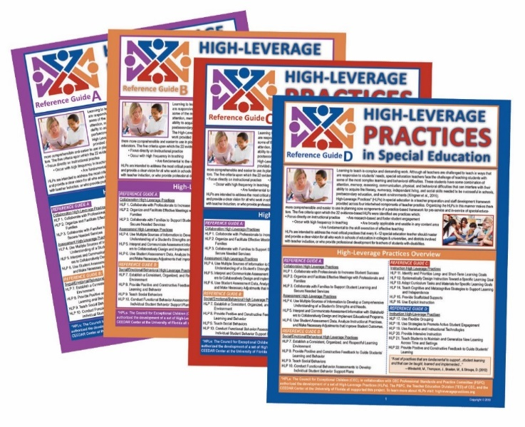
What’s Next?
National Professional Resources, Inc. and Council for Exceptional Children – Laminated Guides

Slide 14
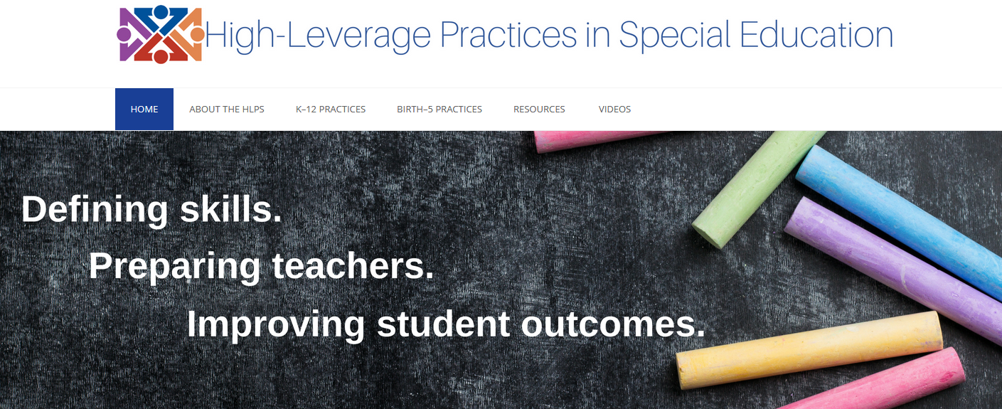
Where to Find HLP Resources
Book
www.HighLeveragePractices.org

Slide 15
Models are a first step, but then. ..
Teachers need to practice and receive feedback, and
Learn to analyze their performance and its influence on students

Slide 16
CEEDAR and CEC

Slide 17
Who? What?
Developed for school leaders implementing K-12 professional development
Special education administrators
Principals
Mentors and coaches
Web-based guide
Can be downloaded
Use online
interactive tools/fillable forms
Free!

Slide 18
What is Included?
Getting to Know High-Leverage Practices
Sharing High-Leverage Practices
Reflecting on High-Leverage Practices

Slide 19
Getting to Know High-Leverage Practices
Section 1: Getting to Know High-Leverage Practices
Overview
A Look at Collaboration
A Look at Assessment
A Look at Social/Emotional/Behavioral
A Look at Instruction
Bibliography of Selected Resources
Resources You Will Want! Resources You Can Trust!

Slide 20
Sharing High-Leverage Practices
Section 2: Sharing High-Leverage Practices
Professional Development Tools: Sharing (brief)
A Leader’s Guide to Agendas: Presentation Materials (tool)
Slide Presentation: Overview (tool) (slides)
Slide Presentation: A Look at Collaboration Practices (tool) (slides)
Slide Presentation: A Look at Assessment Practices (tool) (slides)
Slide Presentation: A Look at Social/Emotional/Behavioral Practices (tool) (slides)
Slide Presentation: A Look at Instruction Practices (tool) (slides)
Professional Development Engagement Tools
A Walking Tour of www.highleveragepractices.org
Closing and Reflection
Dear Colleague …
Glossary Review
Orientation: High-Leverage Practices in Special Education
Sharing Strategies That Reflect High-Leverage Practices
Using High-Leverage Practices Videos

Slide 21
Reflecting on High-Leverage Practices
Section 3: Reflecting on High-Leverage Practices
Professional Development Tools: Reflection (brief)
Professional Development Reflection Tools
Analyzing High-Leverage Practices: Current Status
Identifying Resources: Developing an Inventory
Learning from Colleagues
Reflecting on High-Leverage Practices: Next Steps
Taking the Next Step: Planning

Slide 22
Let’s Look at the Tools!
AGENDA 1-HOUR
Introducing High-Leverage Practices in Special Education
Welcome and Introductions
Purpose: To introduce the twenty-two high-leverage practices that all teachers who instruct students with disabilities should know and use.
Goal: Participants will gain a basic understanding of these practices and how they can learn more about them on www.highleveragepractices.org
Introduce the High-Leverage Practices
Orientation: There’s a lot of talk about high-leverage practices—what they are and why we need them.
Slide Presentation: High-Leverage Practices in Special Education: Overview
Conversation.
Introduce www.highleveragepractices.org
Activity: Walking Tour of the High-Leverage Practices Website: www.highleveragepractices.org
Watch Video: Welcome to Our New Series on High-Leverage Practices
Next Steps and Wrap-up
Closing and Reflection

Slide 23
Let’s Look at the Tools!
AGENDA 3-HOUR
Introducing High-Leverage Practices in Special Education
Welcome and Introductions
Purpose: To introduce the twenty-two high-leverage practices that all teachers who instruct students with disabilities should know and use.
Goal: Participants will gain a basic understanding of these practices and how they support the learning and behavior of students with disabilities. Participants will decide next steps for reflecting on how to use the practices with students with disabilities.
Introduce the High-Leverage Practices
Orientation: There’s a lot of talk about high-leverage practices—what they are and why we need them.
Slide Presentation: High-Leverage Practices in Special Education: Overview
Conversation
Introduce www.highleveragepractices.org
Activity: Walking Tour of the High-Leverage Practices Website www.highleveragepractices.org
Watch Video: Welcome to Our New Series on High-Leverage Practices
Focus on Practice Areas: A Closer Look at One or More Practice Areas
Slide Presentation
Conversation
Activity: Watch Video of a High-Leverage Practice
Next Steps and Wrap-up
Closing and Reflection

Slide 24
Let’s Look at the Tools!
Analyzing Current Practice.
Select one high-leverage practice.
Identify what the practice looks like in action.
Review the practice in relation to strategies you currently are using (e.g.,
lesson plan, meeting agenda, instructional delivery, classroom organization).
What strategies are you currently using that reflect the practice?
What strategies do you want to consider using that you currently are not using?
Consider changing your current practice.
How do you predict students or other adults will respond? How will they benefit?
Will changing or enhancing your practice eliminate or solve a current challenge you are experiencing, or that your students may be experiencing? How so?
Make a plan for getting verification that you are ready to implement changes to your practice.
Who will you enlist as a peer coach? How will you go about seeking feedback from this individual? What kinds of support do you need from them?
How will you inform your administrator, mentor, or coach about your findings and implementation plans?

Slide 25
Let’s Look at the Tools!
High-Leverage Practices Planning Form
HLP Practice
Goal
Activities to Reach Goal
Resources Needed
Begin Date/End Date
Outcomes
Activity Overview
School leaders may find that some school staff members will want to analyze their own practices to determine the extent to which they reflect the high-leverage practices. Investigating all twenty-two practices may not be a realistic task, but teachers can select one or two practices to begin their self-discovery. The tool, “Analyzing My Current Practice,” can be given to teachers as a guide.

Slide 26
Let’s Look at the Tools!
Surveying Staff Members’ Interest in High-Leverage Practices
Let’s take the Survey!

Slide 27
G

Slide 28
www.
highleverage
practices
.org

Slide 29
#myfirstclassroom
Fascinating!
Engaging!
Awesome!
Positive!

Slide 30
Questions for you to discuss:
Turn to your neighbor and consider the following questions:
How are you addressing high-leverage practices in your professional development plan?
What actions could you take in your program to use this HLPS Professional Development Guide?

Slide 31
Questions?

Slide 32
References
McLeskey, J., Barringer, M., Billingsley, B., Brownell, M., Jackson, D., Kennedy, M., Lewis, T., Maheady, L., Rodriguez, J., Scheeler, M., Winn, J., & Ziegler, D. (2017). High leverage practices in special education: The final report of the HLP Writing Team. Arlington, VA: CEC & CEEDAR Center.

