Slide 1
Reflective and responsive reform:
Statewide efforts to diversify educator pipeline and practice
Meg Kamman & Erica McCray
University of Florida
Nichelle Boyd
University of Mississippi
Jingzi (Ginny) Huang
University of Northern Colorado

Slide 2
Today
Challenges
National Efforts
State Efforts
Resources
Discussion

Slide 3
Think about the teachers and leaders at the schools you attended.
Turn to the person next to you and tell them about all the teachers and leaders of color you had throughout school.

Slide 4

Centering thoughts
Children are indigenous to classrooms
Willingness to change children, coupled with an unwillingness to change schools
  (Shalaby, 2017)

Slide 5
Teacher Population
SOURCE: U.S. Department of Education, National Center for Education Statistics, Schools and Staffing Survey (SASS), "Public School Teacher Data File," 1987-88 through 2011-12; "Private School Teacher Data File," 1987-88 through 2011-12; and "Charter School Teacher Data File," 1999-2000; and National Teacher and Principal Survey (NTPS), “Public School Teacher Data File,” 2015-16. (This table was prepared September 2017.)

Slide 6
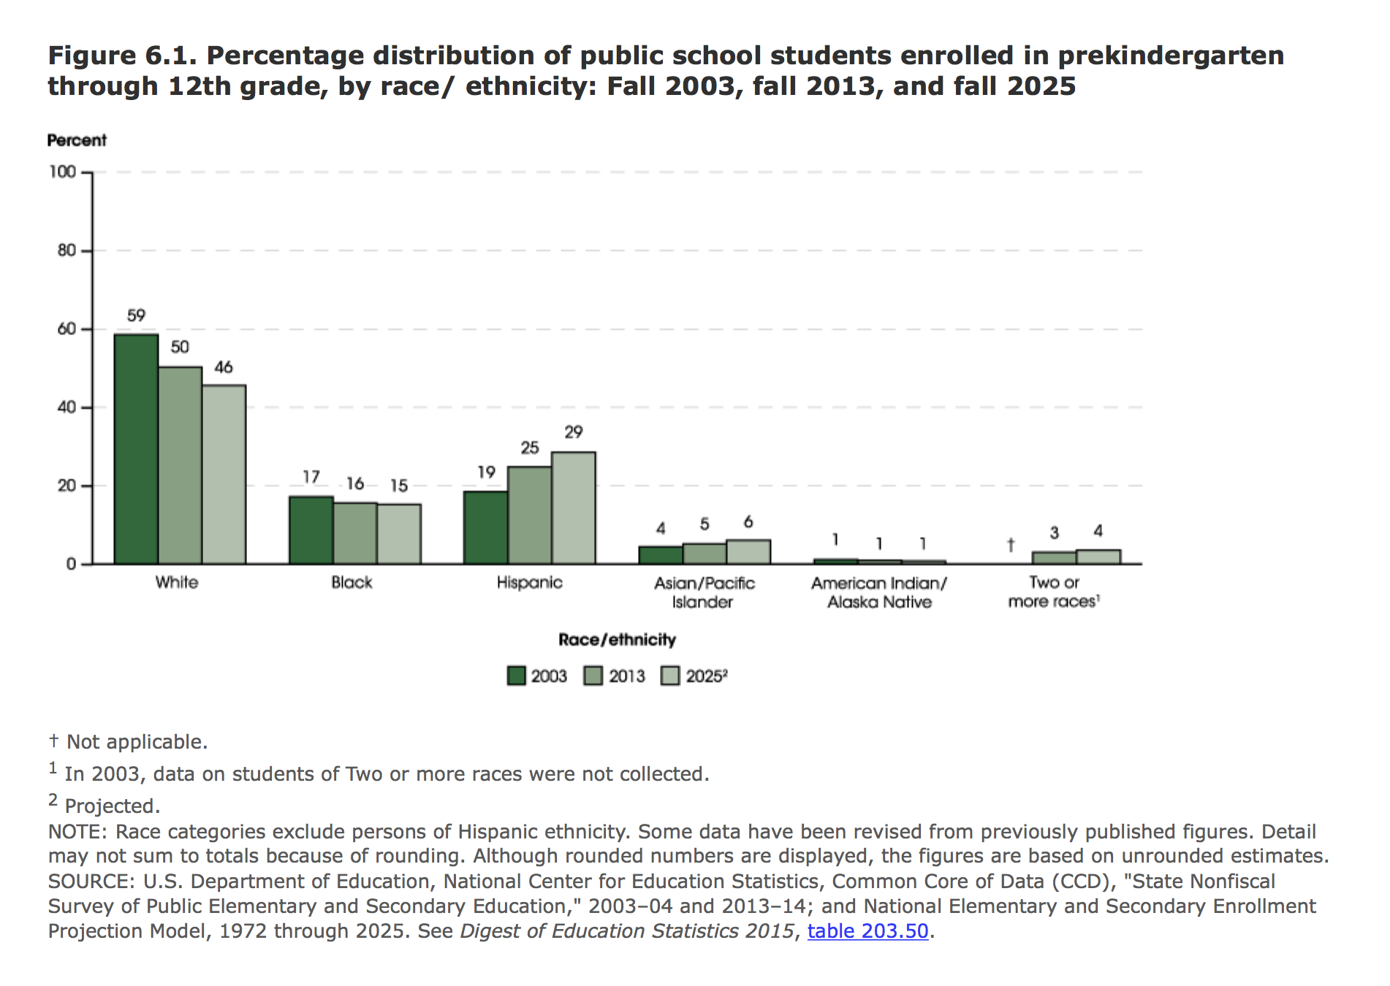
Student Population

Slide 7

Discuss with your neighbor:
What are some of the challenges you see to having many diverse students and few diverse teachers?

Slide 8
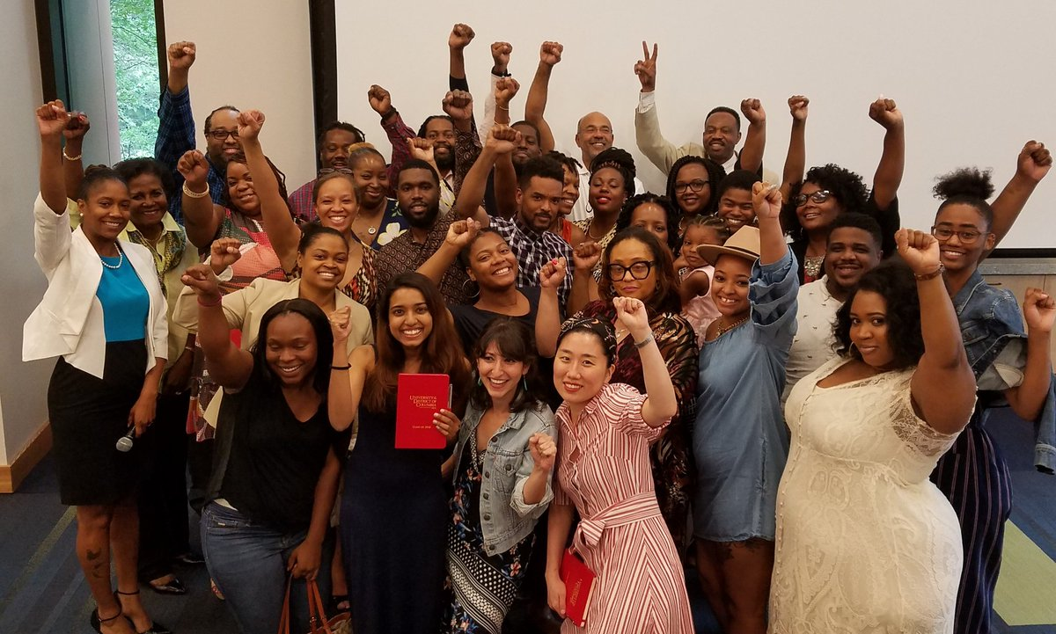
Challenge:
Need Greater Racial Diversity in Teacher Workforce
  All students benefit from being educated by teachers from a variety of different backgrounds, races and ethnic groups,
  Research shows minority students benefit from seeing teachers from their own racial and ethnic group
Notes:
Problem we are trying to solve: Achieve greater racial diversity in the teacher workforce.
All students benefit from being educated by teachers from a variety of different backgrounds, races and ethnic groups, as this experience better prepares them to succeed in an increasingly diverse society, but today, more than 40 percent of public schools have no minority teachers on staff.
Research shows minority students benefit from seeing teachers from their own racial and ethnic group who can serve as academically successful role models and who can share greater knowledge of their heritage culture.

Slide 9
Challenge:
Ensure All Teachers Demonstrate Culturally Responsive Practice
Many teachers are inadequately prepared for supporting the learning of diverse students.
Positive exposure to individuals from a variety of races and ethnic groups, especially in childhood, can help to break stereotypes, grow more comfort with differences, reduce unconscious implicit biases and lead to innovation and greater social-cohesion.
Notes:
And ensure all teachers regardless of their race demonstrate culturally responsive practice.
Many teachers are inadequately prepared with the relevant content knowledge, experience, and training, particularly for supporting the learning of diverse students.
White teachers have been shown to have significantly lower expectations for students of color than their non-white peers, creating an “expectation gap” for too many students, especially black males, and their student outcomes suffer as a result.
Inadequate preparation can create a cultural gap between teachers and students that limits the ability of educators to choose effective instructional practices and curricular materials.
Positive exposure to individuals from a variety of races and ethnic groups, especially in childhood, can help to break stereotypes, grow more comfort with differences, reduce unconscious implicit biases and lead to innovation and greater social-cohesion.

Slide 10
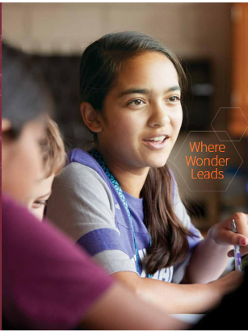
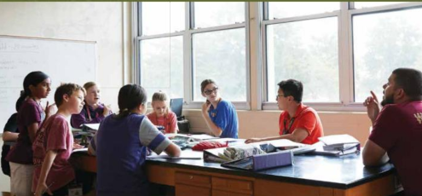
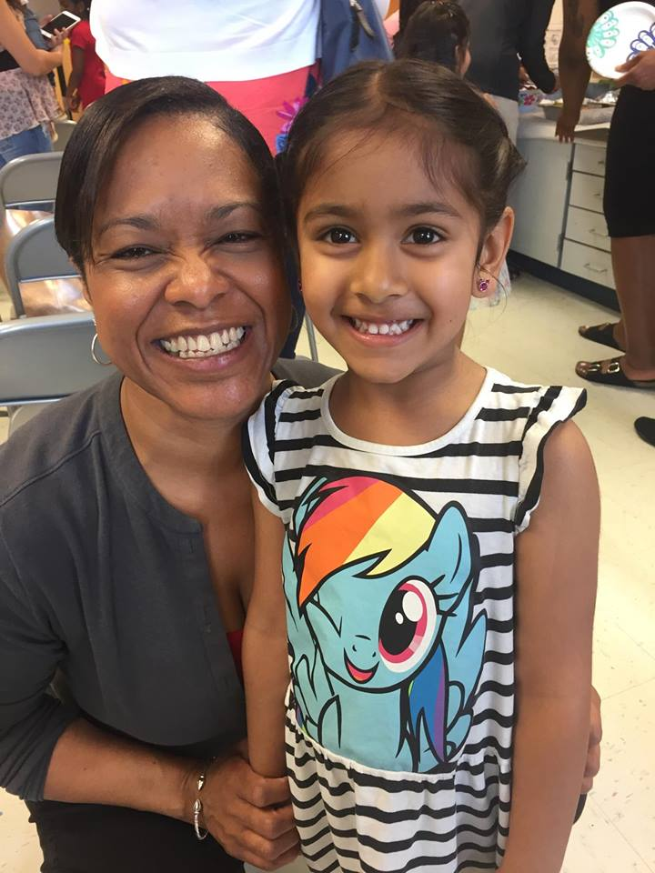
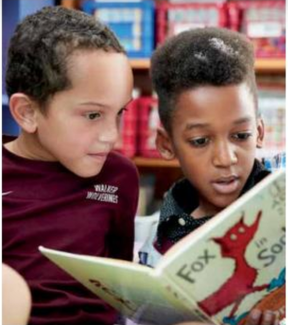
Each student deserves effective teachers and leaders
Notes:
It means building a diverse and prepared pipeline of highly effective educators and leaders that mirror the demographics of the student population.
It means providing teachers with excellent professional development to build better and more responsive instructional practices throughout their careers.
It means recognizing and engaging teachers as leaders to thoughtfully inform policy and drive improvement across schools, districts, and states.

Slide 11
Two National Approaches
Collaboration for Effective Educator Development Accountability and Reform -CEEDAR Center
Diverse and Learner Ready Teacher Initiative- DLRT

Slide 12
Comprehensive Pipeline & Systems Approach
Attract
Prepare
Support
Retain
DATA
Notes:
Not random acts of improvement but a comprehensive pipeline and systems approach.
The work states in this room are doing is happening in partnership with experts from the research community and national collaborating organizations
States will develop this week preliminary plans of action that:
Are driven by a clear theory of action for change
Are informed by data
Support the use of evidence-based best practices and strategies to meet goals
Identify milestones and indicators for measuring progress
Include stakeholder engagement and communications strategies
The policy levers from OROP continue to be key in the preparation space.
The added challenge in this work will be figuring out the SEA policy and influence arena in the post-licensure space.
While we get better at teacher prep, both ensuring we recruit and prepare a diverse crop of teachers and that they can demonstrate CRP, we have to continue to transform the current teacher workforce to develop their abilities to be CR in practice and remain in the profession, especially teachers of color.

Slide 13
Ceedar center
Focus Areas
Preparation Program Reform
General Education
Special Education
Preparation Program Evaluation
Standards, Licensure, and Program Accreditation
Leadership
Alignment
Data Collection & Use
Equity & Access
Notes:
States choose goals that fit within their contexts across the pipeline.

Slide 14
CCSSO’s Diverse and Learner Ready Initiative
9 states, 2 goals:
  Increase the racial diversity of the teacher workforce to reflect the racial diversity of K12 students
  Ensure all teachers, regardless of race, demonstrate culturally responsive practice
State Policy Levers– preservice space
  Licensure
  Ed prep program approval
  Data collection, analysis and reporting

Slide 15



Colorado Approach
Context:
CDE ( 2017). Teacher Shortages Across the Nation and Colorado: Similar Issues, Varying Magnitudes;
A finding: mismatch between the diversity of the overall student population and that of the teacher workforce;
Teachers not prepared to address the needs of culturally and linguistically diverse students in their instructional practices

Slide 16
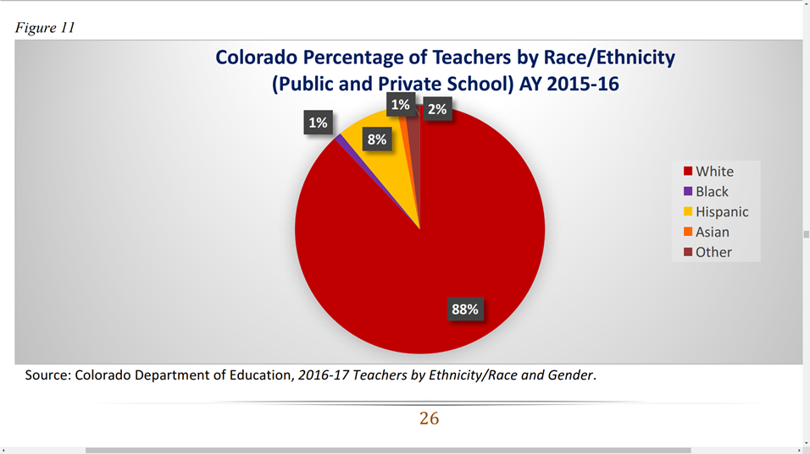
Proportion of minority students in CO: 43%
Proportion of Teachers by Race/Ethnicity: 12% (National: 18%)

Slide 17
CO State Level Effort: DLRT
Pre DLRT effort: For Colorado Kids: Diversifying the Colorado Educator Pipeline (Educator Pipeline Strategic Implementation Team, Draft 2017)
CCSSO’s DLRT National Initiative has managed to encourage the state to pay specific attention to the challenges, which has led the state to systematically identify minority recruitment strategies employed in a variety of settings that have been proven to be more effective;
Colorado had been working on encouraging the teaching professionals to be culturally responsive, pressured by the Department of Justice. The DLRT initiative has helped validate and thus further encouraged policy changes that is making tangible impacts.
Notes:
Colorado had started an effort to recruit more diverse teachers into the pipeline in 2017 prior to the launch of DLRT, while participating in the national initiative of Diversifying Teacher Pipeline. The result of the 2017 convening in DC is a draft of the document titled For Colorado Kids: Diversifying the Colorado Educator Pipeline., where ideas were explored by rep from CDE, IHE, DA, and Teacher Rep. Then nothing really happened till DLRT Initiative was launched in 2018.
The 2018 DLRT initiative almost functioned as a force for acceleration. It has managed to encourage the state to pay specific attention to the challenges, which has led the state to systematically identify minority recruitment strategies employed in a variety of settings that have been proven to be more effective. In terms of culturally responsive practice, Colorado had been working on encouraging the teaching professionals to be culturally responsive, pressured by the Department of Justice. The DLRT initiative has helped validate and thus further encouraged policy changes that is making tangible impacts.

Slide 18
CO Theory of Action for Goal 1- DLRT
If the State of Colorado creates opportunities for diverse candidates entering the education profession by:
promoting multiple pathways into education as a career, including early career awareness and grow your own programs;
developing a statewide Diverse Educator Alliance focused on support for diverse educator candidates and statewide district and EPP-based culturally responsive systems
Then we will elevate the profession and recruit, attract, and retain an increased diverse educator workforce that is highly effective and purposefully reflective of our students population.

Slide 19
Does your state have similar awareness of and/or eagerness to solve an urgent issue related to diversifying teacher pipeline and practices?
Are there already grass roots efforts that could leverage support from the state or vice versa?

Slide 20
CO Theory of Action for Goal 2- DLRT
If the State of Colorado promotes culturally relevant and responsive instruction for our diverse population of students by:
ensuring our pre-service and core content teachers have knowledge, skills, and efficacy around culturally responsive practices; and
curating and enhancing accessibility of culturally responsive resources and support to our educational leaders.
Then we will increase the number of learner-ready teachers and provide all students access to a meaningful, dynamic educational experience for postsecondary and workforce success.

Slide 21

Progress Being Made:
Recruitment of Diverse Teachers
2017: For Colorado Kids: Diversifying the Colorado Educator Pipeline (draft)
2018: DLRT Colorado Diverse Educator Alliance was formed:
Work in progress
Cultural Responsiveness in Practice
Prior to 2018: The internal need of CO student population with external pressure from the DOJ
2018: The launch of the English Language Learners Educator Preparation Requirements

Slide 22
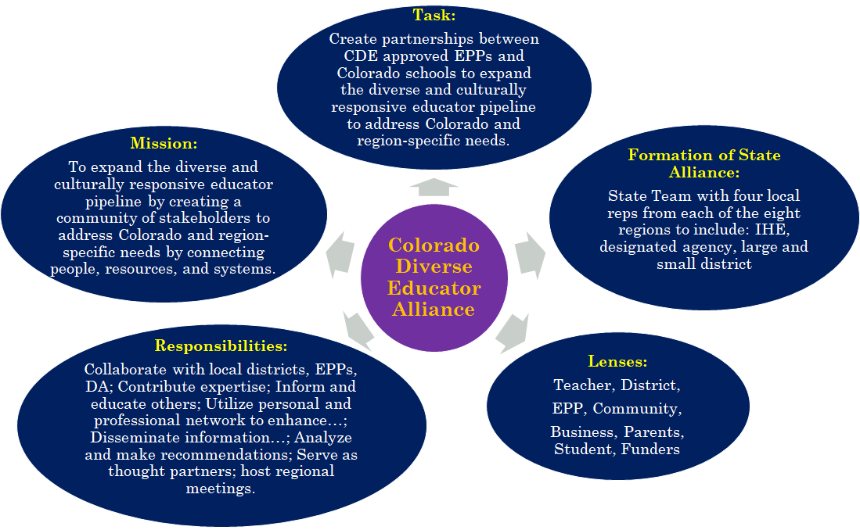
Notes:
Recruitment of Teachers of Color
2018: validated and encouraged by DLRT Initiative, Colorado Diverse Educator Alliance was formed: Effort led by CDE; Process facilitated by National Collaborators from DLRT; Plan for actions developed and advocated by Alliance members:

Slide 23
Is there any potential for your state to form a coalition or alliance?
Who would be the members with the commitment and resources (human, financial, etc.)

Slide 24
Evolving Effort on Diversifying Teaching Force
Focus on Teachers of Colors:
Not just a recruitment issue: impossible to narrow the gap immediately due to many and various factors;
Retention plays a crucial role
  What challenges do teachers of color face once in the teaching profession?
  What drives teachers of color out of the teaching profession and how we collectively contribute to the practices that result in unsuccessful retention of teachers of colors?
  How did some teachers of color manage to stay and grow?
Two convenings are being planned by the CO Diverse Educator Alliance

Slide 25
Effort on Cultural Responsiveness in Practice
Legislation:
2018: The launch of the English Language Learners Educator Preparation Requirements: http://www.cde.state.co.us/educatortalent/eledprep
Support
EPPs reaching out to districts via CDE system: http://www.cde.state.co.us/educatortalent/elpdprograms
Districts reaching out to EPPs:
CEEDAR Involvement: Cross Walk of CEEDAR elements and new ELL teacher quality standards.

Slide 26
CLD – CEEDAR Crosswalk: an example
 | Course | Evidence/Outcomes | CEEDAR IC Essential Elements
5.12 Quality Standard I: Educators are knowledgeable about CLD populations
5.12(1) ELEMENT A: Educators are knowledgeable in, understand, and able to apply the major theories, concepts and research related to culture, diversity and equity in order to support academic access and opportunity for CLD student populations. |  |  | AI-3.1 Consider transferability of literacy skills for student literate in first language. AI-3.2 Provide students with bilingual programs when possible (including intervention in language of instruction). AI-3.3 In English-only instruction, primary language support is useful. FSP-1.4 Consider the concerns, ideas, and cultural resources of parents.
5.12(2) ELEMENT B: Educators are knowledgeable in, understand, and able to use progress monitoring in conjunction with formative and summative assessments to support student learning. |  |  | MSP-3.1 Consider multiple variables when explaining ELs’ lack of progress. MSP-3.2 Collaborate with qualified educational professionals. MSP-3.4 Monitor short- and long-term progress, and more frequently with ELs experiencing difficulty. MSP-3.5 Support teacher judgment regarding the performance of ELs with multiple and consistent documented examples of progress over time.

Slide 27

Effort continues: No conclusion

Slide 28
A Framework for Enhancing Culturally Responsive Teaching in the Teacher Education Curriculum
Developed by: Dr. Nichelle C. Robinson
The University of Mississippi

Slide 29
Year 1 Goals and Objectives:
GOALS | OBJECTIVES | FACULTY ACTIVITIES | STUDENT ACTIVITIES
Goal 1: Increase faculty understanding and use of culturally responsive pedagogy | Obj 1: Explore personal beliefs/perceptions of diversity/culturally responsive pedagogy Obj. 2: Introduce faculty to best practices for culturally responsive teaching Obj 3: Review Courses and integrate culturally responsive practices through programs. | Expert talk on implicit bias. Expert talk on creating an identity safe and culturally responsive learning community. Expert talk on culturally responsive evidence-based practices. IC training with faculty developing graduate courses by CEEDAR experts.

Slide 30
Year 1 Goals and Objectives continued
GOALS | OBJECTIVES | FACULTY ACTIVITIES | STUDENT ACTIVITIES
Goal 2: Increase program graduate’s skill in using culturally responsive practices | Obj 1: Provide opportunities for program graduates to learn culturally responsive practices. Obj 2: Increase program graduates’ skill in using culturally responsive practices. | Teacher education faculty developed 5 graduate diversity courses to be used for an emphasis area in diversity for the specialist degree program. | -Workshop on implicit bias with topic expert. -Workshop on addressing sensitive topics of diversity with expert from Facing History and Ourselves. -Chamber music performance that explores diversity through chamber music, Of Ebony Embers (explored the Harlem Renaissance). -Special viewing and discussion of Hidden Figures movie in partnership with the School of Engineering, Center for Inclusion, and Student Activities Association in the Grove. -Video chat discussions filmed with undergraduate and graduate students about their diversity experiences (Multicultural Moments).

Slide 31
Year 2 Goals and Objectives
GOALS | OBJECTIVES | FACULTY ACTIVITIES | STUDENT ACTIVITIES
Goal 1: Increase faculty understanding and use of culturally responsive pedagogy | Obj 1: Explore personal beliefs/perceptions of diversity/culturally responsive pedagogy Obj 2: Introduce faculty to best practices for culturally responsive teaching Obj 3: Review courses and integrate culturally responsive practices through programs | Brown Bag – Engaging in Courageous Conversations about Charlottesville: How to and When? Education Symposium – Faculty in and outside of the School of Education presented posters on topics related to the state of education for African American students in Mississippi 63 years after Brown v. Board of Education

Slide 32
Year 2 Goals and Objectives continued
GOALS | OBJECTIVES | FACULTY ACTIVITIES | STUDENT ACTIVITIES
Goal 2: Increase program graduates’ skill in using culturally responsive practices | Obj 1: Provide opportunities for program graduates to learn culturally responsive practices. Obj 2: Increase program graduates’ skill in using culturally responsive practices through experiences. | Workshop on using the CEEDAR NIC to analyze programs and courses with CEEDAR experts. Syllabi and course activities uploaded to the CEEDAR NIC. | -Workshop on using culturally relevant children’s literature. -Workshop on addressing sensitive topics of diversity with expert from Facing History and Ourselves. -Education Symposium – Undergraduate and graduate students in and outside of the School of Education presented posters on topics related to the state of education for African American students in Mississippi 63 years after Brown v. Board of Education -Doctoral student panel discussion on the state of education for African American Students in Mississippi 63 years after Brown v. Board of Education in conjunction with the Black History Month celebration. -Chamber music performance that explores diversity through chamber music, Equally Divine (explored gender fluidity) in conjunction with Women’s History Month celebration.

Slide 33
Year 3 Objectives and Tasks
GOALS | OBJECTIVES | FACULTY ACTIVITIES | STUDENT ACTIVITIES
 | Obj 1: Provide opportunities for program graduates to learn culturally responsive practices. Task 1: Revise 300/400 level teacher education courses to ensure culturally responsive practices are being addressed with fidelity. | Use the culturally responsive CEEDAR IC to review and revise course syllabi. Explore Iris Module on culturally responsive practices. Faculty diversity retreat on diversity, equity, and inclusion. | Workshop on addressing sensitive topics of diversity with expert from Facing History and Ourselves. Workshop on implementing high leverage practices (HLPs) into instruction with CEEDAR expert. Workshop on implicit bias with topic expert.

Slide 34
Year 3 Objectives and Tasks continued
GOALS | OBJECTIVES | FACULTY ACTIVITIES | STUDENT ACTIVITIES
 | Obj 2: Increase program graduates’ skills in using culturally responsive practices through experiences. Task 1: Develop district partnership and provide PD on culturally responsive practices. Task 2: Create a faculty/student book study discussion group that focuses on books that explore issues of diversity. | Expert talk on implicit bias with Oxford School District administrators and teachers. Expert talk on implicit bias with SOE faculty. Book study on The Hate U Give and Skype discussion with author of the book (Fall 2018). Book study on another book addressing a diverse topic (Spring/Summer 2019). Book study group will attend The Hate U Give movie together and discuss/compare movie and book. Expert talk on HLPs with Oxford School District administrators/teachers and SOE faculty. | Chamber music performance that explores diversity through chamber music, Los Valientes (explores the lives of Diego Rivera, Archbishop Oscar Romero, and Joaquin Murrieta: Zorro) in conjunction with Hispanic Heritage Month celebration. Book study on The Hate U Give and Skype discussion with author of the book (Fall 2018). Book study group will attend The Hate U Give movie together and discuss/compare movie and book. Book study on another book addressing a diverse topic (Spring 2019).

Slide 35
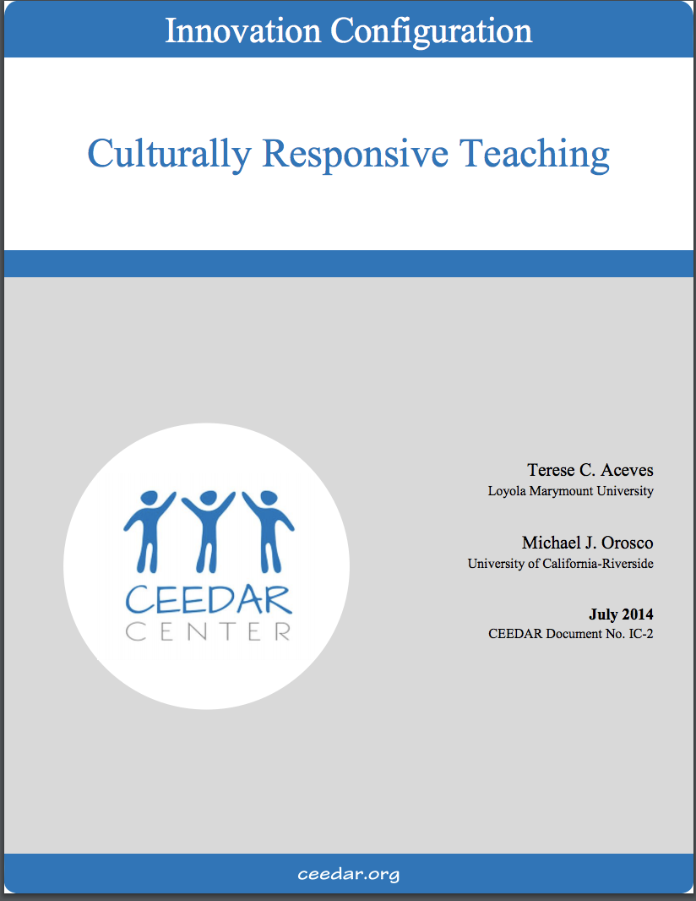
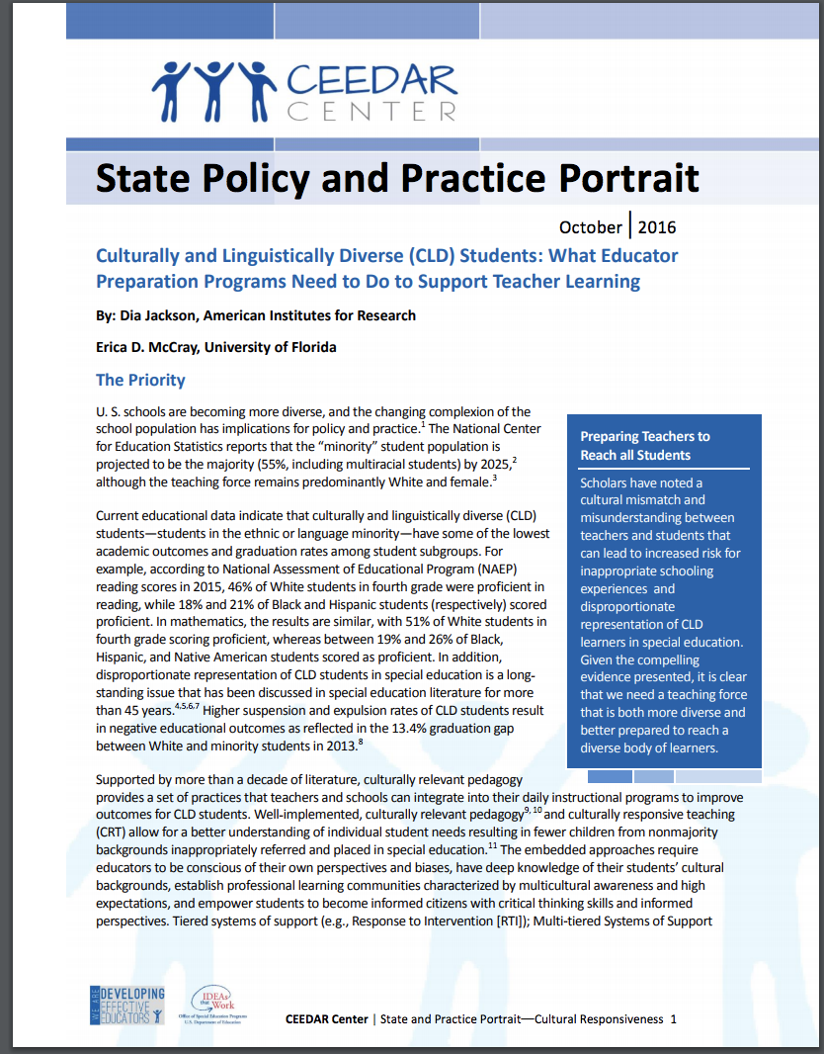


Resources
Ceedar.org Ccsso.org

Slide 36
Discussion
What are some efforts at your University/State?
What are some ways you can personally help in your role?

Slide 37
DISCLAIMER
This content was produced under U.S. Department of Education, Office of Special Education Programs, Award No. H325A170003. David Guardino serve as the project officer. The views expressed herein do not necessarily represent the positions or polices of the U.S. Department of Education. No official endorsement by the U.S. Department of Education of any product, commodity, service, or enterprise mentioned in this website is intended or should be inferred.

