Slide 1
High Expectations for Access, Outcomes & Collaboration
Special Education Division
Spring 2019
Office of Superintendent of Public Instruction

Slide 2
OSPI Values:
OSPI Vision:
All students prepared for post-secondary pathways, careers, and civic engagement.
OSPI Mission:
Transform K–12 education to a system that is centered on closing opportunity gaps and is characterized by high expectations for all students and educators. We achieve this by developing equity-based policies and supports that empower educators, families, and communities.
Ensuring Equity
Collaboration and Service
Achieving Excellence through Continuous Improvement
Focus on the Whole Child

Slide 3
OSPI Equity Statement:
Each student, family, and community possesses strengths and cultural knowledge that benefit their peers, educators, and schools.
Ensuring educational equity:
Goes beyond equality; it requires education leaders to examine the ways current policies and practices result in disparate outcomes for our students of color, students living in poverty, students receiving special education and English Learner services, students who identify as LGBTQ+, and highly mobile student populations.
Requires education leaders to develop an understanding of historical contexts; engage students, families, and community representatives as partners in decision-making; and actively dismantle systemic barriers, replacing them with policies and practices that ensure all students have access to the instruction and support they need to succeed in our schools.
…actively dismantle systemic barriers, replacing them with policies and practices that ensure all students have access to the instruction and support they need to succeed in our schools.

Slide 4
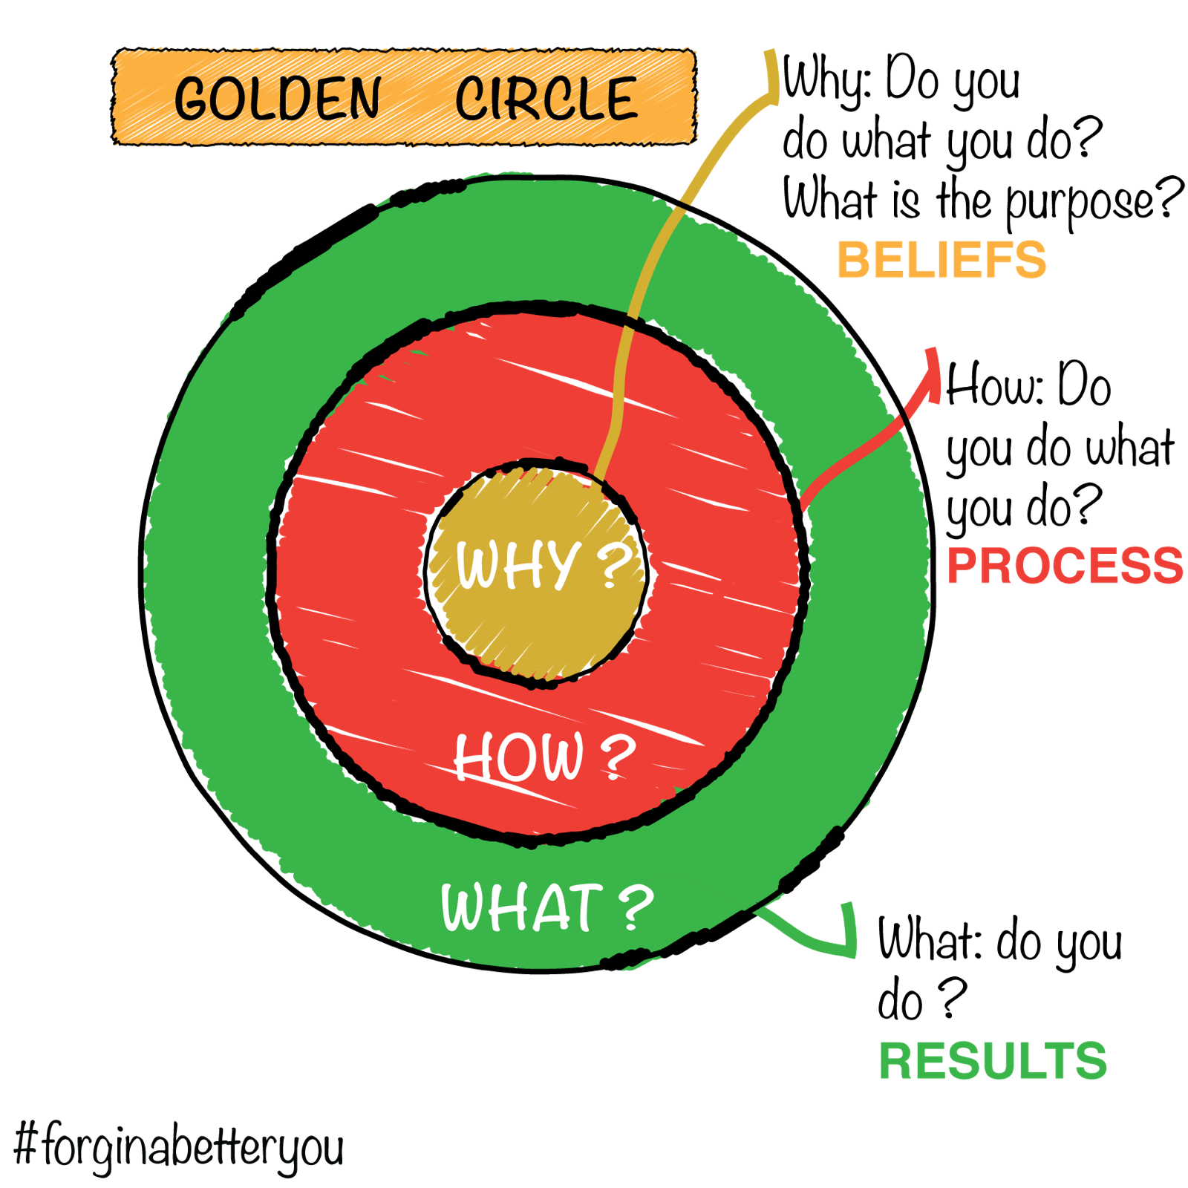
https://i.pinimg.com/originals/0d/b7/15/0db715b1b2a52cf229ed8bc9f59de056.png
Source: Sinek, S. (2009). Start with why: How great leaders inspire everyone to take action. New York: Portfolio.
TED Talk: Simon Sinek How great leaders inspire action

Slide 5
Today’s Conversation:
Starting with Why:
Research & Data Updates
The How: Policy & Priorities:
Managing Complex Change
Data Tools & Resources
What This Means for Practice:
District & Building Data Reports
LRE Data Activity & Discussion
https://www.ourtowneguilderland.com/wp-content/uploads/2018/02/checklist-1024x768-300x225.jpg

Slide 6
WHY?
Starting with Why…

Slide 7
Research on Placement
What does the say?
Over 80 years of research has shown
that placement in the general education setting positively impacts outcomes!
Carlberg & Kavale (1980)
50 research studies from 1932 – 1970
Wang & Baker (1985)
Meta-analysis from 1975 – 1984
Oh-Young & Filler (2015)
Research studies from 1980 – 2013
Theobald, et al. (2018)
WA Study on CTE & Outcomes
Notes:
Carlberg & Kavale – 50 research studies from 1932 – 1970
Wang & Baker – meta-analysis from 1975 – 1984
Oh-Young & Filler from 1980 – 2013
Theobald – WA-state study on impact of CTE on post-school outcomes; found outcomes highest for students placed in gened 80-100% of the day

Slide 8
What does the say?
The overrepresentation of students of color in special education programs correlated with decreasing
racial segregation after Brown v Board of Ed.
Artiles et al., 2010
Reviewed the history of disproportionality 1975-2008
Ford & Russo, 2016
Disproportionality in IDEA, 2005-2014
Annamma, Connor & Ferri, 2013
Dis/ability Critical Race Studies

Slide 9
2018 Percentage of WA Students with Disabilities, by Category
2018 Students with Disabilities, age 6-21: 130,488
Source: Special Education Federal Child Count, Office of Superintendent of Public Instruction, 2017 and (Draft) 2018.
Notes:
Top categories: SLD, HI, and CD = 70.8%

Slide 10
2018 Percentage of WA Students with Disabilities, by Eligibility & EL Status
Students with Disabilities, age 6-21: 130,488
English Learners with Disabilities, 6-21: 20,717
Source: Special Education Federal Child Count (Draft), Office of Superintendent of Public Instruction, November 1, 2018.
Notes:
Top categories: SLD, HI, and CD
All SWDs: 70.8%
ELWDs: 76.7%

Slide 11
2018 Percent of LRE category within a specific disability category
Source: Special Education Federal Child Count (Draft), Office of Superintendent of Public Instruction, November 1, 2018.
Source: November 2018 November Federal Child Count by Serving District, students aged 6-21

Slide 12
2018 Percent of LRE category by Race/Ethnicity
Source: Special Education Federal Child Count (Draft), Office of Superintendent of Public Instruction, November 1, 2018.

Slide 13
Assessment and Accountability
&
Accountability
Source: Washington State Report Card, Office of Superintendent of Public Instruction, 2019

Slide 14
2017-18 Adjusted Cohort Graduation Rates
Sources: Washington State Report Card, Office of Superintendent of Public Instruction, 2019;
2018 Graduation Rates, Legislative Appendices, Office of Superintendent of Public Instruction
Notes:
This chart shows 2017-18 graduation rates (Indicator B-1) - the percentage of all students (blue line) and students with disabilities (red line) that graduated within 4 years, 5 years, 6 years, and 7 years – which helps to account for those students for whom the IEP team decided the student needed more than 4 years to graduate. These data are cause for both celebration and concern:
[Celebration] - The gap gets narrower the more years the student has to graduate.
[Concern] - There is still a gap between the two groups. Note: all students includes students with disabilities, so if you remove students with disabilities from the all students group, the gap would be wider.

Slide 15
Graduation Pathways Used by SWDs in 2016-17
Source: Guidance for IEP Teams: Student Participation in Statewide Assessments for Accountability and Graduation, Office of Superintendent of Public Instruction, 2019.
Notes:
Of 2018 11th graders with disabilities… 1,879 of them took the 3rd grade math (1,315 for ELA), - without attempting an on-grade-level retake or a higher off-grade-level test. ~20% of all SWDs were routed to the lowest possible option.

Slide 16
2016-17 Post-School Outcomes for SWDs
Source: Indicator 14 Post-School Outcome Mini-Report, Washington state, 2016-17, Center for Change in Transition Services, Seattle University, 2018
Notes:
One year after students with IEPs leave high school, district staff contact them to complete the post-school survey (through the Center for Change in Transition Services website). The survey measures whether the student is engaged in post-secondary education or employment, which is our State Performance Plan (SPP) Indicator B-14.
The most current data available are for the 2016-17 “leavers”, who completed the survey on or before November 1, 2018:
Yellow is the not engaged – those students who are not employed or involved in any sort of postsecondary education or training. This is the area we would want to be the smallest.
Light blue = participating in higher education (full or part time in a 2-year community college or 4-year university program for at least one complete term).
Red = competitively employed (20 hours or more a week at minimum wage for at least 90 total days).
Green = other education training (e.g. Job Corps, vocational/technical school, on the job training, apprenticeships) for at least one complete term.
Dark blue = other employment (less than 20 hours or less than minimum wage – student has worked for pay for at least 90 total days).
These data show that more than ¼ of students with IEPs are not participating in any form of education, training, or employment one year after leaving high school.

Slide 17
Data: Access
The State of the State of Special Education:
Less than 4% of students are identified with an intellectual disability.
Upwards of 90% present with average to above-average intellectual functioning.
Yet only 56.6% are placed in general education for 80-100% of the day. [For students of color, that total falls to 49%]
2016-17 Outcome Data:
Graduation Alternative options (CIA): ELA 48.9%; Math 52%
Achievement gap for ELA: 30% in 3rd grade ➔ 50% in 10th grade
Sources: OSPI Guidance for IEP Teams: Student Participation in Statewide Assessments for Accountability and Graduation & Annual Performance Report, FFY 2016 & (Draft) 2017.
Notes:
CAA: ELA 28.8%; Math: 25.6%

Slide 18
Stars and wishes
https://4.bp.blogspot.com/-1L3f5hS8i6E/VQMeyRD1pNI/AAAAAAAACqw/cgNSaCZTMFo/s1200/header.png
Finding your why…
What are the stars, or points of light, in these data? Where are some leverage points for change?
What do you hope to learn from today’s data discussion?
Notes:
Here we’ll pause and reflect

Slide 19
How do
we disrupt these patterns?
WHY?
HOW?
Notes:
This stage is about process, procedures, how we build and shape the vision of why

Slide 20
Systems Change
Source: Batalden, P. & Davidoff, F. (2007). Teaching quality improvement: The devil is in the details. JAMA, 298(9), 1059–1061.
Flipping
the conversations
Notes:
This is how we are attempting the reframe the conversation: how is the environment disabling to students, rather than expecting our students to “earn the right” to be included!

Slide 21
OSPI Priorities
OSPI Priorities:
Improving Outcomes for Students
with Disabilities
Leadership
Growth Mindset
Evidence-based Practices
Professional Development
Resource Allocation
Recruitment & Retention
Growth Mindset
Professional Development
Recruitment & Retention
Leadership
Evidence-Based Practices
Resource Allocation
Source: OSPI Priorities for Improving Outcomes for Students with Disabilities, Office of Superintendent of Public Instruction

Slide 22
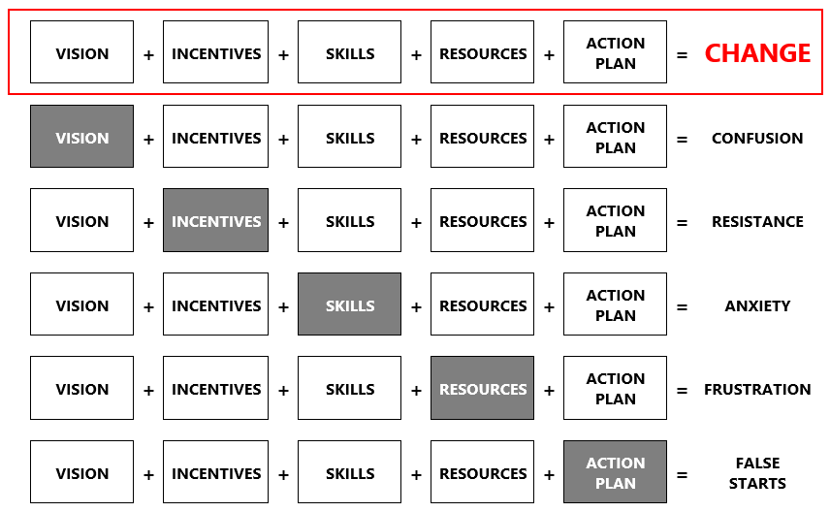
Facilitating Systems Change
Adapted from: Knoster, Villa and Thousand (2000). A Framework for Thinking about Systems Change.
Notes:
It is our hope that this past year of discussions of data, access and equity, and mindset have started to ripple across divisions. These data tell a story, create urgency, and form the foundation for our vision. They are the incentives to help us leverage much-needed changes.
As that vision continues to shape and coalesce, we continue to collaborate with partners across regions, agencies, and communities to continue building capacity.

Slide 23
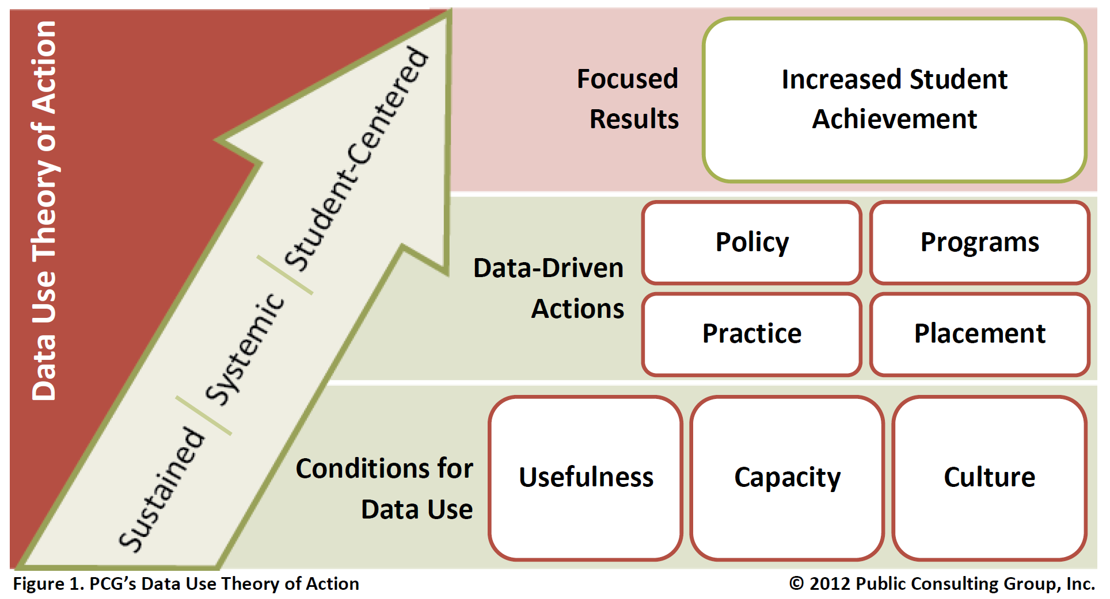
PCG’s Data Use Theory of Action
Source: District and School Data Team Toolkit, 2011, p. 2.

Slide 24
The Seven Stages of Concern
STAGE | GENERAL CONCERN | OBSERVABLE BEHAVIORS
Awareness | What is this change I’ve been hearing about? | Expressions of surprise and sometimes disbelief that a change has been initiated.
Information | Tell me everything I need to know. | Direct questions about the reasons behind the change, and what they are being asked to do differently.
Personal | What does this mean for me? | Expressions of confusion about the change and what it will mean personally for them.
Management | How will I manage all of this? | Expressions of frustration about the change with an underlying feeling that this change is another thing added to a full plate.
Consequence | What will happen if I implement the change? What will happen if I don’t? | Behaviors and expressions of potential resistance to implementing the change with possible underlying concerns similar to those in the personal and management stages.
Collaboration | How can we help each other through the change? | Expressions of acceptance of the change being called for and a willingness to work with others as they try it out.
Refocusing | How can I make it even better? | Behaviors/expressions that indicate a person understands the big picture and has ideas about how to make improvements.
Source: District and School Data Team Toolkit, 2011, p. 9.

Slide 25
Data Analysis for Continuous School Improvement
Source: OSSI District and School Data Team Toolkit, 2011, p. 6.

Slide 26
WHY?
So… What do we do next?
HOW?
WHAT?
Notes:
Transition to Kristen!

Slide 27
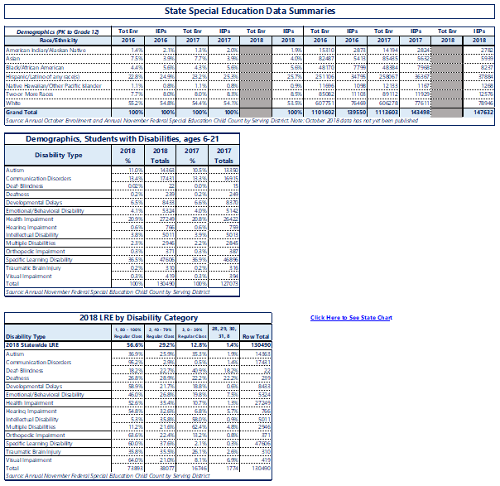
Diving Deeper: State Data
On your tables, you should have a few printouts of state data

Slide 28
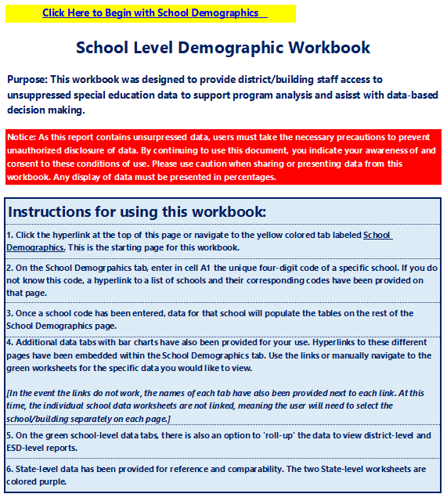
Diving Deeper: Building Data
Open the data file, titled ‘Building_Data_v3.12_DOWNLOAD OR SAVE AS’

Slide 29
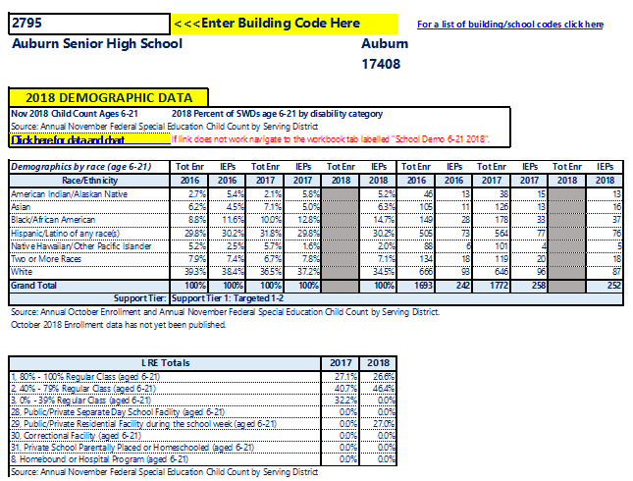
Navigating the Data Reports
1
3
2

Slide 30
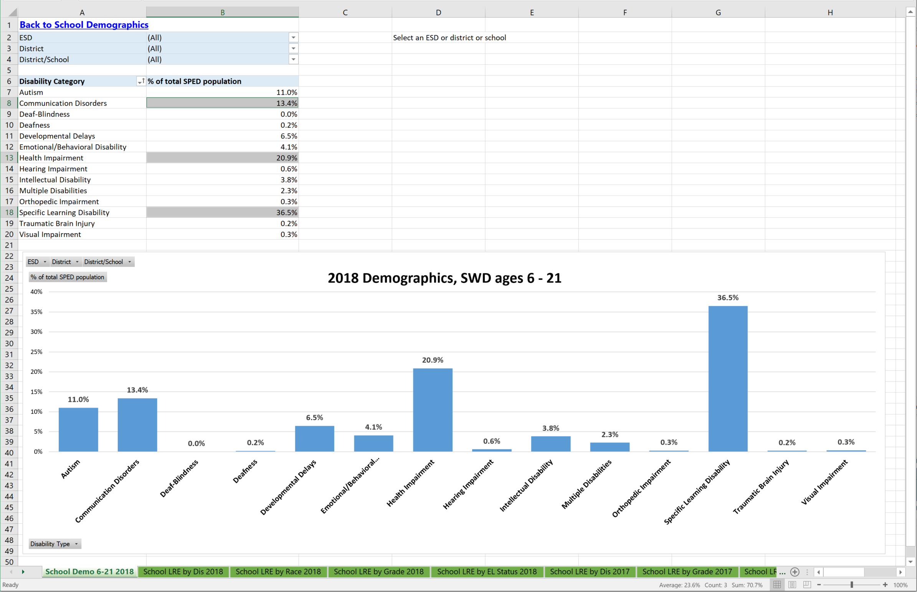
Navigating the Data Reports
2
3
3
3
1
4

Slide 31
Analyzing 2018 LRE Data
 | Demographics: % of SLD + HI + CD | LRE: % at 80-100% in GenEd
Statewide | 36.5 + 20.9 + 13.4 = 70.8% | 56%
District: ______________ | ______ + ______ + ______ = ______% | ______%
Building: ______________ | ______ + ______ + ______ = ______% | ______%

Slide 32
Building Inclusive Environments
System Supports | Preferred Future
Current Reality | System Barriers
Adapted from: District and School Data Team Toolkit, 2011.

Slide 33
Data Discussion Questions
Who are the stakeholders in your system who have influence over building inclusive practices?
At what stage(s) do you believe these stakeholders are with respect to building inclusive environments?
What are some next steps for engaging these stakeholders and identifying points of leverage for increasing inclusive practices?

Slide 34
What More Can We Do?
Foster collaboration between general & special education and community partners!
Build a Multi-Tiered System of Supports (MTSS)
Framework of tiered interventions & supports
Data-informed (culturally-responsive!) pre-referral interventions
Mindset matters!
Student need (academic, social/emotional, etc.) ≠ disability
All students are capable of achieving with the right supports
Addressing structural inequality must be part of the discussion
Notes:
In too many situations, segregation is the default, and SWDs are expected to “earn the right” to be included, rather than accommodating settings to be inclusive of all students.

Slide 35
Thank you!
Thank you!
https://pbs.twimg.com/media/CyBBuVCXAAAryfY.jpg
https://pbs.twimg.com/media/CyBBuVCXAAAryfY.jpg
Notes:
It is my great hope that today’s discussion brought to mind your why. Thank you for this opportunity—and for all that you do, every day, for your students.

Slide 36
Connect with Me!
Tania May
Director of Special Education
tania.may@k12.wa.us
@TaniaMay_OSPI
www.k12.wa.us
360-725-6075
https://www.data.com/connect/index_files/connect-home-image-0118.png

