Slide 1
Notes:
Melinda

Slide 2
Sustaining the CEEDAR Work through Connections and Collaborations

Slide 3
Session Presenters
Facilitator: Lauren Artzi
State Teams/Presenters: Tracey Sridharan, Angel Turoski, Kathleen Puckett, Estee Aiken, Jennifer Gresko, Kim Rice

Slide 4
Session Overview
Aligning to and leveraging other work or initiatives to further/scale CEEDAR’s goals and better align the groups and efforts
Discussing methods for engaging stakeholders and keeping them engaged in the CEEDAR work
Discussing methods for overcoming barriers to align, leverage, and engage stakeholders
Notes:
Breakout Session Short Description: This interactive breakout session will explore why aligning the work and engaging stakeholders are key components to sustaining CEEDAR within different contexts. Participants will consider ways to leverage resources, initiatives, collaborations, and relationships. Including:
Aligning to and leveraging other work or initiatives to further/scale CEEDAR’s goals and better align the groups and efforts
Discussing methods for engaging stakeholders and keeping them engaged in the CEEDAR work
Discussing methods for overcoming barriers to align, leverage, and engage stakeholders

Slide 5
Essential Questions
What are ways to leverage other initiatives to sustain the CEEDAR work?
Why is stakeholder engagement a key component to sustaining and aligning CEEDAR?
What are ways to leverage resources to sustain the CEEDAR work?

Slide 6
Engagement Activity
Consider your past and present CEEDAR Work. Turn to your table and answer the following question on chart paper:
Is your state focused on the alignment of initiatives that SEAs and EPPs are engage in? If yes, how so and how is that going? If no, what has been the barriers or challenges to the alignment?
How are you reaching out/engaging stakeholders in the CEEDAR work? Who are the appropriate stakeholders to leverage?

Slide 7
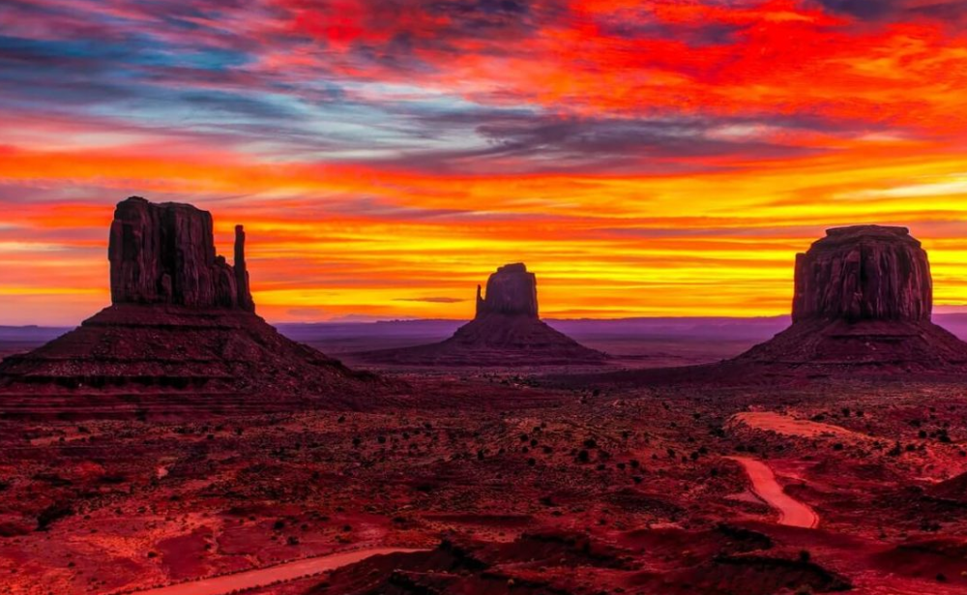
Sustaining the CEEDAR Work through Connections: Spotlight on Aligning of Initiatives from the Arizona Team
Notes:
Members from Arizona’s SSC will discuss how they are collaborating to implement the High Leverage Practice work with State Systemic Improvement Plan and preservice and in-service professional development initiatives.

Slide 8
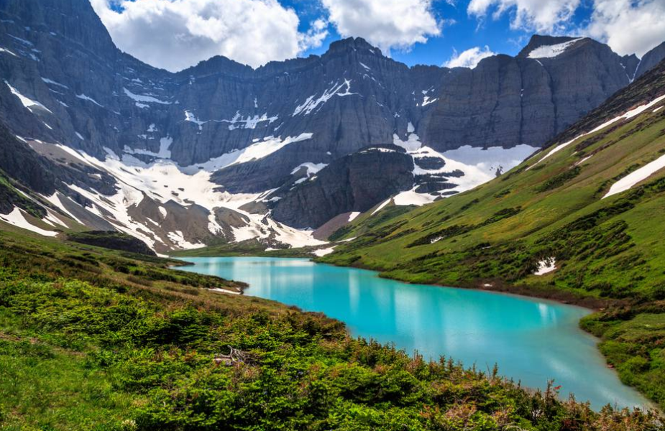
Sustaining the CEEDAR Work through Collaborations: Spotlight on Engaging Stakeholders from the Montana Team
Notes:
Members from Montana’s SSC will discuss how they have engaged stakeholders in their HLP initiative and how they are linking in with the Higher Education Consortium. They will also talk about how they are engaging local partners in the CEEDAR work.

Slide 9
Activity: Gallery Walk
There are posters around the room that specify: Ideas I have, my conversations, my questions I still have.
Consider contexts, including rural, and rotate to the posters with teams to engage in conversations and chart ideas on the posters. Teams will rotate to each poster in a gallery walk fashion.

Slide 10
Poster Topics
Aligning to other initiatives
Leveraging resources
Engaging stakeholders
Overcoming barriers with alignment

Slide 11
Closing Connections
Process what was shared and how it applies to own context
Discuss actionables to take to team time at the convening
Write down, what is important to share with my team that helps my context, lessons learned or things to avoid?
Consider networking. Who should I connect with later/ when and what should I follow up?

Slide 12
Thank you!

