Slide 1
Inclusive Principal Leadership:
National and State Contexts
Tuesday, April 23rd
CEEDAR Cross-State Convening
Notes:
Kaylan
Welcome, everyone
Thank you for joining the Inclusive Principal Leadership: National and State Contexts session
Glad you all have joined us today around the role that school principals play in establishing inclusive learning environments for the success of each child—with a focus on those with disabilities

Slide 2
Introductions
Kaylan Connally, Program Manager, Student Expectations, Council of Chief State School Officers (CCSSO)
James Paul, Program Associate, Student Expectations, CCSSO
Sheryl Cowart Moss, Clinical Associate Professor and Director of Advanced Leadership Programs, Georgia State University
Pam VanHorn, Manager, Special Projects and Programs, University of Cincinnati
Notes:
Kaylan
My name is Kaylan Connally, and I am a Program Manager at CCSSO where I support states’ efforts to improve outcomes for SWDs, have the privilege of supporting our longstanding partnership with the CEEDAR Center and work on inclusive principal leadership
I am pleased to be joined by my colleague and partner on this work James Paul
Along with Sheryl Cowart Moss, Clinical Associate Professor and Director of Advanced Leadership Programs at Georgia State University
And Pam VanHorn, Manager of Special Projects and Programs at the University of Cincinnati and Coordinator of the Ohio Leadership for Inclusion, Implementation, & Instructional Improvement (OLi4), which she will share more about

Slide 3
Agenda
Inclusive Principal Leadership: National Context
  National Collaborative on Inclusive Principal Leadership
  Advancing Inclusive Principal Leadership State Initiative
Georgia Context: Educator Preparation and Inclusive Leadership
Q&A and Discussion
Ohio Context: Professional Development and Inclusive Leadership
  Ohio Leadership for Inclusion, Implementation, and Instructional Improvement (OLI4)
Q&A and Discussion
Wrap-up/Closing
Notes:
Kaylan
James and I will share about CCSSO’s work on inclusive principal leadership
We will share about the resource Supporting Inclusive Schools for the Success of Each Child: A Guide for States on Principal Leadership developed by the National Collaborative on Inclusive Principal Leadership (NCIPL) in partnership with the Collaboration on Effective Educator Development, Accountability, and Reform (CEEDAR) Center and Oak Foundation.
As well as provide information on CCSSO’s new Advancing Inclusive Principal Leadership (AIPL) State Initiative designed to help state education agencies develop and implement a plan to advance the preparation and practice of effective inclusive principal leadership anchored in the online guide developed by the Collaborative
Georgia and Ohio are both a part of the AIPL State Initiative
Sheryl will share about the Georgia context and work already underway in her state to better prepare leaders to lead inclusive schools
Pam will share about the Ohio context and work already underway in her states to better support practicing principals to lead inclusive schools

Slide 4
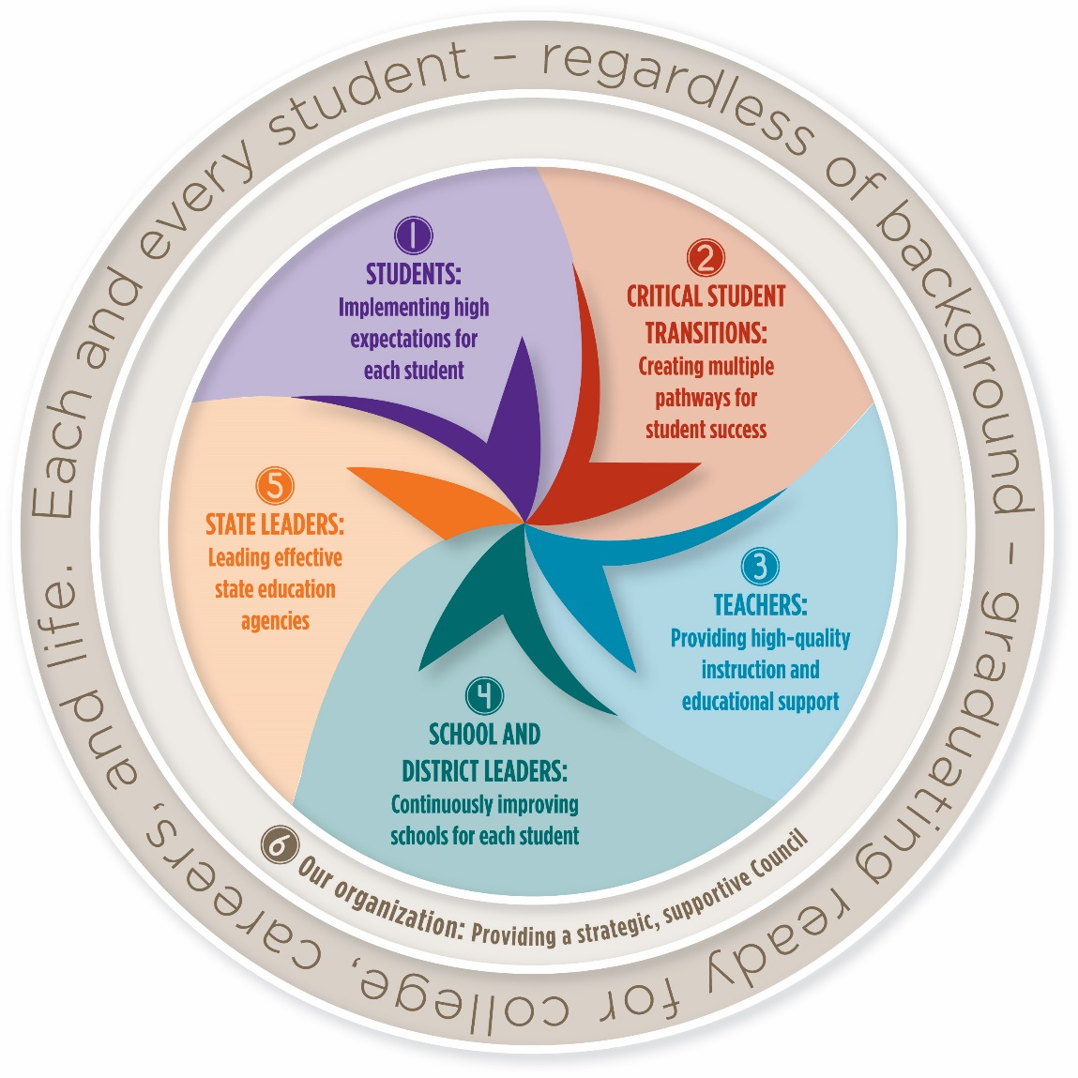
2017-2020 CCSSO Strategic Plan
Overview of CCSSO’s 2017-2020 Strategic Plan
Notes:
Kaylan
Before we dive into the National Collaborative and the AIPL, wanted to provide context on where this work sits within CCSSO’s strategic plan
While this work intersects across the CCSSO strategic plan, it particularly aligns with two main areas, including ensuring high expectations for each student and supporting continuous improvement of schools
James and I are both on the Goal 1 team – ensuring high expectations for each student, specifically strategy 1.2 directed by Kathleen Airhart, CCSSO’s Program Director for Special Education

Slide 5
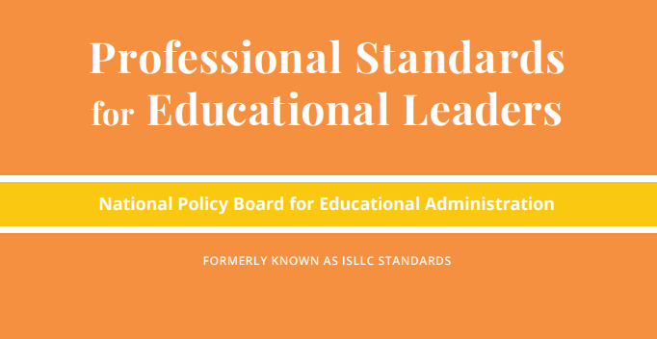
Inclusive Principal Leadership: Where We’ve Been
In 2015, the National Policy Board for Educational Administration (NPBEA) released the Professional Standards for Educational Leaders (PSEL)
  PSEL better reflects the role of leaders today, both as building managers and instructional leaders who advance learning for an increasingly diverse group of students
CCSSO worked with NPBEA and educational leaders in the field to update the standards
Notes:
Kaylan
The Professional Standards for Educational Leaders are foundational to our work on school leadership at the Council and our inclusive principal leadership work is grounded in and builds from the PSEL standards
In 2015, CCSSO worked with the National Policy Board for Educational Administration (NPBEA) in to update the professional standards for educational leaders
These standards refreshed the Interstate School Leaders Licensure Consortium Standards (ISLLC) and emphasized the principal’s role not only as building manager but also instructional leader.

Slide 6

Inclusive Principal Leadership: Where We’ve Been
In January 2017, CCSSO and the Collaboration for Effective Educator Development, Accountability, and Reform (CEEDAR) Center released a supplementary guidance document for students with learning differences
  Developed by an Advisory Group of principals, leaders from state and local education agencies, the higher education community, and professional associations
Outlines key steps every state can take to ensure all school principals are prepared and supported to lead learning environments that meet the needs of students with disabilities and others who struggle to learn in school
Notes:
Kaylan
Effective principals are particularly important for the success of students with disabilities. When principals create safe, supportive learning environments, students who may struggle to learn in school are able to thrive.
And so, we then worked in partnership with the CEEDAR Center to extend the standards to the context of supporting students with disabilities
In January, we, in partnership with the CEEDAR Center, released the supplementary guidance document PSEL 2015 and Promoting Principal Leadership for the Success of Each Child
It was developed by an Advisory Group of principals, leaders from SEAs and LEAs, higher education leaders, and professional associations and outlines key steps states can take to ensure that principals and prepared and supported to lead inclusive schools

Slide 7

Inclusive Principal Leadership: Where We Are
We, in partnership with the National Collaborative on Inclusive Principal Leadership (NCIPL), CEEDAR Center, and Oak Foundation believe inclusive principal leaders are vital to supporting students with disabilities and other diverse learners
Together, we released Supporting Inclusive Schools for the Success of Each Child: A Guide for States on Principal Leadership (https://ccssoinclusiveprincipalsguide.org)
Notes:
Kaylan
We didn’t want to stop at the release of the document, and so CCSSO launched the National Collaborative on Inclusive Principal Leadership (NCIPL) to support states’ efforts on advancing inclusive leadership in preparation and ongoing professional development.
The National Collaborative on Inclusive Principal Leadership (NCIPL) is a diverse alliance that includes principal associations, member organizations, technical assistance centers, researchers, educator preparation programs, and nonprofits.
These organizations convened from September 2017 to May 2018 to develop Supporting Inclusive Schools for the Success of Each Child—a microsite that provides eight strategies and accompanying resources to support states in integrating inclusive principal leadership in policy and practice, grounded in the PSEL document referenced earlier.
The link to the site is up on the screen – the URL is CCSSO inclusive principals guide dot org. The link has also been sent via the chat box.
We will spend the next portion of the webinar highlighting aspects of the online guide, so please feel free to follow along there.

Slide 8
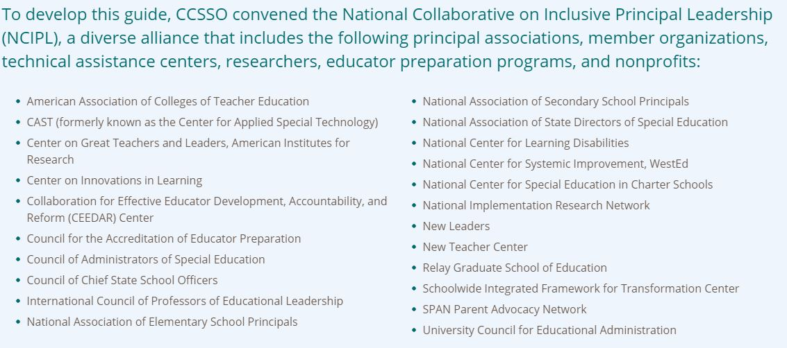
National Collaborative on Inclusive Principal Leadership (NCIPL)
Notes:
Kaylan
These organizations partnered over the past year and provided their time, resources, and expertise to develop this online guide
The guide identified 8 key strategies states can take to integrate inclusive leadership in policy and practice, along with associated resources aligned to each strategy from Collaborative member organizations as well as others
The Collaborative collectively defined what we mean when we talk about inclusive principal leadership and inclusive education
With that, want to turn it over to James to share more about the definitions and strategies included in the online guide

Slide 9
Inclusive Principal Leadership
Inclusive Principal Leadership
Inclusive principals…
  Create strong school cultures
  Establish high expectations and ensure appropriate services and supports for students with disabilities
  Distribute leadership across staff to serve all learners well and ensure all students feel safe, supported, and valued in school
  Play an essential role in improving instruction, promoting collaboration between general and special education teachers
  Support and retain effective teachers of students with disabilities
Notes:
James

Slide 10
NCIPL: Where We Are
Supporting Inclusive Schools for the Success of Each Child: A Guide for States on Principal Leadership contains 8 key strategies to support states in integrating inclusive principal leadership in policy and practice:
  Strategy 1: Set a Vision and Plan for Inclusive Principal Leadership
  Strategy 2: Cultivate Coherence and Collaboration
  Strategy 3: Transform Principal Preparation and Licensure
  Strategy 4: Promote Principal Development on Inclusive Practices
  Strategy 5: Provide Targeted Supports to Districts and Schools
  Strategy 6: Connect School Improvement and Principal Development Initiatives
  Strategy 7: Meaningfully Engage Stakeholders as Partners in the Work
  Strategy 8: Adopt Processes and Supports for Continuous Improvement
Notes:
James

Slide 11
Strategy 3: Transform Principal Preparation and Licensure
Analyze assessments used for licensure and program approval to ensure they address the knowledge, skills, and dispositions inclusive school leaders need, and ensure district capacity for data collection around principal preparation efficacy in inclusive schools
Create or adapt leadership performance assessments to ensure they address the degree to which leaders foster productive collaboration among special education teachers, general education teachers, and related service providers
Establish and/or implement principal preparation program approval processes and standards/criteria that include the content, coursework, and the length and quality of field experiences necessary for effective inclusive principal leadership
Use the standards for school leader preparation programs such as the National Educational Leadership Preparation (NELP) Standards, which are aligned to the PSEL 2015 standards, to update program approval processes
Review CAEP requirements to determine if requiring that the leadership programs approved to operate in your state earn national accreditation will advance inclusive leadership practices
Notes:
James

Slide 12
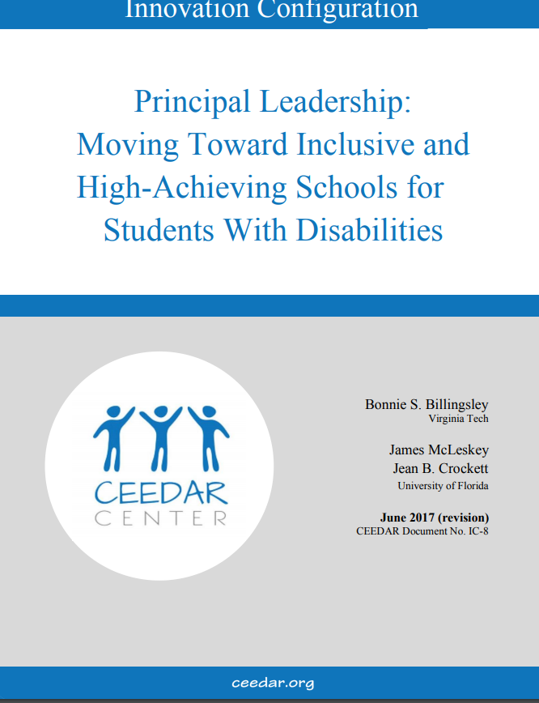
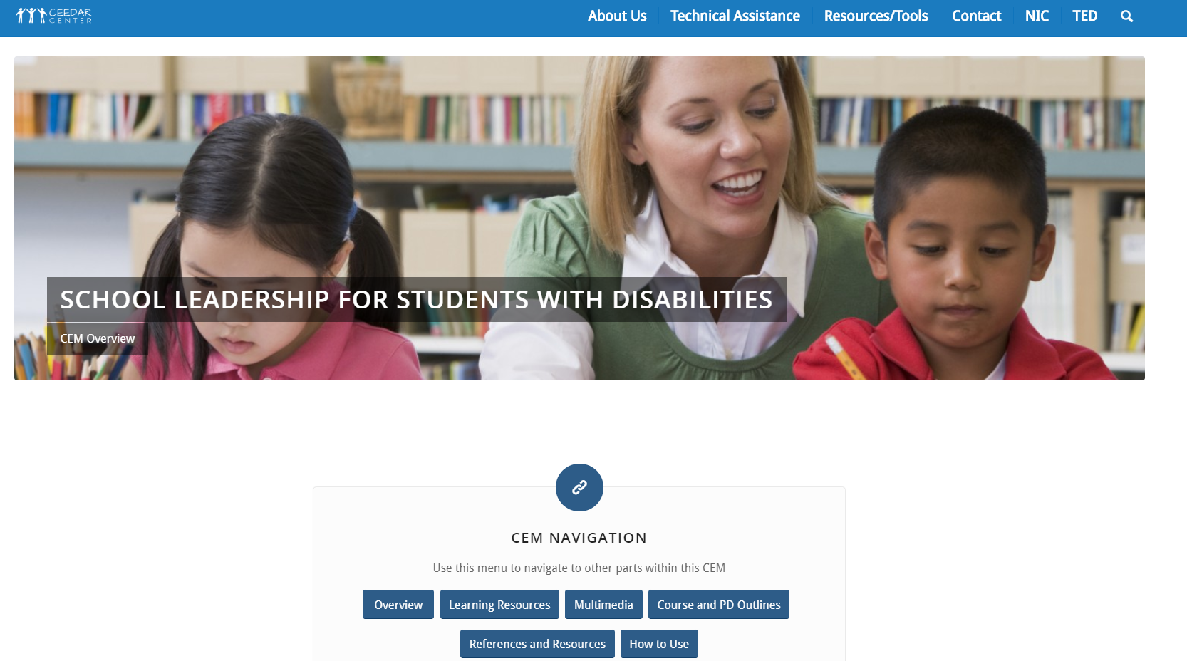
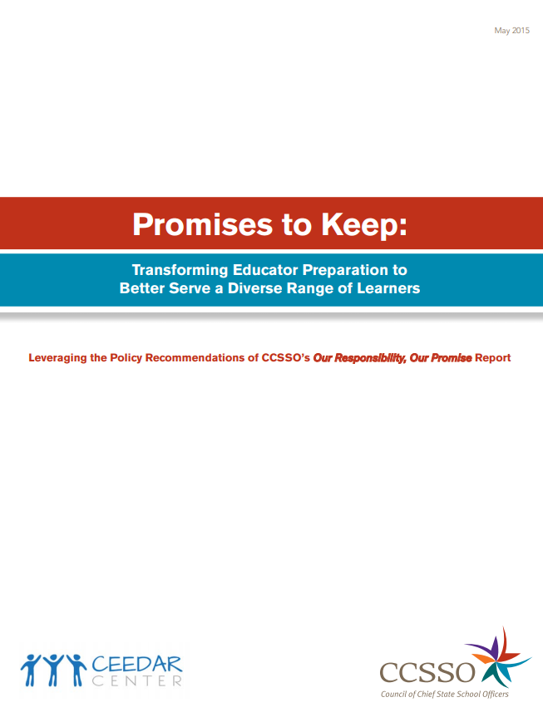
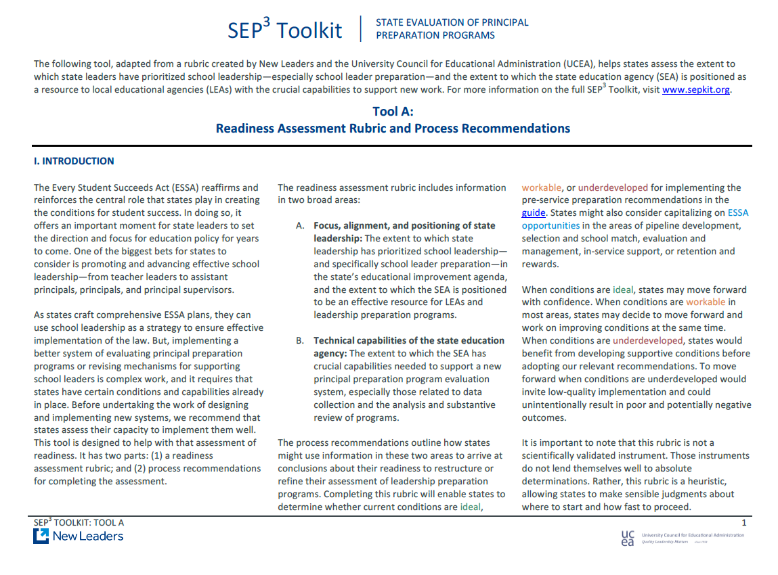
Strategy 3: Related Resources
Innovation Configuration: Principal Leadership
CEEDAR Course Enhancement Module
Promises to Keep: Transforming Educator Preparation to Better Serve a Diverse Range of Learners
SEP³ Toolkit – State Evaluation of Principal Preparation Programs
Notes:
James

Slide 13
Strategy 4: Promote Principal Development on Inclusive Practices
Articulate a clear set of practices that advance inclusive and learner-centered leadership as guidance to augment current principal development work
Provide and promote effective systems of in-service support, evaluation, and professional development for principals at the state and local levels that emphasize inclusive principal leadership practices
Establish incentives for principal mentoring, coaching and induction programs to include a deliberate focus on supporting the skills leaders need to establish optimal inclusive learning environments
Ensure that all leaders are knowledgeable of evidence-based and high-leverage practices teachers need to advance positive outcomes for students with disabilities
Consider developing and using micro-credentials to ensure principals pursue professional development opportunities that hone their skills to support students with disabilities
Notes:
Kaylan
Listed here are suggested actions a state agency could take to effectively develop inclusive principal leadership practices amongst existing school leaders through in-service supports
To develop inclusive leadership practices, SEAs can provide, promote, and evaluate the efficacy of in-service support, evaluation, and ongoing professional learning opportunities for principals at both the state and local levels
And they can support and ensure all leaders are knowledgeable of high-leverage evidence-based practices for SWDs

Slide 14

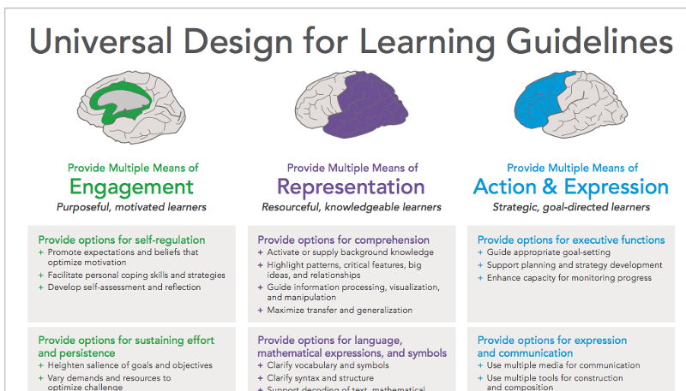
Strategy 4: Related Resources
High-Leverage Practices in Special Education: A Professional Development Guide for School Leaders
UDL Guidelines
Notes:
Kaylan
Here are just a couple of related to resources that could be helpful to you all to support inclusive practice of current principals serving in schools across your state
Including High-Leverage Practices in Special Education: A PD Guide for School Leaders – just recently released by CEC to accompany the HLP guide for teachers; provides a helpful toolkit for leaders to understand, develop, and promote these practices in schools
Along with the Universal Design for Learning guidelines

Slide 15
CCSSO’s Advancing Inclusive Principal Leadership (AIPL) State Initiative
A network of states that will focus on systems-level changes to advancing inclusive principal leadership in policy and practice
States will prioritize two of the following content strategies identified by the NCIPL in the online guide:
  Strategy 3: Transform Principal Preparation and Licensure
  Strategy 4: Promote Principal Development on Inclusive Practices
  Strategy 5: Provide Targeted Supports to Districts and Schools
  Strategy 6: Connect School Improvement and Principal Development Initiatives
Notes:
Kaylan
Through CCSSO’s Advancing Inclusive Principal Leadership, a network of 5 states will deepen and refine their principal development efforts to ensure an intentional focus on supporting the academic and social success of each learner, with an emphasis on those with disabilities anchored in the online guide developed by the National Collaborative on Inclusive Principal Leadership.
This work will continue to be advanced and supported through CCSSO’s longstanding partnership with the CEEDAR Center and through the Oak Foundation
States in the AIPL will prioritize two content strategies, and many are prioritizing 3 and 4—preparation and professional learning—recognizing the importance of supporting this work across the principal pipeline

Slide 16
Five States in the
Advancing Inclusive Principal Leadership State Initiative
Arkansas
Colorado
Georgia
Mississippi
Ohio
Four states will build upon CEEDAR state goals/plans.
Notes:
Kaylan
The five states in the AIPL State Initiative are Arkansas, Colorado, Georgia, Mississippi, and Ohio
Have members of the initiative in the room – will be convening following the CEEDAR Cross-State Convening to support states in the development of their plans to advance this work in policy and practice
4 of the 5 states are also in CEEDAR and will build upon work already underway in those states, which Sheryl and Pam will share about shortly
But first, James and I wanted to see what questions you may have of us…

Slide 17
Q&A and Discussion
What questions do you have for us?
How is this information applicable to your state, district, or IHE context?
Notes:
Kaylan and James

Slide 18

Perspectives on Leadership in Georgia
“The General Assembly and I have lost our patience in trusting superintendents and local boards of education.”
Governor Nathan Deal, 2016
Notes:
Sheryl

Slide 19



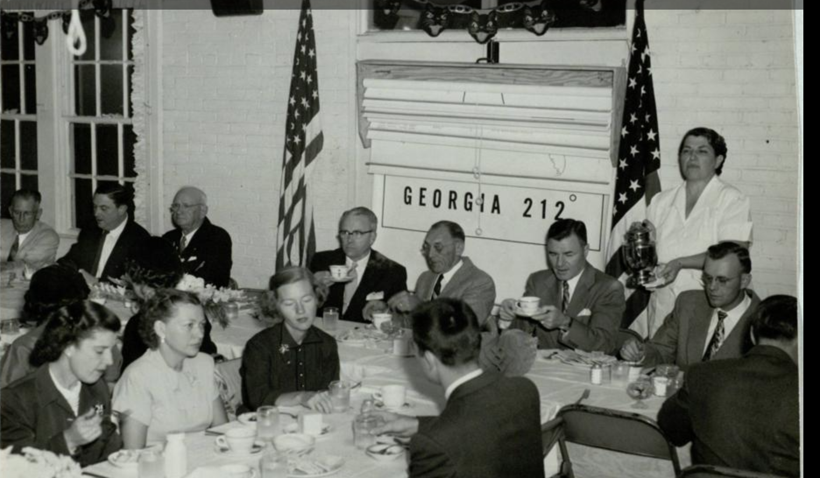
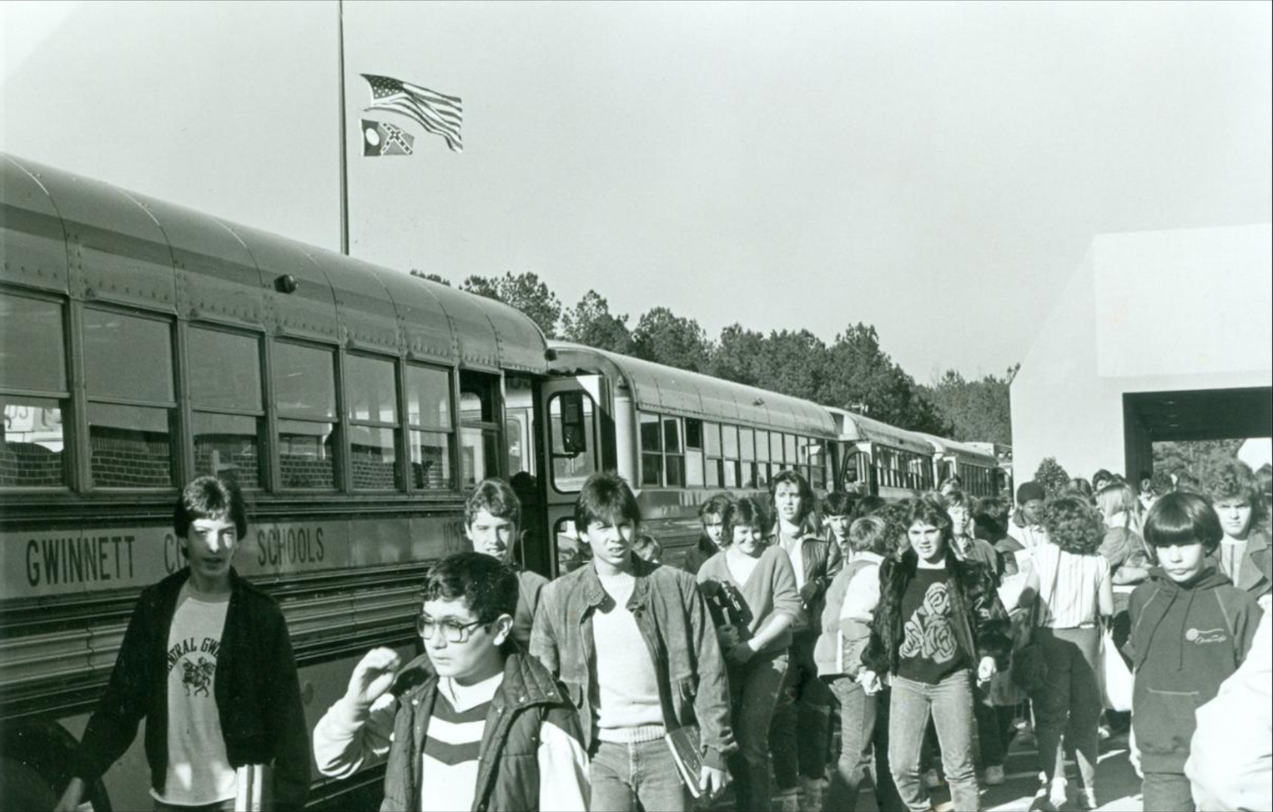
Historical Perspectives
Notes:
Sheryl

Slide 20
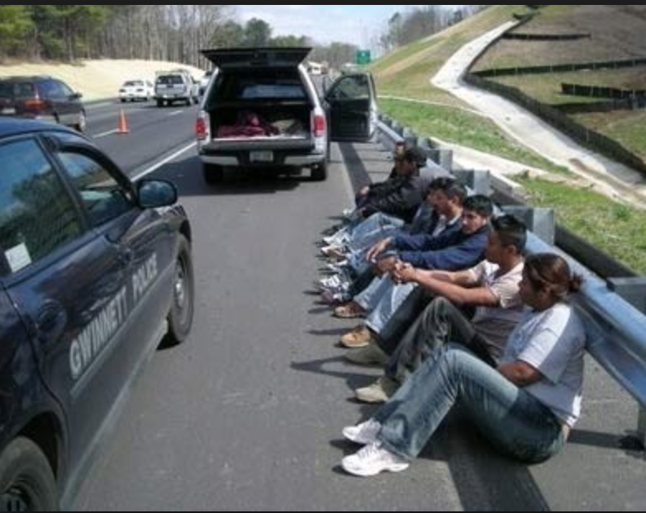
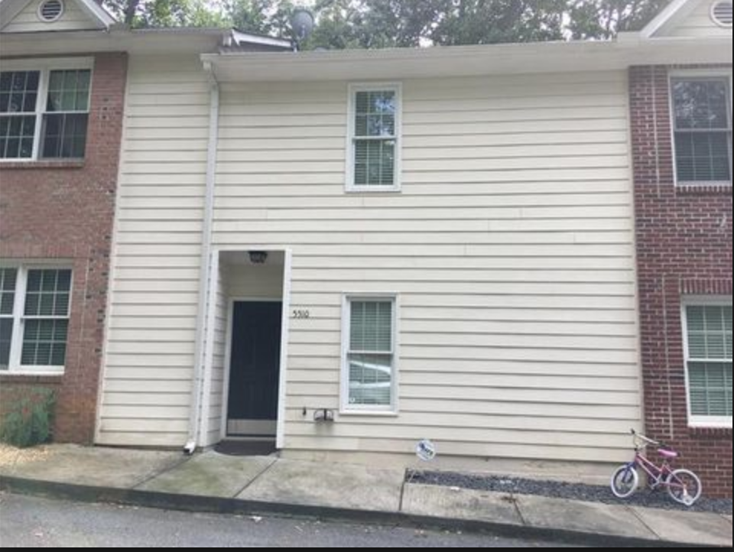
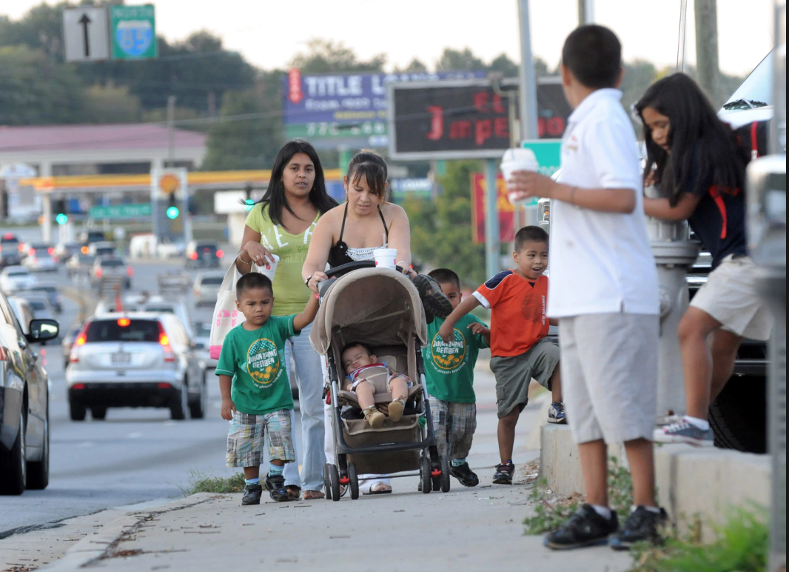
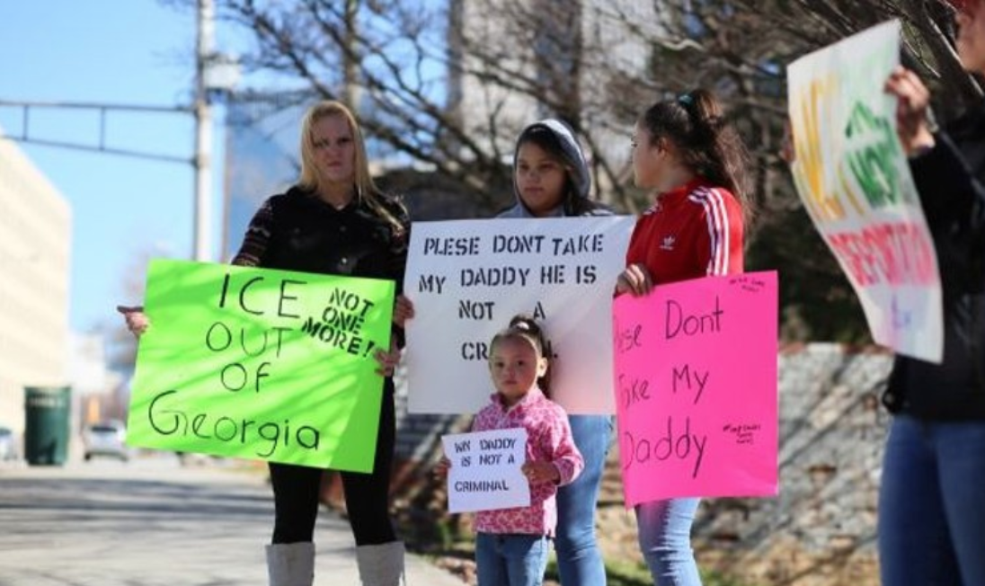
Changing Perspectives
Notes:
Sheryl

Slide 21
Leader Keys
Effectiveness System
Leader Keys
Effectiveness System
LKES
Generates a Leader Effectiveness Measure
Leader Assessment on Performance Standards
30%
Documentation of Practice
Student Growth
40%
School Mean Growth Percentile
School Climate Star Rating
10%
CCRPI School Climate Star Rating
Combination of Additional Data
20%
Achievement Gap Reduction
Beating The Odds
CCRPI Data
Notes:
Sheryl

Slide 22
Practitioner Perspectives
The district has its expectations, but these don’t allow for the challenges we face. You may think that multiple families in one apartment is appalling, but for these families it is light-years beyond what they had before they came here. Having a child to complete 8th grade is a dream fulfilled for many of these families. Having a child to actually graduate from high school is often seen as an unattainable goal. It is easy to say that these parents don’t care, but they do care. They just define success differently. These folks need to hear that their children are capable, that college is a realistic goal. And they need to hear it over and over again. (Principal)
Notes:
Sheryl

Slide 23
Practitioner Perspectives
Last year we were told that we were making impressive gains; we were told that we were great. Then the benchmarks changed and this year we are told that we are not making acceptable progress; this year we are a concern. If you look at our typical increases over three year cycles, even though many of those students haven’t been with us for all three years, I know that we are making a difference. It is very discouraging that a change in measurement makes our hard work seem inadequate. (Assistant Principal)
Notes:
Sheryl

Slide 24
Perspectives and Tensions
FRAMEWORK FOR MACRO-MICRO EXAMINATION OF SCHOOL CONTEXT
The International School Leadership Development Network, 2014
Notes:
Sheryl

Slide 25
Leadership in Georgia
Reform
Culture
Inclusivity
Notes:
Sheryl

Slide 26
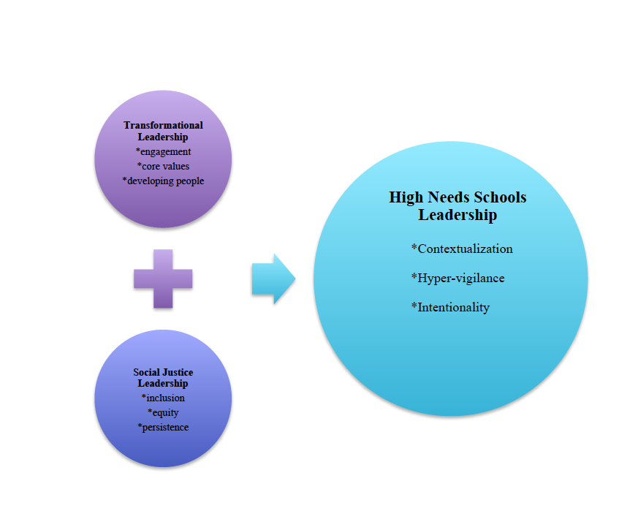
High Need Schools Leadership Model
(Berry, Cowart Moss, and Gore, 2018)
Notes:
Sheryl

Slide 27
Georgia’s Vision
Teacher/Leader Preparation
Certification/Licensure
Program Evaluation
Notes:
Sheryl

Slide 28
Georgia’s Context
Nine Universities (all public: Cohort I in 2014, Cohort II in 2017)
Georgia Professional Standards Commission
Georgia Department of Education
University System Board of Regents
University System Dean’s Conference
Georgia Induction Summit
Professional Organizations (GAEL, GELFA)
P-20 Collaboratives
Notes:
Sheryl

Slide 29
Georgia’s Approach
Identification of
KEY AREAS of Interest
Subtitle
Alignment to Modules
Classroom Management & Community Building
Culturally Responsive Pedagogy
Technology
Assessment
Reading/Academic Language
Universal Design for Learning
Align KEY AREAS of interest with CEEDAR modules
Access CEEDAR resources
  IC’S
  CEMS
Notes:
Sheryl

Slide 30
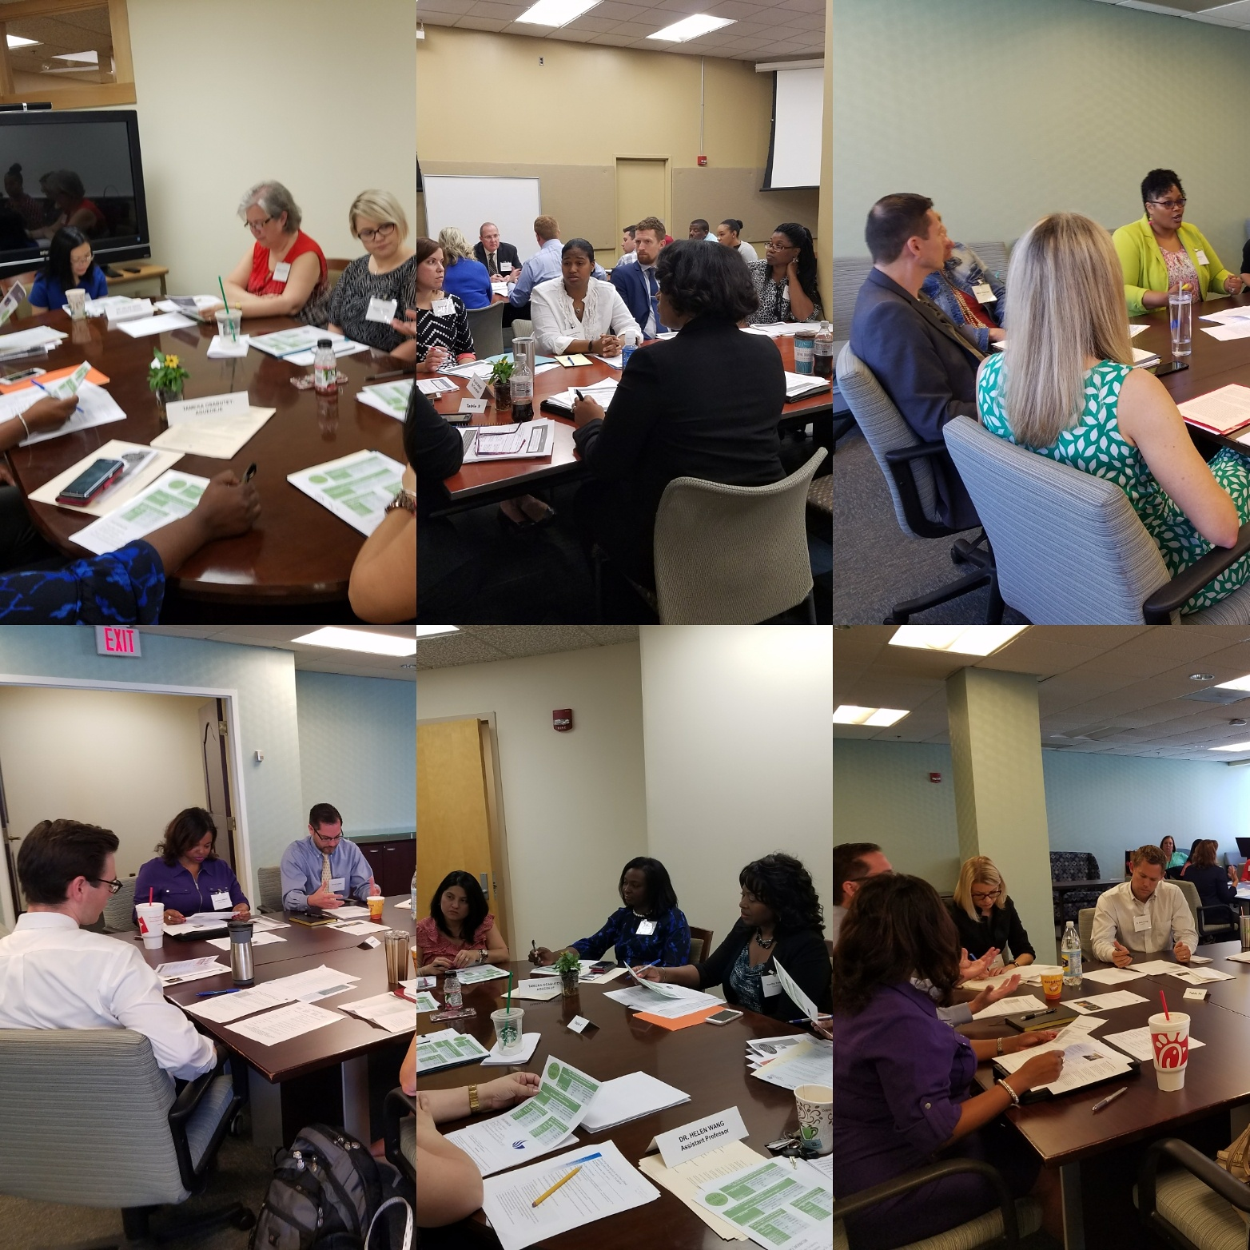
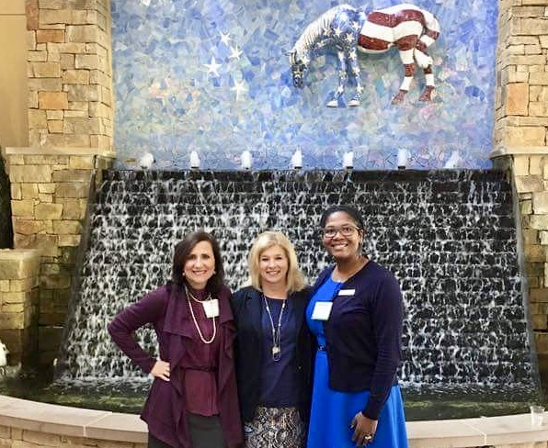
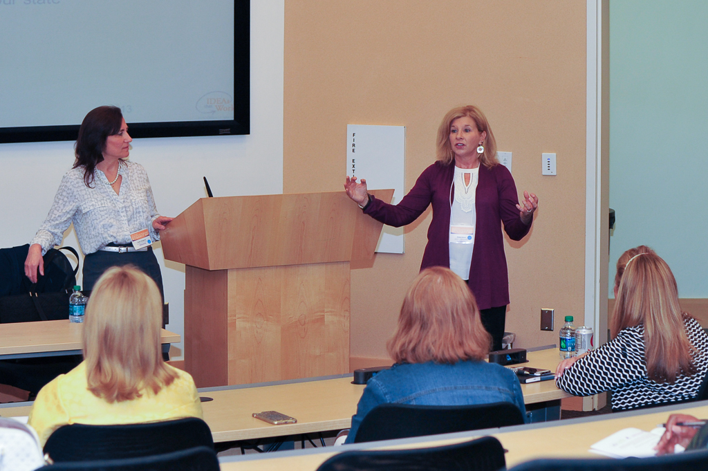
A reform state of mind: Approaches to improve educator preparation in the Peach State
RELATED BLUEPRINT GOALS
OUTCOMES & SUCCESSES
NEXT STEP/SCALING UP
Evidence-Based Practices
Review and revision of EPP programs
Scale up: collaboration and sustainability
Review our data
CEEDAR Resources
Talk to our own experts
Talk to stakeholders
Review course syllabi
Revise programs
Share the work
Mentor others
Continue the work
Georgia’s team in action
Notes:
Sheryl

Slide 31
CEEDAR Resource Support:
Restructuring of signature courses
Focusing on removing silos
Showcasing our practitioners
High leverage practices and inclusive leadership emphasis (summit and ongoing support)
Notes:
Sheryl

Slide 32
Restructuring Signature Courses
*Content enhancement modules
*NIC syllabus reviews
Fierce Conversations (Scott, 2017)
*CEEDAR TOOLS
Notes:
Sheryl

Slide 33
Restructuring Signature Courses
Themes
Alignment Needs
Relevance of content and need for an inclusive focus
Movement beyond legalities
Preparation of leaders to support induction level teachers and inclusive instruction and assessment
High Leverage Practices
Changes in certification
Eliminate “the course” and embed content in all courses
Notes:
Bx/management/ABA classes covered similar content which could be streamlined
Relevance of content--edTPA, assessment, reading curriculum (scripted vs guided)
Expertise with new/changing faculty---- realization of the loss of faculty and the impact that has on the course delivery and comfort with content

Slide 34
Virtual Professional Learning Community
(2015 – present)
Georgia Educational Leadership Faculty Association
OUR MISSION IS TO SUPPORT PERSONAL AND PROFESSIONAL GROWTH FOR IMPROVING THE TEACHING AND LEARNING OF EDUCATIONAL LEADERSHIP IN GEORGIA.
Joint project of GaPSC and GELFA
Over 100 members
Monthly webinars and conversation
Structured support
Notes:
Sheryl

Slide 35
High Leverage Practices Summit
Statewide conference
Monthly webinars
Structured support
Notes:
Sheryl

Slide 36
Practitioner Showcase:
Leadership, High Leverage Practices, and Equity
Highlighting our successes
Specific examples of inclusive leadership in practice
Structured follow-up support
Notes:
Sheryl

Slide 37
Other Georgia Accomplishments
Induction/ PLP Plan
Syllabi Review by Educator Preparation Programs (EPP Program and Course Revisions)
High Leverage Practices emphasis
Targeted Focus on Inclusive Leadership
Alignment and Communication of the Work
Technical Assistance Modules to Support GaPSC and EPPs in Data Usage
Mentoring for inclusive leadership development through the state Educational Leadership Faculty Association (GELFA)
Notes:
Sheryl

Slide 38
Where are we headed in Georgia?
Documenting changes
Sharing our work with others
Maintaining momentum while scaling up
Quality Measures Self-Assessments (King, 2018)
Developing a formalized mentoring program for our state
Targeted training for policy makers, part-time instructors, P-20 partners
Branding and empowering the state leadership team
Inclusion of non-traditional preparation programs
Notes:
Sheryl

Slide 39
Accomplishments Bring New Goals
Content Area 1: Recruit and Prepare
Objective #1
Develop a leader tracking system to provide superintendents
with information necessary to hire and assign principals in schools where their skills
and knowledge are best matched to the needs of students.
Objective #2
Develop processes and procedures to collect and analyze data addressing the
inclusive leadership knowledge and skills of leader preparation program completers
directly associated with the specific needs of learners – SWD, EL, student of poverty and
non-white students of color.
Notes:
Sheryl

Slide 40
Accomplishments Bring New Goals
Content Area 2: Support and Retain
Objective #1
Revisit, realign, and revise the state mandated evaluation system for leaders
– LKES- to ensure inclusion of behaviors and practices that specifically address meeting
the needs of ALL learners including SWD, EL, students of poverty and non-white students
of color.
Objective #2
Develop professional learning opportunities – face-to-face and virtual –
to address the behaviors and practices critical to meeting the needs of ALL learners
including SWD, EL, students of poverty and non-white students of color.
Notes:
Sheryl

Slide 41
Selected References
Berry, J, Cowart Moss, S., and Gore, P. (2018) Leadership in high needs/high performing schools: Success stories from an urban school district. In Murakami, E. Gurr, D., Nottman, R. (Eds.), Leadership,culture, and school success in high needs schools. Charlotte, NC: Information Age Publishing.
Cowart Moss, S. and Kahrs, J. (2018) Building capacity for effective preparation and practice through virtual learning communities: An exploration of the GELFA/GaPSC model. Georgia State University IRB# H18402.
DeMatthews, D. (2015). Making sense of social justice leadership: A case study of a principal’s experiences to create a more inclusive school. Leadership & Policy in Schools, 14(2),139–166.
Dodman, S. (2014). A vivid illustration of leadership. Journal of Staff Development, 35(1), 56-62.
Evans, R. (1997). The human side of school change: Reform, resistance and the real-life problems of innovation. San Francisco: Jossey-Bass, Inc..
Furman, G. (2012). Social justice leadership as praxis: Developing capacities through preparation programs. Educational Administration Quarterly, 48(2), 191-229.
Griffin, S.W. & Green, R.L. (2013). Transforming high poverty, underperforming schools: Practices, processes, and procedures. National Forum of Applied Educational Research Journal, 26(1-2), 77-93.
Hanson, A. (1996). The search for a separate theory of adult learning: Does anyone really need andragogy? In Edwards, R., Hanson, A., & Raggatt, P. (Eds.). Boundaries of Adult Learning (Adult Learners, Education, and Training), 1, 99-108. New York, NY: Routledge.
Hazel, C.E., Pfaff, K., Albanes, J., & Gallagher, J. (2014). Multi-level consultation with an urban school district to promote 9th grade supports for on-time graduation. Psychology in the Schools, 51(4), 395-420. doi: 10.1002/pits.21752
Theoharis, G. (2007). Social justice educational leaders and resistance: Toward a theory of social justice leadership. Educational Administration Quarterly, 43(2), 221-258. doi: 10.1177/0013161X06293717
King, C. (2018). Quality Measures™ principal preparation program self-study toolkit: For use in developing, assessing, and improving principal preparation programs (10th ed.). Waltham, MA: Education Development Center, Inc.
Knowles, M. (1984). Andragogy in Action. San Francisco: Jossey-Bass.
Scott, S. (2017) Fierce conversations: Achieving success at work & in life, one conversation at a time. New York: Berkley (Random House).
Notes:
Sheryl

Slide 42
Q&A and Discussion
How is this information applicable to your state, district, or IHE context?
Given your context, what are some potential challenges or barriers to implementation? How might you solve for them?
Notes:
James

Slide 43
Ohio Leadership for Inclusion, Implementation, & Instructional Improvement
Developing
Principal Capacity
Notes:
Pam

Slide 44
Welcome to OLI⁴
We’re excited about the opportunity to partner with districts around Ohio in supporting principals as they facilitate the work of building leadership teams and teacher-based teams, and improve instruction for all students, including those with disabilities and learning difficulties. We’re also very pleased to be doing this work in collaboration with the ODE, BASA, OLAC, OAESA, OASSA, and OCPEA.
Notes:
Pam

Slide 45
OLI⁴ – Purpose & Intent
To improve principal capacity to improve teacher instructional effectiveness
To facilitate shared leadership and ownership for the success of every student
To focus the core work of the school
To foster a culture of inquiry
To ensure effective implementation, monitoring, and evaluation of selected strategies/actions
Notes:
The intent of OLI4 is to improve the capacity of principals and assistant principals throughout Ohio to support instructional improvement in ways that facilitate higher levels of learning for all students and adults.
So this work is about making and sustaining improvements in the collective capacity of teachers and other educators by:
Getting focused and prioritizing the core work of the school around learning;
Fostering shared responsibility and ownership on the part of all adults for the success of every child;
Selecting and implementing instructional strategies fully, and monitoring the degree of implementation and the effect it’s having on adult and student learning; and
Working within a distributed leadership structure that connects the work of the building leadership team to the district’s goals and priorities, and guides the work of collaborative teacher teams
The work of this project sits within the larger ongoing work of the OIP and OLAC.
Don Washburn will talk more about this.

Slide 46
OLI⁴ – Critical Connections
OLI⁴ professional learning—including coaching—and technical assistance (PL - TA) will be aligned with the Ohio Improvement Process (OIP) and Inclusive Leadership Practices.
OLI⁴ PL -TA will rely on resources available through the Ohio Leadership Advisory Council (OLAC), aligned with Ohio’s Leadership Development Framework (2nd edition), and the Ohio Standards for Principals.

Slide 47
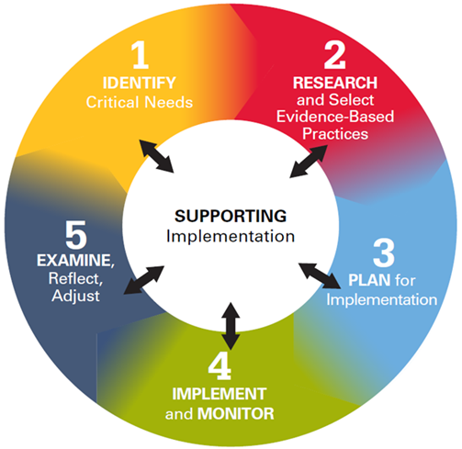
The Ohio Improvement Process: Supporting Implementation
Provides the basis for establishing the collaborative structures and processes necessary to develop, implement, monitor, and evaluate the focused plan.
Notes:
p. 5 handouts

Slide 48
Mapping OLI⁴ Content to Ohio Principal Standards
Standard 1 - Continuous Improvement: Principals help create a shared vision and clear goals for their schools and ensure continuous progress toward achieving the goals.
Standard 2 - Instruction: Principals support the implementation of high-quality standards-based instruction that results in higher levels of achievement for all students.
Standard 3 - School Operations, Resources, and Learning Environment: Principals allocate resources and manage school operations in order to ensure a safe and productive learning environment.
Standard 4 - Collaboration: Principals establish and sustain collaborative learning and shared leadership to promote student learning and achievement of all students.
Standard 5 - Parents and Community Engagement: Principals engage parents and community members in the educational process and create an environment where community resources support student learning, achievement, and well-being.

Slide 49
OLI⁴ Foundation: What We Know
From the Largest Leadership Study to Date
9 states
43 school districts
180 schools
Data from a total of 8,391 teachers and 471 school administrators
[Seashore, Louis et al., 2010]

Slide 50
OLI⁴ Foundation: What We Know
The truth is the best learners are the best leaders.
Learning is the master skill.
[Kouzes & Posner, 2010]

Slide 51
OLI⁴ Foundation: What We Know
Focus is the Key
Marzano, Waters, McNulty (2005)
Robinson (2007, 2008, 2011, 2013)
Leithwood ( 2007, 2008, 2012)
Seashore Louis (2010)
McNulty & Besser (2014)
Goddard R. et al (2015)
Moody (2015)

Slide 52
OLI⁴ Foundation: What We Know
Collaborative Inquiry
Can schools and districts answer the BIG Questions?
Do you know which schools, classrooms, and subgroups are making progress and why?
Do you know which schools, classrooms, and subgroups are not making progress and why?
What actions have they taken?
  – How well did those actions work?
  – How do they know?

Slide 53

OLI⁴ Foundation: What We Know
The Impact of Leadership on Student Outcomes: An Analysis of the Differential Effects of
Leadership Types
Viviane M. J. Robinson
Claire A. Lloyd
Kenneth J. Row
Notes:
Background on this Study: Viviane Robinson received her doctorate at Harvard and is now Director of the Center of Educational Leadership at the University of Auckland. She was made a Fellow of the American Educational Research Association and has consulted for governments all over the world on Ed Leadership and research. This book illustrates the findings that she and her colleagues published in their study entitled, The Impact of Leadership on Student Outcomes: An Analysis of the Differential Effects of Leadership Types published in Educational Administration quarterly, December 2008.
Research Design: The methodology involved an analysis of findings from 27 published studies of the relationship between leadership and student outcomes. The first meta analysis, including 22 of the 27 studies, involved a comparison of the effects of transformational
and instructional leadership on student outcomes. The second meta-analysis involved a comparison of the effects of five inductively derived sets of leadership practices on student outcomes. Twelve of the studies contributed to this second analysis.

Slide 54
Robinson’s Findings
Notes:
This study is included to illustrate the powerful effects of the principal leading teacher learning and development- in this case coaching teaching- and its impact on student learning outcomes. More about the study follows below.
In order to apply the five dimensions wisely in any given context, leaders need to understand why and how the practices involved make a difference to teaching and learning.
Leading teacher learning and development--The most powerful way that school leaders can make a difference to the learning of their students is by promoting and participating in the professional learning and development of their teachers. These leadership practices go well beyond organizing and resourcing the professional development program. Much of the evidence that contributed to this fining was about leaders themselves participating in the learning in the role of leader, learner, or both.
Ensuring quality teaching--The second most powerful way that school leaders can positively influence student achievement is through planning, coordinating, and evaluating teachers and their teaching. The evidence suggests that in schools where teachers report that their leadership is heavily involved in these activities, students do better. This type of leadership is at the heart of what is called instructional leadership. The powerful leadership practices include such things as program coherence, effective teaching, and creating a culture of inquiry.
Establishing goals and expectations--Next in leadership practice importance involves establishing goals and expectations. Goal setting is a ubiquitous feature of leadership work. It is part of strategic and annual planning, principal and teacher evaluation, and many other school development and review processes. One of the ways that leaders can reduce fragmentation and promote coherence is through the process of setting and communicating clear goals. Goal setting includes deciding what goals to set, gaining the commitment of those responsible for achieving them, and communicating them to all those with an interest in their achievement.
Strategic resourcing--Leaders who take a strategic approach to resourcing ensure that money, time, and people are used in ways that reflect priority goals. When clear goals are in place, leaders can be strategic about allocating and organizing money, time, and staffing in ways that increase the chance of success. Initially, this leadership practice is about taking a more strategic approach to the organization of these resources and to analyze and evaluate existing patterns of resource allocation in terms of alignment to learning goals. Further, even though staffing is constrained by contractual obligations, high-quality, proactive, and school- and district-based recruitment, retention, and replacement policies can improve teacher quality. High-quality teachers need to work with high-quality instructional resources. An increasingly rich evidence base shows that investments in instructional resources that include professional learning components are more effective than investments in instructional technology and curricula. It is the improvement in quality of daily classroom practice that has the most powerful impact on student progress.
The fifth dimension of “ensuring an orderly and safe environment,” provides the foundation for all of the rest. Teachers feel respected, students feel their teachers care about them and their learning, and school and classroom routines protect instructional time.
Now zero in on the effect sizes and have them realize that promoting, participating and leading teacher learning and development has twice the effect on student learning than even the closest next one.

Slide 55
OLI⁴ Foundation: What We Know
Strengthening Instruction Must
Include Implementation of:
Powerful Instructional Practices
Teacher-Based Teams (TBTs)
These 2 areas are the focus or the “buckets” of our OLi⁴ work!

Slide 56

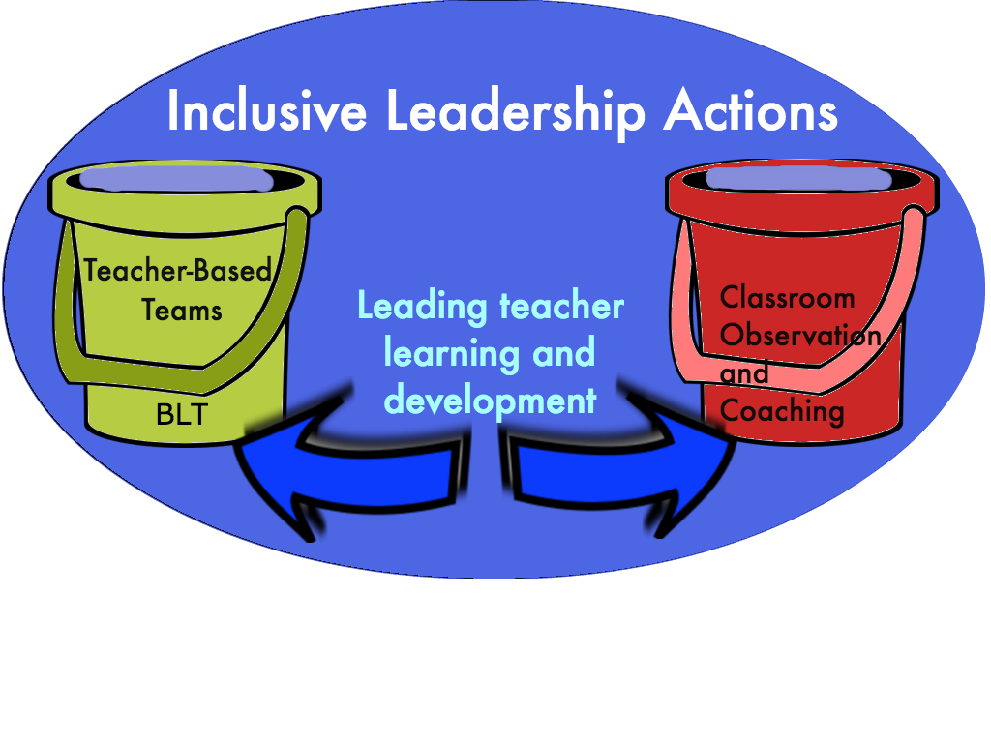

BIG picture OLi⁴

Slide 57


Inclusive Instructional Practices
Inclusive Leadership Practices
Think outside
the box
ACT outside
the box
P.L.
44 years of
Special Education
Practices
94-142
…includes all actions leaders take to ensure educational quality and equity through the participation of ALL STUDENTS in a high-quality and engaging general education curriculum. This works best to cultivate an informed and productive citizenry.

Slide 58
OLI⁴ Foundation: What We Know
The inclusive leadership practices that comprise the two OLi⁴ buckets are defined in the Inclusive Leadership Practices Rubric by six domains in the next slide. Each domain is linked to one/both of the OLi⁴ Buckets

Slide 59
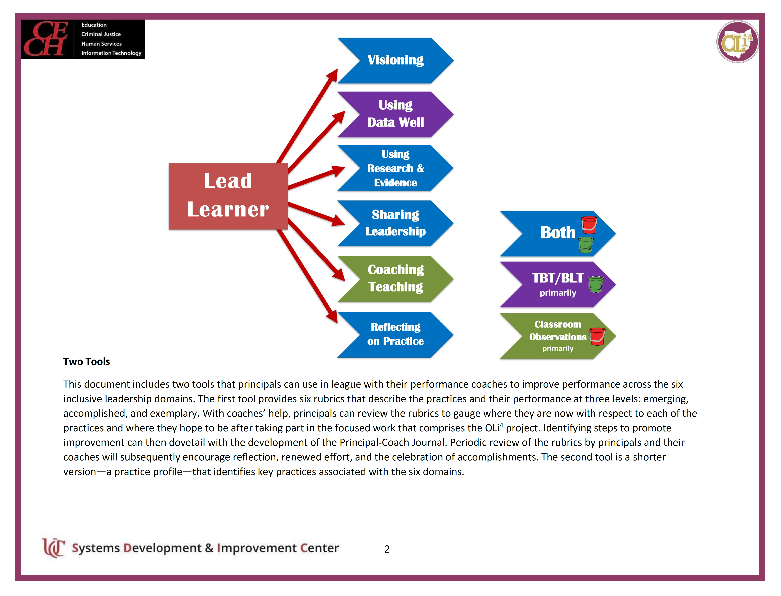

Slide 60

1. VISIONING
The principal uses district and school non-negotiables to set specific achievement targets for all classrooms and students, and ensure the consistent use of evidence-based instructional strategies in all classrooms to reach those targets.
[Ohio Principal Standard 1: Elements 1.1 and 1.2]

Slide 61

Vision, Mission & Core Values
Notes:
Begin Targets 1 & 2
-Understand the purpose and benefits to a clear vision, mission and core values in schools
-Analyze use success criteria for creating effective vision, mission and core values statements

Slide 62


2. USING DATA:
The principal uses data to make effective decisions.
[Ohio Principal Standard 2: Element 2.5]
2. The principal helps teachers use data to make more effective decisions.
[Ohio Principal Standard 2: Element 2.5]

Slide 63

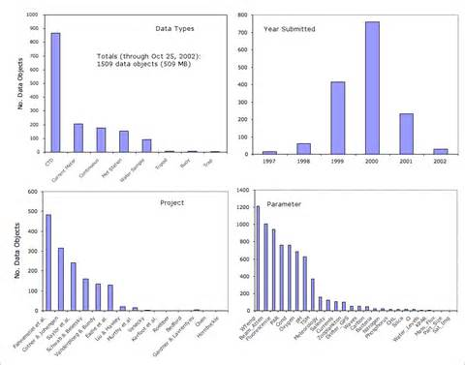
There are two kinds of data
Adult performance data
Student performance data
Monitoring of adult actions
Feedback
Provision of supports
Do not expect changes in student outcomes before you have changes in adult practices
Formative data should precede summative data
You should however start to see correlations between the two
Myth of Linearity (Reeves, 2008)

Slide 64


3. USING RESEARCH AND EVIDENCE TO GUIDE INSTRUCTION:
The principal guides teachers in their selection of evidence-based instructional practices for diverse learners.
[Ohio Principal Standard 2: Elements 2.4 and 2.6]

Slide 65
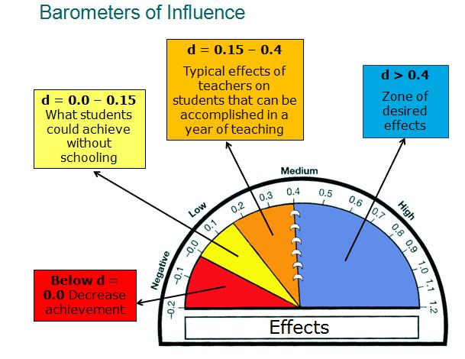


The Research Details
Notes:
Depending on the group- you may want to explain the way Hattie illustrates the effect sizes of the influences he has studied

Slide 66

What Is the #1 Factor Influencing Student Achievement?
Collective Teacher Efficacy
(E.S.= 1.57)

Slide 67

4.SHARING LEADERSHIP:
The principal shares leadership with teachers based on their expertise.
[Ohio Principal Standard 4: Elements 4.2 and 4.3]
The principal engages teachers, through the TBT and BLT structures, in collaborative problem-solving and other collaborative learning.
[Ohio Principal Standard 4: Elements 4.1, 4.2, and 4.3]

Slide 68

2 Overall Findings
1. Collective leadership (collective capacity) has a stronger influence on student learning than any individual source of leadership
Higher-performing schools award greater influence to teacher teams
Seashore Louis et. al, 2010

Slide 69

5.COACHING TEACHING:
The principal monitors teaching for effectiveness.
[Ohio Principal Standard 2: Element 2.2]
The principal calls into question teaching practices that appear to be ineffective.
[Ohio Principal Standard 2: Element 2.2]

Slide 70

Schools are better served if principals spend more time using the (walk-through) information for school improvement…
than just collecting it!
Grissom, Loeb, & Master (2013).

Slide 71

6. REFLECTING ON PRACTICE
The principal reflects on his or her own practice.
[Ohio Principal Standard 1: Element 1.3]
2. The principal models and encourages self-reflection, active learning, and application of that learning.
[Ohio Principal Standard 1: Element 1.3]

Slide 72
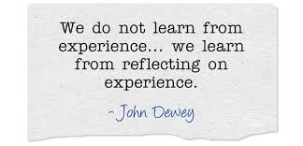

The reflective question is a gift
Downey (2004)

Slide 73
Longitudinal Data: Inclusive Practice
Trend Group | Practices
all rising | Inclusive Practice Total, Visioning, Coaching, Sharing Leadership
3 rising, 1 falling | Teams, Research
2 rising, 2 falling | Data
1 rising, 3 flat | Observation
1 rising,3 falling | Reflection

Slide 74
Q&A and Discussion
How is this information applicable to your state, district, or IHE context?
Given your context, what are some potential challenges or barriers to implementation? How might you solve for them?
Notes:
James

