Slide 1
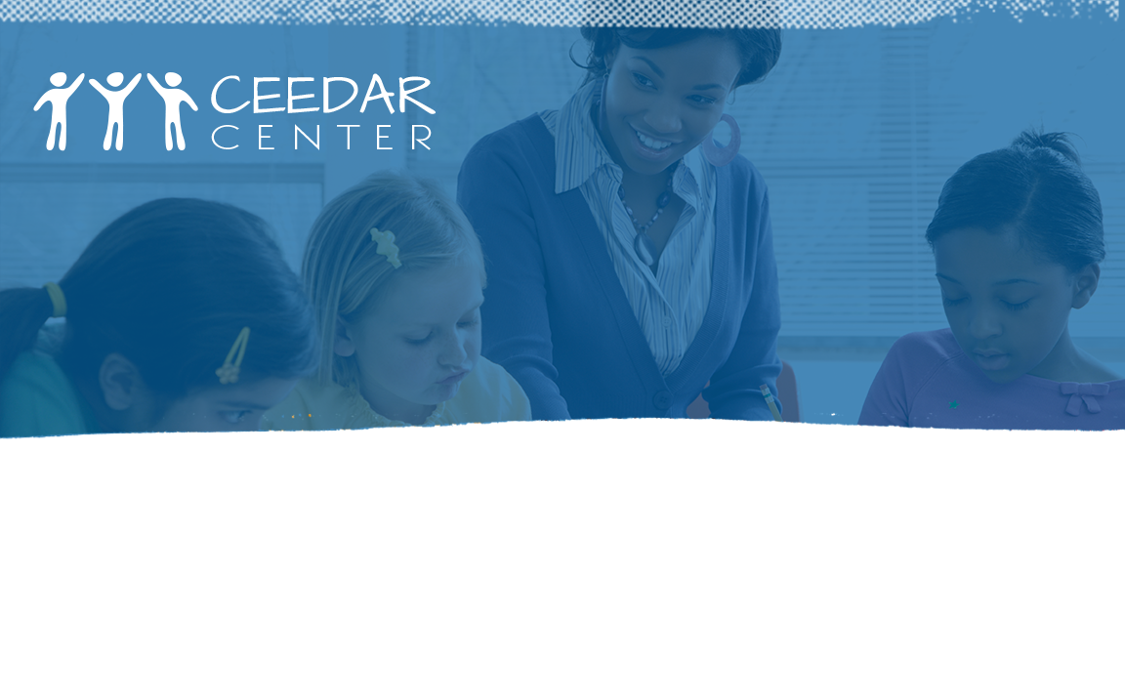
Part 3: culturally RESPONSIVE classroom management

Slide 2
CRCM Overview
Part 1: What is culturally responsive classroom management (CRCM)?
Part 2: Teacher perceptions and culturally responsive classroom management
Part 3: School-wide strategies, classroom strategies, and strategies for individual students
Part 4: Implications for student outcomes and implications for teachers

Slide 3
What is Culturally Responsive Classroom Management?

Slide 4
Goals
Objectives: After participating in this professional learning opportunity, participants will be able to:
Understand what culturally responsive classroom management is and is not.
Understand how their biases impact how they manage their classrooms and their students’ behavior.
Understand the difference between school-wide, classroom, and individual strategies to address culturally responsive classroom management.
Understand the implications for students and teachers.
Notes:
You will learn the following four big takeaways from this portion of the presentation.
1. You should know how to define CRCM.
2. You should know how your perceptions of your students impact how you manage their behavior.
3. You should know what school-wide, classroom, and individual CRCM strategies are and how they differ.
4. You should be able to share how using CRCM strategies benefits student outcomes and how they improve your practice.

Slide 5
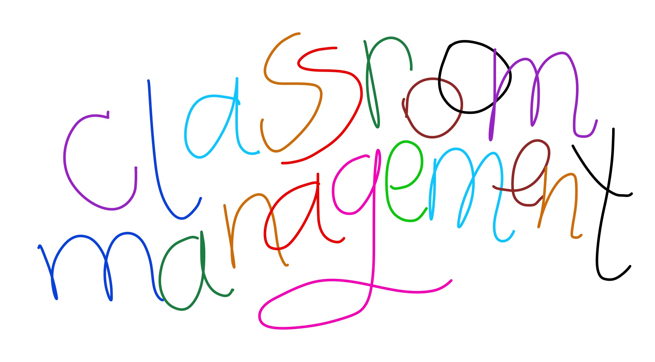
What is culturally responsive classroom management?
CRCM is an approach to running classrooms with all children (not simply for racial/ethnic minority children) in a culturally responsive way.
More than a set of strategies or practices, CRCM is a pedagogical approach that guides the management decisions that teachers make (Metropolitan Center for Urban Education, 2008).
Notes:
Why do you think the point is made that CRCM is more than strategies or practices? Why is this distinction important to point out? Possible talking points: It's what your belief system is, the biases you carry, etc. It's similar to what you believe about how children learn. Do you think all children can learn or just some? Do you think you can positively manage all students' behavior can, or do you think you have to be mean to get the attention of students of color? It's all in your mindset and what you believe about the behavior of students of color.

Slide 6

Examples of Culturally Responsive Classroom Management
(Metropolitan Center for Urban Education, 2008)
Recognize your own cultural bias and lens (self).
Know your students’ cultural backgrounds (other).
Be aware of the broader social, economic, and political context (context).
Be willing to use culturally appropriate management strategies.
Commit to building caring classroom communities.
Notes:
Always start with yourself. Who are you? What do you believe? How do you view those with different backgrounds than you? How can you learn about your students' backgrounds in a meaningful way that lets them know that you care about who they are outside of school? How does what's going on in the community and our state, nation, and world impact what we do in classroom? How does the socioeconomic status (SES) of your students' parents impact what happens in the classroom? How do recent issues in the national or local news impact the dynamics of your classroom? How do federal and state government policies impact your students and what happens in your classroom? Be open to doing things differently while managing the behavior of your students of color. Be willing to move out of your comfort zone. Make sure that every student in your classroom feels he or she belongs in your classroom. Build positive and meaningful relationships with each student. If you accomplish these tasks, the academics will take care of themselves. Remember, students don't care how much you know until they know how much you care.

Slide 7

How does diversity look in my classroom?
Use the web to brainstorm every type of diversity represented in classrooms today.
Use words, pictures, and phrases to describe the different characteristics.
Be prepared to share your webs with the group.
Notes:
Think in terms of culture; language; learning needs (e.g., gifted, special education, struggling learning); racial/ethnic background; SES; gender; sexual orientation; and religion.

Slide 8
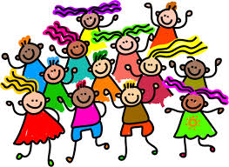
Who are our students? How are they diverse?
(Parker & Beck, 2017)
Race, ethnicity, and culture
Social class and religion
Language and dialect
Sex/gender
Sexual orientation
Learning differences
Multiple intelligences
Notes:
Would you add any group to this list? If so, which group is missing? How many of these different groups are represented in your classrooms? How? How do these groups impact how you manage your classroom?

Slide 9
Activity: Thinking, Feeling, Saying, Doing
Brainstorm what you would be thinking, feeling, saying, and doing about working with the diverse students in your classroom.
Create a heading for each: thinking, feeling, saying, and doing, and then brainstorm your thoughts, words, actions, etc. on separate post-its. Place your post-its underneath the appropriate heading.
Be prepared to share your brainstorm with the group.
Notes:
Each group should have a different heading. For example, Group 1 (thinking), Group 2 (feeling), Group 3 (saying), Group 4 (doing). If you have more than four groups, repeat headings until each group has one. Give each group post-its on which to brainstorm thoughts, and then have them place their post-its on their poster and hang the posters on the wall around the room. Then, the participants will complete a walk-about of all of the posters. They will pull post-its to take back to their seats that they feel they need to discuss further. Facilitate a whole-group discussion of brainstorms through participants sharing the post-its that they brought back to their seats.

Slide 10

Teacher perceptions: Culturally Proficient Conversations
(Nuri-Robins, Lindsey, Terrell, & Lindsey, 2005)
  What is cultural proficiency? Cultural proficiency is an inside-out approach that makes explicit the values and practices that enable both individuals and schools to effectively interact across cultures. It raises awareness of and closes the gap between a person’s expressed values and how others perceive and experience the person.
Notes:
View cultural proficiency as a way to understand, embrace, and talk about differences that recognizes and respects individuals and their cultures. To achieve this task, educators must align their values and educational philosophies with their daily practices to create learning communities among and between educators, students, and their families. This model focuses on middle and high schools, but elementary administrators and teachers can easily adopt these principles.

Slide 11

Teacher perceptions: Culturally Proficient Conversations
(Nuri-Robins, Lindsey, Terrell, & Lindsey, 2005)
  Conversation Along the Continuum: Discuss the questions below.
    What is the nature of the conversations that you hear about students and their families?
    What conversations would you like to have about your students?
    What conversations would you like to hear among your students?
    What conversations would you like to have with your students?
Notes:
Notice that the key in all of these questions is communication. What are you hearing/saying? What are your students hearing/saying? Having these conversations are key to building cultural proficiency.

Slide 12
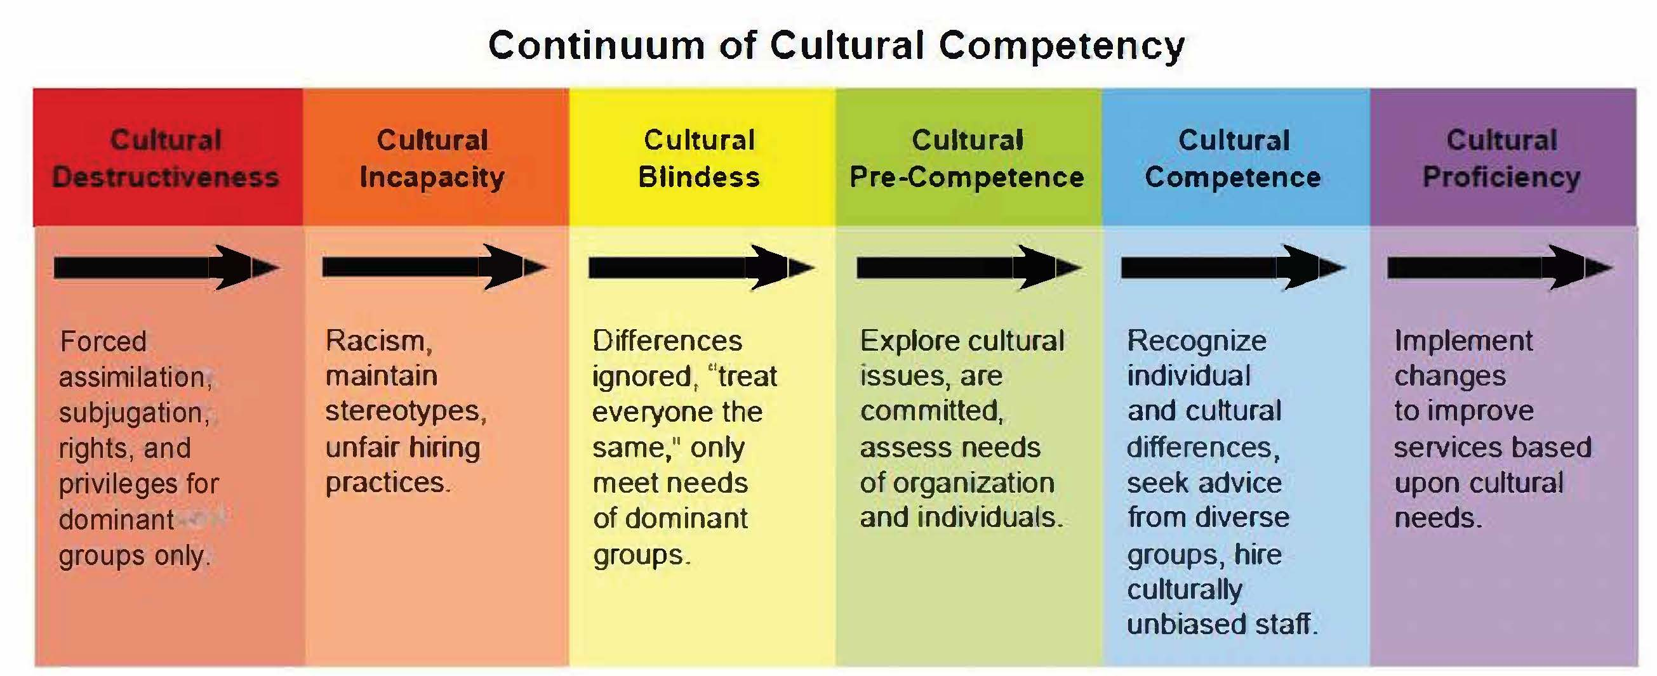
Culturally Proficient Continuum
(Nuri-Robins, Lindsey, Terrell, & Lindsey, 2005)
    Where are you on the continuum? (Discuss this question.)
Notes:
Discuss this question with your table. Be honest and reflective. If you aren't where you'd like to be, what are some practical changes you can make to get to where you'd like to be on the continuum. Be prepared to share where your group members are on the continuum and why each person felt that way. Choose a spokesperson to share this information.

Slide 13
5 Essential Elements
(Nuri-Robins, Lindsey, Terrell, & Lindsey, 2005)
Essential Element: | Role of Teachers:
Assess Culture | Assess own culture and its effect on students, assess the culture of the classroom Support students in discovering their own cultural identities
Value Diversity | Teach all subjects from a culturally inclusive perspective Insist on classroom language and behaviors that value difference
Manage the Dynamics of Difference | Use conflicts as object lessons Teach students a variety of ways to resolve conflicts
Adapt to Diversity | Learn own instructional and interpersonal styles Develop processes to enhance them so that they meet the needs of all students Help students understand why things are done in a particular way
Institutionalize Cultural Knowledge | Teach students appropriate language for asking questions about other people’s cultures and telling other people about theirs
Notes:
An important point for you and your students to know is that we all have a cultural identity—not just ethnically/linguistically diverse groups, but all groups have a cultural identity. You have to be aware of your identity to understand and value another group's identity. By creating culturally inclusive lessons, you will show your students that you value who they are and where they come from, which goes a long way toward curtailing behavior problems and building strong relationships with your students. As the saying, "Physician heal thyself” goes, so should "Teachers know thyself so that you can know your students." Model appreciation for different cultures and languages for your students and teach them how to appropriately ask others about their cultures without offending.

Slide 14

Teacher Perceptions
(Nuri-Robins, Lindsey, Terrell, & Lindsey, 2005)
Examine your own barriers:
  What is the nature of your privilege?
  How can you use your privilege to catalyze change in your school?
  What systemic barriers to cultural proficiency exist in your school’s culture?
  Identify some of the systems of privilege and oppression in your school.
Notes:
Be honest and reflective in how you answer these questions.

Slide 15
Teacher Perceptions Continued
(Nuri-Robins, Lindsey, Terrell, & Lindsey, 2005)
Examine your own barriers:
  Where do you see evidence of a need to adapt to the diversity of your faculty and staff members, students, or their families?
  What resistance can you expect to a culturally proficient initiative in your school?
  How might you intervene to prevent or redirect the resistance?

Slide 16
Harvard Implicit Bias Tests
Project Implicit – https://implicit.harvard.edu/implicit/
Take one of the implicit bias tests about social attitudes. The test should take about 15 minutes. After taking your test, discuss your results with your group.
  Do you agree with the results? Why/Why not?
  How will your results impact how you interact or perceive other groups in the future?
  Be prepared to share what your group discussed about the test results.
Notes:
Choose a spokesperson to share a synopsis of what your table discussed about the IAT.

Slide 17
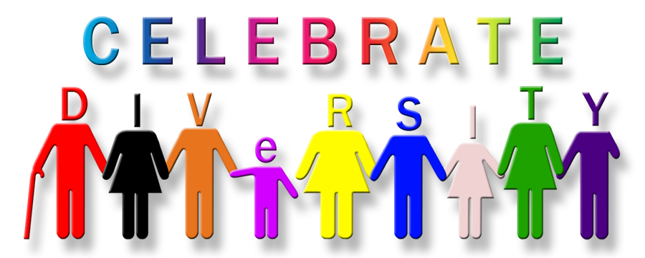
What is multicultural education?
Multicultural education is an idea, an educational reform movement, and a process (Banks, 1997). As an idea, multicultural education seeks to create equal educational opportunities for all students, including those from different racial, ethnic, and social-class groups.
This Photo by Unknown Author is licensed under CC BY-NC

Slide 18
Banks’ Dimensions of Multiculturalism (Banks, 1995)
Multicultural Education
Content Integration
Prejudice Reduction
Equity Pedagogy
Knowledge Construction Process
Empowering School Culture & Social Structure

Slide 19
Dimensions Defined
(Banks, University of WA, College of Education):
Content integration deals with the extent to which teachers use examples and content from a variety of cultures and groups to illustrate key concepts, generalizations, and issues within their subject areas or disciplines.
The knowledge construction process describes how teachers help students to understand, investigate, and determine how the biases, frames of reference, and perspectives within a discipline influence the ways in which knowledge is constructed within it (Banks, 1996). Students also learn how to build knowledge themselves in this dimension.
Prejudice reduction describes lessons and activities teachers use to help students to develop positive attitudes toward different racial, ethnic, and cultural groups. Research indicates that lessons, units, and teaching materials that include content about different racial and ethnic groups can help students to develop more positive intergroup attitudes if certain conditions exist in the teaching situation (Banks, 1995b). These conditions include positive images of the ethnic groups in the materials and use multiethnic materials in a consistent and sequential way.
An equity pedagogy exists when teachers modify their teaching in ways that will facilitate the academic achievement of students from diverse racial, cultural, and social-class groups (Banks & Banks, 1995). Research indicates that the academic achievement of African-American and Mexican-American students increases when cooperative teaching activities and strategies, rather than competitive ones, are used in instruction (Aronson & Gonzalez, 1988). Cooperative learning activities also help all students, including middle-class White students, to develop more positive racial attitudes.
An empowering school culture and social structure exists when the culture and organization of the school transform in ways that enable students from diverse racial, ethnic, and gender groups to experience equality and equal status. Implementing this dimension requires reforming the total environment of the school, including the attitudes, beliefs, and actions of teachers and administrators; the curriculum and course of study; assessment and testing procedures; and the styles and strategies teachers use.

Slide 20
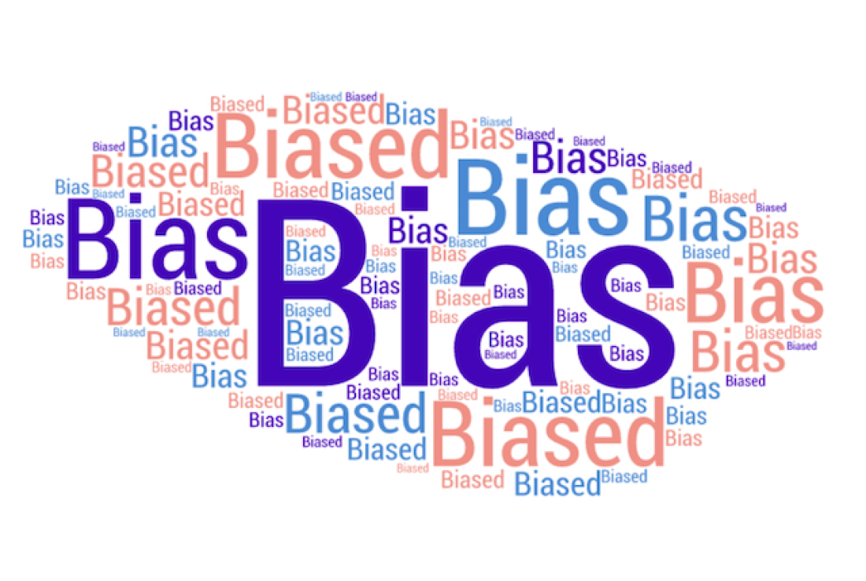
Debrief: Teacher Perceptions
How do teacher biases impact how teachers manage student behavior?
Notes:
How does what you believe about different cultural groups impact how you manage students' behavior from those groups? Are you always fair and equitable when managing behaviors? Are you more patient with certain students because they are more similar to you?

Slide 21

School-wide Strategies
Positive Behavioral Interventions & Supports (PBIS): PBIS improves social, emotional, and academic outcomes for all students, including students with disabilities and students from underrepresented groups. The broad purpose of PBIS is to improve the effectiveness, efficiency, and equity of schools and other agencies (OSEP Technical Assistance Center).
Notes:
Key point: Focus is not just on academic outcomes, but also on social and emotional outcomes. How and why is this focus beneficial to the students? How is Positive Behavioral Interventions & Support (PBIS) an equitable practice based on the definition and purpose of PBIS?

Slide 22
PBIS and Tiers – Adapted from Sheperd & Linn, (2015)
Tier 1/Universal Interventions
1. Traditional Hierarchy Behavior Management Plan
2. Office Referrals
3.Teacher Nominations
4. Continuous Progress Monitoring
5. Universal Screening
Tier 2/Intensive Interventions (Response-to-Intervention – Rti)
1. Small-Group Instruction
2. Teacher-Mediated Instruction
3. Peer-Mediated Instruction
4.Self-Management Strategies
5. Behavior Education Program
6. Social Skills Training
Tier 3/Individualized Interventions
1. One-on-One Instructions
2. Intensive Small-Group Instructions
3. Intervention Specialists
4. Wraparound Services
5. FBA/BIP
Notes:
Just as tiers for academic learning exist, with PBIS, the tiers relate to different ways to address the behavioral needs of students. Just as with the academic tiers, continuous progress monitoring for students is part of the tier system for behavior. Response to Intervention (RtI) has transitioned to Multi-Tiered System of Supports (MTSS). MTSS is defined as "the practice of providing high-quality instruction and interventions matched to student need, monitoring progress frequently to make decisions about changes in instruction or goals, and applying child response data to important educational decisions" (Batsche et al., 2005). Retrieved from https://www.pbis.org/school/mtss

Slide 23
School-wide Strategies
PBIS is an approach to prevent inappropriate behavior and teach appropriate behavior systematically (Metropolitan Center for Urban Education, 2008).
PBIS offers a method for identifying the environmental events, circumstances, and interactions that trigger problem behavior, developing strategy prevention, and teaching new skills (Metropolitan Center for Urban Education, 2008).
Notes:
Many factors within students’ environments can impact their behavior in the classroom. Knowing these factors allows the teacher to prevent certain behaviors by knowing triggers while allowing the teacher to teach students new skills to control their own behavior. Another key is to systematically teach these skills in a very specific manner.

Slide 24
School-wide Strategies
PBIS includes all students and staff, including teachers, administrators, cafeteria workers, bus drivers, and custodians, and is applied consistently throughout the school—classrooms, hallways, cafeterias, bathrooms, playgrounds, and the school bus (Metropolitan Center for Urban Education, 2008).
Notes:
This practice brief provides information on PBIS in the classroom: https://www.pbis.org/Common/Cms/files/Forum15_Presentations/RDQ%204%20Brief%20-%20Classroom.pdf

Slide 25
Potential of PBIS: Multicultural Perspective
Understand that cultural expectations influence how people perceive behavioral appropriateness. In other words, what people perceive as inappropriate varies across cultures, and behaviors occur within larger social and cultural contexts.
Connect with students in ways that convey respect and caring.
Explicitly teach rules and expected behaviors within a culture of care.
Notes:
Example of cultural appropriateness or inappropriateness: You expect students to participate in a lesson in which they question what you are telling them. You chastise the students for not asking questions when their culture teaches them that they do not question the teacher in school.
Example 2: You indirectly suggest that students should consider adding an illustration to their writing with the expectation that they will, but several of your students of color do not add the illustration. You penalize them for not adding the illustration when they felt that they did not have to add the illustration because you did not explicitly state that you wanted them to add an illustration.
Both are examples of cultural expectations (i.e., respect for the teacher by not questioning and expecting explicit directions versus an indirect message).

Slide 26
School-wide Strategies
Restorative Justice – Restorative justice (RJ) is a powerful approach to discipline that focuses on repairing harm through inclusive processes that engage all stakeholders. Implemented well, RJ shifts the focus of discipline from punishment to learning and from the individual to the community. However, it is often misperceived and misapplied (Centre for Justice and Reconciliation).

Slide 27
School-wide Strategies
Restorative justice doesn’t work as an add-on. It requires us to address the roots of student “misbehavior” and a willingness to rethink and rework our classrooms, schools, and school districts. Meaningful alternatives to punitive approaches take time and trust. They must be built on school-wide and district-wide participation. They are collaborative and creative, empowering students, teachers, and parents. They rely on social justice curriculum, strong ties among teachers and with families, continuity of leadership, and progress toward building genuine communities of learning (Rethinking Schools).
Notes:
Key point: district wide >>>>> school-wide (both must commit to this strategy); does not focus on punishing and addresses the root cause of student misbehavior (Why is the student acting out?)

Slide 28
Restorative Justice Video (Rethinking Schools)
Restorative Welcome and Reentry Circle
Notes:
Notice the number of people who are in this group to support the student’s return to school. Knowing that he has this many people in his corner helps him positively transition back to school and alleviates potential behavior problems that could occur.

Slide 29
Implement Restorative Justice with Fidelity
(Ferlazzo, 2016)
First, intentionally create a community that is anchored in shared values.
Second, make participation in the community a requirement, not an option.
Third, model and teach your community values.
Finally, enforce the values and be willing to hold students accountable
Notes:
First: Provide a common language for students, parents, and teachers to understand what is expected of all members of the school community. June Jordan School for Equity uses the acronym RICH to describe its four core values: Respect, Integrity, Courage, and Humility.
Second: Lots of items are necessary in schools: No. 2 pencils, backpacks, binders. Why can't you ask every student to adopt the core values that signify membership in your sacred community? Think of this as benevolent branding: "This is a special place where you want to belong." Requiring students to participate in the community means a couple of things. First, they must do their best to practice its values in word and deed.
Second, they commit to engage in restorative processes if they have harmed the community or another member harms them. A reciprocal principle is implied here: We will keep you safe, but in return, you have to show up as a full participant.
Third: We know that students need four to 40 exposures to learn a new vocabulary word. Internalizing your school's values is no different. Leverage your most personalized school structures—advisory, circle time, community-building days—to explicitly teach the values of your beloved community. Take time to teach in interactive ways like role-playing, reading and writing stories about the values in action, and asking students to recall their life experiences related to the values.
Finally: A cookie-cutter approach to restorative justice does not exist. You are asking students to make a commitment to stay in a relationship with each other and their community. By extension, if they violate or harm that relationship, they need to make amends. Accountability might look like a verbal "talking-to," having to reflect on choices in a restorative circle, engaging in a restorative conference with the harmed party, or perhaps even being suspended. Real, felt consequences along with opportunities to make amends and learn from mistakes are necessary. A helpful guiding principle is that consequences should always be educational in nature rather than punitive. Matt offers, "I don't care about the quantity of suspensions; I care about the quality.”

Slide 30
Social-Emotional Learning (CASEL):
Social and emotional learning (SEL) is the process through which children and adults understand and manage emotions, set and achieve positive goals, feel and show empathy for others, establish and maintain positive relationships, and make responsible decisions.
SEL is another school-wide approach that can be used in conjunction with PBIS and RJ to assist students and teachers in improving negative behaviors.

Slide 31
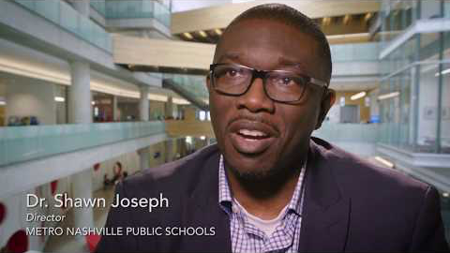
CASEL SEL video:

Slide 32
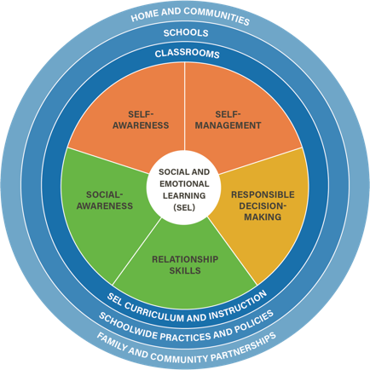
SEL Competencies Wheel (CASEL):

Slide 33
Framework for Systemic Social and Emotional Learning (CASEL):
Self-awareness: Know your strengths and limitations with a well-grounded sense of confidence, optimism, and a “growth mindset.”
Self-management: Effectively manage stress, control impulses, and motivate yourself to set and achieve goals.
Social awareness: Understand the perspectives of others and empathize with them, including those from diverse backgrounds and cultures.
Relationship skills: Communicate clearly, listen well, cooperate with others, resist inappropriate social pressure, negotiate conflict constructively, and seek and offer help when needed.
Responsible decision-making: Make constructive choices about personal behavior and social interactions based on ethical standards, safety, and social norms.

Slide 34
Benefits of SEL (CASEL):
Increased Academic Achievement: According to a 2011 meta-analysis of 213 studies involving more than 270,000 students, those who participated in evidence-based SEL programs showed an 11% point gain in academic achievement.
Improved Behavior: Studies show decreased dropout rates, school and classroom behavior issues, drug use, teen pregnancy, mental health problems, and criminal behavior.

Slide 35
Classroom Strategies
Building Relationships
Notes:
Although you don't have to create a special handshake for each of your students, greeting them at the door daily is an easy way to build relationships. This practice also clues you in to who will have a good/bad day and allows you prevent students from exhibiting negative behaviors by turning their day around before they enter the class.

Slide 36
Classroom Strategies
(Weinstein, Curran, & Tomlinson-Clarke, 2003)
Build caring and inclusive classroom strategies
  Greet students with a smile and a warm, welcoming comment.
  Greet second-language learners with a phrase from their culture.
  Shares stories about your life outside of school and let students share their interests and activities outside of school.
  Allow students to make choices and decisions about class activities and listen to their concerns or opinions.
  Deliberately model your respect for diversity by expressing admiration for students’ bilingual ability, praising the different languages represented in the classroom, and including examples of and content from a variety of cultures in your teaching.
  Communicate high expectations for every student and hold them accountable for high-quality academic work.
  Create a sense of community: illustrate to students how they are similar and different and engage students in morning meetings and cooperative learning activities.

Slide 37
Classroom Strategies (cont.)
(Weinstein, Curran, & Tomlinson-Clarke, 2003)
Organize your physical environment in a way that supports cultural diversity
    Use a map of the world to highlight students’ countries of origin.
    Welcome students with a sign or banner in the different languages that they speak.
    Use posters to depict people of various cultural groups (be sure to stay away from stereotypical images).
    Mount children’s individual pictures on posters to create a jigsaw puzzle to reinforce that everyone comes together to make the whole.
    Display in your classroom library books that promote themes of diversity, tolerance, and community.
    Arrange desks in clusters to encourage students to work together.
    Reinforce kindness and tolerance by having students drop kindness notes in the Kindness Box (randomly read notes aloud) and creating a bulletin board display that encourages students to commit “Random Acts of Kindness.”
Notes:
Think about the ways in which you can strategically use the environment to communicate respect for diversity, reaffirm connectedness and community, and avoid marginalizing and disparaging students.

Slide 38
Classroom Strategies (cont.)
(Weinstein, Curran, & Tomlinson-Clarke, 2003)
Establish clear expectations for behavior at the beginning of the school year
  Share three to six general rules for behavior with students at the beginning of the school year.
  Make sure that students understand what these specific behaviors look like, especially in culturally diverse classrooms because different cultures have different expectations for appropriate behaviors.
  Explicitly explain your expectations by engaging students in discussion about the class behaviors, modeling the expected behavior (share examples and non-examples), and providing opportunities for students to practice through role-playing.
Notes:
Positively state your rules. Tell students what they need to do versus what they shouldn't do. Example: “Walk at all times” versus “Do not run.” Set the expectation and be explicit when you set it. Allow students to model for you how each rule looks to them. You can also share examples and non-examples with them.

Slide 39
Classroom Strategies (cont.)
(Hambacher, 2015)
After you share your expectations, continually and consistently remind students of them all year
  Continually remind students of expectations at the carpet, in line, on the way to the library, at lunch, etc.
  Use subtle and direct reminders
    Develop “the look”
    Develop a hand signal that students recognize if “the look” doesn’t work for all students
    Explicitly state to a student your expectation, “I need you to . . . Thank you for . . . ”

Slide 40
Classroom Strategies (cont.)
(Weinstein, Curran, & Tomlinson-Clarke, 2003)
Communicate in culturally relevant/consistent ways with students and their parents (know the students’ ways of communicating and what’s effective)
  Be aware that differences in discourse style can have a direct effect on students’ behavior. For example, African American children and children from working-class families are used to straight-forward communication from authority figures versus the indirect discourse strategies that middle-class White teachers use (Delpit, 1995).
  Teachers may need to modify their discourse style to be consistent with the cultural backgrounds of their students.
  Use parents and guardians as resources to determine the type of discourse or communication style that will work best with students (stern/direct vs. positive reinforcement/compliments/encouragement).

Slide 41
Classroom Strategies (cont.)
(Weinstein, Curran, & Tomlinson-Clarke, 2003)
Collaborate with families
  Be aware that culturally responsive classroom managers understand that a lack of direct involvement reflects a differing perspective about parental responsibility rather than a lack of commitment to their children’s education (e.g., Asian American and Latinx families value education but view education as the responsibility of the school).
  Be aware that teachers and parents may have different expectations about what constitutes appropriate school behavior (e.g., teacher expects students to ask questions, debate and discuss, but parents from other cultures expect students to be quiet and obedient and not contradict their teacher and ask questions).
  Engage in genuine, meaningful two-way communication (e.g., ask parents for their feedback about how you can be effective with their child).
  Greet parents before you begin a conference, give parents time to think about how to respond to you to show sensitivity to cultural differences in communication styles.

Slide 42
Classroom Strategies (cont.)
(Hambacher, 2015)
Use humor:
  To respond to off-task behavior.
  To redirect students.
  To be proactive and non-punitive to deflect inappropriate behavior.
  To develop respectful and caring relationships with students.
  To share that you have students’ best interests at heart.

Slide 43
Strategies for individual students
(Hambacher, 2015)
Know your students’ cultural backgrounds (dig deep to get to know them on a personal level)
  Conduct student interviews.
  Develop relationships with families.
  Observe students as they interact with their peers.
  Incorporating these practices will assist you in learning about the following:
    Students’ impoverished living situations and how they affect students’ lives.
    Specific family struggles.
    Students’ strengths.
    How students learn best.
    Specific skills that need to be improved.
Notes:
You can also administer interest inventories or have parents complete them for younger students, which is an easy way to learn a lot about your students' interests in and out of school as well as their cultural experiences.

Slide 44
Strategies for individual students (cont.)
(Hambacher, 2015)
Co-create individualized action plans for student behaviors
  Students identify personal learning goals for themselves and action plans for reaching these goals.
  Meet with each student individually once every nine weeks and discuss their progress and steps they need to take to continue striving toward their goals.
  Allow students to generate action plans.
  Promote shared decision making, which supports students taking responsibility for their learning
  Co-create action plans to ensure that students understand hat skills such as organization, respect, and having a positive attitude are important for success in the classroom and in society.

Slide 45
Strategies for individual students (cont.)
Use behavior contracts
  Provides students with more one-on-one help, support, and intervention.
  Holds students accountable.
  Provides structure, routine, consistency, and organization.
  Promotes self responsibility.
  Improves students’ grades and accountability.
  Improves student buy-in.
  Increases student motivation and effort.
  Improves school/home communication.
Notes:
pbisworld.com

Slide 46
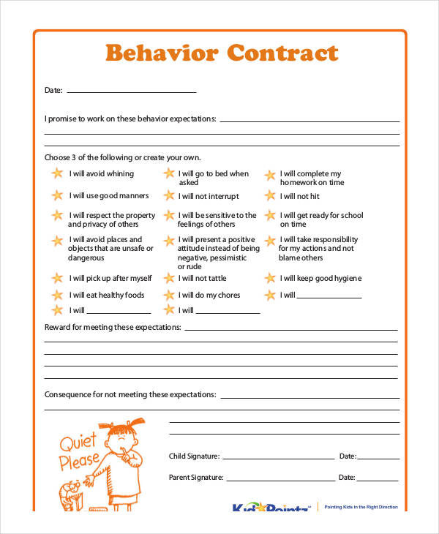
Strategies for individual students - Activity
Choose one of the behavioral contract examples from the link below and share a student that you would use the contract with and why you feel the contract would be effective in managing this or her behavior.
Behavior contract templates: http://www.pbisworld.com/tier-2/behavior-contract/
Notes:
Discuss with your group, and then share the different contracts they chose and why. Choose a spokesperson to share for your group.

Slide 47
Implications for student outcomes
Students receive an equitable education.
CRCM furthers social justice education.
One size does not fit all when disciplining students from culturally diverse backgrounds.
Being culturally responsive in our management practices leads to fewer discipline referrals for students of color.
Not being culturally responsive in our management practices leads to a disproportionate number of discipline referrals for students of color.
Notes:
What is social justice education? Teach your students about making positive change in the world by connecting with them, discussing real-world problems and multiple perspectives, creating classroom community, and including authentic assessment.

Slide 48

Debrief student outcomes
Why should teachers be aware of the student outcomes for implementing effective culturally responsive classroom management?
How do these outcomes positively impact your students and classroom environment?

Slide 49
Implications for teacher outcomes
How do your classroom management decisions promote or obstruct students’ access to learning?
Understand that culturally responsive classroom management is a frame of mind as much as a set of strategies or practices.
Culturally responsive classroom managers recognize their own biases/values and how they affect their interactions with students.

Slide 50
Implications for teacher outcomes (cont.)
Culturally responsive classroom managers ask themselves hard questions about how they treat students based on their cultural background.
Culturally responsive classroom managers work to know the cultures and communities of their students.
Culturally responsive classroom managers explicitly teach their students mainstream ways without making them feel that these ways are better than their own cultural ways.

Slide 51

Debrief teacher outcomes
Rank order the teacher outcomes from least to most important, and then justify your ranking.
Think of these in terms of the impact on students and how you interact with them.

Slide 52
DISCLAIMER
This content was produced under U.S. Department of Education, Office of Special Education Programs, Award No. H325A120003. David Guardino serves as the project officer. The views expressed herein do not necessarily represent the positions or polices of the U.S. Department of Education. No official endorsement by the U.S. Department of Education of any product, commodity, service, or enterprise mentioned in this website is intended or should be inferred.

