Slide 1
High-Leverage Practices
Using Data to Understand Students’ Needs and Inform Practice
(High-Leverage Practices 1 and 4)
Notes:
Good afternoon everyone and welcome to the fifth session in a series of High-Leverage Practices professional learning! We are thrilled you have chosen to join us today! Before we dive deep into the webinar, we would like to take a moment to introduce ourselves.

Slide 2
Facilitator Introductions

Slide 3
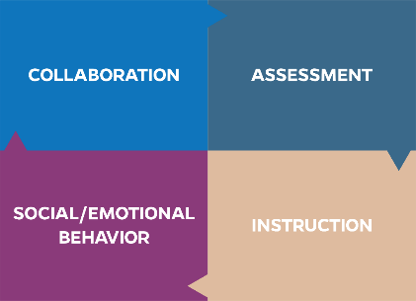
High-Leverage Practices
High-leverage practices (HLPs) are identified as specific teacher practices that are likely to result in improved student outcomes.
Notes:
As a reminder, high-leverage practices, or HLPs as they are commonly referred to, are identified teacher practices that are likely to result in improved student outcomes. HLPs consist of evidence-based strategies backed by decades of research. They are based on the premise that our students need teachers who are well equipped in each of four areas: collaboration, assessment, social/emotional behavior, and instruction. Effective educator practices often span across more than one area. Today we will discuss the role of collaboration, specifically diving into coplanning and analyzing student progress to make informed data-based decisions.

Slide 4
For Today
HLP 1: Collaborate With Professionals to Increase Student Success
HLP 4: Use Multiple Sources of Information to Develop a Comprehensive Understanding of a Student’s Strengths and Needs
Notes:
Resource from the book if needed:
HLP 1: Collaborate With Professionals to Increase Student Success: Collaboration with general education teachers, paraprofessionals, and support staff is necessary to support students’ learning toward measurable outcomes and facilitate students’ social and emotional well-being across all school environments and instructional settings (e.g., co-taught). Collaboration with individuals or teams requires the use of effective collaboration behaviors (e.g., sharing ideas, active listening, questioning, planning, problem solving, negotiating) to develop and adjust instructional or behavioral plans based on student data, and the coordination of expectations, responsibilities, and resources to maximize student learning.
HLP 4: Use Multiple Sources of Information to Develop a Comprehensive Understanding of a Student’s Strengths and Needs: To develop a deep understanding of a student’s learning needs, special educators compile a comprehensive learner profile by using a variety of assessment measures and other sources (e.g., information from parents, general educators, other stakeholders) that are sensitive to language and culture to (a) analyze and describe students’ strengths and needs and (b) analyze the school-based learning environments to determine potential supports and barriers to students’ academic progress. Teachers should collect, aggregate, and interpret data from multiple sources (e.g., informal and formal observations, work samples, curriculum-based measures, functional behavior assessment, school files, analysis of curriculum, information from families, other data sources). This information is used to create an individualized profile of a student’s strengths and needs.

Slide 5

HLP 4: Use Multiple Sources of Information to Develop a Comprehensive Understanding of a Student’s Strengths and Needs
Notes:
Informal and formal assessment measures, including ongoing progress monitoring, provide critical information for educators to make instructional decisions. Once data are collected, they have to be used to drive decisions. When we think of students both with and without disabilities, there are typically numerous adults involved in their education. General education teachers, special education teachers, parents and/or guardians, school psychologists, other service providers, English for speakers of other languages teachers, interventionists—the list goes on. Each individual holds critical information unique to his or her perspective.

Slide 6
Best Practice
Assessments should be sensitive to the importance of culture and ethnic backgrounds.

Slide 7
Assessment
Collect Information
Analyze data to create a learner profile
Interpret and communicate
Collaboratively create an educational plan
Ongoing adjustments to implementation

Slide 8

Analyze and Describe Students’ Strengths and Needs
Analysis of student strengths and needs is aligned with the evaluation criteria and/or assessed learning objectives.
Analysis goes beyond a list of students’ successes and errors; analysis explains students’ understanding in relation to their performance on the identified assessment.
Analysis identifies specific examples from
student work to demonstrate strengths
and needs.

Slide 9

Data-Based Individualization
Data-based individualization (DBI) is a research-based process for individualizing and intensifying interventions through the systematic use of assessment data, validated interventions, and research-based adaptation strategies.
For more information about DBI, see https://intensiveintervention.org/resource/breaking-down-dbi-process-questions-considerations.

Slide 10
Who Needs Intensive Intervention?
The following types of students need intensive intervention:
Students with disabilities who are not making adequate progress in their current instructional program
Students who present with very low academic achievement and/or high-intensity or high-frequency behavior problems (typically those with disabilities)
Students in a tiered intervention program who have not responded to secondary intervention programs delivered with fidelity

Slide 11
Think-Pair-Share
In what ways are Tier III or intensive interventions in your school different from special education services? In what ways are they the same?

Slide 12
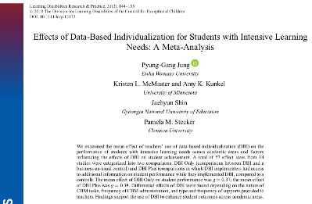
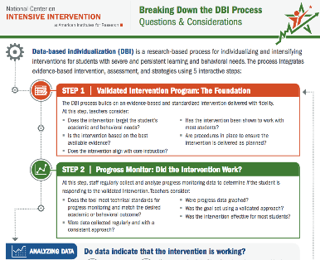
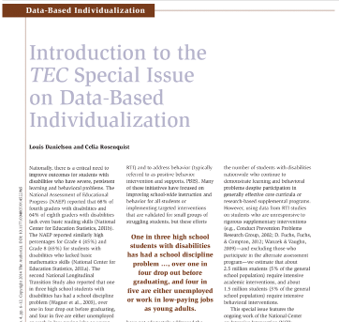
DBI Resources

Slide 13
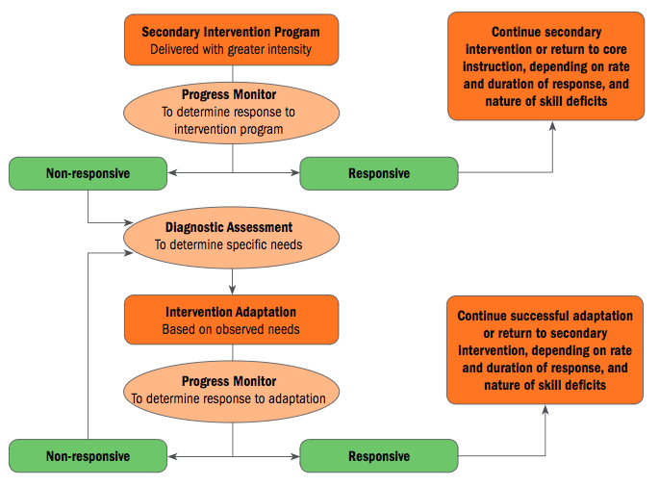
DBI Process: Five-Step Process
  Step 1: Validated Intervention Program
  Step 2: Progress Monitoring
  Step 3: Diagnostic Data
  Step 4: Intervention Adaptation
  Step 5: Ongoing Progress Monitoring
See https://intensiveintervention.org/sites/default/files/DBI_Framework.pdf for a detailed discussion on the DBI process.
Notes:
DBI is at the heart of a Multi-Tiered Support System and begins with a validated intervention program, which intensifies evidence-based core instruction for students.
Progress monitoring data are collected frequently throughout instruction to determine responsiveness to the intervention. If students are not quite responding, a deeper dive into underlying causes through diagnostic assessment occurs. Additional information, through both formal diagnostic data and informal observation, is used to make changes to instruction and adapt the intervention for individual student strengths and needs. After changes are implemented, progress monitoring needs to continue to determine the effectiveness of the instructional changes and determine next steps. If the intervention is effective, continue. If not, return to Step 3.

Slide 14
DBI Quick Share!
  Step 1: Validated Intervention Program
  Step 2: Progress Monitoring
  Step 3: Diagnostic Data
  Step 4: Intervention Adaptation
  Step 5: Ongoing Progress Monitoring
Talk to your partner. How do you see collaboration among stakeholders being a necessary component in making the DBI process effective?
Notes:
Considering the multiple steps involving data collection and analysis, how do you see collaboration among stakeholders (e.g., coteachers, administrators, parents) as a necessary component in making the DBI process effective?

Slide 15
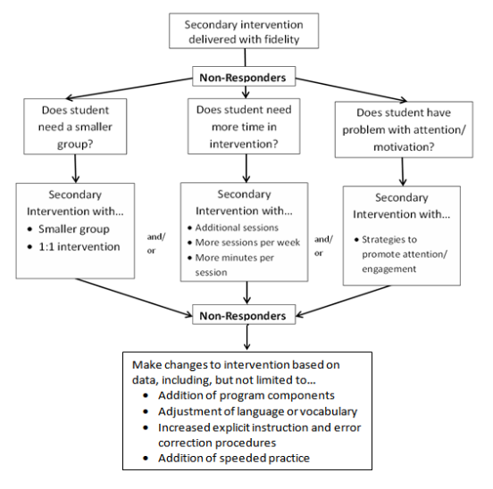
Sample Academic Intervention Progression

Slide 16
Secondary Intervention Program:
Student Example—Kelsey
Background: Kelsey presented with serious reading problems, reading at an early second-grade level at the beginning of fourth grade.
Intervention program: Kelsey’s teacher selected a research-validated program that addressed phonological awareness, word study, and fluency skills.
Notes:
Read slide.

Slide 17
Secondary Intervention Program: Kelsey
Fidelity
    Group size: six students
    Session length: 20–40 minutes per session
    Frequency: three to four sessions per week
    Program duration: 7 weeks
    Instructional content and delivery: explicit instruction covering all components laid out in the instruction manual
    Progress monitoring: Passage Reading Fluency (PRF)

Slide 18
Progress Monitoring: Does Kelsey Need DBI?
Reliable and Valid Tool: Kelsey’s teacher implemented formal progress monitoring using assessments that were a match for her reading skills.
Detect Improvement: This progress monitoring tool is appropriate to her skill level, allowing her teacher to detect changes in Kelsey’s reading.
Rate of Progress: Based on Kelsey’s progress monitoring graph, she was not progressing at the rate needed to meet her goal.
Notes:
Read slide.

Slide 19
Progress Monitoring: Determining Kelsey’s Need for DBI

Slide 20
Intervention Adaptation/Change
When appropriate, use data to make adjustments/adaptations to the secondary intervention program to meet the unique needs of the individual.
In some cases, however, data may indicate that the student requires a different intervention program or approach.
Consider two types of intervention change:
  Quantitative changes to setting or format
  Qualitative changes to delivery

Slide 21
Try Quantitative Change(s) First
    Increase intervention frequency, length of sessions, or duration.
    Decrease group size.
    Decrease heterogeneity of the intervention group.
Note: In many cases, quantitative changes may be necessary but not sufficient to facilitate progress for students with intensive needs.

Slide 22
Consider Qualitative Changes Second
Qualitative adaptations may be made to the intervention program to alter
instruction based on learner characteristics (e.g., addressing working memory or attention problems);
the skill level of the interventionist;
content delivery;
how students respond;
the amount of adult feedback and error correction students receive;
frequency/specificity of checks for retention; and
the materials, curriculum, or whole intervention (could be a complete change in program).

Slide 23

Intensify the Secondary Intervention: Begin With Quantitative Changes

Slide 24
Quantitative Intervention Adaptation:
Kelsey
Kelsey’s teacher intensified her instruction by adding an additional
15 minutes of instruction per session. Despite this change in intervention length, Kelsey continued to make insufficient progress.

Slide 25
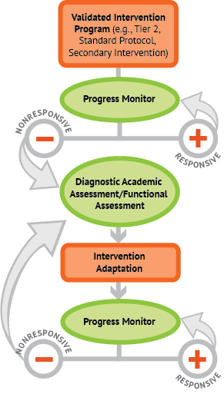
Diagnostic Assessment: What Changes Are Needed to Support Kelsey?

Slide 26
Informal Diagnostic Assessment
Progress monitoring assessments help teams determine when an instructional change is needed.
Informal diagnostic assessments allow teams to use available data (e.g., progress monitoring data, informal skill inventories, work samples) to help determine the nature of the intervention change needed.

Slide 27
Informal Diagnostic Assessment
Potential data sources:
Classroom-based assessments
Error analysis of progress monitoring data
Student work samples
Standardized measures (if feasible)

Slide 28
Informal Diagnostic Assessment: Kelsey
To determine the nature of the instructional change needed, Kelsey’s teacher conducted an error analysis of Kelsey’s most recent PRF data.
She also administered a phonics survey to determine Kelsey’s decoding strengths and weaknesses.
Notes:
Read slide.

Slide 29
Intervention Adaptation:
Use Diagnostic Information to Adapt the Intervention

Slide 30
Intervention Adaptation: Kelsey
Diagnostic assessment showed that Kelsey had difficulty applying decoding strategies to vowel teams. Her teacher applied the following intensive intervention principles to intensify her decoding instruction:
Incorporated fluency practice of newly taught terms, with specified mastery criteria
Provided explicit instruction and error correction
Frequently checked for retention with reteaching as needed
Notes:
Read slide.

Slide 31
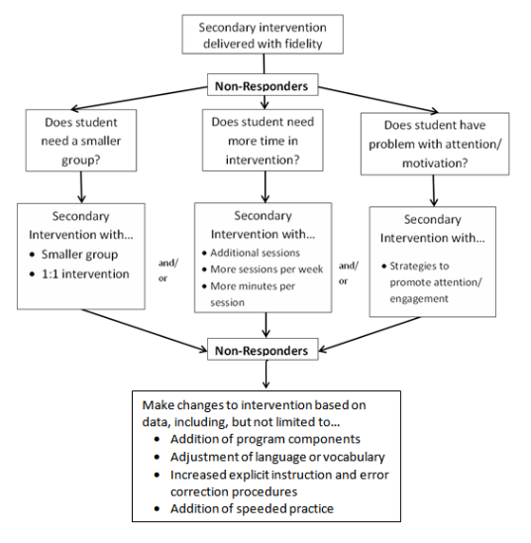
Kelsey’s Intervention Adaptation

Slide 32
Ongoing Progress Monitoring
Is Kelsey responding to the adapted instruction?
Is her response sufficient?

Slide 33
Evaluation of Kelsey’s Progress
Kelsey’s reading is improving but not fast enough to achieve her goal. Another instructional change is needed.
Kelsey’s teacher may collect additional diagnostic data if needed to make an informed instructional change.
Kelsey’s teacher will continue to collect progress monitoring data and meet with the intervention team to evaluate progress and modify the plan as needed.
Notes:
Read slide.

Slide 34
Turn and Talk
Work with a partner to recap HLP 4.
Provide one example of how you can use HLP 4 in the classroom.
Share with the group.

Slide 35

HLP 1: Collaborate With Professionals to Increase Student Success

Slide 36

Making Decisions Collaboratively

Slide 37
Defining Characteristics of Collaboration
Parity
  Teachers are equal partners
  Equally valued decisions and contributions
Mutual Goals
  Shared goal for the student
  Not everyone has to agree on how to reach goal
  Find common ground for reaching that goal
Voluntary
  Collaboration will not be successful if everyone does not want to be involved
  Seek advice from an administrator or a mentor
Shared Responsibility, Resources, and Accountability
  Share materials and resources
  Share responsibility of student outcomes
Source: Billingsley, Brownell, Israel, and Kamman (in press).

Slide 38
Coplanning
Planning
Assessing
Implementation
Reflecting

Slide 39
Coplanning and Coteaching
Coplanning strategies are designed to parallel coteaching strategies.
As with coteaching strategies, coplanning strategies are not intended as a hierarchy or progression.
Coplanning strategies can be selected to fit the needs of a given lesson and the needs of the coteachers.

Slide 40
Coplanning
We use coplanning as a model where two or more teachers
actively engage in planning,
agree on instructional goals and a timeline for instruction,
analyze assessment of student learning,
develop instructional tasks,
select or develop instructional tools, and
design an assessment plan.

Slide 41
Models of
Coplanning

Slide 42
Coplanning Strategies
One plans, one assists
Partner planning
One reflects, one plans
One plans, one reacts
Parallel planning
Team planning

Slide 43
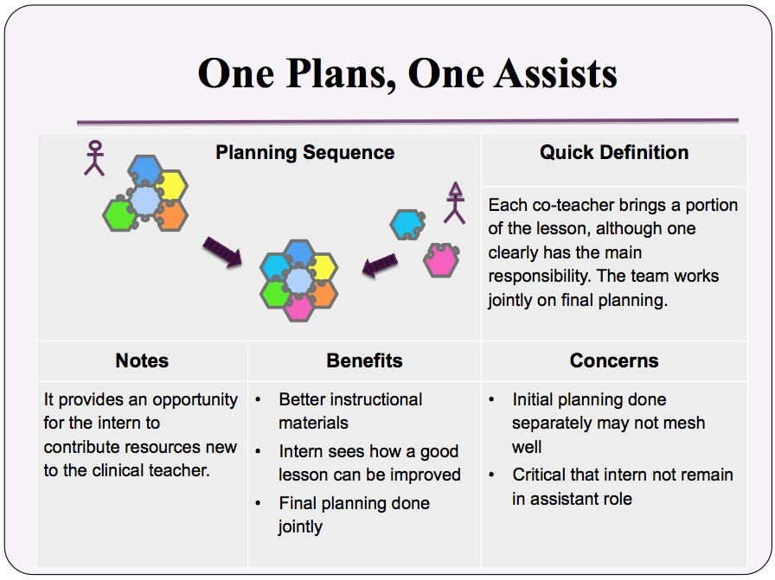
Slide 43
Source: Cayton, Grady, Preston, and Sinicrope (2016).
Notes:
Example:
Mentor develops the core of the lesson, whereas the fellow finds an applet that can be used to demonstrate a concept, brings some higher order questions from the literature to the planning session, finds a video of a real-world application, or changes the context of a problem to one more pertinent to high school students. The pair builds the lesson from these instructional components.

Slide 44
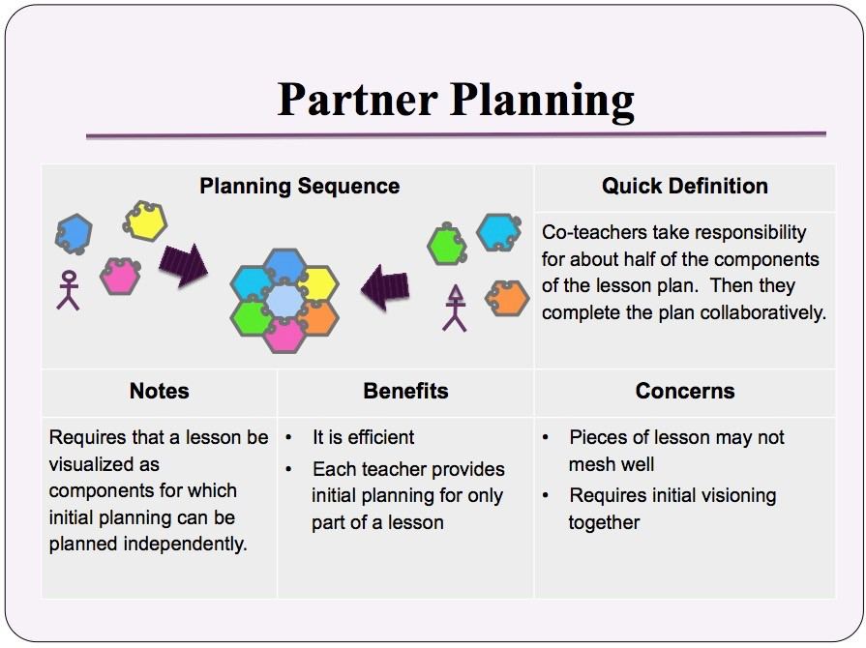
Slide 44
Source: Cayton et al. (2016).
Notes:
Coteachers take responsibility for about half of the components of the lesson plan. Then they complete the plan collaboratively.
Examples:
One teacher develops a hands-on task, and the other develops a presentation of the content.
Coteachers divide responsibility for the motivation, examples, assessment, and connections in a lesson.

Slide 45
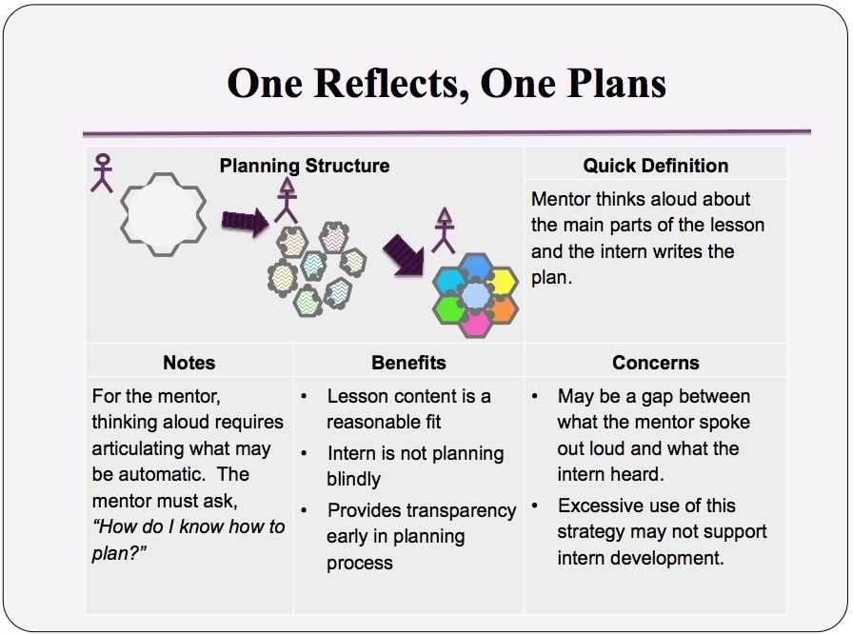
Slide 45
Source: Cayton et al. (2016).
Notes:
Examples:
Mentor reflects on a task to motivate a lesson on geometric transformations, discussing technologies that might be useful and pointing to a source of examples. Fellow writes the plan.
Mentor reflects on a task or activity to support the learning of atomic structure, etc.

Slide 46
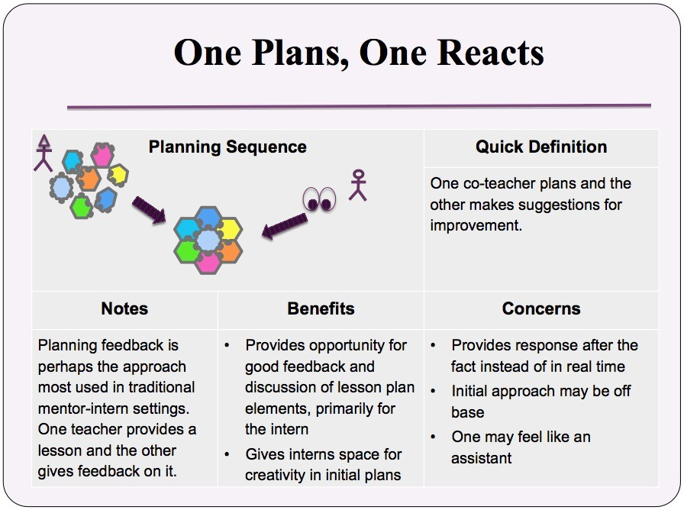
Slide 46
Source: Cayton et al. (2016).
Notes:
Planning feedback is perhaps the approach most used in traditional mentor-fellow settings. One teacher provides a lesson, and the other gives feedback on it. What might be different is for the mentor to provide a lesson for the fellow to reflect on and critique.
Examples:
The mentor prepares a lesson on solving systems of equations, and the fellow provides feedback on the set of examples chosen.
In chemistry, the mentor uses equations to solve stoichiometry problems. The colleague selects and works examples for the lesson; the mentor offers alternatives (examples or approaches).

Slide 47
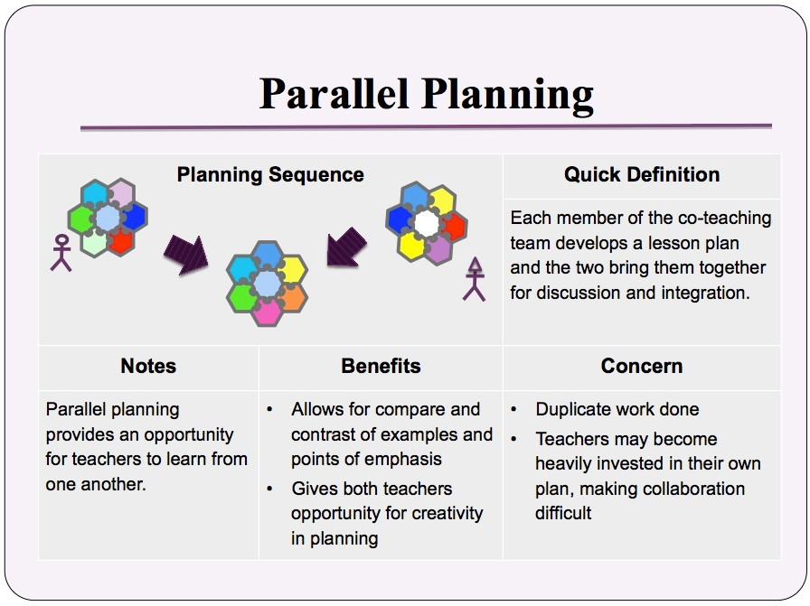
Slide 47
Source: Cayton et al. (2016).
Notes:
Each member of the coteaching team develops a lesson plan and then together they discuss and integrate both lessons into one plan.
Example:
Both teachers brainstorm independently to develop a lesson and then together create the plan to be implemented.

Slide 48
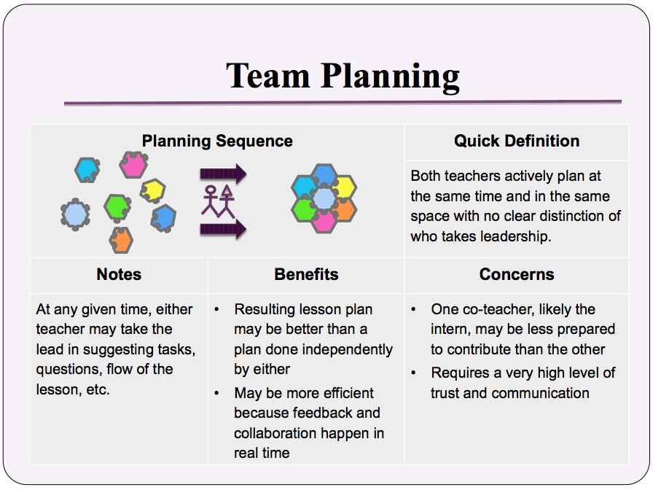
Slide 48
Source: Cayton et al. (2016).
Notes:
Both teachers actively plan at the same time and in the same space with no clear distinction of who takes leadership.
Example:
Coteachers plan a lesson by coming together with the lesson idea and a few notes on goals for the lesson. The coteachers discuss likely student difficulties, a possible sequence of tasks, and strategies for keeping the cognitive demand of the lesson at a high level.

Slide 49

Turn and Talk
Which version of coplanning seems most accessible in your settings?
  One plans, one assists
  Partner planning
  One reflects, one plans
  One plans, one reacts
  Parallel planning
  Team planning

Slide 50
Implementing Coplanning
Ensure time for planning.
Have a positive attitude.
Be clear and open about your strengths and limitations as you collaborate with your coteacher.

Slide 51
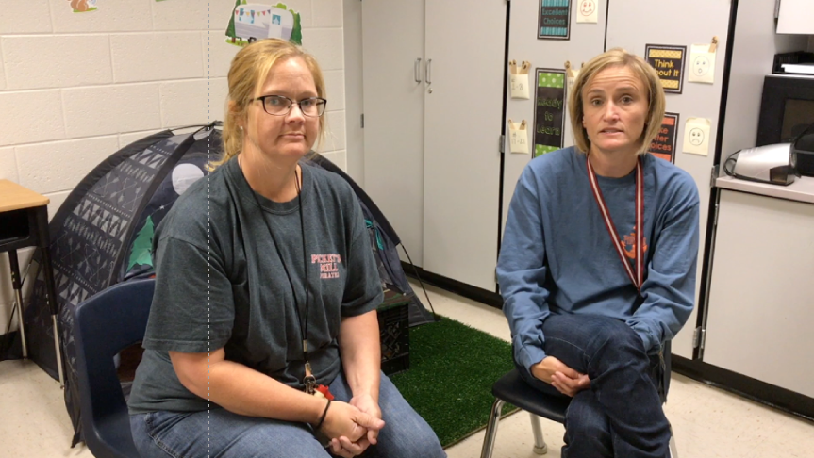
Turn and Talk
What strategy(ies) have you found to be most effective in promoting a positive coplanning relationship?

Slide 52
DBI and Coplanning
Collaboration requires the use of effective collaboration behaviors to develop and adjust instructional or behavioral plans based on student data.
Coplanning models create a structure that make developing data-based interventions possible.

Slide 53
Stakeholder Considerations

Slide 54
Considerations for Teachers
Consider the dynamics between novice and seasoned teachers.
Determine the role of preservice teachers and/or residents.
Shift the model to ensure equity and parity of teachers.
Consider which model is appropriate for the lesson or teacher needs.

Slide 55
Considerations for School Leaders
Create space in the schedule for collaborative planning to occur.
Facilitate review of the data collection procedure.
Review coteaching partnerships regularly.
Review coplanning and coteaching models frequently with teachers to remind them to select the model that fits the lesson or meets the needs of the teachers.

Slide 56
Considerations for Educator Preparation Providers
Integrate the DBI process in course content and fieldwork.
Provide opportunities for candidates to practice collaboration.
Model collaboration and interdisciplinary practice for candidates.

Slide 57
Turn and Talk
Work with a partner to recap HLP 1.
Provide one example of how you can use HLP 1 in the classroom.
Share with the group.

Slide 58
References
Billingsley, B., Brownell, M., Israel, M, & Kamman, M. (in press). A survival guide for new special educators. San Francisco, CA: Jossey-Bass.
Cayton, Grady, Preston, & Sinicrope (2016).
National Center on Intensive Intervention. (2013). Data-based individualization: A framework for intensive intervention. Washington, DC: U.S. Department of Education, Office of Special Education Programs. Retrieved from https://intensiveintervention.org/sites/default/files/DBI_Framework.pdf

Slide 59
Authors
The HLP Induction Professional Development Series was created by the following individuals:
  Wina Low, Karen Suddeth, and Karen Wyler, Georgia Department of Education
  Flavia Gordon-Gunter, Georgia Professional Standards Commission
  Lisa Hill, East Georgia Learning Resources System
  Jessica Simpson and Kristy Brown, Augusta University
  Stacy Arnold, Jefferson County Schools
  Michele Sherman, Columbia County Schools
  Meg Kamman and Amy Colpo, CEEDAR Center
  Melissa Driver, DaShaunda Patterson, Kate Zimmer, and Pam Wetherington, materials adapted from the Georgia’s High-Leverage Practices Webinar Series

