Slide 1
High-Leverage Practices Introduction to High-Leverage Practices Through a Multi-Tiered System of Supports
Notes:
Good afternoon everyone and welcome to the first session in a series of High-Leverage Practices professional learnings! We are thrilled you have chosen to join us today! Before we dive deep into the content, we would like to take a moment to introduce ourselves.

Slide 2
Facilitator Introductions

Slide 3
Slide 3
Session Structure
What is a Multi-Tiered Support System (MTSS?)
What are high-leverage practices (HLPs)?
How do HLPs fit within the MTSS framework?
What HLP resources are available and how do I use them?
What’s next?
Notes:
Let's take a moment to outline the structure of today. In this session, you can expect us to address five elements. First, we want to define and discuss two constructs that you might be hearing more about---Multi-Tiered System of Supports and high-leverage practices. After that, we will discuss the way that HLPs fit within the MTSS framework. This will include examples and implications for various stakeholders. Then we will offer and unpack a variety of resources that are available to support this work. Finally, we will close by giving you a heads up on what's next.

Slide 4
MTSS Statement of Purpose
MTSS is a framework that integrates assessment and intervention within a schoolwide, multilevel prevention system to maximize student outcomes for all learners.
Georgia’s Tiered System of Supports for Students is based on a problem-solving model.
Notes:
What is MTSS? A Multi-Tiered System of Support is a framework that integrates assessment and intervention within a schoolwide, multilevel prevention system to maximize student outcomes for all learners. In Georgia, you will hear MTSS referred to as Georgia's Tiered System of Supports for Students. This framework is intended to be inclusive of all students regardless of their ability level. It also is intended to consider the stakeholders in the system, including, for example, teachers, families, administrators, and support staff These are key players in ensuring that the system is working properly. It is important to note what we mean by the word system. Certainly, the system can refer to a school system, but, more importantly, the system refers to the structures that exist to support students or teachers, plus the protocols and procedures used to determine how and when supports are provided. It is the infrastructure that sustains your work.
This problem-solving model allows you to consider the following:
Who is at risk
Who is making progress
Who needs support
How do we know
You might find that you have already been considering these questions through processes such as response to intervention, or RTI. So what’s the difference?

Slide 5
MTSS, SST, and RTI: Are These Terms Synonymous?
MTSS is a system or framework that integrates assessment and intervention within a schoolwide, multilevel prevention system to maximize student achievement and reduce behavioral problems. It promotes systems alignment to increase efficiency and effectiveness of resources. (Adopted from Center on Response to Intervention, 2010)
Response to intervention (RTI) is a process in which schools identify students at risk for poor learning outcomes, monitor student progress, provide evidence‐based interventions and adjust the intensity and nature of those interventions depending on a student’s responsiveness, and identify students with learning disabilities or other disabilities. (Center on Response to Intervention)
A student support team (SST) is an interdisciplinary team or group that uses a systematic process to address learning and/or behavior problems of students, K–12, in a school. SST is unique to Georgia. (Georgia Department of Education)
Notes:
Ask audience to make a large circle with their arms; this is MTSS and it is a system.
Ask audience to make a tiny circle with their fingers: this is RTI and it is a process.

Slide 6
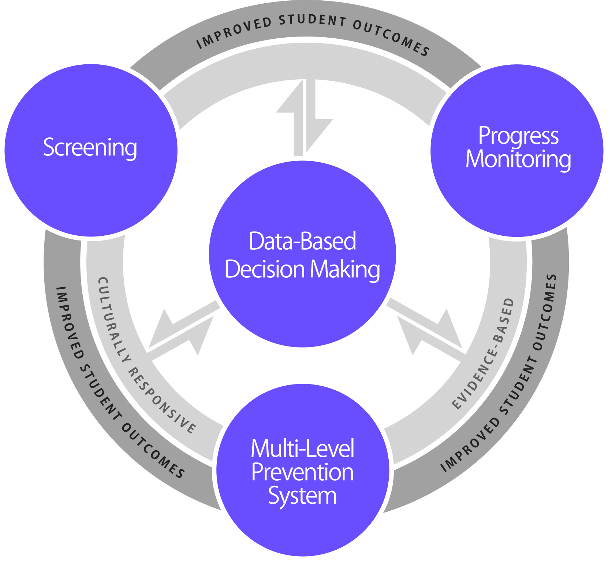
Essential Components of the Nationally Aligned MTSS Framework
Georgia added the
essential component of Infrastructure.
Supported by
District and School
Infrastructure
Notes:
The National Center on Response to Intervention (NCRTI) developed this graphic to highlight the essential components needed for this work. Many of you probably associate the red, green, and yellow triangle with RTI. In reality, the triangle does not represent the RTI framework; it represents only one component, the multilevel prevention system. The NCRTI graphic takes into account all the essential components and, most importantly, the use of data to make decisions, which often is absent from the traditional triangle.
If you look to the far left, you see screening; to the far right, progress monitoring; and at the bottom, the multilevel prevention system. The three outer components require and are necessary parts of data-based decision making, which is why the arrows travel in both directions. If the three other components are in place, but data-based decision making is absent, then Georgia’s Tiered System of Supports for Students is technically not being implemented.
In the center ring, you will see the phrase culturally responsive. The screening tools, progress monitoring tools, core instruction, interventions, and data-based decision making procedures should all be culturally responsive. In the same ring, you will notice the phrase evidence based, implying that all components are evidence based. If these components are implemented through a cohesive model, it is expected that student outcomes would be improved.
At the base of the graphic, you will notice that Georgia added the essential component of infrastructure. Ensuring the proper infrastructure is in place at both the school and district levels can help eliminate barriers to implementation.

Slide 7
Essential Components of Georgia’s Tiered System of Supports for Students
Screening
Progress monitoring
Multilevel prevention system
Tier I: Primary level (instruction/core curriculum)
Tier II: Secondary level (intervention)
Tier III: Tertiary level (intensive intervention)
Data-based decision making
Identify instructional needs for academics and/or behavior
Evaluate the effectiveness of core curriculum, instruction, interventions, and the framework
Determine movement within the multilevel system
Infrastructure
Notes:
As you saw in the definition, the NCRTI identified four essential components. Georgia adopted these four components and added a fifth essential component: Infrastructure.
Screening: a system for identifying students who are in need of enrichment or acceleration or who are at risk for poor learning or behavioral outcomes.
Progress monitoring: a system for monitoring the effectiveness of the supports provided to students.
Schoolwide, multilevel prevention system: at least three increasingly intense levels of instructional support.
Primary: core instruction and curriculum
Secondary: is in addition to the primary level and provides supports targeted to students’ needs
Tertiary: interventions that are more individualized and intensive than secondary
Data-based decision making
Instruction: determining, for example, who needs assistance (e.g., district, school, staff/teacher, student), what type of instruction or assistance is needed, and if the duration and intensity are sufficient.
Evaluating effectiveness: evaluating the effectiveness of the core curriculum and instruction for all students, interventions, and the Tiered System of Supports for Students.
Movement within the multilevel system: when to move students to something more or less intense, who is responding and/or not responding.
Infrastructure: leadership, effective teaming, professional learning, and family and community engagement.

Slide 8
Georgia’s Multilevel Prevention System
Students with disabilities, English learners, gifted
3% to 5% of students
Tier III: Tertiary Level of Prevention: Intensive Intervention
SST
15% of students
Tier II: Secondary Level of Prevention: Intervention
Tier I: Primary Level of Prevention: Instruction/ Core Curriculum
80% of students
Students receive services at all levels, depending on need.
Notes:
Remember, the model used in schools or districts is their interpretation of the framework. Regardless of the number of tiers of intervention that a school or district implements, each should be classified under one of the three levels of prevention: primary, secondary, or tertiary, which allows for a common understanding across schools, districts, and states. Georgia’s Tiered System of Supports for Students has three tiers, and practitioners should recognize that as the number of tiers increases, the complexity of the model also increases. In all models, all students receive instruction within the primary prevention level (the core curriculum), which often is synonymous with Tier I. Evidence-based interventions are provided in both the secondary level (Tier II) and the tertiary prevention level (Tier III).

Slide 9
What’s the Big Deal About a Tiered System of Supports for Students?
1.29 Effect Size
(that’s really large!!)
Improved Outcomes
Decreased expulsion, behavioral referrals, and suspension rates
Sustained academic improvement
Increased on-time graduation
Strong Positive Effects on System Outcomes
Increased instructional and planning time
More efficient use of resources and staff
Decreased inappropriate special education referrals and placement rates
Reduction in amount of time student receives special education services
Reduction in student grade retention
Sources: Burns, Appleton, and Stehouwer (2005); Dexter, Hughes, and Farmer (2008); Hattie (2015); Simmons et al. (2008).
Notes:
The overall MTSS effect size (ES) (original data, ES = 1.07; Hattie, 2015) was recently updated (ES = 1.29) and refers to the results of meta-analyses of RTI/MTSS studies conducted by John Hattie (https://visible-learning.org/hattie-ranking-influences-effect-sizes-learning-achievement/). The original list of 138 effects changed to 150 effects in Visible Learning for Teachers (2011), and then to a list of 195 effects in The Applicability of Visible Learning to Higher Education (2015). In November 2017, it was updated to include 252 effects and is based on more than 1,200 meta-analyses, up from the 800 when Visible Learning first came out in 2009. Determining the effect size of RTI/MTSS has been extremely challenging and, at times, controversial. Hattie offered an illustrative example of what is possible based on current meta-analyses at the school level. He suggested that anything greater than .4 is desirable in education.
Lead table talk around the last four bullet points. Ask groups to share out how they think MTSS implementation could impact these points/outcomes in their schools and districts. Clarify any misconceptions.
The following information can be shared with the group or used as a reference if participants have questions about this slide.
In a review of four studies (research-based and large-scale implementation), Burns, Appleton, and Stehouwer (2005) found strong effects on student academic outcomes and system outcomes (referrals to and/or placements in special education, student time in special education services, and the number of students retained in a grade) when a tiered system of support for students was implemented.
Dexter, Hughes, and Farmer (2008) found improved academic performance and a slight decrease in special education referral and placement rates after implementing a tiered system of support.
Simmons et al. (2008) found that students who were identified early as at risk and were provided additional reading supports had improved performance that was sustained across time.
NOTES FROM DISCUSSION
Researchers say that between a 0.6 and 0.8 is a large effect size.

Slide 10
What Are HLPs?
Notes:
So what exactly are high-leverage practices, or HLPs, as you’ll hear us reference throughout? In this next section of the webinar, we will build a common language for our work implementing HLPs in Georgia’s Tiered System of Supports for Students.

Slide 11
High-Leverage Practices
HLPs are identified as specific teacher practices that are likely to result in improved student outcomes.
“The HLPs can become the foundation of a cohesive, practice-based teacher education curriculum that incorporates repeated, scaffolded, effective opportunities . . .” (McLeskey et al., 2017, 9).
Notes:
In the simplest terms, HLPs are specific teacher practices that are likely to result in improved student outcomes, which is really why we are all here. We know from decades of educational research and our own field experience that certain actions, beliefs, and understandings are beneficial for students (and some are not). We also know that there are numerous best practices out there that may or may not have the evidence to back them up. Basically, there is a lot to sort through and decipher for teachers and those who support teachers. Through extensive work done by TeachingWorks out of the University of Michigan, the Council for Exceptional Children, and the Collaboration for Effective Educator Development, Accountability, and Reform (CEEDAR) Center, educators across the United States are narrowing in a set of core practices that are essential for teachers to know and implement. These are high-leverage practices.
The hope is by focusing on these crucial aspects of teaching, we can become even more strategic in our preparation and ongoing support for educators. HLPs have the potential to become the foundation of a cohesive, practice-based teacher education curriculum that incorporates repeated, scaffolded, and effective opportunities for practice.

Slide 12
HLPs Are . . .
Notes:
HLPs include essential skills for teachers to learn and practice. They are not an exhaustive list, and as you review the provided resources, you will see that they include many nonnegotiables for effective teaching (e.g., checking student understanding or building respectful relationships with students). We probably all agree that these things should be happening in the classroom.
There are plenty of beneficial teacher practices out there, but having a defined set helps narrow our focus for what teacher educators must introduce and provide purposeful practice for. Like any skill, preservice and inservice teachers must be introduced to the concept, have the opportunity to apply the learning, and regularly practice with meaningful feedback.
You’ll notice that there is a set of general and special education HLPs. We believe that all educators need both, and this webinar series will explore how they intersect and complement each other in the areas of collaboration, assessment, social and behavioral supports, and instruction. As you become familiar with these HLPs, remember that the special education set is not exclusively for special educators but for educators who work with students with disabilities. In our current educational landscape, where students with disabilities are increasingly being served in general education classrooms, this means this set of HLPs is for everybody: special educators, general educators, academic coaches, teacher leaders, and school and district level administration.

Slide 13
Four Categories
Notes:
HLPs are categorized into four intertwined components of teacher practices:
Collaboration—working with others to improve student achievement.
Assessment—monitor student progress (data-based decision making).
Social Behavior—manage and support student behavior across tiers.
Instruction—provide instruction across tiers.
In subsequent webinars, we will be diving deeper into some of these categories. We will explicitly define specific HLPs, how you can embed them within your instruction, and how this can look within your own school and provide practical materials to share with teachers, academic coaches, school and districts leaders, and teacher preparation programs.

Slide 14
Benefits of HLPs
Appropriate for all learners
Useful across content and subject areas
Established evidence base
Notes:
HLPs are essential dimensions of instruction. They are teacher practices that are essential to promoting improved outcome and are appropriate for all learners. HLPs are useful across all content areas and grade levels. And they are grounded in research and have sufficient evidence to make a positive impact.

Slide 15
Poll Time!
Which of the HLP categories are you most excited to learn about?
Collaboration
Assessment
Social/Behavioral
Instruction
Notes:
Of the four HLP categories—collaboration, assessment, social/behavioral, and instruction—which category are you most interested in learning more about?

Slide 16
How Do HLPs and MTSS Relate/ Work Together?

Slide 17
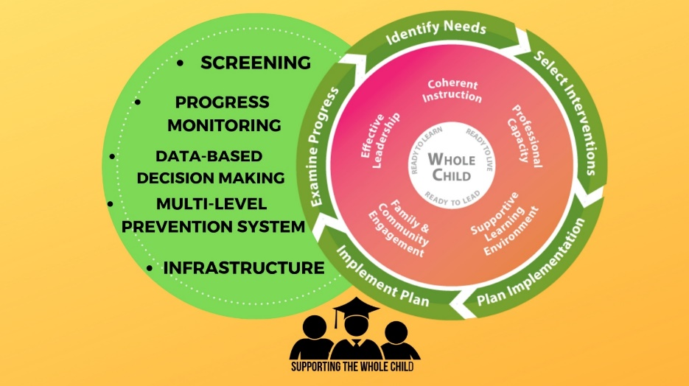
MTSS: Integrating the What and the How
Integrating the essential components of Georgia’s Tiered System of Supports for Students with Georgia’s Systems of Continuous Improvement

Slide 18
Georgia’s Multilevel Prevention System
SWD, EL, Gifted
3% to 5% of students
Tier III: Tertiary Level of Prevention: Intensive Intervention
SST
15% of students
Tier II: Secondary Level of Prevention: Intervention
Tier I: Primary Level of Prevention: Instruction/ Core Curriculum
80% of students
Students receive services at all levels, depending on need.
Notes:
Remember, the model used in schools or districts is their interpretation of the framework. Regardless of the number of tiers of intervention that a school or district implements, each should be classified under one of the three levels of prevention: primary, secondary, or tertiary, which allows for a common understanding across schools, districts, and states. Georgia’s Tiered System of Supports for Students has three tiers, and practitioners should recognize that as the number of tiers increases, the complexity of the model also increases. In all models, all students receive instruction within the primary prevention level (the core curriculum), which often is synonymous with Tier I. Evidence-based interventions are provided in both the secondary level (Tier II) and the tertiary prevention level (Tier III).

Slide 19
MTSS and HLPs
Collaboration
Assessment
Social/ Emotional/ Behavioral
Instruction
Notes:
Many educators associate MTSS with the following triangle. It is intended to represent the three levels of prevention and the percentage of students who would be expected to benefit from these levels of prevention in an effective system. Click for animation. The first level, or Tier I, is indicated in green. It is expected that most students, at least 80%, benefit from core curriculum delivered through differentiated instruction.
The next level, or Tier II, is supplemental to Tier I. Even with good instruction, it is estimated that approximately 15% of students will need supplemental, small-group instruction to benefit from the core instruction and curriculum.
The top level, or intensive instruction or Tier III, includes specialized, individualized systems for students with intensive needs. It typically involves small-group instruction of one to three students who are significantly behind their peers. It is estimated that approximately 3% to 5% of students will need intensive support.
If fewer than 80% of the students are benefiting from the current primary prevention system, schools should consider focusing school improvement efforts on improving the core instruction and curriculum. If a large percentage of students is in the Tier II or Tier III, consider implementing large-group instructional activities and system changes within Tier I to reduce the number of students requiring additional support.
Students with disabilities may receive supports throughout levels of the system, depending on their individual needs.
In the MTSS/Georgia's Tiered System of Supports for Students framework, the ways in which the tiers of support are used re-envisions the current use. Although the general distribution of the way students respond may not be different, the way that students are engaged and supported will be different. Supports may extend beyond students to their families or the teachers in their classrooms. Evidence-based interventions and high leverage practices may be made available in ways that are effective, efficient, and sustainable. HLPs are integral to this framework because these are the areas that have been substantiated to have meaningful and enduring effects on student outcomes and learning environments. As stakeholders work to identify practices within collaboration, instruction, social-emotional learning, and assessment, the HLPs are established as practices that result in meaningful outcomes.

Slide 20
Instructional Understandings About Evidence-Based Practices and Interventions
Evidence-based practices (EBPs) and interventions (EBIs) are generally content specific and result in positive impacts on academics and behavior.
Tessie Bailey, American Institutes for Research (tbailey@air.org)

Slide 21
What Are Evidence-Based Practices/Interventions?
Are Content Specific
Developmentally Appropriate
Learner Dependent
Supported by Research
Tessie Bailey, American Institutes for Research (tbailey@air.org)
Notes:
Clarify EBPs and EBIs
Examples:
Repeated Readings
Reading Mastery
Explicit Vocabulary Instruction
Check-In/Check-Out
Check and Connect

Slide 22
Implementing High-Leverage Practices and Evidence-Based Practices
When HLPs are coupled with EBPs/EBIs, they provide a continuum of supports that result in a rapid response to academic and behavioral needs.
http://www.teachingworks.org/work-of-teaching/high-leverage-practices

Slide 23
What HLP Resources Are Available and How Do I Use Them?
Notes:
So what are the resources available and how can you use them?

Slide 24
Available Resources
Crosswalk with HLP for general and special education and leadership standards: http://ceedar.education.ufl.edu/wp-content/uploads/2017/11/HLP-Crosswalk-with-PSEL1.pdf
This website explains and provides videos on HLPs: https://highleveragepractices.org/
A crosswalk with Georgia TKES and HLPs
Downloadable HLP Book and additional resources http://ceedar.education.ufl.edu/high-leverage-practices/

Slide 25
References
Burns, M. K., Appleton, J. J., & Stehouwer, J. D. (2005). Meta-analytic review of responsiveness-to-intervention research. Educational Psychology, 23(4), 381–394. https://doi.org/10.1177/073428290502300406
Dexter, D. D., Hughes, C. A., & Farmer, T. W. (2008).
Hattie (2015).
McLeskey, J., Barringer, M. D., Billingsley, B., Brownell, M., Jackson, D., Kennedy, M., . . . Ziegler, D. (2017). High-leverage practices in special education. Arlington, VA: Council for Exceptional Children and CEEDAR Center

Slide 26
References
National Center on Response to Intervention. (2010).
Simmons, D. C., Coyne, M. D., Kwok, O.-m., McDonagh, S., Harn, B. A., & Kame'enui, E. J. (2008). Indexing response to intervention: A longitudinal study of reading risk from kindergarten through third grade. Journal of Learning Disabilities, 41(2), 158–173. http://dx.doi.org/10.1177/0022219407313587

Slide 27
Authors
The HLP Induction Professional Development Series was created by the following individuals:
Wina Low, Karen Suddeth, & Karen Wyler, Georgia Department of Education
Flavia Gordon-Gunter, Georgia Professional Standards Commission
Lisa Hill, East Georgia Learning Resources System
Jessica Simpson & Kristy Brown, Augusta University
Stacy Arnold, Jefferson County Schools
Michele Sherman, Columbia County Schools
Meg Kamman & Amy Colpo, CEEDAR Center
Melissa Driver, DaShaunda Patterson, Kate Zimmer, & Pam Wetherington, materials adapted from the Georgia’s High-Leverage Practices Webinar Series

