Slide 1
Mitigating Special Education Teacher Shortages: A Multi-pronged, Strategic, Statewide Approach
Teacher Education Division
Council for Exceptional Children
11/8/2018

Slide 2
Presenters & Moderator
Moderator: Dave Guardino, OSEP
Presenters:
Mary Brownell, UF
Lynn Holdheide, AIR
Meg Kamman, UF
Jonte Myers, UF

Slide 3
Today
Background and research on shortages
Introduce Shortage Toolkit
Gain your feedback

Slide 4

Educator Effectiveness
Accountability systems don’t get schools out of needs improvement status, EDUCATORs do!

Slide 5
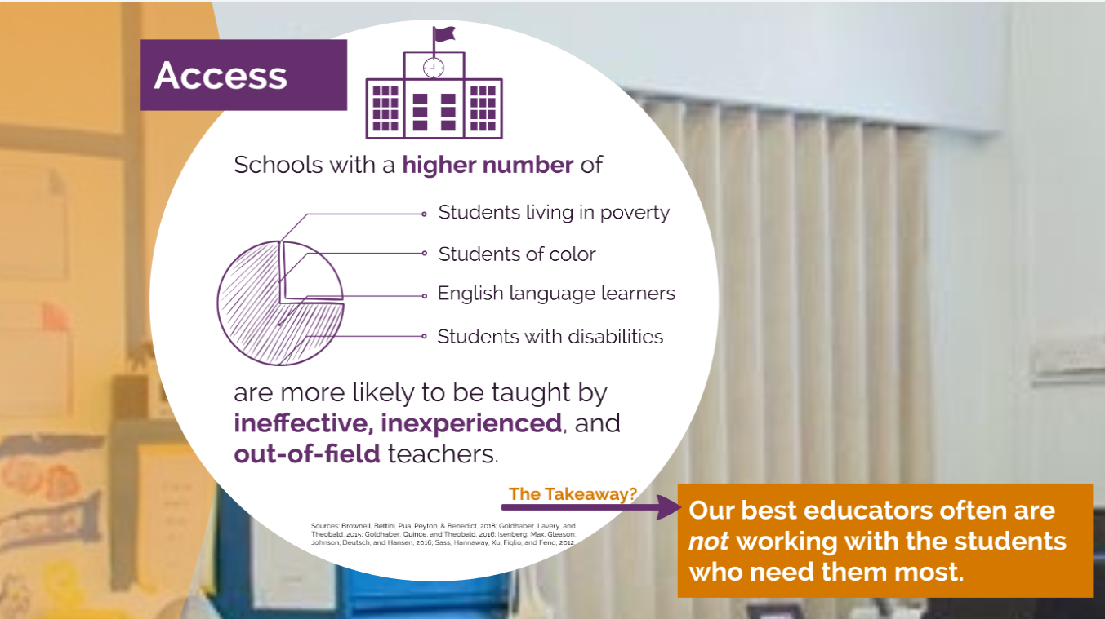
Equitable Access to Effective Teachers
Notes:
We all know that teachers matter – most particularly when it comes to student achievement. We also know that not all students have equal access to effective teachers – most particularly students that need it the most. With national shortages – most particularly in hard to staff schools and subjects – we cannot hire our way to equitable access. We need an infrastructure or systems of support to help all teachers grow in their professional practice.
Not all states included their definition of effective teacher within their state ESSA plan, but of those that did, 16 states are using evaluation data and results within their definition. While yes, many may think of this as just a reporting requirement, the definition of effective educators can be used to inform and target professional learning efforts.
A number of states mentioned their equity plans under the excellent educators for all initiative within their ESSA plans.
Tennessee and Oregon emphasize their equity plans as a basis for their ESSA plans. While other states like North Dakota and Delaware commit to expand the existing plan and strategies.
Building on their earlier equity plans allows states to capitalize on the significant stakeholder engagement they invested and the strategy implementation progress made to date. And it ensures that ESSA is not just another plan layered onto the others but rather part of a multi-year thoughtful, coherent vision for equipping all classrooms with the teachers they need.
ESSA allows the use of Title II Part A dollars to use funds for improving equitable access to effective teachers..if so, they must describe the purpose and report on the use of funds

Slide 6


What Matters?
SETs with a certificate from a preparation program or 30 hours of credit completion have higher student value-added scores in reading and math (Feng & Sass, 2013).
Experience has been linked to the effectiveness of SETs and early childhood teachers (Croninger, King, Rathbun, & Nishio, 2007; Feng & Sass, 2013).
Preparation
Experience
Having experienced and effective peers as colleagues influences the effectiveness of teacher candidates and the effectiveness of other peers (Ronfeldt, Loeb, & Wyckoff, 2013; Sin, Loeb, & Grissom, 2017).
Fully prepared special education teachers demonstrate more effective instruction than those teachers with little preparation (Nougaret, Scruggs, & Mastropieri, 2005)

Slide 7
Shortages
Notes:
This is what Buddy feels like when he is trying to fill the 3 vacant teaching positions at his school.

Slide 8
State responses to shortages
Nobody rises to low expectations!
Oklahoma and California have issued more emergency certificates
Arizona, Illinois, and Minnesota have lowered the standards
Arizona gave local school administrators the power to determine teacher certification
New York has allowed charter schools to certify their own teachers with less rigorous preparation
West, J. (2018). Calling All Teachers, Flexing your Advocacy Muscles to Address Teacher Shortages. MSLD Rethinking Behavior

Slide 9
Quiz – You know this!
Shortages in special education are….pervasive or rare
Schools have many or few choices
The students most impacted are advantaged or disadvantaged
Notes:
but to place individuals into classrooms that have little preparation to teach and with no classroom experience
Students most impacted are those already disadvantaged by virtue of attending low achieving, high poverty schools, where fully qualified teachers already are in short supply

Slide 10
Shortages of Special Education Teachers
In a small group answer the following questions
What are the implications of shortages on the field of special education and for students with disabilities?
If you were only able to select one strategy to fix shortages in special education, what would it be?

Slide 11
What should we do?

Slide 12

No Easy Solution
Select/Hire Me

Slide 13
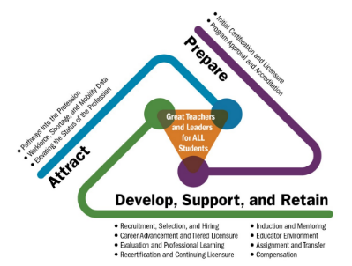
Educator Talent management
Framework that:
Addresses the career continuum
Considers unique contexts
Clarifies partner roles
Educator Talent Management Framework:
Center on Great Teachers and Leaders

Slide 14

Everyone takes a piece of the pie
Federal Education Agency
State Education Agency
Local Education Agency
Educator Preparation Programs
What is my role?
Notes:
The Challenge: The components of talent systems—such as hiring criteria, advanced roles and criteria, career paths, compensation and evaluation—are not simple for states to tackle; they are full of thorny issues related to tradition, turf, politics, and limitations on funding and capacity.
The Opportunity: A clear vision of an ideal talent system must map out a plan that will be achieved over time. Recently, states have endeavored to improve components of talent systems, sometimes by their own initiation and other times in response to mandates with defined parameters.

Slide 15



Shortage Toolkit
Phase I:
Short-Term Strategies
Phase II
Multi-pronged, long-term systemic Strategies
Notes:
Purpose: Just-in-time assistance to schools and districts that have had to place less-than-fully-prepared special education teachers into classrooms.
Purpose: Support state education agencies, local districts, and educator preparation programs to launch a collaborative effort to establish long-term solutions to address shortages specific to local contexts and where all partners are equally engaged and accountable.
Note: This phase acknowledges that while short-term support is provided to these educators, concurrent efforts to lay the foundation for longer-term solutions must occur.

Slide 16
Phase I: Short Term Strategies
Alternative Preparation Programs
Mentoring and Induction
Professional Learning
Micro-credentials
Real-time Support for Immediate “Pains”

Slide 17
Alternative routes – Quality Features
#1
Meaningful collaboration between institutes of higher education (IHEs) and districts
Adequate program length with cohesive learning opportunities
Adequate supervision from IHE supervising teachers and building-based mentors
Rosenberg & Sindelar, 2005

Slide 18
Alternative routes- Models
Typically meet Assurance 14 requirements

Slide 19
Internship Model – Key Features
Bachelor’s degree in any field
Coursework/ PD
Mentoring/Induction
Allows candidates to be the teacher of record
Fulfill state testing requirements
Duration generally up to 3 years
Notes:
Exemplar
Eligibility
28 hours teaching skills coursework
Course requirements
50 hours field experience
Training & Mentorship
Mentorship, Supervision, and Induction
Internship seminar
Test Requirements
Praxis Content Area Praxis PLT
edTPA

Slide 20
Residency model- Key Features
Requires Bachelor’s degree
Coursework/ PD
Mentoring/Induction
Candidates are not initially allowed serve as the teacher of record*
Fulfill state testing requirements
Duration generally up to 3 years
*May assume teaching role after first year in some cases
Notes:
Exemplar
Eligibility
Bachelor’s degree
At least 5 years of work experience
Qualifying test scores for subject
Training & Mentorship
Year I : Coursework-Pedagogy & Instruction + At least 180 hours of instruction, including field experience
Year II: Teaching position and mentorship
Test Requirements
Praxis Content Area Praxis PLT
edTPA

Slide 21
Mentoring and Induction –
Quality Features
#2
Rigorous mentor selection
Mentor training and ongoing professional development
Time for mentee/mentor interaction
Multi-year
Focus on improving instruction, data driven discussions
Ongoing beginning teacher professional development
Administrative support
Process for communication between stakeholders
Notes:
Billingsley, Bettini & Jones, in press
High leverage practices as a instructional framework for special education teacher induction

Slide 22
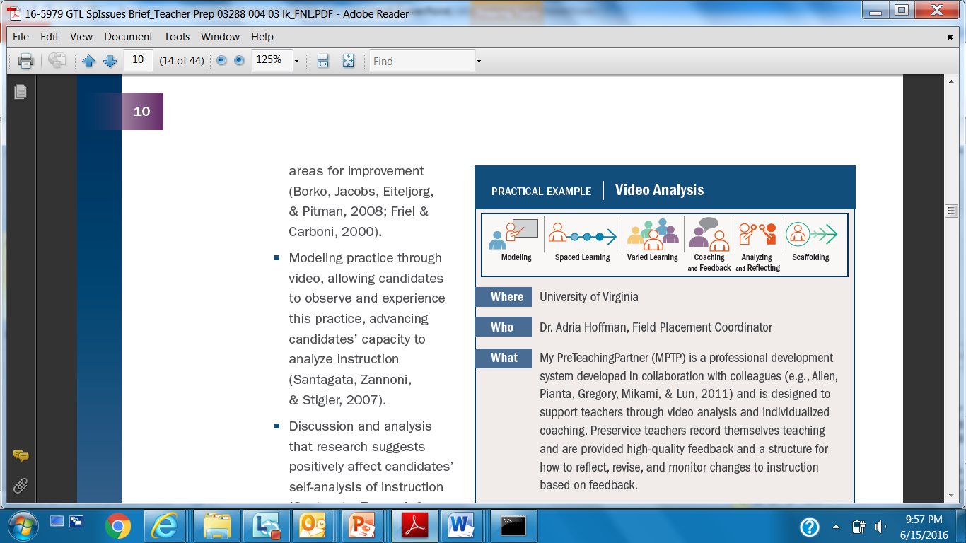
Practice-Based Opportunities & Professional Learning- Quality Features
#3

Slide 23
Micro-credentials- Quality Features
#4
Focus on skills related to teaching students with disabilities
Provide opportunities for educators to learn and demonstrate discrete skills
Recognize educators for mastery of skills with shareable micro-badges

Slide 24


Commonalities & Strategies
Commonalities
Partnerships
Mentor Selection & Training
Pedagogy – Instructional Strategies
Practice-Based Opportunities/Professional Learning
Design Strategies:
High-Leverage Practices
Practice-Based Opportunities

Slide 25
Decision-Guide & How to Guide
 | Role | Steps | Exemplars
What can the school leadership do?
What can the district do?
What can the Educator Preparation Program do?
What can the SEA do?

Slide 26
Phase II: Multi-pronged, long-term systemic Strategies
Notes:
Create a systemic approach to address teacher shortages specific to local context that does not compromise quality;
Facilitate strong networks and partnerships that establish shared ownership, collective action, and joint accountability;
Recognize that no two shortages are created equal and strategies designed to address local contexts and specific needs are needed;
Understand that shortages can be addressed and impacted anywhere across the career continuum.

Slide 27





Existing Educator Shortage Resources
https://www.ecs.org/wp-content/uploads/Teacher-Shortages-What-We-Know.pdf
https://teachershortage.solutiontoolkit.org/

Slide 28

Phase II: Comprehensive, systematic approach
Identification of strategies per gaps across the career continuum
Smorgasbord/diversification of the portfolio
Targeted strategy selection per unique contexts

Slide 29

Phase ii: Strategy Selection Facilitation Process

Slide 30

Gap Analysis
Is it a production problem? (Attract)
Is it an attrition problem? (Prepare and Support)
Is it a distribution/equitable access problem (Attract, Prepare, and Support)?
Center on Great Teachers and Leaders Data Tool to Establish an Diverse, Effective Educator Workforce
Center on Great Teachers and Leaders Data Tool to Establish an Diverse, Effective Educator Workforce

Slide 31
Multiple options based upon needs
Incentives and Loan Forgiveness
Five Year Preparation Programs with Practice-Based Opportunities
National Board Certified Teachers
Grow Your Own Programs
Sign-on Bonus
Paraprofessional Step Up Programs
Competitive Compensation
Teacher Leadership
Quality Professional Learning Systems

Slide 32
Toolkit Feedback
Phase I
  What other short-term strategies should be included/considered in supporting less-than prepared teachers?
  What are some innovative ways that EPPs can or have engaged in short-term solutions?
Phase II
  How can the tool be used to establish regional partnerships to address shortages per unique contexts?
  What role can or have EPPs play(ed) in creating a multi-pronged, long-term approach to addressing shortages? Are there policies/requirements that prevent innovative solutions? What innovative solutions are already underway?

Slide 33
Questions

Slide 34
DISCLAIMER
This content was produced under U.S. Department of Education, Office of Special Education Programs, Award No. H325A170003. David Guardino serves as the project officer. The views expressed herein do not necessarily represent the positions or polices of the U.S. Department of Education. No official endorsement by the U.S. Department of Education of any product, commodity, service, or enterprise mentioned in this website is intended or should be inferred.

