Slide 1

Improving teacher preparation from within: Using data to validate and improve practice-based preparation opportunities

Slide 2
Presenters
Mary T. Brownell, CEEDAR Director, University of Florida
Amber Benedict, University of Florida
Melinda Leko, Chair, University of Wisconsin Madison
Cara Richards-Tutor, California State University at Long Beach
Brian Barber, Kent State University

Slide 3

DISCLAIMER
This content was produced under U.S. Department of Education, Office of Special Education Programs, Award No. H325A120003. Bonnie Jones and David Guardino serve as the project officers. The views expressed herein do not necessarily represent the positions or polices of the U.S. Department of Education. No official endorsement by the U.S. Department of Education of any product, commodity, service, or enterprise mentioned in this website is intended or should be inferred.

Slide 4
Practice-based Teacher Preparation
High leverage practices (HLPs) and select evidence-based practices (EBPs) serve as the curriculum
Practice based preparation allows for the thoughtful implementation of HLPs and EBPs

Slide 5
Practice-based preparation
Involves a cohesive and carefully curated set of practice opportunities designed to help preservice candidates acquire the curriculum.

Slide 6
Individual Features of the opportunities
Modeling
Feedback
Analysis
Interleaving

Slide 7
Overarching features
Scaffolded
Duration
Cohesion

Slide 8
Although practice-based preparation is generating enthusiasm, we still do not have programmatic evidence of its impact (Brownell, Benedict, Leko, Peyton, Pua, & Richards-Tutor, under review).
And, we do not have systematic ways of collecting data that can be used to improve it!

Slide 9
Improvement Science Approach
To guide their efforts, teacher educators need ways of collecting data to design, implement, and improve their practice-based approaches
And, to demonstrate that these approaches are having the desired impact

Slide 10
CSU Long Beach
Dr. Cara Richards-TuTor

Slide 11
CSU Long Beach
Urban Dual Credential Program
Two year clinical residency-like program
Earn both elementary and education specialist credential
Undergraduate and post-bac options
Grounded in MTSS Framework
Strong Partnerships with school districts and schools
Notes:
Here would be a good place to discuss how school district partners use MTSS and that it is a mutual beneficial partnership.

Slide 12
HLPs Addressed
HLP #1: Collaborate with professionals to increase student success
HLP #6: Use student assessment data, analyze instructional practices, and make necessary adjustments that improve student learning
HLP #12: Systematically design instruction toward a specific learning goal
HLP #16: Use explicit instruction
HLP #20: Provide intensive instruction
HLP #22: Provide positive and constructive feedback to guide students’ learning and behavior

Slide 13
Example of One Practice Based Opportunity:
Tier 2/Tier 3 Intervention
Year 1, Semester 1 (Clinical Practice Rounds) | Year 1, Semester 2 (Clinical Practice Rounds) | Year 2, Semester 3 (Student Teaching) | Year 2, Semester 4 (Student Teaching)
Collaboratively develop two tier 1 lessons with input from classroom teachers and faculty using lesson study approach Teach lessons and receive feedback | Coursework in assessment and literacy (intervention) Collaboratively plan with “grade level team” small group intervention instruction for tiers 2/3 | Coursework in Mathematics Collaboratively plan with “grade level team” small group intervention instruction for tiers 2/3 | High leverage practices checklist for student teaching Apply intervention in ”true context”, not for a course assignment
First lesson: Basic comprehension skill, e.g., main idea Second lesson: More complex comprehension skill, e.g., compare and contrast | Critical Content: Reading (PA, phonics, fluency, vocabulary or comprehension) Critical Pedagogy: data-driven decision decision making; intervention—direct instruction, corrective feedback | Critical Content: Mathematics (number sense, word problems, algebra) Critical Pedagogy: data-driven decision decision making; intervention—direct instruction, corrective feedback

Slide 14
Data Collected to inform revisions

Slide 15
Fidelity Data: 2 years
Observation Protocol: modeling, many opportunities to respond, praise, corrective feedback
Observed at least 20% of lessons
Average fidelity scores from first intervention experience=93% Year 1: 82%-100%, Year 2: 71%-100%
Almost all candidates improved to 100% by end of first intervention practice opportunity (4 weeks, 8 intervention lessons)
Notes:
getting higher fidelity as intervention moved on; area of difficulty was corrective feedback and opportunities to respond; candidates who were working with more complex skills like vocabulary and comprehension struggled more with corrective feedback
Component
Stated the objective for the activity.
Gave clear directions.
Modeled each activity prior to guided practice.
Activities were broken down into steps for students.
Provided corrective feedback using staircase.
Provided verbal praise for correct responses.
Students had many opportunities to respond.

Slide 16
K-5 Student data
88 percent of K-5 students in intervention made growth on at least one target skill from DIBELS assessments (reading).
Younger students (K-1) made more growth than older students (2-5).
Notes:
Still need to analyze difference between student in special education and general education.

Slide 17
Candidate Interviews
  Data helped individualize intervention
  Collaborating with classmates helped get ideas to use for my students
  Individualizing the intervention allowed me to meet students’ needs
  Conducting the intervention helped us to feel we were making a difference and helping students succeed
Notes:
Candidates felt empowered that they could create change and be effective
Collecting baseline data: What was helpful about this step of the intervention process? Why? What was challenging? Why?
How did you feel about collaborating with your classmates in discussing data and designing intervention? Challenges? Benefits? What do you think the impact of this was on your intervention and ultimately your students?
Did the data you collected before and during intervention help you plan intervention? How so? Do you think you would use data like this in the future?
What do you believe were the key elements to delivering your intervention?
In class we discussed the following key components of intervention: Which did you find we fairly easy to implement? Which were difficult?
What was your overall take away from this process of implementing intervention

Slide 18
Further Considerations for Program Improvement
Consider collecting same data for math intervention, but there are issues.
Consider reliability across master teachers and university faculty related to intervention for the purpose of professional consensus and feedback
Develop/use a data guide to more strategically help candidates make decisions about instruction during collaborative team time (if school site uses one that directly aligns).
Notes:
While collect data in student teaching on HLPs (one being intervention) do not focus on this level of details in regards to intervention, how can we also collect this data…not overwhelm university supervisors and master teachers
…are we in agreement regarding what we see and therefore guide candidates similarly.

Slide 19
KENT STATE UNIVERSITY
Dr. BRIAN R. BARBER

Slide 20

School-University Partnerships to Promote Ongoing and Reciprocal Training in Effective Classroom Management
Project funded by the Ohio Dean’s Compact on Exceptional Children
Establish partnerships for teacher preparation through university-public school partnerships as contexts for mutually beneficial learning, or “simultaneous renewal” ¹
Project SUPPORT creates shared opportunities for teacher learning and development that are embedded in practical activities related to analysis of P-12 student behavioral outcomes
¹ Goodlad (1994)

Slide 21

Align District and preparation program Priorities
District priorities:
Maintain excellence in teaching by developing data based decision-making skills
Improve technology skills of staff
Utilize expertise of Kent State faculty to improve instruction
Use staff expertise to share knowledge and information through site based inservice
Improve staff classroom management skills
Reduce use of punitive disciplinary practices, such as suspension

Slide 22
Clinical Practice Developmental Continuum
Instructional Foci By Year |  | Learning Objectives | Practice-Based Activities
Y1 | School Systems, Instructional Planning & Delivery Models | Professional Problem Solving & Collaboration, Content Knowledge | Teaming, Co-teaching, Peer Tutoring
Y2 | Universal Instruction and Supports | Evidence-based & High Leverage Practices | Classroom Management, Whole Group Instruction
Y3 | Selected Instruction and Supports | Data Literacy, Risk Assessment, Early Warning Signs | Small Group Instruction
Y4 | Intensive Instruction and Supports | Data-based Individualization | Evaluation Team Reports/Individualized Education Programs, 1:1 Instruction

Slide 23
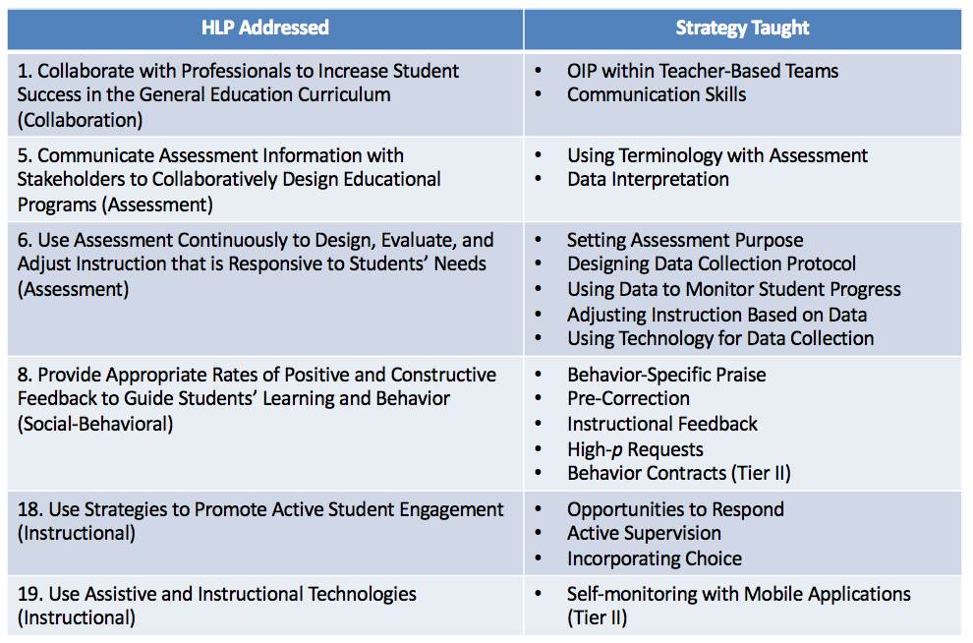
HLPs in Clinical Practice

Slide 24
Engagement Structure
  Student pairs rotate across pods/grade levels to cooperating teacher “strategy experts” every 3 weeks
    Per teacher – 2 preventive, 1 responsive CM strategy
    10 total CM strategies (8 preventive, 2 responsive)
  Strategies selected by pods based on data review, re-evaluated each semester
  Teacher & faculty set time for weekly data review meetings
  Faculty available on-site during practice sessions for observations/consultation
  Students receive, in total, immersive instruction and practice across grade levels with 8 universal, low-intensity CM strategies, while practicing skills associated with 6 HLPs

Slide 25
Revisions Made During and After Implementation
Data revealed ”corrective feedback” was element most often not used. Individual candidates discussed more in class had it modeled as they delivered intervention.
Interviews revealed data analysis helped learn to individualize. We tightly aligned assessment and intervention courses to better support this skill.
K-5 data indicated older students made less growth. Spent additional time on content related to higher level decoding and reading comprehension interventions.
Based on interviews we provided candidates more structured opportunities in assessment and intervention courses to collaborate.

Slide 26
Candidates’ Observed use of practices
  Use of practices and associated change in instances of off-task behavior
  Percentage decrease in classroom off-task behaviors by strategy implemented by candidate (aggregated across 16 candidates)
    Pre correction 7.9%
    Opportunities to Respond 21.7%
    High Probability Request Sequences 10.6%
    Actionable Feedback 23.1%
    Behavior Specific Praise 11.3%

Slide 27
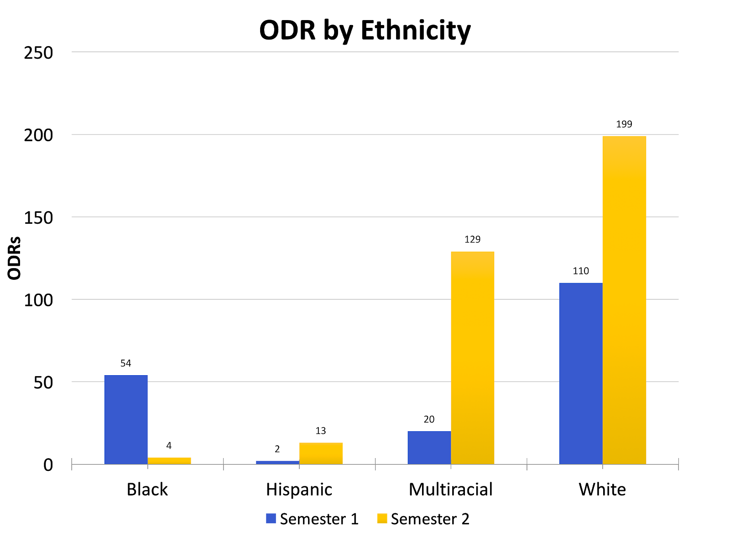
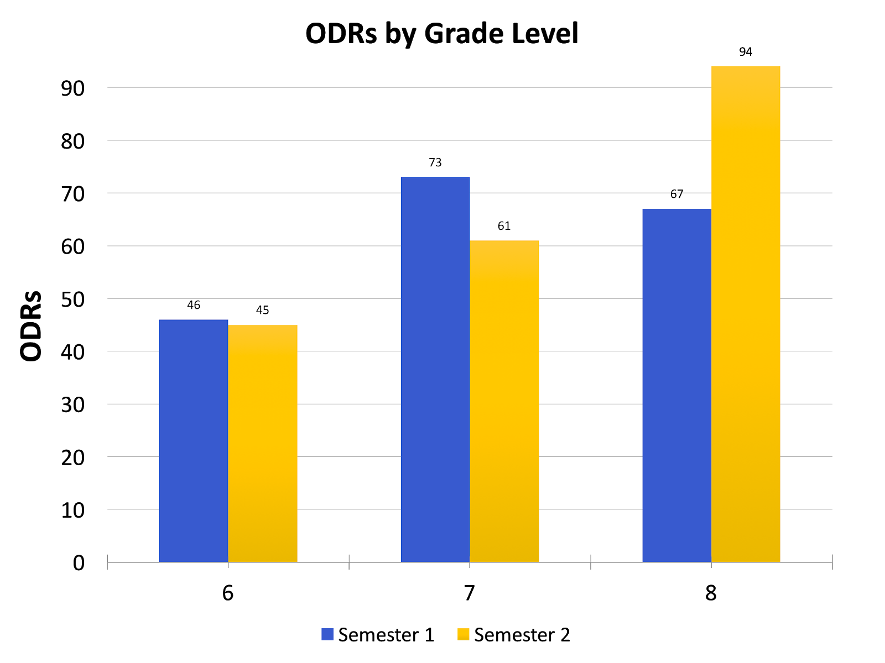
Relation to School-wide ODR data

Slide 28
Teacher & Candidates’ ratings of practices
Teachers and candidates completed Usage Rating Profile-Intervention (UPR-1) after learning each practice during PD training, and at semester’s end
Six factors of analysis for each practice
  Acceptability*
  Understanding*
  Home-School Collaboration
  Feasibility*
  System Climate
  System Support
“Strongly disagree” (1) to “Strongly Agree” (6) Scale

Slide 29
Focus Groups
Teachers
Practice opportunity should be a dedicated course – allowing for more time for observation and getting acclimated to students and the content.
  “If I had a recommendation, I think this should be done in a student teaching or some sort of long term experience so they can one, know the teacher, two, know the students, three, know the content”

Slide 30
Focus Groups
Candidates
Noted [it] would be better as a dedicated field experience course.
  “….because we don’t have a class on classroom management I feel more equipped now to go into Field II and student teaching.”
  “I feel like all in all this field experience was like a much needed one especially since like behavior issues in the classroom is like the number one thing to make teachers not to be teachers anymore”

Slide 31
Limitations
Priority was professional development and training
Design limitations
  Small sample (n = 6 teachers, 18 candidates)
  Training done simultaneously for all teachers
  Each teacher self-selected as a “strategy expert” (e.g. non-random)
Data Collection
  Responsive strategies (e.g. Precision Requests) had to be preceded by a problematic behavior - > which did not occur consistently
  Difficulty reaching 80% criteria on Inter-observer agreement

Slide 32
Data-based revisions
SUPPORT now operates as an independent course during Year 2 of program
Each student (n=26) works with a participating pod in two 4-week cycles, focusing on three strategies per cycle

Slide 33
Data-based revisions
Each cycle includes:
  Observation of teachers using specific classroom management strategies
  Planning a brief lesson with team that includes opportunity to incorporate the strategy
  Teaching brief lesson in which the specific strategy is practiced
  Observing and collecting data on a peer during teaching demonstration (using app)
  Working with teachers to analyze data that was collected during teaching demonstration
  Completing online activities using PowerschoolTM LMS

Slide 34
Conclusions
Programs were clear about the instructional practices (EBPs and HLPs) they wanted teacher candidates to demonstrate
Had clear theories about how those practices would develop; the theories were research based
Used data to refine program

Slide 35
Challenge
This is intellectually demanding and logistically challenging work.

Slide 36
Improvement Science in Teacher Education
Requires a more comprehensive approach to program development and study.
  Where is the place for this sort of scholarship?
  How do we ensure that the work we are doing has merit and is rigorous?
  How can we ensure it adds to the advancement of our knowledge in teacher education?
  How can we educate chairs and administrators about its importance?

