Slide 1
HLP Component: Assessment The Gift of Feedback and Guidance to Support Student Learning
Dr. Carla Tanguay
Associate to the Dean for Clinical Practice
Georgia State University
ctanguay@gsu.edu

Slide 2
“When a teacher teaches, no matter how well he or she might design a lesson, what a child learns is unpredictable. Children do not always learn what we teach. That is why the most important assessment does not happen at the end of learning – it happens during the learning, when there is still time to do something with the information.”
–Dylan Wiliam, 2011
Notes:
https://www.youtube.com/watch?v=9zFmHeUcHXE&feature=youtu.be
Many people have a negative view of assessment. They think of assessment is taking a test. Given the current climate in many locations, assessment for teachers provides anxiety, sometimes for students, but assessment is really a good thing. It is a critical part of ensuring that as educators we are leveraging student strengths and meeting student needs.

Slide 3
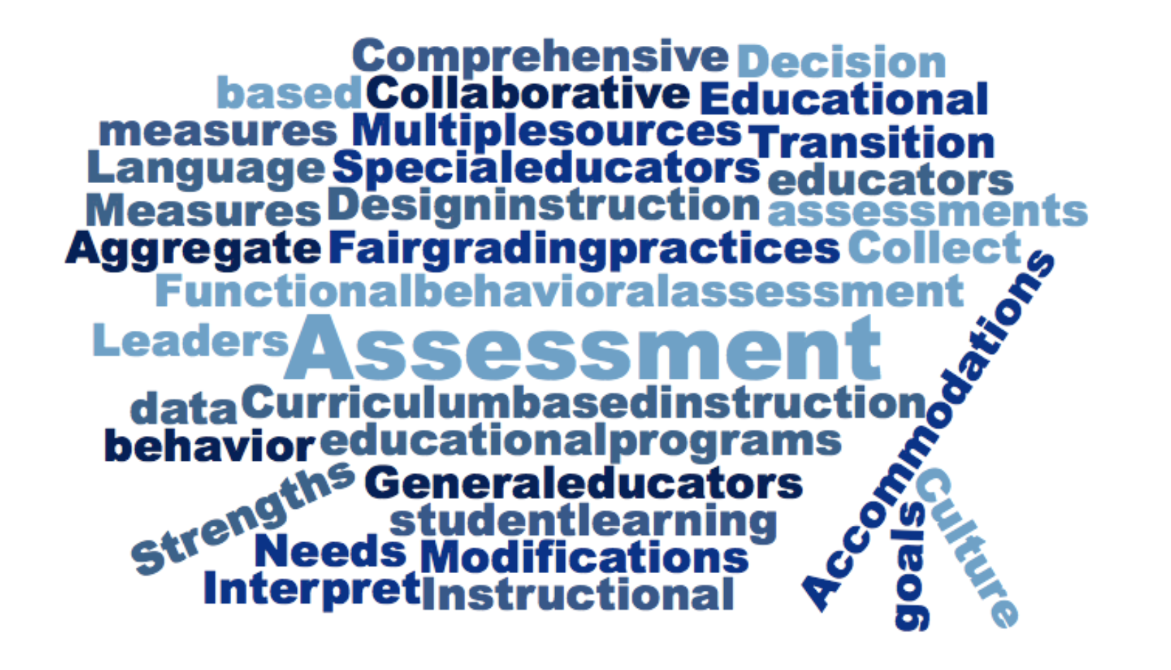
CEEDAR Center
Notes:
Assessment is complex and because it guides educational plans, instruction and student learning- so we want to make sure we get it right.

Slide 4
HLPs: Assessment
Collect Information
Analyze data to create a learner profile
Interpret and communicate
Collaboratively create an educational plan
Ongoing adjustments to implementation
CEEDAR Center
Notes:
Assessment is also not a one and done event. Assessment is a process, that is ongoing. Many teacher candidates come into their programs and field experiences with experiences about assessment that are not aligned with the idea of a process. It is our job to help our teacher and leader candidates have experiences in using assessment to guide educational programing and student learning

Slide 5
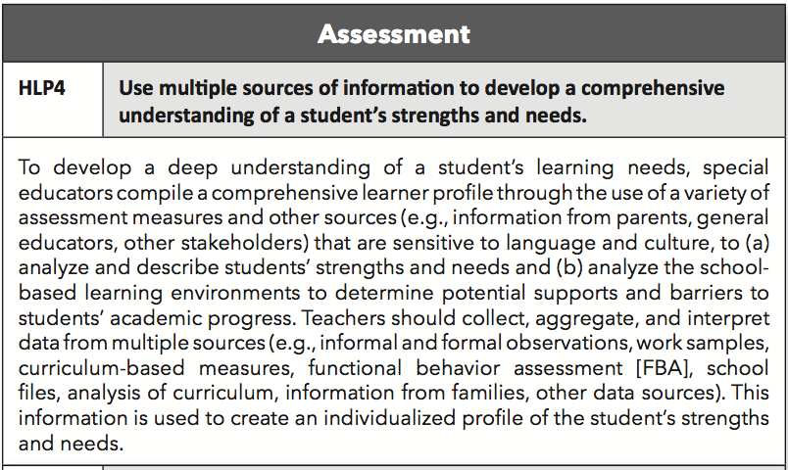
Sample activities and experiences:
Identify appropriate measures from multiple sources
Analyze real student data related to the creation of a lesson or unit
Use real and simulated case studies of students to create learner profiles using assessment data
Use Examples and Non-Examples to reflect culture and language challenges
McLeskey, et al. 2017; CEEDAR Center
Notes:
Beginning teachers have likely had many personal experiences with assessment, but often do not have enough opportunities to learn about what is appropriate assessment data and how to analyze that data to create student learning profiles. General educators aren’t often taught their role in assessments that are appropriate for all their students, including diverse learners and students with disabilities. Special education teachers often do not learn how to use multiple sources of data to better understand student strengths and needs. Finally, parents often do not understand how they can contribute to the data that is used for student learning profiles.

Slide 6
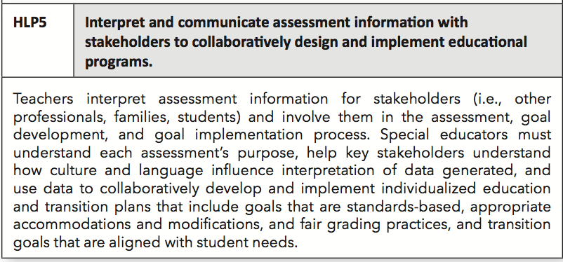
Sample activities and experiences:
Observe IEP meetings where data is discussed
Role play the interpretation of assessment information with different stakeholders
Generate questions parents or other key stakeholders may ask
Create a case study of 3 different families from different backgrounds and how culture and language changes a meeting
McLeskey, et al. 2017; CEEDAR Center
Notes:
When we get the multiple sources of data and it has been analyzed, communicating and interpreting results for key stakeholders is critical. All too often, meetings are held and assessment is either not talked about at all, or it discussed in a cursery way. It might include numbers of scores for different assessments. Often parents and teachers in meetings do not feel like they can ask for further clarification, and so the team is not fully informed when making decisions about educational plans. Having everyone understanding the data together is imperative so that the most effective plans for students with disabilities can be created.

Slide 7
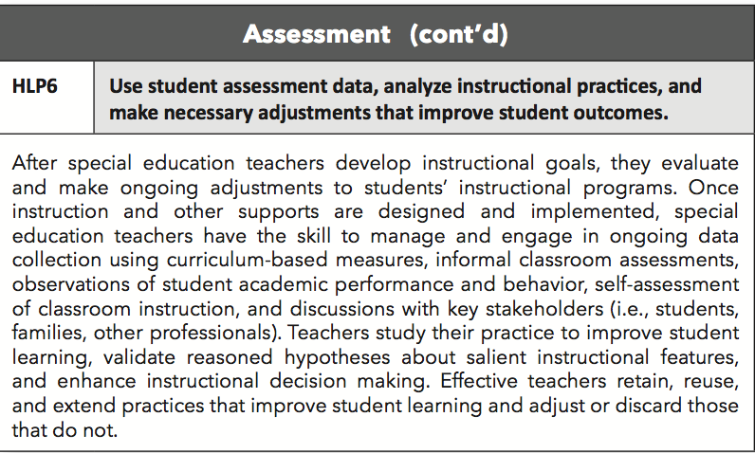
Sample activities and experiences:
Identify learning goals that are being met and not met
Create lessons using student data
Generate opportunities for ongoing assessment
McLeskey, et al. 2017; CEEDAR Center
Notes:
Even when the assessments are complete and then plan made, we are still not done. Helping teacher candidates understand and practice using assessments on an ongoing basis to adjust student instruction. Too often meetings on students with disabilities reveal that progress in student learning was not made. Special and general education candidates need to learn and practice using assessment on a regular basis to adjust the instruction to make sure students are making progress on student learning goals.

Slide 8
Goal of this session: To provide a conceptual framework for understanding feedback, a high leverage practice, included in the Assessment Domain…
Feedback defined
Types of feedback associated with effectiveness
Strategies to support students’ use of feedback to enhance learning
Quality feedback - a critical component of assessment reform

Slide 9
Feedback defined
What is feedback?

Slide 10
High Leverage Practice #8 & #22: Providing Positive and Constructive Feedback to Guide Students’ Learning and Behavior
“Feedback is information about how a person did in light of what he or she attempted – intent versus effect, actual versus ideal performance” (Wiggins, 1998, p. 46).
“Feedback is conceptualized as information provided by an agent (e.g., teacher, peer, book, parent, self, experience) regarding aspects of one’s performance or understanding” (Hattie & Timperley, 2007, p. 81).
As part of the teaching process, feedback is addressed in a learning context and “takes on the forms of new instruction” in addition to providing the student with information about the “consequence” of performance (Hattie & Timperley, 2007, pp. 81, 82).
Feedback has a dual implication as it is included in the instruction (academic) and social/emotional/behavioral high leverage practices domains.

Slide 11
High Leverage Practices Crosswalk
Eliciting & Interpreting individual students’ thinking #3 AND
Providing oral and written feedback #18
Providing positive and constructive feedback to guide students’ learning and behavior #8 & #22
High-Leverage Practices in
Special Education
High-Leverage Practices
Student
Learning

Slide 12
Types of Feedback
What types of feedback are associated with effectiveness and why?

Slide 13
Types of feedback associated with effectiveness
Most effective feedback | Why? | Least effective feedback
Feedback is goal directed. AFFIRM WHAT THEY DID WELL & WHERE THEY ARE GOING | Closes the gap between where students’ are (i.e., current knowledge and understanding) and informs them of where they need to be. | Feedback is not directed toward attainment of goals.
Feedback provides information on the correct response. CORRECT & DIRECT | Promotes understanding of feedback and aids memory of the correct rather than incorrect response (Feedback on the Task – FT). | Feedback focuses on the incorrect response increasing the likelihood that it will be remembered.
Feedback is simple rather than complex. It is age appropriate and relative to the performance. | Is most effective when goals are specific and challenging and task complexity is not too complex and at an appropriate level for the student (Feedback on the Task – FT). | Feedback is too complex.
*Feedback builds on changes from previous trials (more effective than FT). POINT OUT THE PROCESS | Strategically delivers and aims at the processes (i.e., ways to improve) for completion of a task or for creation of a product (Feedback on the Process – FP). | Feedback does not include strategies to achieve goals that will promote student commitment and deeper learning.
Meaningful feedback is verbal, non-verbal, or written and goes beyond marks/scores/grades. | Increases performance rather than involvement. | Feedback focuses only on marks/scores/grades.
“Feedback [is] timely, contingent, genuine, meaningful, age appropriate, and at rates commensurate with task and phase of learning (i.e., acquisition, fluency, maintenance)” (McLeskey, et al. 2017). AIM FOR TIMELY, MEANINGFUL, & AGE APPROPRIATE FEEDBACK | Considers the timing of feedback (i.e., immediate or delayed) based on the phase learning. Feedback is positive and not a threat to self-esteem. | Feedback is not timely. Feedback is a threat to self-esteem. Praise, rather than meaningful feedback, directs attention away from the task to focus on self or the person (Feedback About Self – FS).
Feedback is the catalyst for helping learners create their own feedback and cognitive routines. ENCOURAGE SELF-REGULATION | Aims at increasing motivation, effort, and confidence leading to self-regulation (Feedback about Self-Regulation – FR). | Students are not provided opportunities to self-assess and critique their own work.
Hattie & Timperley (2007)

Slide 14
Strategies to Support Students’ Use of Feedback
What kinds of strategies support students’ use of feedback to enhance learning?

Slide 15
Strategies to support students’ use of feedback to enhance learning
Assist students in answering the following questions:
Where am I going?
How am I going?
Where to next?
(Hattie & Timperley, 2007)
Use models with feedback to provide opportunities for students to use feedback (Wiggins, 1998)
Model
Practice
Perform
Feedback
Perform
Use models
with feedback

Slide 16
Strategies to support feedback use to enhance student learning
Feedback informs
Self-assessment
New goal setting
Self-adjustment
Goals achieved & new goal setting
Ongoing learning
Provide feedback to inform students on the progress of their learning
Provide opportunities for student self-assessment using scoring guides and educative rubrics (Wiggins, 1998)
Encourage goal setting
Promote self-adjustment (i.e., of effort, direction, strategy) as part of an ongoing learning process (Hattie & Timperley, 2007; Wiggins, 1998)
Continue the process when goals are achieved with new goal setting
Promote self-regulation:
The feedback loop
Hattie & Timperley (2007)

Slide 17
Quality Feedback & Assessment Reform
Why is quality feedback a critical component of assessment reform?

Slide 18
Quality Feedback – a Critical Component of Assessment Reform
We can strive for reform by…
Let’s move past the status quo where…
Designing engaging, authentic assessment tasks that will provide students with information to understand the gap between their current performance and the learning goal.
Providing feedback about the task (FT), about the processes or strategies to understand the task (FP), or about self-regulation (FR).
Giving students opportunities to interpret and use the feedback promoting self-efficacy about learning which leads to further learning.
Assessment tasks are aimed at measuring students’ levels of proficiency only (i.e., concern for adequacy of scores/grades).
Hattie & Timperley (2007); Wiggins, (1998)

Slide 19
Implications for Teacher Preparation
How does the gift of feedback and students’ use inform teacher preparation?

Slide 20
Incorporate a conceptual framework for understanding feedback, a high leverage practice…
Feedback Defined
Types of Effective Feedback
Strategies to Support Students’ Use of Feedback
Assessment Reform

Slide 21
Coursework and Clinical Experiences
Thoughts from teacher educators?
Design authentic, meaningful assessment tasks for teacher candidates aligned to learning goals.
Model effective ways of giving feedback about the tasks, about the processes, and about self-regulation.
Provide opportunities for teacher candidates to use the feedback as applied to their own coursework.
Encourage peer feedback and self-assessment in the university classroom.
Connect coursework with clinical experiences by embedding ongoing opportunities for teacher candidates to complete tasks with their students requiring their attention to feedback and student use of feedback.
Assist teacher candidates in making connections to edTPA Rubrics 12 (Providing Feedback) and 13 (Student Understanding and Use of Feedback).
Model effective feedback strategies during clinical experience observations, encouraging self-assessment, reflection, goal setting, and self-adjustment.

Slide 22
edTPA Rubric 12: Providing Feedback to Guide Further Learning
What do you notice or what stands out?
Information taken from the edTPA Elementary Education Assessment Handbook
Copyright 2017 Board of Trustees of the Leland Stanford Junior University
All rights reserved.

Slide 23
edTPA Rubric 13: Student Understanding and Use of Feedback
What do you notice or what stands out?
Information taken from the edTPA Elementary Education Assessment Handbook
Copyright 2017 Board of Trustees of the Leland Stanford Junior University
All rights reserved.

Slide 24
Guiding Questions
Teacher Education Faculty
P-12 Partners
How are you integrating HLPs into the classroom/school?
Which of these HLPs are challenging and support for integration would be beneficial?
Which HLPs are most relevant and potentially helpful for your particular setting?
What HLPs (or domains) are evident in course syllabi?
What strategies/activities are you using to teach these HLPs in the classroom?
How are HLPs embedded in field experience activities?
How can we support teacher candidates to learn and integrate HLPs in field experiences?

Slide 25
Sharing final thoughts
Something you learned
Something you are still wondering about
Something you heard someone else share
Something you heard and can extend

Slide 26
References
Hattie, J. & Timperley, H. (2007). The power of feedback. Review of Educational
Research, 77(1), 81-112. doi: 10.3102/003465430298487
McLeskey, J., Barringer, M.D., Billingsley, B., Brownell, M., Jackson, D., Kennedy,
M., Lewis, T., Maheady, L., Rodriguez, J., Scheeler, M. C., Winn, J., &
Ziegler, D. (2017, January). High-leverage practices in special education.
Arlington, VA: Council for Exceptional Children & CEEDAR Center.
Wiggins, G. (1998). Educative assessment: Designing assessments to inform and
improve student performance. San Francisco, CA: John Wiley & Sons, Inc.

Slide 27
Questions?
Dr. Carla Tanguay
ctanguay@gsu.edu

