Slide 1
Collaboration for Effective Educator Development, Accountability, and Reform
Evidence-Based Transition Planning and Services: Part 2
H325A120003
Notes:
This PowerPoint presentation is part of the Implementing Transition Planning and Services Content Enhancement Module (CEM). This presentation, used in conjunction with the other supporting materials, is intended for use by university and college faculty and other appropriate educator preparation program (EPP) staff to develop and enhance their teacher and leadership education courses as well as their professional development (PD) programs for practitioners.
The CEM is aligned with the innovation configuration (IC) on this topic: Teacher Preparation to Deliver Evidence-Based Transition Planning and Services for Youth with Disabilities. The focus of the CEM is to first provide understanding of transition planning and the IDEA regulations. The remaining topics addressed in this CEM target the critical characteristics of schools that prepare and support youth with disabilities to successfully transition from school to postsecondary education, integrated employment, and community living and participation.
The topics associated with this CEM include:
Introduction to transition planning and IDEA.
Overview of evidence-based predictors and practices associated with transition.
Strategies to ensure transition planning and preparation is student focused.
Access to secondary academic general education curriculum.
Engagement and involvement of families during transition planning.
Strategies to ensure positive collaboration both within school systems and with the community.
This CEM is divided into six hours of content with each hour building on previous information and resources. However, the sessions can stand alone with content embedded into a class or PD session. These speaker notes are provided for most of the PowerPoint slides. The notes provide to supplement the material in the PowerPoint.

Slide 2
CEM Overview
Part 1: Introduction to Transition Planning.
Part 2: Designing Effective Transition Program Structures
Part 3: Student-Focused Planning
Part 4: Providing a Transition-Focused Education
Part 5: Transition and Family Engagement
Part 6: Interagency Collaboration
Notes:
The Transition CEM is divided into six sections. The sections were designed to be one hour in length. However, extension activities are included for those wishing to make these sessions longer. Please refer to the facilitator guide for more information in adapting this section for delivery in various contexts.
This session will focus on Part 2: Designing Effective Transition Program Structures

Slide 3
Part 2: Designing Effective Program Structures for Transition Planning

Slide 4
Objectives
Explain the difference between evidence-based practices (EBPs) and predictors of post-school outcomes.
Identify essential characteristics of effective program structures for transition planning.
Notes:
Review slide.

Slide 5
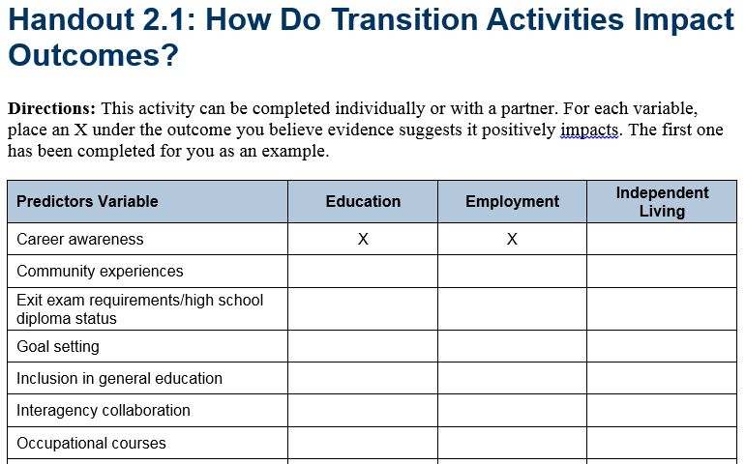
Handout 2.1: How Do Transition Activities Impact Outcomes?
Handout 2.1
Notes:
Refer participants to Handout 2.1. This activity can be completed individually or with partners. For each variable, place an X under the outcome you believe evidence suggests it positively impacts. The first one has been completed for you as an example.
The answers to this activity will be presented in the next section of this presentation.

Slide 6
Evidence-Based Practices in Transition Planning

Slide 7
Evidence-Based Practice
EBP is a teaching method (i.e., strategy, curriculum) used to teach a specific skill that has been shown to be effective based on high-quality research.
EBPs support implementation of predictors.
Notes:
Now, let’s talk about the alignment of the secondary transition evidence-based practices (EBPs) and the predictors of post-school success. EBPs are the teaching methods used to teach specific skills to students. They are practices that have been shown to be effective for youth based on high-quality research. By understanding the EBPs that are available to support secondary transition skill development, teachers and schools can use these practices to support implementation of the predictors.
Refer participants to the NTACT Effective Practices Matrix

Slide 8
Predictors of Post-School Success
A predictor is defined as an in-school experience, typically a program correlated with improved post-school outcomes.
Notes:
A predictor is defined as an in-school experience, typically a program (e.g., a work-based learning experience) correlated with improved post-school outcomes.

Slide 9
What Is a Predictor?
A predictor is used to forecast or tell about something in advance of its occurrence by means of special knowledge or inference.
Predictor
Outcome
Notes:
A predictor is something used to forecast or tell about something in advance of its occurrence by means of special knowledge or inference. In other words, a predictor is a variable that influences an outcome — for example, a program or a demographic variable that influences graduation, postsecondary education, or employment. A predictor, simply put, is the ability to tell about something in advance of its occurrence. It is a variable that influences an outcome. If you do X (the variable), then Y (the outcome) will occur.

Slide 10
Can You Identify the Predictors and Outcomes?
Predictor
Students who participate in career and technical education (CTE) classes while in high school are attending postsecondary education at a higher rate than students who do not participate in CTE courses.
Students who receive career counseling while in high school are graduating at a higher rate than students who do not receive career counseling.
Predictor
Outcome
Outcome
Notes:
This slide includes animation.
This and the next slide provide four opportunities for participants to see the connection between predictors and outcomes. Consider modeling the first example and then provide opportunities for the remaining three examples.
Example activity: Think-Pair-Share or Response Card activity based on number of students in class.
Read off each predictor statement.
Have the audience identify the predictor and the outcome for each item (#s 1-4).
Click to show answer as predictors and outcomes are identified.
Answers:
Career Tech Education & Postsecondary Education
Career Counseling & Graduation
Mentors & Course Completion
Rigorous Academic Instruction & Higher GPA

Slide 11
Can You Identify the Predictors and Outcomes?
Students who have been assigned mentors in high school have higher rates of course completion than students who have not been assigned mentors.
Students who receive rigorous academic instruction have higher GPAs than students who do not receive rigorous academic instruction.
Predictor
Outcome
Predictor
Outcome
Notes:
The next two slides provide four opportunities for participants to see the connection between predictors and outcomes. Consider modeling the first example and then provide opportunities for the remaining three examples,
This slide includes animation.

Slide 12
Types of Predictors
Program: Factors related to engaging youth in academic and career education, services, and supports.
Student: Factors related to academic proficiency, attendance, behavior, and engagement.
Student demographics: Factors to related to student gender, ethnicity, disability, and age.
Notes:
Several types of predictors affect both in-school and post-school outcomes for youth with disabilities. In-school predictors can improve the likelihood of youth achieving better in-school outcomes, like keeping youth in school, improving behavior, and attaining academic skills. In-school predictors can also improve the likelihood of youth achieving better post-school outcomes, like working, attending further education, and living independently.

Slide 13
Activity: Predictors by Outcome Area
What variables have been shown to predict positive postsecondary employment, education, and independent living outcomes?
Handout 2.2
Notes:
Have participants return to their responses to Handout 2.1. The answers will be shown on the next two slides. Facilitators or instructors should pass out a complete copy of the Predictors of Post-School Outcomes Handout 2.2 for reference. This handout will be referenced in each of the remaining sections.

Slide 14
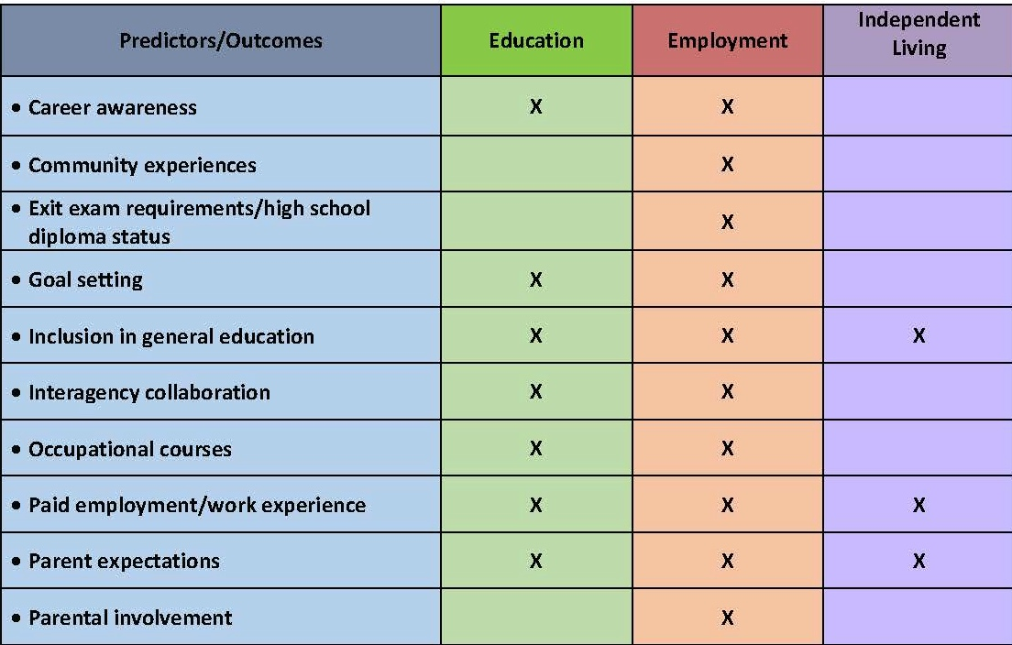
Predictors of Post-School Success
Mazzotti et al., 2015; Test et al., 2009.
Notes:
Currently, 19 evidence-based in-school predictors of post-school success for secondary youth with disabilities exist. This chart identifies the predictor and the outcome area that each predictor is associated with. These will be discussed in more detail in the remaining sections of this CEM.
Read through three to four predictors as an example.
For example, students who have career awareness skills in high school are more likely to experience positive post-school employment and education outcomes. Students who are involved in goal setting related to IEP or ILP goals and post-school goals are more likely to experience positive post-school education and employment outcomes. Secondary youth who engage in paid employment and/or work experiences in high school are more likely to achieve positive post-school outcomes across all three areas.

Slide 15
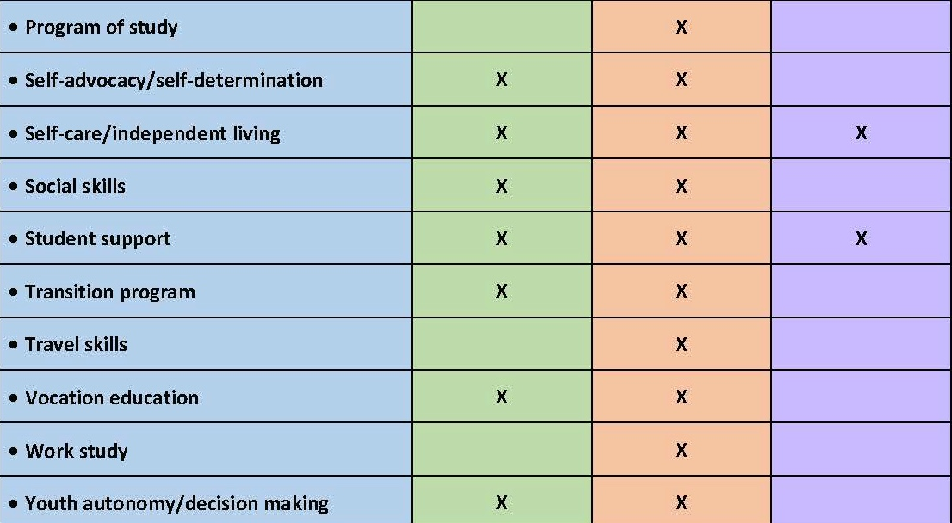
Predictors of Post-School Success
Mazzotti et al., 2015; Test et al., 2009.
Notes:
Read through three to four predictors as an example.
For example, students who have self-determination/self-advocacy skills in high school are more likely to experience positive post-school employment and education outcomes. Students who participate in vocational education are more likely to experience positive post-school education and employment outcomes. Secondary youth who engage in work study experiences in high school are more likely to achieve positive post-school employment outcomes.

Slide 16
Why Implement Predictors of Post-School Success?
Evidence-based information to inform secondary transition programs and practices while youth are in high school.
A framework to
Evaluate, develop, and improve secondary transition programs and practices.
Determine whether transition programs are implementing effective practices to increase the likelihood youth with disabilities will achieve positive post-school outcomes.
Notes:
Predictors provide:
Read slide.
Implementing the predictors should be a priority for all state and local education agencies (LEAs) when considering effective transition planning for youth. The predictors act as a framework that schools, districts, and state personnel can use to evaluate, develop, and improve secondary transition programs and practices with the ultimate goal that all youth will graduate high school college and career ready with the skills to be successful in living, learning, and working post school.

Slide 17
Understanding Evidence Base in Transition
Resource review: https://www.transitionta.org/sites/default/files/effectivepractices/EP_Matrix_print_12_4_2015.pdf
Evidence based
Research based
Promising practice
Unestablished practice
Notes:
Access the link provided and review the descriptions of the four levels of evidence for effective practices and predictors in transition. Read the descriptions available under each header.
OPTIONAL HANDOUT: Consider providing a copy of the Criteria for Levels of Evidence, available online here http://transitionta.org/system/files/effectivepractices/EP_Criteria_2017.pdf?file=1&type=node&id=1185&force=

Slide 18
Discussion: Evidence Base in Transition
In small groups, review the NTACT Effective Practices Matrix.
Discuss the following:
How would you describe the availability of EBPs for students in transition?
How might this affect how you approach the development of the transition plan?
Handout 2.3
Notes:
Provide participants with a copy of the Handout 2.3 NTACT Effective Practices Matrix, available here https://transitionta.org/epmatrix.

Slide 19
Program Structures for Transition Planning
Notes:
How do schools provide students access to evidence-based interventions and program structures likely to predict positive post-school outcomes? In this section, you will be introduced to the Taxonomy of Transition Programming 2.0, which provides the features necessary for providing a transition focused education.

Slide 20
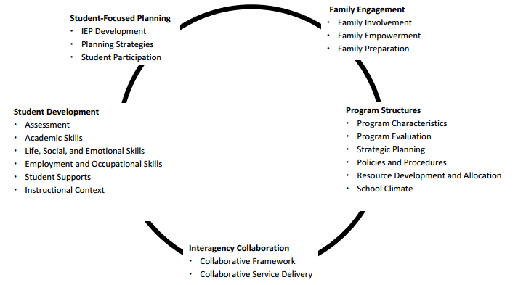
Taxonomy for Transition Programming 2.0
Available Handout
Kohler, Gothberg, Fowler, & Coyle, 2016, p. 3.
Notes:
The Taxonomy for Transition Programming 2.0 Handout, available at http://transitionta.org/sites/default/files/Tax_Trans_Prog_0.pdf, will be referenced in Parts 2-6. Refer participants to Pages 2-3 to learn more about the purpose of the taxonomy.
The Taxonomy for Transition 2.0 combines the most recent literature regarding predictors of post-school success, strategies to increase graduation and reduce dropout, school climate, and vocational rehabilitation services focused on fostering successful transition of youth with disabilities in college and careers. The model continues with five primary practice categories: Student‐Focused Planning, Student Development, Interagency Collaboration, Family Engagement, and Program Structure. In this section, we will look at the category Program Structures and discuss the remaining component in greater detail in Parts 3-6.
Review each of the components. Click for animation.
The predictors discussed in the previous section align with the program structures in the LEAs, and schools should be using predictors to develop and evaluate transition programs, which aligns with the Taxonomy category.
Resource: Kohler, P. D., Gothberg, J. E., Fowler, C., & Coyle, J. (2016). Taxonomy for transition programming 2.0: A model for planning, organizing, and evaluating transition education, services, and programs. Western Michigan University. Available at www.transitionta.org.

Slide 21
Activity: Taxonomy and Program Structures
Review Taxonomy for Transition Programming 2.0: Program Structures.
In teams, identify the three activities in each column that should be considered first when embarking developing program structures to support transition.
Explain your selections to the group.
Notes:
This is an optional activity and can be adapted for in-service and pre-service settings.
In-service: Review the components under the program structures framework and service delivery model. On chart paper, have teams record the strengths and areas of improvement for their current transition programming in each area. Refer to this throughout the session. Consider including action planning activities around identified areas of improvement.
Pre-service: Review the components under the program structure framework and service delivery model. With a partner(s), identify the three activities in each column that should be considered first when developing program structures. Be prepared to explain your selections.
Handout: Taxonomy for Transition Programming 2.0 (Pages 9-10)

Slide 22
Program Structures for Transition Planning
Infrastructures and systems related to stakeholder involvement and participation in stakeholder groups while providing in-school and post-school transition services for students with disabilities.
Notes:
Read slide.

Slide 23
Components of Program Structures
Program Structure
Essential Components
Extended transition services (ages 18–21)
Inclusion in general education
Effective practices
Student supports
Exit requirements/ graduation
Dropout prevention
Morningstar & Mazzotti, 2014, p. 21.
Notes:
Review slide.
The following essential components are outlined in IC Transition Planning and Services. Each of these essential components are discussed in more detail in this portion of the module.

Slide 24
Essential Characteristics of Effective Transition Program Structures

Slide 25
Predictors of Post-School Success
Mazzotti et al., 2015; Test et al., 2009.
Notes:
Refer participants back to the CEM Handout: Predictors of Post-School Success presented earlier. This slide has animation.
Now that you have a better understanding of transition program structures, which of the predictors fall under this category of program structures? Technically, all of the predictors align with program structures and should be used to develop, improve, and evaluate transition programs and practices. In this module, we will highlight just five of the predictors related to program structures. At the top of the predictors of post-school success handout, you will see three of them.
Click for animation. Community experience involve those activities occurring outside of the school setting, supported with in-class instruction, where students apply academic, social, and/or general work behaviors and skills.
Click for animation. Inclusion in general education predicts positive post-school outcomes in education, employment, and independent living skills. It entails students with disabilities having access to general education curriculum and engaging in regular education classes with peers without disabilities.​

Slide 26
Predictors of Post-School Success
Mazzotti et al., 2015; Test et al., 2009.
Notes:
At the bottom half, you will see two more.
Click for animation. The first is student support that is also a significant predictor of positive post-school outcomes in education, employment, and independent living. It is a network of people (e.g., family, friends, educators, adult service providers) who provide services and resources in multiple environments to prepare students to obtain their annual transition and postsecondary goals aligned with their preferences, interests, and needs.
Click for animation. The second is a quality transition program. A program that prepares students to move from secondary settings (e.g., middle school, high school) to adult-life, utilizing comprehensive transition planning and education that creates individualized opportunities, services, and supports to help students achieve their post-school goals in education/training, employment, and independent living. The components of the Transition Plan, which outlines the components of the program, was discussed in the previous section. This section will discuss how program structures help ensure that implementation of the plan is likely to lead to positive outcomes for students with disabilities.
The next section provides information about how we develop and expand secondary transition programs using the predictors and supporting evidence base.

Slide 27
Program Structure Predictor: Career Awareness
Learning about opportunities, education, and skills needed in various occupational pathways to choose a career that matches one’s strengths and interests.
Rowe, Alverson, Unruh, Fowler, Kellems, & Test, 2015, pp 118.
Notes:
Let’s review the operational definitions of each of the predictor variables and discuss the essential program characteristics needed for implementation of these predictors.
Read slide.

Slide 28
Essential Program Characteristic: Career Awareness
School-wide comprehensive and systematic opportunities to learn about various careers.
Embedded career awareness opportunities in the general curriculum.
Systematic, age-appropriate student assessment of career awareness.
NSTTAC & NPSO, 2015.
Notes:
Optional: Provide participants to the predictor self-assessment, retrieved from http://www.transitionta.org/sites/default/files/Predictor_Self-Assessment2.0.pdf. This document will be used for an optional activity at the end of this section.
Effective transition program structures systematically embed career awareness K-12. Here are several other more specific program characteristics related to the predictor career awareness.
Provide school-wide comprehensive and systematic opportunities to learn about various careers via job shadowing, internships, guest speakers, industry tours, Career Technical Education classes, or career fairs.
Embed career awareness in the general curriculum to teach about occupations related to the core content areas.
Provide systematic, age-appropriate student assessment of career awareness (e.g., interest inventories, aptitude tests) for students to learn about their preferences and aptitudes for various types of career.
Source: National Secondary Transition Technical Assistance Center and National Post-School Outcomes Center. (2015). Predictor Implementation School/District Self-Assessment. Retrieved from http://www.transitionta.org/sites/default/files/Predictor_Self-Assessment2.0.pdf

Slide 29
Career Awareness: EBPs to Support Implementation of the Predictor
Career exploration services.
Career academies.
Career and technical education courses.
Notes:
Here are promising and EBPs that support development of career awareness. Career exploration services and career academies are promising practices. Many states include minimum courses of study K-12 to support career development. Students can also access career awareness activities through participation in career and technical education courses.

Slide 30
Program Structure Predictor: Community Experiences
Activities occurring outside of the school setting, supported with in-class instruction, where students apply academic, social, and/or general work behaviors and skills.
Rowe et al., 2015.
Notes:
Read slide.

Slide 31
Essential Program Characteristics: Community Experiences
Sufficient resources.
Ecological assessments.
Instruction on skills needed to safely access community environments.
Community-based instruction.
Instruction on using public transportation.
Involvement of parent and adult service providers.
Family support for afterschool community experiences.
NSTTAC & NPSO, 2015.
Notes:
Here are program characteristics related to community experiences for students with disabilities. Be sure to also consider work study, apprenticeships, and internship environments that are culturally sensitive to students from different cultural backgrounds. Effective transition program structures:
Allocate sufficient resources to support meaningful community-based experiences.
Conduct ecological assessments to determine skills needed for various community environments.
Provide instruction on skills needed to safely access community environments as identified via ecological assessments.
Use community-based instruction to teach, assess, and monitor the attainment of desired academic and/or functional skills.
Instruct students in use of public transportation.
Involve parent and adult service providers to support student involvement in community experiences.
Provide supports for parents to arrange community experiences after school hours.
Refer participants to the predictor self-assessment for the remaining characteristics.
Source: National Secondary Transition Technical Assistance Center and National Post-School Outcomes Center. (2015). Predictor Implementation School/District Self-Assessment. Retrieved from http://www.transitionta.org/sites/default/files/Predictor_Self-Assessment2.0.pdf

Slide 32
Community-Based Instruction EBPs to Support Implementation of the Predictor
Using community-based instruction to teach
Employment skills.
Safety skills.
Communication skills.
Community integration skills.
Cooking skills.
Purchasing skills.
Notes:
Here are the EBPs that align with the community experiences predictor. As you can see, yet again, these are skills that all students need, not just students with disabilities.

Slide 33
Program Structure Predictor: Inclusion in General Education
Activities occurring outside of the school setting, supported with in-class instruction, where students apply academic, social, and/or general work behaviors and skills.
Rowe et al., 2015, pp 120.
Notes:
Read slide.

Slide 34
Essential Program Characteristics: Inclusion in General Education
Administrative support.
Evaluation of the effectiveness of inclusive programming.
Inclusive atmosphere for including students with disabilities in general education.
Professional development.
Active student engagement.
NSTTAC & NPSO, 2015.
Notes:
Inclusion in general education is a predictor of positive employment, education, and independent living outcomes. Effective transition program structures:
Provide administrative support (e.g., PD for teachers and paraprofessionals, common planning, providing paraprofessionals) to teachers for students with disabilities included in general education classrooms.
Evaluate the effectiveness of inclusive programming by using formative assessment to identify when adjustments are needed to accommodate all students’ learning differences (e.g., pace, communication skills).
Develop a receptive and inclusive school atmosphere for including students with disabilities in general education by educating administrators, teachers, other staff, and students about person-first language and disability rights.
Provide PD for secondary personnel to ensure personnel are qualified to use Universal Design for Learning (UDL) and evidence-based instructional strategies.
Engage students as active participants in general education instructional processes utilizing multiple models of inclusive learning.
Refer participants to the predictor self-assessment for the remaining characteristics.
Source: National Secondary Transition Technical Assistance Center and National Post-School Outcomes Center. (2015). Predictor Implementation School/District Self-Assessment. Retrieved from http://www.transitionta.org/sites/default/files/Predictor_Self-Assessment2.0.pdf

Slide 35
Inclusion in General Education: EBPs to Support Implementation of the Predictor
Graphic organizers.
Anchored instruction in math.
Mnemonics to support learning.
Peer-mediated embedded instruction.
Strategy instruction.
Technology to support instruction.
Notes:
Here are the EBPs that align with the inclusion in general education predictor. Model where students can access descriptions and related lessons plan for each practice. If time allows, have small groups of students review the related download and have them share out with the class. The downloads can be accessed at https://transitionta.org/evidencepractices.

Slide 36
Program Structure Predictor: Student Support
Network of people (e.g., family, friends, educators, adult service providers) who provide services and resources in multiple environments to prepare students to obtain their annual transition and postsecondary goals aligned with their preferences, interests, and needs.
Rowe et al., 2015, pp 123.
Notes:
Read slide.

Slide 37
Essential Program Characteristics: Student Support
System of community networks.
System of linking students to resources, post-school support, and mentors.
Opportunities for meaningful engagement.
NSTTAC & NPSO, 2015.
Notes:
Develop and implement procedures for cultivating and maintaining school and community networks to assist students in obtaining their postsecondary goals. Consider networks that are culturally, racially, and ethnically representative to accommodate the needs of CLD students.
Link students to appropriate individuals who can assist students in obtaining access to assistive technology resources and teach students to use technology to enhance their academic and functional performance; can provide support for financial planning, navigating the health care system, adult services, or transportation; and a community mentor and/or school based mentor/ graduation coach.
Provide opportunities for meaningful engagement in the community (e.g., clubs, friends, advocacy groups, sports).
Refer participants to the predictor self-assessment for the remaining characteristics.
Source: National Secondary Transition Technical Assistance Center and National Post-School Outcomes Center. (2015). Predictor Implementation School/District Self-Assessment. Retrieved from http://www.transitionta.org/sites/default/files/Predictor_Self-Assessment2.0.pdf

Slide 38
Student Supports: EBPs to Support Implementation of the Predictor
Check and Connect.
Integrated Students Supports (ISS).
Notes:
Here are the practices that align with the student support predictor. Check and Connect is a research-based intervention used with K-12 students who show warning signs of disengagement with school and who are at risk of dropping out. At the core of Check and Connect is a trusting relationship between the student and a caring, trained mentor who both advocates for and challenges the student to keep education salient. Integrated Students Supports (ISS) is a promising practice for support students at risk. For more information, check out https://www.childtrends.org/wp-content/uploads/2014/02/2014-05ISSWhitePaper1.pdf.

Slide 39
Program Structure Predictor: Transition Program
Prepares students to move from secondary settings (e.g., middle school/high school) to adult life, utilizing comprehensive transition planning and education that creates individualized opportunities, services, and supports to help students achieve their post-school goals in education/training, employment, and independent living.
Rowe et al., 2015, pp 123.
Notes:
Read slide.

Slide 40
Essential Program Characteristics: Transition Program
Systems-level infrastructure.
Integrated instruction in all areas of independent living.
Instruction and training in natural environments.
Opportunities for engagement with non-disabled peers in the school and community.
Multiple strength-based assessments across multiple domains at different points in time.
Family training and resources.
Ongoing program evaluation.
NSTTAC & NPSO, 2015.
Notes:
Transition programs were found to predict positive outcomes in employment and education for students with disabilities. Effect program structures:
Provide systems-level infrastructure (e.g., highly qualified staff and administrators with defined roles and responsibilities, sufficient budget) to monitor and guide students to obtain post-school goals.
Provide integrated instruction in all areas of independent living (e.g., community living, transportation, recreation leisure, self-advocacy, goal setting, decision making) for all students with disabilities.
Provide instruction and training in natural environments supported by classroom instruction.
Provide opportunities for engagement with non-disabled peers in the school and community.
Use multiple strength-based assessments across multiple domains at different points in time to assist student and IEP teams in post-school planning.
Provide training and resources to families to involve them in transition planning and connect them to adult agencies and support and information networks.
Conduct program evaluation to assess effectiveness of transition program.
Refer participants to the predictor self-assessment for the remaining characteristics.
Source: National Secondary Transition Technical Assistance Center and National Post-school Outcomes Center. (2015). Predictor Implementation School/District Self-Assessment. Retrieved from http://www.transitionta.org/sites/default/files/Predictor_Self-Assessment2.0.pdf

Slide 41
Optional Activity: Identifying Transition Program Structures
Handout: Predictor Implementation School/District Self-Assessment
In small groups, complete the following; identify examples of essential transition program characteristics:
Option 1: Review current school program.
Option 2: Review video of transition program.
Notes:
NOTE: This is an optional, but recommended, activity.
Required handout: Predictor Implementation School/District Self-Assessment, available at http://www.transitionta.org/sites/default/files/Predictor_Self-Assessment2.0.pdf
ESTIMATED TIME: 10-30 minutes, depending on scope
OPTION 1: Recommended for educators currently working in or observing a transition program.
Provide participants with a copy of the Predictor Implementation School/District Self-Assessment (from previous discussion).
Have participants review their current transition programs for some or all of the predictor essential characteristics just discussed: career awareness, community experiences, inclusion in general education, student support, and transition program.
Discussion questions: What program structure characteristics do you currently have in place? What evidence do you have? To what extent are these predictors and characteristics being implemented?
OPTION 2: Recommended for pre-service students or teachers new to the profession.
1. Provide participants with a copy of the Predictor Implementation School/District Self-Assessment (from previous discussion).
2. Watch a short video about a transition program (see examples below).
3. Have participants identify essential characteristics from some or all of the predictors just discussed: career awareness, community experiences, inclusion in general education, student support, and transition program.
4. Discussion questions: What characteristics did you see or hear about? How were these being implemented within these programs?
Sample Videos:
“Transition Program” Young Adults With Disabilities Are Beating The Odds, https://www.youtube.com/watch?v=j8X-oXCQGk8 (7:30 min)
Helping Young People with Special Needs Transition Into Adulthood, https://www.youtube.com/watch?v=XEPuD3oSULQ (5:03 min)
Special Beyond Special Needs - DPS 18-21 Transition Program, https://www.youtube.com/watch?v=Nxfz_v_DeC4 (2:40 min)

Slide 42
Closing

Slide 43
Case Study: Program Structures and Transition Services
Stephanie is a 16-year-old student with specific learning disabilities in reading and written expression. Her reading and writing performance requires accommodations, including extended time, read-aloud, and computer software resources to support reading comprehension and writing, for testing and participation in the general curriculum.
Goal: After high school, Stephanie will work part-time in the computer lab at the college she attends.
Handout 2.4
Mazzotti, Rowe, & Test, 2013.
Notes:
Refer participants to Handout 2.4. Group participants in small group and have them complete the activity. Provide time for sharing out.

Slide 44
Did We Meet Our Objectives?
Explain the difference between EBPs and predictors of post-school outcomes.
Identify essential characteristics of effective program structures for transition planning.
Notes:
Review the objectives of this section. Have participants reflect on their learning.
Consider the following partner discussion prompts:
Explain the differences between EBPs and predictors of post-school outcomes.
Identify three essential characteristics of effective program structures for transition planning (choose one or all): career awareness, community experience, inclusion in general education, student support, and transition program.

Slide 45
Ticket Out the Door…
Ticket Out the Door
Do you have follow-up questions related to today’s content?
What additional information would you like to have?
Notes:
Materials: note card or post-it for Ticket Out the Door
(Provide participants with note card). Take a moment to talk with a partner and identify follow-up questions you have related to today’s objectives or content and any additional things you would like to know. Write your questions and responses on the notecard, which will serve as your Ticket Out the Door for today.

Slide 46
Collaboration for Effective Educator Development, Accountability, and Reform (CEEDAR)
H325A120003

Slide 47
Disclaimer
This content was produced under U.S. Department of Education, Office of Special Education Programs, Award No. H325A120003. Bonnie Jones and David Guardino serve as the project officers. The views expressed herein do not necessarily represent the positions or polices of the U.S. Department of Education. No official endorsement by the U.S. Department of Education of any product, commodity, service, or enterprise mentioned in this website is intended or should be inferred.

