Slide 1
Collaboration for Effective Educator Development, Accountability and Reform
Evidence-Based Transition Planning and Services: Part 3
H325A120003
Notes:
This PowerPoint presentation is part of the Implementing Transition Planning and Services Content Enhancement Module (CEM). This presentation, used in conjunction with the other supporting materials, is intended for use by university and college faculty and other appropriate educator preparation program (EPP) staff to develop and enhance their teacher and leadership education courses as well as their professional development (PD) programs for practitioners.
The CEM is aligned with the innovation configuration (IC) on this topic: Teacher Preparation to Deliver Evidence-Based Transition Planning and Services for Youth with Disabilities. The focus of the CEM is to first provide understanding of transition planning and the IDEA regulations. The remaining topics addressed in this CEM target the critical characteristics of schools that prepare and support youth with disabilities to successfully transition from school to postsecondary education, integrated employment, and community living and participation.
The topics associated with this CEM include:
Introduction to transition planning and IDEA.
Overview of evidence-based predictors and practices associated with transition.
Strategies to ensure transition planning and preparation is student focused.
Access to secondary academic general education curriculum.
Engagement and involvement of families during transition planning.
Strategies to ensure positive collaboration both within school systems and with the community.
This CEM is divided into six hours of content with each hour building on previous information and resources. However, the sessions can stand alone with content embedded into a class or PD session. These speaker notes are provided for most of the PowerPoint slides. The notes provide to supplement the material in the PowerPoint.

Slide 2
CEM Overview
Part 1: Introduction to Transition Planning
Part 2: Designing Effective Transition Program Structures
Part 3: Student-Focused Planning
Part 4: Providing a Transition-Focused Education
Part 5: Transition and Family Engagement
Part 6: Interagency Collaboration
Notes:
The Transition CEM is divided into six sections. The sections were designed to be one hour in length. However, extension activities are included for those wishing to make these sessions longer. Please refer to the facilitator’s guide for more information about adapting this session for delivery in various contexts.
This session will focus on Part 3: Student-Focused Planning.

Slide 3
Part 3: Student-focused planning

Slide 4
Part 3: Objectives
Demonstrate the importance of building self-determination in students with disabilities.
Involve students in transition planning.
Discuss the importance of involving families in providing self-determination skill development.
Notes:
Review slide.

Slide 5
THINK-PAIR-SHARE
What is self-determination?
How do students demonstrate that they are self-determined?
Notes:
Think about the term self-determination. How would you describe it to another person? How would you know if someone was self-determined?
Pair with a neighbor and share your thoughts.
Allow 2-3 minutes for partners to discuss.

Slide 6
Defining Self-Determination
Watch the following short video: https://www.youtube.com/watch?v=5r-kVhemaAQ
Discussion:
How do the advocates define self-determination?
How does this compare to your thinking?
Notes:
Read slide.
Video: Self-determination, https://www.youtube.com/watch?v=5r-kVhemaAQ (2:06 minutes)

Slide 7
Definition of Self-Determination
Self-determination refers to
awareness of personal strengths and weaknesses;
the ability to set goals and make choices;
the ability to be assertive at appropriate times; and
the ability to interact with others in a socially competent manner.
A self-determined person is able to
make independent decisions based on his or her ability to use resources, which includes collaborating and networking with others.
Serna & Lau-Smith, 1995
Notes:
Many components involved with effectively teaching self-determination skills exist. The components required are: (read bulleted points along with additional notes listed at bottom).
When students effectively use self-determination skills, they are able to:
Be aware of their strengths and weaknesses—also their preferences and interests.
Set goals and make choices.
Advocate for themselves in a competent manner and communicate with others appropriately and effectively.
Sometimes people interchange the terms self-determination and self-advocacy, but being a competent self-advocate is part of being self-determined. Another important part of self-determination is the ability to use the supports and resources available and to be resourceful/creative by identifying other/new supports and resources. A self-determined person makes choices and decisions based upon collaborating and networking to gather the resources and information to make decisions.

Slide 8
Definition of Self-Determination
The outcome for a self-determined person is
the ability to realize his or her own potential;
to become a productive member of a community; and
to obtain his or her goals without infringing on the rights, responsibilities, and goals of others.
Serna & Lau-Smith, 1995
Notes:
Finally, a self-determined person uses these skills to meet his or her own needs without infringing upon the rights, responsibilities, and goals of other individuals—focus is again on interacting with others.
In summary, teachers need to focus on specific skills but also the different environments where students may need to use those skills.

Slide 9
Why Focus on Self-Determination?
Engage students in their education.
Develop lifelong skills for variety of environments.
Increase self-awareness.
Notes:
Read slide.

Slide 10
Why Focus on Self-Determination?
Watch this video: https://www.youtube.com/watch?v=JGRjMNBfl58
Identify reasons why self-determination is important.
What other reasons can you think of for ensuring that students are self-determined?
Notes:
As you watch the video, identify reasons listed by the advocates for why self-determination is important.
Watch the following short video: What Is Self-Determination and Why Is It Important? https://www.youtube.com/watch?v=JGRjMNBfl58 (5:00 minutes)
Share your list with your partner. Discuss what other reasons can you think of for ensuring that students are self-determined.

Slide 11
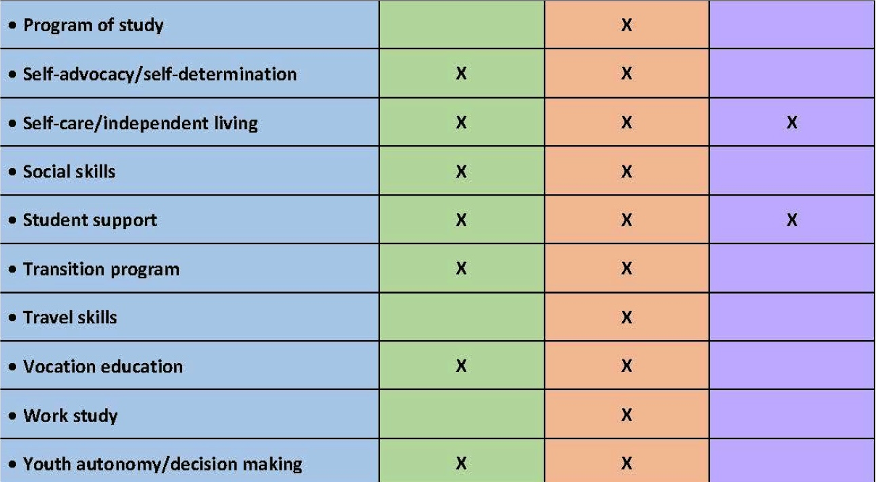
Predictors of Post-School Success
Mazzotti et al., 2015; Test et al., 2009
Notes:
Refer participants to their copy of the Predictors of Post-School Success from Part 2.
In Part 2, you were introduced to the predictors of post-school success.
Click for animation. You will notice that self-advocacy and self-determination are predictors of both post-school education and employment success. Rowe et al. defined self-advocacy as “the ability to make choices, solve problems, set goals, evaluate options, take initiative to reach one’s goals, and accept consequences of one’s actions” (p. 19 of IC).

Slide 12
The Research Says…
Students who are self-determined exhibit behaviors/skills that impact these areas:
Engagement
Post-school outcomes
Participation in IEP development
Quality of Life
Networks
Skills (social skills, problem solving, choice making, self-advocacy)
Algozzine, Browder, Karvonen, Test, & Wood, 2001.
Notes:
Here’s what the research tells us about students who are self-determined. Meta-analysis of 22 studies involving SD—Algozzine, B., Browder, D., Karvonen, M., Test, D., & Wood, W. M. (2001).
Below is a summary of the research.
Engagement—ED/BD youth increased engagement with transition coordinator; positive educational achievement (Bullis et al.); effective involvement in general curriculum.
Post-School and Achievement Outcomes—NSTTAC predictors:
Students more likely to be engaged in post-school employment and IL; self-advocacy skills correlated with higher achievement outcomes.
IEP Participation—Increased student participation in IEP meetings (Allen et al., 2001; Arndt, Konrad, & Test, 2006; Martin et al., 2006); increased participation in IEP meeting of adolescents with ED/BD (Bullis, et al., 2002; Snyder & Shapiro, 1997). NLTS-2 has identified “significant relationships” between SD, IEP participation, and transition planning process.
NSTTAC evidence-based practices (EBPs)—all in moderate level of evidence of cause: Involving students in IEP Planning (meta-analysis of 16 studies), Using Self-Advocacy Strategy (specific curriculum), Using the Self-Directed IEP.
Skills—Improved personal and social responsibility, enhanced social problem-solving skills, improved choice making, problem solving, self-regulation, self-esteem, self-advocacy (O’Reilly, Lancioni, & O’Kane, 2000; Storey, 2002; Wehmeyer & Schwartz, 1997)—transfer skills from special education to general education courses and positively navigate social situations.
Quality of Life—Positive community participation, independent living, improved community life, and enhanced quality of life (Sowers & Powers, 1995; Wehmeyer & Palmer, 2003; Wehmeyer & Schwartz, 1998).
Networks—Increased size of support network; improved recruiting behaviors, improved ability to obtain accommodations for employment, housing, academic, and leisure activities (Balcazar et al., 1991; Bowman & Marzouk, 1992).

Slide 13
IDEA Requirements Related to Student Involvement
Invite Student to Meeting:
At age 16, or earlier if required by state law.
Student participation and leadership on the IEP team is exemplary practice.
Transition Assessments:
To identify student interests, needs, preferences, and strengths.
Measureable Postsecondary Goals:
Generated from results of transition assessment.
U.S. Department of Education. (2004). Individuals with Disabilities Education Act. Retrieved from http://idea.ed.gov/explore/search?search_option=all&query=transition&GO.x=0&GO.y=0
Notes:
In Part 1, we learned about the IDEA requirements related to student involvement. Although self-determination isn’t specifically addressed in the transition requirements of IDEA, several points in the law relate to self-determination.
Invite Student
Inviting the student to transition/IEP meetings meets minimum compliance for IDEA; however, usually, without adequate preparation in self-determination skills, students cannot be active participants in planning.
Self-determination skills teach students not only how to be actively involved, but also help them see the importance of their involvement and direction in their IEP planning for transition.
Exemplary practices include students receiving self-determination training, practice using the skills in real situations, and leading their transition-focused IEP meetings. We’ll see some examples of how this works later today.
Students’ active involvement in their transition planning makes helps the IEP team to develop the IEP, and self-determination facilitates this. Please make sure to check with your state about legal requirements for inviting students to IEP meetings because each state differs on the age in which students are required to attend.
Transition Assessment
One of the key steps in self-determination training/curricula is knowing and valuing yourself—this process includes some assessment that can be collected over time as part of the transition assessment process. In this way, the transition assessment process helps the self-determination training process and vice versa.
Creating Postsecondary Goals
The information gathered from the ongoing transition assessment, which can be embedded in self-determination training, feeds directly into the development of the postsecondary goals.
Self-determined students can identify their postsecondary goals and are probably more apt to have a clearer idea of what they want for their futures and have realistic goals for their futures.
Self-determination training and experiences give students a natural opportunity to articulate their preferences and goals and work to identify strategies and resources to help achieve their goals.

Slide 14
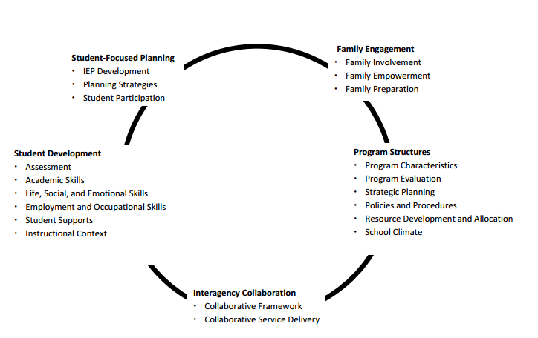
Taxonomy for Transition Programming 2.0
Available Handout
Kohler, P. D., Gothberg, J. E., Fowler, C., & Coyle, J. (2016). Taxonomy for transition programming 2.0: A model for planning, organizing, and evaluating transition education, services, and programs. Kalamazoo, MI: Western Michigan University. Retrieved from www.transitionta.org.
Notes:
Refer participants to the Taxonomy for Transition Programming 2.0; handouts from Part 2.
In Part 2, you were introduced to the Taxonomy for Transition Programming 2.0 and were able to dive deeper into program structures. Now let’s look more closely at Student-Focused Planning.
Resource: Kohler, P. D., Gothberg, J. E., Fowler, C., & Coyle, J. (2016). Taxonomy for transition programming 2.0: A model for planning, organizing, and evaluating transition education, services, and programs. Kalamazoo, MI: Western Michigan University. Retrieved from http://www.transitionta.org/sites/default/files/Tax_Trans_Prog_0.pdf

Slide 15
Activity: Taxonomy and Student-Focused Planning
Review Taxonomy for Transition Programming 2.0: Student-Focused Planning, page 4.
In teams, identify the three activities in each column that should be considered first when implementing student-focused planning.
Explain your selections to the larger group.
Notes:
The Taxonomy for Transition Programming 2.0 handout is available at http://transitionta.org/sites/default/files/Tax_Trans_Prog_0.pdf.
Review the components under the student-focused planning framework and service delivery model. With a partner(s), identify the three activities in each column that should be considered first when implementing student-focused planning. Be prepared to explain your selections.

Slide 16
Strategies: IEP Development
Learning style inventories.
Preference/interest surveys.
Disability research assignments (e.g., students research their particular disability).
Resume development.
Adapted from Hoffman, A., & Field, S. (2006). Steps to self-determination (2nd ed.). Austin, TX: PRO-ED.
Notes:
Here are several specific strategies to support students with student-focused planning (read slide). Having students take learning-style inventories and complete preference/interest surveys support students with their academic planning. In addition, having students complete these inventories as part of a transition assessment is helpful in guiding transition planning and creating student-focused goals.

Slide 17
Strategies: IEP Development
Video role play job interview.
Attend adventure challenge course at recreational center or park.
Research and report on famous individuals with disabilities.
Field, S., Hoffman, A., & Spezia, S. (1998). Self-determination strategies for adolescents in transition. Austin, TX: PRO-ED; Hoffman, A., & Field, S. (2006). Steps to self-determination (2nd ed.). Austin, TX: PRO-ED.
Notes:
These are ideas for helping students learn to value themselves and find value in others.
Have students participate in a video role play in which they act out a job interview or a situation in which someone needs to present their skills and qualifications. Then have students evaluate themselves. Video recording is best for interviews so students can watch themselves and evaluate based upon certain criteria.
Have students participate in adventure/team challenge courses at state or other types of parks. Involve team building in which each team member brings worth to the entire team, and the entire team has to support each team member as individuals. For example, the Shawnee Mission South Interpersonal Skills Class has a campout at a park that has a challenge course as one of the first activities. If you can’t attend a challenge course, you can do lots of teambuilding and group challenge at school—Google it!
Have students research and report on famous individuals with disabilities. Through this activity, the Know/Value areas somewhat overlap. As you know more about yourself and discover more about yourself, hopefully you’ll learn to value yourself more as well. This exercise allows students to learn more about others with disabilities to value themselves more.

Slide 18
Strategies: Student-Focused Planning
Product Development:
Collage, poem, essay, visual art, song, PowerPoint presentation.
Inspiration map to share students’ dreams and aspirations, fears and motivations, etc.
Adapted from Hoffman, A., & Field, S. (2006). Steps to self-determination (2nd ed.). Austin, TX: PRO-ED.
Notes:
Educators use many strategies to increase the engagement of the students in transition planning and ensure the students remain the focus of the planning. Creating a product like a PowerPoint presentation, collage, dance, song, poem, drawing, etc. is one method for students to connect more with themselves and their dreams for the future.

Slide 19
Strategies: Student-Focused Planning
Learn to plan with small goals first—practice this by each identifying a weekly goal and a plan to meet that goal.
Teach problem-solving skills—lots of practice.
Use student goals and problem-solving skills with students’ individual issues as well as course activities.
Field, S., Hoffman, A., & Spezia, S. (1998). Self-determination strategies for adolescents in transition. Austin, TX: PRO-ED; Hoffman, A., & Field, S. (2006). Steps to self-determination (2nd ed.). Austin, TX: PRO-ED.
Notes:
Students will need multiple practice opportunities to actively engage in transition planning. Here are several approaches teachers can take. Use basic, real-life problems/issues that your students have for class discussion relating to solving the problem (with the student’s permission to share the problem). This practice also helps you to get to know your student on a more personal/individual basis, which can help you guide him or her in transition planning.
An example of problem solving is: test on Friday in history, but basketball game takes place Thursday night = what to do?
OR: I really want this expensive pair of shoes, but my mom says they cost too much, so no. What to do?
All of this will take continued practice. Find ways to embed these activities into your lessons.

Slide 20
Strategies—Student-Focused Planning
Share your own goals and plans to reach them; invite guest speakers/mentors to do the same.
Develop group goals and walk through the planning process with the class to demonstrate the process.
Use published problem-solving curriculum with students.
Plan for their IEPs.
Field, S., Hoffman, A., & Spezia, S. (1998). Self-determination strategies for adolescents in transition. Austin, TX: PRO-ED; Hoffman, A., & Field, S. (2006). Steps to self-determination (2nd ed.). Austin, TX: PRO-ED.
Notes:
Teachers can also model how to engage in transition planning. For example, you can share your own goals or get a mentor or someone respected in the school or community to talk to the class about students’ goals/plans and how they have or haven’t achieved them. Sometimes, someone can discuss changing goals as a result of an unexpected outcome.
Most common curricula focus on IEP planning, and quite a few exist.

Slide 21
Strategies: Student-Focused Planning
Communications skills training and practice.
Practice through role play for negotiation, communication, and conflict resolution.
Practice specific situations that might come up with each student’s goal.
Students identify resource people and groups that can help them meet their goals.
From Field, S., Hoffman, A., & Spezia, S. (1998). Self-determination strategies for adolescents in transition. Austin, TX: PRO-ED; Hoffman, A., & Field, S. (2006). Steps to self-determination (2nd ed.). Austin, TX: PRO-ED.
Notes:
Teachers should design ongoing opportunities for practicing the skills necessary for the students to actively engage in the process.
Giving students many opportunities to practice using their self-determination skills is essential. Practice is how we all learn best.
In addition, providing students the opportunity to practice leading their IEP meetings in a role-play method is helpful so that they are able to replicate in “real life.” Role play a variety of scenarios with a variety of people in a variety of settings. Don’t just do it one time. Do it often, varying the circumstances slightly each time.
Identifying a resource person or just resources that help students meet their goals is part of the IEP planning strategies. Teaching students to be creative in identifying people to help them is critical to helping them be divergent and creative thinkers/planners.

Slide 22
Strategies: Student-Focused Planning
Use articles (newspaper/magazine) describing others’ experiences being self-determined—have a reflective discussion about the article.
Review the plan, strategize, and adjust.
Field, S., Hoffman, A., & Spezia, S. (1998). Self-determination strategies for adolescents in transition. Austin, TX: PRO-ED; Hoffman, A., & Field, S. (2006). Steps to self-determination (2nd ed.). Austin, TX: PRO-ED.
Notes:
Part of successful planning it to celebrate successes—and most important, our students’ successes.
Have a monthly celebration event to recognize different students’ efforts and successes.
Use outside resources, such as magazine or newspaper articles, to discuss what acknowledging a “good job” means and how it is meaningful to your students.
Share your own successes!
Then, back to work, review the plan to reach a goal, determining if it went “according to plan,” where adjustments need to be made, and strategizing to change the outcome. Teaching students to be reflective thinkers is critical.

Slide 23
Reflect
What self-determination strategies will or do you use in your classroom?
What can you do to improve the development of self-determination skills in your classroom?
Notes:
With a partner, discuss which strategy, from those shared, you would like to try with your students for either IEP development or student planning.
Provide 3-4 minutes.

Slide 24
Techniques to Help Students Actively Participate in IEP Meetings
Ask students questions such as:
What are your learning strengths?
What are your areas of improvement?
What are your goals for school?
What are your career and employment interests?
How do you learn best?
What are your hobbies?
Be positive—focus on what the student can do.
Notes:
Now that students have developed the skills to participate, the next step is to support them in actively participating during the meeting. Here is a list of techniques you can use to engage students in actively participating in their IEP meeting.
Stay positive—you will be amazed at how positive IEP meetings go when students are there and are addressing the participants with their information (such as the PowerPoint).

Slide 25
Techniques to Help Students Actively Participate in IEP Meetings
Listen attentively and take notes.
Give students plenty of time to think and respond.
Use information that the student provides.
Summarize the student’s goals and plans.
Encourage the student to ask questions.
Notes:
Asking students questions throughout the meeting is helpful—perhaps a lot of these questions are addressed in their PowerPoint presentation or other similar materials. Teachers should be sure to return the issue back to the student.
Example:
Nicole, what do you think about that idea for your math course that you need to take?
Damien, what is your preference? Do you think it will work?
Matt, do you have any other questions?
Sometimes you might need to ask more direct or probing questions after you ask a general question. Or, just allow students enough time to think and process the information before they respond.

Slide 26
Strategies: Student Participation
Reflection questions for self-determination evaluation.
Students interview each other about their experiences.
Hold monthly “celebration” events to acknowledge students’ efforts/successes.
Field, S., Hoffman, A., & Spezia, S. (1998). Self-determination strategies for adolescents in transition. Austin, TX: PRO-ED; Hoffman, A., & Field, S. (2005). Steps to self-determination (2nd ed.). Austin, TX: PRO-ED.
Notes:
We often forget to celebrate our successes—and more importantly, our students’ successes.
Have a monthly celebration event to recognize different students’ efforts and successes.
Use outside resources, such as magazine or newspaper articles, to have a discussion about acknowledging what a “good job” means and how it is meaningful to your students.
Share your own successes!
Then, back to work, reviewing the plan to reach a goal, determining if it went “according to plan,” where adjustments needed to be made, and strategizing to change the outcome. Teaching students to be reflective thinkers is critical.

Slide 27
Student-Led IEPs
Watch the video: https://www.youtube.com/watch?reload=9&v=104CPmP-SX4 to learn more about student-led IEPs.
Discuss:
How can involving students in IEP development and facilitation improve outcomes for students with disabilities?
Notes:
This video has examples of students leading IEP meetings. The video is https://www.youtube.com/watch?reload=9&v=104CPmP-SX4 (9:36 min)
Video introduction: “Students who actively participate in their IEP meeting are more engaged in school. They have more success achieving their academic goals and graduating from high school because they are involved in planning their own educational goals. They know about their strengths and weaknesses and what accommodations actually work for them. Students who actively participate in their IEP meeting show an increase in self-confidence, self-determination, and the ability to advocate for themselves, leading to goal attainment and a fulfilling adult life after high school.”
Watch the video for ideas on how you can begin to incorporate student participation in IEP meetings.

Slide 28
Involving Families
Awareness of culture of the family.
Sharing information in multiple ways such as meeting, workshop, letter, student project, phone call.
Engaging families in the process.
Helping families feel comfortable.
Notes:
Involving families as essential partners in student-focused planning. Families are a crucial component to ensuring that students are self-determined. This component is often overlooked and, as you’ll see in Part 5 on family involvement, is a key component and one predictor of postschool success.
Sometimes, the issue of self-determination isn’t realized with families until they see their child using these skills. Students can demonstrate their skills by actively participating at their IEP meeting.

Slide 29
Working With Culturally Diverse Families
Watch the video: https://www.youtube.com/watch?v=Fo7aOjo63Zw&feature=youtu.be
Complete Handout 3.1 with a partner or team.
Share with the group.
Handout 3.1
Notes:
Refer participants to Handout 3.1 and introduce the activity. Access the video here: https://www.youtube.com/watch?v=Fo7aOjo63Zw&feature=youtu.be (6:00 minutes)
Estimated time: 10–15 minutes

Slide 30
Closing

Slide 31
Did We Meet Our Objectives?
Demonstrate the importance of building self-determination in students with disabilities.
Present strategies for involving secondary students with individualized planning, including the transition IEP.
Discuss the importance of including families in the self-determination process.
Notes:
Review the objectives of this section. Have participants reflect on their learning.
Consider the following partner discussion prompts:
Provide two reasons why developing self-determination is important for students with disabilities.
Describe two strategies educators can use to involve students in the transition IEP development or meeting facilitation.
Why should parents be included in the self-determination process?

Slide 32
Ticket Out the Door…
Ticket Out the Door
Do you have follow-up questions related to today’s content?
What additional information would you like to have?
Notes:
Materials: note card or post-it for Ticket Out the Door
(Provide participants with note card). Take a moment to talk with a partner and identify follow-up questions you have related to today’s objectives or content and any additional things you would like to know. Write your questions and responses on the notecard, which will serve as your Ticket Out the Door for today.

Slide 33
Collaboration for Effective Educator Development, Accountability and Reform (CEEDAR)
H325A120003

Slide 34
Disclaimer
This content was produced under U.S. Department of Education, Office of Special Education Programs, Award No. H325A120003. Bonnie Jones and David Guardino serve as the project officers. The views expressed herein do not necessarily represent the positions or polices of the U.S. Department of Education. No official endorsement by the U.S. Department of Education of any product, commodity, service, or enterprise mentioned in this presentation is intended or should be inferred.

