Slide 1
Collaboration for Effective Educator Development, Accountability, and Reform (CEEDAR) Center
U.S. Department of Education, H325A120003

Slide 2
CEEDAR Center
Funded by OSEP for five years
Cooperative Agreement with the University of Florida
Directed by Dr. Mary Brownell
Began Jan 1, 2013
Intensive technical assistance to 20 states

Slide 3
CEEDAR Center
Leadership
Partners
Mary Brownell, Director
Paul Sindelar and Erica McCray, Co-directors
Meg Kamman, Project Coordinator
American Institutes for Research (AIR)
University of Kansas, Center for Research on Learning
Council of Chief State School Officers
Major organizations
AACTE
CEC
NASDTEC
Senior advisors
OSEP Project Officers: Dr. Bonnie Jones and Dr. David Guardino
Notes:
I want to introduce some of the key people who are involved in the Center. AIR and KU. We also are working with the key professional organizations. New Teacher Center and Goodlad Institute for Educational Renewal. In fact, Lynn Holdheide and Amy Elledge, our colleagues from AIR, are joining us and may be helping to answer questions in the chat box.

Slide 4
Today
Provide an overview of the Center’s work and examples of state work
Provide information about the tools and resources we have available
Introduce CEEDAR TED presentations

Slide 5
CEEDAR’s Mission
To create aligned professional learning systems that provide teachers and leaders effective opportunities to learn how to improve and support core and specialized instruction in inclusive settings that enable students with disabilities to achieve college and career readiness standards
Notes:
Where does CEEDAR come in? On the preparation side
FIRST, I WILL TALK ABOUT how WE ARE FRAMING OUR WORK

Slide 6
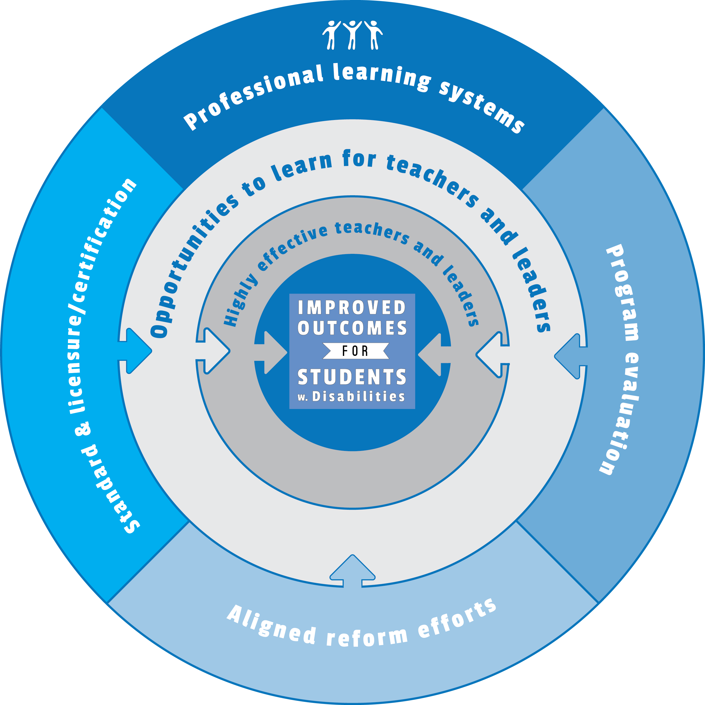
Our Approach
Notes:
To create aligned professional learning systems that provide teachers and leaders effective opportunities to learn how to improve and support core and specialized instruction in inclusive settings that enable students with disabilities to achieve college and career readiness standards

Slide 7
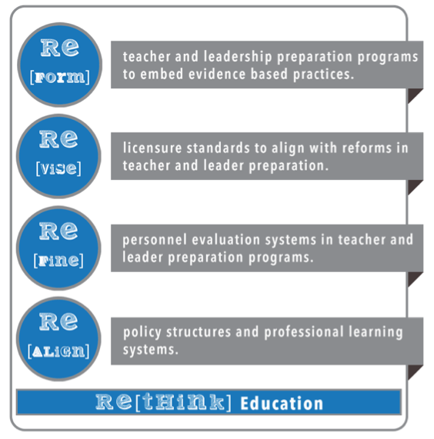
Fundamentals of Our Approach
Facilitate collaborative relationships among SEAs, IHEs (and other training programs), and LEAs to:
Notes:
Within this approach, CEEDAR is . . .

Slide 8
State Leadership Teams
Notes:
Designed to ensure that the influencers of reform are at the table. Must be empowered to make strategic decisions in policy and practice

Slide 9
Key Assumptions
Powerful strategies
Effective learning opportunities
Supportive policies
Sustained learning opportunities
Change through collaboration
Notes:
Teachers and leaders must use the most powerful strategies (powerful strategies are those that have proven to be effective in promoting student achievement and positive social outcomes)
Teachers and leaders need effective opportunities to learn
Effective opportunities to learn must occur over time
Policies must support preparation institutions in providing sustained, effective learning opportunities. In other words, the approach must be systemic

Slide 10
Intensive State Partners

Slide 11
The Three reform areas

Slide 12
Standards & Licensure
Analyze/revise policy/requirements to determine alignment with standards
Examine preparation program implementation
Determine consistency with evaluation systems

Slide 13
Examples of State Work
Ensuring general education teachers can work with students with disabilities
Notes:
California developed general teacher education standards that align with MTSS
Ohio modifying for dual licensure structure
http://www.craftguardinsurance.com/california-considers-bill-to-shorten-construction-red-tape/
http://www.tribune-courier.com/pages/ohio_facts.htm

Slide 14
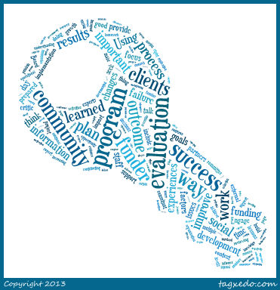
Program Evaluation & Approval
Identify systems in place to measure program effectiveness
Determine appropriateness of existing or piloting new measurement systems
Align CEEDAR efforts
and CAEP standards

Slide 15
Examples of State Work
Kentucky is developing systems to track data and program progress
Notes:
Kentucky is developing systems to track data and program progress
Michigan aims to align program approval with CAEP and CEEDAR goals
California is modifying teacher observation rubrics
http://animals-partner.blogspot.com/2015/06/list-of-kentucky-state-symbols-kentucky.html
https://wcmu.org/news/?p=5663

Slide 16
Examples of State Work
Michigan aims to align program approval with State Board of Education Standards, CAEP, and CEEDAR reforms
Notes:
Kentucky is developing systems to track data and program progress
Michigan aims to align program approval with CAEP and CEEDAR goals
California is modifying teacher observation rubrics
http://animals-partner.blogspot.com/2015/06/list-of-kentucky-state-symbols-kentucky.html
https://wcmu.org/news/?p=5663

Slide 17
Examples of State Work
California is modifying teacher observation rubrics to align with new teaching standards
Notes:
http://animals-partner.blogspot.com/2015/06/list-of-kentucky-state-symbols-kentucky.html
https://wcmu.org/news/?p=5663

Slide 18
Strand Presentation
Educator preparation policy as a lever for improving teacher and leader preparation: Keeping promises in Tennessee
Friday 10:00am
Crimson Clover Room
Dual credential preparation: California State University-Long Beach’s (CSULB) vision for equity and excellence in education
Friday 1:00pm
Lilly of the Valley Room
Notes:
TN and CEEDAR staff describe how one state revised policy to align with its statewide implementation of Response to Instruction and Intervention. Participants will have an opportunity to learn how Tennessee revised standards to ensure alignment and coherence in the preparation of general and special educators and school leaders.
CSULV created a dual credentialing program to align with California’s vision of all educators demonstrating a common foundation to meet the needs of all students. Participants will learn about the development and implementation of the new program and collaboration with partnering schools in clinical practice.

Slide 19
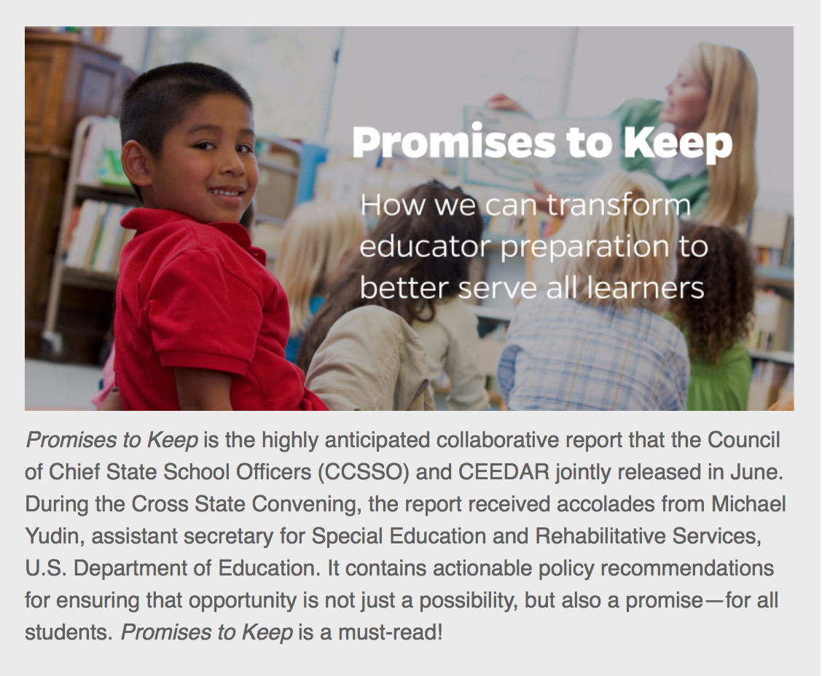
CEEDAR Policy Tools
Notes:
Provides recommendations for the educator preparation policy levers that states have: Standards, Licensure and certification, program approval and evaluation. These recommendations are aligned with the CCSSO Our Responsibility: Our Promise, but keyed to ensure that they reach students with disabilities.

Slide 20
CEEDAR Policy Map
Link to policy map

Slide 21
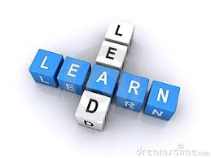
Program Reform
Identify key collaborators
Develop common focus area for reform
Complete IC process/identify high leverage practices to analyze program efforts
Engage in program reform

Slide 22
Georgia Example
Tackling special education, general education, and leadership reform for inclusion
Linkages to induction
Notes:
Georgia – multiple areas
Connecticut- literacy
Michigan – literacy and field experiences
Oregon- high leverage practices and leadership
http://awesomeamerica.com/connecticut/
http://awesomeamerica.com/georgia/

Slide 23
Michigan Example
Literacy, high leverage practices, and practice-based preparation – using MTSS as a framework
Notes:
Define evidence-based practices in literacy instruction for struggling learners K-3 within an MTSS (multi-tiered system of support) model and link educator’s access to the resources.
This work specifically addresses literacy instruction and is aligned with the Third Grade Reading Workgroup Report to Governor Rick Snyder and Top Ten in Ten Years initiative from the MDE, which hopes to make Michigan a top ten state in education in ten years.

Slide 24
Connecticut Example
Statewide effort to improve beginning teachers’ ability to teach literacy
Notes:
Achieve common core standards. Goals are based on beginning teachers’ performance on the Foundations of Reading tests.

Slide 25
Ohio Example
Design dual certification programs and certification; practice-based preparation
Notes:
http://www.tribune-courier.com/pages/ohio_facts.htm

Slide 26
Preparation Tools
Innovation Configurations (ICs)
Course Enhancement Modules (CEMs)
Reports
Practice Review
High Leverage Practice (HLP)

Slide 27
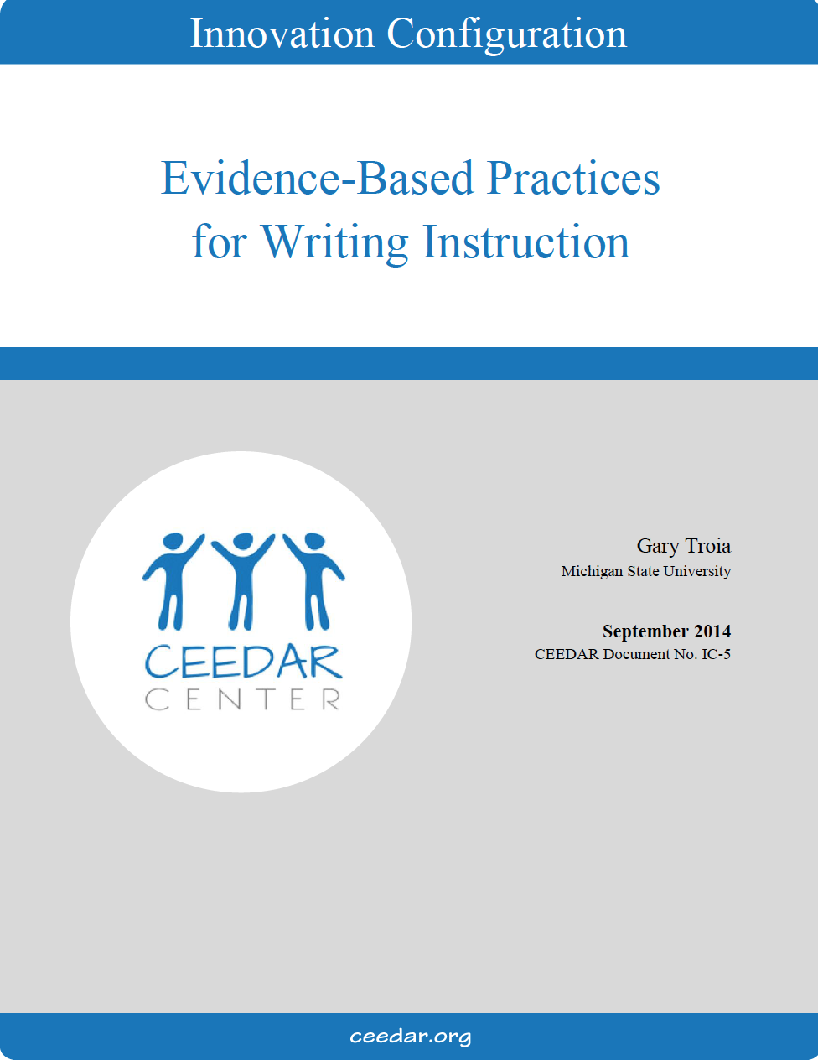
Innovation Configurations
Reading Instruction Grades K-5
Reading Instruction Grades 6-12
Transition Services
Universal Design for Learning (UDL)
Culturally Responsive Teaching
Writing Instruction
Principal Leadership
Content Learning with Technology
Students with Sensory Impairments
Students with Severe Disabilities
Mathematics
Technology in Pre-Service Prep
Behavior Management

Slide 28
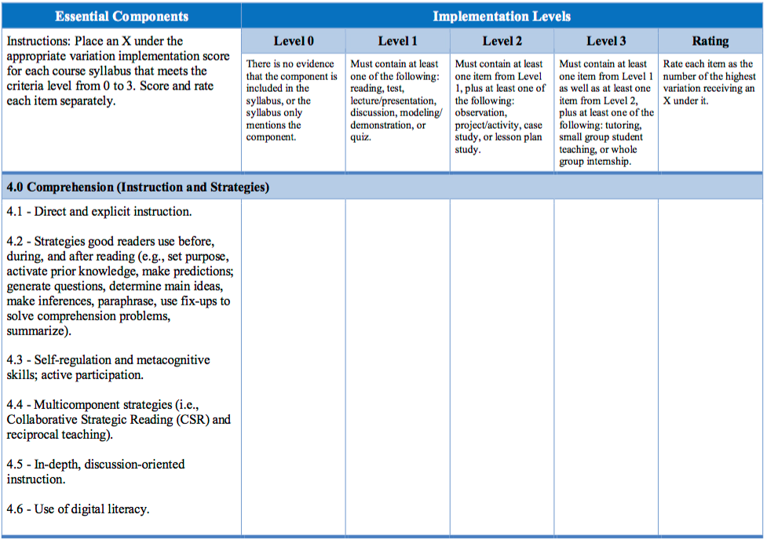
Evidence-Based Reading Instruction for Adolescents
Link to Innovation Configurations

Slide 29
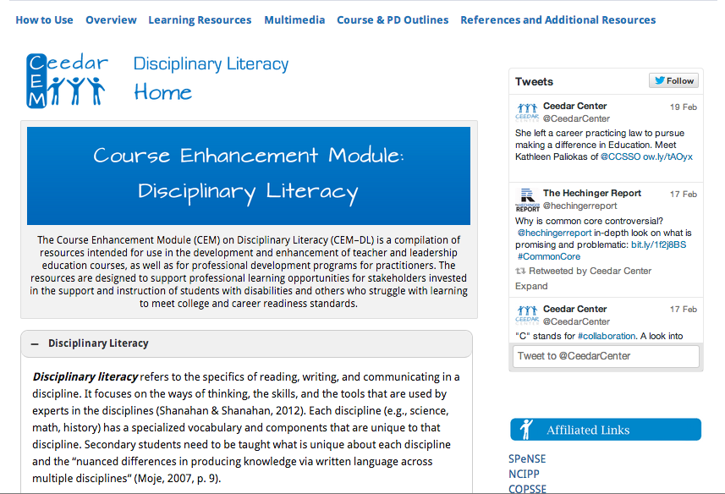
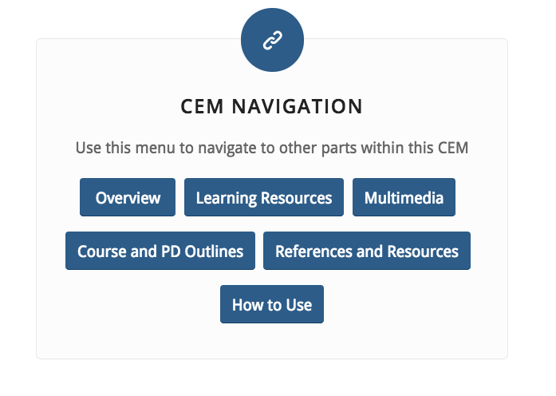
Course Enhancement Modules
Disciplinary Literacy
Classroom and Behavior Management
Universal Design for Learning
EBP for students with severe disabilities
Inclusive Education
MTSS for math
Reading K-5
Leadership

Slide 30
Reading
Overview: Purpose and objectives
Reading CEM
Learning resources:
Introduction
Multi-tiered systems of support
Essential components of reading instruction
Supplemental reading instruction
Intensive reading instruction
Multimedia
Course and PD Outlines
References and resources
Link to CEMs

Slide 31
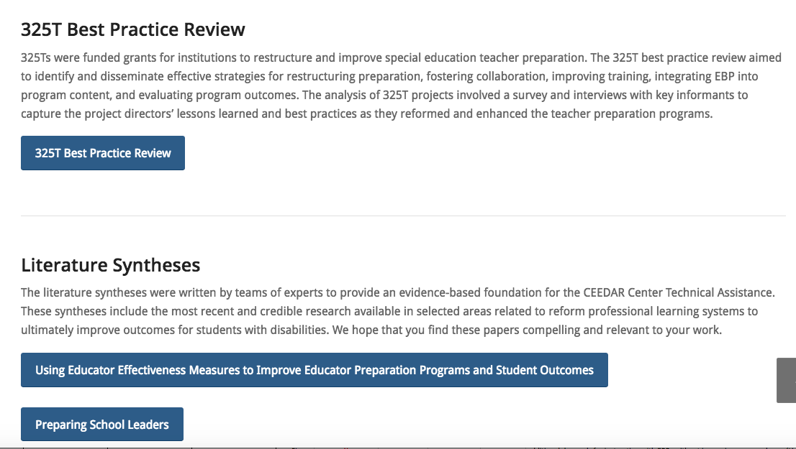
Reports

Slide 32
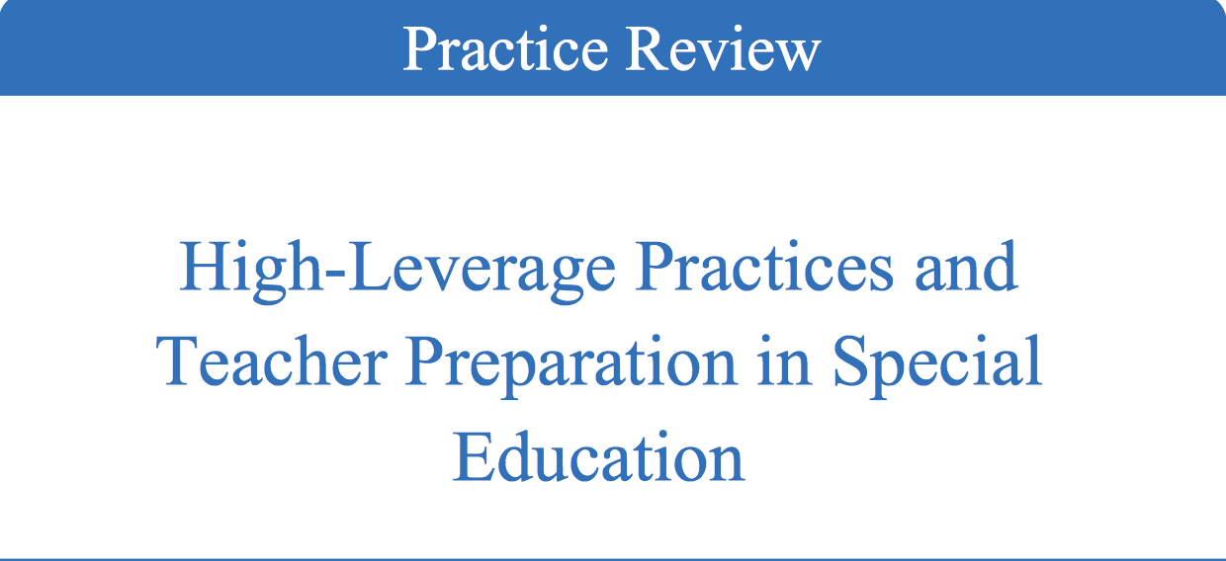
High Leverage Practices
Upcoming: Publication & Videos

Slide 33
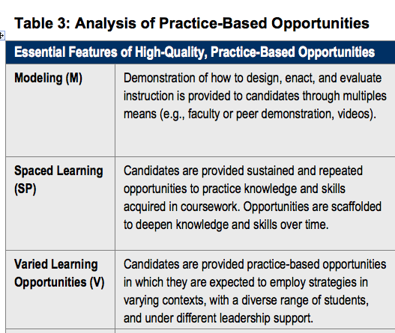
Practice-Based Preparation
Learning to Teach Rubric

Slide 34
Strand Presentations
Tightening the toolkit: Focusing reform on HLP | Thurs,11/10 4:00pm | Grand Kentucky Ballroom A
Practice-based approaches to improving teacher education | Fri, 11/11 11:00am | Grand Kentucky Ballroom B
Walking the walk: Collaboration across special, general, and leadership education at GSU | Fri, 11/11 2:00pm | Arabian Room
Leaders for all learners: Reforming ed leadership prep in Oregon | Fri, 11/11 3:00pm | Grand Kentucky Ballroom A

Slide 35
Other Presentations
Title | Time | Room
TOP: A validity and feasibility study examining teacher candidates’ practice opportunities | Friday 12:00 PM | Bluegrass I
Preparing secondary general and special educators together: A model for inclusive schooling | Friday 12:00 PM | Grand Kentucky Ballroom B
A status report on special education teacher licensure in US | Friday 4:00 PM | Grand Kentucky Ballroom B
Using lesson study to improve preservice teachers’ capacity for implementing evidence-based practices for students with significant disabilities | Saturday 8:00 AM | Blackberry Lilly Room

Slide 36
Other Products Available
Available at ceedar.org
Briefs
Webinars
Monthly Newsletters

Slide 37
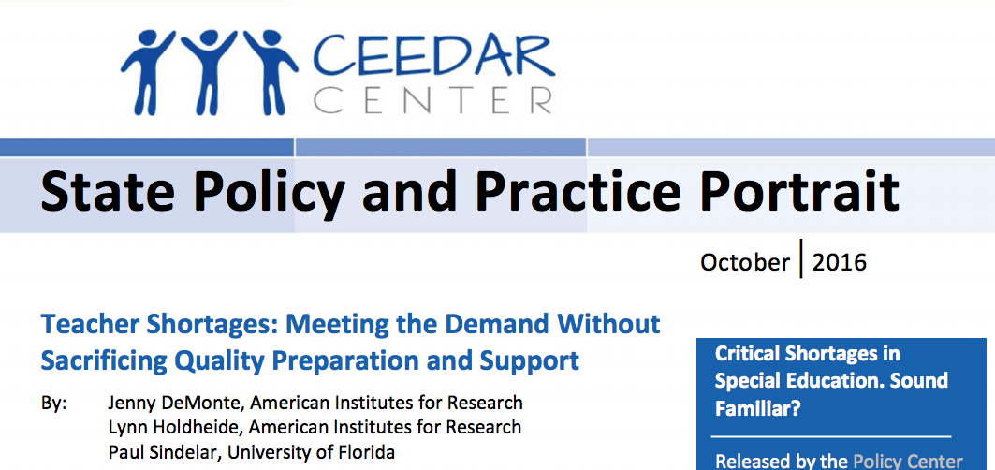
Briefs
Recently released

Slide 38
Upcoming Briefs
Culturally and Linguistically Diverse (CLD) Students: What Do Educator Preparation Programs Need to Know and Do to Support Their Learning?
Educator Preparation Programs and Local Partnerships
Integrating HLPs and EBPs
ESSA Opportunities to Leverage and Continue State CEEDAR Efforts
Special Education and General Education Program preparation reform
Leadership Preparation Reform-highlight database results and leader preparation work in states

Slide 39
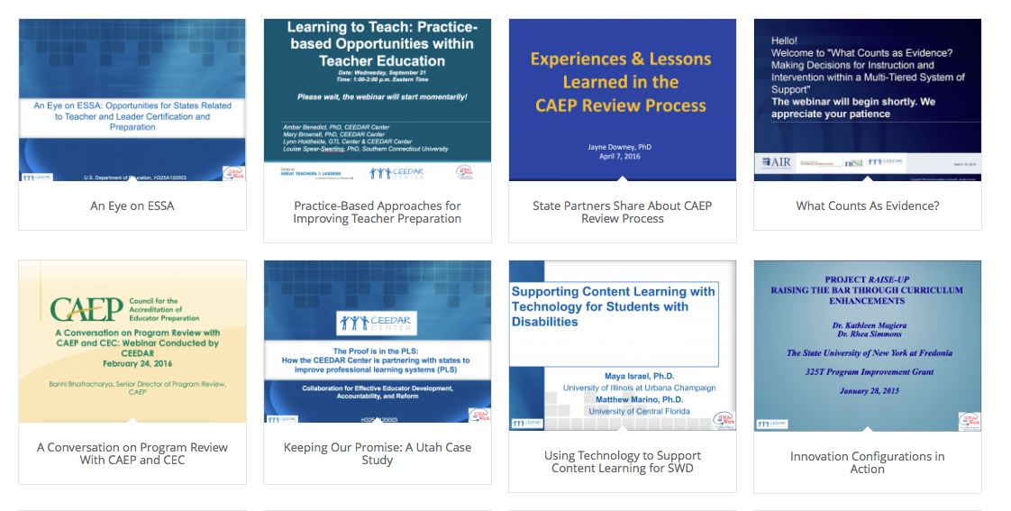
Webinars
Always free, offered bi-monthly, archived on ceedar.org
Notes:
Remind them of the upcoming webinar on integrating information about working with families in educator preparation, November 14th

Slide 40
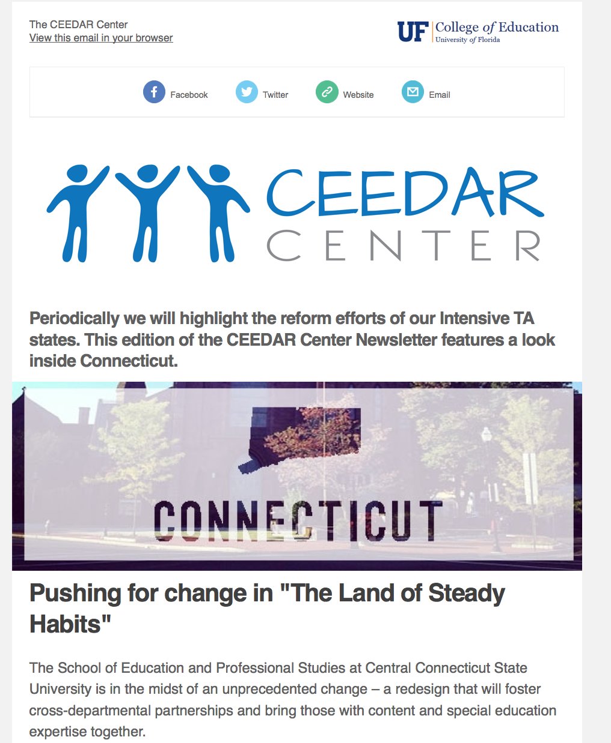
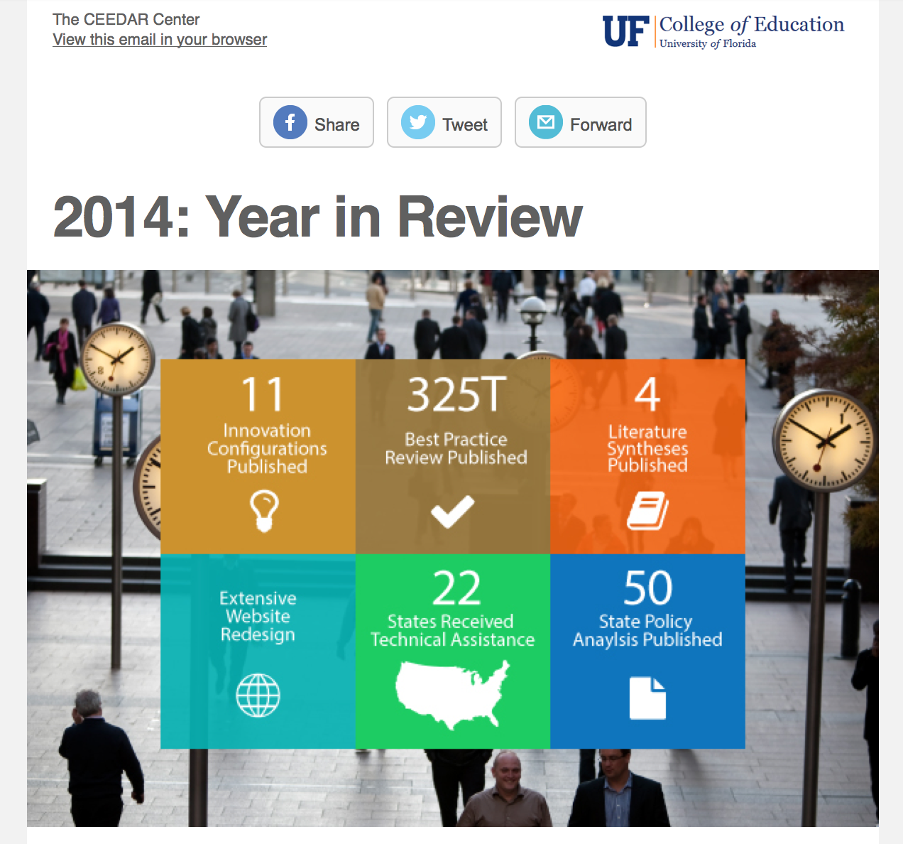
Monthly Newsletter
Highlights of Intensive State Work, Tools, Events and more!

Slide 41
Conversation starters
What information from today’s presentation piqued your interest?
What information would be helpful to you in improving your preparation programs in special education, general education, and leadership?
What additional questions do you have?

Slide 42
Disclaimer
The contents of this webinar were developed under a cooperative agreement from the U.S. Department of Education, H325A120003. However, those contents do not necessarily
represent the policy of the U.S. Department of Education, and you should not assume endorsement by the Federal government.

