Slide 1
Practice Makes Perfect
Practice Makes Perfect: Improving Our Profession
Mary T. Brownell
www.ceedar.org
H325A120003

Slide 2
Disclaimer
This content was produced under U.S. Department of Education, Office of Special Education Programs, Award No. H325A120003. Bonnie Jones and David Guardino serve as the project officers. The views expressed herein do not necessarily represent the positions or polices of the U.S. Department of Education. No official endorsement by the U.S. Department of Education of any product, commodity, service, or enterprise mentioned in this website is intended or should be inferred.

Slide 3
Effective practice
Accounts for about 20-33 percent of the variance
Notes:
Accounts for a sizeable portion of the variance in expert performance, anywhere from about 20 to 30 percent. Of course, there are other things that matter, such as individual cognitive processes and personality variables that enable one to learn more effectively from practice (e.g., working memory, attention, motivation, etc.)
Image from http://progressions.prssa.org/index.php/2013/09/30/expertise-becoming-an-ethical-expert/

Slide 4
Effective practice (cont.)
Allows for the development
of fluent performance and
situated knowledge
Notes:
I liked this picture of neurons and their synapses as it made me think about the acquisition of knowledge.
But the type of knowledge effective teachers and other applied professionals, such as early interventionists, leaders, school psychologists, etc. need is not just acquired through learning from a book. It is acquired by applying in those settings and situations where we will ultimately be asked to use it.
Practice is what allows an expert to almost seem as if they are making decisions that are intuitive.

Slide 5
Wayne Gretzky Quote
When hockey great Wayne Gretzky was asked for the secret to his success, he replied, “I don’t know; I just go to where the puck is going to be” (Berliner, 1994, p. 167). Although he cannot explain how or why he knows where to go, research suggests that it is not through some innate clairvoyant ability, but rather it is the result of thousands of hours of deliberate practice, years of experience, and the use of appropriate cognitive processes. One of these processes is intuition. Gretzky was subconsciously making very fast decisions based on his knowledge, stored memories, and a holistic view of his surroundings. --Pierre & Smith, 2014
Notes:
To cite this article: Peter St. Pierre & Mark Smith (2014) Intuition in Coaching: It's Not Magic, Strategies, 27:2, 37-42, DOI: 10.1080/08924562.2014.879430
To link to this article: http://dx.doi.org/10.1080/08924562.2014.879430

Slide 6
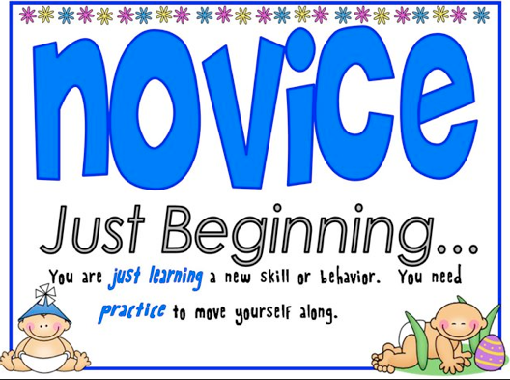
Novices
”they are prisoners of their own lack of experience and have no choice but to be relatively inflexible.”
Berliner, 1992
Notes:
Images from http://www.samatters.com/developing-situational-awareness-in-novice-responders/
Images from http://scs-connect.com/expert-leader-follower-or-copycat/
There is a difference in knowing that and knowing how. Novices have a lot of “knowing that” . They know facts and rules – the sorts of information you gain in school, coaches clinics and other trainings, and conferences. They learn rules and routines. At this stage of skill acquisition, coaches are inflexible and deliberate; they “are prisoners of their own lack of experience and have no choice but to be relatively inflexible.” (Berliner, 1992, p. 101). Rules and facts are all they have on which to base decisions.

Slide 7
Experts
Make decisions that seem effortless, intuitive, and highly responsive to the situation at hand.
Notes:
Images from http://scs-connect.com/expert-leader-follower-or-copycat/
Experts make decisions in apparently effortless, and intuitive ways. Sometimes people are tricked into thinking it is some innate ability that experts have, as if it did not involve formal knowledge, but that is not the case. Intuition is a process that involves formal knowledge, keen perceptual abilities, and holistic recognition of patterns that have been drawn from memory. Through experience, experts have amassed recognition of many situations and how to respond successfully and these become tightly integrated with their knowledge – at the subconscious level.

Slide 8
In initial preparation
we are not preparing experts
Notes:
See http://www.buylocalexperts.com/sanantonio/

Slide 9
Advanced Beginners
Rely less on rule-driven behavior and begin to use context to determine when to apply rules.
Notes:
As they spend more time coaching, they begin to recognize similarities across contexts. With a growing foundation of experience, professionals at the advanced beginner level start to rely less on rule-driven behavior. Although still somewhat rule-oriented, they are increasingly guided by context to determine when to apply rules. At this level, coaches develop strategic knowledge — when to ignore or break rules and when to follow them. For example, a novice coach who notices two players whispering in the back of a huddle would likely stop to discipline them. To avoid disrupting the flow of the lesson, an advanced beginner-level coach might ignore these players and carry on without interruption. He or she would then talk to the players at a more appropriate opportunity.

Slide 10
A Practice-Based Approach
Notes:
The important role of practice in developing the ability to apply knowledge and skills in more flexible ways, such as the skill that begins to emerge in advanced beginners, suggests that applied professions, such as teaching, leading, early intervention and related service professions adopt a practice-based approach to educating their candidates.

Slide 11
Three Key Ideas
Notes:
A practice-based approach is based on three key ideas
Image from https://www.pinterest.com/pin/37647346861601972/

Slide 12
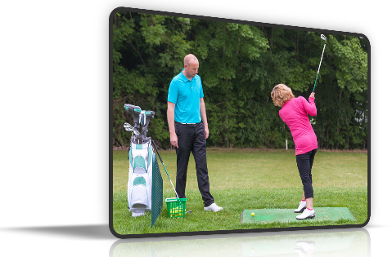
Practices are learnable
Notes:
One is that practices can be learned. They can be broken down into their subskills and taught to a novice

Slide 13
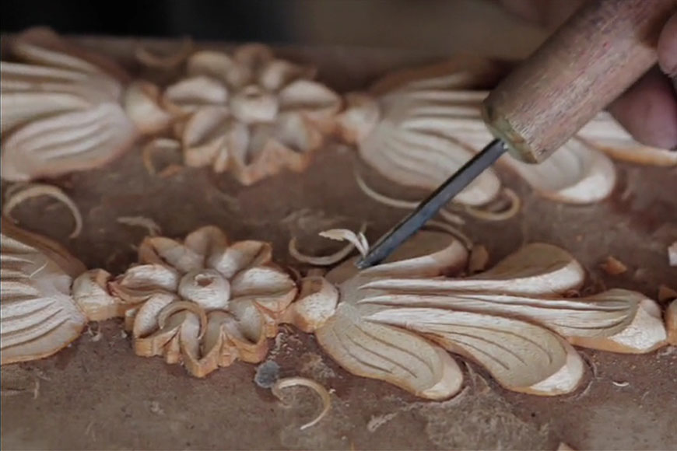
They can be refined
through on-going learning

Slide 14
High Quality Practice
Notes:
However, they can only be acquired when novices have multiple opportunities to practice that include such learning supports as coaching and feedback.

Slide 15
Overcoming Challenges
Notes:
However, there are some challenges in preparing novices to be Advanced Beginners
Source for image: https://www.linkedin.com/pulse/20141028151652-131400631-we-need-challenges-in-our-lives

Slide 16
Time is short
Notes:
The time to develop teachers through traditional or nontraditional programs is relatively short, and this is particularly true for truncated programs that many teachers often participate in.
Source for image: https://www.linkedin.com/pulse/2014

Slide 17
Coursework and Field work
Coursework
Field work
Notes:
Preparation programs are heavily based in coursework. The program does not have jurisdiction over what is happening in the field in many cases, unless they have been able to establish a strong partnership where they have collaboratively agreed to focus on certain aspects of practice. Even when programs are largely field based, the number of excellent mentors who can demonstrate high leverage practices and evidence based practices in action and be effective in mentoring is questionable. University budgets rely on coursework and numbers of students in those courses, so this fact must be taken into consideration.
Source for image
\https://www.romancatholicman.com/

Slide 18
Too much heterogeneity
Notes:
See image at http://epi-thinking.org/HETROGENEITY.html
This is especially true in teacher education where we have not agreed upon key content and critical practices that all teachers should know, particularly in special education where we want teachers to know how to do a little bit of everything just in case they end up in a context other than what they learned to teach in. However, this is fallacious thinking – they end up really learning how to do very little. Instead, they end up memorizing a lot of information rather than learning to practice some select strategies. We end up violating what we know about the development of advanced beginners.

Slide 19
Moving Forward
Notes:
Will require that we think carefully about what we are trying to accomplish, the sequence of opportunities we have in our programs to help our candidates learn to practice, and the individual qualities of those programs.
Image from http://www.calsoapsb.org/avanzando-juntosmoving-forward-together/

Slide 20
Focusing
Reasonable set of practices that:
are the essence of effective teaching, leading, etc.
can improve student outcomes
are fundamental to developing more complex practice
Notes:
How can we focus on a reasonable set of practices that are the essence of teaching, leading, etc.

Slide 21
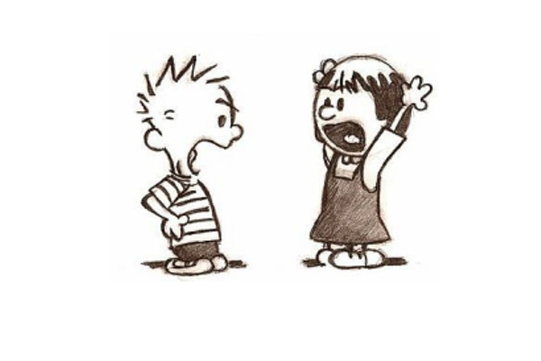
This might involve
Difficult conversations about what to emphasize and what to eliminate
Notes:
This problem is most pronounced in special education and even in elementary education where the expectations to have command of different types of content and the ability to work across grade levels and service delivery models is high.
However, we have to come to terms with the fact that in most 2 year campus based undergraduate programs, one year post baccalaureate programs, and classroom based alternative programs it is impossible to cover a broad range of topics and simultaneously focus our efforts. Only the latter will result in competence
Image from http://dcc.umd.edu/portfolio/zzhao/2016/03/15/the-art-of-having-difficult-conversations/

Slide 22
Coherent Venn Diagram
Notes:
Thinking about the opportunities that your candidates have access to in order to have multiple opportunities to practice over time.
See https://davidhobbsconsulting.com/how-to-articles/coherence-consistent-connected

Slide 23
Less authentic to more authentic
More
authentic
More
complete representation
of practice
More full
participation by novice
Closer to
real time
Enacting the practice with more support
Less
authentic
Fewer facets of practice highlighted
Narrower participation of novice
Greater opportunity for rehearsal
Crafting a piece of practice
Engaging in a live role play
Analyzing a written case

Slide 24
Deliberate Practice
Notes:
Do those opportunities allow candidates to deliberately practice key skills?

Slide 25
High Quality Practice (cont.)
Notes:
However, they can only be acquired when novices have multiple opportunities to practice that include such learning supports as coaching and feedback.

Slide 26
You can retrieve at
CEEDAR Center Reports
GTL Center Resources

Slide 27
Questions?

