Slide 1
Essential Components of Reading Instruction K–5
Part 3.4: Fluency
Collaboration for Effective Educator Development, Accountability, and Reform
H325A120003
Notes:
Materials Required:
3.4: References: Fluency
 Text to model fluent and non-fluent reading
(Suggested: Wolf! By Becky Bloom)
 Timers
 Overhead projector or Smartboard displaying charts
 Chart paper for participants to graph words correct per minute
 Red and blue markers for each participant.
Handouts
 3.4A: Fluency Norms
 3.4B: Partner Reading Simulation
In the previous parts of this CEM we learned how to teach children to crack the alphabetic code and decode words. We learned about how to support advanced phonics and word study through the study of morphemes and word parts.
In this module, we will focus on the students who read slowly, word by word, and comprehend little. We must teach these students to read fluently so that less of their attention is devoted to decoding the words and more effort is given to understanding the meaning of the text.

Slide 2
Module Outcomes
Design instruction for all students
Differentiate instruction
Use assessment data to inform instruction; form groups; and monitor progress
Incorporate standards and evidence-based practices (EBPs)
Notes:
In addition to learning about the big ideas and answering the big-idea questions, after you have completed this module, you will be able to: (1) design and evaluate instruction for all students, including those at risk for reading difficulties; (2) differentiate instruction for each student; (3) use assessment data to inform your instruction, to form groups, and to monitor student progress and (4) incorporate state standards and evidence-based practices (EBPs).

Slide 3
Acknowledgments
Much of the information in this fluency presentation has been adapted from:
Texas Fourth Grade Teacher Reading Academy, Vaughn Gross Center for Reading and Language Arts at the University of Texas at Austin, ©University of Texas System/TEA
And from the work of:
Jan Hasbrouck, Ph.D., Educational Consultant
Notes:
Some of the slides we will discuss today are adapted from the Texas Fourth Grade Teacher Reading Academy by the Vaughn Gross Center for Reading and Language Arts at The University of Texas at Austin. Acknowledgments also go Dr. Jan Hasbrouck for her work in this area and her willingness to share her research with us.

Slide 4
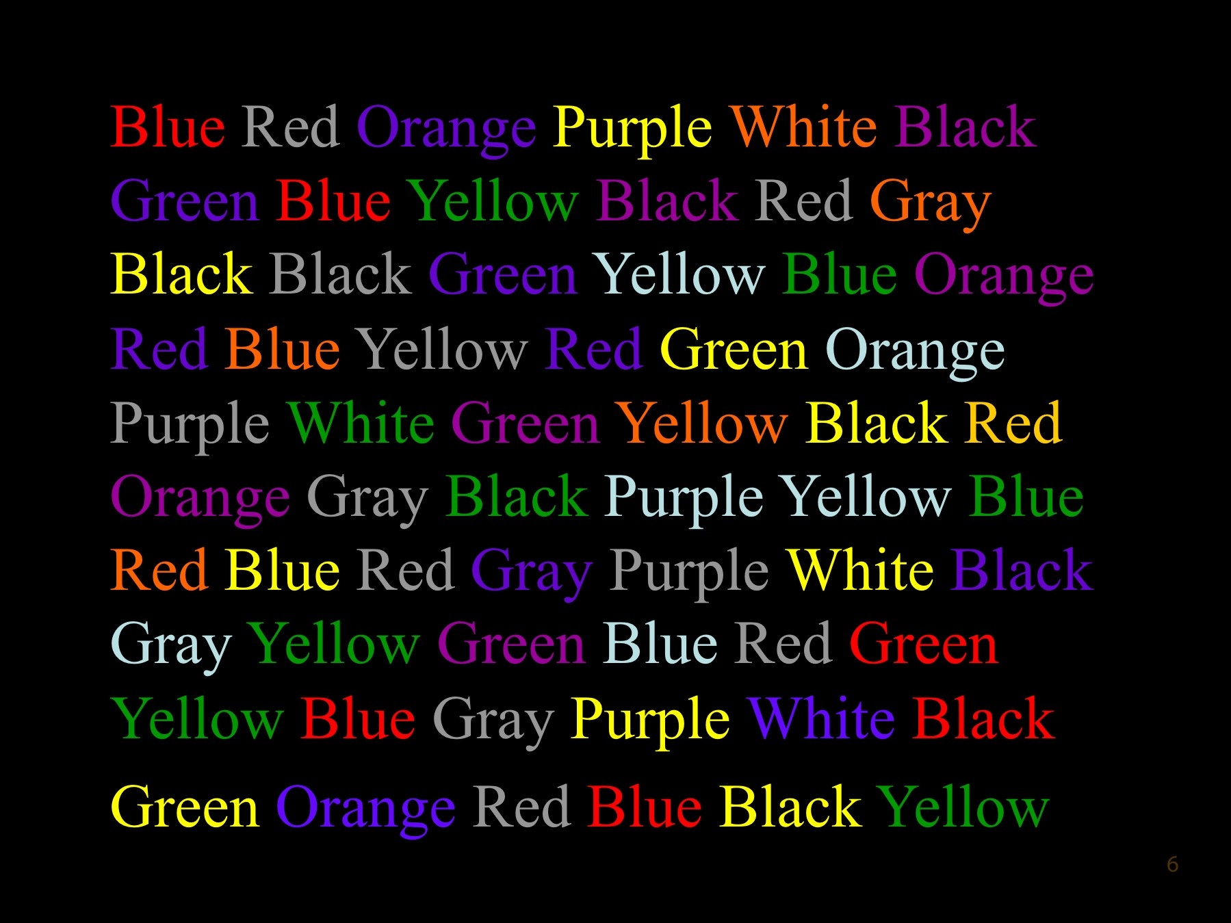
Notes:
Stroop Test
Let’s experience how some students read, consciously thinking about every word. Look at the slide (Stroop, 1935). When I say, “Go,” say the colors aloud as you see them. For example, the first three colors are red, gray, and purple. Use your best reading. You may begin, everyone reading aloud in whisper voices, as fast as you can..
Allow the participants to read three to four lines of colors.
It took awhile to get the hang of that, didn’t it? Even though you knew the colors and the words, you had to concentrate on saying the color and not reading the word. It was not automatic, and it could be tiring!
Now try reading the words and ignoring the color.
Pause.
Which was easier? Yes, reading the words was easier. Why?
Elicit a few comments.
Yes, you could read the words automatically. The first time, when you had to say the color rather than read the word, your mind automatically determined the semantic meaning of the word and then had to override this first impression. Such a process is hardly automatic.
I wanted you to experience how difficult it is to read when you cannot read with automaticity and fluency.

Slide 5
Common Core Standards
Read with sufficient accuracy and fluency to support comprehension.
Read on-level text with purpose and understanding.
Read on-level text orally with accuracy, appropriate rate, and expression on successive readings.
Use context to confirm or self-correct word recognition and understanding, re-reading as necessary.
http://www.corestandards.org/
Notes:
Fluent reading of connect text is expected of students, generally by the second semester of first grade or when students can read at least 40 words per minute. These are the Common Core State Standards (CCSS) for Grades 1-5.
Note letter b, which is bolded. This is the generally accepted definition of reading fluency: reading with accuracy, appropriate rate, and prosody, or expression, leading to understanding or comprehension (letter a).
According to author and researcher Jan Hasbrouck, “Reading fluency can be defined as reasonably accurate reading (not perfect with zero errors, but within a range of approximately 95%-99% accuracy), performed at . . . a minimal rate that is appropriate to the purpose of the task, with appropriate prosody that leads to successful comprehension. Reading fluency is accurate reading at a minimal rate with appropriate prosody that leads to successful comprehension.”
So, what does “performed at a minimal rate appropriate to the purpose of the task” mean? Turn to your partner and discuss for 30 seconds.
Pause for discussion. Then, solicit responses. Guide candidates to the conclusion that people read at different rates, depending on the text. The more difficult or obtuse the text is, the slower one reads. For example, one would likely read a complex physics text slower than a romance novel.

Slide 6
Fluency Terms
Automaticity is the quick, effortless, and accurate reading of words.
Prosody is reading expressively, pausing for punctuation and phrasing appropriately.
Hasbrouck & Hougen, 2012
Notes:
Read the first definition on the slide.
Proficient readers read with automaticity—they do not have to stop to sound out each word.
Read the second definition on the slide.
Prosody does not mean reading as fast as you can.
Demonstrate reading very quickly with no pauses.
Rather, it means reading quickly, effortlessly, and expressively; pausing for punctuation; and phrasing appropriately. Reading with prosody sounds similar to how you speak.
Read the same text again, appropriately.
When students read with prosody, they are more likely to understand what they read.

Slide 7
Fluency Involves . . .
Reading with automaticity, accuracy, and prosody.
Phonological, orthographic, and morphological knowledge of letters, letter patterns, and words.
Effective and efficient processing of this information in connected text.
Hasbrouck & Hougen, 2012; O’Connor, 2014
Notes:
Students who read fluently demonstrate an understanding of phonological, orthographic (spelling), and morphological knowledge at the letter and word levels. When students read fluently, they can efficiently and effectively process this information.

Slide 8
Fluency
Should be taught from the beginning of the reading-acquisition process
Has implications for assessment, intervention, and prevention of reading difficulty.
Hasbrouck, 2010; National Reading Panel Report, 2000; National Research Council, 1998; Wolf et al., 2000;
Notes:
Fluent reading must be modeled and taught from the beginning. Instruction in reading fluency can help to prevent and remediate other reading difficulties, and measures of fluency can be used as a predictive assessment of future reading problems.
Please note that fluency instruction does not involve reading connected text and measuring words read per minute until after students have learned to decode a substantial number of words. However, fluency instruction can begin as students are learning letter names and sounds, then reading individual words.

Slide 9
Ultimate Goal
Comprehension of text
Motivation to read
Notes:
The ultimate goal of fluency is NOT to read as quickly as one can but to learn to read with automaticity so one better comprehends what is read. When reading becomes automatic and easy, students are motivated to read more for pleasure and for information.

Slide 10
Causes of Comprehension Difficulties
Lack of . . .
Background knowledge
Language foundation
Metacognitive skills
Ability to organize content and context
Decoding skills
Fluency
Pikulski & Chard, 2005
Notes:
Many factors can cause some students to have difficulty comprehending what they read. Read this slide to yourself and be prepared to discuss what you think is the cause of one of your students’ comprehension difficulties.
Pause to give participants time to read the slide.
What comments and observations can you offer about your students’ comprehension difficulties?
Elicit at least three comments.
Turn to your partner and discuss why you think that problems reading fluently may cause comprehension difficulties.
Pause for 30 seconds. Elicit some comments. Point out that lack of metacognitive skills refers to students’ inabilities to recognize when they are having difficulties understanding. Often, they just keep on reading rather than stopping to figure out what is causing their problems with comprehension.
You see that fluency is one cause of reading difficulties. It is also the result of the lack of the other skills. Dr. Hasbrouck often describes fluency as a thermometer. A thermometer can measure your temperature and tell you that something is wrong with your body, but it does not tell you what is causing the rise in temperature. To find out the cause, other diagnostic tests have to be administered.

Slide 11
Fluent Readers . . .
Focus attention on comprehension
Do NOT focus on decoding
Read effortlessly
Enjoy reading
Notes:
Yes, fluency is important! Please read the slide to see whether your answers about the relationship of fluency to comprehension match what reading researchers have discovered.
Provide time for the participants to read the slide silently.
Note that good readers do not focus on decoding because they can decode with automaticity. They decode with accuracy, and they have learned to recognize words quickly, not read letter by letter. They can think about the meaning of the words and use their cognitive resources on comprehending the text.

Slide 12
Notes:
As you can see, fluency links word recognition skills to the ability to comprehend text. If the fluency link is missing or weak, comprehension suffers.

Slide 13
Kindergarten Skills
Letter naming
Letter-sound correspondence
Phrase reading
Rereading of decodable and predictable
text
Honig et al., 2008
Notes:
We cannot expect children to read connected text fluently until they read about 40 WCPM, which is usually the second semester of first grade. However, they can practice reading fluently beginning in kindergarten. Students can practice naming letters with automaticity, reading phrases, and then rereading decodable and predictable text.

Slide 14
First Grade
Letter-sound correspondence
Word recognition
Phrase reading
Rereading of decodable, predictable text
50-60 WPM by EOY
Honig et al., 2008; O’Connor, 2014
Notes:
By the end of first grade, typically achieving students develop the ability to read connected text at 50-60 WCPM. You will find that different assessments may have different goals for the end of first grade, but if your students can read 50-60 WCPM by the end of first grade, they are likely to continue to be successful readers.
If students are reading 40 words or fewer, they are at-risk for reading difficulties.
EOY=End of year

Slide 15
Second Grade
Word recognition
Phrase reading
Reading of grade-level book.
90-100 WCPM by EOY
Honig et al., 2008
Notes:
What do you notice about expectations for second-graders? They should read more words correctly per minute.

Slide 16
Third Grade
Read grade-level text aloud with appropriate rate, accuracy, and prosody
More than 110 WPM by EOY
Honig et al., 2008
Notes:
By the end of third grade, students should be reading more than 110 WCPM (words correct per minute), with automaticity, accuracy, and prosody.
70 WCPM or lower places the student at risk for reading difficulties.

Slide 17
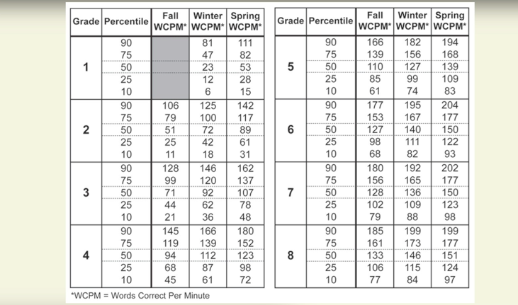
Hasbrouck & Tindal, 2006
Notes:
These are the Hasbrouck–Tindal Oral Reading Fluency norms. Researchers Hasbrouck and Tindal gathered fluency rates from students throughout the country and determined rates for students in Grades 1–8. (Hasbrouck, J. & Tindal, G. 2006). Note the scores for fall, winter, and spring. The percentile column indicates where students fall in relation to other students. For example, a percentile of 50 means half of the students assessed read more fluently and half read less fluently than their peers.
Look at the chart. How many WCPM (words correct per minute) should you expect a student to read at the 50th percentile in the spring of second grade ?
Pause.
Yes, 89 words correct per minute on grade level text.
Many students who struggle read at the 25th percentile or lower. What WCPM might a student read at the 10th percentile in the fall of fourth grade?
Pause.
Yes, 45—fewer than we expect a typical first-grader to read.
Oral Reading Fluency (ORF) scores are highly predictive of comprehension. We can predict which students may have difficulty with a certain text simply by listening to them read the text aloud for 1 minute. Note: New norms will be published in 2016.
There is no reason for students to read more words per minute than at the 50% on the Hasbrouck-Tindall norms. Reading faster than that does not increase comprehension. Therefore, once students reach the 50 percentile and maintain that rate, even as the materials get more difficult with each grade, there is no need for them to strive to read faster.

Slide 18
WCPM Gains Per Week by Grade
Grade | Words per Week
1 | 2 to 3
2 | 1.5 to 2
3 | 1 to 1.5
4 | .85 to 1.1
5 | .5 to .8
6 | .3 to .65
Fuchs et al., 1993
Notes:
Researchers have determined expected gains of WCPM per week on cold readings, or texts the students are reading for the first time.
Read the slide.
Why do you think students gain fewer words per week as they progress through the grade levels?
Elicit at least three responses, guiding the participants toward conclusions such as the material increasing in complexity, etc.

Slide 19
50 Percentile ORF EOY Norms
Grade | WCPM at 50 %tile
1 | 53
2 | 89
3 | 107
4 | 123
5 | 139
6 | 150
Hasbrouck & Tindal, 2006
Notes:
If your students can read aloud the number of words indicated correct per minute, plus or minus 10 words, it is predicted that they will continue to learn to read as expected.

Slide 20
NAEP Measures of Prosody
Levels
4: Reads with expressive interpretation.
3: Reads in three- to four-word phrase groups.
2: Reads in two-word phrases, awkwardly grouped
1: Reads primarily word by word.
National Center for Education Statistics, NAEP-Oral Reading Fluency, 2002
http://nces.ed.gov/nationsreportcard/studies/ors/scale.asp
Notes:
Measuring prosody is a bit more challenging. The National Assessment of Educational Progress (NAEP) offers some general descriptors, which are summarized on the slide.
I will model each level.
Read a passage four times, once at each of the four levels of prosody described on the slide.
Partner A, read any passage at one of the four levels, and Partner B, determine which level of prosody your partner is modeling.
Pause.
Now switch roles and do the same thing.
Pause.
We all know word-by-word and awkward reading when we hear it.
NAEP Oral Reading Fluency Scale: http://nces.ed.gov/nationsreportcard/studies/ors/scale.asp

Slide 21
Fluency Assessment
Students read aloud for 1 minute
Count number of words read
Subtract words read incorrectly
Difference is words read correct per minute (WCPM)
Assess percent accuracy (in needed)
Check with oral reading fluency norms (ORF)
Notes:
Before we explore how to help students improve their fluency rates, let’s discuss how we measure reading fluency.
The best way to determine a student’s reading fluency is first to listen to the student read a passage aloud for 1 minute. Follow along, marking any words read incorrectly. Then determine the total number of words read correctly (words correct per minute, or WCPM) and compare that number with established oral reading fluency (ORF) norms.

Slide 22
Procedures
Encourage best reading, not fastest
Do NOT say “Ready, set go!”
DO say, calmly, “You may begin now.”
Notes:
Some teachers make the mistake of encouraging students to read as quickly as they can. Rather, students should be told to do their best reading. Do not start fluency practice as you would a race, with “Ready, set, go!” Rather, calmly say, “You may begin reading now.”

Slide 23
Comprehension Probes
Ask one to two comprehension questions.
OR
Ask the student to retell the story or summarize the passage.
Notes:
Even while students are reading for fluency practice, comprehension of the text should be emphasized. Therefore, it is helpful to tell the students you will be asking them a few questions about the text when they are through reading.

Slide 24
Fluency Instruction
Teacher models
Repeated reading
Partner reading
Choral reading
O’Connor, 2014
Notes:
In the next several slides, we will discuss some activities that will promote reading fluency. Note that these activities should be applied to narrative and expository texts.

Slide 25
Repeated Reading
Fosters fluent word recognition
Encourages rapid decoding
Increases confidence
Enhances comprehension
Hasbrouck & Hougen, 2012; O’Connor, 2014
Notes:
Repeated reading can improve fluency in multiple ways.
Read and discuss the slide.

Slide 26
Repeated Reading Procedures
Student reads short passage aloud.
When student makes an error, hesitates, or asks for help, teacher says the word.
Student repeats the word and rereads the sentence.
Student reread the text three times.
Notes:
This slide illustrates one way to implement repeated reading.
Read the slide.

Slide 27
Partner Reading: Benefits
Provides repeated reading benefits
Increases fluency
Increases time reading
Maximizes student engagement
Provides a model of fluent reading
Creates opportunities for individual support
O’Connor, 2014; Vaughn & Linan-Thompson, 2012
Notes:
Partner reading is fun, and better yet, it improves reading fluency. Some of partner reading’s benefits are listed on the slide.
Read and discuss the slide.

Slide 28
Partner Reading Procedures
Reader 1 reads passage aloud
Reader 2 listens and corrects
Readers change roles; Reader 2 reads same text as Reader 1
Repeat allowing each partner to read the same text two times
Notes:
When this activity is first implemented, Reader 1 should be the better reader so that Reader 2 hears a model of the reading. Students are provided with a script to correct errors the partner may make. Of course, this procedure must be practiced with teacher support before students are to do this independently.

Slide 29
Partner Reading Scripts
Stop. Read that word again.
Yes, that word is . . .
Reread the sentence.
OR
No, that word is . . .
What word?
Reread the sentence.
Notes:
Here is an example of a script that you can have your students use when providing feedback to their partner. It is important to teach students how to use the script and to be a supportive partner. Be sure they practice the script before they use it with their partner.
Practice the script with your partner. Partner B, read a paragraph from your text and intentionally make one or two mistakes.
Partner A, correct your partner using this script.
Pause while participants practice the script.

Slide 30
Sample Retell
Reader 2 asks questions about sequence of events in passage.
Reader 1 retells the passage by answering the questions.
Notes:
We always want students to think about comprehension as they read. Having a way for them to be accountable for comprehending the text is important. A simple retell or asking the students a couple of questions is often sufficient. When the partners have each read the selection twice and followed along twice, have them engage in this retell exercise. Use questions that you have provided or have participants ask their own questions.
This practice supports comprehension.

Slide 31
Notes:
This is an example of a graph charting the first or “cold” reading (in blue), and the last, practiced “hot” reading, in red. This student gain about 35 words from the cold reading (105) to the hot reading (140 wcpm).

Slide 32
Notes:
This slide shows the second and third times our example student practiced fluency. Note that both the red and blue lines have increased. Seeing this progress motivates students and parents.
Of course, students will need to be taught to graph this way. Younger students will need explicit instruction and practice before they are efficient and accurate.
What if there is no improvement in fluency scores? What could be the reason?
Pause for comments.
The material could be too difficult or the student could be having a bad day. However, if there is no improvement after three measurements, examine your instruction. What must be changed?
We will talk about how to determine and implement changes when we discuss interventions. However, it is important to know that fluency scores can indicate whether your instruction is resulting in student progress or whether something must be modified. You do not have to wait until the end of the semester to determine whether a student is having difficulty reading.
More information about charting student progress is available in Hasbrouck & Hougen, 2012.

Slide 33
Other Fluency-Building Activities
Choral reading
Echo reading
Computer-based and tape-assisted reading
Chunking or rereading portions of text
Performance reading
Hasbrouck & Hougen, 2012; O’Connor, 2014
Notes:
You can use many other fluency-building activities, including:
• Choral reading—the entire group reads together.
• Echo reading—you read, then the students read.
• Computer-based and tape-assisted reading—students follow along.
• Chunking or rereading portions of text—“Read your favorite sentence or phrase three times, like an actor would read it.”
• Performance reading, such as Readers’ Theatre—students learn to read a few lines of a short play.
The important thing is to practice fluency for 15-20 minutes at least three times per week.

Slide 34
Research indicates…
Repeated reading is the “gold standard”
Combine strategies for best results and to motivate students
Modeling
Repeated reading
Progress monitoring
Hasbrouck, 2010
Notes:
Read this slide to yourself.
Pause.
Turn to your partner and, in the next 2 minutes, discuss what you think are the most important points you learned about fluency today. Partner B, please scribe the points you and your partner discuss.
Pause 2 minutes.
Now, take 1 minute to discuss questions or concerns about teaching fluency. Partner A, please write the concerns or questions you and your partner raise. You will turn in these questions before you leave today.
Begin.
Pause 1 minute and then collect the questions. If you have time, respond to some of the questions. If not, be sure to address them either online or at the next session.

Slide 35
Helpful Sites
www.fcrr.org
www.meadowscenter.org
http://reading.uoregon.edu
http://iris.peabody.vanderbilt.edu/
Notes:
More information about fluency, including free videos and instructional activities, is available from these websites.

