Slide 1
Inclusive Education
An Overview for Teachers
Project #H325A120003
Notes:
Today we will explore inclusive education, including the definition, key components and quality indicators of inclusive service delivery, evidence-based planning and instructional practices to promote meaningful access to core general education curriculum and settings, and peer relationships and supports in inclusive classrooms.

Slide 2
Objectives
After studying this module, you will be able to:
Knowledge
Understand what inclusive education is and is not.
Understand how inclusive education is related to meeting the needs of ALL students and is not just an issue related to students who receive special education services.

Slide 3
Objectives (continued)
Skills:
Provide access to the Common Core State Standards (CCSS) to students with disabilities, providing embedded instruction of core academics and functional skills within the general education context.
Design and implement inclusive support strategies for a variety of students.
Identify how evidence-based instructional practices are operationalized in preschool, elementary, and middle and high school contexts.

Slide 4
Objectives (continued):
Skills (continued):
Develop individualized education program (IEP) goals and benchmarks that align with CCSS and facilitate embedded instruction in general education settings.
Analyze the environment to determine which supports, services, etc. are necessary.
Apply evidence-based strategies to facilitate social experiences of students.

Slide 5
Objectives (continued):
Dispositions:
Value educational equity for ALL students, including those with the most significant support needs.
Committed to collaborate and problem solve with other professionals and educators, families, and students to develop and implement effective inclusive practices.

Slide 6
Terminology
Notes:
This graphic is a useful illustration of the importance of terminology and having clarity about the topic of inclusive education. The image on the bottom left illustrates exclusion. The dots that are different colors (i.e., blue, red, yellow) represent students who learn, move, or otherwise interact with the learning environment differently. When excluded, these dots are outside of the circle, which we can think of as a classroom; they are not interacting with the general education curriculum, activities, or students. This exclusion may be purposeful because some students are not allowed entry. It could also be functional because the materials, instruction, activities, or environment are not accessible to these learners. Although they may be physically present, they are functionally excluded due to lack of meaningful support and instruction.
The bottom middle circle represents segregation. Segregation is a purposeful form of exclusion. Students who have different learning needs are grouped together, outside of the regular setting for “specialized” instruction, represented here as a small circle outside of the regular circle. No effort is made to make the regular environment, curriculum, or materials meaningful and engaging for this group of students. These students are outsiders.
Integration, also referred to as mainstreaming, occurs when students with disabilities are allowed physical entry into the regular classroom environment, but their needs remain unaccounted for. Integration is represented in the bottom right circle as a small circle inside the larger circle. Students who are integrated will be seen working on different activities with different materials, sometimes at a desk with a one-to-one paraprofessional teaching the student. Although students are physically present in integrated or mainstreamed settings, their learning needs and supports are not considered in the planning and teaching of the classroom. They are a group within a group, or an island in the mainstream.
Last, the top circle represents inclusion. Here, the dots are spread throughout the circle, illustrating that students are full members of the class with provisions made for their learning needs. Teachers in inclusive settings teach all students, providing the supports and services needed so that all students learn.

Slide 7
Definition of Inclusive Education
The most basic definition of inclusive education is as follows: “Students with disabilities are supported members of chronologically age-appropriate general education classes in their home schools, receiving the specialized instruction delineated by their IEPs, within the context of the core curriculum and general activities” (Halvorsen & Neary, 2009, p. 1).
Notes:
This definition of inclusive education highlights that students with disabilities have the opportunity to attend their home schools of attendance or charter or other schools of choice (e.g., magnet schools for the arts or the sciences) within the district because these options are available for students without disabilities. By students attending their home/neighborhood schools, inappropriate placement of too many students who have IEPs at a particular school can be avoided. One goal is to have the natural proportion of students with disabilities in our schools and communities.
It also emphasizes the difference between inclusive education and mainstreaming or integration in that the students are members of the general education class and do not belong in another separate, special class. There is no special education classroom, although there may be places for enrichment or supplemental instructional activities that are used for all students.

Slide 8
Important Characteristics of Inclusive Education
School-wide approach to delivery of supports and services, not a program or place (Sailor & McCart, 2014).
ALL students are valued members of chronologically age-appropriate general education classrooms.
No special classroom exists, except for integrated enrichment and supplemental instructional activities for all students (Halvorsen & Neary, 2009).
All means all; disability type or severity does not prevent student from being included.
Notes:
Sailor & McCart (2014) and the work of the Schoolwide Integrated Framework for Transformation (SWIFT) Center (www.swiftschools.org) advocate for a school-wide reform effort that does not just focus on special education. In other words, there must be a school-wide approach to inclusive education which utilizes a multi-tiered system of supports (MTSS) and services to provide academic and behavioral instruction to all students. These efforts require collaboration and shared responsibility among general and special educators. Aspects of MTSS will be discussed in further detail later in this module.
As previously noted, all students are valued members of chronologically age-appropriate general education classrooms. Students move with their peers to subsequent grades in school as indicated by their IEPs. Supports and services are provided to the student in natural contexts (i.e., within general education settings). Consequently, there is consideration of the full array of services to meet individual needs including supplementary aids and instructional services (e.g., for communication, mobility sensory) provided in the general education classroom/settings through a trans-disciplinary team approach.
No special classroom exists, except for integrated enrichment and supplemental instructional activities for all students, not just those with IEPs.
Finally, the type of disability or severity of disability does not prevent a student from being included. This is a zero-rejection approach. There are also no prerequisites for a student to be included. For example, students are not required to be achieving at or near the grade-level standard within the appropriate grade level curriculum to be included. All means all.

Slide 9
“Inclusion is a right, not a privilege for a select few.”
(Oberti v. Board of Education of Clementon School District, 1993)
Notes:
This quote is from the court decision for the court case Oberti v. Board of Education of Borough of Clementon School District, 1993. In this decision, the Third Circuit Appellate Court ruled that the school district had violated Rafael Oberti’s right to continue in the general education classroom as the least-restrictive environment by determining that he be placed in a segregated special education classroom.
The decision states:
“We construe IDEA's mainstreaming requirement to prohibit a school from placing a child with disabilities outside of a regular classroom if educating the child in the regular classroom, with supplementary aids and support services, can be achieved satisfactorily. In addition, if placement outside of a regular classroom is necessary for the child to receive educational benefit, the school may still be violating IDEA if it has not made sufficient efforts to include the child in school programs with nondisabled children whenever possible. We also hold that the school bears the burden of proving compliance with the mainstreaming requirement of IDEA, regardless of which party brought the claim under IDEA before the district court . . . . We emphasize that the Act does not require states to offer the same educational experience to a child with disabilities . . . . To the contrary, states must address the unique needs of a disabled child, recognizing that the child may benefit differently from education in the regular classroom that other students . . . . Inclusion is a right, not a privilege for a select few.”

Slide 10
Quality Indicators of Inclusive Education
Natural proportions.
Team teaching.
Community building.
Differentiation.
Students do not leave to learn.
Engaging instruction.
Notes:
Definitions of inclusive education are useful in developing a common language. It is important for school administrators to be able to examine their schools and school practices to determine the extent of inclusive practices currently in place and have a checklist from which to build and strengthen those practices.
Causton and Theoharis (2014) identified six indicators of inclusive education that school principals (or other administrators) can use to determine if inclusive education is being implemented effectively.
First, any one classroom should reflect the natural population of students with disabilities in the school. For example, if 11% of the school students have an IEP, the principal could expect to see 11% of students with disabilities in a given classroom. An inclusive classroom will not have half of the class made up of students with disabilities. Having a greater number of students with disabilities in one setting increases the density of need, making the class more like a special education setting and constraining resources to one setting. Because principals are often very involved in making staff and student schedules, this is a particularly important indicator.
Second, inclusive classrooms will often have more than one educator present. This may be one special and one general education teacher who have equitable responsibility for all students. Or it may be another co-teaching configuration so that one teacher provides content instruction and the other provides adaptations. It could also include a general education teacher and a paraeducator, with the paraeducator focusing her attention on a few students but assisting all students in the classroom.
Third, inclusive classrooms embrace the idea that people learn in different ways. Teachers act on this principle by ensuring that students feel connected to one another and to their teachers. Teachers facilitate friendships, disperse students with IEPs around the classroom (rather than sitting together), use cooperative learning strategies, and engage in other activities that build this community of learners.
Fourth, in an inclusive classroom, it is clear that learners with different academic, social, and behavioral needs share one learning environment. The content is differentiated so that students work on similar goals in different ways. For example, all students are working on math problems, with some students using manipulatives, some drawing out their answers, some checking their answers on calculators, and some using peer buddies.
Fifth, students do not leave an inclusive classroom to learn. Instead, therapies and services occur within the context of the general education classroom. For example, rather than leaving the classroom for speech therapy, the speech therapist comes to the general education classroom and works on speech goals while participating in a social studies activity.
Last, inclusive classrooms are engaging, active classrooms. Teachers do not rely on lectures, and students are not expected to passively sit and learn. Teachers plan instruction with the range of learning styles and needs in mind. Students work together, moving around and talking to one another. Adults move around the classroom, providing assistance as needed to individual and small groups of students.

Slide 11
All Means All
Notes:
A large body of research supports the need for inclusive education of students with disabilities. Students who are struggling, gifted, living in poverty, students with disabilities, high achievers, students from culturally and ethnically diverse backgrounds, and students with the most extensive support needs all benefit from inclusive education. In fact, a meta-analysis by Kalambouka et al. in 2007 found that inclusive education is associated with positive or neutral effects on learning for students without disabilities, while students with disabilities have been found to learn academic, social, communication, and self-help skills to a greater extent in inclusive compared to segregated special education settings. In this era of accountability, inclusive education is an important factor to consider when improving educational outcomes for all students.
(Watch video: 2 minutes in length)

Slide 12
Inclusive Service Delivery – Multi-Tiered System of Supports (MTSS)
All academic and behavioral instruction is delivered through a school-wide, data driven system using Universal Design for Learning (UDL) principles (Sailor, 2009; Sailor & Roger, 2005).
Educators collaborate in teams to provide and monitor academic and behavioral interventions across tiers.
Universal screening tools are utilized to identify students at risk for poor learning outcomes.
Ongoing and frequent progress monitoring measures and assesses students’ responses to instruction (SWIFT, 2014).
Notes:
School-wide implementation of MTSS strives to improve the academic and behavioral outcomes for ALL students, not just students receiving special education services. All students are provided with the appropriate level of academic and behavioral support based on their skill levels and needs. Academic tier model is often called Response to Intervention (RtI) behavioral support model is referred to as Positive Behavioral interventions and Supports (PBIS).
“Through a MTSS framework each student is given, based on their measured educational need, what they instructionally need to succeed when they need it, rendering irrelevant the physical location of supports and services (i.e., special education is a service, not a place)” (Sailor & McCart, 2014, p. 58).

Slide 13
School-Wide Academic and Behavioral Support Across Tiers
Academic Systems
Behavioral Systems
Intensive, Individual Interventions
Individual students
Assessment based
High intensity
Intensive, Individual Interventions
Individual students
Assessment based
Intense, durable procedures
1-5%
1-5%
Targeted Group Interventions
Some students (at risk)
High efficiency
Rapid response
5-10%
5-10%
Targeted Group Interventions
Some students (at risk)
High efficiency
Rapid response
80-90%
80-90%
Universal Interventions
All settings, all students
Preventive, proactive
Notes:
This visual illustrates the school-wide academic and behavioral supports across tiers that are implemented.
As the visual represents, for both academic and behavioral systems, schools will implement universal interventions for all students and in all settings, and these interventions will be effective for approximately 80-90% of students. Approximately, 5-10% of students who are considered at risk may require targeted group interventions. Finally, approximately 1-5% of students may need teams to develop intensive, individual interventions.

Slide 14
Inclusive Academic Instruction
Response to Intervention (RtI)
Tier 1: Universal Interventions:
All students.
Preventive, proactive.
Tier 2: Targeted Group Interventions:
Some students (at risk).
High efficiency.
Rapid response.
Tier 3: Intensive, Individual Interventions:
Individual students.
Assessment based.
High intensity.
Longer duration.
Notes:
Inclusive academic instruction uses school-wide approaches, such as RtI, to promote academic success and prevent academic failure.
All students receive Tier 1 instruction. Progress is screened and monitored for all students. The focus is on high-quality instruction.
Accommodations and modifications are made as necessary to ensure achievement by all students.
Tier 2 involves differentiated instruction in the classroom using evidence-based intervention programs. Students who are falling behind their peers receive additional targeted instruction in small groups. A collaborative problem solving approach is used to Identify specific strengths and weaknesses of individual students.
Tier 3 utilizes intense specialized instruction, which is also assessment based. The instruction is high intensity and for longer duration and/or frequency than previous intervention.
It is important to keep in mind that the multi-level instructional strategies in reading and math include all students, including those with disabilities, in the general education curriculum. The school identifies priorities for instruction by analyzing multiple sources of data. Inclusive academic instruction involves differentiation, Universal Design for Learning (UDL), and flexible grouping, which will be discussed later in this presentation.

Slide 15
Inclusive Behavioral Instruction
Implementation of school-wide, targeted group, and individual positive behavior interventions and supports:
Primary prevention (all).
Secondary prevention (targeted group or simple individual plans).
Tertiary prevention (individual, comprehensive plan).
Notes:
Inclusive behavioral instruction uses school-wide approaches to prevent challenging behaviors and provide social and behavioral support to facilitate learning and achievement for all learners. Behavioral support interventions are developed and implemented based on the identification of functions of behavior. As with inclusive academic instruction, the school identifies priorities for instruction by analyzing multiple sources of data.
Primary prevention involves the school staff developing and then explicitly teaching all students the rules, routines, and physical arrangements of all school environments to prevent initial occurrences of behavior the school would like to target for change.
Secondary prevention provides intensive or targeted interventions to support individual or small groups of students who are not responding to primary prevention efforts.
Tertiary prevention focuses on the needs of students who exhibit patterns of problem behavior. A primary goal is to diminish problem behavior and increase the student's adaptive skills and opportunities for an enhanced quality of life.
Each of the levels of behavioral instruction and support involve a proactive approach that seeks to intervene prior to a behavior becoming a problem. In addition, at all levels, focus is on the empowerment of students and involves providing ways for students to express choices, promoting personal growth, and ensuring respect and dignity. The desired, socially meaningful outcomes of inclusive behavioral instruction and support for all students are community participation, development of communication and social skills, and increased quality of life. For additional information about the multi-tiered approach to positive behavioral interventions and supports, go to the Technical Assistance Center on Positive Behavioral Interventions and Supports established by the U.S. Department of Education’s Office of Special Education Programs (OSEP) at http://www.pbis.org

Slide 16
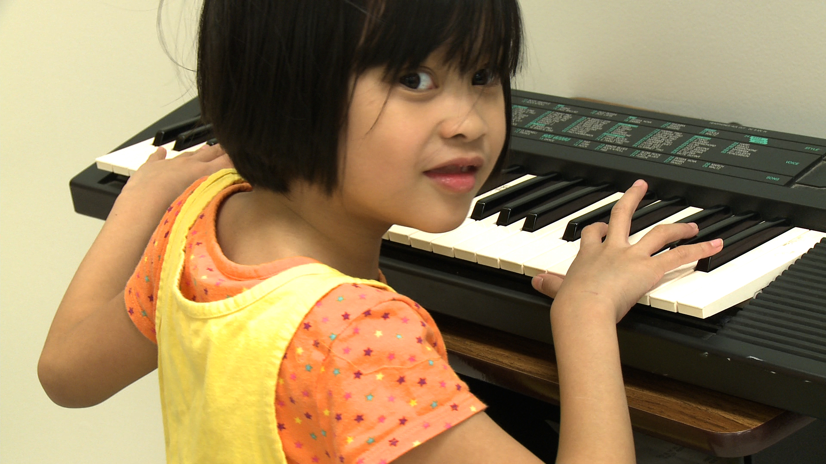
Multi-Tiered Supports in Action
Notes:
Watch and discuss the Thaysa video at http://whocaresaboutkelsey.com/multimedia
Thaysa is a 13-minute mini-film/documentary by Dan Habib. Thasya Lumingkewas, 8, has autism and thrives at Maple Wood Elementary School in Somersworth, NH. The school has implemented RtI, PBIS, and UD. (UDL will be discussed in subsequent sections of this module). This film highlights the power of presuming competence, differentiated instruction, and augmentative and alternative communication to support students to meaningfully participate and learn.

Slide 17
Collaborative Teaming
Working effectively in collaborative teams is vital to successful inclusive education.
Each member has a valued and critical role to play.
Notes:
Collaborative teams are essential to successful inclusive education. Each member of a student’s team has a valued and critical role to play in supporting successful inclusive education.

Slide 18
Collaborative Team Members
General educator.
Special educator.
Related services personnel (e.g., speech-language pathologist, occupational therapist, physical therapist, reading specialist).
Paraeducators.
Parents.
Student.
Peers.
Principal.
Notes:
This slide shows a list of collaborative team members often responsible for implementing inclusive services. This list is not exhaustive. Some students may require different types of support, based on their individual needs.
For some team members who have worked in/experienced traditionally non-inclusive schools, these roles and responsibilities as a collaborative team member may require change in their previous practice.
In the following slides, the roles of each of the key team members in inclusive schools will be discussed in more detail.

Slide 19
Key Team Member Roles in Inclusive Schools
General educator:
Welcome ALL students as members of the general education classrooms.
Uses UDL to design and implement accessible curriculum and instruction.
Shares in the responsibility to develop accessible instructional materials for all students.
Participates in team meetings to plan instruction and supports.
Works with special educators to evaluate work of students with disabilities.
Jorgensen, Fischer-Mueller & Prud’homme, 2014
Notes:
Give participants time to read the slide and discuss the roles and responsibilities of the team member and the possible implications.

Slide 20
Key Team Member Roles in Inclusive Schools
Special educator:
Serves as Inclusion facilitator for students with disabilities and/or co-teacher.
Develops students’ IEP goals based on general education standards and functional skills in collaboration with team members.
Facilitates regularly scheduled meetings for instructional planning and designing supports for students’ full participation in general education instruction.
Shares in the responsibility to develop accessible instructional materials for all students.
Jorgensen, Fischer-Mueller & Prud’homme, 2014
Notes:
Give participants time to read the slide and discuss the roles and responsibilities of the team member and the possible implications.

Slide 21
Key Team Member Roles in Inclusive Schools
Related services personnel (e.g., speech-language pathologist, physical therapist):
Writes goals and objectives that prioritize skills for students to participate meaningfully in general education instruction and typical social relationships.
Integrates services within the instructional routines and typical social activities of the general education classroom and settings.
Jorgensen, Fischer-Mueller & Prud’homme, 2014
Notes:
Give participants time to read the slide and discuss the roles and responsibilities of the team member and the possible implications.

Slide 22
Key Team Member Roles in Inclusive Schools
Paraeducator:
Contributes to the development of the educational program, instructional plans, and activities for the student.
Supports the implementation of instructional programs; facilitates learning activities; collects student data; and carries out other assigned duties (e.g., supervise students at lunch or recess, provide personal care supports to students, do clerical tasks) based on plans developed by the teachers and special educators.
Notes:
Give participants time to read the slide and discuss the roles and responsibilities of the team member and the possible implications.

Slide 23
Key Team Member Roles in Inclusive Schools
Parents/family members:
Share knowledge and understanding of the student that is valuable to the team.
Assist other team members in assessing the student’s skills.
Collaborate with other team members to identity priority goals for instruction.
The student:
Shares with other team member’s his/her preferences, interests, etc.
Participate in “circle of friends.”
Peers:
Provide natural supports to the student in the classroom, cafeteria, play yard, hallways, etc. throughout the school day.
Participate in “circle of friends.”
Notes:
We would be remiss to not discuss that parents/family members, peers, and of course, the student him/herself are valued members of the student’s team in inclusive schools. Parents and/or other family members provide valuable knowledge, information, and understanding of their child that is essential for the team to consider. Educational teams must take into consideration how the student with disabilities can be actively involved on his/her team in order to share his/her preferences, interest, etc. Peers can provide natural supports to the student throughout the school day. Both the student and peers can participate in “circle of friends” to increase understanding and acceptance of individual differences and brainstorm strategies to support the meaningful participation and inclusion of students with disabilities. Circle of friends will be discussed later in this presentation.
Again give participants time to read the slide and discuss the roles and responsibilities of the team member and the possible implications.

Slide 24
Key Team Member Roles in Inclusive Schools
Principal:
Provide support and allocate resources to ensure the successful education of all students.
Ensure the fidelity of implementation of MTSS.
Demonstrate values of inclusive education through leadership and administrative activities.
Support inclusive practices through professional and staff supervision and development.
Jorgensen, McSheehan & Sonnenmeir, 2010
Notes:
Finally, the principal is another key member in inclusive schools. In fact, strong leadership and support for inclusive practices by the principal is consistently documented as a critical component of inclusive reform.
We will now discuss administrative and teacher leadership for inclusive education in more detail.

Slide 25
Access to Core General Education Curriculum and Settings
Evidence-based practices (EBPs) to support ALL students to have access to core general curriculum and settings:
Ecological/contextually based assessment.
Person-centered planning.
UDL.
Differentiated instruction (DI).
Collaborative planning and communicating.
Curricular, instructional, and ecological adaptations.
Embedded instruction.
Notes:
IDEA of 2004 mandates that students with disabilities have access to and be involved in the general education curriculum “in order to (i) meet developmental goals, and to the maximum extent possible, the challenging expectations that have been established for all children and (ii) be prepared to lead productive and independent lives, to the maximum extent possible” (§682[c][5][A]).
For ALL students, including those with disabilities, to have access to core/general education curriculum in inclusive school settings, key practices need to be in place. These evidence-based practices(EBPs) include ecological/contextually based assessment; person-centered planning; UDL; differentiated instruction; collaborative planning and communicating about curriculum; curricular, instructional, and ecological adaptations; and embedded instruction. Each of these practices will be discussed in further detail.

Slide 26
Purpose of Ecological/Contextually Based Assessment
To gather highly individualized information about specific demands in the learner’s environment related to all aspects of that person’s life (i.e., the need to live a quality lifestyle as independently as possible and work and recreate within the community).
To identify discrepancies between student’s actual and desired performance in the relevant school and community environments to determine what to teach.
To identify strategies that will effectively remediate or accommodate for those discrepancies.
Notes:
Ecological/contextually based assessment assists in prioritizing student’s needs and recognizing his/her strengths and abilities to determine what to teach and how to teach it.
Ecological assessments involve observations of activities in a given context (e.g., morning circle in third-grade classroom) to determine what students are expected to do (i.e., the skills needed to perform and participate in the activity, routine, or task at hand); what the natural cues are that prompt this expected behavior/skill; and what supports or barriers may be present that may interfere with the demonstration of the expected behavior/skill. Next, observe the student in the actual context/activity and record his/her performance for each step of the activity (i.e., the student’s ability to perform the skills expected). If the student does not perform a step/skill required in the activity, it must be determined if he/she can be taught the skill or if he/she needs an adaptation to support his/her participation.

Slide 27
Ecological/Contextually Based Assessment
Identify the demands of routines and activities required across relevant settings for the student.
Occurs in the natural environment where the demands of this environment can be seen.
Identify the strength, as well as opportunities, for the student to learn skills.
Notes:
Through ecological assessment of the student in his/her current school and community environments, educators are able to determine the demands of the activity and plan purposeful supports so that the student can meet these demands in a meaningful way. This process also prevents over-adapting and over-supporting a student, which could result in learned helplessness. An important focus of ecological assessment is capacity building versus deficit finding.
“The most critical point is that these [standardized] measures often provide little useful data for educational programs, while nonstandardized, or alternative, assessment procedures, also referred to as environmental [ecological] assessment, provide more relevant and useful data regarding educational programs and a student’s achievement of desired outcomes” (Snell & Brown, 2011, p. 88).
An ecological assessment occurs in the natural context where a student is able to gain cues from the natural environment and routine of the activity.

Slide 28
Outcomes of Ecological/Contextually Based Assessment
Goals that potentially increase membership and participation with peers without disabilities in school and/or the community.
Goals that potentially increase access to more environments in school and/or the community.
Goals that increase meaningful skills that will improve quality of life.
Goals that are agreed upon as priorities by the whole team.
Goals that are robust (i.e., pivotal and non-trivial in the broader picture).
Notes:
Ecological assessments can be conducted to assess student’s independence and present levels of participation so that meaningful goals can be set to teach the necessary academic, communication, social, behavioral, and cognitive skills that the student needs to maximize performance in the current and future contexts. The outcomes of this form of assessment are student’s goals that (1) potentially increase membership and participation with peers without disabilities in school and/or the community, (2) potentially increase access to more environments in school and/or the community, (3) increase meaningful skills that will improve quality of life, (4) are agreed upon as priorities by the whole team, and (5) are robust—that is pivotal, non-trivial in the broader picture of the student’s life.
Clearly, the purpose is to maximize students’ capabilities and participation. In addition, the use of ecological assessments can prevent providing unnecessary adaptations, supports, and prompts, which could lead to students’ learned helplessness and prompt dependency.

Slide 29
Ecological Assessment of Student’s Performance in Small Group Reading
Steps of Activity/Skills Needed | Student Performance | Initial Plans to Intervene (Goal for skill to teach, adaptation to use)
Sit at the table. | June sat at the table appropriately.
Look at the teacher when the teacher is providing instruction. | She did not look at the teacher who was providing instruction. This is not necessarily an indication that June was not listening. | No goal at this time because June may be listening to the teacher although she is not looking at the teacher.
Read along silently when someone is reading. | June did not look at the words in the book while peers were reading. | June will move her finger along the words while a peer is reading.
Read when called on. | June is non-verbal so she cannot read aloud. | June will hit a switch to “read” a pre-recorded section aloud when called on.
Notes:
Here is an example of an ecological assessment conducted for a student, June, in relation to her participation in a small reading group.
Give participants time to review this and the following slide before reviewing the skills to be taught and adaptations to be made that June’s team determined were necessary as a result of this ecological assessment process.

Slide 30
Steps of Activity/Skills Needed | Student Performance | Initial Plans to Intervene (Goal for skill to teach, adaptation to use)
Answer comprehension questions. | June did not answer any questions. Since she is non-verbal, she did not have a means to communicate whether she comprehended the story. | June will respond to literal comprehension questions by pointing to pictures given in a field of four.
Make predictions. | June did not make any predictions. | Provide June with a communication board that has a symbol for “I have an idea.” This can be the words and/or a light bulb. June will hold up the symbol when she wants to make a prediction. To make a prediction, she can use gestures, choose from pictures, use AAC device.
Notes:
From this ecological assessment of June’s performance during small group reading, her team noted a number of ways that June could more actively engage in the activities. Examples of the skills to be taught and adaptations to be made include the following:
June will sit alongside a peer and move her finger along the words while the peer reads from the book.
June will learn to hit a switch to “read” a pre-recorded section aloud when it is her turn to read and she is called on by the teacher.
The teacher will ask June at least one literal comprehension question, and June will learn to respond by pointing to pictures from a field of four.
June will learn to use the symbol on her communication board (i.e., light bulb) to indicate that she has an idea/prediction about the story.

Slide 31
Person-Centered Planning
A variety of tools used to identify strengths, wishes, future goals, and support needs of individuals and/or their family (O’Brien & O’Brien, 2002).
Team-based, problem-solving strategy.
Guides long-term and ongoing planning.
Helps individuals:
Achieve preferred lifestyle.
Create dreams for the future.
Experience respect.
Contribute to community.
Notes:
Person-centered planning is an ongoing problem-solving approach that emerged in the 1980s to help people understand the experiences of people with disabilities, particularly those with developmental disabilities, and to respectfully and effectively support these individuals to achieve a desired quality of life. This approach takes a strengths-based perspective and helps ensure that resources and instruction are devoted to areas that support the student’s preferences and strengths (Snell & Brown, 2011).

Slide 32
Person-Centered Planning: Defining Characteristics
Team driven by the individual and family members.
Important goal: Empower the individual and family members.
Members chosen by the individual and family members.
Meetings tailored to the preferences of the individual.
Plans are designed to build opportunities to experience respect from others (e.g., team members, community members, professionals in school and work settings, family and peers).
Notes:
Traditional approaches to program planning has often focused on the use of tests to determine a student’s deficit and then his/her diagnosis, which leads to treatment. Student was viewed as a client.
With person-centered planning, the focus is on truly understanding who the student is as an individual and identifying capacity and strengths as well as connections to others. This approach to planning also invites the student, parents, and other invited team members to express their views, wishes, and feelings and also empowers them to be a part of the decision-making process.

Slide 33
Person-Centered Planning: Defining Characteristics
Self-determination and the expression of choice is emphasized.
Activities are identified that allow the individual to make valued contributions to society.
Natural supports are tailored for the individual.
Goals and actions build on the individual’s strengths (not deficits or impairments).
Notes:
Key characteristics of the person-centered planning process include the following:
It should facilitate self-determination and the individual’s expression of choices for work, play, etc. through the process
Activities that the individual can do are identified to contribute to his/her community and society
Natural supports (e.g., peers) are tailored to the individual
Action plan and goals developed build on the individual’s strengths and capacities and focus on immediate preferred lifestyle changes as well as achieving one’s dream for the future.

Slide 34
Person-Centered Planning: Defining Characteristics
Long-term goals and short-term actions focus on immediate preferred lifestyle changes and achieving one’s dream for the future.
An important outcome is to develop and maintain significant relationships.

Slide 35
A Number of Person-Centered Planning Processes Exist
McGill Action Planning System/Making Action Plans (MAPS; Vandercook, York, & Forest, 1989).
Choosing Options & Accommodations for Children (COACH; Giangreco, Cloninger, & Iverson, 2011).
Personal Futures Planning (Mount, 2000).
Essential Lifestyle Planning (Smull & Sanderson, 2009).
Planning Alternative Tomorrows with Hope (PATH; Pearpoint, O’Brien, & Forest, 1993).
Notes:
Person-centered planning is not one defined process. There are a range of person-centered planning processes that have been developed over the last three decades to empower individuals from very early childhood to older adulthood.

Slide 36
Notes:
Oftentimes, during the person-centered meeting, notes are taken in a graphic format. Here is a photo of Joseph in front of the graphic record of his PATH (Planning Alternative Tomorrows with Hope) meeting.
Additional visuals and information about person-centered planning are available at
http://inclusive-solutions.com/person-centred-planning/

Slide 37
Definition of UDL
From the Higher Education Opportunity Act of 2008:
“The term UNIVERSAL DESIGN FOR LEARNING means a scientifically valid framework for guiding educational practice that: (A) provides flexibility in the ways information is presented, in the ways students respond or demonstrate knowledge and skills, and in the ways students are engaged; and (B) reduces barriers in instruction, provides appropriate accommodations, supports, and challenges, and maintains high achievement expectations for all students, including students with disabilities and students who are limited English proficient.”
Notes:
Another important approach to ensuring all students access the core general education curriculum is UDL.
Give the participants time to read the definition of UDL from the Higher Education Opportunity Act of 2008 or read the definition aloud.
UDL involves designing curriculum and activities that plan for multiple ways of learning, engaging/motivating, and expressing knowledge for a diverse group of learners. It is an a priori approach that accepts and embraces diversity, rather than a deficit approach that ignores or rejects the diverse way that people learn and demonstrate learning. When instruction is planned within a UDL framework, many student needs are already addressed (e.g., general adaptations). It is then easier to make more specific adaptations to differentiate the curriculum/activity for the unique needs and preferences of an individual student.
Consider viewing UDL at a Glance at http://www.youtube.com/watch?v=bDvKnY0g6e4
This video is less than 5 minutes and was created by CAST, a nonprofit research and development organization that works to expand learning opportunities for all individuals through UDL.

Slide 38
Principles of UDL
Provide Multiple Means of Representation (Input):
To increase recognition and comprehension.
Provide Multiple Means of Action and Expression (Output):
To expand strategic output.
Provide Multiple Means of Engagement:
To enhance involvement.
Notes:
There are three main principles of UDL for curriculum development and design of classroom space. These three principles are (1) to provide multiple means of representation of content or input for students, (2) to provide multiple means of action and expression or output for students, and (3) to provide multiple means of engagement for students.
A physical classroom learning space is considered to be universally designed if it is usable by as many students as possible without having to be modified or retrofitted. Assistive technology is part of a universally designed classroom space and universally designed curriculum (Rapp & Arndt, 2012).

Slide 39
Provide Multiple Means of Representation (Input)
Perception.
Understanding language, mathematical expressions, and symbols.
Comprehension.
Notes:
Providing multiple means of representation of content to students assists them in being able to perceive the information; understand the language, mathematical expressions, and symbols used; and comprehend or assign meaning to the information. Alternative means of representation reduce perceptual and learning barriers. Multiple presentations can adapt to the different ways that students recognize symbols, objects, and information.

Slide 40
Multiple Means of Representation: Examples
Pair oral presentation of information with visuals in words or pictures
Pair vocabulary words, numbers, and symbols with alternative representations of meaning (e.g., photos, illustrations, graphs, charts).
Utilize ways to activate students’ existing knowledge and connect new information to what students already know.
Rapp & Arndt, 2012
Notes:
Give participants the opportunity to review and discuss the examples of multiple means of representation as well as time to brainstorm additional examples.

Slide 41
Provide Multiple Means of Action & Expression (Output)
Physical expression.
Communication.
Executive functions.
Notes:
With multiple means of action and expression, students can respond to information using their preferred means of control. There should be multiple ways for students to show what they know.
Multiple means of expression can accommodate different motor abilities and systems of students. To meet the needs of all students, it is necessary to have options for physical expression, communication, and executive functions (i.e., functions of organization, planning, and task execution).

Slide 42
Multiple Means of Action & Expression: Examples
Physical expression—trace letters or words in sand or shaving cream, operate computer with eye controls.
Communication—drawing, creating storyboards, composing music, film design.
Executive functions—scaffold skills such as goal setting, planning, managing resources available, self monitoring progress.
Rapp & Arndt, 2012
Notes:
Give participants the opportunity to review and discuss the examples of multiple means of action and expression as well as time to brainstorm additional examples.

Slide 43
Provide Multiple Means of Engagement
Catching interest of the students.
Sustaining effort and persistence.
Self-regulation.
Notes:
UDL uses many different ways to engage students in learning. Students become engaged in different types of tasks and learning activities. To increase engagement of students, teachers need to catch the interest of students, assist students in sustaining their efforts, and help them to persist toward a goal as well as to self-regulate their learning behaviors.

Slide 44
Multiple Means of Engagement: Examples
Catching interest—provide choice and autonomy; offer relevant, valuable, and authentic activities; decrease discomfort and distractions.
Sustaining effort and persistence—frequently revisit goals and steps toward goals, vary resources and change materials, foster collaboration and communication through structured groups, provide frequent feedback.
Self-regulation—make students aware of their strengths and needs and strategies that are effective for them, scaffold coping skills self-assessment and self-reflection.
Rapp & Arndt, 2012
Notes:
Give participants the opportunity to review and discuss the examples of multiple means of engagement as well as time to brainstorm additional examples.

Slide 45
Differentiated Instruction (DI)
“The two simple charges of differentiation are 1) do whatever it takes to maximize students’ learning instead of relying on a one-size fits all, whole-class method of instruction and 2) prepare students to handle anything in their current and future lives that is not differentiated, i.e., to become their own learning advocates.”
Wormeli, 2007, p. 9
Notes:
As the quote from Wormeli (2007) indicates, the purpose of differential instruction (DI) for students is to make sure that students are being challenged with work that is challenging but not too difficult and assist students with becoming independent learners.
Similar to UDL, DI requires that educators know their students well and understand that they must be prepared to engage students through different approaches to learning.

Slide 46
Characteristics of DI
Proactive.
More qualitative than quantitative.
Provides multiple approaches to content, process, and product/assessment
Student centered and student led.
Blend of whole-class, small-group, and individualized instruction.
Tomlinson, 1995
Notes:
DI is proactive. The assumption is that students are diverse in a variety of ways, including ability levels, learning styles, cultural/linguistic backgrounds, and interests, and educators need to provide students with multiple means of representation. DI is more qualitative than quantitative because it involves more than just giving some students additional work to do and some students less work to do. DI involves changing the nature of the assignment.
With DI, educators provide multiple approaches to the content, process, and product/assessment of instruction. By adjusting these teaching elements, educators design different approaches to what students learn, how students learn, how they integrate and apply what they have learned, and how they demonstrate proficiency. Learning experiences are most effective when they are engaging and relevant and interesting to the learner. To that end, DI is student centered and student led.
Finally, DI utilizes a variety of instructional groupings (e.g., whole class, small group, individualized instruction) depending on the desired outcomes for students.

Slide 47
Differentiate Four Elements
Content—what the students need to learn, know, and do; how students will get access to the information.
Process—activities through which students engage and make sense or master the content.
Products—culminating projects that require students to rehearse, apply, and extend what they have learned.
Learning environment—how the classroom is arranged, works, and feels.
Notes:
DI begins with high-quality general education curriculum that promotes active learning, connects subject matter with student’s interests, and incorporates learning styles and multiple intelligences (Lawrence-Brown, 2004).
According to Carol Tomlinson (2002), “Differentiation means tailoring instruction to meet individual need. Whether teachers differentiate content, process, products or the learning environment, the use of ongoing assessment and flexible grouping makes this a successful approach to instruction.”
Teachers can differentiate four elements within units and lessons based on students’ readiness, interest/preferences, and/or learning profiles. These are content, process, products, and the learning environment.

Slide 48
Example of Differentiating Content
Use reading materials at varying levels of readability.
Put text materials on audio DVD.
Use spelling or vocabulary lists at readiness levels of students.
Present ideas through auditory and visual means.
Use reading buddies.
Meet with small groups to re-teach an idea or skill to struggling learners or to extend the skills of advanced learners.
Tomlinson, 2000
Notes:
Give participants the opportunity to review and discuss the examples of differentiating content as well as time to brainstorm additional examples.

Slide 49
Examples of Differentiating Process
Use activities through which students engage with different levels of support, challenge, and complexity.
Provide interest centers that encourage students to explore components of the class topic of interest to them.
Offer manipulatives or other hands-on supports for students who need them.
Vary the length of time a student may take to complete a task to provide additional support or to encourage pursuit of a topic in greater depth.
Tomlinson, 2000
Notes:
Give participants the opportunity to review and discuss the examples of differentiating process as well as time to brainstorm additional examples.

Slide 50
Examples of Differentiating Products
Offer students options of how to express required learning (e.g., create a puppet show, write a letter, develop a mural with labels).
Allow student to work on their products alone or in small groups.
Encourage students to create their own product assignments as long as they contain the required elements.
Tomlinson, 2000
Notes:
Give participants the opportunity to review and discuss the examples of differentiating products as well as time to brainstorm additional examples.

Slide 51
Examples of Differentiating Learning Environment
Arrange places in the classroom where students can work quietly without distractions and places where students can collaborate and even move around to learn.
Provide materials that reflect a variety of cultures and home settings.
Establish routines that allow students to get help when teacher is busy with other students and cannot help them immediately.
Tomlinson, 2000
Notes:
Give participants the opportunity to review and discuss the examples of differentiating the learning environment as well as time to brainstorm additional examples.

Slide 52
Planning for Access to Curriculum
Class | Roles of Team Members
Period 3: English 11 | *English teacher will provide book list, materials, and tests in advance to SPED teacher. *SPED teacher will download digital books to iPad. *Vision specialist will provide enlarged text materials. *Speech therapists will provide assistance in writing speeches, comprehension of novels, and improving oral responses in class. *Paraeducator will set up laptop at start of class, scribe written responses, type homework in e-planner, and set up iPad with headphones.
Kurth & Gross, 2014
Notes:
It is critical that every team member is familiar with the call to develop inclusive services and team members understand how to implement their responsibilities in an inclusive setting. The example on this slide demonstrates how teams examine a class activity or, in this case, class period and designate specific roles and responsibilities for each team member. In this instance, the student being planned for is a high school junior who experiences multiple disabilities, including physical and intellectual disabilities. A variety of team members collaborate to meet her unique needs. The team has documented how the student’s needs in English will be addressed; a similar plan would be made for all other class activities. The plan for these roles would be developed collaboratively, ideally before the beginning of the school year, and all team members would agree to their responsibilities. This planning may be completed in person or using online technologies; after it is developed and agreed upon, each team member would receive a copy for his/her permanent records. Periodically, the team may reconvene to troubleshoot and evaluate the effectiveness of the plan.

Slide 53
Communicating About Curriculum
What subjects or skills are you teaching next week/next unit?
Books used (include chapters and/or page numbers).
Materials/labs.
What tests will be given and when?
Topics/chapters/pages tested.
What long-term reports or projects will be part of this week/unit?
What project?
When was it assigned? When is it due?
Is it an individual or group project?
Are there any schedule changes ?
Field trips.
Assemblies.
Notes:
Inclusive educators need to be knowledgeable about the classroom routines, activities, and content to provide the best support to students and teachers. General education teachers and special education teachers need to communicate on a regular basis about the curriculum and instruction in a classroom to plan ahead for student needs. To fully prepare for the meaningful participation of students with disabilities, special educators may use these questions to guide their conversations with general education teachers to better plan for the upcoming week or unit. Specifically, understanding what skills or subjects will be taught, which tests will be given, if there are any long-term reports or projects, and schedule changes can all assist a special educator (or inclusion specialist) in knowing what types of support a student will need. This knowledge will further enable an inclusion specialist to gather or develop any needed adaptations to the curriculum, materials, and tests for the student ahead of time. Inclusion facilitators and teachers may meet face to face to communicate, by emailing these questions, or placing these as worksheets in teacher mailboxes to gain the needed information.

Slide 54
Readiness = Rejection
Some students may simply never be able to perform at the same skill levels as their typical peers.
And, skill levels cannot determine whether a student has access to general education.
And, we aim to provide an appropriate education.
Notes:
While considering the curricular needs of students with disabilities, we must be willing to confront the assumption of readiness skills. Many believe that there are a host of skills students must demonstrate to be ready to participate in general education; for example, a student may be expected to demonstrate appropriate behavior, reading skills, or the ability to care for her physical needs. The problem is that many students with disabilities will not ever pass a readiness test, making them at great risk of being excluded from standards-based, grade-appropriate, high-quality instruction. For example, a student who reads at a primer level is most likely excluded from 10th-grade English, yet may learn an enormous amount from listening to novels and participating in class lectures about perspective. Similarly, a student who demonstrates off-task or disruptive behavior in a special education classroom may learn self-regulation strategies by learning with same aged peers who do not experience disability in inclusive settings. In both of these situations, rejecting a student from a setting is making a dangerous assumption and also preventing a student from benefitting from high-quality instruction.

Slide 55
The Student Should Be Allowed to Participate in the Activity Even When:
the student does not exhibit all the necessary prerequisite skills,
the student will not be able to acquire all components of the skill, and
the student may not complete the entire activity or skill independently.
Notes:
Rather than making these dangerous assumptions and excluding children from learning, we propose allowing a student to participate in general education activities even if the student does not exhibit all of the necessary prerequisite skills. It is possible that a student has splinter skills, meaning that the student will be able to learn skills that are considered well above their current functioning level. We would further allow a student to participate in a skill even if she cannot acquire all components of the skill or cannot complete the skill independently.
55

Slide 56
Principle of Partial Participation
All students
can participate in whatever parts of a task or activity that they can, and in doing so
“can acquire many skills that will allow them to function, at least in part in a wide variety of least restrictive school and nonschool environments and activities” (Baumgart et al., 1982, p. 19).
Notes:
We operate on the principle of partial participation, meaning that students will likely benefit from completing some part of a task or activity, with or without assistance. In fact as Baumgart et al. (1982) shared more than 30 years ago, through partial participation, students “can acquire many skills that will allow them to function, at least in part in a wide variety of least restrictive school and nonschool environments and activities” (p. 19).
56

Slide 57
Remember!
Providing access to the general education curriculum does not mean the student must be able to access the curriculum in the same way as other students!
The level or severity of disability cannot be a reason for segregating students with disabilities!
Notes:
Together, the principle of partial participation and the focus on participation reminds us that it is not possible for us to predict what a person will be capable of learning or how a student will benefit from our instruction. Because none of us can predict what another person will learn, know, or do, we must provide all students with opportunities and support to learn.

Slide 58
Notes:
So how do we do provide meaningful access and participation?
As previously discussed, UDL and DI are frameworks and approaches to create and provide meaningful access and participation. Both approaches utilize adaptations to curriculum, instruction, and the learning environment.
This section will further discuss adaptations, changes to curricular, instruction, and/or the environment to support student’s learning and engagement with the core curriculum.
Curricular adaptations make adjustments to what is taught; instructional adaptations adjust how teaching is delivered and learning is demonstrated. Last, ecological adaptations adapt the setting by removing physical barriers and adding needed personnel or material supports.

Slide 59
Types of Curricular Adaptations
Giangreco 2007
Notes:
Dr. Giangreco at the University of Vermont has identified four main types of curricular adaptations. Curricular adaptations allow a diverse group of same-aged students to learn together at different ability levels (such as advanced students and students with disabilities). In providing these adaptations, students share an activity or experience, and each learner has an individual learning outcome at an appropriate level of difficulty. Multi-level curriculum refers to changes in the curriculum in which students are responsible for more or fewer outcomes at different levels of complexity. Curriculum overlapping occurs when learning outcomes come from two or more curriculum areas such as from both reading and communication skills. Students are responsible for more or fewer outcomes at different levels of complexity. Implementing either multi-level or overlapping curriculum requires time, collaboration, and creativity—but by teaching in these ways, we provide opportunities for all students in a classroom to be successful and learn at a level that is appropriate for them.
59

Slide 60
General & Specific Adaptations
Helpful for everyone
Unique to a student
Graphic organizers.
Writing responses (e.g., type, draw, write).
Peer tutors.
Books at different levels, topics.
Colored overlays.
Visuals/pictures.
Manipulatives.
Embedded examples.
Resource guide/tool kit.
Word banks.
Planners/agendas.
Assignment checklist.
Consider students’ needs
Physical.
Sensory.
Cognitive.
Communication.
Attention.
Notes:
Janney and Snell (2000) further identified that adaptations can be general and specific. General adaptations are those supports educators put in place that provide support to all learners at different times. For example, having examples of a completed multi-step algebraic equation on the top of a worksheet will help all learners receive reminders of how to solve these equations. Although general adaptations are useful for all learners, specific adaptations are unique to the individual needs of a specific student. These take into account the specific physical, sensory, cognitive, communication, and attention needs of a specific student. For example, a student with a sensory loss such as deafness will need a sign-language interpreter (a specific adaptation) but will also benefit from visual cues during lectures and discussions (a general adaptation that would help other learners as well).

Slide 61
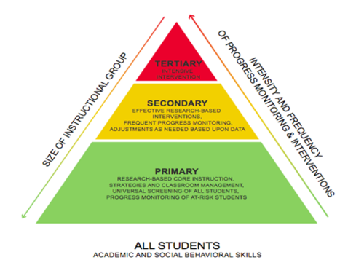
Instructional Adaptations
Providing general adaptations decreases the need for special adaptations (e.g., Tier 2 vs. Tier 3)
Notes:
The UDL framework previously discussed provides further guidance in making adaptations for students. Recall that UDL is premised on the idea that students benefit from having:
Different ways to represent knowledge (how content and directions are presented to students).
Different ways to express knowledge (how students show us what they know).
Different ways to engage (stay motivated in learning and activities).
UDL and a MTSS framework give guidance on developing specific and general adaptation. We can think of general adaptations as Tier 1 (or primary) supports. By providing these, most learners (about 80%) will have their individual learning needs accounted for. There are a group of students who need more intensive general supports, more concrete representations provided, more high-interest books at different reading levels, and so on. These more frequent and intensive general supports account for Tier 2 interventions and will help an additional 15% of students be successful. Last, there is a group of students, those about whom we are talking in this presentation, with complex disabilities who will need specific adaptations that account for their unique physical, sensory, cognitive (e.g., memory), communication, and/or attention needs.
It is important to remember that these MTSS models and UDL reduce the number of students who require specific supports, and those supports will be more natural and easier to provide because the learning environment is already rich with general supports.

Slide 62
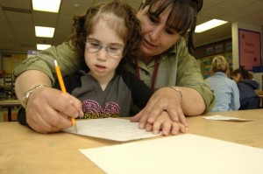
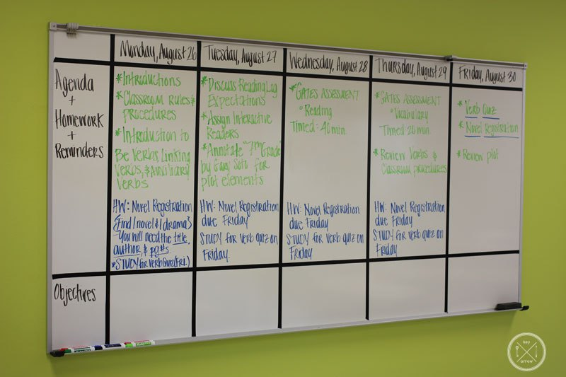
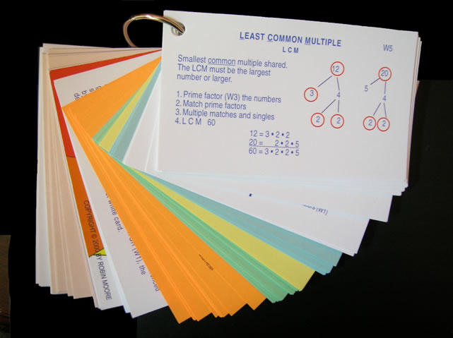
Ecological Adaptations
Notes:
Ecological adaptations are those made to remove barriers and provide supports within a setting. This slide shows a few examples of ecological supports, ranging from (clockwise from top left) wheelchair accessible desks, speech-to-text software, personnel supports, a token economy system, providing examples for completing multi-step math problems, and visual schedules (bottom right). Of course, the needs of the individual student will dictate what ecological adaptations will be needed, as will the demands of the activity.

Slide 63
In-Advance Adaptations
Predict what teachers and classes are doing ahead of time:
What text books?
What curricular materials?
What novels?
What exams?
What field trips?
Where will instruction occur?
Who will be present?
Notes:
To the extent possible, it is ideal to develop curricular, instructional, and ecological adaptations in advance of the lesson. To plan for these adaptations, educators must be able to predict what teachers and classes will be doing ahead of time. Knowing the books, materials, and other expectations of the lesson will be critical. Further, knowing where instruction will occur (e.g., in a science lab, art classroom), along with the people who will be present, will enable inclusion facilitators to make any needed ecological adaptations.

Slide 64
How Do We Make These Predictions?
Curricular maps.
Ask the teacher.
Get teacher editions of all text books, novels, curricular materials (e.g., school library, principal, grade level team).
Notes:
Making predictions about what will be taught is possible using some simple strategies. First, many schools require teachers to develop curricular maps at the beginning of the school year. An inclusion specialist can review these maps and get a general sense of what topics will be covered and what materials will be used. Second, inclusion specialists can follow up with individual teachers to inquire about what will be taught in the upcoming week or lesson unit. Last, it is helpful for inclusion specialists to have teacher editions of all text books, novels, and other materials. These are usually available in the school library or can be obtained by asking a building principal or grade-level team for them.

Slide 65
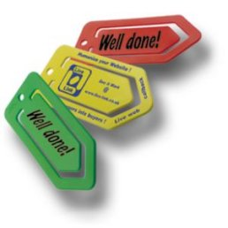
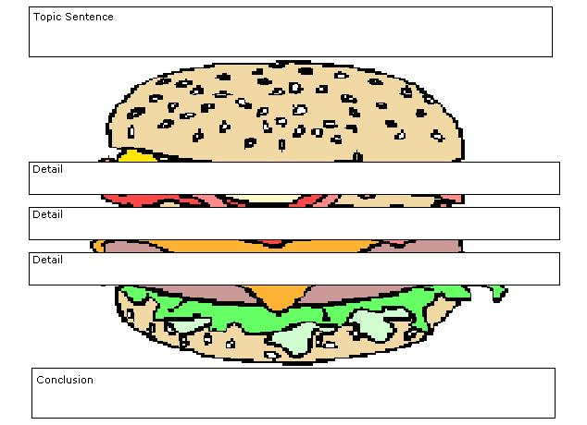
On-the-Spot Adaptations
Magazine pictures to use for reading comprehension and writing assignments.
Blank graphic organizers.
List of sponge activities.
Story starters.
An adaptations materials/supplies box.
Notes:
Despite this background preparation, the best laid plans of mice and men often go awry. Having a substitute teacher, an assembly, a student illness, or for pedagogical reasons, the pacing and sequence of instruction may be altered, making pre-made adaptations less than useful. Thus, making on-the-spot adaptations will be necessary. Inclusion specialists can best prepare for these situations by having a bag of tricks ready to make on-the-spot adaptations. Having items like white out, label makers, highlighters, and graphic organizers readily on hand are very useful for making on-the-spot adaptations to worksheets, lectures, and other assignments.
65

Slide 66
What Is a Good Adaptation?
Does it facilitate social and instructional participation?
Is it “only as special as necessary?”
Does it promote independence?
Does it build on strengths and preferences?
Is it age and culturally respectful?
Did the student make learning progress with it?
Notes:
Simply making in-advance or on-the-spot adaptations can be instrumental in helping students gain access to the core general education curriculum. However, understanding how effective those adaptations are is critical.
Janney and Snell (2006a) and Kurth and Keegan (2014) have identified a few questions that can be useful in determining how effective an adaptation is. First, does the adaptation facilitate social and instructional participation? In other words, was the student better equipped to participate with peers and access the important pieces of instruction by using this adaptation? Second, was the adaptation only as special as necessary? It is rather easy to create adaptations that stigmatize and alienate students. It is important to create an adaptation that assists the student in participating using as many of the same materials, supports, and locations as other peers. Third, does the adaptation promote independence? All instruction will require some adult input and facilitation; however, the adaptation should allow the student to work as independently as possible, with peers, and not requiring extensive one-to-one prompting and support from adults. Fourth, does the adaptation build on strengths and preferences? Paula Kluth and Patrick Schwarz (2008) reminded us in their book Just Give Him the Whale that honoring student preferences facilitates learning. If a student learns best visually, providing visual supports is beneficial. If a student prefers to learn about dinosaurs, incorporating dinosaurs into reading, writing, math, and other activities can provide a useful hook for student learning. Fifth, is the adaptation age and culturally respectful? That is, it would be inappropriate to give an adaptation with cartoon characters on it to an older student. It is important to ask, “Would I feel comfortable giving this adaptation to a similar student without a disability?” If the answer to that question is “yes,” then it is more likely to pass this test. Last, collecting data and engaging in progress monitoring will be necessary to determine if the student made learning progress using the adaptation. It would be disrespectful to the student and her instructional time to continue using adaptations that are not effective. Taking progress-monitoring data can help us avoid using adaptations that are not facilitating learning.

Slide 67
Embedded Instruction
Notes:
Teaming and providing adaptations are necessary first steps in delivering effective inclusive instruction. However, these are inadequate to provide truly inclusive instruction, particularly for teaching skills to students that require specialized instruction and are typically taught in self-contained special education classes. Embedded instruction is emerging as an EBP to deliver high-quality, specialized instruction, in inclusive settings.

Slide 68
Teaching Trials
How many trials does the student need to learn the skill?
The student’s current functioning level.
The complexity of the skill being taught.
The structure of the activities and routines of the class.
Notes:
To begin the process of embedded instruction, and truly any special education, it is critical that the instructor knows how many trials a student requires to learn a skill. We want to be certain to provide students adequate opportunities to learn. Because students with significant intellectual disabilities require more support to learn skills than other students, this is particularly important. For example, if a student is learning to read the sight word the, we want to know approximately how many times we need to teach the word the before the student is likely to learn it. This may require 256 presentations; however, if we stopped our instruction after 200 trials, the student would not learn a skill he/she is capable of learning. How does one know how many learning trials a student will need? It depends on a number of factors, including the student’s learning rate, or current functioning level, and the structure of the activity.
The student’s functioning level tells us approximately the student’s learning rate. For example, if we graphed a student’s sight-word reading and found they were learning five words per month, his/her learning rate would be about one new word per week. We would want to further collect data to determine how many presentations of this word the student needed. Having an estimate of approximately how many times a student needed to see the sight word before it was learned would also be helpful. Factors such as attention, memory, and other cognitive processes will help us approximate a student’s current functioning level.
The overall complexity of the skill to be learned can also help us determine how many trials a student is likely to need. A number of factors contribute to task complexity, including the type of thinking required (e.g., higher order reasoning, abstract concepts); the demands for memory and attention to complete the task; and the underlying skills required to complete the learning task (such as fine motor skills, social skills, and behavior regulation skills). Generally speaking, more complex skills will require more learning trials to reach mastery.
Last, the structure of the activities and routines will help determine how many teaching trials a student will need. Activities and routines that have more structure, such as checklists or visual reminders, will often be learned more rapidly than skills for which there is little context or for abstract reasoning skills.
In general, viewing previous data to learn about the student’s learning history in previous, similar situations, will be key.

Slide 69
Massed Trials
What do we mean?
1-2PM: T₁ T₂ T₃ T₄ T₅ T₆ T₇ T₈ T₉ T₁₀ T₁₁ T₁₂ T₁₃ T₁₄ T₁₅
Video example:
Massed Trials Teaching Example
Pros:
Opportunity, direct instruction.
Cons:
Generalization; authentic/spontaneous use.
Student frustration/boredom/behavior.
Forces segregation.
Notes:
While designing instruction, then, we aim to provide students with enough instructional trials so the student can learn the skill. Typically, special educators use massed trials to deliver this instruction. Let’s imagine that we have a student who needs 150 trials to learn a skill. In this case, let’s say the skill he needs to learn is how to tie his shoes. As depicted in the slide, the team can provide 15 trials of shoe tying between 1:00 and 2:00 in the afternoon. If we do this every day for 2 weeks (15x5x2), we will have provided the needed 150 trials.
Instructor note: Consider playing one or both video examples of discrete trial teaching, which illustrate massed trials. (2:05 minutes; URL http://www.teachertube.com/video/discrete-trial-training-210480)
The advantages of massed trials is that we can use this technique to provide adequate opportunity for students to learn skills and provide direct instruction in teaching the skill.
The disadvantage of massed trials is that the skills taught in these situations rarely generalize to other settings because they are context free. Instead, students learn to perform a skill in a rote manner but do not know how to authentically or spontaneously use the skill when it is needed. Another major disadvantage is that massed-session trials are context free and, thus, are often not intrinsically rewarding to perform. This makes students likely to become prompt dependent and dependent on artificial reinforcement but can also lead to boredom, frustration, and even behavior problems. Last, massed trials are usually completed in segregated settings, as you saw in the video. This is not only a problem with creating segregation, but it is also unlikely to be the authentic space where the skill will be needed. To illustrate, imagine teaching a child to tie and untie his/her shoes 15 times in an hour, every day, for 2 weeks. Common sense tells us that this is just not a very logical approach.

Slide 70
Distributed Trials
Practice goals across a typical school day.
Distributed trials:
8-9 AM: T₁ T₂
9-10 AM: T₃ T₄
10-11 AM: T₅ T₆
11AM-12PM: T₇ T₈
12-1 PM: T₉ T₁₀
1-2 PM: T₁₁ T₁₂
2-3 PM: T₁₃ T₁₄ T₁₅
3PM: Advantages to generalization, maintenance, acquisition.
Notes:
In contrast to massed trials, embedded instruction distributes those learning trials across a day. This is one of the two key characteristics of embedded instruction. The 15 instructional trials were taught in 1 hour with massed trials but are taught across the school day, once or twice per hour. The advantages to distributed trials are promotion of skill generalization, maintenance, acquisition, and decreased student frustration.

Slide 71
Specific & General Goals
“Read five sight words taken from the core vocabulary.”
“Respond to name when called.”
“Identify coins by name and value.”
“Write name correctly.”
Notes:
Embedded instruction using distributed trials can be used to teach specific and general IEP goals. Each of the goals listed here can be distributed across a school day; some of the more general goals (e.g., correctly write name, respond to name when called) are readily embedded in a typical school day. There are plenty of natural opportunities in a general education setting to address these goals.

Slide 72
Natural Teaching Opportunities
Math is a natural time to work on math goals.
Recess and lunch are natural times to work on social and communication goals.
Reading is a natural time to work on reading and writing goals.
PE is a natural time to work on gross motor skills.
Art is a natural time to work on fine motor skills.
Notes:
Natural opportunities are just like they sound; they are naturally occurring times when a skill could be practice. The natural time to teach math skills is during math class. The natural time to work on social communication goals is during lunch or recess. In other words, schools are already created with times set aside for specific types of instruction and activities.

Slide 73
Example
Third-grade math class; graphing lesson.
Students are naming favorite ice cream flavors and using this data to create bar graphs.
Student with ID has goal to count to 10 with one-to-one correspondence.
How can student work on this goal?
Notes:
Let’s look at this example. We have a third-grade math class learning to graph. Students are naming their favorite ice cream flavors, tallying, and graphing them. A student with intellectual disability in the class has an IEP goal to count to 10 with one-to-one correspondence. How can the student work on this goal in this natural setting?
Count how many students have their hands raised for each flavor.
Count number of flavors.
Count number of tally marks.
Count lines on graph paper.
As illustrated in this example, this simple and fun activity provides a great natural opportunity to work on an IEP goal, even an IEP goal that, as in this case, is below-grad-level standard. In other words, we can assume that the other third-graders have mastered counting to 10, and this student with intellectual disability can still practice the skill of counting as a fully participating member of this general education class.

Slide 74
Natural Opportunities & IEP Matrix
Notes:
The IEP goal matrix is a useful tool for identifying natural opportunities. As you can see, the team wrote the student’s schedule in the left hand column. This includes bathroom, math, science and so on. Next, the team wrote the student’s IEP goals across the top row of the matrix. The team then simply placed an “x” whenever the IEP goal could naturally be worked on.

Slide 75
Inclusion & Embedded Instruction
To meaningfully include students and provide embedded instruction, we need to:
Find and implement (enough) opportunities during a typical school day to practice important skills using the materials and activities that are naturally available.
Notes:
Thus, to meaningfully include students and provide embedded instruction, we need to identify, distribute, and teach adequate instructional trials during a typical school day using natural opportunities and also embedded opportunities. This brings us to the second key feature of embedded instruction: The trials should be distributed across natural and embedded opportunities. We have already defined natural opportunities; next, we will define embedded opportunities.

Slide 76
Embedded Opportunities
What it is: Not enough natural opportunities.
Why?
Skill not typically taught to age-mates.
The student needs more opportunities than naturally available.
Notes:
Embedded opportunities are those opportunities that we must create. In other words, sometimes a student will need more teaching trials than are naturally available during a school day. These could include opportunities to learn skills that are not typically taught to other same-grade peers or when a student needs more opportunities to learn than are naturally available due to the student’s learning rate, the complexity of the skill, or the structure of the environment.

Slide 77
Embedded Instruction Example
Biology class.
Wesley enters class and takes out his materials.
Other students also enter and get materials ready.
Peer tutor walks to Wes, greets him, and does an instructional trial (approx. 30 seconds).
Peer tutor records data.
Class lecture takes place.
Class transitions to lab activity.
Peer tutor completes another instructional trial during transition.
Lab activity.
Notes:
Here is an example of how embedded instruction is used in a secondary setting for Wesley, who has autism and is learning to communicate using a voice output device. This example occurs in biology. Wesley enters the biology classroom and takes out his materials, including his communication device, books, and notebooks. Other students are also entering the classroom, chatting to one another, and getting their own materials out and ready. After Wesley has entered the class and has his materials ready, a peer tutor walks up to Wesley, greets him, and does a 30-second instruction trial. The instruction could be on any topic—finding keys on the communication device, identifying sight words, calculating a math problem, responding to a greeting, or any other IEP goal. After the instructional trial, the peer tutor records on a simple data collection sheet the data for that instructional trial. For example, the peer might mark a “+” if Wesley was correct or a “-” if Wesley was incorrect. Class begins, the teacher provides instruction, and Wesley uses adapted materials to participate in the lecture and class activities. About 25 minutes into class, the whole class transitions to a lab activity. During this transition point, the peer tutor repeats a brief instructional trial with Wesley on the same or different IEP goal as before. Following this, the peer tutor once again tracks data, and Wesley joins his lab group and completes the lab activity with needed adaptations.
As illustrated in this example, Wesley was fully included in his class activities through the use of adaptations, and extra instructional trials for needed skills were embedded seamlessly into this routine, maximizing instructional time and providing Wesley with necessary special instruction.

Slide 78
Another Example
Student goal is to identify coins by name and value.
Most high school students have mastered money, which is not typically taught in general education.
Natural times are not sufficient:
Snack bar (open at lunch).
Purchase pencils at library.
Need to identify other times to embed this instruction.
Notes:
In another example, a student who is learning to identify coins by name and value in high school is unlikely to have many other high school peers who are also learning about money. We would like to distribute instruction of identifying money in natural opportunities. What are some natural opportunities to use money in high school (e.g., cafeteria, vending machines). We may chart this out on our IEP matrix and realize that there are not enough trials present in a typical school day, particularly if a student’s learning rate tells us we need a lot of trials.

Slide 79
Find Times to Embed Instruction
Naturally occurring non-instructional times when the skill can be taught:
Standing in line to come in the classroom.
Taking attendance.
Passing out papers.
Walking to cafeteria.
Others?
Notes:
So, we may embed an opportunity to practice identifying money by embedding opportunities throughout the day. A peer, paraeducator, general or special teacher could present instructional trials of identifying coins while the student is in line to enter a classroom, while the teacher is taking attendance, while students are passing out papers, and during many other opportunities.
What may be some considerations for embedding instruction? Certainly, you will want to make sure to provide embedded (and natural) instruction in a non-stigmatizing, age-respectful manner. You will want to keep the instructional trial brief (usually less than 1 minute). This way, the student is less likely to interfere with his learning or the learning of others.
Open up discussion to participants for other considerations

Slide 80
Another Example of Embedded Instruction
Teach sight-word reading to Anthony, who has Down syndrome and is in the fifth grade.
Notes:
Let’s look at another example of embedded instruction, this time for Anthony, a fifth-grader who has Down syndrome.

Slide 81
Example
Notes:
Here is an example of Anthony’s typical school day. On the far left column, you see his typical daily sequence of class activities. The middle column identifies the natural opportunities to work on sight-word reading skills from a list of high-priority sight words. Finally, the column on the far right identifies other natural opportunities during these activities to work on sight-word reading.
Kurth & Gross, 2014. The Inclusion Toolbox. Thousand Oaks, CA: Corwin Press.

Slide 82
Notes:
This slide shows the rest of Anthony’s schedule with natural and embedded opportunities to work on sight-word reading. These sight words could be printed on small notecards, and a peer, paraeducator, general education, or special education teacher could present a few flashcards to Anthony during these times. Can you think of other times or methods for maximizing natural and creating embedded opportunities to instruct Anthony?

Slide 83
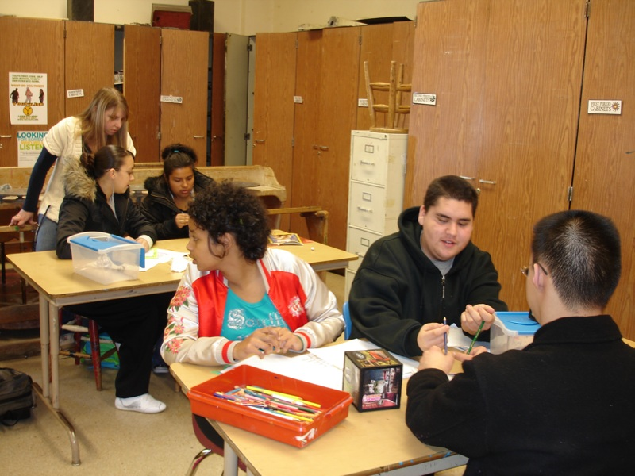
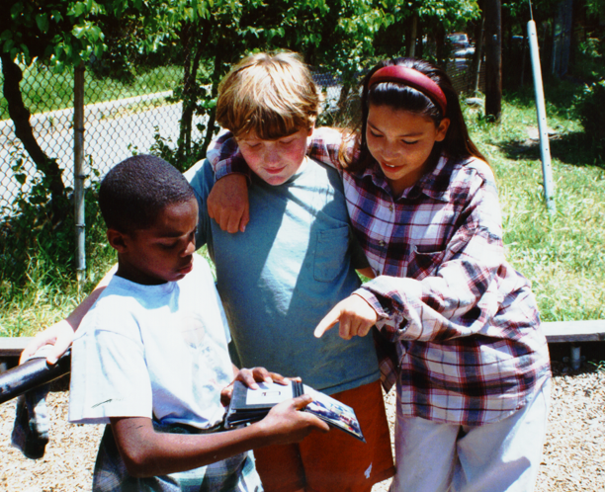
Peer Relationships and Supports in Inclusive Classrooms
Notes:
Within the professional literature describing the administrative, logistical, and curricular practices to achieve successful inclusion, there is a clear mandate to offer students with disabilities the same opportunities for social participation and friendship that are available to all students (Halvorsen & Neary, 2009; TASH, 2010). Peer interaction and relationships now are seen as necessities to be promoted between students with disabilities and their classmates in the general education classrooms and are understood to play key roles in learning and quality of life (Carter, 2011; Carter, Bottema-Beutel, & Brock, 2014; Carter, Cushing, & Kennedy, 2009).

Slide 84
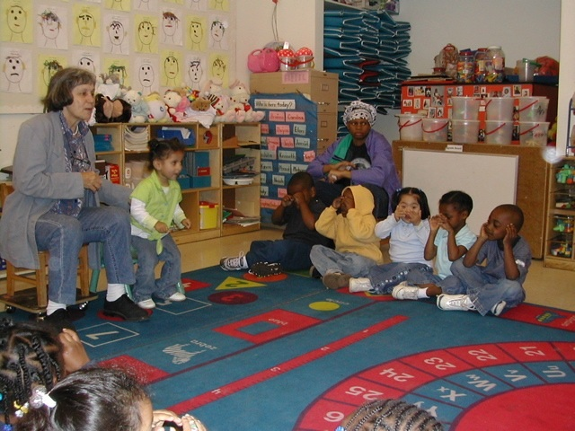
Influential Factors
Teachers and staff behaviors.
Classroom climate.
Instructional practices.
Janney & Snell, 2006b
Notes:
Although studies have demonstrated that opportunities to interact and placement in the general education classroom influences social relationships for student with disabilities, there is also the recognition that just being included does not guarantee that students with disabilities automatically belong and/or have friends (Carter, Sisco, Chung, Stanton-Chapman, 2010; Siperstein, Parker, Bardon, & Widaman, 2007).
Janney and Snell (2006b) identified the following influential factors that can promote the development of positive, reciprocal peer relationships and supports that can lead to friendships:
Teacher and staff behaviors.
Classroom climate.
Instructional practices.

Slide 85
Teacher & Staff Behavior
Model respectful and age-appropriate interactions and support.
Hold high expectations for ALL students.
Value all students’ contributions.
Provide multiple opportunities for interactions and peer supports.
Facilitate positive, reciprocal interactions between students.
Notes:
Teachers (general and special education); staff (e.g., paraeducators); and any team members supporting students in inclusive classrooms and settings can serve as social guides/facilitators by modeling respectful and age-appropriate interactions and support for ALL students, holding high expectations for ALL students, valuing ALL students’ contributions, providing a range of and multiple opportunities during instruction and non-instructional time for peer interactions and supports, and facilitating the maintenance of positive, reciprocal interactions between students with and without disabilities.
Give participants the opportunity to review and discuss as well as time to brainstorm additional examples.

Slide 86
Class Climate
Positive community-building activities.
Conflict resolution practices.
Classroom jobs/roles.
Ability/diversity awareness activities.
Literature that focuses on diversity and ability differences.
Supports self-determined behavior and student-directed learning.
Notes:
Team members also can implement strategies to foster a class climate conducive to positive, social experiences. These strategies include, but are not limited to, the following:
Implement community-building activities on a regular basis (e.g., classroom meetings).
Teach students and reinforce the use of conflict resolution practices.
Provide opportunities to ALL students to perform valued classroom jobs/roles
Conduct ability/diversity awareness activities.
Make available literature that focuses on diversity and ability differences.
Support all students’ self-determined behavior and student-directed learning.
Give participants the opportunity to review and discuss as well as time to brainstorm additional strategies.

Slide 87
Instructional Practices
Small groups and cooperative learning structures.
Peer partner activities.
Activities that require frequent opportunities for interactions between students.
Students have an effective means to communicate.
Use of DI.
Interesting motivating curriculum that requires interdependent efforts.
Notes:
Team members can also mindfully utilize instructional practices that promote meaningful peer interactions and support ALL students to be perceived as valued members of classroom/school. These practices include, but are not limited to, the following:
Small groups and cooperative learning structures.
Peer partner activities.
Activities that require frequent opportunities for interactions between students.
Students have an effective means to communicate.
Use of differentiated instruction.
Interesting motivating curriculum that requires interdependent efforts.
Give participants the opportunity to review and discuss as well as time to brainstorm additional instructional practices.

Slide 88
Social Facilitation
Arrange and facilitate ongoing opportunities for natural participation in joint activities within classroom, school, work, and community events.
Notes:
Many students with disabilities experience difficulty establishing and maintaining social relationships, often due to the nature of their disability. For example, communication barriers make it challenging to express ideas and participate in the rapid-paced exchanges characteristic of childhood and adolescence. Likewise, intellectual or physical disabilities may impede a student’s ability to participate in the games and activities that other students enjoy.
Clearly, it is critical that educators take steps to help facilitate social interactions and relationships with students who experience disability across the school day.

Slide 89
Factors That Influence Social Relationships
Opportunity.
Atmosphere.
Social support and motivation.
Social competence and interaction skills.
Maintenance and generalization of relationships.
Janney & Snell, 2006b
Notes:
Janney & Snell (2006b) identified a variety of factors that influence the development of social relationships for students with disability. First, to have friendships and social relationships, there must be opportunity. This means that students with disabilities must be physically present with students without disabilities on a regular basis with spontaneous opportunities to interact. Next, there must be an atmosphere of positivity toward differences and support for social relationships. There must, likewise, be social supports provided by peers and adults to support students with disabilities to interact socially (e.g., a game with adapted game pieces to support students with physical disabilities, communication devices with age-respectful social phrases programmed to support students with communication impairments). Additionally, students must have social competence and interaction skills, including the ability to initiate interactions, respond to initiations, and elaborate on those initiations and responses. Thus, the role of the educational team in teaching age-appropriate skills is critical. Last, students must have the skills to keep, extend, and build their social relationships across time, place, and people.
Altogether, these factors reinforce the importance of inclusive instruction. Segregated settings simply lack the capacity to provide these factors in adequate frequency or duration. These factors further stress the importance of the entire educational team working together to make sure that each factor is satisfactorily considered and addressed in educational planning.

Slide 90
Social & Communication Skills Instruction
Behavioral strategies.
Cognitive strategies.
Self-management strategies.
Peer-mediated strategies.
Opportunistic strategies.
Notes:
It is critical that the education team provide ongoing instruction in social and communication skills, including access to a reliable, effective means to communicate. There are five broad instructional strategies that an education team may consider when teaching social and communication skills, including behavioral strategies, cognitive strategies, self-management strategies, peer-mediated strategies, and opportunistic strategies. We will examine each of these next.

Slide 91
Behavioral Strategies
Modeling:
Live modeling.
Video modeling.
Video self-modeling.
Video Self-Modeling:
Example
Notes:
Behavioral strategies are those that teach students specific skills and rules or expectations related to an activity. Modeling, in which people act out scenes or scenarios, is one type of behavioral strategy. Live modeling refers to the practice of having peers or adults act out a scene. For example, a team may take a video of two competent peers acting out how to join a recess game. Video modeling is very similar to live modeling, but the scene is recorded, and the recording, rather than the live scene, is viewed by the student learning social and communication skills.
Generally speaking, video modeling (i.e., recording the scenario) is more effective than live modeling because it is possible to pause, re-watch, and call attention to relevant stimuli with video modeling.
A version on video modeling that is particularly effective is video self-modeling. With video self-modeling (VSM), the student himself is recorded completing a new or difficult task. This clip is edited so that the student can observe himself correctly and independently completing the task. In other words, prompts and errors are edited out. Students can this watch this highlight reel on a regular basis to build self-confidence and provide visual reminders of what to do and how to do it.
For example, review the example of video self-modeling of a boy speaking a sentence, and of Lillian playing nicely”(URL: http://www.youtube.com/watch?v=-cGZySiOrAs). As you can see, errors and prompts were removed during editing to only show the child successfully and independently performing the skill.

Slide 92
Cognitive Strategies
Comic strip conversations.
Social narratives.
Gray, 1997
Notes:
Another broad strategy for teaching social and communication skills include cognitive strategies. These strategies teach students how to think through various social or communicative scenarios. They include comic strip conversations and social narratives (Gray, 1997).

Slide 93
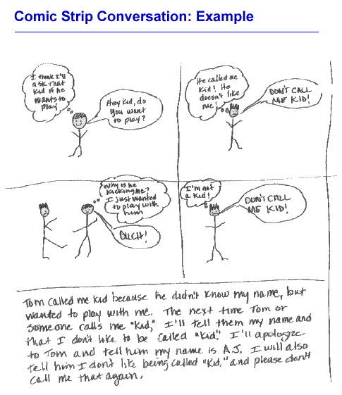
Notes:
Comic strip conversations use speaking and thinking bubbles to help students problem solve a social interaction. They are particularly useful as “social autopsies” to help students understand the perspective of others and figure out why a social interaction may not have gone well. In this example, we can see how a student was upset at being called kid, but using the comic strip conversation, the adult helped the student understand why a peer called him kid and how he may respond differently next time.

Slide 94
Social Narratives
Who, what, and where.
Statement of desired responses.
Age and ability appropriate; use terms like usually or sometimes instead of always.
Written in present tense.
Can include illustrations or photographs.
Notes:
Social narratives are another cognitive strategy for teaching social and communication skills. Social narratives provide detailed information to students about the activity and desired responses within that activity, and they use directive language. They describe what a student should do and can include illustrations or photographs to support students who are learning literacy skills. In this example, we see a brief social narrative for Nancy, including a photograph, of when to make shadow puppets. Notice that although Nancy has been making shadow puppets in the classroom when her teachers use projectors to display PowerPoint slides, this is not mentioned. Instead, the focus is on when Nancy should make shadow puppets rather than when not to.

Slide 95
Self-Management Strategies
Observe what is going on and then act:
SODA strategy (Stop-Observe-Decide-Act)
Bock, 2001
Notes:
Self-management strategies are useful in teaching students to manage their own actions, particularly in a new or challenging environment. For example, when starting a new job, it is helpful to see what type of clothing others wear (e.g., are they wearing business suits to work? Do they carry briefcases or backpacks?). By first observing the environment, we feel more comfortable knowing how to act ourselves. Some students may not be familiar with this strategy; therefore, teaching students to stop what they are doing, observe others, decide what to do, and then act (e.g., the SODA strategy; Bock, 2001) can be very helpful in terms of avoiding embarrassing or inappropriate to the situation behaviors.

Slide 96
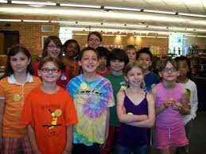
Peer-Mediated Strategies
Teach peers to demonstrate, remind, or reinforce specific social skills.
Teach peers HOW to interact socially.
Notes:
A final strategy involves teaching peers how to facilitate social interactions with peers who have a disability. Peers of any age can be taught to demonstrate (or model) social behaviors and skills, remind students to engage in specific social behaviors, and provide reinforcement of social skills (e.g., interacting with the student who is learning to be social). Simply teaching peers how to interact socially with a student who is learning social skills is likely to benefit all students.

Slide 97
Social Interaction Book
What do you like to do? What does your family do together?
Notes:
A social interaction book, containing pictures, statements, and questions, can be used in peer-mediated social instruction strategies. In this example, a student with an intellectual disability and limited verbal communication skills has a book containing a variety of pictures about the student. The book and pictures were compiled with help from the student’s family and then used as a means to share information with peers. Here, the student with disabilities shares that she likes to go camping with her family, and leaves a space for her peer to share what she does with her own family. These types of strategies break down the communication barriers that many students experience, allowing peers to get to know one another.

Slide 98
Opportunistic Strategies
Identify opportunities for social interactions:
Lunch break.
Recess.
Clubs.
Extracurriculars.
Etc.
Notes:
Finally, opportunistic strategies identify natural opportunities for social interactions such as lunch break, recess, passing periods, clubs, and extra curricular activities. These opportunities are exploited as teaching moments.

Slide 99
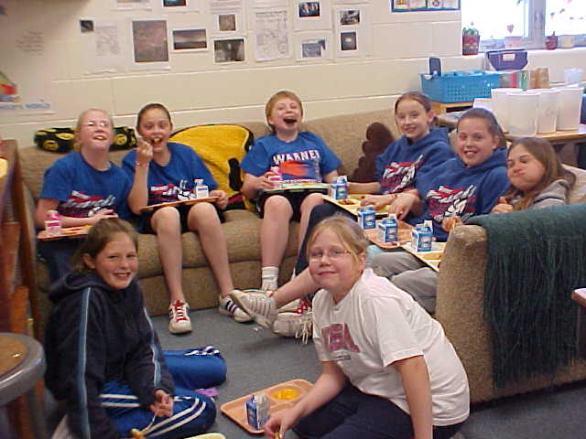
Lunch Bunch
Notes:
For example, educators can facilitate lunch bunches, in which students can invite peers to meet up for lunch. Lunch bunch is a lunchtime social event, in which students with and without disabilities come together and have social interactions. Generally, there is a facilitator of the lunch bunch; this could be a special education teacher, a general education teacher, a paraeducator, a school counselor, or any other interested adult. The facilitator will monitor and facilitate social interactions and provide any scaffolding as needed, arrange the time and place for the lunch bunch to meet, invite students to participate, and develop activities or conversation topics for the lunch bunch. The facilitator can take an active or more of a monitoring role in the lunch bunch. The facilitator may choose conversation topics for the students to discuss or organize games that can be played during lunch. If the student with disabilities requires more support, the facilitator may provide a bank of questions for the student to ask his or her peers and perhaps sentence starters for the student to use when answering questions or making comments. For students in need of less support, the facilitator may simply monitor the conversation and activity and provide clarification or prompting as needed. The goal is always for the students to get to know one another and become friends; the goal of the inclusion facilitator should be to fade out his or her active participation as much as possible over time.

Slide 100
Circle of Friends
Notes:
Circle of Friends is another strategy for developing social relationships and social skills for students with disabilities. Different groups of peers without disabilities (six to eight students per group) support the student with disabilities in activities throughout the day. A Circle of Friends group will meet regularly with a facilitator (as with a lunch bunch, the facilitator can be any educator who knows the students), who provides ongoing support in how to model communication and social skills and problem solve.
To begin, the Circle of Friends will brainstorm with the facilitator the needs of the student with disabilities. These could include behavior regulation (e.g., how to calm down when upset); how to join social activities (e.g., how to enter a game, knowing the rules of a game); and how to sustain an interaction (e.g., taking turns in a game or conversation, sharing). After the list of needs is generated, peers in the Circle of Friends will generate strategies and assign tasks for themselves. For example, peers may decide to tell the student “just forget about it” when the student is upset. They may take turns inviting the student to play with them at recess. They may invite the student to go to a movie over the weekend. Clearly, the list of options is endless but is geared toward meeting the unique needs and interests of the student and peers in the Circle of Friends. Through this type of interaction and group problem solving, the Circle of Friends usually becomes a true group of friends who help and support one another.

Slide 101
School Clubs
Notes:
Many schools have various clubs that meet during or after school. These clubs are typically organized around interests and activities. For example, schools may have theater clubs, robotics clubs, literature clubs, and so on. Middle and high school teachers can work with students to develop a club around the interest areas of students with disabilities. For example, a student who loves history may develop a history club, or a student who excels at video games may start a gamers club. These school clubs are excellent ways for students who often academically or socially struggle in school to have an avenue to shine and develop natural friendships with peers who have similar interests. Sometimes, a teacher must host a club, which may involve providing a classroom space for the club to meet and facilitating the activities of the club.

Slide 102
Extracurricular Homework
Notes:
Extracurricular activities, such as sporting events and school dances, are times for students to get together and have fun. New friendships are often forged in these activities, and are, therefore, a ripe opportunity for social inclusion. Sometimes, however, students with disabilities have very limited experience attending these extracurricular activities. As part of a social curriculum, students can be given assignments to attend a certain number of extracurricular events each semester. The school can help facilitate this by having peer buddies sign up to attend the activity with the student or provide school staff support as necessary.

Slide 103
Effective Social Skills Interventions
Occur across multiple naturalistic settings.
Frequent—every opportunity.
Peer mediated.
Motivating and student directed.
Include cooperative arrangements.
Notes:
The previous slides have demonstrated a range of teaching strategies that can be used to teach social skills to students with disabilities. It is essential to note that simply teaching skills is a necessary step, but multiple opportunities to practice and develop these skills must be provided. This instruction must occur across multiple natural settings and should be provided at every opportunity (a high frequency).
To the extent possible, social skills instruction should be peer mediated. In other words, peers should model, teach, support, and reinforce social skills with peers who have a disability. Social skills include age, context, and gender. Older adults (i.e., teachers) who are often of a different gender than the student will have limited effectiveness in teaching social skills than will same aged and gendered students. Following student interests (of all students) will help make this instruction mutually reinforcing and enjoyable for all students involved.
Social skills instruction must be motivating and student directed. The activities and instruction should incorporate the student’s interests and reflect their goals and preferences.
Last, providing an interesting curriculum that requires interdependent efforts (e.g., peer partner activities) is a simple and effective manner of facilitating social skills instruction and interactions.

Slide 104
Notes:
As a culminating activity for this module on inclusive education, watch and discuss the Axel video at at http://whocaresaboutkelsey.com/multimedia
Axel is a 16 ½- minute mini-film/documentary by Dan Habib. Axel is a fifth-grader with autism who is non-verbal and exhibits significant behavioral challenges. Through effective communication supports, collaborative teaming, differentiated instruction and adaptations to access core/general education curriculum, and strategies to facilitate social interaction and peer supports, Axel was able to learn fifth-grade general education curriculum and meaningfully participate in a general education classroom.

