Slide 1
Anchor Presentation:
Inclusive Education for ALL Students
Hour 2
Rationales for Inclusive Education
Project #H325A120003
Notes:
This section of the module will begin with clarification of terminology used throughout the remainder of the module. Then, the section will explore a series of rationales (e.g., guiding principles, values, empirical evidence, legal foundations) that have led the field to focus on inclusive education for ALL students, including those with extensive and complex support needs.

Slide 2
Terminology
Notes:
This graphic is a useful illustration of the importance of terminology and having clarity about the topic of inclusive education. The image on the bottom left illustrates exclusion. The dots that are different colors (i.e., blue, red, yellow) represent students who learn, move, or otherwise interact with the learning environment differently. When excluded, these dots are outside of the circle, which we can think of as a classroom; they are not interacting with the general education curriculum, activities, or students. This exclusion may be purposeful because some students are not allowed entry. It could also be functional because the materials, instruction, activities, or environment are not accessible to these learners. Although they may be physically present, they are functionally excluded due to lack of meaningful support and instruction.
The bottom middle circle represents segregation. Segregation is a purposeful form of exclusion. Students who have different learning needs are grouped together, outside of the regular setting for “specialized” instruction, represented here as a small circle outside of the regular circle. No effort is made to make the regular environment, curriculum, or materials meaningful and engaging for this group of students. These students are outsiders.
Integration, also referred to as mainstreaming, occurs when students with disabilities are allowed physical entry into the regular classroom environment, but their needs remain unaccounted for. Integration is represented in the bottom right circle as a small circle inside the larger circle. Students who are integrated will be seen working on different activities with different materials, sometimes at a desk with a one-to-one paraprofessional teaching the student. Although students are physically present in integrated or mainstreamed settings, their learning needs and supports are not considered in the planning and teaching of the classroom. They are a group within a group, or an island in the mainstream.
Last, the top circle represents inclusion. Here, the dots are spread throughout the circle, illustrating that students are full members of the class with provisions made for their learning needs. Teachers in inclusive settings teach all students, providing the supports and services needed so that all students learn.

Slide 3
Important Terms
Impairment, disorder, and disability are terms that the World Health Organization (WHO) introduced in 1980.
Impairment is defined as an abnormality of a structure or function.
Disability is the functional consequence of impairment.
Handicap is the social consequence of impairment (e.g., isolation, loss of job, making career changes because of communication difficulties).
Notes:
The World Health Organization (WHO) defined impairment, disability, and handicap in 1980. These terms are often used interchangeably in common speech, but they have different meanings.
An impairment is structural difference; for example, people can have hearing, vision, or physical impairments, meaning that there is something about the way their eyes, ears, or bodies are formed that make them structurally or functionally different from most others. For example, a person can have a hearing impairment that is due to mis-shaped hairs in the ear. Likewise, a person can have a physical impairment due to a spinal cord injury.
A disability is the functional consequence of that impairment. A person who has mis-shaped ear hairs has the functional consequence of not being able to hear certain sounds. A person with a spinal cord injury has the functional consequence of not being able to bear weight on the legs or walk.
A handicap, on the other hand, is the social consequence of the impairment. Handicaps are generally due to stigma and discrimination such as being isolated, losing a job, or the lack of ability to live independently. Handicap is considered a derogatory term and should be avoided. In fact, most people think the word handicap comes from times when people with disabilities would beg for money on the streets, as they were not able or allowed to work. Thus, hand-in-cap became handicap. Because we no longer view disability as something pitiable, we use more appropriate terms such as impairment or disability.

Slide 4
Why Inclusion?
Inclusion
Legal
Guiding Principles
Values
Empirical Evidence
Notes:
As previously noted, there are a series of rationales that have led the field to focus on inclusive education for ALL students with special needs. In this section, we will discuss the guiding principles, values, empirical evidence, and legal foundations of inclusive practices.

Slide 5
Guiding Principles
Social model of disability.
System of supports perspective.
Strengths-based perspective.
Least dangerous assumption.
Inclusion
Guiding Principles
Notes:
There are a series of guiding principles that formed the original foundations for inclusive education long before there was any real empirical evidence to support the practice of including students with disabilities in general education settings. We will talk about each of these guiding principles in more detail next.

Slide 6
Medical Model of Disability
Individual
Can’t Read
Can’t Concentrate
Can’t Talk
Can’t Walk
Has Autism
Is Blind
The condition and, therefore, the individual, is the problem. People with disabilities are passive receivers of services aimed at cure or management.
Notes:
There are two prevailing models of disability: the medical model and the social model. The medical model looks at disability as a problem of an individual. It assumes that the problems people with disabilities face are a result of their physical conditions, and the solution is curing them. In this view, people with disabilities cannot fully participate in society until they are no longer disabled. Many well-meaning charities fall into this view. For example, the Jerry Lewis Telethon has aimed to cure muscular dystrophy. Likewise, there are groups that aim to eradicate autism and a host of other disabilities.
The medical model makes a series of assumptions. First, it assumes that the child is broken and needs to be fixed. This leads to a reliance on diagnosing, labeling, and remediating the impairment. Programs are developed that assess and monitor the status of the impairment and professionals’ progress at remediating it. The desired outcome is fixing, and so professionals are put in positions of power and as experts. Society as a whole remains unchanged by excluding people with disabilities from regular activities.

Slide 7
Social Model of Disability
Individual
High Counters
Complex language
Background Noise
Heavy Doors
Small print
Stairs
The environment is seen as the problem. People with disabilities are active advocates for equality and work in partnership with allies to achieve their dreams.
Notes:
In contrast, the social model takes the opposite view: people with disabilities are prevented from fully participating in society by physical, attitudinal, and institutional barriers. In this view, people who have disabilities can be who they are and lead full, productive lives with the accommodation, support, and accessibility they deserve as basic civil rights. Working in the social model of disability, the child is valued as a whole person. Strengths and needs are defined by the individuals and the people who care about them rather than from a clinical or therapeutic perspective. The barriers in the child’s life are identified, and solutions are developed. Outcomes are defined based on the hopes, dreams, interests, and needs of the child, and resources are made available to support these valued-life outcomes. In this view, diversity is welcomed rather than seen as a deficit, and society evolves to meet the needs of all of its citizens.
We can think here of an example of a person who uses a wheelchair for mobility. In the medical model, the focus is on fixing the person’s paralysis or the underlying reason they use a wheelchair. In the medical model, we focus our research, education, and therapies for fixing paralysis. Perhaps a person is fitted with an exoskeleton or other device to make them conform to the existing environment. The social model, on the other hand, sees that by making environmental adjustments, the needs of a person who uses a wheelchair can be accommodated without changing the person. Instead, the environment and society as a whole will evolve to address the unique needs of that person such as by placing curb cuts into sidewalks, incorporating elevators into buildings, and so on.
The medical model has limited benefits to society as a whole and few benefits to the individual specifically (aside from a lot of therapy). The social model of disability, however, benefits society as a whole; for example, parents can use curb cuts to push their children in strollers more easily down sidewalks. Elderly people or people carrying a lot of groceries will also benefit from elevators. Of course, the list of benefits is lengthy. However, when we remain mired in a medical model of disability, there is no benefit to people with disabilities and, of course, no larger societal benefit.

Slide 8
Needs for Support
Personal Capacity
Demands of the Environment
Notes:
The social model of disability fits closely with current models of disability. Disability is thought of as multidimensional state of human functioning in relation to environmental demands (Thompson et al., 2009). In other words, disability is not static—the extent of disability depends very much on the current demands of the environment. The closer a person’s capacity is to the demands of the environment, the less support that person’s needs are. Here, you can see that there is quite a bit overlap between capacity and demands, suggesting that this person experiences little, or no, disability, and will require little additional support to be successful in this environment or activity.

Slide 9
Needs for Support
Personal Capacity
Demands of the Environment
Need for Support
Notes:
However, when a person’s personal capacity has a greater gap with the demands of the environment, the person experiences more disability and has a greater need for support. The person may need support to access small print or complex text or the person may need more support to access a science lab by making lab desks wheelchair accessible. This model of disability incorporates the social model of disability by defining disability not as the deficits inherent in a person or their impairments but by their support needs. In this CEM, we are considering students who have a greater gap between capacity and demands and, thus, are in need of more extensive and complex supports.

Slide 10
Support Needs
Notes:
Supports are resources and strategies that promote the development, education, interests, and personal well-being of a person and enhance individual functioning (Luckasson et al., 2002). Support needs refer to the pattern and intensity of supports necessary for a person to participate in activities that others of similar age and gender participate in. Supports bridge what is (i.e., a mismatch between capacity and demands) and what can be (i.e., a life with meaningful activities and positive personal outcomes).
When we define disability by support needs, we acknowledge that we all have support needs. John Donne wrote in the 17th century No Man Is an Island to convey the truth that human beings do not thrive in isolation from others. We live in an interdependent world, and everyone needs a variety of supports to function on a daily basis. Think of the supports you depend on daily—from the food you eat (Who raised it? Butchered it? Prepared it?), the clothes you wear, the car you drive, the electricity and batteries that power your tools, and so on. We depend on people across the globe to function on a daily, almost minute-to-minute basis. People with disabilities will require ongoing, extraordinary supports compared to nondisabled peers. “Put another way, if supports were removed, people with disability would not be able to function as successfully in typical activities and settings” (Thompson et al., 2009, p. 137).
Support needs can also be thought of as a psychological construct, much like happiness or anxiety. These constructs have extreme points, such as euphoric or depressed, and many points in between. How much support a person needs will slide up and down this scale, depending on the fit between individual capacity and environmental demands. Thinking of disability this way, as a state of functioning instead of an inherent trait, allows us to focus our attention on making the environment accessible by providing supports rather than focusing on fixing the individual.

Slide 11
System of Supports Perspective
Notes:
When teams plan supports for individuals with disabilities, it is important to build systems of supports so that the person's preferences and priorities are addressed (rather than the priorities or preferences of the team) and the individual is not over-supported, which can lead to reduced quality of life and resources are allocated appropriately. For example, personnel supports may be necessary to meet a student’s health and physical needs in a classroom. However, one-to-one support provided from well-intentioned adults can lead to learned helplessness, dependency, and isolation from peers. In other words, solving a problem for any one issue in a person’s life without addressing the others does little to promote desirable outcomes. Thinking about systems of supports, then, requires us to address multiple elements of human life across multiple settings rather than discrete life activities or separate events.

Slide 12
School Supports
Notes:
In the school context, we are tasked with figuring out the supports our students need on a daily, if not minute-by-minute, basis. In other words, teaching is not just delivering a curriculum. A robot could do that. Instead, teaching is figuring out what supports a student needs to learn and providing those supports. When we enter a classroom with the belief that all students can learn but that our students may need different supports to achieve that outcome, we are creating an inclusive environment in which every student can succeed.

Slide 13
Academic Integrity
Notes:
When we discuss providing supports to students to help them be successful, it is important to keep in mind the need for academic integrity. Providing supports and services to enable students with disabilities to have access to the general education curriculum does not mean that we are lowering standards or expectations. Imagine that the Common Core State Standards (CCSS) are the peak of this mountain top. Today is the first day of school. All students are in this meadow, with their teacher, at the base of the mountain. The expectation is that all students will achieve these rigorous, meaningful standards by making their way from this meadow to the peak of the mountain by the end of the school year. Achieving these standards is going to be tough—there are some flat parts but also some pretty steep parts. So how do we get there from here? How can people climb this peak? Some people may take the steepest, most direct route. Others may wind their way up the mountain through a series of switchbacks. Clearly, there is more than one path to meeting high expectations and achieving learning.

Slide 14
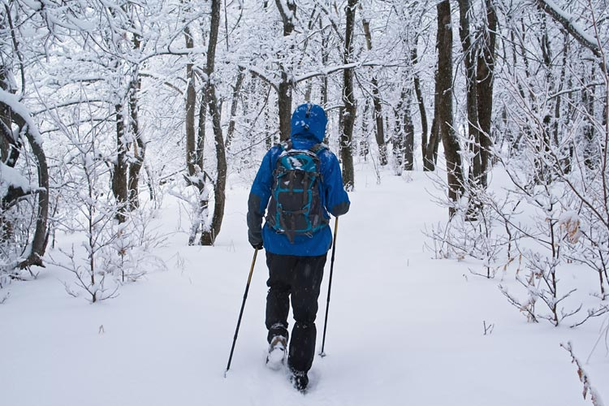
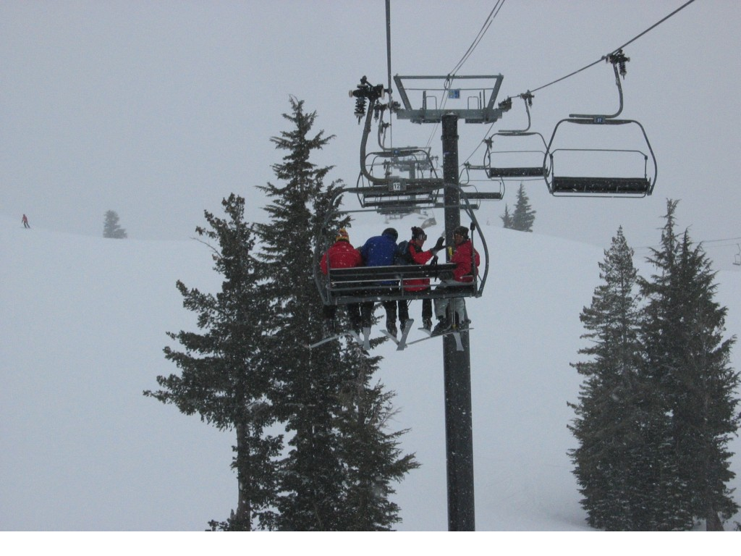
Varied & Purposeful Supports
Notes:
But, as hikers and learners, we are not limited to just one way up a mountain. By providing varied and purposeful supports to students, we can help students get from the meadow to the peak in plenty of ways. Some students may need the excitement and challenge of climbing up sheer walls. Some may use poles and snow shoes. Some may get to the top by helicopter, others by horseback, still others may take the ski lift to reach the top. In other words, what matters is that students achieve our high standards tied to the Common Core. Providing these varied and purposeful supports is the mechanism for reaching these standards, and it is our job as educators to figure out the best route for each of our students. We do not shrink the mountain or choose a different mountain. We simply provide tools to help all students reach the same peak.

Slide 15
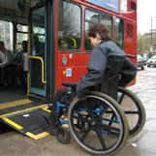
Assumptions
The environment may be disabling.
A person becomes disabled when the environment does not provide needed supports.
Notes:
Further guiding principles are based on assumptions. The supports perspective, or paradigm previously discussed, is based on the premise that the most relevant difference between people with disabilities and the general population is that people with disabilities need different types and intensities of support to fully participate in and contribute to society (Thompson et al., 2009). Viewed through this lens, we now realize that the environment may be disabling and that by adjusting the environment through the provision of supports, we can prevent or minimize the impact of disability.

Slide 16
Further Assumption
If the student is not successful in general education, then general education must provide more supports.
Notes:
This supports paradigm of disability is not limited to physical supports. General education is disabling when varied and purposeful supports are not in place to support students to have meaningful access to the general education curriculum. Teachers provide supports in a variety of ways (e.g., modified curriculum, checklists of the days activities, peer tutors, token economy systems). Providing these supports enables students to learn, participate, and reach the peak of the mountain.

Slide 17
Least Dangerous Assumption
What if?
We assumed that she COULD learn, so we gave her every opportunity, and it turned out she COULD NOT?
We assumed that she COULD NOT learn, so we did not give her the opportunity, and it turned out she COULD?
Notes:
Another assumption to consider is the least dangerous one. This notion was expanded by Ann Donnellan’s Criterion of the Least Dangerous Assumption (1984). This criterion states that in the absence of conclusive evidence, we must treat and educate people with disabilities in such a way that assumes they are capable of learning and benefitting from instruction. This criterion rests on our inability to accurately predict what people are capable of learning, our inability to predict a person’s potential, and our inability to accurately assess people with the most significant and complex support needs. In the absence of this kind of conclusive, factual information, we must assume that our students are capable of learning and will benefit from instruction. To do otherwise lowers expectations and limits opportunities.
There is great potential for harm in assuming that a person is not capable of learning or is not getting anything out of it. Instead, there is very little harm in giving every opportunity. In providing inclusive education, we seek to provide every opportunity for every student to learn and achieve because we are unwilling to make a more dangerous assumption.

Slide 18
Strengths-Based Perspective
“A good education program can be nothing less than a program which provides for every child according to his needs”
Meta L. Anderson, Ph.D.
American Association on Intellectual and Developmental Disabilities president 1940-1941
Notes:
The Individuals with Disabilities Education Improvement Act (IDEA) of 2004 requires educational teams to design a special education program to address the unique needs, wills, goals, and preferences of individual students. Frequently, however, test scores and disability labels determine where and how students are educated. For example, students with an autism label are placed in autism programs. Students with learning disabilities are placed in resource classrooms. Students with severe intellectual disabilities are placed in functional classrooms. These examples illustrate that, too often, we place students into existing systems rather than designing systems to meet their needs, as was intended by IDEA. This proposes a shift from forcing students to conform to existing systems and instead to build and focus on strengths, needs, will, goals, and preferences.
Focusing our educational program on meeting child needs may seem like a radical shift, and in some ways, it may be. But it is important to remember that the adult world is very specialized, unlike K-12 education. There are many skills that, as adults, we assign to others (e.g., maintaining our cars, mowing our yards, butchering our meat). As adults at work, your specializations are even more pronounced. There are sets of skills you need to be successful at work and a set of skills that others do. Allowing students to pursue their strengths and interests in school has valuable consequences. Student motivation, attention, and interest can all be affected in positive ways. To truly prepare students for adult life, it is advised that educators provide students with opportunities for specialization and pursuit of their own strengths and interests in K-12 settings. For example, if a student has an intense interest in cars, perhaps that interest can be incorporated into literacy activities, science, social studies, and so on.

Slide 19
Empirical Support
Outcomes for students with disabilities.
Outcomes for students without disabilities.
Parent perspectives.
Inclusion
Guiding Principles
Empirical Evidence
Notes:
We have now outlined some of the guiding principles of inclusive education. Further supporting inclusive education is a growing body of empirical support. The movement toward inclusive education began in the 1970s, when we knew very little about educating students with disabilities in general and much less about outcomes associated with special education. Today, there are decades of research about understanding how to teach students with disabilities and where that instruction is most effective. Empirical research has looked at outcomes of inclusive education on students who experience disability, students who do not experience disability, and parents and teachers.

Slide 20
Academic Outcomes
Inclusion is associated with higher academic skill development (e.g., literacy, math); greater access to core curriculum; individualized education program (IEP) goals tied to standards; and an emphasis on problem solving.
Dessemontet, Bless, & Morin, 2012; Dore, Dion, Wagner, & Brunet, 2002; Fisher & Meyer, 2002; Hedeen & Ayres, 2002; McLeskey, Henry, & Hodges, 1998; Meyer, 2001
Notes:
Academic outcomes for students with disabilities have consistently found that inclusive education is associated with higher academic skill development, greater access to the core curriculum, and more rigorous individualized education program (IEP) goals. In these studies, students with disabilities who were educated in inclusive settings were compared to similar students educated in segregated special education settings. These studies, and others like them, demonstrate that not only can students with disabilities learn academic skills in inclusive settings, but they can also learn more academic skills in these settings compared to segregated settings.

Slide 21
Communication Skills Outcomes
Rafferty, Piscitelli, & Boettcher (2003).
96 preschoolers (68 inclusion, 28 self-contained).
Hierarchical regression techniques.
Students in inclusion had higher language scores than students in self-contained settings:
Preschoolers with less severe disabilities did not make greater gains in inclusion.
Preschoolers with more severe disabilities did not make greater gains in self-contained settings.
See also: Foreman, Arthur-Kelly, Pascoe, & King 2004
Notes:
Communication skills are often an area of need for many students with disabilities, particularly those with significant and complex support needs. In an analysis of 96 preschoolers, Rafferty, Piscitelli, and Boettcher (2003) used hierarchical regression techniques to look at language outcomes for students with disabilities in inclusive and segregated settings. They found that students educated in inclusive settings obtained higher language scores than students taught in segregated settings. This is in line with other research that also documents the positive impact of inclusive settings on teaching communication skills.

Slide 22
Social-Skills Outcomes
Meta-analysis (Bellini, Peters, Benner, & Hope, 2007).
Inclusive settings more effective in promoting social skills and social competence:
Pull-out instruction was “contrived, restricted, and decontextualized”(Bellini et al., p. 160) with weak generalization and maintenance of skills.
See also: Causton-Theoharis & Malmgren, 2005; Cawley, Hayden, Cade, & Baker-Kroczynski, 2002; Dore et al., 2002; Mastropieri & Scruggs, 2001
Notes:
Research also confirms that education in inclusive settings is associated with improved social-skills outcomes for students with disabilities. Students who were taught in inclusive settings had greater social skills and competence compared to similar students taught social skills in special education settings, as found in a meta-analysis that Bellini and colleagues (2007) completed. These authors, in their synthesis of the literature, found that teaching social skills in segregated settings was contrived, restricted, and decontextualized. Students taught social skills in these settings had poor ability to generalize and maintain the skills, further suggesting the ineffectiveness of special education settings compared to inclusive settings. Many believe that this growth in social skills in inclusive settings is largely due to access to a social network and peer models in inclusive settings (e.g., McDonnell, Johnson, Polychronis, & Riesen, 2002).

Slide 23
Self-Determination Outcomes
Hughes, Agran, Cosgriff, & Washington (2013).
47 students with severe intellectual disabilities from three high schools in high-poverty communities; schools failing to meet academic yearly progress (AYP).
Use of self-determination strategies in inclusive versus traditional schools.
Students attending inclusive schools used more of self-determination skills identified than students in segregated settings.
See also: Shogren et al., 2006.
Notes:
Self-determination includes a complex set of skills, including making choices, advocating, goal setting and monitoring, problem solving, and decision making that are required of adults but also contribute to a quality of life. In a study of self-determination outcomes in segregated and inclusive settings, Hughes and colleagues (2013) found that high school students educated in inclusive settings demonstrated more self-determination skills than students educated in segregated settings.

Slide 24
Adaptive-Behavior Outcomes
Dessemontet, Bless, & Morin (2012).
34 children with ID in inclusive settings; 34 children with ID in self-contained settings.
No differences in adaptive-behavior outcome between the two groups of children (i.e., ABAS-2 and teacher and parent forms).
Notes:
Adaptive behavior skills are those needed for daily life such as social, communication, and self-care skills that are appropriate for person’s age and culture. Dessemontet and colleagues (2012) compared 34 students with intellectual disabilities in inclusive and segregated settings. They found no differences in outcomes between the two groups of students. The finding of no difference is telling because both settings apparently support skill development. When considered with the other findings that inclusive settings are associated with positive gains in academic, social, communication, and self-determination skills (among others), the least dangerous decision would be to educate students with significant disabilities in inclusive settings.

Slide 25
Effect on Peers Without Disabilities
Parents believe that inclusion benefits their child academically and socially (Peck et al., 2004).
No effect on academic performance of typical peers:
Ruijs et al., 2010
Salend & Duhaney, 1999
Dessemontet & Bless, 2013
Sharpe, York, & Knight 1994
Positive academic gains for typical peers:
Cole et al., 2004
Positive social gains for peers:
Kalambouka, Farrell, & Dyson 2007
Notes:
In addition to examining the outcomes of inclusive education on students with disabilities, researchers have examined the impact of inclusive education on students without disabilities and the preferences of their parents. Parents have consistently supported inclusive education, believing that their children benefit from inclusive education both academically and socially. A number of studies have also looked at outcomes on students without disabilities, with findings ranging from no impact on academic performance, to academic gains, to social gains for these peers. In summarizing the literature on the impact of inclusive education on peers in general education settings, no research has indicated a negative impact.

Slide 26
Values
Inherent dignity.
Educational equity.
Valued-life outcomes.
Presumption of competence/Credo of Support.
Inclusion
Guiding Principles
Values
Empirical Evidence
Notes:
Along with guiding principles and empirical evidence, a set of core values has guided the implementation of inclusive practices. These include the inherent dignity of all people, educational equity, valued life outcomes, and a presumption of competence. These values, along with the guiding principles and empirical evidence, further support educational teams in advocating for inclusive practices.

Slide 27
Dignity
All have the right to an enviable life.
All have the right to dignity.
Notes:
Human dignity is at the heart of the social justice and disability rights movements. Dignity can be defined as a perception of respect and competence that allows a person to feel valued, be the authentic version of themselves, grow and learn, and value and care about others (Hill & Tollerud, 1996). Too often, people with disabilities are treated in a manner that revokes dignity—choices are made for them; they are forced to comply with tasks and activities that others demand of them; they experience physical harm, frustration, and loneliness; and they complete functions and tasks that are undesirable or meaningless, usually all in the name of treatment.
Think of typical experiences of students with disabilities: Green Team (or picking up trash and recycling on campus), having limited options of courses to take, being assigned friends, exclusion from extracurricular events, completing endless worksheets, having staff talk about your health care and private needs in a public space, and being restrained and secluded. Certainly, this is not an exhaustive list, and unfortunately, the list of undignified experiences of people with disabilities is very lengthy.
Those who promote inclusive practices see value in also promoting dignity. This is facilitated by including students with disabilities in normative experiences, offering choices, providing opportunities for developing trust and friendship, and facilitating self-determination, among others.

Slide 28
Educational Equity
Notes:
Promoters of inclusive practices also believe that education is a right for all, not a privilege for a few. As illustrated in this slide, inclusion advocates further realize that to give all students the right to education and inclusion, we must not treat people with equality—we must provide to each according to their needs (Lavoie, 1989).

Slide 29
Valued-Life Outcomes
Increased participation in valued roles, activities, and settings
Membership
Skills
Relationships
Notes:
Billingsley and colleagues (1996) articulated the concept of valued-life outcomes for students with disabilities as membership, relationships, and skills. In other words, these are core outcomes that all people seek as a result of education. Membership refers to a sense of belonging. To obtain membership, a student cannot be a part-time visitor, but must be a full member with all of the rights and responsibilities of other classmates. Relationships refer to the outcome of having meaningful relationships with others; to obtain this, students must know each other on a personal level, including one another’s preferences, strengths, and interests. Last, skills refers to the academic skills taught in general education, such as reading, writing, math, science, and all of the hidden curriculum skills such as waiting, turn taking, note taking, and social skills. By participating in inclusive settings with valued roles and activities, these valued-life outcomes are promoted.
29

Slide 30
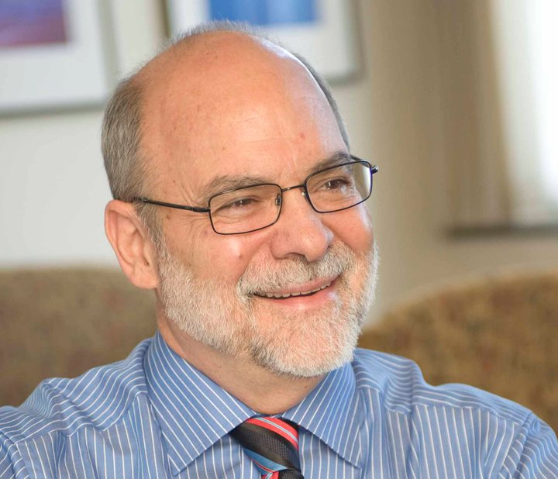
Educator’s Oath
Hippocratic Oath
Presume competence:
“Difficulties with demonstrating ability are not to be taken as evidence of intellectual incompetence . . . .[Rather] as a matter of basic sensitivity and good educational practice, educators must presume that the person is intelligent.” 1990
Prof. Doug Biklen
Notes:
The Hippocratic Oath is familiar to most of us; physicians swear to first do no harm while treating patients. The Hippocratic Oath is readily applicable to educators, as well. In other words, it is advisable that the decisions teachers make should first do no harm to their students in terms of dignity, self-determination, developing relationships and memberships, and learning of skills. Professor Biklen has also proposed that educators may abide by the presumption of competence. As you can see from the quote above, this presumption asks us to make the least dangerous assumption—in other words, an inability to speak does not mean that a person does not have anything to say, and an inability to demonstrate what is known does not mean that a person is incompetent.

Slide 31
Credo of Support
Notes:
To summarize the values that drive inclusive practices, watch the Credo of Support at https://www.youtube.com/watch?v=wunHDfZFxXw)

Slide 32
Legal Guidelines
IDEA 2004 Mandates:
Least restrictive environment (LRE) provisions.
Free appropriate public education (FAPE) requirement.
Case law-judicial standards of review.
Inclusion
Legal
Guiding Principles
Values
Empirical Evidence
Notes:
Finally, we will discuss the legal guidelines that support the provision of inclusive education.
Two key mandates of IDEA, the least restrictive environment (LRE) provisions, and the free appropriate public education (FAPE) requirement have implications for and provide foundations for inclusive education. Furthermore, there exists a body of case law through which the judicial system has helped interpret each of these mandates.

Slide 33
LRE Mandate
“States and school districts must establish policies and procedures to ensure that ‘to the maximum extent appropriate, children with disabilities, including in public or private institutions or other care facilities, are educated with children who are not disabled, and that special classes, separate schooling, or other removal of children from the regular education environment occurs only when the nature or severity of the disability is such that education in regular classes with the use of supplementary aids and services cannot be achieved satisfactorily’” (IDEA, 20 U.S.C.§1412).
Notes:
There is currently no legal definition of inclusive education. Instead, the LRE mandate is used to address the presumptive right for all students with disabilities to be educated alongside their same-age peers without disabilities in general education classrooms and environments. Schools are to make good faith efforts to provide ALL students with education in the least restrictive settings with appropriate individualized supports and services. The assumption is that a student would only receive special education services in a more restrictive setting if an appropriate education could not be provided in the general education setting with supplemental aids and services.

Slide 34
FAPE Requirement
According to IDEA, “free appropriate public education means special education and related services that—
have been provided at public expense, under public supervision and direction, and without charge;
meet the standards of the State Educational Agency;
include an appropriate preschool, elementary school, or secondary school education in the State involved; and
are provided in conformity with the individualized education program required under [this law]”
(IDEA, 20 U.S.C.§1401(9)).
Notes:
The FAPE mandate requires that a student receives IEP developed and implemented to meet the unique needs of the student as identified by evaluations, observation, and the student’s educational team and from which the student receives educational benefit. FAPE necessitates the special education and related services are coordinated to ensure that the student is able to make measurable and meaningful progress in the LRE.

Slide 35
Components of FAPE
All eligible students are entitled to receive FAPE regardless of the severity of their disabilities.
School districts may not charge for special education services or related services nor may they refuse to provide special education services due to the cost of these services.
An IEP developed and implemented to meet the unique needs of the student and from which the student receives educational benefit (i.e., appropriate education).
Yell, 2012
Notes:
There are three key components to FAPE. One is that all eligible students are entitled to receive a free public education regardless of the severity of their disabilities. Second, school districts may not charge parents of students with disabilities for special education services and related services. Further, school districts cannot refuse to provide special education services due to the cost of these services. Third, to provide an appropriate education, the school district must develop an IEP for the student in collaboration with the student’s parents. The IEP must meet the unique needs of the student and must enable the student to receive educational benefits.

Slide 36
Case Law-Judicial Standards of Review
Board of Education v. Rowley (1982).
Cypress-Fairbanks Independent School District v. Michael F (1997).
Roncker v. Walter (1983).
Daniel R.R. v. State Board of Education (1989).
Sacramento City Unified
School District v. Holland (1994).
Notes:
As previously mentioned, a number of seminal court cases have assisted in the interpretations of the LRE and FAPE mandates and have resulted in the establishment of judicial standards of review. A considerable amount of litigation has arisen out of disputes between families and the school districts regarding FAPE and LRE. These five cases and the standards or tests that arose from the court decisions have important implications for FAPE and LRE.

Slide 37
Board of Education of the Hendrick Hudson School District v. Rowley (1982)
Supreme Court decision established a minimum standard for what constitutes FAPE.
“We hold that the state satisfies the FAPE requirement by providing personalized instruction with sufficient support services to permit the child to benefit educationally from that instruction”(Rowley pp. 203-204).
Notes:
Board of Education of the Hendrick Hudson School District v. Hudson School District v. Rowley (1982) was the first ruling by U.S. Supreme Court case in relation to FAPE. The Supreme Court decision established a minimum standard for what constitutes FAPE.

Slide 38
Rowley Standard/Two-Part Test
Has the school complied with the procedures in the act (i.e., IDEA)?
Is the IEP reasonably calculated to enable the child to receive educational benefits?
Notes:
The U.S. Supreme Court developed the Rowley Standard or Two-Part Test to be used to determine if a school has provided FAPE as required by IDEA. To determine if a school has provided FAPE, it must be determined (1) whether the procedural requirements of IDEA have been met and (2) whether the students’ individualized (IEP) and the special education services being provided educationally benefit the student. Educational benefit means that the educational program must be likely to produce meaningful, not trivial, progress. What constitutes a meaningful education can only be determined on a case-by-case basis.

Slide 39
Cypress-Fairbanks Independent School District v. Michael F. (1997)
Four-part test devised:
Was the program individualized on the basis of the students assessment?
Was the program in the LRE?
Were the services provided in a collaborative manner by key stakeholders?
Were positive academic and nonacademic benefits demonstrated?
Notes:
In the case of Cypress-Fairbanks Independent School District v. Michael F., the U.S. Court of Appeals of the Fifth Circuit used the following four factors to determine whether the school district had provided an appropriate education:
Was the program individualized on the basis of the student’s assessment?
Was the program in the LRE?
Were the services provided in a collaborative manner by key stakeholders?
Were positive academic and nonacademic benefits demonstrated?

Slide 40
Roncker v. Walter (1983) (The Roncker Portability Test)
Can the educational services that make a segregated placement superior be feasibly provided in an unsegregated (i.e., integrated and inclusive) setting?
If so, the placement in the segregated setting is inappropriate.
Notes:
Although the LRE mandate is one of the most legally contested requirements of IDEA, to date, the U.S. Supreme Court has not accepted a case to interpret this mandate. Nevertheless, a number of important cases have been heard and decisions made by U.S. Courts of Appeals.
One of the earliest decisions was made by the U.S. Court of Appeals for the Sixth District in the case of Roncker v. Walter (1983). This decision is known as the Roncker portability test and states:
“In a case where the segregated placement is considered superior, the court should consider whether the educational services which make that placement superior could feasibly be provided in a nonsegregated (i.e.. integrated) setting, If they can, the placement in the segregated school would be inappropriate under the Act” (Roncker, p. 1063).

Slide 41
Daniel R.R. v. State Board of Education (1989) (The Daniel Two-Part Test)
Part 1: Can education in the general education classroom with supplementary aids and services be satisfactorily achieved?
Part 2: If it cannot, and the student is removed, is he/she integrated to the maximum extent appropriate?
Notes:
In another key court case regarding the LRE mandate, Daniel RR v. State Board of Education, the U.S. Court of Appeals for the Fifth Circuit developed a two-part test to determine if a school was providing a student education in LRE. First, it must be decided if education in the general education classroom with supplementary aids and services was achieved satisfactorily. In other words, has the school attempted to provide accommodations and modifications for the student with disabilities in the general education classroom? If a school passes the first part of the test, then it must be determined if the school has integrated the student to the maximum extent appropriate.

Slide 42
Sacramento City Unified School District v. Holland (1994) (The Rachel H. Four-Factor Test)
Factor 1: Educational benefits of the general classroom with supplementary aids and services versus special education classroom.
Factor 2: Non-academic benefits of general versus special education classroom.
Factor 3: Effect of the student on the education of others.
Factor 4: The cost of mainstreaming.
Notes:
In the case of Sacramento City Unified School District v. Holland, The U.S. Court of Appeals for the Ninth Circuit affirmed a decision made by the district court. The district court considered the following four factors in making its decision regarding whether the student was provided an appropriate education in the LRE:
Educational benefits of the general classroom with supplementary aids and services v. special education classroom: This factor concerns the educational benefits available to a student in the general education classroom with appropriate supports and services compared to educational benefits of the special education classroom. In this case, the school district did not establish that the educational benefits of the special education classroom were better than the educational benefits of the general education classroom.
Non-academic benefits of general v. special education classroom: This factor concerns whether there are non-academic (e.g., social and communication skills) benefits.
Effect of the student on the education of others: This factor examines the impact of the student with disabilities’ presence on other in the general education setting (e.g., impact on teacher’s ability to teach other children).
The cost of mainstreaming: This factor involves evaluating the cost of placement in the general education classroom. A school would need to provide persuasive evidence that it would be significantly more expensive to educate the student in the general education class.

Slide 43
From Oberti Decision (1993)
“The Act’s strong presumption in favor of mainstreaming . . . would be turned on its head if parents had to prove their child was worthy of being included, rather than the school district having to justify a decision to exclude the child from the regular classroom.”
Notes:
As this quote from the Oberti v. Board of Education of the Borough of Clementon School District implies, there is a congressional preference for including students in the age-appropriate, general education classroom.

