Slide 1
Collaboration for Effective Educator Development, Accountability, and Reform
Course Enhancement Module on Multi-Tiered System of Supports in Mathematics
Part 4: Intensive Math Interventions
H325A120003
Notes:
Introduction to the Module
This module is part of a series of training modules developed by the Collaboration for Effective Educator Development, Accountability and Reform (CEEDAR). The series has been created for pre-service and current teachers of students with disabilities and for school teams involved in the initial planning for using data-based individualization (DBI) as a framework for providing intensive intervention in imathematics. This module is intended to follow the third module, Part 3: Supplemental Math Interventions.
Title Page Speaker Notes:
You will need Internet access to watch the embedded videos.
Participants will need to be able to stop and have group discussions throughout the module.
Participants will also need to have copies of Handout 1.

Slide 2
Collaboration for Effective Educator Development, Accountability, and Reform (CEEDAR)
Notes:
CEEDAR was developed in response to the difficulties students face academically.

Slide 3
Disclaimer
This content was produced under U.S. Department of Education, Office of Special Education Programs, Award No. H325A120003. Bonnie Jones and David Guardino serve as the project officers. The views expressed herein do not necessarily represent the positions or polices of the U.S. Department of Education. No official endorsement by the U.S. Department of Education of any product, commodity, service, or enterprise mentioned in this website is intended or should be inferred.

Slide 4
Note
Part 4 features content and resources from:
The National Center on Intensive Intervention (NCII): www.intensiveintervention.org
Center on Response to Intervention: www.rti4success.org
The IRIS Center for Training Enhancements. (2010). RTI: Mathematics. Retrieved from http://iris.peabody.vanderbilt.edu/module/rti-math/#content
RTI Action Network http://www.rtinetwork.org
Notes:
Slides and other resources have been adapted from materials provided on these centers’ websites. Throughout the CEM, we will highlight Internet resources for specific topics. For additional information, see the references and resources lists on the CEM website.

Slide 5
Essential Questions: Part 4—Intensive Math Interventions
What is the rationale for intensive intervention?
What are the steps in the DBI process?
What methods should be used to intensify instruction in mathematics and research-based intense interventions?
How is this applied in the classroom (case example)?
Notes:
Read the slide. Part 4 will address these four essential questions.

Slide 6
What Are Intensive Math Interventions?
Notes:
In this section, you will learn what intensive math interventions are, how they fit into the RtI model, and how teachers can increase the intensity of these interventions.

Slide 7
Introductory Activity
Interactive Activity
Organize into groups of two to four people.
Identify the three most common things you do to make math instruction more intense.
Choose someone to report out to the larger group.
We will revisit your responses at the end of the module.
Notes:
Define and make sure participants understand the meaning of reading instruction the action or process of teaching.
Activity:
In a group of two to four people, take a few minutes to identify the three most common things you (or others on your staff) do, when necessary, to make instruction or intervention more intense. Now choose someone to report out to the large group.
Circulate as teams discuss. After most groups appear to be ready (3-5 minutes), have each reporter share each team’s items. Record their responses on a piece of chart paper or whiteboard to revisit at the end of the session. If teams note the same strategies, use tally marks to keep track of how often each strategy is noted.
Possible Questions for Teams:
What made you choose these things?
Why do you think they are used so often?
Are they working well for you? How can you tell?
Keep this activity to 10–12 minutes to allow sufficient time for other parts of the module. If needed, remind groups that there will be more time for discussion throughout the session.

Slide 8
What Are Intensive Math Interventions?
Intensive intervention addresses severe and persistent learning or behavioral difficulties. Intensive intervention should be:
Driven by data.
Characterized by increased intensity (e.g., smaller group, expanded time) and individualization of academic instruction and/or behavioral supports.
National Center on Intensive Intervention, 2013b
Notes:
Give participants time to read the two bullets on the slide.

Slide 9
Multi-Level Prevention System
Intensive
level of prevention
(~5% of students)
Supplemental level of prevention
(~15% of students)
Universal level of prevention
(~80% of students)
Filter et al., 2007; Kerr & Nelson, 2010; National Center on Response to Intervention, 2010
Notes:
The universal level includes high-quality core instruction. The secondary prevention level includes evidence-based intervention(s) of moderate intensity. The intensive prevention level includes individualized intervention(s) of increased intensity for students who show a minimal response to secondary prevention. The go
f MTSS is to help every student access the grade-level standards in a very strong and effective core instructional program that is standards based, data driven, and responsive to student needs. Effective use of data from multiple assessment measures allows teachers to make good decisions about what they teach their students, ensuring that rather than teaching students what they already know, they are able to focus on the things they do not know. It also allows teachers to identify students (especially struggling students) who are not accessing grade-level content well and identify any gaps or holes in their learning.
When many people think of MTSS, they imagine this triangle. This triangle represents the three levels of prevention and the percentage of students who would be expected to benefit from these levels of prevention in an effective system. The first or UNIVERSAL level is indicated in green. It is expected that most students (at least 80%) will benefit from differentiated instruction within the core curriculum.
The next level—the supplementary level—is supplemental to the primary level. It is expected that between 10-15% of students will need supplemental, small-group instruction to benefit from core instruction and curriculum.
The top level—or intensive level—includes specialized, individualized systems for students with intensive needs. It typically involves small-group instruction of one to three students who are significantly behind their peers. It is expected that about 5% of students will need intensive support.
If fewer than 80% of students are benefiting from the primary prevention system, consider focusing school improvement efforts on improving core instruction and curriculum. If there is a large percentage of students in the secondary or tertiary level, consider implementing large-group instructional activities and system changes within the primary level to reduce the number of students requiring additional support.
The logic of the triangle suggests that most students—about 80%—will respond positively to strong, systematic prevention techniques. This implies that about 20% of students will not be responsive to the supports widely available in schools to promote academic achievement and behavioral success. The students who are not responsive will require further support to maintain academic and behavioral progress in schools.
The typical process in academics is to move non-responding students to an intervention that provides additional feedback on student progress and opportunities to access academic information using different learning modalities. Fortunately, many of the students who demonstrate difficulty will show improvement. The anticipated response rate to preventative and secondary intervention supports is about 15%. Five% of students will not be responsive to preventative or secondary intervention supports.
Students who have not made adequate progress despite receiving secondary intervention may require tertiary/intense intervention.

Slide 10
Continuum of Instructional Support
Intensive Intervention
Who receives instruction? | Students not adequately responding to supplemental intervention
Who provides instruction? | Intervention specialist or special education teacher
How is instruction delivered? | Individually or in groups of no more than three students
IRIS Center for Training Enhancements, 2010
Notes:
According to the RtI model, students receive individualized intervention at the intensive level individually or in a very small group setting. Students receive interventions in addition to receiving instruction in the core curriculum.
Intensive instruction should not replace core instruction.
Discussion Question:
What is the difference in intensity between supplemental and intensive intervention? What makes the intensive level of intervention distinct?

Slide 11
What Intensive Intervention . . .
Is . . .
Individualized, based on student needs.
More intense, often with substantively different content AND pedagogy.
An intervention that uses more frequent and precise progress monitoring.
Is Not . . .
A single approach.
A manual.
A pre-set program.
More of the same universal instruction.
More of the same supplementary instruction.
National Center on Intensive Intervention, 2013
11
Notes:
Read points on slide.

Slide 12
Why Do We Need Intensive Intervention?
Low academic achievement
Dropout rates
Arrest rates
National Center on Intensive Intervention, 2014
12
Notes:
There is a significant academic achievement gap between students with and without disabilities. According to NAEP data (National Center for Education Statistics, 2014), 83% of fourth-grade students with disabilities scored at or below basic in math in 2013. This gap continues to widen as students get older and matriculate though school, highlighting the need for earlier intervention and prevention of academic failure.
When students experience persistent low academic achievement and school failure, they are at high risk for dropping out of school. Students with disabilities drop out at much higher rates that students without disabilities. Though the graduation rate has increased in the past 10 years, students with disabilities (in particular, students with learning disabilities) graduate at a rate of 68% compared to the national graduation rate of 80% (National Center for Learning Disabilities, 2014; America’s Promise Alliance, 2014).
Without a high school diploma, students are at greater risk for unemployment, poor health outcomes, dependency on social services, and high rates of delinquency.

Slide 13
Why Do We Need Intensive Intervention?
More Help
Validated programs are not universally effective programs; 3-5% of students need more help (Fuchs et al., 2008; NCII, 2013).
More Practice Students with intensive needs often require 10 to 30 times more practice than their peers to learn new information (Gersten et al., 2008).
National Center on Intensive Intervention, 2013
13
Notes:
Based on their low academic achievement, many students are not making progress in the universal level of instruction. Approximately 3-5% of students will not make adequate academic progress—despite research-based supplemental instruction—and will require more intense instruction. Students with intensive needs often require much more practice and teacher support and feedback than their peers in order to learn new information.

Slide 14
Intensive-Level Setting
Intervention takes place in a regular education classroom or other appropriate setting.
Decisions are made on a case‐by‐case basis.
Optimal group size is chosen based on the ages and needs of the students.
National Center on Intensive Intervention, 2013
14

Slide 15
Intensive-Level Instruction Is . . .
Evidence based or based on validated progress-monitoring methods for individualizing instruction.
More intense than secondary-level instruction.
Delivered by well‐trained staff in optimal group sizes.
National Center on Intensive Intervention, 2013
15
Notes:
NCII argues that intensive intervention sometimes involves more than just quantitative changes to a secondary intervention. It also may involve qualitative adaptations or modifications to secondary interventions.

Slide 16
Distinction Between Supplemental and Intensive Intervention
 | Supplemental | Intensive
INSTRUCTION | Follows standardized, evidence-based programs as designed. | Uses a standardized, evidence-based program as a platform but adapts instruction based on student data.
Duration and timeframe | Uses the duration and timeframe defined by developer. | Increases frequency and/or duration to meet student needs.
Group size | Three to seven students (as defined by the developer). | Decreases group size to meet student needs (no more than three students – elementary level).
Progress Monitoring | Weekly . | Two times per week.
Population served | At risk (typically 15-20% of the student population). | Significant and persistent learning and/or behavior needs (typically 3-5% of the student population).
National Center on Intensive Intervention, 2013
16
Notes:
Although this webinar focuses on intensive interventions, it is important to note the features that distinguish supplemental interventions from intensive interventions. As we discussed, it is important that students who require additional support receive supplemental interventions. If supplemental interventions are insufficient, each feature of the intervention is intensified to provide intensive intervention. You will notice that the main distinction between the two is that supplemental intervention components are generally standardized while intensive intervention components are more individualized. Although the instruction of supplemental interventions follows a standardized, evidence-based program as it was designed, instruction at the intensive level involves adapting that standardized program, based on student data, to meet the unique needs of the student.
At the intensive level, however, intervention is typically made more intensive by increasing the frequency and/or duration of instruction and/or decreasing the group size to meet student needs. Although monitoring progress at least once a week is generally sufficient at the supplemental level, at the intensive level progress-monitoring data should be collected twice per week. Last, you will note that the population served by supplemental interventions are students who have been identified as at risk in a particular content area. This is typically between 15-20% of the student population. The population served by intensive interventions are students with significant and persistent learning and/or behavioral needs, which is typically only 3-5% of the student population.

Slide 17
DBI:
The Foundation of Intensive Intervention
17
Notes:
In this section, you will learn about DBI as a framework for increasing the intensity of math interventions for students with intense learning needs.

Slide 18
Our Approach to Intensive Intervention
DBI: a systematic method for using data to determine when and how to provide more intensive intervention.
DBI’s origins lie in data-based program modification/experimental teaching, first developed at the University of Minnesota (Deno & Mirkin, 1977).
It is a process, not a single intervention program or strategy.
It is not a one-time fix. Rather, it is an ongoing process that consists of intervention and assessment, adjusted over time.
National Center on Intensive Intervention, 2013a
18
Notes:
DBI refers to the ongoing use of data to make decisions about whether students are progressing academically. This process should be systematic and frequent in order to adapt and individualize instruction to meet students’ specific needs.
DBI occurs when students have received adequate supplemental interventions but have not made sufficient progress. Diagnostic assessment is about targeting individualization to address specific skill deficits. DBI builds on supplemental intervention by individualizing the intervention in a systematic and diagnostic way in order to individualize instruction. It assumes that effective universal instruction and supplemental instruction have occurred.
For more information about DBI, see the DBI Training Series, which can be found at http://www.intensiveintervention.org

Slide 19
Who Needs DBI?
Students with disabilities who are not making adequate progress in their current instructional programs.
Students who present with very low academic achievement and/or high-intensity or high-frequency behavior problems (typically those with disabilities).
Students in a tiered intervention system who have not responded to secondary intervention programs that have been delivered with fidelity.
National Center on Intensive Intervention, 2013a
19
Notes:
Based on analysis of student responsiveness data from multilevel studies (e.g., Al Otaiba & Fuchs, 2006; Conduct Prevention Problems Research Group, 2002; Fuchs et al., 2008; McMaster, Fuchs, Fuchs, & Compton, 2005; Wanzek & Vaughn, 2009), an estimated minimum 2.5 million students (5% of the general K-12 school population) require intensive academic interventions and approximately 1.5 million students (3% of the general school population) require intensive behavioral interventions (National Center on Intensive Intervention, 2013a).

Slide 20
DBI Assumptions
Students with disabilities who require special education need specially designed instruction to progress toward standards.
A data-driven, systematized approach can help educators develop programs likely to yield success for students with intensive needs.
National Center on Intensive Intervention, 2013a
20
Notes:
Read the points on the slide.

Slide 21
DBI Assumptions
DBI is a distinctively different and more intensive approach to intervention compared to primary prevention’s core program (i.e., Tier 1) and secondary prevention’s validated, supplemental programs (i.e., Tier 2; NCII, 2013).
In a longstanding program of field-based randomized controlled trials, DBI has demonstrated improved reading, math, and spelling outcomes compared with business-as-usual special education practice (e.g., Fuchs, Fuchs, & Hamlett, 1989).
National Center on Intensive Intervention, 2013a
21
Notes:
Read the points on the slide.

Slide 22
Is DBI the Same as RtI or Special Education?
Many components of DBI are consistent with elements of special education and tiered service delivery systems.
Tiered Interventions (RtI, MTSS, PBIS)
Universal, secondary, and tertiary interventions.
Progress monitoring.
Team-based and data-based decisions.
Special Education
Individualized program.
Progress monitoring.
Team-based and data-based decisions.
National Center on Intensive Intervention, 2013a
22
Notes:
Read the points on the slide.

Slide 23
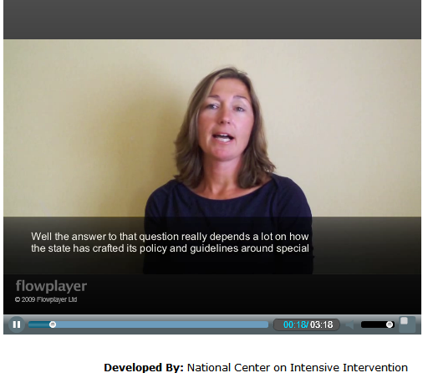
When Do I Refer a Student for Special Education Services?
National Center on Intensive Intervention, 2013a
23
Notes:
Watch this video to hear how one state determines when to refer a child for special education evaluation.
Watch and Discuss Activity: Think-Pair-Share
Think: As a teacher, what factors would you consider when deciding whether to refer a student to special education?
Pair: Find a partner to discuss this question.
Share: Share your thoughts with your partner.

Slide 24
The Implementation Process
24
Notes:
In this section, you will learn how to implement DBI in math. This section will teach you use DBI to address student’s specific needs, implement the intervention with fidelity, and progress monitor to see if the intervention is working and the student is making progress at the intensive level.

Slide 25
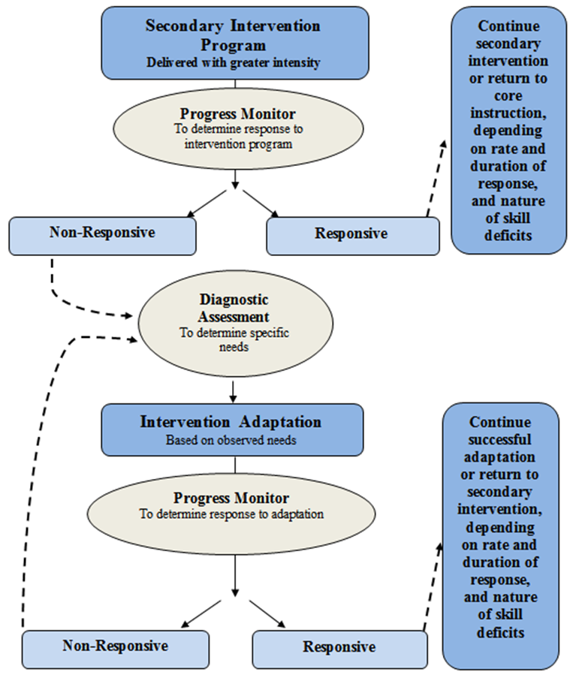
A Bird’s Eye View of DBI
National Center on Intensive Intervention, 2013a
25
Notes:
DBI is an iterative, multistep process that uses progress-monitoring and diagnostic assessment data and then individualizes validated academic interventions. It presumes that all students are receiving effective universal instruction. For students who require supplemental (i.e., secondary) instruction, teachers use progress-monitoring data to determine whether they are responsive to that instruction and are making adequate progress. Students who are making progress continue in that intervention until they reach their goal or return to universal instruction without further intervention, depending on the needs of the student, rate of growth, etc. Students who are NOT making adequate progress with supplemental instruction receive specific diagnostic assessment to determine specific skill deficits and needs. Based on this diagnostic assessment, teachers develop intervention adaptations based on observed needs. The intervention may need to be adapted (i.e., changed) and/or the intensity with which it is delivered may need to be increased.
We will talk more about how teachers can adapt interventions to make them more individualized later in the module.
The teacher then progress monitors the student’s response to the intervention adaptation. The teacher determines whether the intervention adaptation is effective based on the student’s responsiveness to the intervention. The progress-monitoring and decision-making process is ongoing at this level. If the student is making progress in the intervention, his or her progress provides the teacher with evidence that the intervention is effective.

Slide 26
Five DBI Steps
Secondary intervention program, delivered with greater intensity.
Progress monitoring.
Diagnostic assessment.
Adaptation.
Continued progress monitoring with adaptations occurring (as needed) to ensure adequate progress
National Center on Intensive Intervention, 2013
26
Notes:
The first step is to increase the intensity of the (secondary) intervention that is already in place.
Next, you want to look at how student performance changes as a result of this increase in intensity.
Based on that data, you may need to provide the student with a diagnostic assessment to determine the type of intervention they require. Progress-monitoring assessments help teams to determine when an intervention/change is needed. Diagnostic assessments help teams determine the nature of the intervention change that is needed. Diagnostic assessment tools include standardized measures and error analysis of progress-monitoring data and work samples. These tools and processes allow teachers to identify a student’s specific area(s) of difficulty when a lack of progress is evident, and they can inform decisions about how to adapt the intervention (National Center on Intense Intervention, 2013).
Based on the information gathered through your diagnostic assessment, you may need to make adaptations to your intervention using the strategies for intense intervention.
Continue to closely monitor the student’s progress and make placement and instructional decisions as needed.
Let’s look more closely at these step . . . (next slide).

Slide 27
Handout 15
DBI Step 1:
Secondary Intervention Delivered With Greater Intensity
27
Notes:
In this section, you will learn how to identify students at risk for academic deficits, match a math supplemental intervention to a student’s specific need, implement the intervention with fidelity, and progress monitor to see if the intervention is working and the student is making progress at the secondary level. Have participants complete Handout 15—Steps to the Implementation Process—along with this section of the module.

Slide 28
Implement the Secondary Intervention With Greater Intensity
At the intensive level of MTSS, the intervention is implemented among small, homogenous groups or individual students and is differentiated to meet their needs.
Interventions must be used consistently and with fidelity by a trained individual.
This intervention is used to supplement core instruction, not replace it.
28
Notes:
Read the slide. For more information, see Math CEM, Part 3: Supplemental Math Interventions.

Slide 29
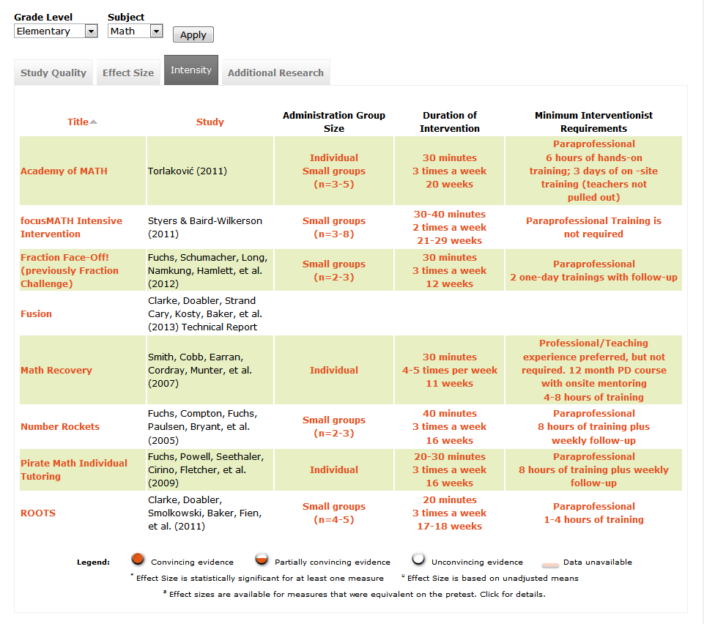
Intense Math Interventions
http://www.intensiveintervention.org/chart/instructional-intervention-tools?grade=elementary&subject=math&=Apply; National Center on Intensive Intervention, 2013
29
Notes:
Start with a validated, research-based, supplemental intervention. This chart is a screenshot of some of the validated math interventions (found on the NCII website: www.intensiveintervention.org), sorted by level of intensity (as noted in the tabs along the top).
This tools chart presents information about studies that have been conducted on academic intervention programs. The first tab—Study Quality—includes ratings from the TRC (The Center’s Technical Review Committee) members on the technical rigor of the study design. The second tab—Study Results—includes information about the results of the studies. The third tab—Intensity—provides information related to the implementation of the program as an intensive intervention. The fourth tab— Additional Research—provides information about other studies and reviews that have been conducted on the intervention.
You can find more information at http://www.intensiveintervention.org/chart/instructional-intervention-tools#sthash.0644bP3G.dpuf

Slide 30
Ways to Increase Intensity
Intervention.
Duration.
Frequency.
Interventionist.
Group size.
For more information on how to increase the intensity of your instruction, see the Practice Guide on Intensive Intervention
National Center on Intensive Intervention, 2013
30
Notes:
Read the points on the slide.
Teachers should utilize data to change the nature and Increase the intensity of the intervention for students who have not yet responded to secondary intervention (Center on Response to Intervention, 2014). For more information, access the Center for Instruction Practice Guide.

Slide 31
Categories of Practice for Organizing and Planning Intensive Intervention
Change dosage or time
Change the learning environment to promote attention and engagement
Combine cognitive processing strategies with academic learning
Modify delivery of instruction
Vaughn, Wanzek, Murray, & Roberts, 2012
31
Notes:
Today’s conversation about how to intensify intervention will be organized along the four dimensions listed on the slide.
As we proceed, think about how the IES practice guide recommendations relate to these dimensions (review slide). We will spend time discussing each of the four dimensions now.
Activity Suggestion:
Write the four dimensions on chart paper (one dimension on each piece of paper). Divide the participants into four groups. Each group rotates to each chart and writes down their ideas. Participants can add to the charts at any time during the day if they think of other suggestions. Make sure to have someone record the ideas on the charts and make handouts for the participants.
Note: All the slide information for the four categories of practice for organizing and planning intensive intervention comes from the Vaughn, Wanzek, Murray, and Roberts (2012) document.

Slide 32
Practice 1: Change Dosage or Time
Methods for increasing the quantity of instruction:
Increase the number of minutes per day.
Increase the number of minutes per session.
Increase the number of sessions per week.
Increase the total number of sessions.
Vaughn, Wanzek, Murray, & Roberts, 2012
32
Notes:
As mentioned previously, Practice 1—changing the dosage or time in instruction—is a change that may already be happening in your school. It is a change that can occur quickly by . . . (read or paraphrase slide).
Activity: Pairs Before Squares
Pose the following question: How can you increase instruction time for at-risk students given the limited amount of time in the school day?
Discuss this with a partner for 5-10 minutes.
Partners talk about their thoughts then find another pair (square the pair) to share out.
What are some possible challenges with this approach?

Slide 33
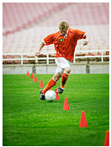
Why Should I Change Intervention Time?
?
Students with intensive needs often require 10 to 30 times the number of practice opportunities required by their peers to learn new information. This takes time!
When well designed, increased time accelerates learning by:
Allowing for more instruction.
Providing more practice with feedback.
Increasing students’ engaged learning time.
Vaughn, Wanzek, Murray, & Roberts, 2012
33
Notes:
You may ask “Why should I change the intervention time?” Increasing the amount of time the student spends in an intervention allows for more instruction to take place, provides more practice with feedback (because the teacher is present), and increases students’ engaged learning time. All of these accelerate student learning. Please note that to achieve the greatest results, increasing the time should (in most cases) be combined with changes to content and the method of delivery. Students with intensive needs often require 10 to 30 times the number of practice opportunities required by their peers to learn new information. This takes time!

Slide 34
What Is the Suggested Duration of Intensive Intervention?
?
Consider:
The size of the achievement gap with universal instruction.
The age of the student.
The number of sessions.
Research on the recommended number of sessions varies, but plan for at least 8-16 weeks, or even longer for older students.
Vaughn, Wanzek, Murray, & Roberts, 2012
34
Notes:
Determining the duration of an intervention depends on student-related and school-related factors. Consider the following:
Students who are further behind need more intervention time.
Students provided less appropriate universal instruction need more intervention time.
Older students will likely need more time in intervention than younger students.
Research on the recommended number of sessions varies, but it is suggested that intervention should last for at least 8-16 weeks, and often longer. Older students will likely need much more time, depending on how far behind they are and the nature of their instructional deficits. Students’ progress data should drive decisions about when they are ready to exit intensive levels of support (Vaughn et al., 2012).

Slide 35
What Is the Suggested Length and Frequency of Intensive Intervention?
What are the Suggested Length and Frequency of Intensive Intervention?
?
Evidence suggests that students with intensive needs may benefit from 60-120 minutes of intervention per day.
Vaughn, Wanzek, Murray, & Roberts, 2012
35
Notes:
When thinking about the length and frequency of intensive intervention, it is important to consider:
How far the student’s achievement is below grade level.
The length and frequency of the previous interventions.
The complexity of the learning tasks (e.g., letter naming in kindergarten is less cognitively complex than comprehension of a third-grade science textbook).
Student stamina and attention span.
To maintain attention and engagement with younger students, staff may consider two sessions per day. Evidence suggests that students with intensive needs may benefit from 60-120 minutes of intervention per day. However, this time may be broken up into several sessions throughout the day (Vaughn et al., 2012).

Slide 36
?
How Should I Use the Additional Time in Intervention?
Use the additional time to accelerate learning by:
Maximizing engaged learning time.
Minimizing waiting and transitions.
Teaching additional skills and strategies.
Providing additional practice opportunities with feedback.
Delivering more explicit, systematic (step-by-step) instruction.
Monitoring student progress to ensure that the additional learning time increases student mastery of skills.
Vaughn, Wanzek, Murray, & Roberts, 2012
36
Notes:
This slide lists different ways to use additional teaching time (paraphrase slide). We will discuss several of these practices in further detail later in the session.
As previously mentioned, simply providing more time is not enough. More time is likely to be most useful when combined with changes to content and the method of delivery.

Slide 37
Strategies for Adding Intervention Time
Double dip.
Use entry or exit routines.
Reinforce independent use of routines.
Vaughn, Wanzek, Murray, & Roberts, 2012
37
Notes:
Some suggestions for adding intervention time include:
Double dip: Rather than providing a single intervention block, students may receive intervention at different times during the day (e.g., 20 minutes in the morning and 20 minutes in the afternoon, rather than a single 40-minute session; Gersten et al., 2009; Vaughn et al., 2012).
Breaking up interventions into multiple sessions over the course of a day can help to address scheduling challenges, facilitate pre-teaching and reinforcement of new concepts, and support young students who are likely to have shorter attention spans and less stamina than older students. For example, a student may start the morning with 30 minutes of phonological awareness and decoding practice and then spend 30 minutes practicing reading connected text in the afternoon. Again, this not only addresses scheduling issues, but also helps to ensure that student stamina and/or attention spans do not become a barrier to learning.
Use entry or exit routines: Provide independent or peer-mediated practice opportunities for students (e.g., letter writing, paired oral reading) to minimize unengaged waiting time and allow multiple small groups to run at once.
Entry and exit routines that provide opportunities for students to practice skills may allow interventionists to manage multiple overlapping small groups. In addition, incorporating these routines may reduce the time students spend waiting and increase engagement.
Reinforce groups for following routines independently.
Reinforcement (e.g., verbal praise, points toward a reward, a sticker chart) helps to promote on-task behavior and allows teachers to manage a larger number of students.
Note: Allow participants to discuss and add additional suggestions after you discuss each strategy.

Slide 38
Strategies for Adding Intervention Time
Sample entry routine: Student comes into the classroom, gets a timer, and practices math multiplication facts for 1 minute, writing down the number of correct answers on a recording sheet.
Sample exit routine: Student finishes the lesson and matches math vocabulary word cards with definitions/pictures, either alone or with a partner.
38
Notes:
Activity:
Option 1—Think-Pair-Share
Work with partners and/or table groups to generate a list of ideas for sample math entry and exit routines during the day.
Option 2
Begin to generate a list on chart paper and encourage participants to add to the list during lunch, break, etc., if they think of additional suggestions.
Note: Pre-service teachers may have little knowledge in this area. They may require more teacher-led/group discussion and examples.

Slide 39
Practice 2: Change the Learning Environment to Promote Attention and Engagement
Reduce the size of the group.
Group students with similar needs.
Change the instructional setting to reduce noise and other distractions and promote academic engagement.
Vaughn, Wanzek, Murray, & Roberts, 2012
39
Notes:
Altering the group or learning environment may increase attention and engagement by minimizing distractions and increasing the number of student-teacher interactions that are relevant to a particular student. This not only increases individual interactions between a student and a teacher, but homogeneity within the group also means that it is more likely that all of the activities within the group will be relevant for all students.

Slide 40
What Is the Ideal Group Size for Providing Intervention?
Small groups (of up to four students) may provide the most intensive intervention at the elementary level.
Research has not identified an ideal intervention group size, particularly in older students in Grades 6-12.
Vaughn, Wanzek, Murray, & Roberts, 2012
40
Notes:
Group Size Recommendations: One to four students at the elementary level. Less is known about secondary grades (i.e., middle and high school), but some data suggest groups may be up to 10-15 students (Vaughn et al., 2012).
Again, these are intervention changes that you probably already make in your school, so we are not going to spend much time talking about them. As with the first strategy, they are unlikely to be effective unless the instruction is an appropriate match in terms of content and method(s) of delivery. We will talk more about those issues now.

Slide 41
Why Small, Homogeneous Groups?
Increases engaged interaction opportunities between student(s) and teacher.
Provides more opportunities for practice with feedback.
Allows teachers to match instruction to specific student needs.
Allows for closer monitoring of on-task behavior and engagement.
Vaughn, Wanzek, Murray, & Roberts, 2012
41
Notes:
Small homogeneous groups have many advantages, including the following:
Increases engaged interaction opportunities between student(s) and teacher.
Provides more opportunities for practice with feedback.
Allows teachers to match instruction to specific student needs, making instruction more relevant.
Teachers are better able to monitor on-task behavior and engagement.

Slide 42
Students With Disabilities
For students with individualized education programs (IEPs), changes to placement when intervention services are delivered may require a revision to the IEP if services are delivered as part of the student’s special education program.
If intervention services are delivered as part of special education, placement must be specified in the IEP.
Changes to placement should be discussed with the IEP team, including parents, and should be considered on an individual, case-by-case basis.
42
Notes:
Discuss the information on the slide.

Slide 43
Practice 3: Use Cognitive Processing Strategies
What are cognitive processes?
Cognitive processes consist of various mental activities that direct thinking and learning.
Students with intensive needs often have challenges with processes related to executive function and self-regulation:
Memory
Attribution
Attention
Strategies to set and monitor learning goals
Vaughn, Wanzek, Murray, & Roberts, 2012
43
Notes:
Cognitive processes comprise various mental activities that direct thinking and learning. Students with intensive needs have frequent issues with cognitive processes related to elements of executive function, metacognition, and self-regulation, including:
Memory.
Attribution.
Attention.
Strategies to set and monitor learning goals.
Discussion Question:
How can difficulty with cognitive processes affect students with intensive needs in math?

Slide 44
Teach Strategies for Taking Notes and Organizing Information
Teach students to write down assignments and include them in their daily routines.
Use graphic organizers and key words and phrases for notes.
Teach students to ask for help if they need information repeated.
Vaughn, Wanzek, Murray, & Roberts, 2012
44
Notes:
Review the slide.
Teach students to record assignments and due dates in a planner/calendar/assignment sheet.
Use graphic organizers and other text organizers to help students take notes and remember what they read. Graphic organizers can be color coded to help support visual learners.
Write key words/phrases, rather than entire sentences/paragraphs, when taking notes.
Encourage students to self-advocate and ask for help if they need information repeated.
If time allows, consider asking participants to add to this list or share strategies they have used in the past to help students develop notetaking skills. Remind participants to think about what they do to help students take notes and organize information.

Slide 45
Present Information Using More Than One Modality
Speak and write/draw/project information as you present it.
Repeat important instructions, key words, etc.
Model procedures to provide students with a visual image of the steps.
Teach students to visualize information in text, including stories, word problems, etc.
Vaughn, Wanzek, Murray, & Roberts, 2012
45
Notes:
Students with intensive needs—particularly in which memory or attention are affected—often need information presented in more than one way. For example . . . (review slide).
Speak and write/draw/project information as you present it.
Repeat important instructions, key words, etc.
Model procedures to provide students with a visual image of the steps.
Teach students to visualize information in text, including vocabulary, word problems, etc.

Slide 46
Review Prior Learning Before Presenting New Information
Have students:
Retell information from the previous lesson.
Summarize key points using just a few words or phrases.
Predict/explain how the new information may relate to prior learning.
Vaughn, Wanzek, Murray, & Roberts, 2012
46
Notes:
Students with intensive needs often need to review prior learning before they learn new information. This review of information—or accessing of background knowledge—can help students with intensive intervention needs connect the new material to previous learning, making it more likely that the students will remember information. It also allows teachers to informally assess students’ mastery of previous content, which can help to clear up any myths or misconceptions students may have.
Teachers can review prior learning by:
Asking students to retell information from the previous lesson (or lessons).
Asking students to summarize key points using just a few words or phrases.
Explaining how the information they are about to learn relates to prior learning.

Slide 47
Practice 4: Modifying Delivery of Instruction
Consider the instructional match and prioritize skills to teach.
Provide systematic instruction.
Provide explicit instruction.
Use precise, simple, and replicable language.
Provide frequent student practice opportunities.
Provide specific feedback and use error correction procedures.
Provide opportunities for practice, development of fluency, and review.
Vaughn, Wanzek, Murray, & Roberts, 2012
47
Notes:
Next, we will talk about modifying how you deliver academic content to make it more intensive. We will discuss the following strategies . . . (briefly review slide).
Give participants time to add their own ideas.

Slide 48
1. Instructional Match and Prioritizing Skills
Prioritize what you want students to know (one or two big ideas).
Maximize learning time by ensuring that instructional content aligns with students’ demonstrated needs.
Use precise, frequent progress monitoring to determine if learning is occurring.
Vaughn, Wanzek, Murray, & Roberts, 2012
48
Notes:
Students with intensive needs often require many more practice opportunities than their peers to learn new information. This takes time and requires you to prioritize what you teach.

Slide 49
2. Systematic Instruction
Break down complex skills into smaller, more manageable “chunks” of learning and carefully consider how best to teach these discrete pieces to achieve the overall learning goal.
Prioritize and sequence learning chunks from easier to more difficult.
Use scaffolding.
Provide temporary supports to control the level of difficulty throughout the learning process.
Vaughn, Wanzek, Murray, & Roberts, 2012
49
Notes:
Systematic instruction means breaking down complex skills into smaller, more manageable chunks of learning and carefully considering how best to teach these discrete pieces to achieve the overall learning goal.
Prioritize and sequence learning chunks from easier to more difficult.
Use scaffolding. When tasks are scaffolded, they allow students to develop independence and competence with the new skills.
Provide temporary supports to control the level of difficulty throughout the learning process, and remove those supports as students become more independent.

Slide 50
3. Explicit Instruction
Overtly teach the steps or processes needed to understand a construct, apply a strategy, and/or complete a task.
Explicit instruction is often used for:
Teacher-led instruction of new skills.
Teaching students to apply generalized knowledge or skills to novel settings.
Addressing learning needs, including strategies to support cognitive processing.
Vaughn, Wanzek, Murray, & Roberts, 2012
50
Notes:
Explicit instruction works well for students with intensive intervention needs because well-designed, explicit instruction comes with scaffolds built into the process.
It is often used for:
Teacher-led instruction of new skills.
Teaching students to apply generalized knowledge or skills to novel settings.
Addressing learning needs, including strategies to support cognitive processing.

Slide 51
Components of Explicit Instruction
Tell students what you want them to know.
Provide an advance organizer.
Assess background knowledge.
Model (“I do”).
Provide guided practice (“We do”).
Provide independent practice (“You do”).
Check for maintenance.
Note: Although there are no specific guidelines for this, the bulk of the instruction should fall within the guided practice phase.
Vaughn, Wanzek, Murray, & Roberts, 2012
51
Notes:
Explicit instruction has many components . . . (review slide).
The “I do, we do, you do” approach—or model/lead/test—is a major part of the scaffolding that is built into explicit instruction. It helps walk students through the steps of what you want them to know, provides a perfect example of what you expect of them, and then gradually releases responsibility to them until they are able to be successful on their own.
For example, while teaching students to add two-digit numbers, you might do the following:
On the board, write 45 + 23.
Model: The teacher solves the first column of the problem, modeling think-aloud (start on top in the right column, write the answer underneath in the 1s column, move to the left/the 10s place).
Lead: The teacher asks students to participate while the teacher is still doing the bulk of the work.
Test: The teacher asks students to complete the problem on their own (or in a pair) without support.

Slide 52
How Can I Make Instruction More Explicit and Systematic?
Organize instruction to allow for high levels of student success—start with easy tasks.
Break tasks into smaller, simpler steps.
Provide:
More modeling with clearer explanations.
More concrete learning opportunities.
Temporary support, which is gradually reduced over time.
More opportunities for response, practice, and feedback.
Vaughn, Wanzek, Murray, & Roberts, 2012
52
Notes:
Making instruction more explicit and systematic will require teachers to be highly organized and purposeful in their planning. Teachers need to organize instruction to allow for high levels of student success by starting with easy tasks. After students feel successful, their confidence increases. Furthermore, starting with smaller component skills will help students to build bigger composite skills using previous knowledge. Tasks should also be broken down into smaller, simpler steps to allow students to access what is being asked of them.
The teacher also needs to provide more modeling with clearer explanations. Students need to know exactly what is being asked of them, and teacher models show students exactly what the teacher is looking for. Teachers should also provide more concrete learning opportunities using pictures, graphics, manipulatives, or think-alouds. Pictures and manipulatives help students who learn better with different modalities. Provide temporary support and gradually it reduce over time. Using the “I do, we do, you do” approach can help teachers give students the support they need while they need it, but it will also remind teachers to gradually give more responsibility to the students. Lastly, teachers need to provide more opportunities for response, practice, and feedback. Remember students with intensive needs often require 10 to 30 times the number of practice opportunities required by their peers to learn new information!

Slide 53
Modeling Think-Aloud Strategies
Model how you approach tasks and solve problems by talking out loud as you:
Reflect on the problem-solving process.
Implement strategies for solving problems.
Solve word problems.
Give yourself feedback.
Check work.
“Hmm, I wonder how I can check my answer? I will use my tools….”
Vaughn, Wanzek, Murray, & Roberts, 2012
53
Notes:
It is important to model think-aloud strategies for students with intensive intervention needs. All students will benefit from hearing how you approach tasks and solve problems. Some students will not realize that they are already be using self-talk (because they do it automatically), but other students do not know that it is a strategy often used by adults. It may be fun to point out to students that they should watch and listen to an adult when the adult cannot find something (e.g., their keys). Adults engage in think-aloud strategies all the time!
Read or paraphrase the slide.

Slide 54
4. Using Precise, Simple, and Replicable Language
Develop specific language for the parts of lessons that involve explaining a very important idea.
Use correct vocabulary for the discipline, as appropriate, such as:
Math: 10s place, composing, decomposing, subtracting, etc.
Make sure you say it the same way every time.
Vaughn, Wanzek, Murray, & Roberts, 2012
54
Notes:
Consistency helps students with intensive needs. When teachers use precise, simple language, students know—right away—exactly what the teacher is talking about. These students are often a few steps behind their peers because they are trying to figure out what is being talked about, meaning that they miss what is actually being taught. When teachers are consistent and say what they mean the same way every time, they can be more successful in delivering content to their students.

Slide 55
5. & 6. Provide Frequent Opportunities for Student Practice With Feedback
Frequent student response can assist the teacher in monitoring student understanding.
Teacher feedback during student practice can be a powerful tool for refining and mastering new skills.
Feedback prompts students to continue successful practice.
Quick corrections prevent students from practicing errors.
Vaughn, Wanzek, Murray, & Roberts, 2012
55
Notes:
Frequent student response can assist the teacher in monitoring student understanding, and teacher feedback during student practice can be a powerful tool for refining and mastering new skills. Feedback prompts students to continue successful practice. Quick corrections prevent students from practicing errors.

Slide 56
What Is the Most Effective Type of Feedback?
Feedback should be:
Clear and precise.
Specific.
Tied directly to the student’s actions.
Vaughn, Wanzek, Murray, & Roberts, 2012
56
Notes:
Effective feedback on student responses is clear and precise, communicating the specific aspects of the task students performed correctly or incorrectly. Feedback should be tied directly to the student’s actions and the learning goals.
Optional Activity:
Have participants (in groups) develop examples of positive feedback. Ask for a volunteer to type up all the responses (avoiding duplicates) and give the handout to participants to keep in their plan books.

Slide 57
What Is the Most Effective Type of Feedback?
When a student makes errors, always:
Explain why the answer is incorrect.
Model the correct response.
Have the student provide a correct response before moving on.
Recheck later in the lesson/activity.
57
Notes:
Read the slide and discuss.

Slide 58
7. Provide Opportunities for Practice, Development of Fluency, and Review
Guided practice: after you have modeled a new skill or strategy.
Independent practice:
Incorporated after students begin to demonstrate mastery of the new skills or content.
Does not substitute for explicit and systematic instruction and guided practice.
Notes:
Practice is an important part of an intervention. Use guided practice after you have modeled a new skill or strategy to develop students’ fluency and independence with it.
Independent practice is essential, but it does not substitute for explicit and systematic instruction and guided practice. Independent practice should be incorporated after students begin to demonstrate mastery of the new skills or content. During independent practice, all reading material should be at the student’s independent level to avoid frustration and practice of errors.
Incorporate daily practice routines at the beginning and/or end of an intervention period.
Give homework that facilitates practice, not that requires the student to learn new information.
Reinforce on-task behavior during independent practice.

Slide 59
Check
Before implementing the practices, check that:
The student’s supplemental (i.e., secondary) program is an appropriate match for his or her needs.
The program has been delivered for a sufficient amount of time to determine the student’s response.
The program has been delivered as planned— for example, if the intervention is supposed to take place for 30 minutes three times per week, did that actually happen?
59
Notes:
To ensure that the suggested practices have the greatest impact on student learning, it is important to check the implementation of the student’s current supplemental (i.e., secondary) program to ensure that it is appropriate for his or her needs. This is an important first step: If there is a disconnect between what the student’s needs are and what the student is being taught, the program will not result in student growth, regardless of how good it is. It is also important to ensure that enough data are gathered to support a recommendation for more intensive support and that the student has received the intervention for long enough to show impact. It can also help to build a student profile to determine which type of program the student will respond to in the future. (The exception to this would be if the team has data indicating that immediate movement to intensive intervention is warranted.) Last, it is important that the program is delivered as planned. If the intervention is supposed to take place for 30 minutes three times a week but is only being implemented twice a week for 20 minutes, a student’s lack of progress could be attributed to lack of time within the program.
Possible Questions for Discussion:
Does your school/staff already have a formal or informal checklist to ensure programs are being implemented as designed?
Do you think having a checklist would be helpful?
What types of information would be on your list?
Who would be responsible?
Allow time for participants to respond.
We will talk more about implementing these recommendations throughout our work together today.

Slide 60
DBI Step 2:
Progress Monitoring
60
Notes:
In this section, you will learn how to monitor a student’s academic progress and make decisions based on that data.

Slide 61
Progress Monitoring
Progress monitoring is the process of systematically planning, collecting, and evaluating data to inform programming decisions. Progress monitoring:
Provides a basis for determining whether an intervention is effective for a given student.
Assists with developing effective intervention plans.
Progress-monitoring probes at the intensive level should be frequentlyadministered and scored (ideally weekly, which is the recommended frequency).
National Center on Intensive Intervention, 2013
61
Notes:
Let’s define progress monitoring. Discuss the definition above. Why is progress monitoring important? (It tells us if an academic intervention is working for a particular student.)
Academic progress monitoring is more than simply collecting assessment data—we must also analyze the data to determine whether the intervention is working.

Slide 62
Where Does Progress Monitoring Fit In?
Progress monitoring is a standardized method of formative assessment that tells us how well students are responding to instruction.
Progress-monitoring tools have the following characteristics:
They explain why the answer is incorrect.
They model the correct response.
They provide measures of age-appropriate outcomes.
They are reliable, valid, and evidence based.
National Center on Intensive Intervention, 2013
62
Notes:
Read the slide.

Slide 63
Why Implement Progress Monitoring?
Data allow us to…
Estimate the rates of improvement (ROI) over time.
Compare the efficacy of different forms of instruction.
Identify students who are not demonstrating adequate progress.
Determine when an instructional change is needed.
National Center on Intensive Intervention, 2013
63
Notes:
You probably already know a lot about using progress-monitoring data to place students in intervention groups or decide which interventions work best for your groups. Today we will focus on using progress-monitoring data to track an individual student’s long-term growth as part of DBI.

Slide 64
Progress Monitoring
Teachers continuously monitor progress based on established learning trajectories indicated by the goal line.
Progress monitoring:
Is diagnostic.
Matches instruction to need.
Informs individualized instructional planning.
Evidence-based intense interventions work for many students. Monitor progress to determine if the plan is working for this student.
National Center on Intensive Intervention, 2013
64
Notes:
Student progress should be judged against a baseline or goal line. This allows the teacher to determine if the student is making sufficient progress toward the goal.

Slide 65
Monitoring English Language Learners
Progress-monitoring data should be collected more often than screening data. (It is recommended that screening data is collected three times a year.)
The severity of the problem should dictate how often progress is monitored.
Students at high risk should be monitored more often.
Center on Response to Intervention, 2014
65
Notes:
Read the slide.
Gersten et al. (2007) recommended that English language learners (ELLs) at high risk for reading problems should be monitored weekly or biweekly. These recommendations are generally consistent with NCRTI recommendations for all students. According to NCRTI, progress monitoring should occur at least once per month at the secondary level and at least weekly at the tertiary level. If you are unfamiliar with the RtI levels of intervention, this will be covered shortly.
Does your district/school have procedures for screening, progress monitoring, and placing ELLs into levels of prevention? If so, what are they?
How are they similar to or different from those used for non-ELLs?

Slide 66
Monitoring English Language Learners
Monitor progress in all languages of instruction.
Set rigorous goals that support acquisition of grade-level standards.
Frequently evaluate growth.
Increase the intensity of instruction when growth is not within the expected limits.
Center on Response to Intervention, 2014
66
Notes:
Read notes on the slide.

Slide 67
Monitoring English Language Learners
Evaluate growth compared to true peers to determine whether instruction is effective.
Compare progress between ELLs and non-ELLs using the same intervention in order to adjust the instructional program.
Center on Response to Intervention, 2014
67

Slide 68
True Peers
True peers are students with similar characteristics, including the following:
Language proficiency.
Cultural and experiential backgrounds.
Center on Response to Intervention, 2014
68
Notes:
Brown and Doolittle (2008) suggested that it can be helpful to compare an ELL’s progress to his or her true peers in order to examine the instructional program provided to a group of similar students. An ELL’s true peers are other ELLs who share similar characteristics, including similar language proficiencies and cultural and experiential backgrounds. The purpose of this comparison is to identify whether a lack of progress may be specific to one student or if there may be a problem with the instructional program provided to a group of students.

Slide 69
Types of Assessment
Type | When? | Why?
Summative | After | Assessment of Learning
Diagnostic | Before | Identify skill strengths and weakness
Formative | During | Assessment for Learning
Center on Response to Intervention, 2014
69
Notes:
Animated slide—click on “formative” to circle the formative row.
Before we delve into progress-monitoring assessments, it may be helpful to discuss the different kinds of assessments and how they are used.
Summative assessments are typically administered after instruction and tell us what a student learned (e.g., end-of-chapter tests, high-stakes tests, final exams).
Diagnostic assessments measure current knowledge and skills for the purpose of planning instruction (e.g., what to teach, selecting an intervention).
Formative assessments are administered during instruction and tell us how well students are responding to instruction (e.g., mastery measures, general outcome measures).
Progress monitoring is a standardized method of formative assessment.

Slide 70
Formative or Summative?
Educational researcher Robert Stake used the following analogy to explain the difference between formative and summative assessments:
“When the cook tastes the soup, that’s formative. When the guests taste the soup, that’s summative.”
National Center on Intensive Intervention, 2014
70
Notes:
Read the slide.
Quote and information from the NCII Intensive Intervention module.

Slide 71
Steps for Using Progress-Monitoring Data
Establish a baseline.
Set a goal.
Analyze data to make decisions.
National Center on Intensive Intervention, 2014
71
Notes:
Before we can analyze data to make instructional decisions, we need to use the data we collect to establish a baseline and set a goal. For more information on progress monitoring, see Module 3: Supplemental Instruction.
There are three approaches to setting goals:
Benchmarking.
National norms for weekly ROI.
Intra-individual framework.

Slide 72
In Summary
Progress-monitoring data help us to:
Decide which students need DBI.
Determine a student’s response to an individualized intervention, which helps us decide when instructional changes need to be made.
Write strong current levels of performance, goals, and objectives for IEPs or other individualized instructional planning
72
Notes:
Read the slide.

Slide 73
DBI Step 3:
Diagnostic Assessment
73
Notes:
In this section, you will learn how to conduct diagnostic assessments as a way to identify students’ individual learning needs.

Slide 74
Types of Assessment
Type | When? | Why?
Summative | After | Assessment of Learning
Diagnostic | Before | Identify skill strengths and weakness
Formative | During | Assessment for Learning
Center on Response to Intervention, 2014
74
Notes:
Animated slide—click on “”diagnostic” to circle the diagnostic row.
You will remember that we discussed three different types of assessment. At the intensive level, teachers need to administer diagnostic assessments.
Summative assessments are typically administered after instruction and tell us what a student learned (e.g., end-of-chapter tests, high-stakes tests, final exams).
Diagnostic assessments measure current knowledge and skills for the purpose of planning instruction (e.g., what to teach, selecting an intervention).
Formative assessments are administered during instruction and tell us how well students are responding to instruction (e.g., mastery measures, general outcome measures).
At the intensive level, this process should also be diagnostic, meaning that it should be able to indicate to teachers precisely where the student’s deficit area lies. This data will allow the interventionist to individualize and adapt the intervention to the student’s specific area of need. For example, a student may receive core or supplemental instruction in geometry or fractions but intensive instruction in place value concepts, based on their data. This data should inform teachers’ instructional practices and planning.

Slide 75
Diagnostic Assessment
Used to determine a student’s specific area of need.
Can include:
Standardized measures.
Error analysis or progress- monitoring data.
Error analysis of work samples.
National Center on Intensive Intervention, 2014
75
Notes:
If the student’s progress is deemed insufficient after receiving the intensified intervention, the team uses progress-monitoring data along with diagnostic assessment and analysis to determine the student’s specific area of need in order to individualize the intervention. Later in the module, we will look at an example of how diagnostic assessment and adaptation guides intervention instruction and student progress.
You can think of diagnostic assessment as similar to a doctor looking at X-rays. The screening test tells the doctor whether you are healthy for your age. The doctor may prescribe medication for you and continue to monitor you. If you are still not showing improvement, the diagnostic test will tell the doctor specifically what needs to be addressed and they can adjust the medication or treatment plan accordingly in order to meet your specific need.

Slide 76
DBI Step 4:
Adaptation
76
Notes:
In this section, you will learn how to intensify your supplemental or intensive intervention to address your students’ specific learning needs as identified by their diagnostic assessment(s).

Slide 77
Adaptation Connection
DIAGNOSTIC ASSESSMENT
ADAPTATION
INTENSIFIED SUPPLEMENTAL
SUPPLEMENTAL
INDIVIDUALIZED INTERVENTION
UNIVERSAL
CONTINUED PM and ADAPTATION
77
Notes:
One way to think about Intensive Intervention is to think about the process a chef uses when cooking.
The process of using progress monitoring to continually adapt and individualize instruction is similar to that of a chef preparing a meal. Everyone gets spaghetti (universal level), some of those students will need additional support, but their foundation remains (supplemental). Some students may need additional strategies to intensity instruction, such as smaller group size (symbolized by the smaller portion size) and different setting (symbolized in the picture by the square bowl instead of the original round bowl). The teacher then administers diagnostic assessments to see where the student’s specific needs lie, and may adapt instruction (see adaptation picture), then further individualize the intervention based on student needs. This process continues based on the students’ response to instruction as assessed by continued progress monitoring.

Slide 78
Adaptation in the Classroom
DIAGNOSTIC ASSESSMENT
INTENSIFIED SUPPLEMENTAL
ADAPTATION
SUPPLEMENTAL
INDIVIDUALIZED INTERVENTION
UNIVERSAL
CONTINUED PM and ADAPTATION
78
Notes:
Using multiple data sources, the teacher or team makes adaptations to the intervention program to target a very specific need. Strategies for intensifying instruction can occur along quantitative lines as described earlier (such as change in group size, setting, or interventionist) as a first step to the intensification process. However, they are not sufficient to facilitate progress for students with the most intensive needs. Qualitative adaptations may also be made to the intervention to alter the way the content is delivered by more carefully selecting target areas aligned with the students’ needs.
The process of using progress monitoring to continually adapt and intensify instruction is shown above. (Discuss the different stages and what this looks like in the classroom.)

Slide 79
How CCSS-M Aligns With MTSS
National Center on Intensive Intervention, 2013
79
Notes:
While discussing MTSS, note that the progression of supports provided at each MTSS level can be and should be aligned with the grade-level CCSS-M standard. As you move along the continuum, the supports increase. Right now, we are focused on universal instruction. However, you can take the CCSS-M grade-level standard and apply it through the different MTSS levels to increase learning supports and help unlock that grade-level standard for students.

Slide 80
Principles for Intensive Intervention
Smaller steps
Precise language
Repeat language
Student explains
Modeling
Manipulatives
Worked examples
Repeated practice
Error correction
Fading support
Fluency
Move on
National Center on Intensive Intervention, 2013
80
Notes:
Read the slide.
Teachers can adapt their instruction in several ways to make it more intense. This is an overview of the principles teachers should use to intensify their instruction based on student data. We will look at each of these principles in more detail later in the module.

Slide 81
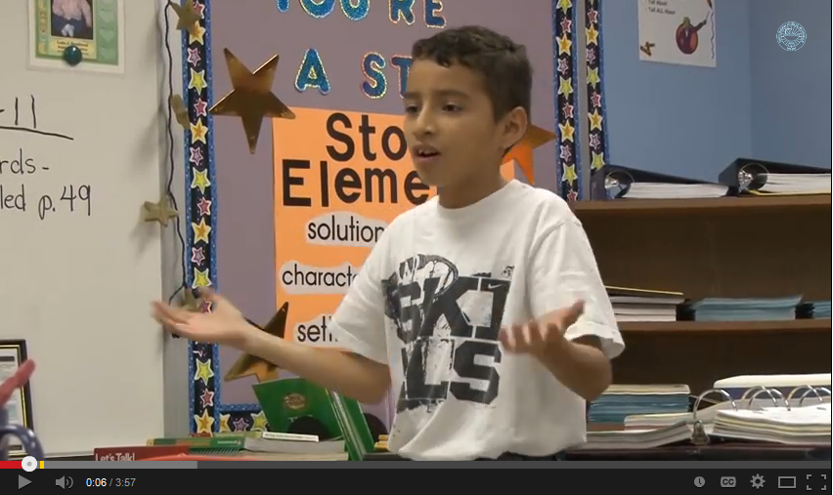
RtI Math Video Clip
Interactive Activity
(http://www.youtube.com/watch?v=vxYHecsTPhM; Harlingsen CISD, 2011
81
Notes:
Watch as one school describes their process for developing an RtI framework for math intervention in their school (http://www.youtube.com/watch?v=vxYHecsTPhM).
Discussion Questions:
What were some of the key changes the school made to implement RtI in math?
What was their purpose or impetus for adapting this framework?
What is their process for identifying students to participate in interventions?

Slide 82
Intensive Intervention in Mathematics
82
Notes:
In this section, you will learn how to implement intense interventions. The following slides provide examples of how to make math interventions more intense.

Slide 83
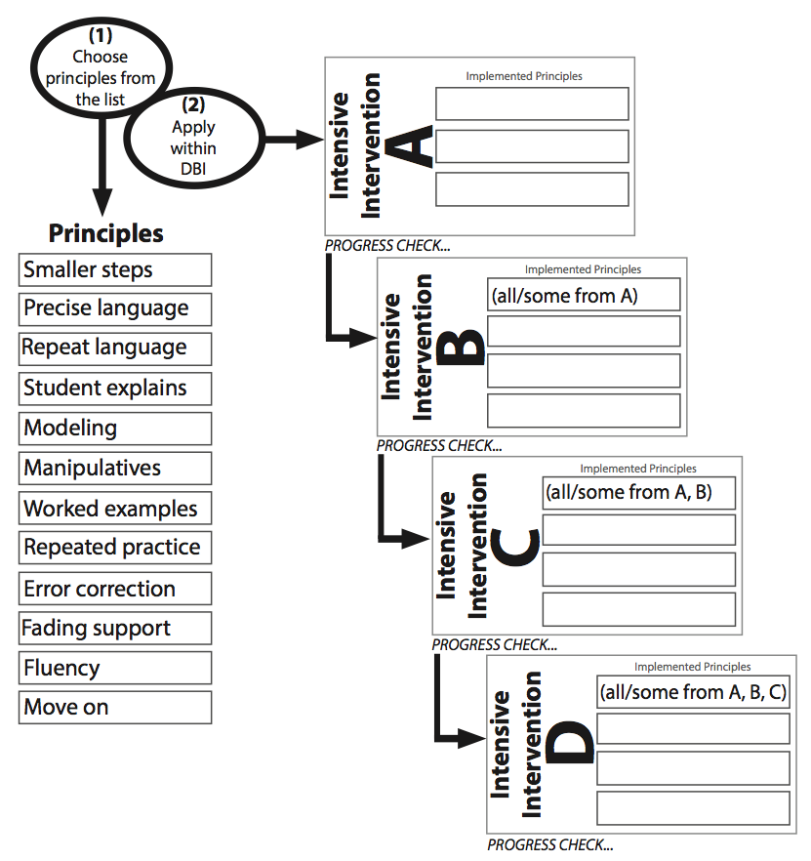
National Center on Intensive Intervention, 2013
83
Notes:
This slide shows an overview of the process teachers may go through to intensify and adapt their instruction to meet a student’s intense needs. Let’s look at each of these principles in more detail.

Slide 84
Smaller Steps
Use a task analysis to break problems into smaller steps.
Look at the first fraction. Multiply the numerator and denominator by the denominator of the second fraction. Rewrite.
Look at the second fraction. Multiply the numerator and denominator by the denominator of the first fraction. Rewrite.
Write addition and equal signs.
Add numerators and rewrite denominator.
Reduce the fraction to the lowest terms (when necessary).
National Center on Intensive Intervention, 2013
84
Notes:
Read the slide.

Slide 85
Precise Language
Generate a list of important vocabulary with student-friendly definitions.
Provide directions and instruction with precise language.
For example, instead of saying, “The denominator is the bottom number,” say:
The denominator is the whole divided into equal parts.
National Center on Intensive Intervention, 2013
85
Notes:
Read the slide.

Slide 86
Repeat Language
Repeat important vocabulary and definitions, algorithms, and steps for problem solving.
Whenever you need to solve a word problem—even a word problem with fractions—use the mnemonic RIDE:
R tells you to Read the problem.
I tells you to Identify important information.
D tells you to Determine the operation.
E tells you to Enter the correct numbers and solve.
National Center on Intensive Intervention, 2013
86
Notes:
Read the slide.

Slide 87
Student Explains
Students explain their thinking in their own words.
This helps the teacher check for understanding of concepts, correct use of vocabulary, and understanding of procedures.
The teacher may need to model talk-alouds and give students opportunities for practice with feedback.
In this problem, I multiply both the numerator and the denominator by 5.
Now, look at the next problem. Explain to me your multiplication.
National Center on Intensive Intervention, 2013
87

Slide 88
Modeling
Model concepts and procedures.
To find a common denominator, I multiply the numerator and denominator of the first fraction by the denominator of the second fraction. The denominator of the second fraction is 3, so I multiply by 3.
So, the numerator of the first fraction is 2. We multiply 2 times 3. What’s 2 times 3? (6) I write 6 here.
The denominator of the second fraction is 9. We multiply 9 times 3. What’s 9 times 3? (27) I write 27 here.
National Center on Intensive Intervention, 2013
88

Slide 89
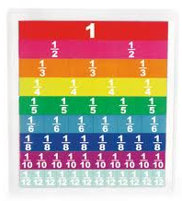
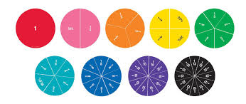
Manipulatives
Use manipulatives to demonstrate concepts and procedures.
National Center on Intensive Intervention, 2013
89
Notes:
Read the slide. These are just a few examples of manipulatives that students may use to better understand abstract mathematical concepts.

Slide 90
Worked Examples
Provide a worked example to promote discussion of how the work was completed.
3
1
+
=
8
3
9
8
17
+
=
24
24
24
National Center on Intensive Intervention, 2013
90
Notes:
Read the slide.

Slide 91
Repeated Practice
Provide multiple opportunities for repeated practice of skills.
Examples:
Practice finding common denominators for addition and subtraction using multiplication.
Practice multiplication facts.
Practice discriminating between addition of fractions and multiplication of fractions.
National Center on Intensive Intervention, 2013
91
Notes:
Read the slide.

Slide 92
Error Correction
Provide error correction for mistakes in the student’s work.
Let’s look at this part again. You need to multiply both the numerator and denominator by 4.
The numerator is 2. What’s 2 times 4? (8) Yes. 2 times 4 is 8. Write 8 here.
The denominator is 5. What’s 5 times 4? (20) Yes. 5 times 4 is 20. Write 20 here.
National Center on Intensive Intervention, 2013
92
Notes:
Read the slide.

Slide 93
Fading Support
Begin fading support as the student becomes more confident and proficient with a skill.
Remember to multiply by the denominator of the second fraction. Go ahead and try it on your own.
National Center on Intensive Intervention, 2013
93
Notes:
Read the slide.

Slide 94
Fluency
Provide opportunities to build fluency with a skill.
Let’s practice our multiplication facts so that finding common denominators is quick and easy.
National Center on Intensive Intervention, 2013
94
Notes:
Read the slide.

Slide 95
Move On
When the student demonstrates proficiency with a task, it is time for the teacher to move on.
You’ve learned how to add and subtract fractions with unlike denominators, so now let’s learn how to multiply fractions.
National Center on Intensive Intervention, 2013
95

Slide 96
National Center on Intensive Intervention, 2013
96
Notes:
Now let’s look at an example of how you would use these intensive instruction principles within the DBI framework.

Slide 97
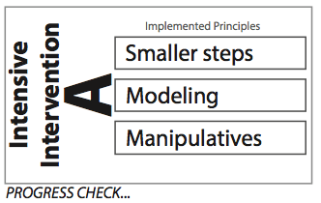
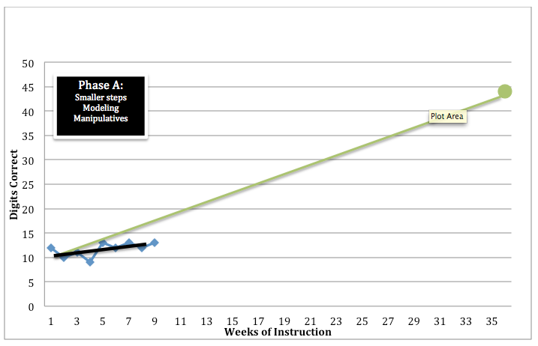
National Center on Intensive Intervention, 2013
97
Notes:
In Phase A, the teacher applies these principles to intensify instruction. The teacher/team sees (through frequent progress monitoring) that this student is not making progress despite these interventions. You can see on the graph that the student has made inconsistent progress and is not on a trajectory toward reaching the goal line.

Slide 98
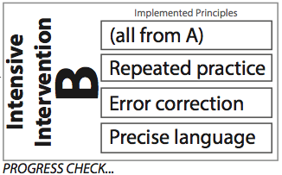
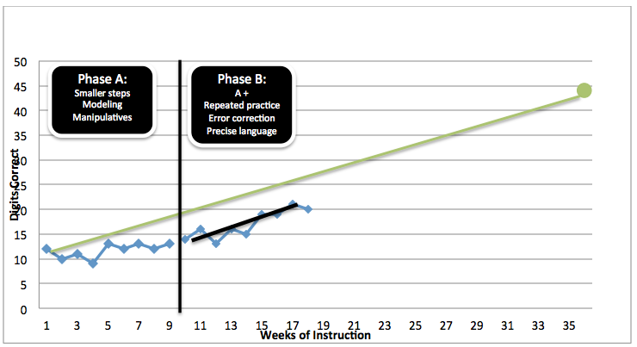
National Center on Intensive Intervention, 2013
98
Notes:
In Phase B, the teacher continues the strategies to intensify instruction from Phase A but also adds three additional principles. As you can see, the student’s progress slowly begins to improve but is inconsistent and still far from the goal line. At this point, the teacher needs to analyze the student’s progress to determine the next steps. Should the intervention be continued, changed, or further intensified? Allow participants time to discuss and make recommendations.

Slide 99
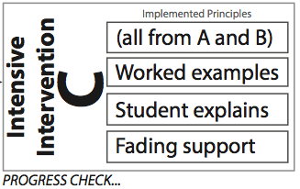
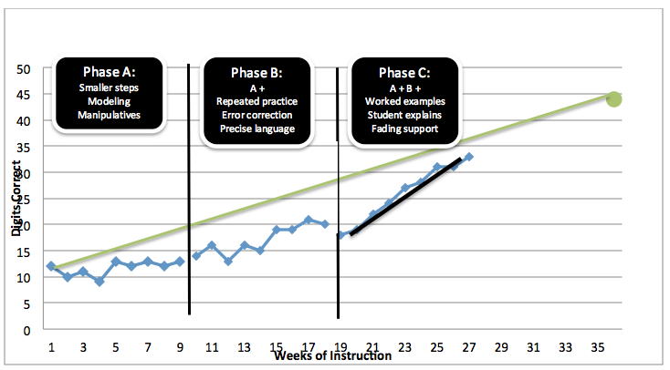
National Center on Intensive Intervention, 2013
99
Notes:
In Phase C, the teacher again begins by looking at the student’s data from the previous phase, continuing the strategies that are already in place and adding three NEW strategies to help internalize the material and gain independence. Now we can see that the student’s academic achievement has improved significantly and that he or she is showing sufficient progress towards the goal. These additional strategies sufficiently increased the intensity of the intervention and the student is now making progress towards the goal line. Progress monitoring will continue to ensure that these strategies are allowing the student to sustain learning and continue to make progress toward the goal.

Slide 100
DBI Step 5:
Continued Progress Monitoring, Analysis, and Adaptation
100
Notes:
In this section, you will learn how to monitor student progress, analyze the data and use that information to adapt the intervention.

Slide 101
Intensive-Level Decision Making
Decisions about responsiveness to intervention are based on reliable and valid progress-monitoring data.
Decisions reflect judgment based on the slope of improvement or final status at the end of the intervention period.
Decision‐making rules are in place and applied accurately.
Center on Response to Intervention, 2010
101
Notes:
For more information on making data-based decisions, go to http://www.rti4success.org/video/making-sound-rti-decisions-who-responds-secondary-prevention

Slide 102
To Move or Not to Move?
Interactive Activity
Discussion Question:
What considerations do you need to keep in mind when determining if a student should move directly into intensive supports?
National Center on Intensive Intervention, 2014
102
Notes:
Discussion Question:
What are some things to keep in mind when determining if a student should move to intensive-level (i.e., Tier 3) instructional supports?
Click the video to watch.
See more at: http://www.intensiveintervention.org/ask-the-expert/2014july-38#sthash.77f4rZPR.dpuf

Slide 103
Case Study:
Following Ethan
Bear Lake Elementary School
103
Notes:
Now it is YOUR turn to apply what you have learned!
In this section, you will meet Ethan, who is receiving the supplemental intervention for academic concerns in math. This case study will illustrate the various topics we have talked about in this module.

Slide 104
Intensive Level
IEP goals.
Weekly PM: Change ineffective instructional programs.
Make decisions about which students continue or exit special education.
104

Slide 105
Data-Based Decision Making
IRIS Center for Training Enhancements, 2010
105
Notes:
Let’s quickly review the decision-making process that school teams must engage in.
School personnel must use the data to make an informed decision about whether the student has acquired and can maintain new skills once they have met the benchmark.

Slide 106
Meet Ethan Bear Lake Elementary
Handout 15
Let’s review . . .
Ethan was suspected of being at risk.
CBM computation score was 6 (below 10 cut‐off).
Primary prevention performance was monitored for 7 weeks.
CBM computation slope was 0.14 (below 0.20 cut‐off).
Ethan was unresponsive to primary prevention.
Center on Response to Intervention, 2010
106
Notes:
Purpose of the Activity: to review the implementation process and make sure that the intervention is implemented with fidelity to achieve the desired outcomes.
Directions:
This activity has been designed to be completed in pairs. Adult learning principles suggest that it is important for partners to work together in learning new content. For example, two partners can share information and build on each other’s ideas. However, this activity can also be adapted for individuals or small groups.
With a partner:
Read and discuss the directions on the slide.
Use Handout 15 to fill in the five steps in the implementation process and answer the discussion questions.
Review answers in a large group to allow for additional learning and processing.
This activity will serve as a review for participants. It is important that the steps of DBI are implemented as directed to achieve the desired outcome(s).

Slide 107
Bear Lake Elementary: Ethan
Handout 16
Ethan was moved to secondary prevention tutoring.
Ethan received secondary prevention tutoring: 30 minutes, three times a week, for 16 weeks.
CBM computation was administered once each week.
Center on Response to Intervention, 2010
107
Notes:
Read the slide.
Complete Handout 16, Ethan Case Study, which accompanies these slides.

Slide 108
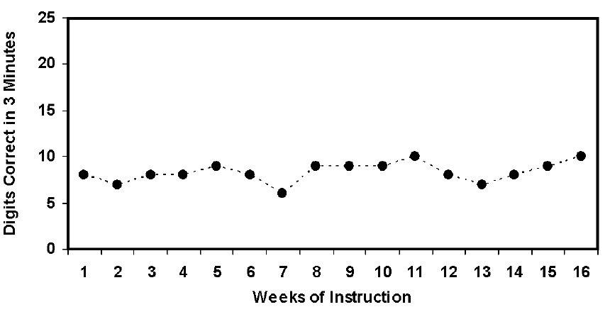
Bear Lake Elementary: Ethan
Center on Response to Intervention, 2010
108
Notes:
This is Ethan’s data chart over the 16 weeks.

Slide 109
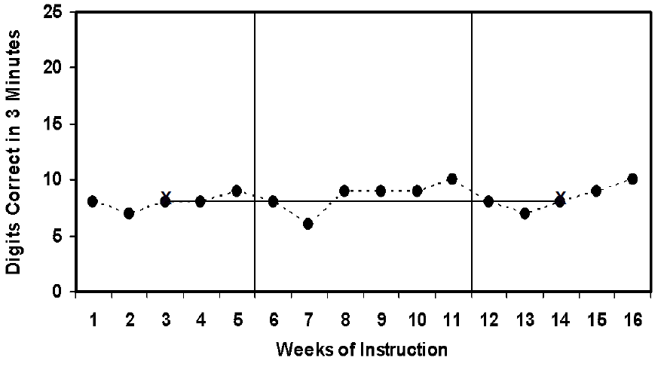
Bear Lake Elementary: Ethan
Center on Response to Intervention, 2010
109
Notes:
When you look more closely at his data points, you can see that Ethan was unresponsive to the universal instruction during the first 7 weeks. His teacher used data to determine how to adapt his instruction, which resulted in some improvement in his scores. By looking at Ethan’s progress at the intensive level, we can see that he barely maintained his learning from the previous weeks and showed minimal improvement by the end of the 16 weeks.

Slide 110
Bear Lake Elementary: Ethan
A comprehensive evaluation was conducted:
Interviewed primary prevention teacher and secondary prevention tutor.
Assessed using Vineland Adaptive Rating Scale and Wechsler Abbreviated Scale of Intelligence: Ruled out mental retardation.
Assessed using expressive and pragmatic language measures: Ruled out language impairment.
Assessed using rating scales and conducted classroom observations and parent interviews: Ruled out emotional behavioral disorder.
Center on Response to Intervention, 2010
110
Notes:
As a result, the team decided to move forward with special education evaluation to gain further information about Ethan’s academic strengths, deficits, and areas of needs.

Slide 111
Bear Lake Elementary: Ethan
Ethan in intensive intervention: Classified as LD.
IEP goals set.
Individualized program established.
PM: One-digit improvement per week
Center on Response to Intervention, 2010
111

Slide 112
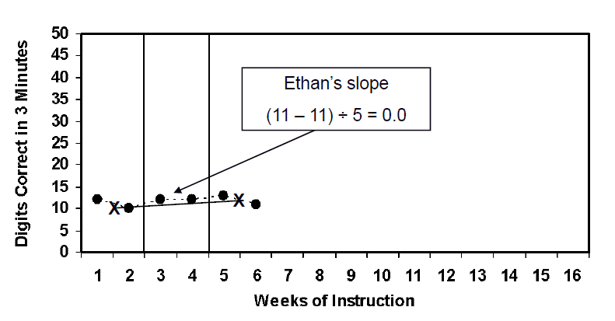
Bear Lake Elementary: Ethan
Center on Response to Intervention, 2010
112

Slide 113
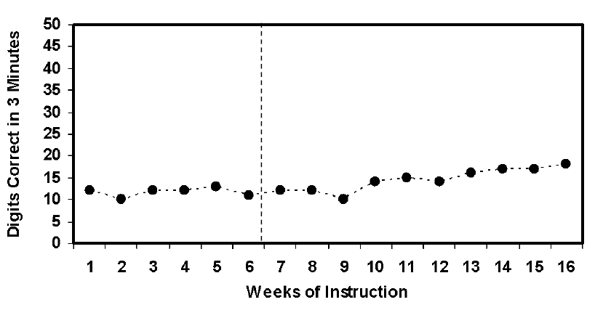
Bear Lake Elementary: Ethan
Center on Response to Intervention, 2010
113

Slide 114
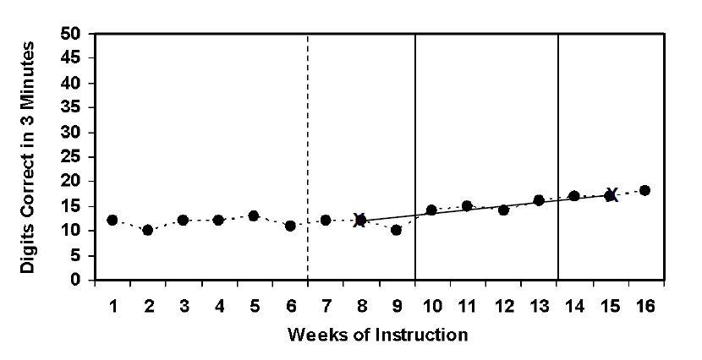
Bear Lake Elementary: Ethan
Center on Response to Intervention, 2010
114

Slide 115
Closure Activity
Interactive Activity
Organize into small groups of two to four people.
Revisit your list of the three most common things you do to make math instruction more intense.
How would you add to or change this list?
What new strategies would you add?
What old strategies would you revise or delete?
Choose someone to report out to the group.
115
Notes:
Define and make sure participants understand the meaning of intensive math instruction—the action or process of teaching.
Activity:
In a group of two to four people, take a few minutes to review the three most common things you (or others on your staff) listed as strategies to make instruction or intervention more intense when students need it. Then, discuss new learning and
change or add new strategies to list. Choose someone to report out to the large group. Circulate as teams discuss. After most groups appear to be ready (3–5 minutes), have each reporter share each team’s items. Record their responses on a piece of chart paper or whiteboard. If teams note the same new strategies recorded, use tally marks to keep track of how often each strategy is noted. Identify these as “big ideas” learned from this module.
Possible Questions for Teams:
What changes did you make to the list? Why?
What made you choose these new strategies?
Why do you think they are used so often?
Which strategy do you plan to try in your classroom?
Keep this activity to 10–15 minutes to allow sufficient time for participants to debrief and ask clarifying questions about the module.
Other Optional Activities:
Mingle/Birthday Party/Cocktail Hour/Ice Cream Social: Participants get cards with an open-ended question. They discuss and then trade the cards and find another person. Participants can make their own questions as a variation.
Multiplicative Mingle/Growing Group Mingle (Variant): Partners pick one card and discuss their answer. They then find another pair and discuss both cards. That pair then finds another group of four to discuss and come up with an outcome sentence (i.e., 3-2-1) to post for the group.
Paired Inside Outside Circle: This works the same way as inside outside circle, except pairs stay together and groups of four share.

Slide 116
Resources to Locate Intense Interventions
National Center on Intensive Intervention
http://www.intensiveintervention.org/
What Works Clearinghouse
http://ies.ed.go/ncee/wwc/
Organizing Instruction and Study to Improve Student Learning
http://ies.ed.gov/ncee/wwc/pdf/practiceguides/20072004.pdf
Center on Response to Intervention
http://www.rti4success.org/
IRIS Center
http://iris.peabody.vanderbilt.edu.
Star Legacy Modules from The IRIS Center for Training Enhancements RTI (Part 5): A Closer Look at Tier 3
http://iris.peabody.vanderbilt.edu/rti05_tier3/chalcycle.htm
116
Notes:
This slide lists websites for evidence-based resources.

Slide 117
NCII Resources
Visit www.intensiveintervention.org for:
Tools charts to identify intervention and progress-monitoring tools in academics and behavior.
The DBI training series.
Webinars.
Sample adapted activities and supplemental materials.
Ask the Expert videos.
Reports.
Newsletter.
National Center on Intensive Intervention, 2014
117

Slide 118
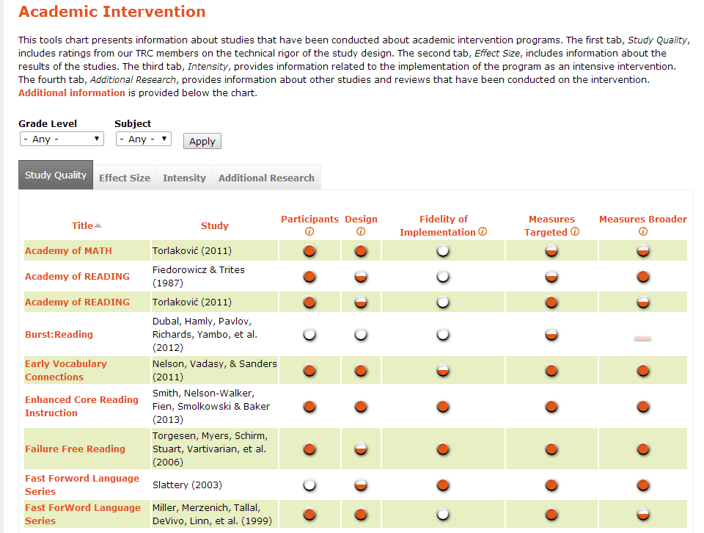
Tools Charts
National Center on Intensive Intervention, 2014
118

