Slide 1
Universal Design for Learning
Collaboration for Effective Educator Development, Accountability, and Reform
H325A120003
Notes:
This PowerPoint presentation is part of the Universal Design for Learning (UDL) Content Enhancement Module (CEM). This presentation, used in conjunction with the other supporting materials, is intended for use by university and college faculty and other appropriate institutions of higher education (IHE) staff to develop and enhance their teacher and leadership education courses as well as their professional development (PD) programs for practitioners.
This CEM describes the background and genesis of UDL and the principles and guidelines that make up the UDL framework and provides opportunities for participants to practice implementing the UDL framework.
These speaker notes are provided for most of the PowerPoint slides. The notes provide additional details about the information presented in the slide, including the context for the information being presented as well as further elaboration of key points. The notes also indicate when the speaker may want to use a handout that has been created to supplement the material in the PowerPoint.

Slide 2
Goals
By the end of the presentation, participants will understand the Universal Design for Learning (UDL) framework.
By the end of the presentation, participants will be able to apply the UDL framework to support diverse learners in their classroom practices.
Notes:
The two primary goals of the CEM are to facilitate an understanding of UDL and create teachers who can and will use the UDL framework.
NOTE: If you are going to use the vocabulary handout, this would be a good time to pass it out.

Slide 3
Why?
The Challenge:
Access, participation, and progress in the general education curriculum for all learners
IDEA (1997)
Notes:
UDL is a framework that directly addresses the law’s demand for the general education curriculum to be made accessible to all learners. In a learning environment created with the UDL principles in mind, all students benefit, so it is not only a legal responsibility, but also a moral responsibility.

Slide 4
CEM Overview
Part 1: An introduction to UDL, including its origination and the model of learner variability upon which it is based.
Part 2: A general overview of how to use the UDL framework for planning instruction for diverse learners.
Parts 3 & 4: An opportunity to practice planning instruction using the UDL framework.
Notes:
This PowerPoint is divided into four parts. The first part is an introduction and background, the second part features the bulk of the big UDL ideas, and the final two parts focus on practice.

Slide 5
Part 1: UDL History and Research Base
UDL
Notes:
The first part if this PowerPoint focuses on UDL’s roots in architecture and design and the brain science related to learner variability that provides the basis for UDL.

Slide 6
Let’s Start With a KWL Chart
You need:
One piece of paper
A pen or pencil
Steps:
1. Divide your paper into three equal-sized columns.
2. Label the first column: What I Know About UDL.
3. Label the second column: What I Want to Know About UDL.
4. Label the third column: What I Have Learned About UDL.
Notes:
Many of your participants will be familiar with a KWL chart, but just in case they are not, it would be worthwhile to explain that a KWL chart is a useful classroom tool that we will use as we go through this PowerPoint. The “K” stands for “Know” (as in “What I Already Know”), the “W” stands for “Want” (as in “What I Want to Know”), and the “L” stands for “Learn” (as in “What I Have Learned”). The participants will refer back to this chart multiple times throughout the presentation.

Slide 7
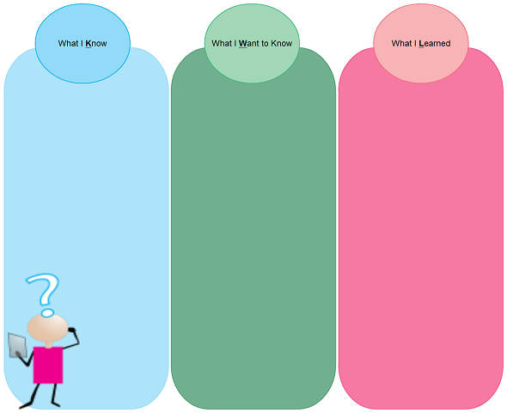
KWL Chart
You can fill in your KWL columns with words, phrases, sentences, or pictures. Keep them handy—we will use them often!
Notes:
Encourage the participants to be thoughtful as they fill this out. There should not be anything in the third column yet unless participants learned something from the IDEA slide. If time permits, ask them to share now with a person near them something they want to learn or something they already know. Another option is to ask them to stand up and find someone else in the room who has a response that is similar to their own.

Slide 8
What Is the Origin of UDL?
The following video shows how UDL comes from the world of architecture and design.
https://www.youtube.com/watch?v=1jB_cQWRRn0
Notes:
This video is a little more than 6 minutes long. It is not professionally made, but it is a good, brief introduction to Universal Design (UD) in the world of architecture, landscape, and product design. Before you show it, you may want to briefly explain that UDL has its origins in fields other than education.

Slide 9
UD Principles in Architecture and Design
:
Equitable Use—useful and appealing to all users.
Flexibility in Use—caters to individual preferences and abilities.
Simple and Intuitive Use—design is easy to understand.
Perceptible Information—necessary information is clear to all users.
Tolerance for Error—minimizes user hazards.
Low Physical Effort—comfortable and non-strenuous.
Size and Space for Approach for Use—proper size and space provided for all users.
Notes:
These principles are taken directly from the video. If time permits, you may want to ask the participants to look around and see if they can find an example or non-example of UD.

Slide 10
Examples and Non-Examples
of UD in Architecture and Design
Examples:
Large, easy-to-read signs with graphics basket and pulley system.
London Eye—entry at ground level, plenty of space.
Comfortable, large seats with open approaches.
LED lights on elevator to tell you what floor you are on.
Non-Examples:
Poorly paved walkways with no supports.
Bathrooms with poor supports and not enough room.
Doorways that are too small.
Notes:
These are the examples and non-examples from the video.

Slide 11
What Is the Origin of UDL?
The following video is about how a company used UD principles to design a house.
https://www.youtube.com/watch?v=-21IeGEu6dE
Notes:
This video is a little more than 5 minutes long. It is about how one home was built using UD. This video is an especially strong example of how UD done well means that accommodations do not have to be made later on.

Slide 12
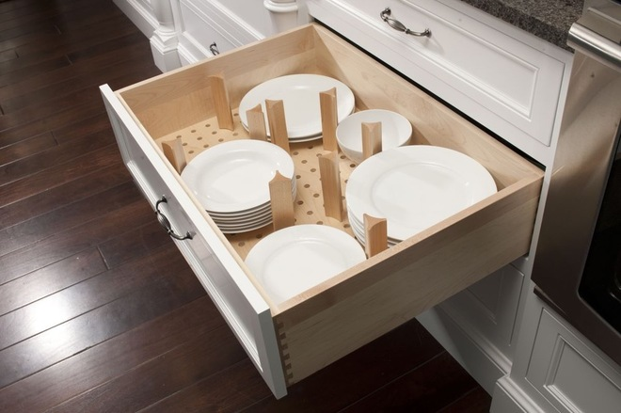
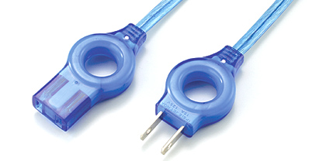
Discuss with the people near you: What makes these products examples of UD?
UD in Products
Notes:
This slide serves to offer an opportunity for the participants to synthesize some of the information from the videos.

Slide 13
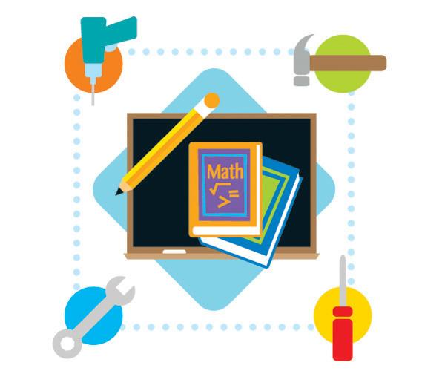
Architecture Education
In education, UDL is an attempt to fix the curriculum instead of trying to fix the student. (image from CAST, 2013)
Notes:
This slide transitions us from UD to UDL. In architecture, UD is an attempt to make the product fit the user, and in education, UDL is an effort to make the curriculum fit the student, instead of vice versa. This is a critical concept.

Slide 14
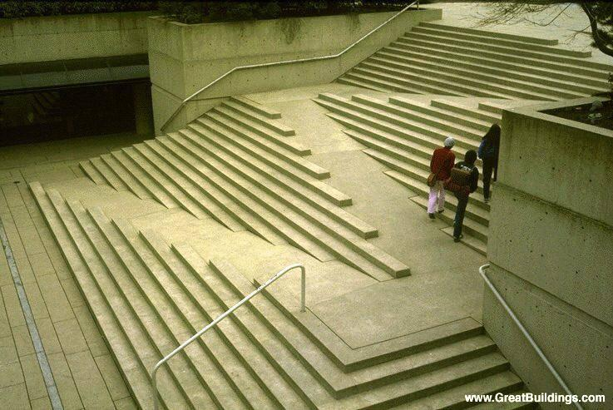
Architecture Education
UDL is the proactive design of our courses to ensure that they are educationally accessible regardless of learning style and physical or sensory abilities.
From: http://www.udluniverse.com/
Introduction to UDL ppt
Notes:
If time permits, you could take a moment at this point to ask participants to relate the words to the picture. How does the staircase/ramp relate to course design that is accessible?

Slide 15
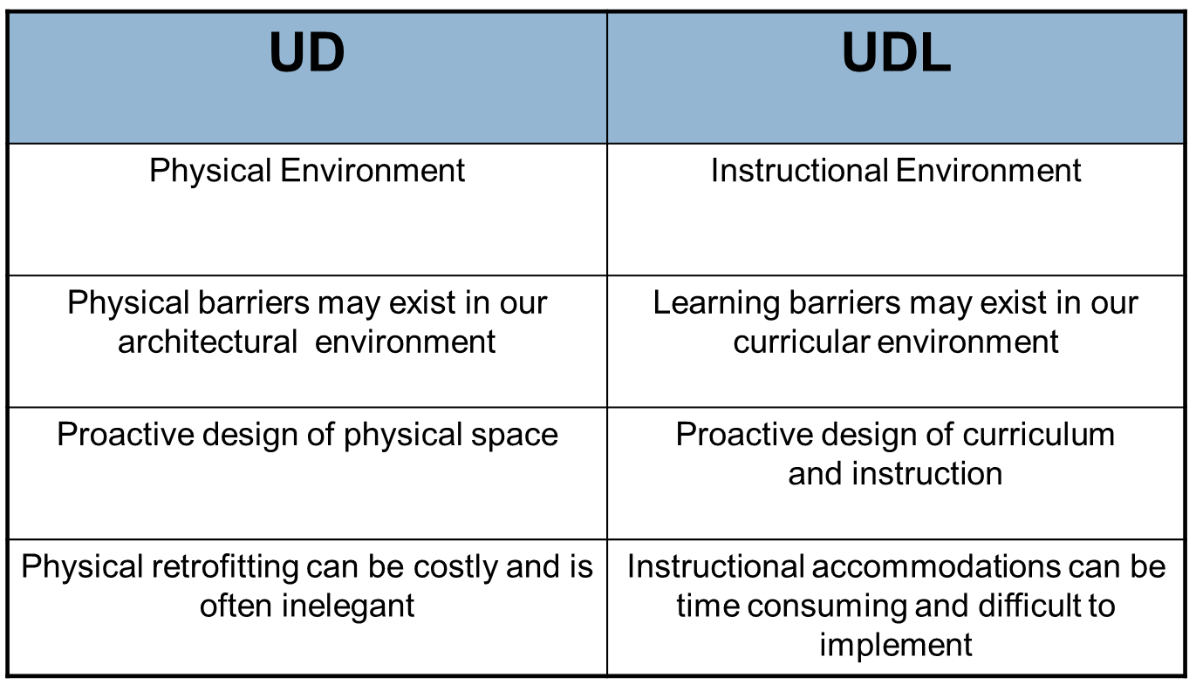
Architecture Education
From: http://www.udluniverse.com/
Introduction to UDL ppt
Notes:
This chart compares how UD and UDL implementation can be parallel experiences.

Slide 16
Architecture Education
If a building or product is created using the principles of UD, then it is accessible to almost all people without any modifications.
________________________
If a teacher uses the UDL framework to create a lesson, the lesson is accessible to almost all students without any modifications or accommodations.
.
Notes:
This is the final slide about the relationship between UD and UDL. This is the most important takeaway idea from this first part.

Slide 17
UDL Introduction:
Revisit KWL Chart
Is there anything to add to the What You Know column?
Are there items to add to the Want to Know column?
Have you learned anything you can add to the What I Learned column?
Remember—you can use words, phrases, sentences, or pictures.
Notes:
This is an opportunity for participants to reflect on the ideas that have been introduced so far. Again, you may want to find a reason to get the participants out of their seats, so you could ask someone to read something they learned, and then ask the participants to stand if it was something they also learned.

Slide 18
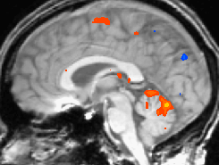
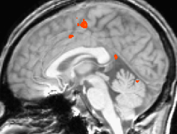
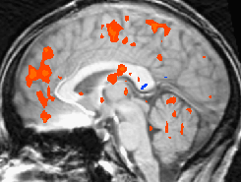
UDL Introduction:
Learner Variability
These three functional magnetic resonance images (fMRI) show brain activity patterns of three different people performing the same simple finger-tapping task. The level of brain activity during performance of this task is designated using color. Blue indicates a low to moderate level of activity, red indicates a high level of activity, and yellow indicates an extremely high level of activity.
CAST: Teaching Every Student
© 2002-2009
Notes:
The UDL framework is based on learner variability, which is scientifically validated. We all use different parts of our brains to do all kinds of things—no learner is exactly like another learner. This slide shows how even the simplest task is processed in different parts of three people’s brains.

Slide 19
UDL Introduction:
Learner Variability
A video about learner variability and UDL:
http://udlseries.udlcenter.org/presentations/learner_variability.html?plist=explore
After you have watched the video, think about these three questions:
1. Why are curricula limited if they are designed for the average learner?
2. What makes learner variability systematic?
3. Why is it important for educators to know about systematic learner variability?
Share your thoughts with a partner.
Notes:
This video is 15 minutes and 36 seconds long.
NOTE: There is a handout that you can use to accompany this video. There is a point in the video at 4:55 when you are prompted to stop the video and then come back after you have had a chance to respond to the prompt. It stops again at 8:55 and asks you to download a worksheet—this is the one in your handout. You will have to click to restart the video both times. After you have watched the video, read the questions aloud and allow the participants to reflect and then respond to the questions with a partner.

Slide 20
UDL Introduction:
Equitable Opportunities
The basic UDL premise is that to provide equitable opportunities to reach high standards across variable students in our schools, we must
provide multiple means of engagement,
provide multiple means of representation, and
provide multiple means of action and expression.
Notes:
This is the first mention in this PowerPoint of the three major principles of UDL. All of UDL comes back to these three principles, and these three principles are based entirely on the idea of learner variability, so it is important that you make the connection explicit here.

Slide 21
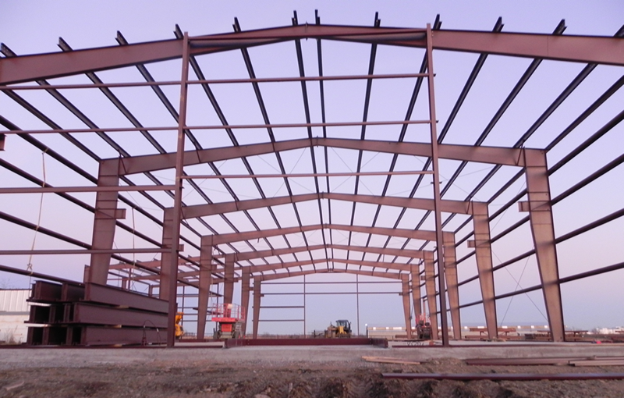
UDL Introduction: Vocabulary
Framework: UDL is a framework—not a checklist. It is the interior frame around which you build the structure that is to become your lesson. Just like a steel or metal building frame, the UDL framework has been carefully calibrated and tested to ensure that it will stand the test of time.
Notes:
This slide and the next are text heavy. We suggest that you invite different participants to read the definitions aloud. There is a space on the vocabulary handouts for participants to take notes on these terms.

Slide 22
UDL Introduction: Vocabulary
Learning Environment: When we talk about the learning environment as it relates to UDL, we are talking about both the space/location of your lesson and the way the students can use the space. In an ideal scenario, a teacher has the opportunity to tailor spaces to meet the needs of students for each lesson and provide access to tools, resources, and strategies for learning. Further, the tools and resources are flexible in a UDL environment, meaning their use is not specifically prescribed by the teacher.
photo from udlmcps.weebly.com

Slide 23
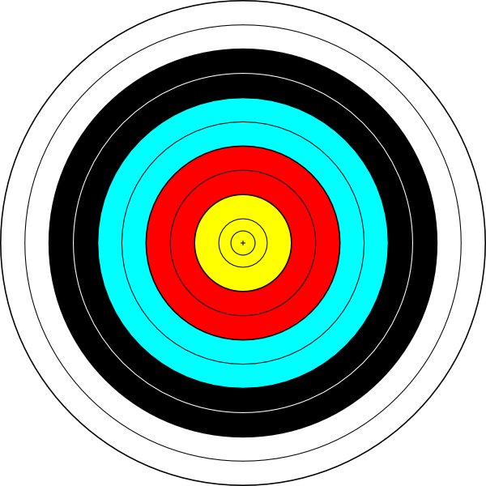
UDL Introduction: Vocabulary
Lesson Goal: In the UDL framework, the lesson goal is most important. A well-planned lesson goal will describe what the student is supposed to learn but not how the student is going to learn. Goals should be observable and measurable, but the means of achieving the goal should be flexible.

Slide 24
UDL Introduction: Vocabulary
Access: When we use the term access in a conversation about UDL, we can be referring to a student’s physical ability to access the information and/or to a student’s ability to connect with the information. If students have access, it means that they are given a reason to emotionally attach to the lesson; they know they will have a variety of opportunities to interact with the topic, and they will have multiple chances to demonstrate their understanding of the topic.

Slide 25
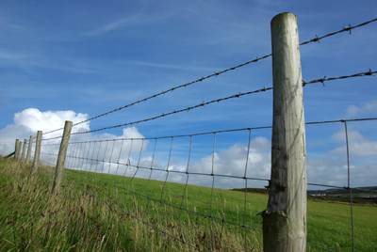
UDL Introduction: Vocabulary
Barriers: A barrier in UDL is anything that inhibits a student’s ability to fully engage with the lesson. It can be a physical barrier, a lack of background knowledge, difficulties with learning, or difficulties regarding emotionally connecting with the lesson or the instructor.
Vocabulary adapted from Design and Deliver: Planning and Teaching Using Universal Design for Learning by Louie Lord Nelson, Ph.D and Allison Posey, M.Ed

Slide 26
UDL Introduction:
Revisit KWL Chart
Is there anything to add to the What You Know column?
Are there items to add to the Want to Know column?
Have you learned anything you can add to the What I Learned column?
Remember—you can use words, phrases, sentences, or pictures.
Notes:
This is another opportunity for participants to revisit their KWL charts.

Slide 27
You Have Completed Part 1
This is the end of Part 1
of the PD presentation on UDL

Slide 28
CEM Overview
Part 1: An introduction to UDL, including its origination and the model of learner variability upon which it is based.
Part 2: A general overview of how to use the UDL framework for planning instruction for diverse learners.
Parts 3 & 4: An opportunity to practice planning instruction using the UDL framework.
Notes:
This is the same slide the participants saw at the beginning of Part 1. We are now getting ready to begin Part 2, which is about what the UDL framework is and how it can be applied in a classroom setting.

Slide 29
Goals
Understand the concepts of UDL.
Apply the concepts of UDL to support diverse learners in your classroom practices.
Notes:
These are the same goals that were at the beginning of Part 1. We are just returning to them as a refresher.

Slide 30
The Four Questions
Part 2:
In this section, we will look at four big questions.
1. How can the UDL framework reduce barriers to learning and support high expectations for learning?
2. How can we apply the four curricular pillars of UDL implementation (i.e., goals, instruction, materials, and assessment) in different instructional contexts?
3. What are the three principles of the UDL framework and how do they apply to instructional planning, instruction, and environments that support learning?
4. How can the UDL guidelines and accompanying checkpoints be used to create instructional environments that support learning?
Notes:
In this section, we will address these four questions, which are adapted from the essential components from the Universal Design for Learning: Recommendations for Teacher Preparation and Professional Development innovation configuration (IC) that the CEEDAR Center produced.
NOTE: There is a timeline handout that can pass out now that correlates to these four questions and will serve as a guide through Parts 2 and 3. There is no need to go into depth about these questions at this point or even read them if you passed out the handout. This slide is meant to serve as a guide for what is coming in general, not in detail.

Slide 31
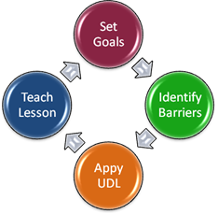
What are barriers to learning?
What are high expectations?
[post-it activity]
{brainstorm at your table}
What are barriers to learning?
What are high expectations?
Notes:
This is the first slide that addresses question 1.1: How can the Universal Design for Learning framework reduce barriers to learning and support high expectations for learning?
Pass out post-it notes and have everyone write five separate post-its that each have a barrier to learning on it. Then have everyone write another five with high expectations on them. Give them space on a wall to put their post-its up next to others who are similar. (It should turn into a series of clusters.) The purpose of this activity is twofold. It is meant to get the participants thinking about real-life example rather than abstract concepts so that as they learn more about UDL they are in the mindset that it is a pragmatic framework, rather than a theory or idea, and it also to begin the conversation about barriers and expectations.

Slide 32
There are some barriers (e.g., feeling hungry) that UDL cannot fix. But most academic barriers, like poor writing skills, a small vocabulary base, or difficulty with number fluency, can be mediated by providing multiple means of engagement, representation, action, and expression.
All students can succeed in a UDL classroom; that is, everyone can work toward mastery.
Notes:
It may be interesting at this point to ask the participants to think about the barriers they wrote down and raise up fingers indicating how many of the barriers to learning they wrote down could be addressed by providing multiple means of engagement, representation, action, and expression.

Slide 33
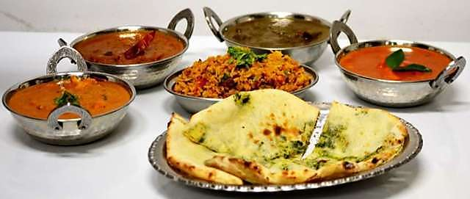
Let’s make it all about you for a moment!
Imagine that you are asked to fix a three-course meal for 12 people. Here is the menu:
First Course: Tandoori Mackerel
Second Course: Lamb Chili Masala
Third Course: Gulab Jamun
What about this task would intimidate you?
What would be your preferred method for beginning to learn about how to prepare this meal?
How would proceed after overcoming your barriers and preparing to begin?

Slide 34
If the dinner challenge had been created using the UDL framework, how would it have been different?
How could the barriers have been reduced?
How could we have supported the high expectations?
Notes:
This slide addresses the question of how the UDL framework can reduce barriers to learning and support high expectations for learning? Hopefully, participants will say that the barriers would have been reduced and it would have made the task more approachable if the dinner challenge had been created so that people could work in teams, if all of the ingredients had already been bought, if the recipes had been provided, if they had a commercial kitchen in which to work etc. Similarly, the participants may say that scaffolding the dinner challenge, providing a chef guide, or going out to an Indian restaurant first would have been supports that would have allowed them to meet an expectation of success. Depending on time and dynamics, you can have participants respond to this slide individually, with partners, in small groups, with the whole group, or on large posters you have placed around the room.

Slide 35
UDL
Instruction
Assessment
Goals
Materials
Notes:
This slide introduces the four curricular pillars of UDL. We have moved from 1.1 to 1.2, and we are now focusing on this question: How can we apply the four curricular pillars of UDL implementation (i.e., goal, instruction, materials, and assessment) in different instructional contexts? We will address each of these four curricular pillars in the following slides.

Slide 36
Clear learning goals are the foundation of any effective curriculum. Only by clarifying what we want to accomplish and when—in the next 10 minutes, in the next lesson, in the next year—can we begin to consider which assessments, methods, and materials will be most effective.
Goals are often described as learning expectations.
Notes:
This slide introduces the first curricular pillar—goals.

Slide 37
Traditionally, goals represent the knowledge and skills that all learners should master and are generally aligned to standards. From a UDL perspective, affective goals such as developing enthusiasm for learning and an ability to self-regulate are equally important. In our view, affective goals should be more clearly articulated in standards and, more specifically, should be included in assessment.
Universal Design for Learning - Theory and Practice.
By Anne Meyer, David H. Rose, and David Gordon.
Notes:
This slide further expands on the idea of goals to include the idea that affective goals are important in a UDL classroom.

Slide 38
From a UDL perspective, effective goals are goals that
– separate the means from the ends,
– consider all three learning networks,
– challenge all learners, and
– actively involve learners.
Notes:
We have not introduced the three learning networks yet, so if participants ask about them, assure them they will learn more two slides from here.

Slide 39
Question 2: Instruction
Instructional methods include the decisions, approaches, procedures, and routines that teachers use to accelerate or enhance learning. Because learners vary in the ways they become and stay motivated to learn, comprehend information, and strategically approach tasks, the UDL framework emphasizes the need to employ many kinds of teaching methods.
Notes:
This slide introduces the second curricular pillar—instruction.

Slide 40
Question 2: Instruction
To support diverse affective networks:
Offer choices of content and tools.
Offer adjustable levels of challenge.
Offer choices of rewards.
Offer choices of learning context.
To support diverse strategic networks:
Provide flexible models of skilled performance.
Provide opportunities to practice with supports.
Provide ongoing, relevant feedback.
Offer flexible opportunities for demonstrating skill.
To support diverse recognition networks:
Provide multiple examples.
Highlight critical features.
Provide multiple media and formats.
Support background context.
Notes:
NOTE: There is a handout that goes with this slide that features pictures of the brain networks. This is relevant to the instruction pillar because supporting all three of the brain networks with different instructional methods is key to working with the UDL framework.

Slide 41
According to UDL, effective materials are those that align to goals and engage learners in becoming proactive.
Notes:
This slide introduces the third curricular pillar—materials.

Slide 42
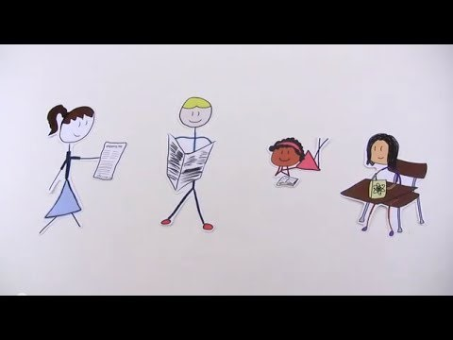
The National Center on Accessible Educational Materials (AEM) is one resource for finding flexible tools for students to use in the classroom. Here is a brief introduction video:
https://www.youtube.com/watch?v=6U3uKNKMv7s
Notes:
The video on this slide runs for 3:42. It is about materials that address literacy issues. After the participants watch the video, you can do one of three things: 1. Initiate a discussion about how the materials discussed in the video help students who do not have disabilities. 2. Discuss other materials that help students in other subjects (e.g., science, math). 3. Move on.

Slide 43
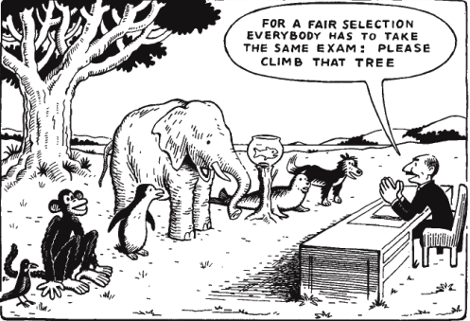
Question 2: Assessment
Turn and talk to your partner:
Why is this cartoon funny?
How does it connect to UDL and assessment?
Notes:
This slide introduces the fourth curricular pillar—assessments. Give the participants a chance to share their ideas with their partners. If it is time to get folks to stand up, you may want people to stand if they have seen this cartoon before. Ask them to keep standing if seeing it while thinking about UDL has given them a new perspective.

Slide 44
From a UDL perspective, effective assessments
– are ongoing and focused on learner progress;
– measure both product and process,
– are flexible, not fixed;
– are construct relevant; and
– actively inform and involve learners.
Notes:
This slide defines assessments in UDL terms.

Slide 45
https://www.youtube.com/watch?v=bDvKnY0g6e4
Notes:
This slide addresses question 1.3: What are the three principles of the UDL framework and how do they apply to instructional planning, instruction, and environments that support learning? The video is mostly a 4-minute and 36 second review of what has already been touched on, but it organizes the information and frames the three principles in the larger ideas.

Slide 46
9 Guidelines
Notes:
This slide introduces question 1.4: How can the nine UDL guidelines and accompanying checkpoints be used to create instructional environments that support learning? This graphic shows the three principles and underneath, the nine guidelines that correlate to each principle.

Slide 47
Notes:
This is an expanded version of the principles and guidelines document that includes the checkpoints.
NOTE: There is a handout of this slide if you would like to pass it out.

Slide 48
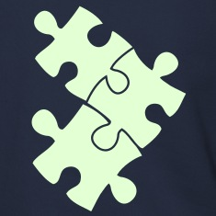
Jigsaw Activity:
Separate into three groups.
Group 1 will focus on classrooms.
Group 2 will focus on online tools, especially teacher websites.
Group 3 will focus on the school environment beyond the classroom.
In your groups, generate examples of qualities that your instructional environment would have if it were carefully designed with the UDL framework in mind. Please be prepared to present your ideas to the rest of the group, either in a list form, picture form, digital format, or something else that works for your group.
Notes:
Question 1.4 specifically asks us to think about learning environments, and this jigsaw activity is an attempt to get the participants to engage with the idea of UDL as a framework that does not just address lesson planning, but also asks us to look at our entire environment as a part of the learning process. It is important that the participants have plenty of time to share ideas in their individual groups and share with the larger group.

Slide 49
Part 2 Closing Activity
Notes:
This slide begins a series of slides that uses the Food Network show Chopped as a metaphor for UDL. This is an open-ended closing activity. For people who are not familiar with Chopped, it is like Iron Chef and other food competition shows. Chopped brings four chefs together to compete. Each chef is given a small amount of time to prepare a dish during each round. The resultant meals are judged on presentation, taste, and use of ingredients. After each round, one chef is “chopped,” or eliminated.

Slide 50
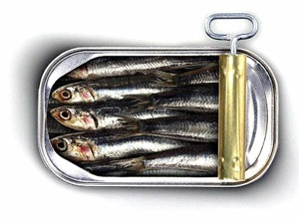
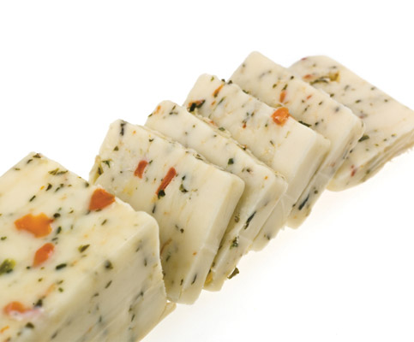
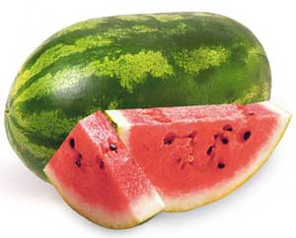
Mandatory Ingredients
Notes:
Each chef is given mandatory ingredients. These are items that must be included in the final dish the chef presents to the judges. In this example, the mandatory ingredients are sardines, watermelon, and herb cheese.

Slide 51
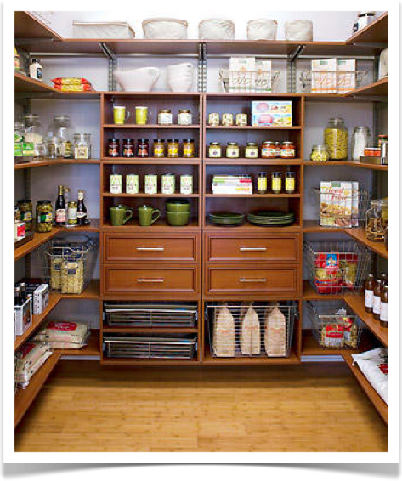
Supports to Help Complement the Dish
Notes:
Chefs are not limited to the mandatory ingredients. In fact, they have access to a fully stocked pantry. Spices, pastas, wine, etc. are all available to enhance the dish.

Slide 52
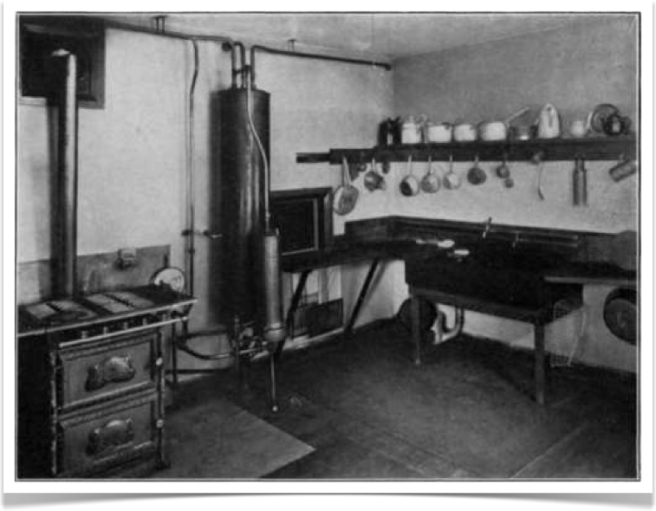
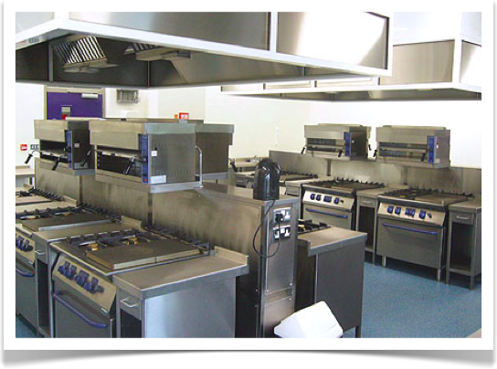
Chefs work in a kitchen stocked with all of the appliances, amenities, and space that they need.
The results would be very different if the chefs were told to work in an old-fashioned kitchen.
Notes:
The kitchen where the chefs work was designed to be efficient and include all of the appliances they could want. Additionally, everything is easy to reach, and the chefs do not have to clean up after themselves.

Slide 53
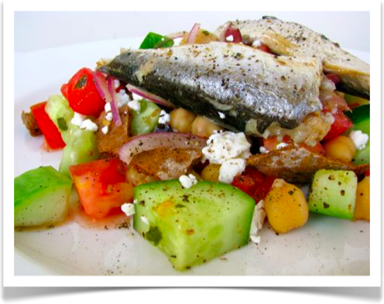
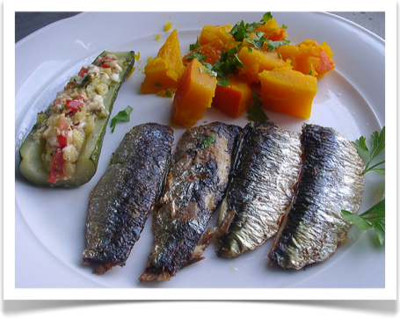
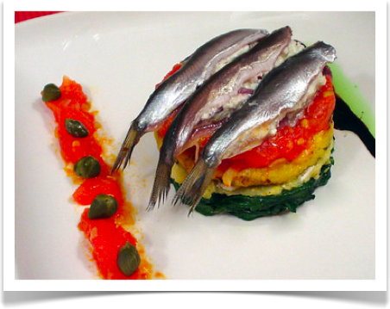
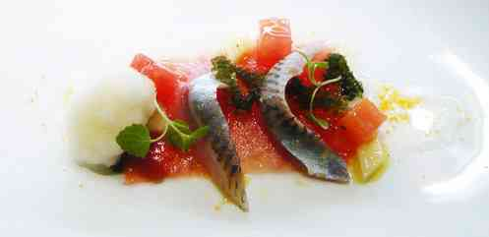
Notes:
The resultant dishes are different—they look and taste very different, yet they each contain the mandatory ingredients.

Slide 54
Part 2 Closing Activity
The television show Chopped can be a metaphor for UDL in a variety of ways. What metaphor do you see in this example? There is a handout with the images on it. Write, draw, or in some way demonstrate a connection between Chopped and UDL.
Notes:
NOTE: The handout is intended to allow the participants to make a full-scale metaphor, connecting all of the parts. There is no right answer to this activity. The participants could connect the show to the essential elements of UDL, a student’s experience of an assignment, a teacher creating a lesson, or building professionals trying to adopt UDL. The goal of this activity is for the participants to think through everything they have learned and form a narrative of the information.

Slide 55
Time to Return to the KWL Pages
Is there anything to add to the What You Know column?
Are there items to add to the Want to Know column?
Have you learned anything you can add to the What I Learned column?
Remember—you can use words, phrases, sentences, or pictures.
Notes:
This is the final chance in Part 2 for participants to add to their KWL charts. If you are a facilitator with a strong grasp of UDL, you may want to collect the KWL charts at this point and make notes of what questions the participants still have that have not been addressed so that you can address them during Part 3.

Slide 56
You Have Completed Part 2
This is the end of Part 2
of the PD presentation on UDL

Slide 57
UDL
Part 3: Putting UDL Into Action
Notes:
This is the beginning of the third section of this PowerPoint.

Slide 58
CEM Overview
Part 1: An introduction to UDL, including its origination and the model of learner variability upon which it is based.
Part 2: A general overview of how to use the UDL framework for planning instruction for diverse learners.
Parts 3 & 4: An opportunity to practice planning instruction using the UDL framework.
Notes:
The purpose of this section is to give participants an opportunity to practice some of the skills they need to implement the UDL framework in their classrooms.

Slide 59
Goals
Understand the concepts of UDL.
Apply the concepts UDL to support diverse learners in your classroom practices.
Notes:
This is a reiteration of the same goals that were introduced in Parts 1 and 2.

Slide 60
UDL Road-Trip Review
Notes:
This is the first slide in a short series that uses a road-trip metaphor to remind the participants of some of the key ideas about UDL.

Slide 61
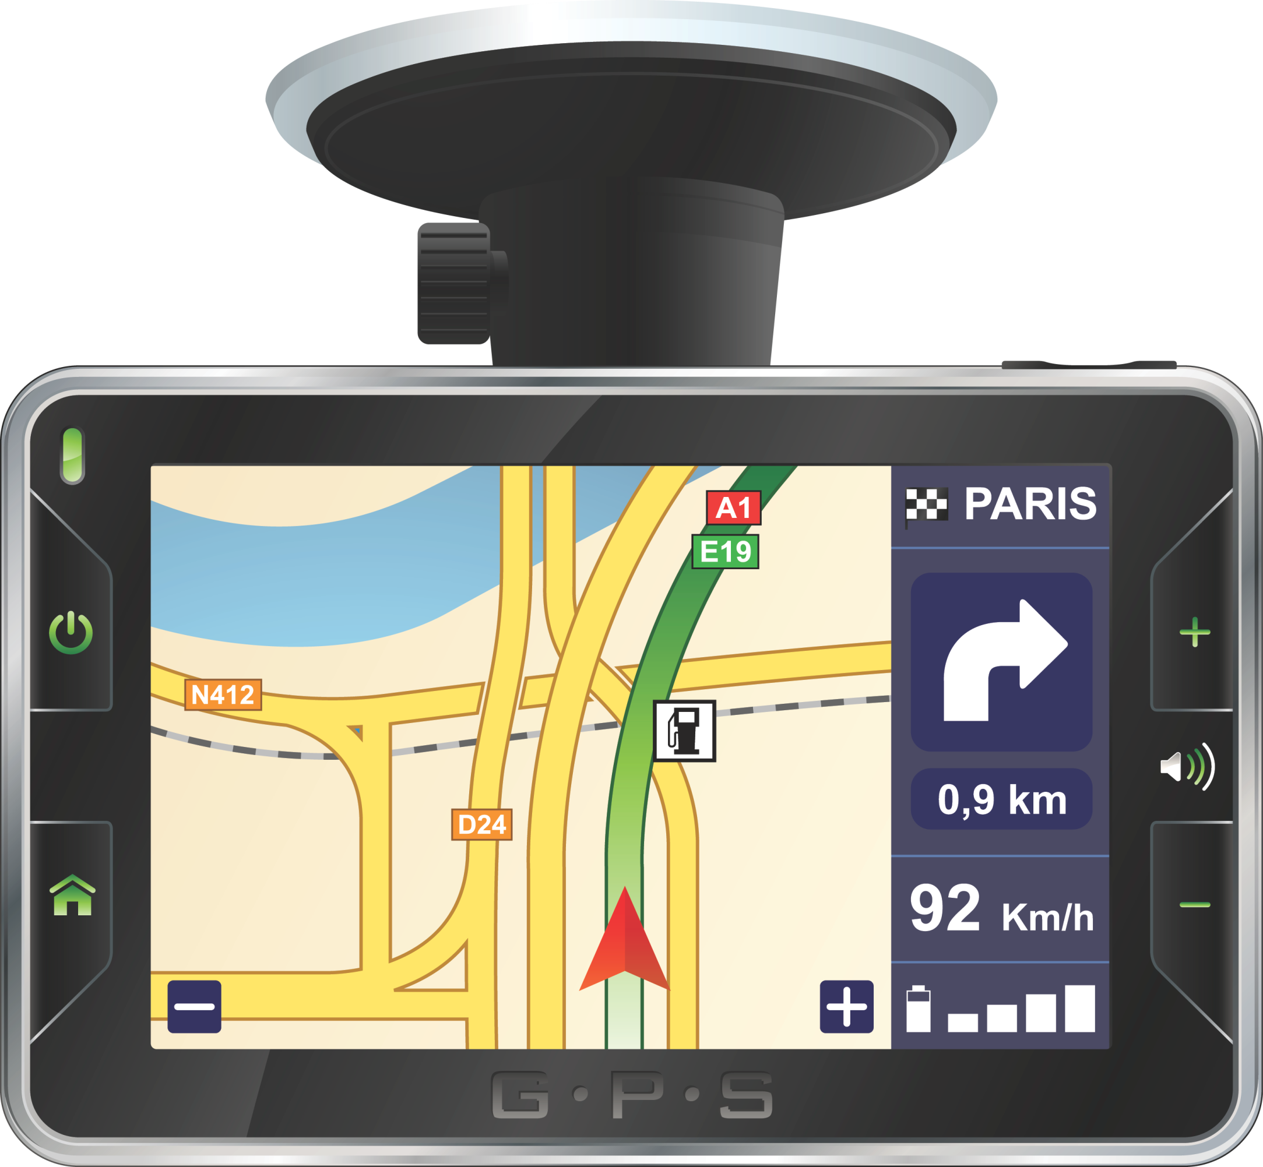
UDL Road-Trip Review
Goals
Methods
Assessment
Materials
3 Principles of UDL Multiple Means of:
Representation
Expression
Engagement
Back
Detour
Notes:
This graphic is meant to look like a GPS. The top four squares are the four curricular pillars—goals, methods, assessment, and materials. The bottom row of squares represents the three big principles of UDL—multiple means of representation, multiple means of expression, and multiple means or engagement.

Slide 62
UDL Road-Trip Review
Goals
Traditional Route
Students will write a descriptive essay about Greek mythology
Back
Detour
Notes:
In a traditional classroom, teachers write prescriptive goals, like “Students will write a descriptive essay about Greek mythology.”

Slide 63
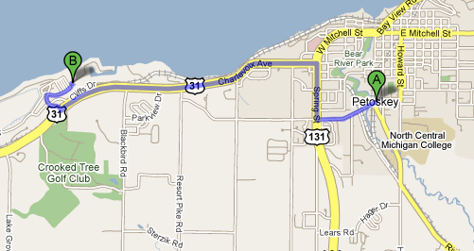
UDL Road-Trip Review
Traditional Route
Notes:
The goal in a traditional classroom is to get from the starting point to the ending point in a single, seemingly efficient way. You may take time here to point out how this route may not work for everyone. Some people may not have cars, for instance, or there may not be sidewalks for people who primarily bike. Public transportation may not offer service on this route, or there may be construction going on that makes the route impassable. Having a single route sometimes works, but often, it does not.

Slide 64
UDL Road-Trip Review
Goals
UDL Route
Students will demonstrate knowledge about Greek mythology
Back
Detour
Notes:
The UDL classroom teacher writes goals that allow students to show what they know in a variety of ways.

Slide 65
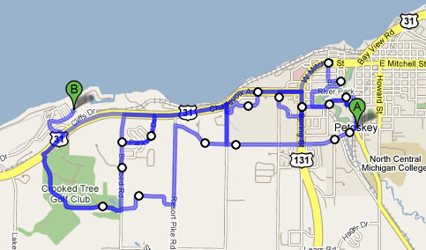
UDL Road-Trip Review
UDL Route
Notes:
The UDL classroom offers students (and teachers!) a variety of options so that people can find their own best ways.

Slide 66
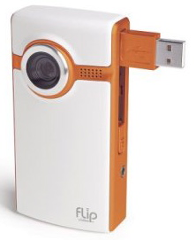
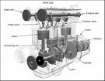
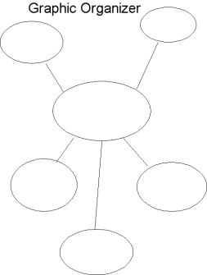
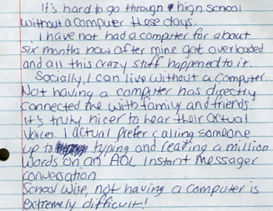
UDL Road-Trip Review
Routes =
GPS graphic and Chopped slides adapted from a PowerPoint by Jeff Diedrich
Notes:
Students can use graphic organizers, PowerPoint, videos, handwritten papers, typed papers, diagrams, oral presentations, podcasts, etc. to present the information they know. This is an example of how a goal can be written with the UDL framework in mind and how multiple means of expression and action can be used to show what students know. This example is limited, but it activates the participants’ memories of the UDL principles and gives them another metaphor to relate to UDL.

Slide 67
Let’s Review in Your Own Words
1. What is UDL? (handout activity)
2. Why is it worthwhile to practice implementing the UDL framework?
3. On a scale of 1-100, how much do you already use the principles of UDL in your classroom? (1 = not at all; 100 = all day, every day)
Notes:
NOTE: There are two handouts that contain the same information in different activity formats that you can use at this point. The activities ask participants to identify examples and non-examples of UDL in the classroom.

Slide 68
The Five Questions
Part 3
In this section, we will work with five questions.
1. How can we proactively plan instruction using the UDL framework three principles, nine guidelines, and accompanying checkpoints?
2. How can we create and evaluate learning environments that align with the UDL framework?
3. How do we identify and strategically use materials, curricula, and technologies that align instruction with the UDL framework?
4. How do we use progress monitoring and data-based decision making to inform instruction and student learning in order to provide timely, mastery-oriented feedback?
5. How do we strategically integrate evidence-based practices (EBPs) into UDL planning, teaching, and assessment?
Notes:
In this section, we will address these five questions, which are adapted from the essential components from the Universal Design for Learning: Recommendations for Teacher Preparation and Professional Development IC that the CEEDAR Center produced. There is no need to go into depth about these questions at this point or even read them if you passed out the handout. This slide is meant to serve as a guide for what is coming in general, not in detail.

Slide 69
UDL Implementation
Can you design to the edges?
Watch this video:
https://www.youtube.com/watch?v=4eBmyttcfU4
After you watch the video, respond and/or reflect with a partner about the metaphor on your handout.
Notes:
This video’s running time is 18:26. It is a video featuring a high school dropout turned Harvard faculty member who talks about how a simple, new way of thinking helps nurture individual potential. After the participants have watched the video, have them respond to the video using their handouts.

Slide 70
Notes:
This is the first slide that addresses the 2.1 question: How can we proactively plan instruction using the UDL three principles, nine guidelines, and accompanying checkpoints? Take a moment to revisit this handout. This may be a good time to ask the participants to highlight one checkpoint they absolutely think they can implement in their classrooms.

Slide 71
Notes:
This slide features the same information on the handout but in a different format. You can point out that each of the principles has a checkpoint that addresses access, guided practice and supports, and independent practice.

Slide 72
Let’s return to our Indian meal that we were asked to prepare in Part 1.
Remember—you were asked to fix a three-course meal for 12 people. Here is the menu:
First Course: Tandoori Mackerel
Second Course: Lamb Chili Masala
Third Course: Gulab Jamun
Separate into three groups.
Group 1—focus on the Engagement principle.
Group 2—focus on the Representation principle.
Group 3—focus on the Action and Expression principle.
Go through the guidelines and checkpoints and determine what it would look like if you were guiding students through the process of making this meal. How would you address each of the points that fall under the umbrella of your principle?
Notes:
Make sure participants have the UDL guidelines handout. If there is time, have each group do each of the principles.

Slide 73
Question 1
Let’s re-write some lesson objectives using phrases that fit within the UDL framework.
Move from here
to here
Read
Listen
Write
Speak
Manipulate calculations
Remember concepts
Remember procedures
Solve problems
Take in information
Express information
Demonstrate understanding of processes
Demonstrate understanding of concepts and ideas
Show what they know through personally accessible formats
Create a representation of what they know
Notes:
NOTE: There is a handout that goes with this slide. Invite the participants to work on their own or in groups. Invite them to share examples when they are finished.

Slide 74
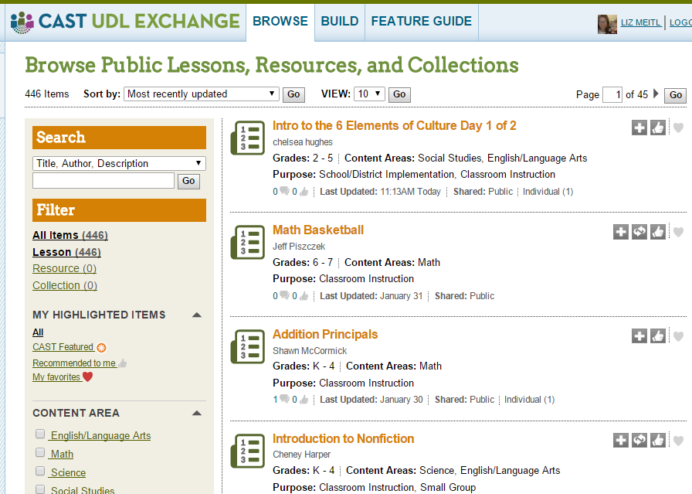
Question 1
The CAST UDL Exchange is an amazing resource. There are lesson plans, resource collections, and a lesson-building tool all in one place. Let’s all take a moment to register an account right now.
URL: http://udlexchange.
cast.org/
Notes:
This is a great resource for the participants to use as they implement the UDL framework in their classrooms. Encourage participants to use their laptops or phones to immediately sign up.

Slide 75
Materials Competition!
Each table has a large piece of paper.
We are going to set a timer for 5 minutes.
The team that can list the most materials and means of representation in 5 minutes wins.
Examples: Highlighters, Quizlet, Venn Diagrams
Notes:
You will need to distribute markers and large pieces of paper. It would be awesome if you had prizes for the winners. Anything the participants list that you could use in a classroom is a good answer—iPads, globes, dictionaries, colored pencils, stickers, post-its, etc. The purpose of this activity is to help the participants realize that they have access to many items that can help them create a UDL environment and can be used to plan UDL lessons.

Slide 76
Self-reflection time:
1. What is one lesson that you could adjust to incorporate more ideas from the UDL framework?
2. How would you adjust it?
Jot down your ideas. Then, highlight the parts of your UDL guidelines sheet that will be addressed with these changes.
Notes:
Some pre-service participants may not have a lesson they can think about off the top of their heads. Invite them to think of a lesson in which they were recently engaged as a student. Ask how the teacher may have made it more interesting/effective/meaningful using the UDL framework.

Slide 77
Learning Environment
Creating Barriers Versus Removing Barriers
Creating possible barriers: Student desks remain in rows and columns throughout the year. This way, the students face you, and you can see what they are doing at all times while you lecture, display information on the screen, and have them work at their desks.
Removing barriers: Student desks are moved based on the structure of the lesson (e.g., collaborative work, individual work, partner work, presentations) and desired learning (e.g., students will combine their predictions of random issues to develop a group hypotheses).
Notes:
This is the first slide that addresses question 2.2: How can we create and evaluate learning environments that align with the UDL framework? You could ask the participants how the Creating possible barriers example in this slide does create barriers.

Slide 78
Learning Environment
Creating Barriers Versus Removing Barriers
Creating possible barriers: Alphabet posters are hung on the narrowest wall because they visually look best there.
Removing barriers: Alphabet posters are hung in a spot where learners can easily see them, and they are consistently used as a teaching tool.
Adapted from Design and Deliver, Planning and Teaching Using Universal Design for Learning by Loui Lord Nelson
Notes:
This slide presents a good opportunity to share that in a UDL environment, everything has a purpose, and every item is placed where it can best serve its intended function. If you want, you could ask the participants if they design their homes in this way or if their homes are designed for beauty over function. In an ideal situation, a UDL environment is both visually appealing and functional.

Slide 79
http://udl-toolkit.cast.org/home
Notes:
This slide is the first to address question 2.3: How do we identify and strategically use materials, curricula, and technologies that align instruction with the UDL framework? The link below the web-page picture on the slide links to the UDL Toolkit on the CAST website. It is a good resource, and depending on how much time you have and your web-exploring capabilities with the whole group, you may want to navigate through some of the website.

Slide 80
Time to create your own personal plan of action for implementing UDL.
What part of your curriculum will you try to adjust to incorporate more of the UDL framework?
What materials and technology will you use?
How will get support and feedback about your process?
Notes:
This is an opportunity for the participants to answer a few basic questions to get them to begin to own the next big step, which is taking what they have learned and applying it in their classrooms. Depending on time and energy level, you could have the participants respond on their own or in small groups and have everyone share one answer with the whole group.

Slide 81
As you watch this video, think about how the practice of responding to a rubric serves as a progress-monitoring tool and as a way of giving mastery-oriented feedback.
If we were to create a rubric for this UDL presentation, what would it look like?
https://www.teachingchannel.org/videos/designing-rubrics#
Notes:
This slide addresses question 2.4: How do we use progress monitoring and data-based decision making to inform instruction and student learning in order to provide timely mastery-oriented feedback? The 2-minute and 11-second video is about a teacher who is using a mid-project review rubric. The question then asks participants to engage in conceptualizing a rubric for this PowerPoint. If you have time, it would be effective to have the participants break into groups and create a rubric that could be used to provide both progress monitoring and mastery-oriented feedback for this presentation.

Slide 82
Choose one unit you teach or you can imagine teaching and outline, draw, or describe to a friend or write about how you are going to implement better progress monitoring, data-based decision making, and mastery-oriented feedback.
Notes:
This slide asks participants to look at question 2.4 from a personal point of view.

Slide 83
Evidence-Based Practice Websites:
What Works Clearinghouse
NEA Research Tool for Best Practices
SERC Resource Page for Best Practices
CAST Learning Tools
Notes:
This slide introduces question 2.5: How do we strategically integrate EBPs into UDL planning, teaching, and assessment? Your participants’ comfort levels with this question will have a lot to do with their familiarity of EBPs. The websites above are all resources for finding lists and examples of EBPs. It would be ideal if you could click on the websites so that teachers can see the available resources that are available.

Slide 84
What are the EBPs you use?
Create a poster, by yourself or with others, that lists or illustrates or in some other way conveys some of the EBPs with which you are already familiar or that you already use. Keep this information on one side of the poster.
On the other side of the poster, demonstrate in some way how you can connect these EBPs with the UDL framework.
Notes:
This is a final opportunity for the participants to think about what they are already doing or are familiar with and how they can use that knowledge in their UDL implementation.

Slide 85
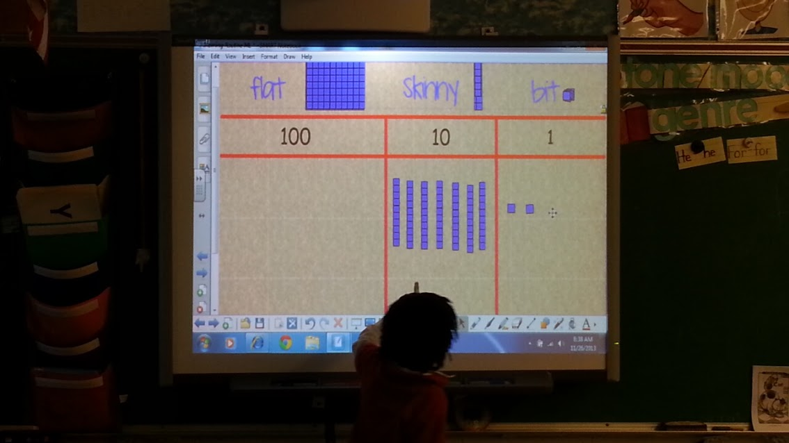
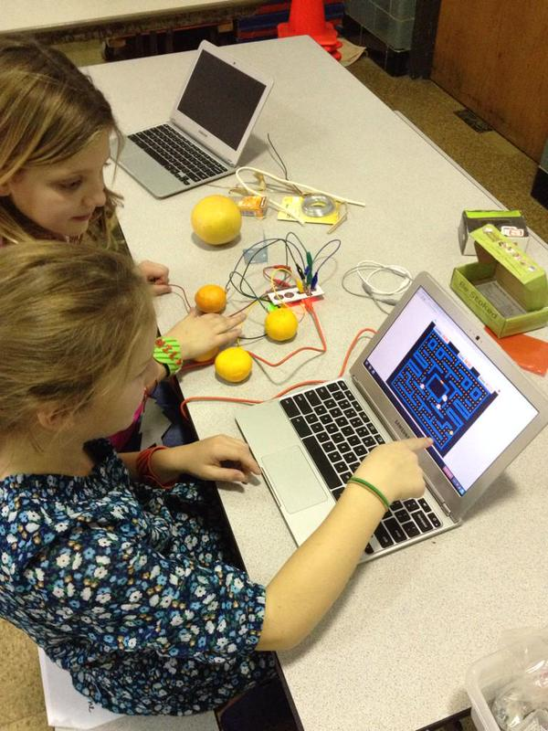
UDL
Part 4: A Deeper Dive Into UDL Implementation
Notes:
This is the beginning of the fourth and final section of this PowerPoint.
Speaker Notes: These speaker notes are intended to facilitate discussion about integrating UDL into instruction. They provide additional details about each of the slides, including examples and context.

Slide 86
Clarifying Some Confusions
UDL is NOT . . .
UDL is . . .
modifying instruction after lesson planning.
just about using technology, although tech is important!
an EBP.
the same thing as differentiated Instruction (DI).
an instructional planning framework for embedding EBPs.
a flexible method of thinking about the learning environment, instruction, assessment, and instructional materials.
related to differentiation, which fits within the UDL framework.
Notes:
There is often confusion about what IS and what IS NOT UDL. This confusion occurs for several reasons. It is helpful to start by considering what IS and what IS NOT UDL before we talk about how to integrate UDL into instruction.
FIRST, UDL is NOT:
Modifying instruction after lesson planning. One of the key ideas of UDL is that it proactively accounts for learner variability. Therefore, creating one lesson for most students and then modifying that instruction for a few is not UDL.
UDL is NOT just about using technology. There is a great deal of debate about the relationship between UDL and technology, and the two are interrelated. The way the field is currently considering the role of technology in UDL is that technology is a tool alongside proactive planning. For example, when I consider reading instruction that is proactively meeting the needs of all learners, I will likely plan to use technology to provide options for representation (e.g., multimedia); action and expression (e.g., presentation software); and engagement (e.g. simulations). In a society in which technology is ubiquitous, it is hard to imagine instruction that does not leverage technology, but technology and UDL are not the same things. However, it is still possible to plan reading instruction without these technologies in a manner that still offers multiple means of representation (e.g., leveled books); action and expression (e.g., dioramas and poetic expressions); and engagement (e.g., options for text activities).
UDL is not an EBP: There is a great deal of research that points to the positive effect of the UDL framework and evidence associated with each of the checkpoints, but the UDL framework itself is not an EBP. Rather, it is a planning framework in which we can embed EBPs.
UDL is not the same as differentiated instruction (DI), although the two are very much related. DI emphasizes how the teacher can modify activities, instruction, assignments, and materials to meet the needs of a wider range of learners. According to CAST (2013), UDL is an instructional design approach that is broad and encompasses both the instruction (i.e., goals, assessments, materials, and methods) and the instructional environment from the onset of instructional planning. DI, on the other hand, emphasizes how teachers respond to individual students. Both, in combination, support student success.
Resource: UDL interactions: Universal Design for Learning and Universal Design. (2013). Retrieved from http://www.udlcenter.org/sites/udlcenter.org/files/UDL-DI%20BRIEFfinal.pdf
UDL IS:
An instructional framework in which EBPs can be embedded: If we proactively plan for learner variability using the three principles of UDL within that instruction, we should be embedding evidence-based strategies and methods. In the reading example above (related to UDL and technology), as students are provided instruction aligned with UDL, teachers are teaching strategies such as paraphrasing and self-questioning.
A flexible way of thinking about learning, the environment, instruction, and assessment. Because we are not only teaching to the middle/average learner, we are ensuring that our instructional planning is flexible. We cannot have only one content delivery method or one way of assessing learning. Therefore, lesson planning becomes more flexible. In later slides, there will be several examples of how this looks in practice.
UDL is related to differentiation and often uses the same language, which may cause confusion (see above). There are several resources available to support a deeper understanding of the relationship between differentiation and UDL. For example, The National Center on Accessing the General Curriculum (NCAC) has developed a white paper titled Differentiated Instruction and Implications for UDL Implementation: Effective Classroom Report (http://aim.cast.org/sites/aim.cast.org/files/DI_UDL_10.6.14_0.docx)

Slide 87
Acknowledge Learner Variability
Once teachers get over the “myth of the average learner,” they start to work on:
– UDL, differentiation, tiered instruction
This is sometimes challenging for content teachers.
– Belief about what students can and cannot do based on labels.
– Belief that they will only teach advanced courses (e.g., AP Physics vs. Remedial Earth Science; Calculus vs. Algebra 1).
– Belief that they will not have students with disabilities in their classes.
Notes:
A slide in Part 1 of the PowerPoint describes the need to acknowledge learner variability.
Question: What would you say about equity, access, and meaningful engagement? What is a brief example of a student with disabilities succeeding in a content class?
When working with content teachers (e.g., math, science, history teachers), there are sometimes naïve ideas about what students with and without disabilities can do academically.
They may have preconceived ideas about what students can and cannot do based on their disability status, socioeconomic status, etc. Many times, we hear comments such as, “If only they were not so low, we could . . . ”
They often also have naïve ideas about which classes they will teach. For example, many pre-service content teachers think that they will be teaching only advanced content courses. They may not realize that in schools, there are many decisions that go into who teachers which classes, and new teachers are often assigned introductory classes.
Last, they often believe that they will not have students with disabilities in their classes because they have little experience with students with disabilities.
Question: What would you do if you were working with a teacher who stated that students with disabilities did not belong in his/her advanced math or science class?
Question: What strategies would you propose to move teachers away from these attitudes about students with disabilities?

Slide 88
Integrating Technology Tools to Support Students in Learning From a UDL Perspective
Notes:
Although we previously shared that UDL and technology are not the same, it is helpful to provide some examples of how technologies can intersect with pedagogy and proactive planning for learner diversity. These next slides provide a few illustrative examples.

Slide 89
UDL Is More Than Simply Using Technology!
It is about the pedagogy and planning!
Notes:
Question: What do you think is the relationship between technology and UDL? How do you think technology can facilitate instruction designed through the UDL framework?
Discuss the relationship between technology and UDL using the examples that the students create.
The main point is that UDL is more than simply using technology. It is about the pedagogy and planning, and the technologies are the tools that help facilitate learning and engagement.

Slide 90
Applying the 3 Principles of UDL: Some Examples
Notes:
The examples that follow do not fall into one of the three principles, but they can be examples of all three principles in action. To simplify, we are highlighting them as related to each of the three principles in turn.
Here is a word of wisdom from teachers who have implemented UDL in their classrooms: As a new special or general education teacher, you are going to have to learn so many new things—your students’ needs and strengths, the curricula, the standards, navigating a new school culture, etc. It is important to remember that as you start implementing UDL, you may want to take an incremental approach that is doable. Because there are not many curricula out there that align well with UDL, there is a lot of teacher work that goes into designing this type of instruction. Rather than trying an all-or-nothing approach that may fail and result in giving up on UDL, consider a realistic approach to planning; that is, learn about different resources, materials, assessments, and technologies with the goal of providing instruction that aligns with the UDL framework, but realize that teaching in this manner is difficult and will take time to implement well. Perhaps in one unit, focus on assessment practices that align with UDL. In the next unit, explore various technologies that may increase engagement.

Slide 91
Multiple Means of Representation
Options in how students acquire information and knowledge.
LOTS of different ways of presenting information to students.
A few examples . . .
Notes:
Providing multiple means of representation means that students can access content in different ways. Essentially, they can learn content through different pathways. For some students, listening to the teacher lecture and reading the textbook provide the needed context to access content. Other students benefit from different representations of content such as multimedia, simulations, audio books, graphic novels, etc. More representations result in the increased likelihood that students will have access to the instructional content. This does not mean that you, as the teacher, must have ALL of these options ALL of the time; it means that you should consider alternative ways of representing content in your planning.

Slide 92
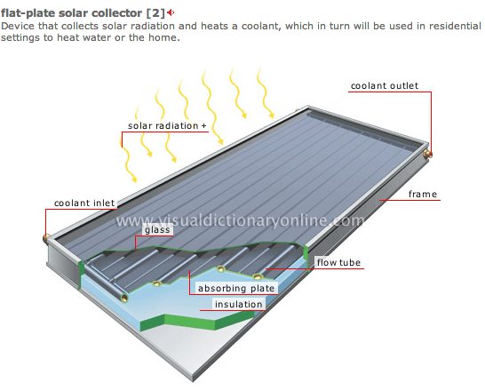
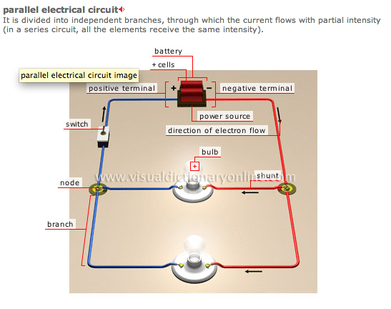
http://visual.merriam-webster.com/
Example: Visual Dictionaries
Solar Panel
Parallel Circuit
Notes:
Because we want multiple ways for students to engage in content, we often end up searching for materials that provide that access. We do not have to create everything as teachers; there are LOTS of materials already available to us. One example is the use of visual dictionaries. Students with disabilities and other struggling learners often struggle with complex concepts, vocabulary, and lack of background knowledge. Using visual representations alongside text and multimedia can be very helpful. Merriam Webster Dictionary, for example, uses visualizations tied to content areas such as astronomy, animal kingdom, foods, society, and sports/games. The pictures above depict both solar panels and parallel circuits alongside associated vocabulary. If students need to understand vocabulary, such as solar radiation, and they can see the visualization of the solar radiation on the solar panel and the absorbing plate within the solar panel, they are more likely to understand how solar panels work compared to simply reading about them in the textbook or listening to the teacher explain them. If the teacher also had an actual solar panel alongside this visual, that would add another representation that would strengthen the association between the concept, the vocabulary, and the process of using solar power.

Slide 93
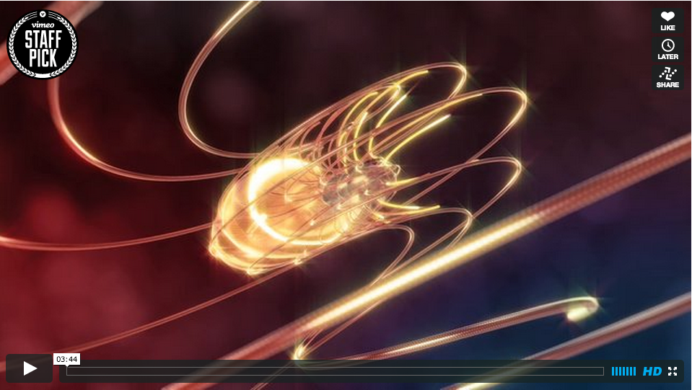
Example: Videos
Teacher Tube/You Tube
Khan Academy
Vimeo
Fibonacci example
—Teaching standards related to patterns, sequencing, and relating math to the real world.
http://vimeo.com/9953368
Notes:
Videos are another way to represent content in multiple means. This video about Fibonacci sequence in nature is a great example of how to provide background knowledge and different access points to material.
Let’s watch this video. After you watch this video, reflect on the two areas below and then share.
Write down a few mathematical ideas that could be represented through this video.
Reflect upon which elements of this video can support learning for students with limited background knowledge as well as students who struggle with mathematics.

Slide 94
Multiple Means of Action and Expression
Different ways of demonstrating understanding.
Notes:
Discussion: How do you typically express your understanding of information you learned in class? Do you have preferred ways of demonstrating your understanding?
If the students talk about writing papers, doing group projects, etc., discuss advantages and disadvantages of these different formats. The main point here is that along with representing information in multiple ways, it is important to provide students with multiple ways of expressing their understanding. Again, there are technology- and non-technology-based tools that allow students to express their understanding.

Slide 95
Simulations and Video Games
PhET interactive simulations
Gizmos
Filament Games
Example: You Make Me Sick!
Learn about bacteria, viruses, general germs, staying healthy, etc.
http://youtu.be/tO7VWBLM7CI
Notes:
Instructional video games and simulations are increasing in availability, and there is a growing body of literature that points toward their use in content instruction to increase engagement and learning.
This slide includes some examples of simulations and instructional video games.
PhET interactive simulations are free, interactive, research-based science and math simulations developed at the University of Colorado. These are typically used for higher grades.
Gizmos are math and science simulations typically used in Grades 3-12. These are not free, but there is a free trial if you are interested in playing around to see if they are useful to your pre-service program instruction.
In addition to simulations, there are a growing number of instructional video games tied to content standards. For example, Filament Games has games in areas such as science and civics.
Watch the video explaining one game called You Make Me Sick! In this game, students learn about viruses and bacteria in order to play a game in which they must make someone as sick as possible as fast as possible. They can either engineer their own pathogen or pick from a suite of pathogens. This game also has several cognitive supports that provide hints and background knowledge.
After watching the video: What are your impressions of using video games or simulations to demonstrate content understanding? Is there a place for video games in traditional instruction?
Because video games focus on engagement, they often have many pathways into learning and expressing understanding, as illustrated in this game example. It is important to understand that games and simulations will not replace the teacher. They are there to enhance learning and add multiple pathways to learning.

Slide 96
Apps for Learning
Across content areas
Many are free
Schools investing more and more in mobile technologies
Notes:
There are also many educational apps available. Given that many schools have already invested in mobile devices, it is helpful to consider how these would fit within the context of UDL-based instructional planning.
Discussion: What kinds of apps to you use? Have you used any apps that support learning (e.g., math games)?
Remember, though, that not all technology is equal. Not all mobile devices are accessible, and not all apps result in learning. It is very important to do your homework and reflect upon whether the technology tools/apps under consideration fit within the instruction; have data to support their use for learning; and lead to better representation, expression, and engagement. In one of our early studies, we examined how students used an app for increasing math automaticity with an app game that had them quickly go through math facts. We found that for a significant minority of the students in our study, the pressure of this game led to frustration and was not a good fit. It was not a great tool for allowing these students to express their understanding. They, therefore, would have chosen another tool for expressing understanding of math facts. In another study, we looked at how students engaged with eBook apps (e.g., Kindle, Nook, iBook). We noticed that although there were many tools built into these that would increase access, the students often did not use these because they did not know when to use supports such as highlighting, tabs, and the embedded dictionary. Therefore, if we wanted students to highlight the main ideas and essential details in passages, we needed to not only teach them this strategy, but also how to use the technology to do so.

Slide 97
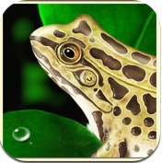
Examples: Science Apps
Frog dissection: Virtually dissect and explore the inner workings of your frog. Also contains extended content about frogs.
https://itunes.apple.com/us/app/frog-dissection/id377626675?mt=8
Notes:
How many of you remember having to do dissection at school? What was that experience like?
Within the UDL framework, you will think about which barriers to learning students face during instruction. What would be difficult for students with disabilities and other struggling learners? Which barriers to learning exist during these types of activities?
There is much debate regarding the ethics of dissection in schools. Regardless of where people fall on the debate, for many students, before doing real dissection or in place of real dissection, a virtual dissection is helpful. These experiences provide three-dimensional views of the animal organs as well as information, background knowledge, and multiple access points to the anatomy content. Therefore, they are great tools for providing background knowledge and practice. NOTE: The frog dissection video is available for purchase on iTunes.

Slide 98
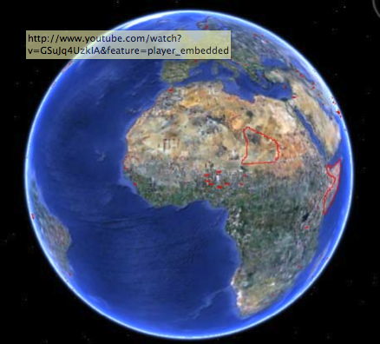
Google Earth
Satellite images from anywhere on Earth
Under the sea
Through time
Famous landmarks
Your house
Notes:
Google Earth is an example of a global visualization tool. It provides information about oceans, landscape, and landmarks, and it even allows you to find your home. There is body of literature that highlights how such technologies can be used to teach data analysis, environmentally literate students, and even learning about the relationships between local and global environments. While learning geography or astronomy, for example, honing in on states, nations, landmarks, and even looking at planets and stars through Google Earth is a great way of integrating technology.
Again, if a known barrier to learning involves spatially understanding the geography, using a tool like Google Earth can increase meaningful engagement.

Slide 99
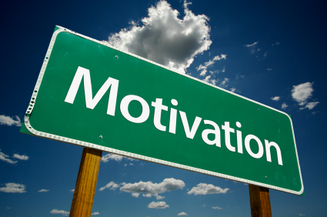
Multiple Means of Engagement
Options for tapping into the learners’ interests and motivation.
Notes:
As you could tell from the previous slides, these technologies and tools do not fall into one clear-cut UDL principle. For example, instructional video games allow students to express their understanding but can certainly increase engagement. Below are a few other examples that fit into all three principles but illustrate multiple means of engagement.

Slide 100
Student Examples: Making Mystery Fraction Problems Using Scratch
Notes:
Many students struggle with learning fractions. One strategy that supports students in learning mathematics concepts is going through a sequence beginning with concrete representations of concepts and accompanying procedures, then transitioning to graphical representations, and then finally moving on to abstract interactions. As a teacher planning through the UDL framework, you can consider how to help transition students from using manipulatives, such as counters and number lines, to a more abstract representation. Here is an example of how one third-grade teacher did so using Scratch programming.
Scratch is a user-friendly, tile-based programming software that allows students to do computer programming without knowing sophisticated coding such as Python or Java. Scratch makes use of these tiles that attach, much like LEGO blocks.
Third-grade students in this example created story problems using number lines, and they illustrated their story problems using Scratch programming. This is an excellent example of how students can have multiple options for demonstrating their understanding and increase engagement because they have choice in how they create their illustrated story problems. Here, the level of sophistication of the story problems, as well as the level of programming, is different from one student to another, yet students can engage in their own ways. You can learn about Scratch at https://scratch.mit.edu/ and about instruction that integrates Scratch into art, math, science, social studies, etc. at the ScratchED community of practice at http://scratched.gse.harvard.edu/resources

Slide 101
Important Notes
UDL does not replace individualization.
UDL belongs to everyone (e.g., general educators, special educators, students receiving enrichment/gifted services, students with significant disabilities).
Notes:
There are a few points that are important to make.
First, although UDL allows us to plan instruction to address the variability we see in today’s classrooms, this does not mean that we will not need to individualize instruction for some students. We will always need to provide individualized supports, teach explicit strategies that address the individual needs and individual education program (IEP goals), use specialized assistive technologies, and provide accommodations and modifications for some students with disabilities.
Second, the point of UDL is to provide accessible and engaging instruction to ALL learners. This means that UDL is not for students in one particular category or another. If we plan for learner variability, instruction will be more enriching for ALL learners.

Slide 102
UDL, MTSS, and Individualization
Tier 3
Tier 2
Tier 1
Tiers are not physical locations.
UDL fits throughout the pyramid
Notes:
UDL is appropriate across all tiers within the Multi-Tiered System of Supports (MTSS) framework.

Slide 103
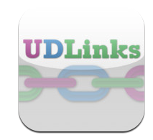
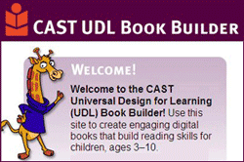
Resources Available to You
UDLinks
– Free App
Maryland State Dept. of
Education
CAST
Book Builder
iSolveit
Science Writer
Notes:
There are many supports that can help you design instruction through the UDL framework. One such resource is UDLinks, which was developed through the Maryland State Department of Education. https://itunes.apple.com/us/app/udlinks/id454517781?mt=8
The CAST website has a lot of resources, including free tools such as UDL Book Builder, which allows you to create your own digital books to support reading/literacy instruction (http://bookbuilder.cast.org/); iSolveIt, where students can learn math reasoning (http://isolveit.cast.org/home); and CAST Science writer, which scaffolds students’ development of science lab reports (http://sciencewriter.cast.org/welcome;jsessionid=2D68C28F3AF2E7CB1D66F1588861C509)

Slide 104
Examples of Lessons and Assessments
Lessons
Assessments
Student Work Examples

Slide 105
Primary Reading (Poetry) Tic-Tac-Toe
Find and read a poem with a peer. Have tiered resources. | Read a biography of a poet (e.g., Shel Silverstein). Have tiered books. | Write your own acrostic poem.
Write a holiday poem (e.g., Mother’s Day). | Find rhyming words in a poem. | Illustrate what is happening in a poem.
Interview a poem and provide answers. | Find metaphors, similes, and hyperbole in poems. | Write a poem from a different point of view.
Notes:
Tic-tac-toe assignment guides utilize UDL principles of multiple means of representation and multiple means of expression. Students are required to complete three activities—either in a row, a column, or diagonally.

Slide 106
Secondary Algebra Tic-Tac-Toe
You be the teacher: Correct the homework. | Watch Khan Academy video and answer questions. | Review work examples using order of operations.
Complete a math extended response. | Create data and then write a word problem using that data. | Practice online with algebra tiles.
Print out and complete worksheet. | Create word problems and illustrate them in Scratch. | Complete online algebra game.
Notes:
Handout 12 is a template of the assignment guide that you can use in your classroom.

Slide 107
Industrial Revolution Tic-Tac-Toe in Practice
In this video, teachers describe how they use this strategy to engage all learners.
https://vimeo.com/6104437
Notes:
In this video, you will hear two teachers describe how they use the tic-tac-toe method to assign projects to students for a unit on the Industrial Revolution.
While you watch this video, think about these questions. We will discuss them afterwards.
Why do you think the teachers emphasized that it was important to think about the placement of the projects on the tic-tac-toe chart?
How might you have one rubric to assess all these projects?
There are many other examples of tic-tac-toe activities. This website by Dr. Dave Edyburn includes links to several other examples: https://pantherfile.uwm.edu/edyburn/www/tictactoe.html

Slide 108
Example: Interview a Poem
Poem: Harry Potter in 99 Seconds
https://www.youtube.com/watch?v=y57sYHIDP_Y
K’s Poetry Assignment—Interview With a Poem
https://www.youtube.com/watch?v=0FySnKVOhfQ&list=UUtyE1Uf5uYQNKAxPBbtn42w&feature=c4-overview
Notes:
In this example, the student chose to “interview a poem” as an option for a project. The teacher allowed students to find poems, write questions, and then answer them through video. In this example, the student completed this assignment by having her parent interview her with the questions she created. It is rather funny, but it exemplifies how students can have autonomy and produce learning products that are flexible and still allow teachers to assess their learning.

Slide 109
Reading Project Options
Interview a character from your book. Write 10 questions that will give your character an opportunity to discuss feelings, roles, etc.
Write a diary that one of the story’s main characters may have kept before, during, or after the story’s events.
Write a newspaper book review.
Construct a diorama of a main event in the book.
Read a book made into a movie. Compare/contrast book and movie.
Create a comic book or graphic novel version of a book.
Design a book jacket including a blurb, author history, and illustrations.
Retell part of the story from a different point of view
Make a PPT of the book with summary and comparison of main characters to yourself.
Notes:
Another way to provide options, aside from tic-tac-toe, is to simply provide options for students. This list is from fifth-grade teacher Ms. Alyssa Meyer.
Let’s look at all of these. If you were a student in Ms. Meyer’s class, which choices would be most appealing to you? Why?
For students with disabilities who may struggle with reading and writing, which choices may be good options? Why?

Slide 110
Reading/Book Review Assignment
Notes:
Just like the teachers who taught about the industrial revolution, Ms. Meyer created one rubric from which all the reading/book review assignments could be assessed.
Let’s look at this rubric and pick some choices from the list. Does this rubric allow Ms. Meyer to assess all the projects on the previous slide?

Slide 111
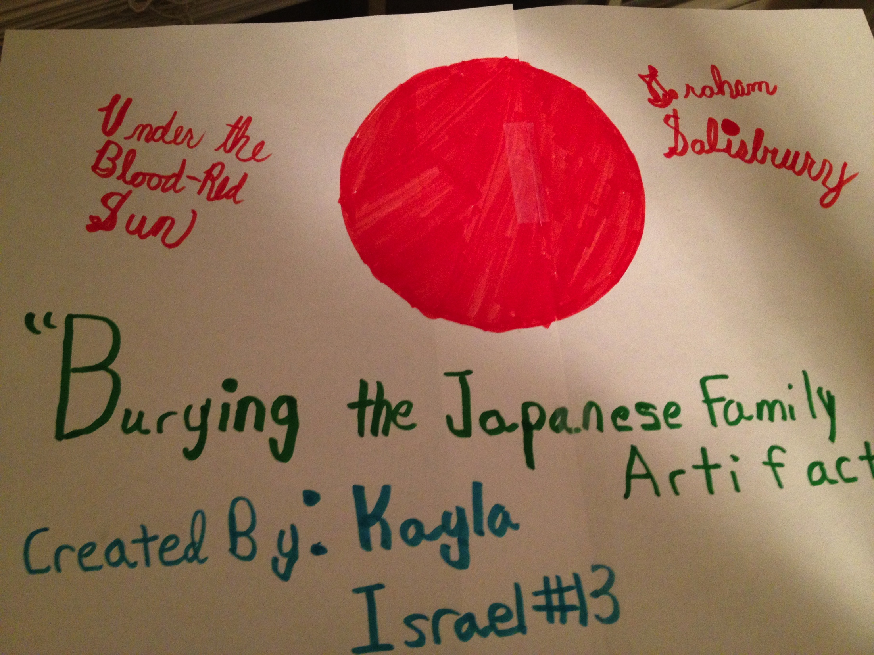
Example: Diorama
Book: Under the Blood Red Sun
Chosen Assignment: Create a diorama and write a descriptive statement.
Notes:
In this example, Ms. Meyer asked the students to pick a book with the following criteria: Historical fiction from the World War II era. Students could use the rubric in the previous slide.
This student picked a critical scene from the book Under the Blood Red Sun and illustrated it in a diorama. She picked the scene in which the Japanese American family decided to bury their Japanese artifacts in their backyard for fear that these items would implicate them as enemies.

Slide 112
Example: Song
Book: Princess Diaries
Assignment: Write and perform a song.
Notes:
In this example, the student decided to compose a song describing the plot of the book The Princess Diaries from the perspective of the main character, Mia. Although it is funny to listen to this song, it clearly illustrates that the student understands the main ideas of the story. This student has significant fine motor issues, so writing a book report would have produced a much less detailed product.
What do you think about the option for creating a diorama or song instead of a book report?

Slide 113
Assignment: Applying UDL
Introductory UDL Assignment:
For this assignment, you will investigate instruction and curricular materials in your practicum setting to:
1. Assess the level of UDL built into instruction as well as the materials used during instruction, including the curricula, technologies, and assessments.
2. Make recommendations for how to integrate the principles of UDL into the curriculum. You may present your information in a variety of formats, including
a traditional paper,
PowerPoint/Keynote/Prezi, etc. presentation,
poster, and
multimedia presentation such as a short video.
Notes:
In this assignment, you will observe instruction and pay attention to the instructional delivery method, materials, and assessments. Evaluate whether the instruction is consistent with the UDL framework. Which aspects were consistent? Which aspects were not?
Then, think about how you could teach that lesson in a manner that aligns with the UDL framework. You can present your findings in many ways, including a multimedia presentation, a traditional paper, a poster, or another method that allows you to express your understanding of UDL in practice.

Slide 114
Assignment, continued
Please provide the following
Curriculum material used by the teacher (e.g., teacher’s manual lessons, chapter, book, technologies):
Content area
Grade level
Publisher
Year of publication
Description of the materials you reviewed (e.g., teacher’s manual, workbook, textbook, DVD)
UDL features within instruction and the curriculum materials: Please describe how well the principles of UDL were evident within the curriculum that you reviewed.
Describe the UDL features within the instruction. If there were no UDL features present, please indicate and explain this. Remember to include ALL three UDL principles.
Describe at least three UDL features (one for each of the three UDL principles) you would include when planning this instruction.
Notes:
In your description, please provide a description of the materials that were used as well as the teacher’s instructional delivery. For example, describe the content area, grade level, materials, publisher, etc.
See Handout 13

Slide 115
Parting Advice
UDL is not an EBP but an instructional planning framework in which to embed these practices.
Start small and build upon emerging knowledge. UDL is not an all-or-nothing process. It takes time!
Collaborate across special and general education to embed UDL in teacher prep programs.
Notes:
My parting words are:

Slide 116
Please Complete the Exit Sheet
Your exit sheet is valuable to us—please take a moment to thoroughly complete it.
This is the end of the UDL PD presentation.
Thank you!
Notes:
NOTE: You can use Handout 14 for an exit sheet.

Slide 117
Thank you

