Slide 1


Prompting: Impact on Inferences about Student Learning
Developed by Diane Browder, Leah Wood, and Caryn Allison for CEEDAR
Project #H325A120003

Slide 2
Goals for Presentation
Describe how to create a task analysis
Define prompts and contrast with supports, assistive technology, and scaffolding
Describe how prompts are used to promote student learning
  Differentiate between response and stimulus prompts
  Identify ways to fade prompts for independent student responding
Notes:
The purpose of the session goals are to clearly define prompts and specific prompting systems that promote student learning.

Slide 3
Student Achievement vs. “Something Else”
Student achievement
  Select picture for main idea
    Full credit- eye gaze, point
  Find main idea across stories
  More credit for more complex text
“Something Else”
  Select picture with model prompt- point where I point
  Student works with peer who selects the picture
  Student did not select picture, but could check “not my best work”
Notes:
We have to be aware of “learned helplessness,” the tendency for our students not to try to learn or participate in independent responses because of a history of other people doing a task for a student. We have to ensure both the tasks we select and the methods we choose for the student to demonstrate learning are promoting the greatest degree of independent response. Real student achievement occurs when a student is making an intentional response to demonstrate understanding of content. If a student is only ever mimicking a model, always being physically guided to make a response, or if someone else is selecting the response for the student, this is NOT real student achievement. This is “something else,” and we should be careful to promote real achievement.

Slide 4
Task analysis
Forward chaining (FC)
Backward chaining (BC)
Total task (TT)
Video Example: http://youtu.be/NG0ADknJBYY
Notes:
When designing instruction for teaching a skill, you first have to decide if the skill is discrete (can be performed by the student in one step) or chained (requires multiple steps to perform). For skills that require multiple steps, each step must be taught. First, a teacher will write a task analysis of all of the steps necessary to perform the skill. For instance, consider all of the steps it takes to prepare a salad for dinner. After identifying the steps, you must decide how you will train the steps. This clip demonstrates the steps in a task analysis.

Slide 5
Forward Chaining (FC)
Train one step at a time
First step in a task analysis is trained to mastery before teaching second step
Step 1
Train 1st
Step 2 Train 2nd
Step 3 Train 3rd
Notes:
Here are is the sequence of training if using forward chaining.

Slide 6
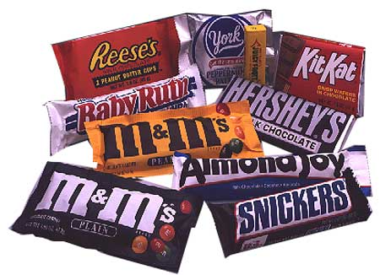
Example of FC
http://youtu.be/mP7qh6x4O9I
Notes:
Here is a video example of forward chaining.

Slide 7
Backwards Chaining (BC)
Train one step at a time
Instructor performs all steps in the TA for the student except the very last step – this step is trained to mastery.
Then, the instructor performs all but the last two steps in the TA – this step is trained to mastery…
Step 3 Train 1st
Step 2 Train 2nd
Step 1 Train 3rd
Notes:
Here are the steps for backward chaining. Notice how this differs from forward chaining.

Slide 8

Example of BC
http://youtu.be/LbBj4Tzi9CQ
Notes:
Here is a video example of backward chaining to teach the skill handwashing.

Slide 9
Total Task (TT)
Teach all steps of the TA each time you teach it
Continue until all steps are mastered
Step 1 Train 1st
Step 2 Train 1st
Step 3 Train 1st
Notes:
A common method is total task. A benefit of total task is students receive exposure to all steps in the task analysis during each teaching session.

Slide 10
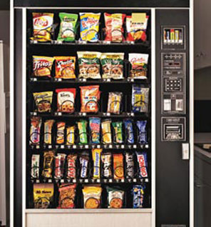
Example of TT
http://mast.ecu.edu/modules/ta/concept/
Notes:
Here is a video example of a student learning the steps to use a vending machine with total task instruction.

Slide 11
Your Turn
Work in a small group to develop a task analysis for performing a functional or academic task.
Demonstrate task analysis for the whole group
Describe the chaining procedure that would be used to teach the steps.

Slide 12

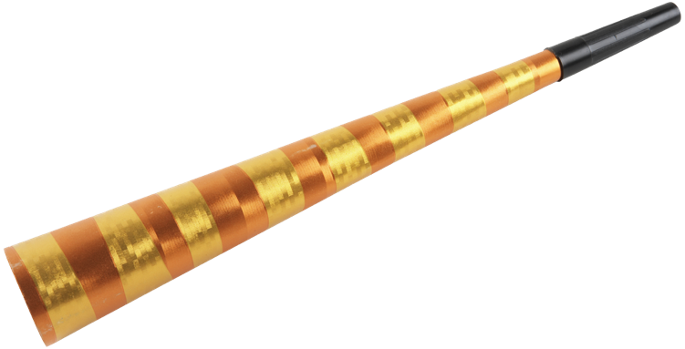

Prompting is from Principles of Applied Behavior Analysis
From principles of applied behavior analysis
  Basic principle is that every response is preceded by stimulus and followed by a consequence
    Reinforcer: a consequence that increases the recurrence of the response in the presence of this target stimulus
    The stimulus becomes a discriminative stimulus for making the response
Notes:
Now it is time to learn how to teach a skill, whether it is a single discrete skill or the steps of a task analysis (a chained skill). The basic principle of a stimulus, response, consequence contingency is critical to understanding the relationship between the stimuli and reinforcers we select and the student response. Responses are any observable, measurable behavior. We measure discrete, or singular, responses as performed independently correct, prompted correct, incorrect, or not performed at all (no response). Initially, we may need to provide prompts in addition to the stimulus to help students make a correct response. The goal is to fade these prompts over time so that students are making independent correct responses. Reinforcing every correct response, both independent correct and prompted correct, is very important. Choosing reinforcers that are desirable to each particular student is critical to the effectiveness of the reinforcer in promoting learning. The stimulus itself is not a prompt, but rather, the signal a teacher uses to let the student know it’s time to make a specific response. The stimulus might be a sight word flashcard, or the teacher giving a verbal directional cue, like “Pick up your tray.”

Slide 13
Learning Has Occurred…
When individual consistently makes a response in the presence of a specific, discriminative stimulus
This is called “stimulus control”
Notes:
Learning has occurred when the student is presented with a stimulus (e.g., the teacher says: “Read this word” and shows a sight word card) and the student reads “cat” without any help or prompting. The “be quiet” means we must give students an opportunity to perform the response independently in order to assess if learning has actually occurred. It can be tricky for teachers to withhold help, but it’s important to know what the students truly can and cannot do independently.

Slide 14
Discriminative Stimulus is the Cue to Respond
Examples
  Stimulus: “coat”
    Response: reads “coat”
  Stimulus: 3+3=
    A) 5
    B) 9
    C) 6
    Response: selects c)
  Stimulus: “Where do we get apples?”
    Response: “From a tree”
Note:
  In each of these examples, the student has an equal chance of being right or wrong…the stimulus or cue to respond in no way provides help with the answer
Notes:
The SD, or discriminative stimulus, is the cue for the student to respond. It’s what the student sees or hears that lets him know he is supposed to perform a certain skill. The SD does not provide any hints or help as to how to perform the skill or what the correct response actually is. It can be a question, asked verbally. It can be a flashcard the student needs to read. It can be an equation for the student to solve.

Slide 15
Add a Stimulus
If the target stimulus does not control the behavior, pair it with a stimulus that does to develop stimulus control
  This supplementary antecedent stimulus is a prompt
When shown cards with sight words and told, “find the word ‘coat’,” the student does not select ‘coat’
So something is added to the flash card and task direction
Notes:
If a student cannot perform a skill in the presence of the stimulus alone, prompts may be needed. Maybe the target behavior is for the student to write his name. Initially, the teacher would deliver the directional cue, “Write your name, Sam.” In order to write his name, Sam needed the teacher to first model how to write “S - a – m” using stamps and an ink pad. Eventually, by practicing several times following the teacher’s model, Sam learns to stamp his name without the model prompt. Now, when the teacher says, “Write your name, Sam,” Sam picks up the stamps and stamps his name independently. Learning has occurred, and the stimulus control has shifted from the prompt (the model) to the directional cue (“Write your name, Sam”). In the coat example on the slide, this prompt, or help, was added to the stimulus materials (the flash card).

Slide 16
Definition of a Prompt
Stimuli added to the target stimulus to help the student make the target response
Notes:
Prompts can be in many different forms, including verbal, modeling, pointing or gesturing, physical, or alterations made to a tangible target stimulus, like adding a picture of a target word on a word card.

Slide 17
Two Types of Prompts
Stimulus Prompts
Response Prompts
Embedded in the materials
  Color coding correct answer
  Position cue
  Making correct answer more salient (e.g., bold; larger font)
Provided by the teacher
  Tell student the student how to respond
    Verbal prompt
  Show the student how to respond
    Model prompt
  Guide the student to make the motor response
    Physical prompt
Notes:
Stimulus prompts are supports the teacher makes and adds to lesson materials. Response prompts are teacher behaviors that are delivered after the initial directional cue. For example, after providing the directional cue, “Show me the number 5,” the teacher can provide response prompts as needed.

Slide 18
Two Examples
Where do we find apples? (shows three pictures)
Where do we find apples? (shows three pictures)
Places picture of trees closer to student
  Position cue
Puts a red dot on the corner of the correct card
  Color coding
Has picture of tree with apples drawn on ‘trees’ card
  Picture cue
“On trees, point to the word ‘trees’”
  Verbal prompt
“On trees, this one; point like this”
  Models pointing to ‘trees’
“On trees, let me help you point”
  Guides student to point to ‘trees’
Notes:
Here are examples of stimulus prompts (on the left) and response prompts (on the right). What additional examples can you think of?

Slide 19
To Establish Stimulus Control (Show Learning), Prompts are Faded
Stimulus Prompt Fading
Response Prompt Fading
Make less salient across teaching trials
  The red dot becomes smaller and smaller on each trial
  The placement of the correct card is put closer to the other card on each trial
  Parts of the apple tree are erased on each trial
Time Delay
Least to Most Intrusive Prompting
Most to Least Intrusive Prompting
Notes:
If we continually help students (provide prompts), students may never be motivated to perform the skill independently. To prevent students from becoming dependent on prompts, we have to fade prompts. Fading stimulus prompts can be time consuming, as it often requires creating duplicate sets of materials with varying degrees of supports. There are several response prompt procedures that include guidelines for fading prompts in the instruction itself.

Slide 20
Time Delay
Pair the target stimulus with prompt
  E.g., Model correct answer immediately
    “Where do we find apples? On trees, this one..” (points to answer)
Add small increments of time to transfer stimulus control from prompt to target stimulus
    “Where do we find applies?” (Waits 4 seconds for student to anticipate correct response. If no answer, models correct response)
  When implemented correctly, can produce near errorless learning
Notes:
The first response prompt procedure we will discuss is called “Time Delay.” “Time Delay” refers to a specific set of instructional procedures. Sometimes this term is misused, confused with the concept of “time increment.” For instance, we may insert a 5-s increment of time between delivery of prompts. This time increment is not interchangeable with the procedures of “Time Delay.” The basic premise of the procedures for time delay is to initially pair a target stimulus with a prompt and eventually insert a small increment of time between the target stimulus and the prompt. This increment allows students a chance to answer independently if possible, but if students are not able to answer, the prompt will be provided quickly (following the predetermined delay increment).

Slide 21
Time Delay
Two types:
  Constant Time Delay
  Progressive Time Delay
ALL types start with zero-delay (0-s) trials
Only ONE response prompt is used
  This is called CONTROLLING PROMPT
Notes:
Prior to beginning time delay procedures, you must ensure you have identified a true controlling prompt. If the student is not able to successfully perform the skill after receiving the prompt, then a true controlling prompt has not been identified. Often a model prompt is selected as the controlling prompt, because most students are able to successfully perform most skills after given a clear model. Only one controlling prompt is selected and used when using time delay to teach a specific skill.

Slide 22
Steps for Time Delay
Directional cue (e.g., “Touch the word ‘cat’.”)
Delay (0-s or #-s)
  Constant Time Delay: Increment is always the same (e.g., 4-s)
  Progressive Time Delay: Delay time increases incrementally across sessions or trials (e.g., 2-s, 4-s, 6-s)
Prompt (e.g., “Here is ‘cat’.” Pointing. “Touch ‘cat’.”)
Reinforce (praise) OR error correction (prompt, student responds, no praise)
Example vide: http://youtu.be/CssFi6TbRFo
Notes:
Here are the specific steps for implementing time delay. Watch the video clip and identify each step of the procedures. Identify if this is constant or progressive time delay.

Slide 23
Prompt Hierarchies
Least to Most
Most to Least
Wait 3 seconds for independent response
If no response, give verbal prompt…wait 3 seconds
If no response, give model prompt…wait 3 seconds
If no response, physically guide correct
  Begins to make error on any step, interrupt and give next level prompt.
Physically guide on first trials of learning
After set number of trials, fade to model prompt
After set number of trials, fade to verbal prompt
After set number of trials, wait for independent response
Notes:
The last two response prompt procedures we will talk about can be described as prompt hierarchies. While time delay utilized only one prompt (the controlling prompt for a particular skill), these two prompting systems utilize a hierarchy of prompts. Hierarchies can be ordered from “least to most” intrusive or most to least” intrusive.

Slide 24
Least to Most steps
Teacher picks about 3 response prompts and orders them from least to most intrusive
  PRACTICE: Order these- physical, verbal, model
Select a delay interval (e.g., 4-s, 5-s)
First: provide directional cue
Second: wait for the specified delay (e.g., 4-s)
Third: praise (if correct within 4-s), OR if student does not respond, after 4-s, provide first prompt
Notes:
Prior to instruction, select three response prompts that a teacher can implement separately. Verbal – model – physical is how you would order these three types of prompts from least intrusive to most intrusive. Remember, a verbal prompt is NOT the same as a directional cue. This prompt is additional information that is told to the student that explains exactly how to perform a skill. The model prompt involves demonstrating the skill fully, and a physical prompt (the most intrusive type) involves physically guiding the student to perform the skill. The same delay interval will be used throughout instruction (e.g., 5-s between delivery of directional cue, then verbal cue, then model cue, and then physical cue, if needed). The student should receive praise for all independent or prompted correct responses. Prompted correct responses occur if the student performs the skill without an error, even if the student required the most intrusive prompt in the hierarchy. Remember to increase the intensity of the reinforcement based on the level of independence exhibited by the student. This differential reinforcement will help teach the student that it is most desirable to perform the skill independently.

Slide 25
Least to Most
Error Correction & Fading
What if student makes an error?
  Skip to most intrusive prompt (e.g., show or demonstrate the answer)
  Tell student to repeat response after you have modeled it
  Do not praise, even after student repeats response
The prompts are self-faded
  Students ability to respond dictates the level of prompt used; as student becomes better at the skill, less intrusive prompts are delivered (the teacher doesn’t decide when to fade prompts- this is based on the student’s own progress)
Notes:
At the beginning of each instructional session, and throughout the session as needed, tell the student not to guess if he or she does not know the answer. Instead, teach the student to wait for help if the answer is not known. It is important to prevent the student from making an error at possible. Instead, they should have repeated opportunities to perform the skill correctly, even if prompted, and receive reinforcement for performing the correct skill. The prompts in the least to most procedures are self-fading, which helps promote independent responses.

Slide 26
Most to Least steps
Teacher begins with the prompt that is most likely to result in a correct student response (e.g., physical prompt)
Over trials, less intrusive prompts are used (e.g., verbal prompt)
Notes:
Unlike the least to most, the most to least system begins with a controlling prompt. This may be a full physical prompt or a model prompt. The teacher will decide how many sessions to conduct using the controlling prompt before switching to the next level of prompting. This method is a good choice for motor skills that may be require maximum prompting upfront to avoid injury.

Slide 27
Fading Most to Least Prompts
Teacher decides before beginning instruction how many trials to conduct at each level of prompting
Review: How were prompts faded in a system of least prompts? Time delay?
Notes:
For example, a teacher might teach three sessions while delivering the controlling prompt (a model prompt) immediately after the directional cue. If the student is able to perform the skill across all three sessions, the teacher can drop to the next level of prompting for three sessions. Now the teacher provides the directional cue followed by a gestural or pointing prompt. If the student is able to perform the skill consistently at this level of prompting, the teacher can drop back to another level of prompting (e.g., a verbal prompt), and after another three sessions, the teacher can allow the student to perform the skill independently.

Slide 28
Two Important Points
Reinforcement
Error Correction
Praise student for making correct response with no more assistance than needed on prior trials
  e.g., If student can make response with verbal prompt, don’t praise waiting for a model prompt
In time delay, use small increments of time to discourage errors
  Correct any errors and remind student to wait for help if needed.
In prompt hierarchies, may correct error but try to interrupt and give next level prompt
Notes:
This slide reiterates the importance of promoting independent responses by delivering no more support or prompts than needed. It is important to know the students well and be clear about their present level of performance prior to teaching a skill.
If you anticipate an error, try and interrupt the error and provide the next level of prompting. If the student is reaching for an incorrect response, this interruption might be gently guiding the students hand to the correct response instead. Ideally, the student would only ever make the correct response, first after receiving prompting and over time, independently.

Slide 29
Learning Has Occurred…
Progress…
Transfer of stimulus control
Because learning can be slow, teachers may keep track of progress by noting movement from one prompt level to the next
  e.g., Did need physical guidance, now only needs a model
    1. M
    2. M
    3. M
From prompt to the target stimulus
  e.g., Student can now select correct answer with no teacher assistance
Notes:
It is important to keep detailed record of the prompting levels at which students perform the skill because this information is valuable for demonstrating progress. For students who have not yet progressed to responding after a model prompt, this shift, from needing physical prompts to needing model prompts, is a substantial accomplishment. While independent student responses are still the “gold standard” and represent true learning, progress across prompting levels should not be discredited.

Slide 30

What about Scaffolding?
Behaviorist would consider a verbal prompt hierarchy
New for this population…because new to academics
Where do we get apples?
  Let’s read the paragraph again (rereads paragraph)
  Let me read some key sentences (rereads sentences with correct answer)
  Listen to this sentence- “The apples came from an orchard of well established trees.”
Notes:
We can have hierarchies within a prompting level. Applying this concept to academics is a relatively new application for students with moderate and severe disabilities. For example, to teach listening comprehension of text, a teacher might deliver a least to most prompting system using various levels of verbal prompts. In this example, the first prompt, if needed, is a reread of the entire paragraph in which the answer is contained. After a delay, if needed, the next level of prompting is a reread of three sentences that contain the answer. The final prompt, if needed, is a reread of the target sentence. These are all types of verbal prompts. A final model prompt, in which the teacher points to and says the target response, could be delivered as the most intrusive level of prompting if needed.

Slide 31
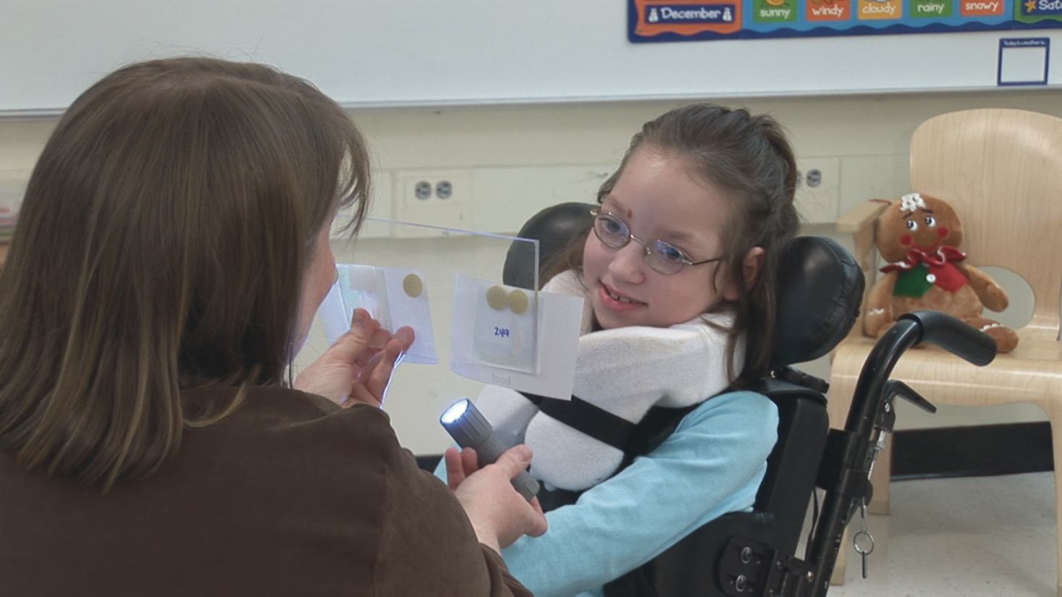
Five Ways to Eliminate Prompts
1. Change Response Mode
Define an active response the student CAN make; minimize the barrier of response mode
Permission to use photograph obtained from Attainment Company
Notes:
In picture to the right, the student is using eye gaze to respond. The teacher is using a stimulus prompt (flashlight) in this early stage of learning. She will fade this using time delay (by waiting longer for Sheila to make the response before adding the light).

Slide 32
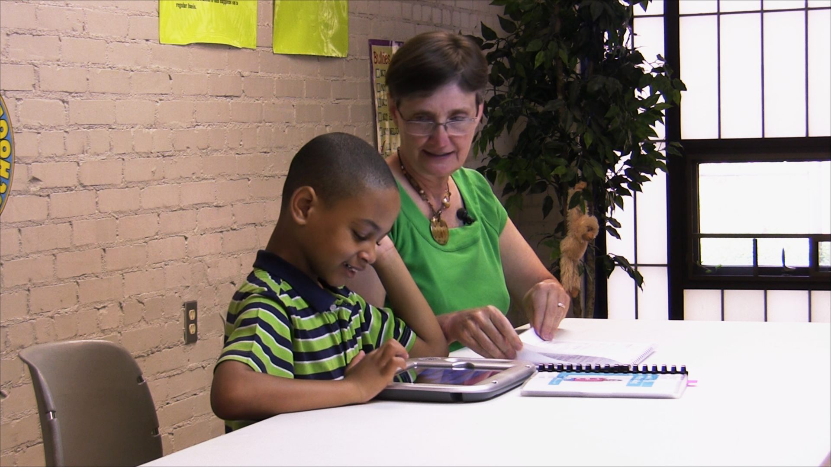
Five Ways to Eliminate Prompts
2. Assistive Technology
Use AT to remove barriers to responding
Permission to use photograph obtained from Attainment Company
Notes:
Carlos has autism and his vocal responding is traditionally echolaliac. Carlos is learning to use a communication app on an iPad to voice phonemes and read connected text. His teacher is using time delay to teach him to identify phonemes and blend and segment sounds that he could not voice on his own.

Slide 33
Five Ways to Eliminate Prompts
3. Use Prompt Fading
Response Prompts (Teacher delivers during instruction)
Stimulus prompts (embedded in the materials)
Use time delay or a prompt hierarchy to fade teacher response prompts
Reduce salience of any stimulus prompts across teaching trials
Notes:
Teachers need to plan for prompt fading when initially designing instruction. Prompts fading may depend on student progress, but the understanding that prompts may need to be intentionally faded is something teachers should articulate in their lesson plans.

Slide 34
Five Ways to Eliminate Prompts
4. Use Differential Reinforcement
Reinforce students for responding without teacher assistance during instruction
  Ms. Williams praised correct responses with our without prompts, but when a student made a correct response without help, she gave the student a “high five” and an enthusiastic “Wow! By yourself!”
  Mr. Thomas recognized responses made without teacher help by giving students tokens for each unprompted correct; at the end of the lesson enough tokens earned the leisure material of choice
Notes:
Initially, you may need to fully praise all correct responses. Quickly fade to differential reinforcement, in which independent correct responses receive the greatest level of praise. Make it more desirable to perform a skill independently than with prompting.

Slide 35
Five Ways to Eliminate Prompts
5. Increase the Delay
Wait longer for an independent response before giving the prompt
  In the beginning the teacher may also need to let the student know why s/he is waiting
    “You try it…”
Notes:
Progressive time delay is based on this concept. Time increments gradually increase across trials or sessions.

Slide 36
Prompt Confusion
The task direction is not a prompt
  “Read the word” is NOT a verbal prompt; it’s the cue to respond
Support to get student ready to respond is not a prompt
  Placing students hands above all answers so can slide hand to correct card is NOT a physical prompt
Notes:
Remember the basic contingency of stimulus, response, consequence. The stimulus is the task direction, or directional cue. Prompts are either added to the stimulus (stimulus prompts) or inserted in tandem with or after the delivery of the stimulus (response prompts). These prompts are intended to promote a high level of correct responses and help the student avoid making an error.
It is critical to ensure the student is ready to receive instruction. A new way to think about the structure of the contingency is: get student’s attention, provide stimulus, wait for student response, provide reinforcement. The act of obtaining student attention (e.g., saying, “Look” or “Time to work” or “Are you ready” and saying the student’s name) is not a prompt. This is just a way to set the stage for learning to occur.

Slide 37
Prompts and Research
The standard for showing learning in research with students with moderate and severe developmental disabilities is unprompted correct responses
  Typically only independent correct responses are graphed
  Sometimes researchers will also graph prompted responses to show how prompted responses decreased as independent responses increased
Notes:
Even though it’s good practice for teachers (and researchers) to document or code the exact level of prompting needed for the student to respond correctly, researchers typically only graph independent student responses.

Slide 38
How Much Learning
Although the standard for research is responding without prompting for showing skill acquisition in research, the amount of learning may be small and occur after extended instruction (e.g., months)
  For example
    Naming five sight words
    Counting out dollars up to 10

Slide 39
FINAL THOUGHT
Can we infer student learning?
YES...equal opportunity for student to be right or wrong
SOMEWHAT
Using an alternative response mode (e.g., eye gaze)
Using assistive technology
Support to get ready to respond (e.g., moving hands onto the table; better positioning in chair)
Universal design of test materials
Giving a direction to make a response (e.g., “show me the answer”)
Measuring simpler, smaller responses
Partially faded stimulus prompt
Verbal direction; model
NO
Full physical guidance
Notes:
Teachers should plan for fading prompts when designing instruction. Giving a student the opportunity to answer independently gives a student an opportunity to demonstrate learning and promote self-determination skills.

