Slide 1
Collaboration for Effective Educator Development, Accountability, and Reform
Course Enhancement Module on Evidence-Based Behavioral Interventions: Part 4 (Identifying and Monitoring a Target Behavior for Intensive Intervention)
H325A120003
Notes:
Part 4 of the CEEDAR Course Enhancement Module on Evidence-Based Behavioral Interventions focuses on identifying and monitoring a target behavior for the purpose of designing and evaluating intensive, individualized interventions. Part 5 will address the design and implementation of intensive intervention. While all educators should have some knowledge of the content in these sections, those who provide intensive behavioral intervention will need more in-depth knowledge and practice in application.
Part 4 builds on the content presented in the previous three parts of the module. In particular, the audience should be familiar with the ABCs of behavior (Part 1) and progress monitoring (Part 3).
Speaker notes are provided for most of the PowerPoint slides included in each of the five parts of this CEM. The notes provide additional details about the information presented in a particular slide, including the context for the information being presented as well as further elaboration of key points being discussed. Thus, the speaker notes are intended as a guide for a presenter who is using the PowerPoint slides and may be modified as needed.
Instructions for using the speaker notes
Text formatted in standard font is a sample script for the presenter. While these may be read verbatim, speaker notes are intended as a guide for the presenter and may be modified as needed.
Text formatted in italics is intended as directions or notes for the facilitator; italicized text is not meant to be read aloud.

Slide 2
Part 4: Identifying and Monitoring a Target Behavior for Intensive Intervention
Introduction to Data-Based Individualization
Gathering Information on Behavior
Identifying Target Behaviors
Progress Monitoring Target Behaviors
Case Study: Progress Monitoring Jeff’s Target Behaviors
Additional Resources
Notes:
Review slide.

Slide 3
Note
Part 4 of this module uses content and resources from
The National Center on Intensive Intervention (NCII) www.intensiveintervention.org
Direct Behavior Ratings (DBR) www.directbehaviorratings.com
OSEP Technical Assistance Center on Positive Behavioral Interventions and Supports (PBIS) www.pbis.org
Notes:
Additional resources can be found on these websites, as well as other sources cited throughout this presentation.

Slide 4
Intensive Intervention
Intensive intervention is designed to address severe and persistent learning or behavior difficulties.
Intensive behavioral interventions should be
Driven by data
Characterized by increased intensity and individualization
Notes:
Intensive interventions are usually reserved for students who have not sufficiently responded to universal and supplemental supports.

Slide 5
Individual/Intensive:
Specialized
Individualized
Systems for Students With High-Risk Behavior
CONTINUUM OF
SCHOOLWIDE
INSTRUCTIONAL AND
POSITIVE BEHAVIOR
SUPPORT
(PBIS.org)
~5%
Supplemental: Specialized Systems for Students With At-Risk Behavior
~15%
Universal:
School/Classroom-
Wide Systems for
All Students,
Staff, and Settings
~80% of Students
Notes:
In a three-tiered model of support, intensive behavioral intervention would fall in Tier 3. Because individualized intervention is too intensive to provide to all students, it is reserved for the small percentage of students whose needs can not be met with universal and supplementation supports (Tiers 1 and 2).
Part 2 covers the PBIS framework and universal supports. Part 3 addresses supplemental interventions. Parts 4 and 5 focus on intensive intervention. Part 4 focuses on the target behaviors that allow for data-based individualization of supports.

Slide 6
Target Behavior
The target behavior is the behavior we want the intervention to change.
The function of the target behavior guides intervention planning
The target behavior is tracked to monitor the student’s progress
By planning based on an individually selected target behavior, we take individual differences into account and make sure the intervention is working for a given student.
Notes:
At the intensive level, it is crucial to first identify the individual student’s target behavior or behaviors so that we can understand behavior concerns in greater depth. Understanding the ABCs of this behavior (see Part 1) will help us determine the behavior’s function and plan an intervention (to be covered in Part 5). This target behavior can also be monitored so we know if the intervention is working for the student.

Slide 7
Introduction to Data-Based Individualization: The Role of Target Behaviors in Intensive Intervention
Notes:
In this section, we will provide a brief overview of the role of target behaviors in data-based individualization---a framework for providing intensive intervention.

Slide 8
Data-Based Individualization (DBI)
DBI is a systematic method for using data to determine when and how to intensify intervention.
See the DBI training series and other resources from the National Center on Intensive Intervention (NCII) at: http://www.intensiveintervention.org/content/dbi-training-series
Notes:
We’ll talk about this more in Part 5 of the module, which focuses on intensive behavioral intervention.

Slide 9
DBI Steps
Deliver the secondary (supplemental) intervention program with greater intensity
Monitor progress
Perform diagnostic assessments
Adapt the intervention
Continue progress monitoring, adapting the intervention when needed to ensure adequate progress
Notes:
Throughout the DBI process, we use progress monitoring data to evaluate a student’s response to intervention, moving to the next component as needed:
We usually begin by intensifying the supplemental intervention already being used. This intervention should be evidence based (see Part 3).
Progress monitoring data are used to evaluate the student’s response to the intensified intervention. If the student is still not showing enough progress, we need to collect more information on the student’s current skills and needs.
Informal diagnostic assessment data are used to identify skill deficits and the function of the problem behavior.
Based on these identified needs, we may choose to adapt the current intervention or try a new intervention.
We continue monitoring progress, making intervention changes as needed.

Slide 10
Target Behaviors in the DBI Process
Progress monitor the target behavior to determine when the intervention needs to be modified.
Perform diagnostic assessments to determine the function of the behavior, which guides modifications (intervention is individualized to meet student needs).
Notes:
See part 3 for information on selecting evidence-based supplemental interventions. Part 5 will talk about making evidence-based intervention adaptations aligned to function to provide individualized, intensive intervention.

Slide 11
Problem Solving for Behavior
Identify target behavior(s)
Hypothesize function of behavior(s)
Develop function-based behavior intervention plan
Monitor student progress and plan implementation
Notes:
Animated slide. Click to bring up the arrows:
Once we identify a target behavior…
We hypothesize its function to inform…
Intervention planning. We then…
Monitor changes in that behavior to see if the intervention is working for that student. If it’s not working, we may need to revisit an earlier step in the problem-solving process.

Slide 12
Introducing a Collaborative Problem-Solving Team
A problem-solving or behavior support team should meet to review data to
Consider behavior across settings
Pool expertise
Notes:
Different team members may play different roles, such as helping to understand the problem behavior, designing the intervention, implementing the intervention, and tracking behavior to monitor progress.

Slide 13
Representative Team
Consider including
The student’s teacher(s)
Specialists (e.g., counselor, school psychologist, social worker, behavior analyst)
Special education teacher(s), when appropriate
Administrator(s) and other school staff
Family
Student
Notes:
Team composition may vary depending on the situation, but we always need at least one person with expertise in behavior. Most of all, we need a breadth and depth of knowledge of the student and the behaviors of concern across relevant settings.

Slide 14
First Team Task: Identify the Problem
How is the student’s current behavior different from what we expect to see?
Unacceptable behavior(s)
Failure to perform the expected behavior(s)
What is our target behavior for intervention and progress monitoring?
Does a disability or other factor impact the student’s ability to perform the expected behavior, or their likelihood of performing that behavior?
Notes:
Many students with intensive needs display clear “problem” behaviors that are not acceptable in the school setting. They may be disruptive or even dangerous and they may interfere with learning. At other times, the concern may be that the student is NOT doing something, such as not attending class, not turning in homework, or not interacting with peers.
The current situation of concern may encompass many behaviors, but we need to select no more than a few target behaviors to try and change through intervention. Selecting too many behaviors may make it harder to determine function and plan intervention, and it will make it more difficult to monitor progress. We will talk more about the importance of prioritizing target behaviors.

Slide 15
Steps for Identifying Target Behaviors
Identify behavior(s) of concern
Prioritize target behavior(s)
Define the target behavior(s)
Notes:
Soon, we will go over each of these steps, but first we want to talk about ways to learn more about an individual student’s behavior.

Slide 16
Gathering Information on Student Behavior
Notes:
This section discusses methods for gathering information on student behavior. This information will help us identify a target behavior, and it will inform later parts of intervention planning, covered in Part 5.

Slide 17
What Do We Need to Know About Behavior?
Key features of the behavior:
What does it look like?
How long does it last?
How frequently does it occur?
How intense is it?
Context(s) of occurrence
Notes:
Key features help us describe and define behaviors. They may also help us prioritize among potential target behaviors. Information on the context in which the behavior is more or less likely to occur will later help us determine the behavior’s function.

Slide 18
Why Do We Want to Know?
We want to
Determine which behaviors of concern are the most meaningful targets for change
Clearly define the behavior for reliable progress monitoring
Some methods used to identify the target behavior may also provide preliminary information on function.
Notes:
The function of behavior will guide intervention planning, as we will discuss in Part 5.

Slide 19
Data Collection Methods
Information on potential target behaviors may be gathered
Retrospectively
Checklists
Questionnaires/interviews
In real time or soon after the event
Anecdotal reports
Direct observation
Notes:
Multiple sources of information can be considered in order to make a stronger decision. Some of these methods will also help us develop a functional hypothesis.
Different methods may be completed by different educators, or even parents or students, depending on their knowledge of behavior and the student.

Slide 20
Checklists
Help identify and describe behaviors
Allow you to select from among many specific behaviors, often sorted into broader categories of behavior
Identify areas of need or describe risk status (if you are using a commercial product that offers this option)
Notes:
Checklists may be particularly helpful when we are first identifying all the behaviors of concern before prioritizing the target behaviors we will monitor. Some established rating scales ask teachers about specific behaviors to identify areas of concern (such as hyperactivity) and may also provide a risk status or compare a student’s behavior to national peer norms. Some commercial checklists come in different versions for teachers, parents, and students.

Slide 21
Questionnaires/Interviews
These are used to gather information from school personnel who commonly interact with the student in order to
Clarify the reason for referral
Obtain a description of the behavior
Search for antecedents and consequences that may maintain the behavior of concern
Handout #9: Target Behavior Questionnaire
Notes:
Review the questions in the handout.
The sample questionnaire in Handout #9 begins with questions that can help with problem identification. Later questions could help with preliminary ABC analysis. The last question can help a team prioritize behaviors.
When we talk about functional assessments of behavior in Part 5, we’ll look at a longer, more detailed interview form.

Slide 22
Anecdotal Reports
Provide the ABCs for each event:
Behavior frequency, duration, and intensity
Preliminary information on antecedents and consequences
Use narrative and checklist formats
Handout #10: ABC Anecdotal Report
Handout # 11: ABC Checklist
Notes:
Anecdotal reports can serve a dual purpose. By recording the key features of the behavior each time it occurs, we can get information that can help us prioritize target behaviors according to frequency, duration, and intensity. Since these forms also include information on setting, antecedents, and consequences for each event, we can look for patterns that might help us hypothesize the behavior’s function during the functional behavior assessment (FBA).
The ABC Anecdotal Report provides a template for recording ABC information about each occurrence of the behavior. Review this form.
NCII’s ABC Checklist shows how anecdotal reports can incorporate a checklist format to allow quicker recording of the ABCs. This may work best when the student’s ABCs are fairly common, or when you know a student well enough to make a customized checklist for his or her common ABCs.

Slide 23
Systematic Direct Observation
Is considered the “gold standard,” because it offers a direct representation of a student’s behavior (the observer systematically records behavior as it occurs)
Can be
Event-based
Time-based
Is the most intensive method of progress monitoring in terms of the staff qualifications and time commitment it requires
Notes:
Examples of event-based methods include frequency, duration, and latency. Time-based methods include whole interval, partial interval, and momentary time sampling.
Because these methods require careful observation for a period of time, they are time and labor intensive. They also require more training than other methods. School psychologists and other behavior specialists may need to be called in. For these reasons, you probably only want to do this as needed. It may be a great source of information for defining a problem and developing a hypothesis, but it is probably not feasible for frequent progress monitoring. We’ll talk more about this later.

Slide 24
Who Collects This Information?
We want information from people who know the student best:
The student
The student’s teacher or other school staff
The parent(s)
Trained specialists (e.g., the school psychologist or a behavior specialist) may be needed to interpret results or conduct systematic direct observations.
Notes:
There are many ways to get information directly from those people who best know the student. Anecdotal reports may be simple enough for the teacher to complete. Questionnaires, interviews, and checklists or rating scales are all good ways to get information from school staff and, when appropriate, the parent or even the student. School leaders should think about who among their staff is qualified to conduct interviews and interpret results. Some standardized rating scales will need to be scored by someone familiar with that tool.
When the most reliable and detailed information is needed, we turn to systematic direct observations. A classroom teacher cannot do this while also instructing, so a trained observer will need to visit the classroom. To save time on these observations, use the information from other methods to identify the best times and settings to observe.

Slide 25
Integrate Information
Not all methods need to be used, but you can use more than one.
During the team meeting, review all available data sources to look for patterns or inconsistencies.
Notes:
Review slide.

Slide 26
Identifying Target Behaviors
Notes:
This section describes the process used to identify behaviors of concern, prioritize one or a few target behaviors, and define target behaviors in objective, measurable terms.

Slide 27
Identify Target Behavior(s)
Identify behavior(s) of concern
Prioritize target behavior(s)
Define the target behavior(s)
Identify target behavior(s)
Hypothesize function of behavior(s)
Develop function-based behavior intervention plan
Monitor student progress and plan implementation
Notes:
Now that we’ve looked at ways to gather behavioral information, let’s look back at our steps for identifying target behaviors.

Slide 28
Identify Behaviors of Concern
Generate a list of potential target behaviors:
Using teacher reports/interviews
In a team meeting
Focus on measurable behaviors:
Behaviors that are objectively observable
Behaviors that are quantifiable (e.g., you can record frequency, latency, or duration)
Notes:
When we talk about defining the problem, we’ll go into more detail about making good, observable, measureable behavior definitions. For now, try to avoid vague behaviors like “bad attitude” and think about behaviors we could ultimately use for progress monitoring.

Slide 29
Why Prioritize?
Data collection will be more feasible
Data analysis will be more efficient
Intervention decisions will be
Made more quickly
Based on the most important behavior(s) for a given student
Notes:
If we have many behaviors of concern, why can’t we address them all at once? If we have too many target behaviors, it will not be practical to collect enough data on them all for either initial planning or progress monitoring.

Slide 30
Prioritizing Target Behavior(s)
Does the behavior
Present a danger to the student or others?
Interfere with learning?
Occur frequently?
Limit the student’s access to positive attention?
What is school success for this student at this time? Consider academic, social, and functional goals.
Notes:
Select target behaviors that are most important for school success.

Slide 31
Discussion
Do you think some questions or considerations from the previous slide are particularly relevant?
How might they vary by student or situation?
How might different people answer the same questions differently?
Different teachers or staff
Parents
Students
Notes:
Activity Directions - Depending on the size of the group, start the discussion in pairs or small groups before sharing out as a whole group. Chose one person to be the note taker and one person who will be the reporter to report out to the whole group.
Possible talking points include:
How might this vary?
Danger: The same behavior may be more or less dangerous depending on different students’ age/ size/ strength.
Learning: Age/grade may impact which behaviors most interfere with school success.
Frequency: Particularly intense or dangerous behaviors may be a higher priority than more frequent behaviors that are less dangerous or interfering.
Positive attention: Some students will not be motivated by increased positive attention, so it would not increase a behavior’s priority.
Different responses:
Parents or students might have different priorities than educators regarding what behaviors are most important for the student’s success.
Different rates of the behavior in different settings, including with different people present, will influence how often a teacher or parent sees a potential target behavior, if at all.
The same behavior may be more or less disruptive or dangerous depending on the setting.
Positive attention may be more available in certain settings or may be more likely to be provided by certain staff members.

Slide 32
Define the Target Behavior
Use objective language referring only to observable characteristics of the behavior.
Delineate the boundaries of what the behavior does and does not include.
Allow for the behavior to be readily measured by different observers.
Notes:
Now that we’ve identified our target behaviors, we must define them.

Slide 33
Objective, Observable Language
Ambiguous
Observable
Hits
Looks
Pokes
Raises hand
Seated
Takes
Requests
Apathetic
Aggressive
Bad attitude
Defiant
Hyperactive
Lazy
Unmotivated
Notes:
Review slide.

Slide 34
Delineate Boundaries
Behavior | Examples | Non-Examples
Kicks | The student extends his/her leg toward another person with the intent to injure or harm. | The student extends his/her leg for stretching or play.
Calls out | The student makes verbal statements during instructional tasks that were not prompted by a question or not focused on the academic material. | The student makes an incorrect choral response or asks questions about an assignment.
Notes:
Review slide.

Slide 35
Improving Definitions
Bad | Better | Best
Rick loses control. | Rick cries and tantrums. | Rick cries, flops to the floor, kicks his feet, pounds his fists on the floor, and/or grabs at objects.
Tara is disruptive. | Tara makes inappropriate comments during class. | Tara curses at the teacher or her peers, talks excessively about unrelated tasks/work, or insults her peers during class.
Robin has been acting withdrawn. | Robin is not engaging with her peers. | Robin sits quietly by herself at her desk and does not speak with other students, even those who approach her to engage.
Notes:
Review slide.

Slide 36
Practice
What target behavior definitions might fit the broad, ambiguous concern that “Lisa is rude”?
Lisa interrupts other speakers without raising her hand or otherwise requesting a turn to speak.
Lisa takes objects that others are using without asking.
Lisa makes noises during class that interfere with others’ ability to attend to instruction.
Notes:
Animated slide. Click to bring up sample definitions.
First, pose the question and give the audience time to think of examples, perhaps by discussing the question in small groups. Share the examples on the slide and allow the audience to share other examples.

Slide 37
Activity
List examples of possible target behaviors for the following broad, ambiguous behaviors:
Aggressive
Defiant
Lazy
Unmotivated
Hyperactive
Notes:
Purpose of the activity - Help participants describe/clarify ambiguous target behaviors so that they can be objectively defined and measured.
Directions for the activity –
Divide the participants into five table groups.
Assign each group one of the ambiguous target behaviors listed on the slide.
Give each table group a piece of chart paper and markers.
Groups should define and generate as many examples of the targeted behavior as possible using words, pictures, and phrases that illustrate the behavior being as specific as possible. Encourage groups to be creative in their presentation.
When all groups are finished, give each group an opportunity to share their work. See if other group members can add other examples.
Display the charts around the room for participants to review during break or lunch.
Pulling it all together – Charts can serve as a model for participants to remind them to be as specific and concise as possible when describing student behavior(s).

Slide 38
Progress Monitoring Target Behaviors
Notes:
While progress monitoring was introduced in Part 3, this section focuses on progress monitoring using a student’s individually selected target behaviors. We will discuss general considerations as well as potential methods and tools for progress monitoring.

Slide 39
Target Behaviors Inform All Steps in the Problem-Solving Process
Identify target behavior(s)
Hypothesize function of behavior(s)
Develop function-based behavior intervention plan
Monitor student progress and plan implementation
Notes:
Now that we’ve defined our target behavior, how do we measure it? We’ll need this for progress monitoring.
We’ll talk about functional hypotheses and intervention planning in Part 5.

Slide 40
What Is Progress Monitoring for Intensive Interventions?
NCII defines behavioral progress monitoring as repeated measurement of the targeted behavior for the purpose of helping educators determine the effectiveness of intervention programs for students in Grades K–12 who have intensive social, emotional, or behavioral needs.
Notes:
Review slide.

Slide 41
How Often Should We Monitor Progress?
For monitoring intensive interventions, NCII recommends collecting progress monitoring data at least every 20 days—or more frequently depending on the construct—to evaluate whether the student’s progress is adequate to meet their long-term behavioral goal.
Notes:
Some types of behavior progress monitoring data can easily be collected much more frequently than every 20 days. Simple rating scales may be used weekly, daily, or even every class period. Any kind of point system associated with a behavioral intervention will yield data every time the intervention is implemented (e.g., see examples of Check In Check Out cards in Parts 3 and 4). If we are monitoring the frequency of behavior, we will collect data whenever the behavior occurs and review the counts regularly.

Slide 42
Progress Monitoring Tools
These tools
Accurately reflect student behavior
Can be used repeatedly
Are sensitive to change
Help guide decisions about behavioral intervention
Notes:
Review slide.

Slide 43
NCII Behavioral Progress Monitoring Tools Chart
Tool developers voluntarily submit evidence to the Technical Review Committee. (This is not an exhaustive list of tools.)
Tools are rated against a set of standards, rather than being compared with each other.
Notes:
Review slide.

Slide 44
NCII Behavioral Progress Monitoring Tools Chart
Ratings on
Technical Standards
Psychometric Standards
Progress Monitoring Standards
Data-Based Individualization Standards
Usability
Notes:
Review slide.

Slide 45
NCII Behavioral Progress Monitoring Tools Chart
http://www.intensiveintervention.org/chart/behavioral-progress-monitoring-tools
Notes:
This screenshot was taken 3/21/2014; the tools chart will be updated in the summer of 2014.
We recommend a live demo; click on a tool or rating bubble for more information.
Note that the tool chart includes information on Direct Behavior Rating—a tool we will discuss in this section.

Slide 46
Developing a Measurement Approach
Initial considerations:
How often will data be collected?
This relates to the intensity of the behavior and the timelines for making intervention decisions
When, where, and by whom will data be collected?
When and how will the data be entered to allow for evaluation?
Notes:
Before we discuss specific methods to measure the target behavior, we should discuss general considerations for creating a progress monitoring plan. Recall that progress monitoring for students in need of individualized behavioral interventions requires data to be collected more often than for less intensive interventions. The teacher and school team must consider the most appropriate schedule. Is daily assessment needed, or is weekly assessment enough? The frequency should reflect the intensity of the behavior and the timelines for making intervention decisions.
Other questions to consider relate to who will collect the data, at what times, and in what context(s). The answers to these questions will depend on the selected target behavior and the student’s behavioral patterns.
Finally, it is necessary to design the procedures for ensuring the data are entered for evaluation.

Slide 47
Progress Monitoring Methods
Systematic Direct Observation
Direct Behavior Rating (DBR)
Notes:
We will review two behavioral assessment methods that can be used for progress monitoring.

Slide 48
Systematic Direct Observation (SDO)
Observable dimensions of behavior include
Frequency
Rate
Duration
Latency
Intensity
Notes:
Frequency: The number of times the behavior occurs.
Rate: The number of times it occurs within a given time period (e.g., 10 times per hour).
Duration: How long the behavior lasts.
Latency: The temporal relation of the behavior to other events (e.g., time to respond).
Intensity: The the magnitude or strength of the behavior.

Slide 49
Practice Activity
What dimension would you use for each of the following behaviors?
Kyle raising his hand
Sara completing the task
Brad following directions upon request
Bonnie engaging in positive social interactions during recess
Notes:
Purpose of the activity – To practice identifying the observable dimensions for behaviors
Directions for the activity
Look at the sample behaviors listed on the slide.
As a group, write down at least one dimension that could be used to measure each behavior. Give each table group time to reflect and answer. As soon as the table group has come to consensus, everyone at that table group stands up. As soon as all groups are standing, call on the table group finished first to give their answer.
See if the other groups agree. If they don’t, have a class discussion and come to consensus.
Proceed in the same way with the other behaviors listed on the slide.
See possible answers below.
Possible answers:
Kyle: Frequency or rate
Sara: Percentage of tasks completed, frequency (assignments submitted)
Brad: Latency (from the time of the request to the execution of the task), percentage of requests
Bonnie: Frequency or rate

Slide 50
SDO Strengths
Observation data are a direct representation of the behavior.
Direct observation is applicable to a wide range of observable behaviors.
Adaptable procedures can measure various dimensions of behavior.
Notes:
Systematic direct observation offers several advantages. First, the data collected are closely aligned with the behavior being observed. Another advantage is its flexibility for collecting data on a wide range of behaviors. Virtually all behavior that can be seen can be the subject of direct observation techniques. Lastly, a wide range of procedures is available for collecting data. These methods can be readily adapted to allow behavior data to be collected along various dimensions and for a variety of purposes.

Slide 51
Limitations of SDO for Progress Monitoring
Time-intensive
May require a trained observer
Can be difficult to implement if the observer must perform other duties at the same time, such as teaching
Notes:
While systematic direct observation can provide very strong and useful data, these methods are often time intensive and difficult to implement, particularly within the context of busy school classrooms. Because of the difficulty of having to attend to instruction, behavior management, and data collection (not to mention a whole host of other issues!), the primary advantage of systematic direct observation—that the method provides a direct index of behavior—might be lost. Moreover, if the method is not feasible and requires too much effort, it is not likely to be used. This would result in no progress monitoring data and no opportunity for data-based individualization.
These limitations do not mean that SDO should never be used—it is often an important part of understanding student behavior and collecting baseline data. However, for the purpose of progress monitoring, it is often too intensive for a teacher to consistently collect SDO data during instruction, and it is rarely feasible for an external observer to help frequently over an extended period of time.

Slide 52
SDO Lessons
Align the method with the target behavior. Think about
The definition of the behavior
The dimension you want to track
Ensure the data collection method is feasible to implement
Notes:
Despite these limitations, there are some important lessons to be learned from direct observation techniques. The primary advantage of this method is that it provides a direct reflection of the behavior. We want our data to provide accurate information on the chosen dimension of our clearly defined target behavior. For example, if the behavior of concern is desk flips during math, we need to choose a data collection method that tracks how often the behavior occurs (the frequency or rate). Work refusal might be considered in terms of the percentage of work requests the student refuses, or we might want to know how long the student spent refusing to do work (duration). The final consideration is feasibility. If a strong method is too difficult to sustain, it will not be useful for progress monitoring.

Slide 53
Direct Behavior Rating (DBR)
Allows teachers to reliably and accurately rate student behavior on a continuum after a specified period of time has elapsed (e.g., math class)
Can be used to measure general outcomes or individualized target behaviors
www.directbehaviorratings.com
Notes:
Fortunately, there is an alternative method to the often burdensome direct observation approach. Direct Behavior Rating (DBR) can be adapted to focus on a range of target behaviors while also providing an opportunity to measure broader, more general outcomes. The premise of DBR is that teachers can reliably and accurately rate student behavior on a continuum after a specified period of time. These ratings are then used to monitor student progress.
DBR can also be completed by the student, the parents, or others who directly observe the student. Multiple versions of DBR forms are available on the DBR website.

Slide 54
DBR Standard Behaviors
School Success
Academically Engaged
Non-Disruptive
Respectful
Permission for using the DBR form as part of this module has been granted by the authors for educational purposes only (Chafouleas, Riley-Tillman, Christ, & Sugai, 2009).
www.directbehaviorratings.org
Direct Behavior Rating (DBR) Form: 3 Standard Behaviors available from www.directbehaviorratings.org
Notes:
Refer to Direct Behavior Rating (DBR) Form: 3 Standard Behaviors, available for download from http://www.directbehaviorratings.org/cms/files/pdf/V%201.4%20DBR%20Standard%20Form%20with%203%20Standard%20Behaviors.pdf
DBR can be used with three pre-defined, standard behaviors: (a) academically engaged behavior; (b) non-disruptive behavior (looking for reduced occurrence of disruptive behavior); and (c) respectful behavior. These are broader behaviors that are needed for successful school functioning. We will consider the application of these examples and then discuss how to incorporate students’ individualized target behaviors into the instrument.

Slide 55
DBR: Academic Engagement
Active or passive participation in the classroom activity
Examples include writing, raising a hand, answering a question, talking about a lesson, listening to the teacher, reading silently, and looking at instructional materials
(Chafouleas, Riley-Tillman, Christ, & Sugai, 2009)
Notes:
Review slide.

Slide 56
Academic Engagement Example
Academically Engaged
Place a mark along the line that best reflects the percentage of total time the student was academically engaged during math today.
Interpretation: The teacher estimated that the student displayed academically engaged behavior during 60 percent of large-group mathematics instruction today.
Slide adapted from Chafouleas (2011) with permission.
Notes:
Animated slide. Click to bring up Interpretation.

Slide 57
DBR: Respectful
Compliant and polite behavior in response to adult direction and/or interactions with peers and adults
Examples include following the teacher’s direction, engaging in prosocial peer interactions, responding positively to an adult’s request, and engaging in verbal or physical disruption without a negative tone/connotation
(Chafouleas, Riley-Tillman, Christ, & Sugai, 2009)
Notes:
Review slide.

Slide 58
Respectful Example
Respectful
Place a mark along the line that best reflects the percentage of total time the student was respectful during language arts today.
Interpretation: The teacher estimated that the student displayed respectful behavior for 80 percent of whole-class language arts today.
Slide adapted from Chafouleas (2011) with permission.
Notes:
Animated slide. Click to bring up Interpretation.

Slide 59
DBR: Disruptive
A student action that interrupts regular school or classroom activity
Examples include being out of their seat, fidgeting, playing with objects, acting aggressively, and talking/yelling about things that are unrelated to classroom instruction
(Chafouleas, Riley-Tillman, Christ, & Sugai, 2009)
Notes:
Review slide.

Slide 60
Disruptive Example
Disruptive
Place a mark along the line that best reflects the percentage of total time the student was disruptive during small-group science today.
Interpretation: The teacher estimated that the student displayed disruptive behavior during 30 percent of small-group science instruction today.
Slide adapted from Chafouleas (2011) with permission.
Notes:
Animated slide. Click to bring up Interpretation.

Slide 61
DBR Standard Item Takeaways
All standard item behaviors are defined clearly.
Examples are provided for what constitutes the behavior.
All behaviors can be readily measured, and interpretations for responses are stated clearly.
Notes:
Review slide.

Slide 62
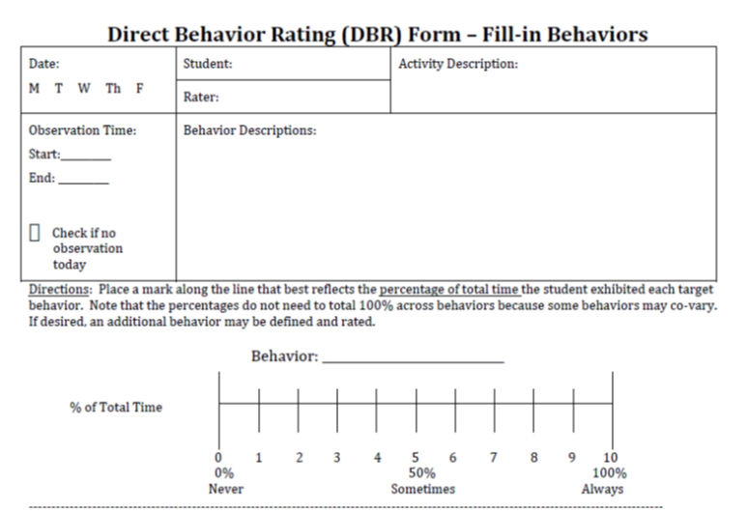
DBR Fill-In Behaviors
Use DBR to track a student’s individualized target behavior.
Individualized target behaviors can be combined with standard DBR behaviors.
Direct Behavior Rating (DBR) Form – Fill-in Behaviors available from www.directbehaviorratings.org
(Chafouleas, Riley-Tillman, & Christ, 2010)
Notes:
Provide or reference Direct Behavior Rating (DBR) Form – Fill-in Behaviors (V 1.3 DBR Standard Form – Fill-in Behaviors), available for download from http://www.directbehaviorratings.org/cms/files//pdf/V%201.3%20DBR%20Standard%20Form%20-%20Fill-in%20Behaviors.pdf
The standard DBR items are useful for tracking a student on broad indicators of school success. However, the data-based individualization process often will require the tracking of behaviors specific to the particular student. The DBR form also provides an option to fill in your own target behaviors. This will require school personnel to clearly define the target behaviors and align them with specific criteria or anchors to increase the consistency of the ratings. Examples of this alignment include considering whether the behavior occurs a lot or little, or the percentage of time during which the behavior occurs.

Slide 63
Developing a DBR Behavior Definition
Example Operational Definition:
Toby’s aggression is defined as any behavior that involves making contact with others in an attempt to injure or harm. This includes punching, hitting, kicking, spitting, scratching, pushing, and biting. This does not include patting on the back or shaking hands.
Notes:
Review slide.

Slide 64
DBR Rating Scale Anchors
Target behavior information is used to develop clear anchors for ratings.
Anchors are used to gauge whether the behavior was occurring at low, medium, or high levels.
Low |  |  | Medium |  |  |  |  | High
0 | 1 | 2 | 3 | 4 | 5 | 6 | 7 | 8 | 9 | 10
0% | 10% | 20% | 30% | 40% | 50% | 60% | 70% | 80% | 90% | 100%
Slide adapted from Chafouleas et al. (2011) with permission.
Notes:
Animated slide. Click to bring up table.
As much as possible, DBR anchors are based on the preliminary information collected to identify, prioritize, and define the target behavior. Information related to the frequency of the behavior, or how likely it is to occur (e.g., the percentage of time), can be used to determine whether the behavior is occurring at high, moderate, or low levels during a particular time period.

Slide 65
Developing Toby’s DBR Anchors
Data reviewed at the team meeting indicated that Toby’s aggression
Mostly occurred during math class
Encompassed many different behaviors
Occurred 0–12 times per math class
Notes:
Review slide.

Slide 66
Toby’s DBR Anchors
Anchors may reflect the frequency of the behavior per period rather than the percentage of the period during which the behavior occurs.
 | Low |  |  | Medium |  |  |  |  | High
Rating | 0 | 1 | 2 | 3 | 4 | 5 | 6 | 7 | 8 | 9 | 10
Frequency of behavior | 0 | 1–2 | 3 | 4 | 5 | 6 | 7 | 8 | 9 | 10 | 10+
Notes:
If your preliminary data included direct observation, you may know the range of frequencies for your target behavior, and you can set the upper range as a rating of 10.

Slide 67
Activity: Individualizing the DBR Form
NCII developed a handout to help you individualize a fill-in DBR form.
For each target behavior, consider the
Measurable definition
Anchors (based on data, where possible)
Observation period
Current performance and goal
Handout #12: Direct Behavior Rating (DBR) Individualization Form
Notes:
Review slide and handout.
Activity-To be completed independently and reviewed in pairs
Purpose of the activity- Practice filling out a DBR Individualization for a single target behavior. This activity will address behavioral definitions as well as DBR anchors.
Directions for the activity
Think of a student that you have previously worked with.
On handout #12, fill out the Direct Behavior Rating (DBR) Individualization form. To save time, you may choose to have them do this for only a single target behavior, although the form has room for up to three.
When participants have finished, pair them up and have them share their form with a partner and discuss.
Debrief with the whole group.
*Was it difficult or easy to identify the target behavior(s) and provide the definitions?
*How difficult was it to provide DBR anchors for the target behavior(s).
*Did you find this activity worthwhile to complete? Please explain.
Putting It All Together – By completing the DBR handout and sharing with a partner, participants will begin to feel more comfortable filling out the form and using it in their classroom. Discussing together will create additional learning.

Slide 68
Tips for Implementing DBR
Review the definitions and anchors
Have the form ready to be completed
Complete the ratings immediately after the pre-specified time period only if
You directly observed the student for a sufficient amount of time
You are able to complete the form soon after the end of the activity
Slide adapted from Chafouleas et al. (2011) with permission.
Notes:
Review slide.

Slide 69
Baseline or Pre-Intervention Data Collection
Five or more data points are recommended to
Pilot test the tool
Determine current performance as measured by this tool
Revisit the definition and anchors if
DBR data are inconsistent with other data on the target behavior
The tool seems unlikely to be sensitive to change
Notes:
After the process for entering data has been outlined, it is necessary to pilot the tool and establish how the individual is currently performing on the tool before intervention begins. The purpose of this “try-it-out” phase is to make sure the DBR anchors and ratings are reflective of student behavior, and to determine a present level of functioning (the baseline). There are no set rules for how long this phase needs to last, but we need enough information to determine whether the tool is accurately reflecting student behavior. The general recommendation is five or more assessment points. Indications of problems with the tool might be the collection of data that are inconsistent with other data on the same target behavior or that seem unlikely to be sensitive to changes in the target behavior. In such cases, it might be necessary to revise the definition or anchors to make sure the instrument is providing accurate assessments of individual performance.

Slide 70
Using Progress Monitoring Data: Is the Intervention Working or Do We Need a Change?
Notes:
This section discusses considerations for using progress monitoring data to make intervention decisions. For information on interpreting graphed data, see Part 3.

Slide 71
Managing Data
Graphing data allows for visual analysis to support evaluation.
Questions to consider:
Who will be responsible for entering/ graphing the data?
How often will the data be reviewed?
Who will review the data?
Notes:
The first consideration for evaluation is the actual management of the data. This includes determining the process for moving the ratings from the DBR form into some tool for graphing. This might include using a graphing program such as Microsoft Excel, a website such as Chart Dog from interventioncentral.com, or you may do it by hand. NCII also offers a tool to graph a small set of DBR data points (see the progress monitoring module listed in the resources at the end of this PowerPoint).
As time allows, preview available tools such as Chart Dog or the NCII graphing tool.
Remember, however, that entering data is not enough! We have to analyze it and use it to make intervention decisions. We’ll talk about this in the next few slides. Part 3 talks more about interpreting graphed behavior data.

Slide 72
Using Progress Monitoring Data
These data are used to
Establish the baseline
Set a goal
Make data-based decisions
Notes:
Review slide.

Slide 73
Developing Intervention Decision Rules
Individualize the process—define responsiveness up front to assist with evaluation
Make goals ambitious but feasible, considering
The student’s current performance
Expected or acceptable levels for the target behavior
Are there any reasons the student should not be expected to reach peer levels right away?
Notes:
Data collected during the baseline or pre-intervention phase can tell you about the student’s current performance, helping the team determine a reasonable goal.

Slide 74
Setting DBR Goals
Are there expected levels for the classroom or school?
Link the goals to pilot data and anchors:
Do we consider baseline levels to be low, medium, or high?
How much change is reasonable in a given period of time?
Were baseline data stable? If not, do we know why the student’s behavior might be so variable?
Notes:
Variable data could reflect a problem with the tool, but they may also reflect true variations in student behavior. We can look for patterns in the data to see if we can find antecedents that predict the behavior (see the ABCs of behavior in Part 1). These might relate to the setting or the task the student has been asked to complete, or they might relate to student engagement or motivation. Remember to consider not only triggering antecedents but also setting events such as student health or events at home. We’ll talk more about analyzing function in Part 5, but these points highlight the importance of communicating with parents and students about patterns in behavior and the influence of non-school factors.

Slide 75
Guidelines for Decision Rules
Specify an amount of time the intervention must be in place for before any revisions are made.
Goals should not be static; they can change and evolve over time depending on student responsiveness.
Notes:
Review slide.

Slide 76
Sample Decision Rules
Jacob will be deemed non-responsive if his verbal aggression DBR ratings in mathematics class average more than five for a one-month period following introduction of the intervention.
Jacob will be deemed responsive if his verbal aggression DBR ratings in mathematics class improve after the introduction of the intervention (as evidenced by visual analysis of the trend, level, and/or stability of graphed data).
Notes:
The school team will review the data at the end of the month to determine whether Jacob was responsive and decide on next steps.
Activity Extension – Think about the student that you used to fill out DBR handout #12. Create some sample decision rules for that student. Share with the same partner as before when you are finished.
For more information on visual analysis, see Part 3.

Slide 77
Case Study: Progress Monitoring Jeff’s Target Behaviors
Notes:
This case study shows how Jeff’s support team identifies and monitors his target behaviors.

Slide 78
Meet Jeff
Jeff is a 12-year-old student who is consistently demonstrating disruptive behaviors in class, such as calling out, talking back, and interrupting peers. Despite supplemental intervention supports, Jeff’s disruptive behaviors seemed to increase in frequency and intensity, leading to no significant reduction in the number of Office Discipline Referrals (ODRs). Jeff’s teacher, Mrs. Coleman, referred him to the school team.
Notes:
Review slide.

Slide 79
Jeff’s Potential Target Behaviors
Gets out of his seat
Curses
Talks out
Threatens
Fights
Argues
Hits and kicks
Notes:
During the team meeting, Mrs. Coleman identified these potential target behaviors for Jeff.
Read the list.
The team decided to collect observational data to learn more about these behaviors.

Slide 80
Considerations for Prioritization
The most frequent behaviors: threatens, curses, argues, and talks out
The most dangerous behaviors: hits/kicks
The most interfering behaviors: hits/kicks, threatens
Notes:
The team decided to prioritize the two behaviors that most interfered with learning for Jeff and his peers. While hitting and kicking did not occur as often as the other behaviors, they are potentially dangerous and need to be monitored.

Slide 81
Jeff’s Individualized Target Behavior Definitions
Behavior | Definition
Hits/Kicks | Jeff will be considered to be hitting or kicking if his foot or hand makes contact with another student with the intent to cause harm. The physical contact must be initiated by Jeff and put forth with sufficient intensity to harm the intended target. Hitting and kicking will not include instances in which Jeff accidentally touches a student with his hand or foot.
Threats | Threats are verbal statements that refer to harming other people including peers or teachers. Threats will include statements such as “I will throttle you” or “I will knock you out,” but will not include statements such as “I said, leave me alone,” or other statements indicating an attempt to cope with the situation.
Notes:
Review slide.

Slide 82
Jeff’s Progress Monitoring Plan
Mrs. Coleman will complete the DBR form each day, which will record
Threats
Disruptive behavior
Academic engagement
Mrs. Coleman will enter and graph the data once a week.
Notes:
To make intervention decisions, the team will primarily focus on threats. However, they also wanted to monitor disruptive behavior, since it encompasses some of his other frequent behaviors such as being out of his seat and talking out. Academic engagement is also included on the DBR form to see if reducing disruptive and threatening behavior helps Jeff participate more in class.
While hits/kicks are dangerous, they are rare enough that the team did not think they needed to be included on a daily DBR form. This behavior will be tracked by a frequency count, with ODRs serving as a record.

Slide 83
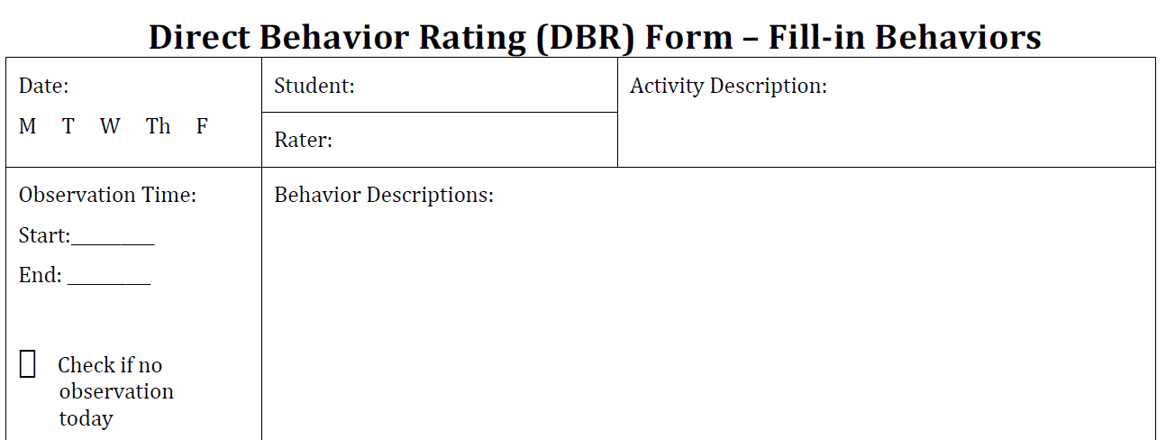
Jeff’s DBR for Threats
Threats are verbal statements that refer to harming other people, including peers or teachers. Anchors are 0 = 0 threats per observation, 1 = 1−2 per observation, 2 = 3 per observation, 5 = 6 per observation, 9 = 10 per observation, 10 = >10 per observation.
 | Low |  |  | Medium |  |  |  |  | High
Rating | 0 | 1 | 2 | 3 | 4 | 5 | 6 | 7 | 8 | 9 | 10
Frequency of behavior | 0 | 1–2 | 3 | 4 | 5 | 6 | 7 | 8 | 9 | 10 | 10+
(Chafouleas, Riley-Tillman, & Christ, 2010)
Notes:
Review slide.

Slide 84
Jeff’s Goals and Decision Rules
Long-term goals:
No threats, hits, or kicks
Reach peer norms for disruptive behavior (20 percent) and academic engagement (80 percent)
Decision rules:
Evaluate the intervention in two weeks
Consider Jeff responsive if the data visually improve
Consider fading the intervention when the goals are met
Notes:
If Jeff is not responsive in one or more of the target behaviors, the team will consider if the intervention needs more time to work or should be adapted.

Slide 85
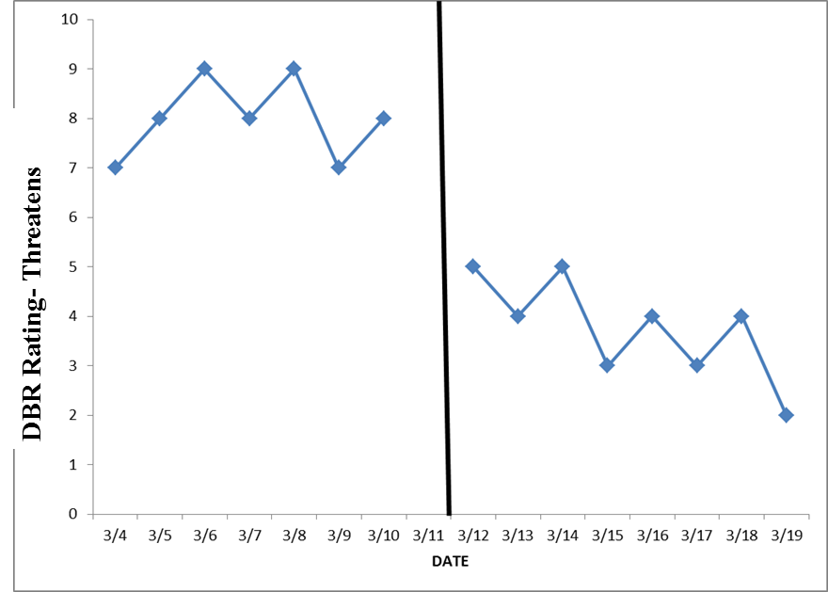
Jeff’s Target Behavior Data (Threatens)
Notes:
What does this graph tell us about Jeff’s threatening behavior before and after the intensive intervention was introduced?
Give participants a few moments to think about how to answer this question based on the graphed data. If time allows, discuss as a group.
During the intervention, Jeff’s threatening behavior dropped in level and showed a decreasing trend.

Slide 86
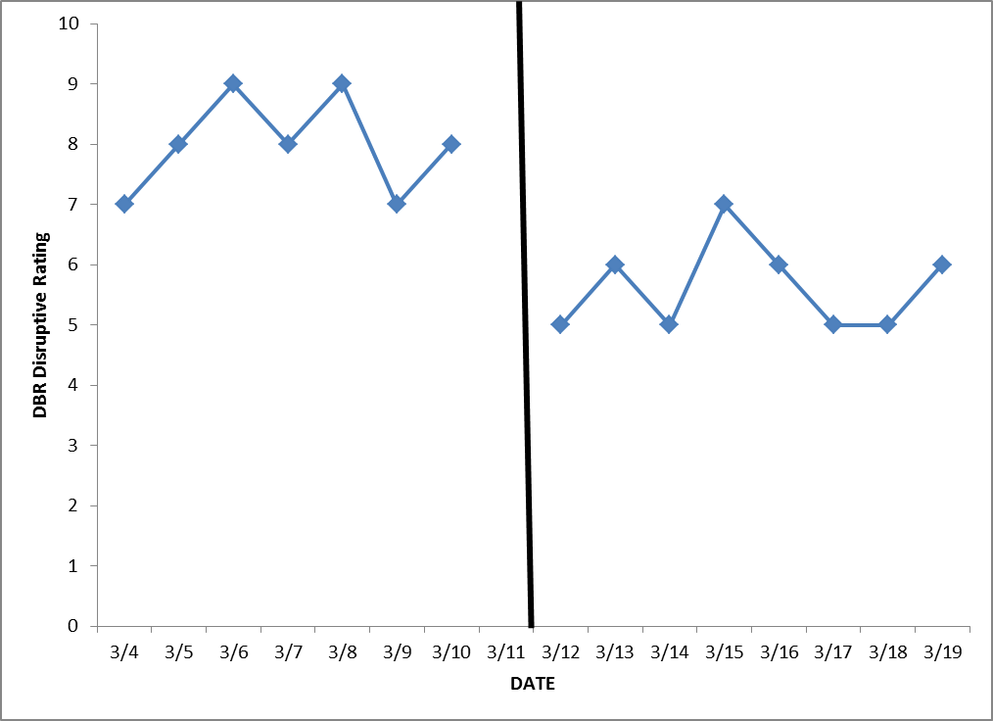
Jeff’s Target Behavior Data (Disruptive)
Notes:
Did Jeff’s disruptive behavior change after the intensive intervention was introduced?
Give participants a few moments to think about how to answer this question based on the graphed data. If time allows, discuss as a group.
Jeff’s disruptive ratings showed a small decrease in level after the intervention was introduced.

Slide 87
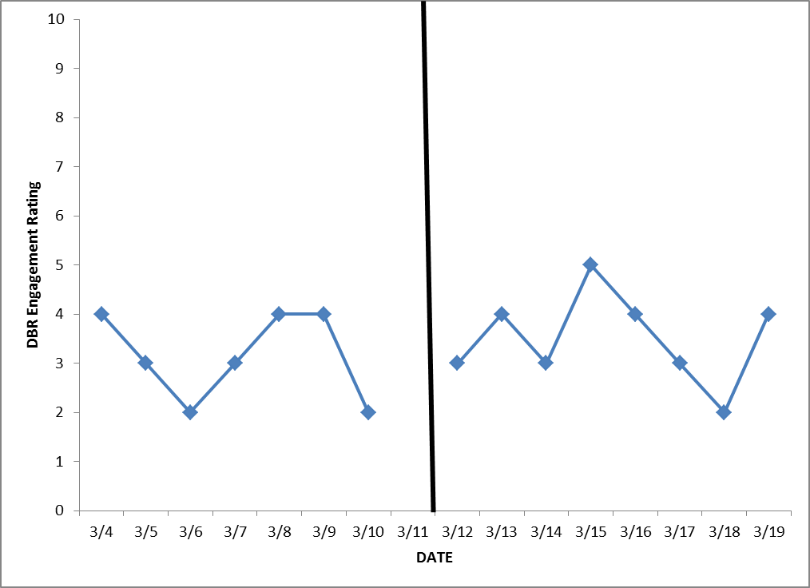
Jeff’s Target Behavior Data (Engagement)
Notes:
Did Jeff’s academic engagement change after the intensive intervention was introduced?
Give participants a few moments to think about how to answer this question based on the graphed data. If time allows, discuss as a group.
Jeff’s engagement was variable both before and during the intervention. We cannot see any clear change in the level or trend of his engagement data.
Taken together, these three graphs suggest that the intervention has helped reduce concerning behaviors such as threats and disruptions, but it has not helped Jeff become more academically engaged. Jeff needs additional support in this area.

Slide 88
In Closing…
DBI requires identifying and defining a target behavior for
Intervention planning
Progress monitoring
Individualized behavior assessment is an intensive process. Reserve DBI for only those students with the most intensive needs (3–5 percent of the school population).
Notes:
Individualized intervention requires individualized assessment.

Slide 89
Exit Activity
Fishbowl Activity
Anonymously write down a question that you have about the lesson today.
Notes:
Activity
Purpose of the activity – Review concepts presented in Part 4 of the Behavior Module
Directions
Have participants follow the direction on the slide.
Collect and mix up questions in a bowl.
Draw questions and have participants answer.
Putting it all together – This serves as a review for Part 4 as well as an introduction to Part 5 of the Behavior Module and helps participants take ownership of their learning.

Slide 90
Additional Resources
Notes:
This section provides internet resources on progress monitoring behavioral interventions.

Slide 91
NCII Progress Monitoring Module
Monitoring Student Progress for Behavioral Interventions (DBI Training Series Module 3) http://www.intensiveintervention.org/resource/monitoring-student-progress-behavioral-interventions-dbi-training-series-module-3
Note: The presentation is designed for qualified trainers, but the module also includes handouts and other resources for practitioners.
Notes:
This module focuses on behavioral progress monitoring within the context of the DBI process. It addresses: (a) the methods available for behavioral progress monitoring, including (but not limited to) Direct Behavior Rating (DBR); and (b) using progress monitoring data to make decisions about behavioral interventions.

Slide 92
Direct Behavior Rating
http://www.directbehaviorratings.org/cms/
This website provides
Multiple versions of DBR forms
Instructions and a DBR overview
Evidence that supports using DBR
Information about DBR as a component of an incentive program or self-management intervention
Notes:
Examples of form versions:
Standard behaviors
Fill-in
Booklets with graphing charts
Smiley faces (e.g., for use with small children learning to self-monitor behavior)

Slide 93
NCII Direct Behavior Rating Overview
NCII’s overview of DBR is available (as a video, a PowerPoint, and a PowerPoint with embedded audio) at
http://www.intensiveintervention.org/ask-the-expert/dbr-overview
It serves as a refresher and an extension of the Monitoring Student Progress for Behavioral Interventions module.
Notes:
Review slide.

