Slide 1


Educator preparation policy as a lever for improving teacher and leader preparation: Keeping promises in Tennessee
Collaboration for Effective Educator Development, Accountability, and Reform
TED-CEC Conference
November 11, 2016
H325A120003

Slide 2
CEEDAR Center
Leadership
Partners
Mary Brownell, Director
Paul Sindelar and Erica McCray, Co-directors
Meg Kamman, Project Coordinator
American Institutes for Research (AIR)
University of Kansas, Center for Research on Learning
Council of Chief State School Officers (CCSSO)
Major organizations (e.g., AACTE, CAEP, CEC, TASH)
Senior advisors
OSEP Project Officers: Dr. Bonnie Jones and Dr. David Guardino
Notes:
I want to introduce some of the key people who are involved in the Center. AIR and KU. We also are working with the key professional organizations. New Teacher Center and Goodlad Institute for Educational Renewal. In fact, Lynn Holdheide and Amy Elledge, our colleagues from AIR, are joining us and may be helping to answer questions in the chat box.

Slide 3

CEEDAR Technical Assistance

Slide 4
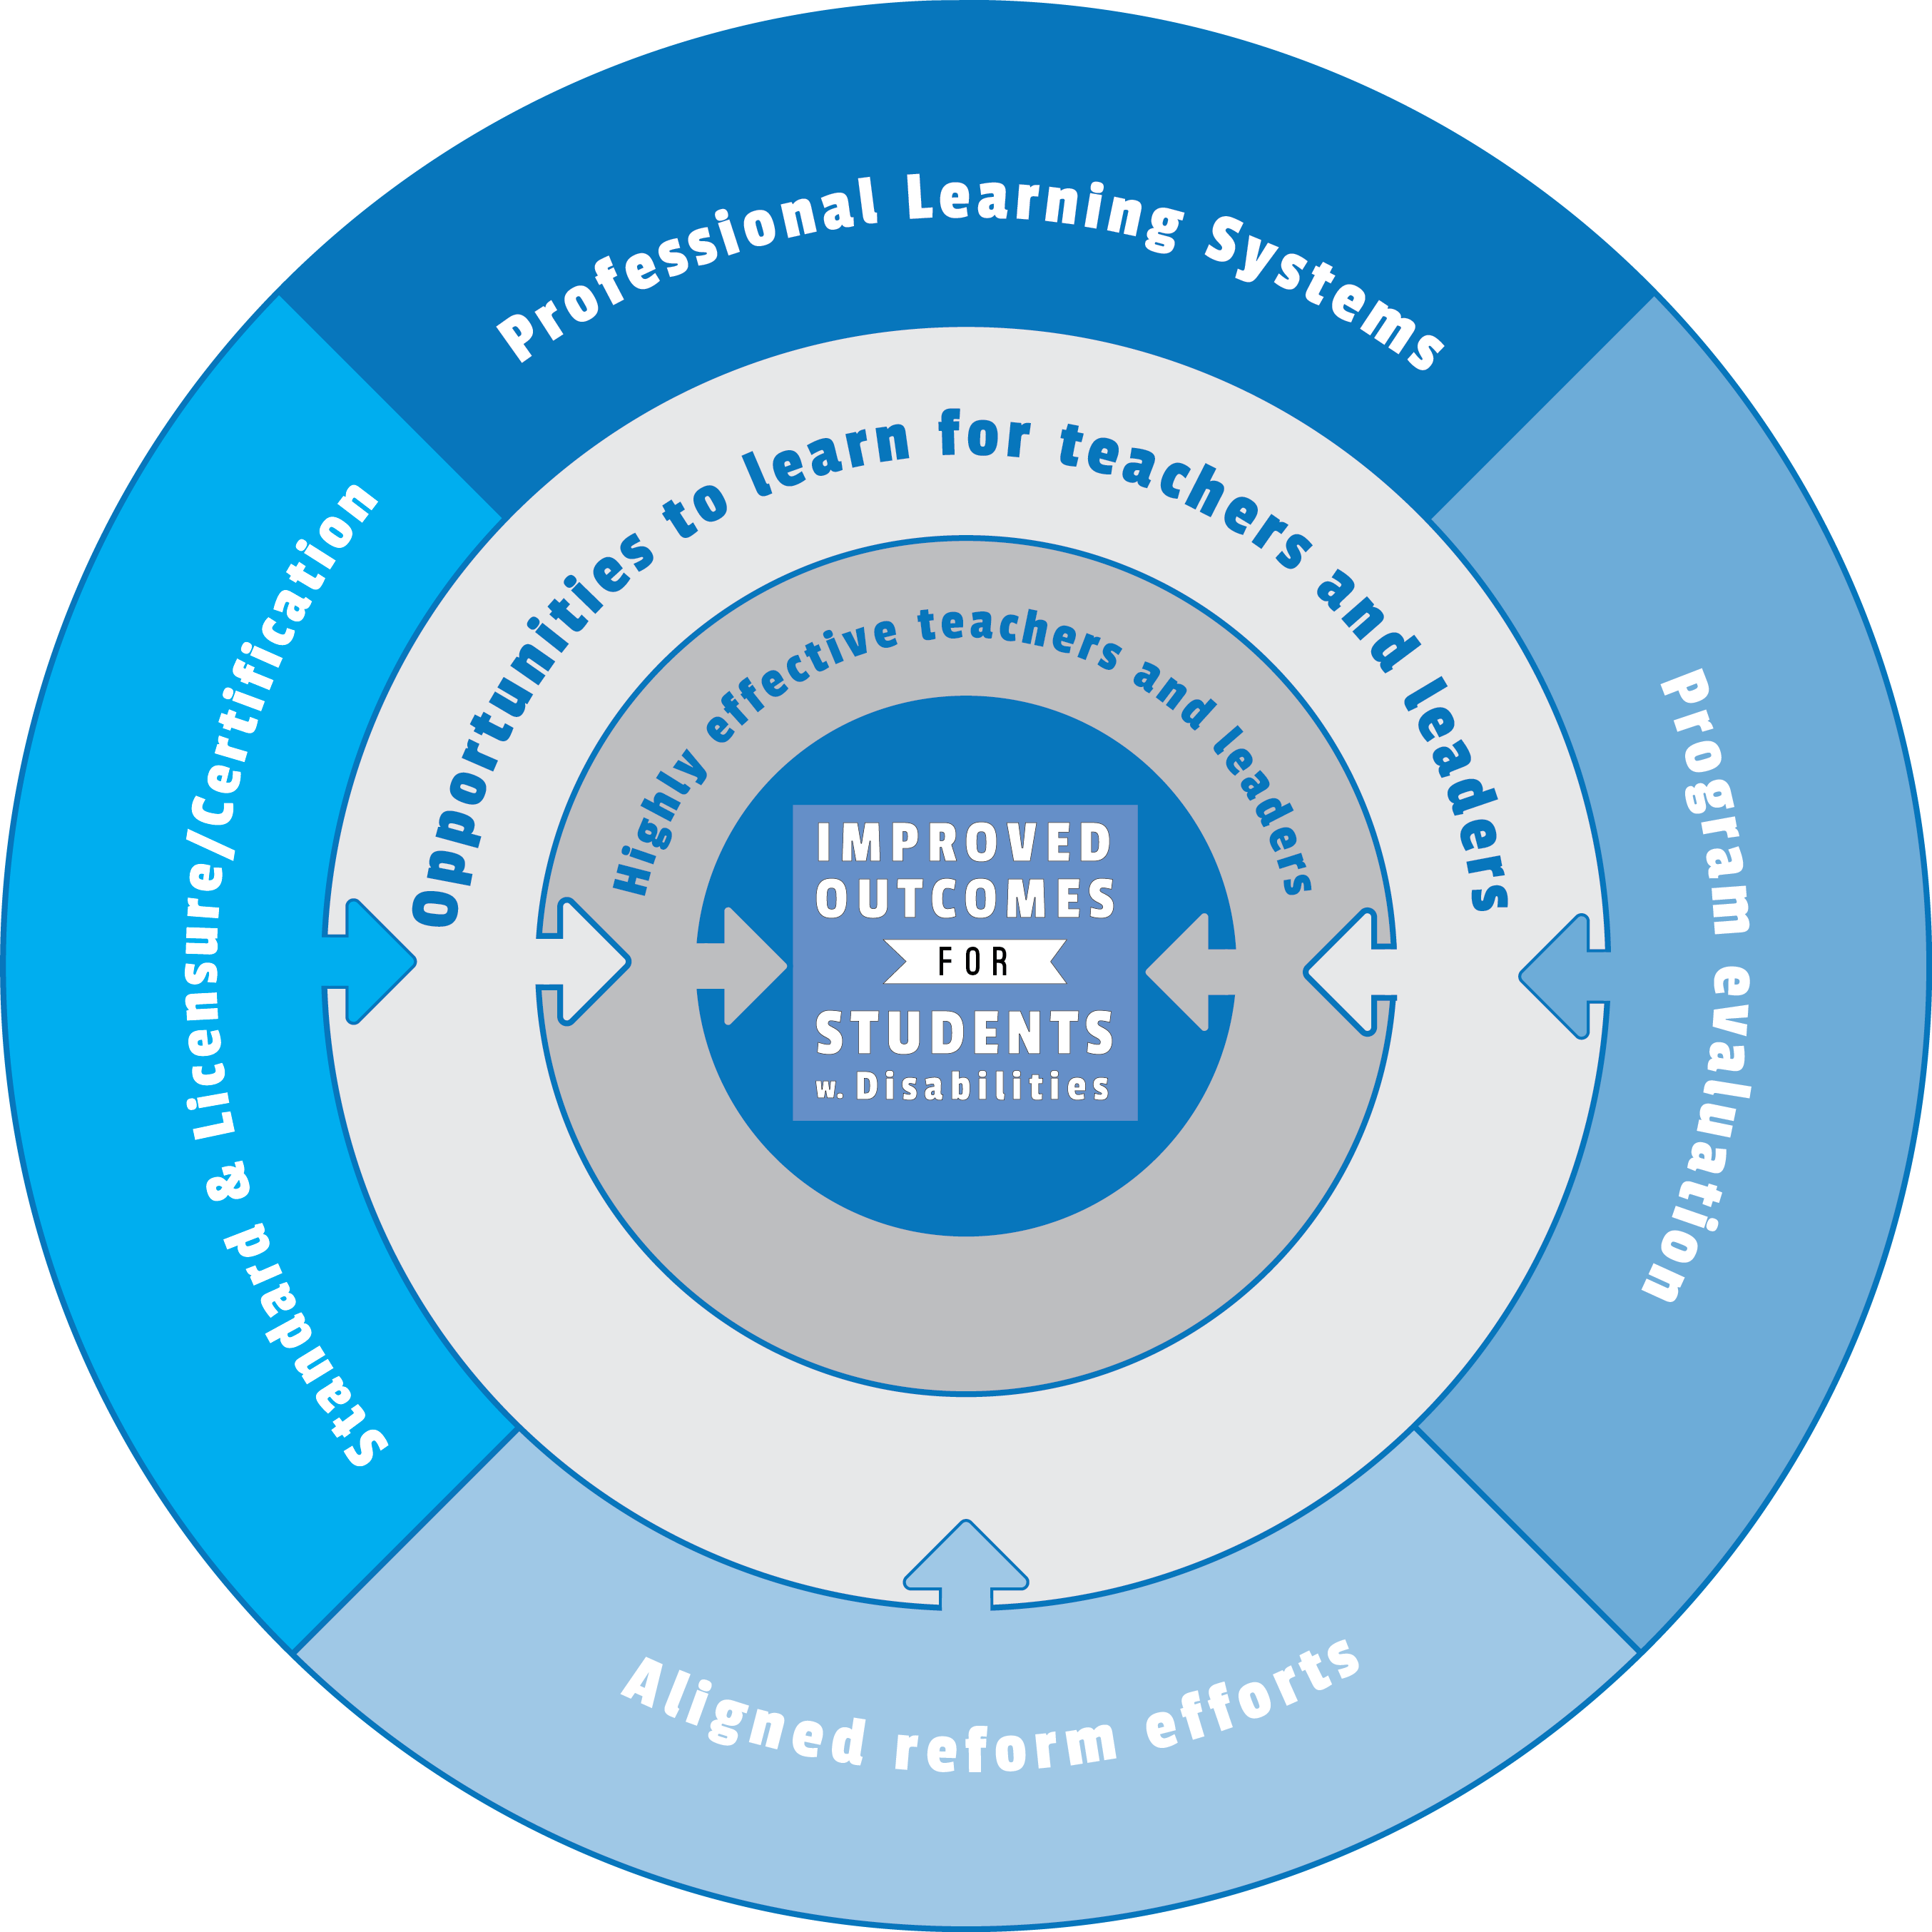
Our Approach
Notes:
To create aligned professional learning systems that provide teachers and leaders effective opportunities to learn how to improve and support core and specialized instruction in inclusive settings that enable students with disabilities to achieve college and career readiness standards

Slide 5
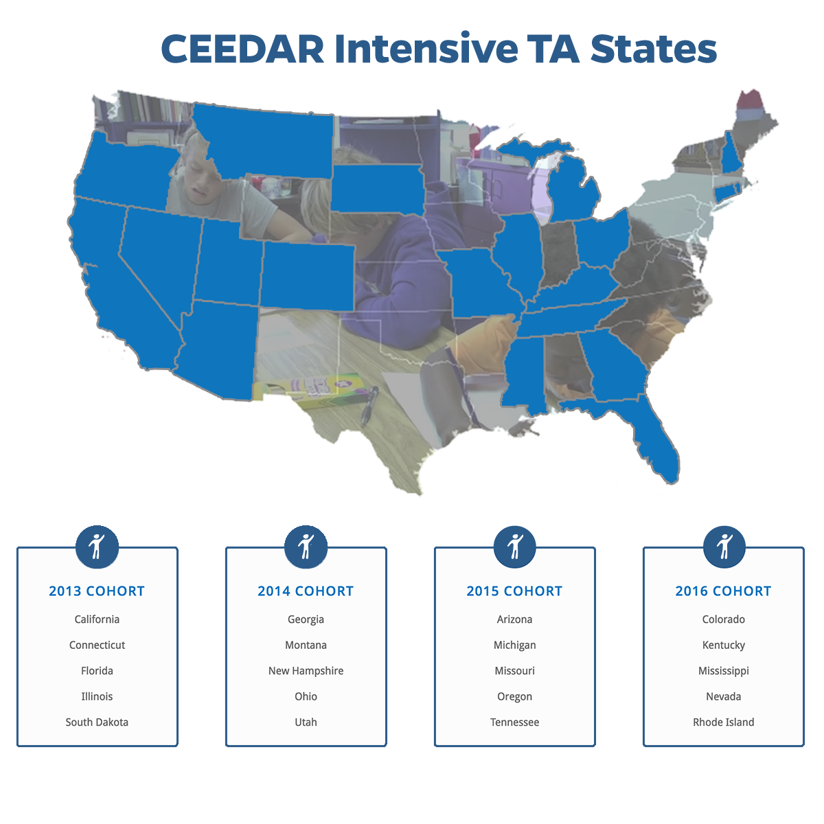
Notes:
Cooperative agreement to work intensively with 20 states

Slide 6

TN-CEEDAR

Slide 7




TN-CEEDAR Team Contacts
Jennifer Nelson
Kim Paulsen
David Cihak
Blake Shearer
Instructional Programming for Special Populations
Susan Jones
Educator Licensure and Preparation

Slide 8
TN-CEEDAR Goals
Align statewide educational efforts to improve outcomes for students who are at-risk and students with disabilities
Ensure effective communication and collaboration among stakeholders
Ensure effective processes for the collection and dissemination of high quality data for improving educator preparation
Ensure educator preparation program completers have the knowledge and skills to provide effective instruction and intervention for all students
Review the professional education standards related to the special education and RTI² frameworks for potential recommendations to the educator preparation policy

Slide 9
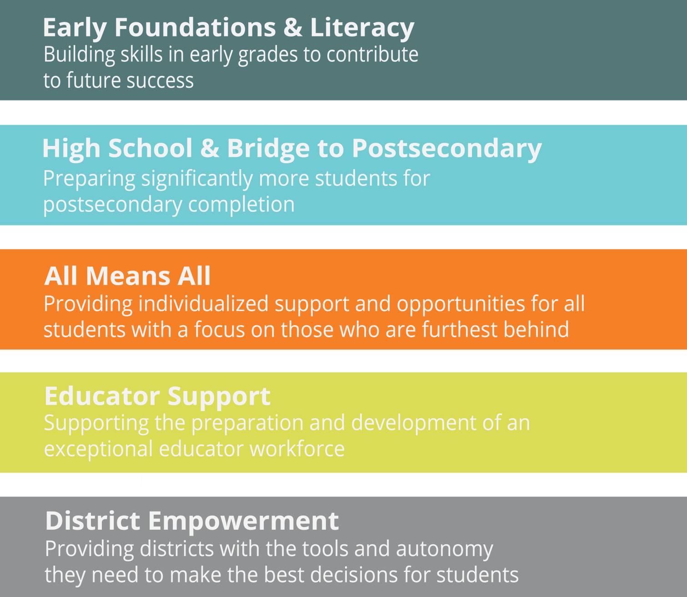
Tennessee Priorities

Slide 10
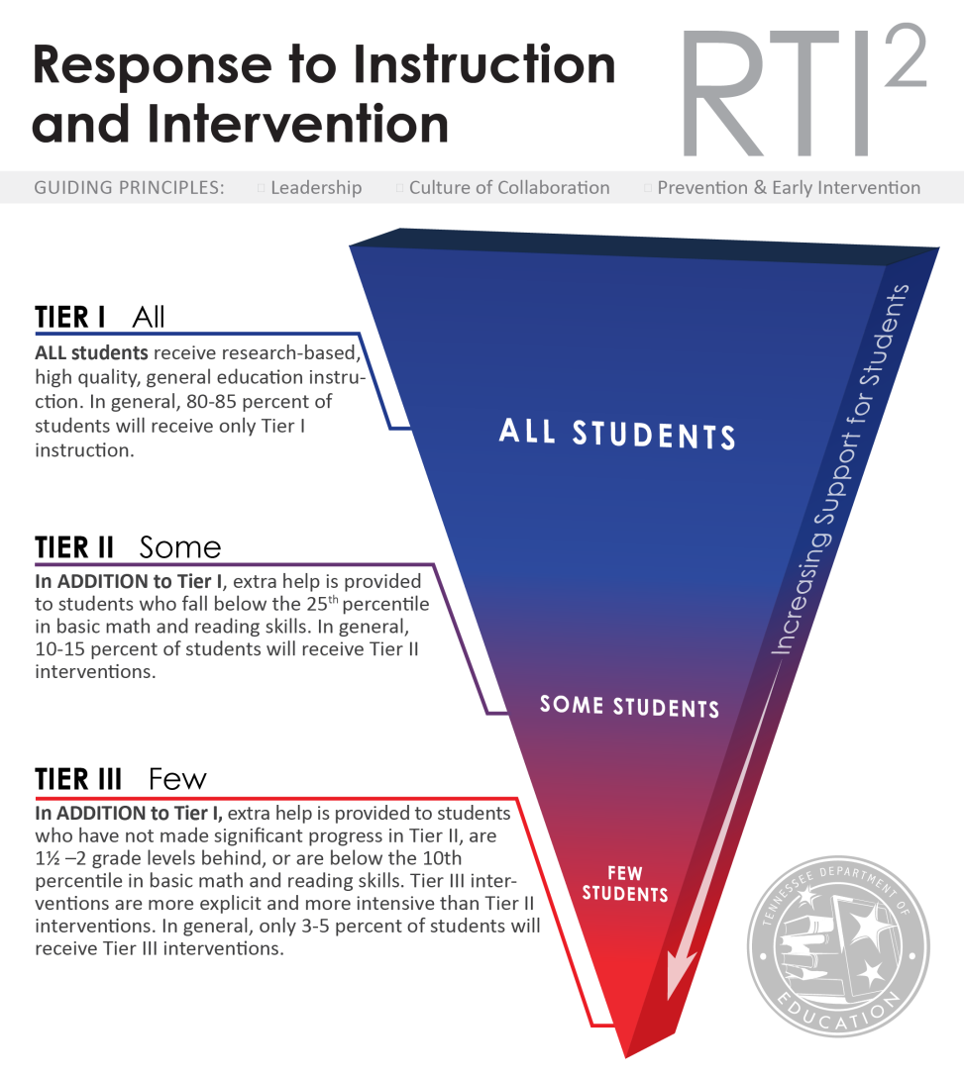
Tennessee: RTI² Guiding Principles
Leadership
Culture of collaboration
Prevention & early intervention
Notes:
TIE + SANDY
Briefly talk about each Tier but emphasize “Guiding Principles” that will allow for the fluidity of RTI²
Leadership at all levels is essential for ensuring the success of all students throughout the RTI² Framework. (state, district, building level)
A culture of collaboration that is focused on student achievement, for all students, should include educators, families and communities.
RTI² focuses on prevention and early intervention that uses assessment data for instruction, intervention and transitions between tiers. This is includes differentiation of instruction.

Slide 11

TN Special Education Framework
Evaluations & Eligibility
Instructionally-appropriate IEPs
Intensive interventions
Progress monitoring
Transition planning
Accommodations
Behavior

Slide 12

Alignment
Notes:
State implementing initiatives and changes to certification – critical to get every aspect aligned from certification to prep to evaluation

Slide 13

CEEDAR TA Tool:
Promises to Keep
Review the professional education standards related to the special education and RTI² frameworks for potential recommendations to the educator preparation policy

Slide 14
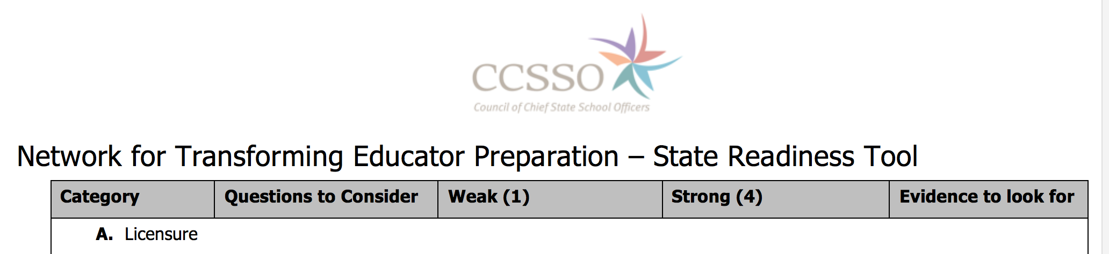
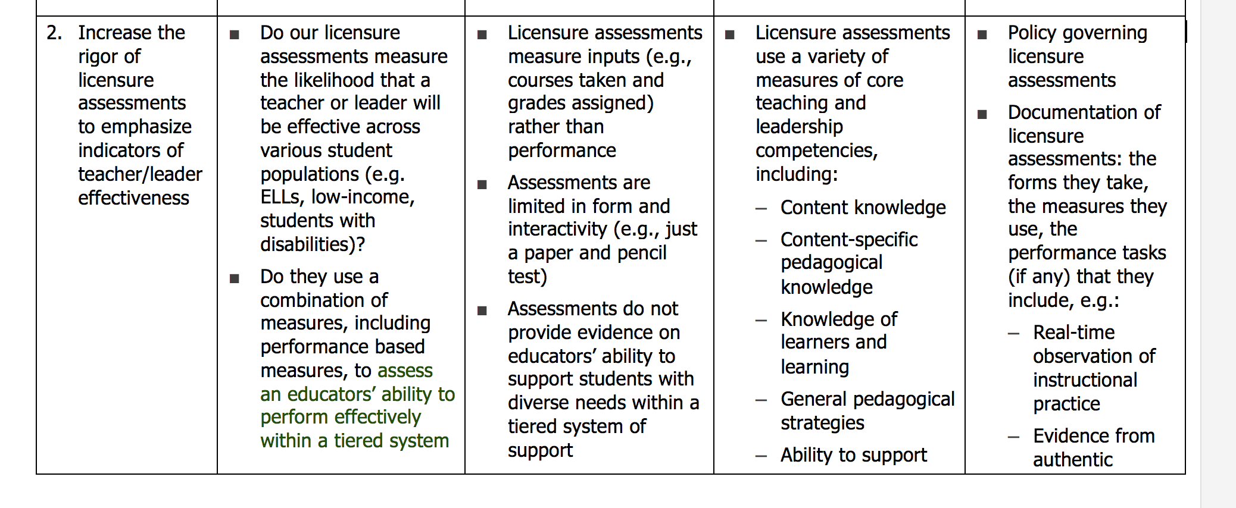
State Readiness Tool

Slide 15
Current Implementation Policy
All preparation programs must include training to support candidates’ readiness to deliver instruction informed by Response to Instruction and Intervention Framework (RTI²). Candidates not seeking endorsement in Special Education should be prepared to deliver instruction and intervention at the Tier I and II levels.

Slide 16
Identifying Levels of Competence

Slide 17
Next Steps
Too broad vs. too specific for policy
Understanding roles within departments
Continuing the discussion

Slide 18
Disclaimer
The contents of this webinar were developed under a cooperative agreement from the U.S. Department of Education, H325A120003. However, those contents do not necessarily
represent the policy of the U.S. Department of Education, and you should not assume endorsement by the Federal government.

