Slide 1


Collaboration for Effective Educator Development, Accountability, and Reform
Supplemental Behavioral Interventions
H325A120003
Notes:
In this presentation, you will learn about Evidence-Based Behavioral Interventions, the importance of implementing supplemental behavior interventions with fidelity, and using data to assess if the intervention(s) are working to improve student behavior.
Speaker notes are provided for most of the PowerPoint slides included. The notes provide additional details about the information presented in a particular slide, including the context for the information being presented as well as further elaboration of key points being discussed. Thus, the speaker notes are intended as a guide for a presenter who is using the PowerPoint slides and may be modified as needed.
Instructions for using the speaker notes
Text formatted in standard font is a sample script for the presenter. While these may be read verbatim, speaker notes are intended as a guide for the presenter and may be modified as needed.
Text formatted in italics is intended as directions or notes for the facilitator; italicized text is not meant to be read aloud.
Text formatted in underline indicates an appropriate time to click to bring up the next stage of animation in an animated slide.

Slide 2
Supplemental Behavioral Interventions
What Are Supplemental Interventions?
The Importance of Choosing Evidence-Based Behavioral Interventions
The Implementation Process and Implementing With Fidelity
Example of a Supplemental Strategy
Measuring Student Progress
Case Study: Meet Aiden
Notes:
Here are the topics that will be covered in this presentation.
Give participants time to read this slide.

Slide 3
Note
This presentation uses content and resources from
The National Center on Intensive Intervention (NCII) www.intensiveintervention.org
OSEP Technical Assistance Center on Positive Behavioral Interventions and Supports (PBIS) www.pbis.org
Missouri Schoolwide Positive Behavior Support
www.pbismissouri.org
Notes:
Briefly give time for participates to view the slide.

Slide 4

What Are Supplemental Interventions?
Notes:
In this section, you will learn what supplemental interventions are, how they fit into the Positive Behavioral Interventions and Supports (PBIS) or other multi-tiered models, and what their key characteristics are.

Slide 5
What Are Supplemental Interventions?
Supplemental interventions are designed for at-risk students and students who are not responding to universal strategies.
Universal strategies can be effective for approximately 80 percent of students. Supplemental interventions can have a positive impact on approximately 15 percent of students.
        (Filter et al., 2007; Kett & Nelson, 2010)
Notes:
Give participants time to read the two bullets on the slide.
We will now move on to discuss the supplemental interventions, also referred to as the secondary tier or tier 2. Interventions at the supplemental tier address the learning or behavioral challenges of at-risk students. The intervention(s) is targeted, evidence-based, and supplemental to core instruction. These interventions are delivered to small groups, and they occur in either the general education classroom or another general education setting, such as an intervention block. The types of assessments used in the secondary tier are the same as those used in the primary tier, but progress monitoring occurs with greater frequency to measure the student’s responsiveness to the secondary intervention.

Slide 6

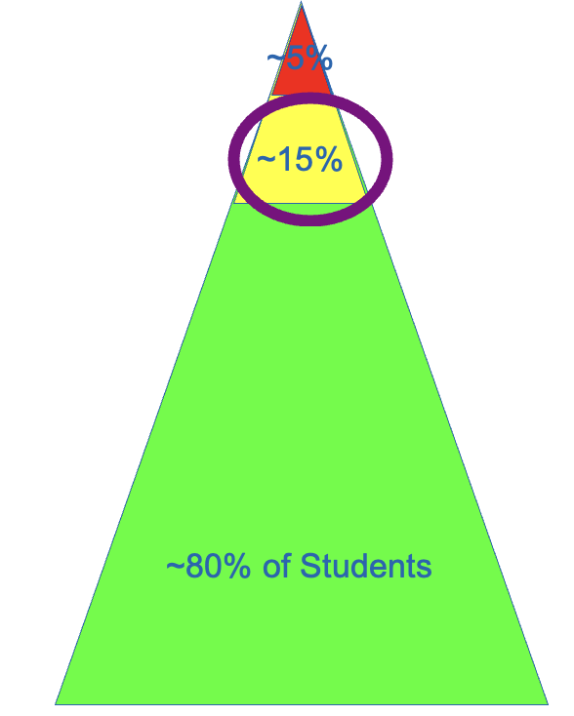
CONTINUUM OF
SCHOOLWIDE
INSTRUCTIONAL AND
POSITIVE BEHAVIOR
SUPPORT
(PBIS.org)
Individual/Intensive:
Specialized
Individualized
Systems for Students With High-Risk Behavior
Supplemental: Specialized Systems for Students With At-Risk Behavior
Universal:
School/
Classroom-
Wide Systems for
All Students,
Staff, and Settings
Notes:
The logic of the triangle suggests that most students—about 80 percent—will respond positively to strong, systematic prevention techniques. This implies that about 20 percent of students, therefore, will not be responsive to the supports widely available in schools to promote prosocial behavior. The students who are non-responsive will require further support to maintain appropriate behavior in schools.
The typical process is to move these non-responding students to an intervention that will provide additional feedback on student behavior and opportunities to access rewards and positive attention. Fortunately, many of the students who demonstrated difficulty will show improvement. The anticipated response rate to preventative and secondary intervention supports is about 15 percent. Five percent of students will not be responsive to preventative or secondary intervention supports.

Slide 7

Supplemental Interventions
No more than 15 percent of students identified as “at risk”
Examples of supplemental
interventions:
    Social skills instruction
    Check In Check Out (CICO)
~15%
Notes:
Remember, supplemental Interventions are used for students who do not respond to universal interventions. No more than 15 percent of students should be identified as needing supplemental interventions.
Why are secondary interventions so important? By providing secondary interventions in academics and behavior to students who are flagged as “at risk,” schools are able to effectively meet the needs of the majority of these students and can begin to close the performance gap that may exist between them and their grade-level peers.
Because secondary interventions are standardized and often scripted, and because they include resources, they provide a means for schools to meet the needs of at-risk students and allow resources (including teachers’ time) to be used more efficiently. Effective secondary intervention programs provide teams with a more accurate picture of which students require intensive intervention. Additionally, data collected on a student’s response to an evidence-based secondary intervention program may be used as part of the Specific Learning Disability (SLD) identification process in your district or state, in accordance with state law.
Note: Social Skills Instruction will be described in more detail later in the presentation.

Slide 8
Key Characteristics
Continuously available
Quickly and easily accessible
Minimal time commitment required from classroom teachers
Required skill sets can be easily learned by classroom teachers
Aligned with schoolwide expectations
(Crone, Hawken, & Horner, 2010)
Notes:
We’ll now discuss some of the key elements of secondary interventions.
Supplemental intervention supports should be available in school so that students can be added to the intervention at any time. Some interventions are organized so that students can begin receiving supports quickly. Other interventions, such as group counseling or other group approaches, may have a set cycle that dictates when a student can join a group, as well as a preparation period prior to initiating the intervention.
Some supplemental interventions may require classroom teachers to modify traditional methods or implement new teaching practices (e.g., increase positive feedback, monitor student progress, and evaluate behavioral and academic progress). Ideally, supplemental interventions will fit within existing classroom routines, require minimal changes to methods and strategies, and require only a few more minutes of teacher time each day.
The skill sets classroom teachers need are consistent with quality instruction or can be easily learned. Strategies that require intensive training and skill development not typically present in the repertoire of classroom teachers may be beyond the scope of supplemental interventions and may be considered intensive interventions.

Slide 9
Key Characteristics continued
Staff/faculty are aware of the intervention(s) and their roles in the process
The intervention(s) is consistently implemented with most students, but with some flexibility
The selected program is matched to the function of the student’s behavior
Notes:
Supplemental interventions should be consistent with the universal approaches the school has developed. Schoolwide expectations should be taught and applied consistently across all three tiers (levels) for greater consistency in implementation.
All staff should understand the rationale and be able to describe the supplemental interventions used in their school. Staff with responsibility for implementation should have the training, skills, and administrative support to implement with fidelity.

Slide 10
The Importance of Choosing Evidence-Based Behavioral Interventions
Notes:
In this section, you will learn how to choose evidence-based interventions. Later we will discuss how important fidelity is when implementing supplemental interventions.

Slide 11
Evidence-Based Interventions
Evidence-based interventions (EBIs) reflect a base of research evidence that documents their effectiveness.
EBIs are likely to be effective in changing target behavior if implemented with fidelity.
Notes:
How do you know if a program or strategy is evidence-based?
You can focus your efforts by looking at these areas when examining the evidence base:
First, consider the type of information and the source from which you are gathering this information. Is the information coming from the intervention vendor or a reputable website? It is also worth considering the type of evidence that is available. Did the study involve experimental design (i.e., where the intervention group was compared to an equivalent control group?).
Next, consider the population. For which populations has the program been researched and found effective? Is the sample described? Is the population similar to, or representative of, your student population? Are there different effects for different population groups?
It is also important to consider whether or not the desired outcomes assessed in a study are relevant to the outcomes you hope to achieve with an intervention.
Finally, consider the effects. Were the effects identified in the study large?

Slide 12
Examples of Evidence-Based Interventions
Some commonly used and well-researched interventions include
The Behavior Education Program (also known as Check In Check Out)
Check & Connect
Social Skills Instructional Groups
Academic Instructional Groups
Academic Accommodations
Supplemental Environmental Interventions
pbismissouri.org
Notes:
Here are some examples of evidence-based interventions that meet the criteria we just talked about.
Briefly describe Check In Check Out (since it was referred to at the start of the presentation); also state that this presentation will focus on social skills instruction as a supplemental behavioral intervention.

Slide 13
Examples of Evidence-Based Behavior Curricula
Bully-Proofing Your School
Cool Tools: An Active Approach to Social Responsibility
First Steps to Success
Good Talking Words
Second Step Violence-Prevention Curricula
Stop and Think
Skillstreaming
The Social Skills Curriculum
The Walker Social Skills Curriculum: The Accepts Program
PBIS Center, www.pbis.org
Notes:
Note: We are not personally supporting these programs. They are presented here for informational purposes only. They are programs that have been found, by the PBIS Center, to be evidence-based.
Here are some examples of curricula that have been found, by the PBIS Center, to be evidence-based.

Slide 14
Resources to Locate Evidence-Based Practices
What Works Clearing House
- http://ies.ed.go/ncee/wwc/
Promising Practices Network
- http://www.promisingpractices.net/
Current Practices Alert
- http://www.teachingld.org/Id_resources/alerts/
Evidence Based Interventions Network
-http://ebi.missouri.edu/
IRIS Center
    - http://iris.peabody.vanderbilt.edu
Florida’s Positive Behavior Support Project
- http://flpbs.fmhi.usf.edu/index.cfm
Notes:
This slide lists websites for resources that are evidence-based.

Slide 15
Activity: Evidence-Based Behavior Curricula
Using the list of evidence-based curricula provided, choose one or two that you would like to learn more about.
Research these curricula so you can explain them to the group. Provide the group with information about:
  Which students would benefit from the curricula
  Who should implement them
  How long they should be implemented for
  How to determine whether they are working
Handout #6: Examples of Evidence-Based Behavior Curricula
Notes:
Note - Computers need to be available to students in order to complete this activity. This activity can be completed during class or as a homework assignment. In addition, it can be completed individually or in pairs.
Purpose of the activity – To familiarize participants with various evidence-based curricula that is available.
Directions for the activity:
Allow participants time to sign up for the curricula that they would like to review.
Form groups according to curricula choices. Make sure groups are even in number.
Have groups review information that is available on the web for their specific curricula and answer the four questions on the slide using Handout #6.
Debrief – Have each group share their findings with the large group. Inform participants that they will be the expert on their curricula and will impart their knowledge to the large group so all participants will have a better understanding of the various evidence-based curricula.
Putting it all together – Participants should now be aware of the various evidence-based curricula available to address behavior issues in the classroom.
Note: If computer/internet access is not available, print out in advance a description of EBI curricula for participants to use during the activity. Make sure the description you provide allows participants to answer all four questions on Handout #6.

Slide 16
The Implementation Process
Notes:
In this section, you will learn how to match the behavior intervention to student need, implement the intervention with fidelity, and progress monitor to see if the intervention is working and student behavior is improving.

Slide 17
The Implementation Process Pathway
1. Identify students at risk
2. Match intervention to student need
3. Implement intervention
4. Progress monitor
Notes:
The 4-step implementation process includes these steps. We will talk about each step in more detail in the following slides.

Slide 18
1. Identifying “At-Risk” Students
Office discipline referrals (ODRs)
  These identify students who are not successful at the universal level
Teacher referrals
  These follow a clear process
  They also provide supporting data
Screening
  This involves the use of a tool or checklist, such as
    Systematic Screening for Behavior Disorders (SSBD)
    Walker-McConnell Scales
Notes:
Note: Office discipline referrals or ODRs are also referred to as incident reports.
Identifying “at-risk” students might be the responsibility of your school’s leadership team, but you should know what the processes are for identifying students who are at risk.
Multiple methods are used to identify students for supplemental supports. Students should be identified through various methods, such as office discipline referrals, screenings, teacher nominations, parent and support service recommendations, formative assessments, and so on. No single method is likely to identify all the students who may need supplemental supports. The identification methods selected should be efficient in terms of their cost and amount of time they require from school personnel.
Identify students early before problems develop to a level that requires intensive intervention.

Slide 19
2. Match Intervention to Student Need
Remember the ABCs of behavior
Choose an intervention(s) that matches the likely function of the behavior
Notes:
A = Antecedent. What happens before the behavior?
B = Behavior. What does the person do (measureable or observable)?
C = Consequences. What happens after the behavior?
Ask yourself, is the student performing the behavior to get something or avoid something?

Slide 20

Academic Supports
Students displaying inappropriate behaviors may need more academic supports.
Curriculum-based assessment should be used to monitor academic performance.
  Center on Response to Intervention
    www.rti4success.org
Notes:
Identify students that have academic and behavior challenges. Consider that their behavior challenges could be related to their academic challenges.
Discuss as a group

Slide 21
3. Implement the Intervention
Make a plan for implementing the intervention in accordance with the developers’ directions:
  Who will deliver the intervention?
  When and where?
  For how long?
Notes:
Who will deliver the intervention? Has the person(s) been properly trained?
When and where will the intervention be delivered?
What is the duration of the intervention?

Slide 22
Evidence-Based and Implemented With Fidelity
Evidence-Based Intervention
Fidelity
  Adherence
  Student Engagement
  Program Specificity
  Quality of Delivery
  Exposure
Notes:
First, let’s take a look (or review) at what it means for a secondary intervention to be evidence-based.
We have already discussed EBIs. Does someone want to provide a definition for us again? (Allow for responses and provide feedback)
Evidence-based interventions are recommended for secondary and intensive levels of prevention. These materials have been evaluated using rigorous research design, and there is evidence that they have had positive effects on the students who received them. This means that programs used as secondary interventions have been rigorously evaluated as a whole, and that the specific intervention program was found to have positive effects for students receiving the program.

Slide 23
Elements of Supplemental Interventions
Evidence-Based Intervention
Fidelity
  Adherence
  Student Engagement
  Program Specificity
  Quality of Delivery
  Exposure
Notes:
Now let’s discuss what it means to deliver supplemental interventions with fidelity and why it is important.
Fidelity refers to how closely prescribed procedures are followed and, in the context of schools, the degree to which teachers implement programs the way program developers intended. It also relates to the quality of the implementation. This means that teachers are implementing the intervention with consistency and accuracy and adhering to the instructional plan with integrity.
Note: Throughout discussions of fidelity, it is important to ensure that teachers believe that they work in an open, non-threatening environment that values their skills and expertise and allows them to learn from their colleagues. With a system of open communication and productive feedback, fidelity checks of classroom techniques and the essential components of multi-tiered systems of support can be a useful and supportive way for teachers to collaborate and become a stronger teaching network. This may be a useful discussion point for some groups.

Slide 24
Why Is Fidelity Important?
Ensures that intervention has been implemented as intended
Allows us to link student outcomes to intervention
Helps us to determine if the intervention is effective and make instructional decisions
Helps us achieve positive student outcomes
(Pierangelo & Giuliani, 2008)
Notes:
Why is fidelity important? If teachers aren't consistent and accurate in delivering supplemental interventions, they aren’t able to confidently explain a student's lack of response to an intervention. Did the student make insufficient progress because they require more intensive intervention? Or, did the student make insufficient progress because the supplemental intervention wasn’t delivered with fidelity? Without practicing consistency and integrity in intervention delivery, we can't link, or attribute, student outcomes to the instruction provided. Fidelity allows us to evaluate the effectiveness of the supplemental intervention, and it tells us when a student may require a more intensive level of intervention.
Furthermore, Pierangelo and Giuliani (2008) concluded that positive student outcomes are particularly dependent on aspects of fidelity within the framework of a tiered support system. One of these aspects is fidelity of implementation at the classroom or teacher level.

Slide 25
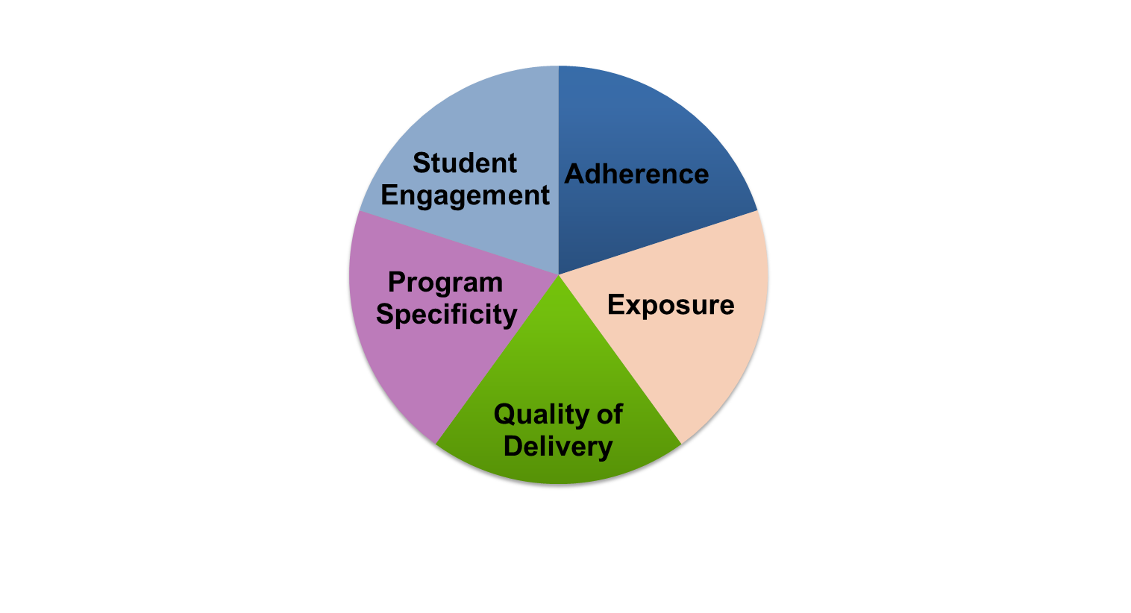
Five Elements of Fidelity
Student Engagement: How engaged and involved are the students in this intervention or activity?
Adherence: How well do we stick to the plan, curriculum, or assessment?
Program Specificity: How well is the intervention defined and how is it different from other interventions?
Exposure/Duration: How often does a student receive an intervention? How long does an intervention last?
Quality of Delivery: How well is the intervention, assessment, or instruction delivered? Do you use good teaching practices?
(Dane & Schneider, 1998; Gresham et al., 1993; O’Donnell, 2008)
Notes:
Interactive slide
This graphic provides one example of how to think about fidelity, and it includes the elements of adherence, exposure, quality of delivery, program specificity, and student engagement.
Schools should have procedures in place to monitor the fidelity with which they implement supplemental interventions. While these don’t have to be formal, it is important to consider whether or not schools are implementing programs the way that they are intended to be delivered. In the midst of all the responsibilities of educators, small checks can make a big difference in keeping services for students on track.
Note: The notes on each element of fidelity are animated to pop up with each click. Click ahead each time you discuss a new element of fidelity, and click again to close that element.
1. (Click) When we discuss adherence we are focused on how well we stick to the plan/curriculum/assessment, or whether we are implementing the plan/curriculum/assessment as it was intended to be implemented based on research. For a supplemental intervention, this may mean how well teachers implement all pieces of an intervention, and whether they implement them in the way they were intended to be implemented. This doesn’t necessarily mean that teachers should follow a script word for word, but covering certain content with appropriate pacing and relevant language and techniques is important. (Click)
2. (Click) Duration/Exposure refers to how often a student receives an intervention and how long an intervention lasts. When thinking about fidelity, we are considering whether the exposure/duration being used with a student matches the recommendation by the author/publisher of the curriculum.
In the case of supplemental interventions, developers and researchers typically specify the required exposure/duration that is needed for the intervention to be effective for most students. If the intervention developer calls for the intervention three days a week, for 45 minutes each day, is the student receiving this dosage? (Click)
3. (Click) Not only is it important to adhere to the plan/curriculum/assessment, but it is also important to look at the quality of the delivery. This refers to how well the intervention, assessment, or instruction is delivered. For example, do you use good teaching practices? Quality instructional delivery also means that teachers are engaged in what they’re teaching and animated in their delivery, not simply reading from a script. Providing teachers with constructive feedback on their instructional delivery is one way to improve the quality of delivery for supplemental interventions. (Click)
4. (Click) Another component is program specificity, or how well the intervention is defined and how different it is from other interventions. Having clearly defined interventions/assessments allows teachers to more easily adhere to the program as defined. Is the intervention a good match for the student’s needs? Or does every low reader get the same intervention? (Click)
5. (Click) Just as the quality of the delivery is critical, it also is important to focus on student engagement, or how engaged and involved the students are in the intervention or activity. Following a prescribed program alone is often not enough. Consider whether or not competing behaviors make it difficult for students to take part in the intervention as designed. During the delivery of supplemental interventions, teachers may need to use behavior management strategies to manage student behaviors, including providing choice, adding elements of competition, and offering frequent opportunities to respond. (Click)

Slide 26
4. Progress Monitoring
Progress monitoring is the process of systematically planning, collecting, and evaluating data to inform programming decisions. Progress monitoring
  Provides a basis for determining whether an intervention is effective for a given student
  Assists with developing effective intervention plans
Evidence-based supplemental interventions work for many students. Monitor progress to determine if the plan is working for this student.
Notes:
Let’s define progress monitoring. Discuss the definition above. Why is progress monitoring important? (It tells us if a behavior intervention is working for a particular student.)
Behavioral progress monitoring is more than simply collecting assessment data—we must also analyze the data to determine whether the intervention is working or not.

Slide 27
Progress Monitoring Uses
Data allow us to…
Assess current performance
Determine the rate of progress or response to the intervention
Identify when an intervention change is needed
Hypothesize potential sources of need
Notes:
Here are some uses for progress monitoring data. Discuss each one and explain why it is important.
Data results help us to:
Hypothesize the potential sources of need
Identify when an intervention change is needed
Determine the rate of progress or response to the intervention
Assess current performance

Slide 28
Progress Monitoring Benefits
Accountability
Evaluation
Transparency
Justification
Dissemination
Notes:
Ultimately, the information generated through progress monitoring will support an evaluation of the intervention’s effectiveness, increase the transparency of—and provide justification for—programming decisions, and allow information to be readily disseminated among key stakeholders.

Slide 29
Activity: How Much Do You Remember?
With a partner:
List the four steps in the implementation process
Write as many facts as you can that describe each step
Explain why each step is important
Handout #5: The Four Steps in the Implementation Process
Notes:
Purpose of the activity is to review the implementation process and make sure that the intervention is implemented with fidelity to achieve desired outcomes.
Directions:
This activity has been designed to be completed in pairs. Adult learning principles suggest that it is important for partners to work together in learning new content. For example, two partners can share information and build on each others’ ideas. However, this activity can also be adapted for individuals or small groups.
With a partner:
Read and discuss the directions on the slide.
Use handout #5 to fill in the four steps in the implementation process.
Answer question 3 in a large group to allow for additional learning and processing.

Slide 30
Example of a Supplemental Strategy
Social Skills Instruction
Notes:
In this section, you will be introduced to one specific supplemental strategy and will learn how to implement it.

Slide 31
What Are Social Skills?
Social skills can be defined within the context of social and emotional learning—recognizing and managing our emotions, caring and developing concern for others, establishing positive relationships, making responsible decisions, and handling challenging situations constructively and ethically (Zins, Weissbert, Wang, & Walberg, 2004).
Notes:
Give participants time to read the slide and discuss.
Social skills are not the same as behavior. Rather, they are components of behavior that help an individual understand and adapt across a variety of social settings.

Slide 32
Activity – Giving and Accepting Compliments
When the music starts walk around the room.
When the music stops, introduce yourself to someone standing near you.
Give each other a compliment.
After the activity, discuss:
  How did it feel to give and receive compliments?
  Why is it important for students to understand how to give and receive compliments?
Notes:
Purpose of the activity- Sometime it is difficult for students to give and accept compliments from their peers.
Directions for the activity
Turn on some music and have participants walk around the room in any direction. After about 30 seconds, stop the music.
Participants pair up with someone near them. They introduce themselves to each other and then give each other a complement. When compliments are given, participants acknowledge them.
When partners appear finished, continue to play the music and have participants continue walking around the room again.
Stop the music after 30 seconds and repeat the same activity.
Continue with this process until participants meet and compliment three to five new people.
When participants are finished with the activity, discuss as a group how it felt to give and accept compliments. Why might students have a difficult time with this social skill? Why is it important for students to know how to give and receive compliments?
Putting it all together - This is an activity that you can do with your students to practice/model accepting and giving compliments. It is an important social skill for students.

Slide 33
How Do We Teach Social Skills?
Modeling
Coaching
Self-management
Positive reinforcement
Students with disabilities may need additional modeling, coaching, self-management, and positive reinforcement.
Notes:
As a classroom teacher, it is important to include all of the components (e.g., modeling, coaching, self-management, and positive reinforcement) during a social skills instructional lesson. When you hear the word “lesson,” the first thought that probably comes to your mind is, “When will I be able to teach a social skills lesson?” Well, many times you are already teaching social skills without even knowing that you are!
Is anyone already teaching social skills? (Wait for answers, respond with feedback, and prompt the follow-up question) Does anyone have any ideas of when they might be able to add in a social skills lesson during their day? (Wait for answers and provide feedback)
Just a few tweaks to your existing instructional practices can ensure that you are following the guidelines of teaching social skills in an evidence-based way. The three components to teaching specific social skills are modeling, coaching, and self-management. You want to couple each of these with positive reinforcement.
Right now, I’m going to introduce an example of when social skills instruction can take place during the school day. Then, as we move forward in the presentation, I will provide detail about how each instructional component can be included.
Note: Discuss the example that most closely aligns with your audience – if the majority of your in-service teachers are elementary, use those examples)
Early Elementary: A natural time to teach social skills to early elementary students is during circle time or read-alouds. For example, many of you are probably already reading stories that address specific social skills (e.g., listening to others, sharing, helping others). Does anyone have an example of a story they use? (Wait for responses). Those are great suggestions! As we move forward, we will revisit the story time example to show how each of the components can be added to support your instruction of a specific social skill.
Intermediate Elementary: A great time during the day to include a social skills instruction lesson would be during guided reading. A lot of times, you can find leveled texts that teach about specific social skills, or you can include a social skills lesson as the students move through literacy centers. You could set up centers so all students practice a skill, or you could design your centers around the needs of a small group of students. As we move forward, we will revisit the guided reading example to show how each of the components can be added to support your instruction of a specific social skill.
Middle School/High School: In secondary settings, finding the time to incorporate social skills instruction may be confusing, since there are many different teachers responsible for instructing students. A time during the day that could be considered for a social skills lesson would be an advisory or study hall period (Use the term from the district/school for advisory or study hall. Some places may have a completely different name for it, like “enrichment”). In middle school/high school, we often assume that students have acquired the social skills they need to be successful. However, middle school/high school offers more freedom to students and adolescence brings its own challenges. As a result, we need to teach specific social skills as they relate to student need. A great way to do this in middle school/high school is through cooperative learning groups. As we move forward, we will visit a cooperative learning example to show how each of the components can be included to support your instruction of a specific social skill.

Slide 34

Modeling
Demonstration of the skill or behavior
Contrived or natural
Verbal explanation
Student is aware of both the model and the behavior
Students with disabilities may need more explicit modeling examples, both verbal and non-verbal.
Notes:
Modeling is the first component needed for social skills instruction to be considered evidence-based.
You can model a behavior or have a peer demonstrate the skill or behavior to be learned (for example, walking through the hall appropriately). If a peer will be modeling a specific action/behavior for the class, small group, or individual student, it is important to remember that he/she should only model appropriate behaviors.
The modeling may be contrived. (For example, a teacher says to his student, "I am going to show you how to walk appropriately through the hall" and follows this by walking down the hall with his arms by his side, going directly to the destination, looking ahead, and not talking. The teacher then stops and points out to the student all the things that he just did and then shows the student again).
The modeling may be natural. (For example, while observing another class, a teacher says to her student, "Look how Annie is walking down the hall. She has her hands by her side, she is looking straight ahead, she goes directly to the library, and she is silent.”)
A verbal explanation is given to the student to describe the skill they are seeing. The student must be aware of the model and the correct behavior in order for it to be effective.
Note: Select the example from the grade/age level that best relates to your audience - the same level you referred to in the previous slide.
Early Elementary: Rather than just reading a story about a social skill, it is important to model the skill, as well. A great way to model a skill during circle time would be invite a student to the front of the class to help you “act-out” a scene from the story. Make sure to select a scene that incorporates the social skill you are targeting for a small group of students in the class. Provide step-by-step description of how to perform the scene and then act it out with the student that volunteered to assist you. Remember that students should only model appropriate behaviors. I will now describe coaching and we will continue to explore this example.
Intermediate Elementary: After reading a leveled text that relates to a specific social skill during guided reading, “act-out” a scene from the story with one of the students in your teacher-led reading group. Make sure to select a scene that incorporates the social skill you are targeting for an individual student in your guided reading group. Provide step-by-step description of how to perform the scene and then act it out with the student that volunteered to assist you. Remember that students should only model appropriate behaviors. I will now describe coaching and we will continue to explore this example.
Middle School/High School: Before using cooperative learning as a method to model a social skill, it is important that all students in your classroom understand the expectations for working in small, student-led groups. Once students are broken up into cooperative learning groups, pre-assign roles to the students. While a couple of the students begin working on a task, assign a pair of students in the group to role-play a specific social skill before they start working with the other group members. Any student who needs practice with a social skill should be included in the role-playing pair. Provide the pair with a script that has them act-out how to demonstrate the social skill. Keep in mind that students should only model the appropriate way to perform a skill. I will now describe coaching and we will continue to explore this example.

Slide 35
Coaching
Goes hand-in-hand with modeling
Requires immediate feedback from the teacher
Involves discussion
Invites student feedback
Students with disabilities may need immediate feedback more often.
Notes:
As a student practices the skill, his or her teacher provides prompts when necessary. (For example, "Jordan, remember that your hands belong at your sides when you are walking down the hall.”)
The teacher provides immediate feedback to the student on their progress toward the skill. (For example, "Jordan, you did a great job keeping your hands in place and going directly to the cafeteria. Next time, don't forget to do it silently.")
The teacher discusses the skill with the student so the student can also provide feedback on how he or she did. (For example, "Jordan, how do you feel about how you walked down the hall today?” "Well, Ms. Teacher, I had some trouble keeping silent.")
Additional prompts might be verbal or non-verbal (e.g., thumbs up).
Note: Select the example from the grade/age level that best relates to your audience - the same level you referred to in the previous slide.
Early Elementary: After having a student volunteer to “act-out” a scene with you, assign the rest of the class/group to work in pairs to role-play the same social skill as you just modeled. As the students are role-playing, make sure to watch how a targeted student is performing the skill. Give immediate feedback on how the student is doing with performing the skill and provide corrective feedback where necessary. Also comment on how the other student in the pair is doing as a way to “re-model” or continue the coaching. If the student is still having trouble, have them act out the scene with you so you can coach them step-by-step. Engage the student in discussion and remember to provide positive reinforcement when they are demonstrating the skill correctly.
Intermediate Elementary: After your teacher-led, guided reading group moves into other centers, have one of their center assignments be to work in pairs to role-play the same social skill as you just modeled. As the students are role-playing, make sure to watch how a targeted student is performing the skill. Give immediate feedback on how the student is doing with performing the skill and provide corrective feedback where necessary. Also comment on how the other student in the pair is doing as a way to “re-model” or continue the coaching. If the student is still having trouble, have them act out the scene with you so you can coach them step-by-step. Engage the student in discussion and remember to provide positive reinforcement when they are demonstrating the skill correctly. If you are working with another reading group, you could also assign peers to coach one another, but this should be done selectively, as peer modeling and coaching requires training beforehand!
Middle School/High School: As the student pairs are role-playing, you can circulate to individual cooperative learning groups and provide immediate feedback on student performance and positive reinforcement for students who are demonstrating the social skill as modeled. At the secondary level, students can have some autonomy with performing role-plays. This can be done by teaching all students in advance how to coach one another. Students in the pairs can provide immediate feedback on performance and positive reinforcement, but this should be done selectively, as peer modeling and coaching requires training beforehand!

Slide 36

Self-Management
Is the ideal
Requires regular feedback in the beginning
Involves cues
Invites reflection
Self-management might be more difficult for students with disabilities and younger students.
Notes:
The last component to instructing social skills through an evidence-based approach is self-management.
Self-management is the ideal. You want students to manage their behavior and notice when they are doing it correctly (or not). Self-management comes out of coaching.
Students receive regular feedback on the skill in the beginning, but the teacher reduces how often that feedback is offered as students refine the skill.
Students are given cues or a way to prompt themselves to remember the behavior and know when to use it. (For example, a series of pictures by the door shows appropriate walking behaviors that the student sees on the way out of the classroom.)
Students are given a way to measure their behavior and reflect on whether they completed the skill or not. (For example, a checklist at the student's desk or in a notebook, where the student can check off each element of appropriate hall walking and whether or not it was done.)
Students are taught to self-monitor their own behavior during a specific time period. The student records his or her own behavior at predetermined intervals on a data sheet. The teacher also periodically observes the student, records the student's behavior, and provides feedback on the accuracy of the student's recording. Goal-setting is a key component of this procedure. For young students, a data sheet should use more visuals (e.g., smiley faces) than text.

Slide 37
Positive Reinforcement
Positive reinforcement works by presenting a motivating/reinforcing stimulus to the student after the desired behavior is exhibited, making the behavior more likely to happen in the future.
Reminder: Different people respond to different reinforcers!
Notes:
There are many different types of reinforcers that can be used to increase positive behaviors, but it is important to note that the type of reinforcer you use depends upon the individual and the situation. While gold stars and tokens might be very effective reinforcement for a student in the second grade, they are not going to have the same effect with a high-school or college student.
As a teacher, you spend a lot of time with your students. Try and see if they respond to different things if you do not already know what reinforces their behavior. For example, do they like being around you? Working with peers? Do they like earning something? If you can’t determine what is reinforcing to a student, you may want to talk with his/her parent, as well.

Slide 38
Measuring Student Progress
Notes:
In this section, you will learn how to measure student progress by analyzing data in order to assess if the behavior intervention(s) is working or needs to be changed.

Slide 39

Data Collected for Supplemental Interventions
Data to assess impact:
  Office Daily Referrals (ODRs)
  Data collected as part of the intervention (e.g., check-in, check-out points)
Data to assess implementation:
  Implementation checklists
  Classroom observations
Notes:
Why is it important to collect data?
Possible responses:
Lets you know if an intervention is working.
Lets you know if more intensive intervention is necessary.
Share with other faculty members and parents
Informs instruction (if academics play a part in the undesired behavior).
Another piece of data that you could analyze to assess impact would be the self-monitoring data sheets students complete as the last component for practicing social skills.

Slide 40
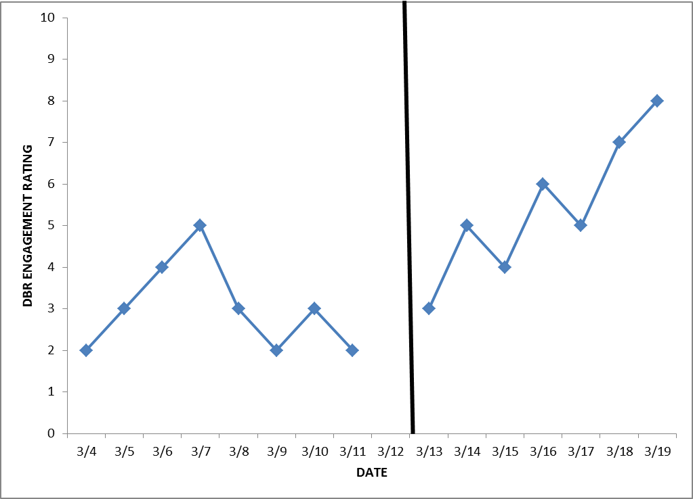
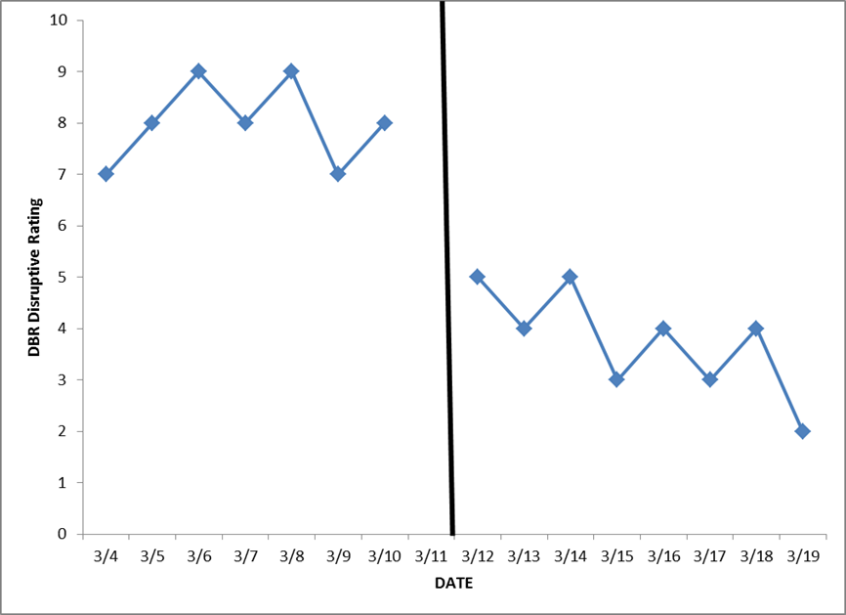
Pattern: Improved Behavior
After Intervention Change
Notes:
Let’s look at some data to see if our intervention is working.
Study the two graphs on the slide. What is the data telling you?
We sometimes want our target behavior to decrease (see the graph on the right). We sometimes want our target behavior to increase (see the graph on the left).

Slide 41
Interpreting Improved Behavior
After Intervention Change
Situation: The student’s response improves after an intervention change (direction depends on target behavior).
Analysis: No change in intervention is needed at this time. Continue monitoring until a change is needed or the goal is met.
Notes:
Discuss the situation and analysis on the slide.
Based on the graphs on the previous slide, the behavior improved after the intervention.

Slide 42
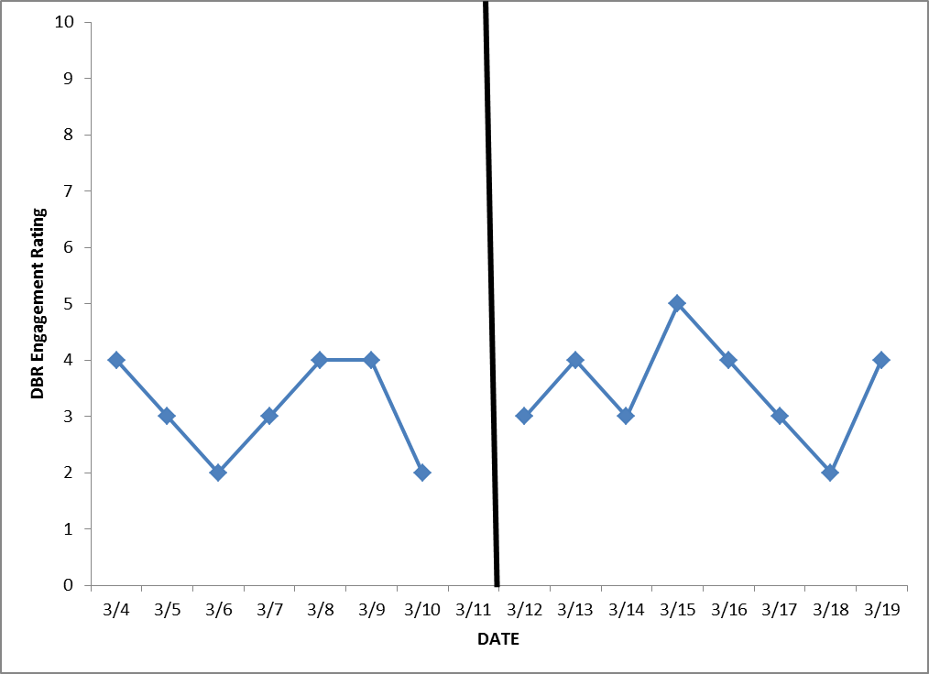
Pattern: No Change in Behavior
Notes:
Study the graph on this slide. What is it telling you? Discuss with your neighbor.
No change looks very similar for both academics and behavior.

Slide 43
Interpreting No Change
Situation: The data are similar before and after the change in intervention.
Possible interpretations:
  The student is not responding to the intervention.
  The student has not received the intervention with fidelity.
  The DBR tool is not sensitive to change for this behavior (revisit definition or anchors).
  The intervention is not an appropriate match for the student’s needs.
  The intervention is not addressing the function of the behavior.
Notes:
Give participants time to read the slide and discuss the possible interpretations listed on the slide.

Slide 44
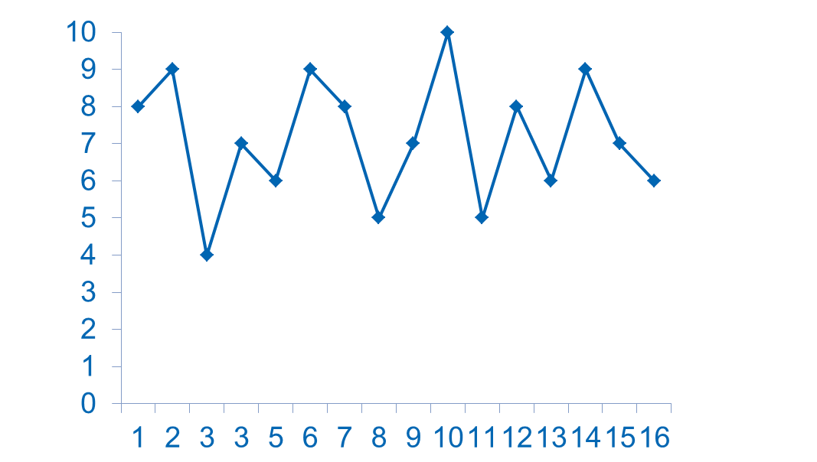
Pattern: Highly Variable Data
Disruptive DBR Rating
Number of School Days
Notes:
Study the graph on this slide. What is it telling you? Discuss with a partner.

Slide 45
Daily Data Used for Decision Making Steve
Steve’s Check In Check Out Performance
2010-2012
Notes:
What is this daily data telling you? Discuss with a partner.
What would your next steps be for this student?

Slide 46
Daily Data Used for Decision Making Rachelle
Rachelle’s Check In Check Out Performance
2010-2012
Notes:
What is this daily data telling you? Discuss with a partner.
What would your next steps be for this student?

Slide 47
Case Study:
Meet Aiden
Notes:
In this section, you will meet Aiden and you will work with others to determine a plan of action based on what we have covered today.

Slide 48
Aiden’s Story
Background: Aiden is a 12-year-old boy enrolled in the seventh grade. School records indicate that he has had difficulty getting along with his teachers and he gets easily frustrated when given certain academic assignments, especially in mathematics. He refused to complete his work and causes disruptions in the classroom. When the teacher gives back mathematics quizzes and tests, he usually rips his up. None of Aiden’s peers want to sit next to him.
Notes:
Take a few minutes to read about Aiden.

Slide 49
Activity – Case Study
Review Aiden’s case study and decide the following:
What is the behavior issue?
How you would address it? What intervention would you use and why?
How would you implement the intervention?
How would you tell if it was working?
Notes:
Purpose of the activity – In your classroom you might have a student like Aiden. This activity will prepare you to take the necessary steps to make sure student(s) with behavior issues are successful both academically and behaviorally.
Directions:
Work in groups of 3-4 students.
Allow 15-20 minutes for groups to reread Aiden’s case study, brainstorm and discuss
the four questions on the slide. Groups will choose one person to record ideas on chart paper and one person to be the speaker. The speaker will share the group’s ideas with the large group.
2. After all the groups have shared their recommendations, try to come to consensus regarding how to best help Aiden.
Debrief – Allowing participants to collaborate together will help them see that it is important to have more than just the classroom teacher make decisions about a student(s) intervention. Other staff in a school will be instrumental in the success of a student(s)

Slide 50
Key Questions to Ask Before Intensive Interventions
Has the student been taught using an evidence-based, supplemental intervention program (if available) that is appropriate for his or her needs?
Has the program been implemented with fidelity?
  Content
  Dosage/schedule
  Group size
Has the program been implemented for a sufficient amount of time to determine the response?
Notes:
In most cases, we would not determine that a student requires intensive intervention until we have evidence that she or he is not responding to supplemental intervention. Key questions in reviewing this evidence include:
Has the student been taught using an evidence-based supplemental intervention program (if available) that is appropriate for his or her needs? The supplemental intervention should match the student’s identified needs.
Has the program been implemented with fidelity? Fidelity addresses whether or not the intervention is being delivered as planned.
Content. Are all key components being delivered per the instructions?
Dosage/schedule. Has the intervention been delivered as intended in terms of frequency and length of sessions?
Group size. Is the group the size recommended by the intervention developer? You might also want to consider the group composition: Do these students have similar needs that match the intervention? Do any students have competing behavior issues?
Has the program been implemented for a sufficient amount of time to determine the response? Consider this question in terms of how long the intervention is intended to be implemented for, and consider whether there is enough data to detect a change in performance.

Slide 51
Distinction Between Supplemental Intervention and Intensive Interventions
 | Supplemental | Intensive
Instruction | Follow standardized, evidence-based programs as designed | Use standardized, evidence-based programs as a platform, but adapt instruction based on student data
Duration and Timeframe | Use the duration and timeframe defined by the developer | Increase the frequency and/or duration to meet student needs
Group Size | Use the group size defined by the developer | Decrease group size to meet student needs
Progress Monitoring | At least once per month | Weekly
Population Served | At-risk (typically 15% of the student population) | Significant and persistent learning and/or behavior needs (3-5% of the student population)
Notes:
There will be times when a supplemental intervention will not be sufficient for a student(s) and an intensive intervention is needed.
Read and study the slide to gain a better understanding of the difference between supplemental and intensive interventions. Give participants time to read the slide and then discuss together.

Slide 52
In Summary
Supplemental interventions should
Be evidence-based and implemented with fidelity
Help students be successful, both academically and behaviorally
Set the foundation for intensive intervention, if necessary
Notes:
In summary, implementing effective supplemental interventions is crucial for schools to establish a foundation for intensive intervention. When supplemental interventions are evidence-based and implemented with fidelity, schools are able to meet the needs of most at-risk students and obtain a clearer sense of which students require intensive intervention. Furthermore, the way supplemental interventions are implemented has important implications for identifying students. IDEA regulations for identifying students with specific learning disabilities no longer require the use of the discrepancy model, and they allow schools to identify students using a process based on the child’s response to scientific, research-based intervention. With this in mind, it is crucial for schools to have effective systems for evidence-based supplemental interventions in place, as a child’s responsiveness to these interventions has a large impact on their identification and future services.

