Slide 1


Collaboration for Effective Educator Development, Accountability, and Reform
Supplemental Behavioral Interventions
H325A120003
Notes:
In this presentation, you will learn about Evidence-Based Behavioral Interventions, the importance of implementing supplemental behavior interventions with fidelity, and using data to assess if the intervention(s) are working to improve student behavior.
Speaker notes are provided for most of the PowerPoint slides included. The notes provide additional details about the information presented in a particular slide, including the context for the information being presented as well as further elaboration of key points being discussed. Thus, the speaker notes are intended as a guide for a presenter who is using the PowerPoint slides and may be modified as needed.
Instructions for using the speaker notes
Text formatted in standard font is a sample script for the presenter. While these may be read verbatim, speaker notes are intended as a guide for the presenter and may be modified as needed.
Text formatted in italics is intended as directions or notes for the facilitator; italicized text is not meant to be read aloud.
Text formatted in underline indicates an appropriate time to click to bring up the next stage of animation in an animated slide.

Slide 2
Topics Overview
What Are Supplemental Interventions?
The Implementation Process
The Importance of Choosing Evidence-Based Behavioral Interventions and Implementing Them With Fidelity
Measuring Student Progress
Notes:
Here are the topics that will be covered in this presentation.
Give participants time to read this slide.

Slide 3
Note
This presentation uses content and resources from
The National Center on Intensive Intervention (NCII) www.intensiveintervention.org
OSEP Technical Assistance Center on Positive Behavioral Interventions and Supports (PBIS) www.pbis.org
Missouri Schoolwide Positive Behavior Support
www.pbismissouri.org
Notes:
Briefly give time for participates to view the slide.

Slide 4

What Are Supplemental Interventions?
Notes:
In this section, you will learn what supplemental interventions are, how they fit into the Positive Behavioral Interventions and Supports (PBIS) or other multi-tiered support models, and what their key characteristics are.

Slide 5
Supplemental Interventions Explained
Supplemental interventions are designed for at-risk students and students who are not responding to universal strategies.
Universal strategies can be effective for approximately 80 percent of students. Supplemental interventions can have a positive impact on approximately 15 percent of students.
        (Filter et al., 2007; Kett & Nelson, 2010)
Notes:
Give participants time to read the two bullets on the slide.
Supplemental interventions are used in the secondary tier or tier 2 of PBIS or multi-tiered systems of support. Interventions at the supplemental tier address the learning or behavioral challenges of at-risk students. The intervention(s) is targeted, evidence-based, and supplemental to core instruction. These interventions are delivered to small groups, and they occur in either the general education classroom or another general education setting, such as an intervention block. The types of assessments used in the secondary tier are the same as those used in the primary tier, but progress monitoring occurs with greater frequency to measure the student’s responsiveness to the secondary intervention.

Slide 6
CONTINUUM OF
SCHOOLWIDE
INSTRUCTIONAL AND
POSITIVE BEHAVIOR
SUPPORT
(PBIS.org)
Individual/Intensive:
Specialized
Individualized
Systems for Students With High-Risk Behavior
~5%
Supplemental: Specialized Systems for Students With At-Risk Behavior
~15%
Universal:
School/Classroom-
Wide Systems for
All Students,
Staff, and Settings
~80% of Students
Notes:
The logic of the triangle suggests that most students—about 80 percent—will respond positively to strong, systematic prevention techniques. This implies that about 20 percent of students, therefore, will not be responsive to the supports widely available in schools to promote prosocial behavior. The students who are non-responsive will require further support to maintain appropriate behavior in schools.
The typical process is to move these non-responding students to an intervention that will provide additional feedback on student behavior and opportunities to access rewards and positive attention. Fortunately, many of the students who demonstrated difficulty will show improvement. The anticipated response rate to preventative and secondary intervention supports is about 15 percent. Five percent of students will not be responsive to preventative or secondary intervention supports.

Slide 7

Supplemental Interventions
No more than 15 percent of students identified as “at risk”
Examples of supplemental
interventions:
    Social skills instruction
    Check In Check Out (CICO)
~15%
Notes:
Remember, supplemental Interventions are used for students who do not respond to universal interventions. No more than 15 percent of students should be identified as needing supplemental interventions.
Why are secondary interventions so important? By providing secondary interventions in academics and behavior to students who are flagged as “at risk,” schools are able to effectively meet the needs of the majority of these students and can begin to close the performance gap that may exist between them and their grade-level peers.
Because secondary interventions are standardized and often scripted, and because they include resources, they provide a means for schools to meet the needs of at-risk students and allow resources (including teachers’ time) to be used more efficiently. Effective secondary intervention programs provide teams with a more accurate picture of which students require intensive intervention. Additionally, data collected on a student’s response to an evidence-based secondary intervention program may be used as part of the Specific Learning Disability (SLD) identification process in your district or state, in accordance with state law.

Slide 8
Key Characteristics
Continuously available
Quickly and easily accessible
Minimal time commitment required from classroom teachers
Required skill sets can be easily learned by classroom teachers
Aligned with schoolwide expectations
(Crone, Hawken, & Horner, 2010)
Notes:
We’ll now discuss some of the key elements of secondary interventions.
Supplemental intervention supports should be available in school so that students can be added to the intervention at any time. Some interventions are organized so that students can begin receiving supports quickly. Other interventions, such as group counseling or other group approaches, may have a set cycle that dictates when a student can join a group, as well as a preparation period prior to initiating the intervention.
Some supplemental interventions may require classroom teachers to modify traditional methods or implement new teaching practices (e.g., increase positive feedback, monitor student progress, and evaluate behavioral and academic progress). Ideally, supplemental interventions will fit within existing classroom routines, require minimal changes to methods and strategies, and require only a few more minutes of teacher time each day.
The skill sets classroom teachers need are consistent with quality instruction or can be easily learned. Strategies that require intensive training and skill development not typically present in the repertoire of classroom teachers may be beyond the scope of supplemental interventions and may be considered intensive interventions. Your role as a leader is to support teachers in understanding the importance of using supplemental interventions to address student needs, and to model data-based decision making.

Slide 9
Key Characteristics continued
Staff/faculty are aware of the intervention(s) and their roles in the process
The intervention(s) is consistently implemented with most students, but with some flexibility
The selected program is matched to the function of the student’s behavior
Notes:
Supplemental interventions should be consistent with the universal approaches the school has developed. Schoolwide expectations should be taught and applied consistently across all three tiers (levels) for greater consistency in implementation.
All staff should understand the rationale and be able to describe the supplemental interventions used in their school. Staff with responsibility for implementation should have the training, skills, and administrative support to implement with fidelity. By understanding the implementation process, you can more effectively support teachers and other professionals as they deliver interventions with students.

Slide 10
Elements of Supplemental Interventions
Evidence-Based Intervention
Fidelity
  Adherence
  Student Engagement
  Program Specificity
  Quality of Delivery
  Exposure
Notes:
Now let’s discuss what it means to deliver supplemental interventions with fidelity and why it is important.
Fidelity refers to how closely prescribed procedures are followed and, in the context of schools, the degree to which teachers implement programs the way program developers intended. It also relates to the quality of the implementation. This means that teachers are implementing the intervention with consistency and accuracy and adhering to the instructional plan with integrity.
Note: Throughout discussions of fidelity, it is important to ensure that leaders believe that they work in an open, non-threatening environment that values their skills and expertise and allows them to learn from their colleagues. With a system of open communication and productive feedback, fidelity checks of classroom techniques and the essential components of multi-tiered systems of support can be a useful and supportive way for teachers to collaborate and become a stronger teaching network. This may be a useful discussion point for some groups.

Slide 11
Why Is Fidelity Important?
Ensures that intervention has been implemented as intended
Allows us to link student outcomes to intervention
Helps us to determine if the intervention is effective and make instructional decisions
Helps us achieve positive student outcomes
(Pierangelo & Giuliani, 2008)
Notes:
Why is fidelity important? If teachers aren't consistent and accurate in delivering supplemental interventions, they aren’t able to confidently explain a student's lack of response to an intervention. Did the student make insufficient progress because they require more intensive intervention? Or, did the student make insufficient progress because the supplemental intervention wasn’t delivered with fidelity? Without practicing consistency and integrity in intervention delivery, we can't link, or attribute, student outcomes to the instruction provided. Fidelity allows us to evaluate the effectiveness of the supplemental intervention, and it tells us when a student may require a more intensive level of intervention.
Furthermore, Pierangelo and Giuliani (2008) concluded that positive student outcomes are particularly dependent on aspects of fidelity within the framework of a tiered support system. One of these aspects is fidelity of implementation at the classroom or teacher level.

Slide 12
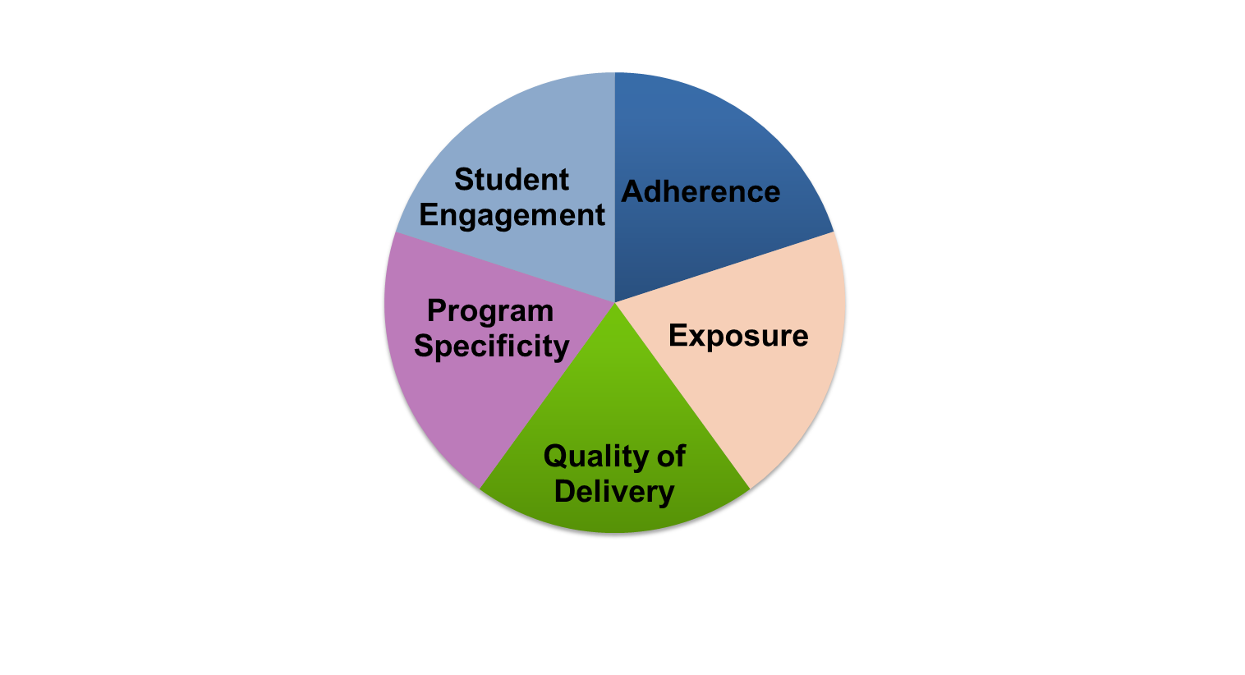
Five Elements of Fidelity
Student Engagement: How engaged and involved are the students in this intervention or activity?
Adherence: How well do we stick to the plan, curriculum, or assessment?
Program Specificity: How well is the intervention defined and how is it different from other interventions?
Exposure/Duration: How often does a student receive an intervention? How long does an intervention last?
Quality of Delivery: How well is the intervention, assessment, or instruction delivered? Do you use good teaching practices?
(Dane & Schneider, 1998; Gresham et al., 1993; O’Donnell, 2008)
Notes:
Interactive slide
This graphic provides one example of how to think about fidelity, and it includes the elements of adherence, exposure, quality of delivery, program specificity, and student engagement.
Your school should have procedures in place to monitor the fidelity with which they implement supplemental interventions. While these don’t have to be formal, it is important to consider whether or not your programs are being implemented the way that they are intended to be delivered. In the midst of all the responsibilities of educators, small checks can make a big difference in keeping services for students on track.
Note: The notes on each element of fidelity are animated to pop up with each click. Click ahead each time you discuss a new element of fidelity, and click again to close that element.
1. (Click) When we discuss adherence we are focused on how well we stick to the plan/curriculum/assessment, or whether we are implementing the plan/curriculum/assessment as it was intended to be implemented based on research. For a supplemental intervention, this may mean how well teachers implement all pieces of an intervention, and whether they implement them in the way they were intended to be implemented. This doesn’t necessarily mean that teachers should follow a script word for word, but covering certain content with appropriate pacing and relevant language and techniques is important. (Click)
2. (Click) Duration/Exposure refers to how often a student receives an intervention and how long an intervention lasts. When thinking about fidelity, we are considering whether the exposure/duration being used with a student matches the recommendation by the author/publisher of the curriculum.
In the case of supplemental interventions, developers and researchers typically specify the required exposure/duration that is needed for the intervention to be effective for most students. If the intervention developer calls for the intervention three days a week, for 45 minutes each day, is the student receiving this dosage? (Click)
3. (Click) Not only is it important to adhere to the plan/curriculum/assessment, but it is also important to look at the quality of the delivery. This refers to how well the intervention, assessment, or instruction is delivered. For example, do you use good teaching practices? Quality instructional delivery also means that teachers are engaged in what they’re teaching and animated in their delivery, not simply reading from a script. Providing teachers with constructive feedback on their instructional delivery is one way to improve the quality of delivery for supplemental interventions. (Click)
4. (Click) Another component is program specificity, or how well the intervention is defined and how different it is from other interventions. Having clearly defined interventions/assessments allows teachers to more easily adhere to the program as defined. Is the intervention a good match for the student’s needs? Or does every low reader get the same intervention? (Click)
5. (Click) Just as the quality of the delivery is critical, it also is important to focus on student engagement, or how engaged and involved the students are in the intervention or activity. Following a prescribed program alone is often not enough. Consider whether or not competing behaviors make it difficult for students to take part in the intervention as designed. During the delivery of supplemental interventions, teachers may need to use behavior management strategies to manage student behaviors, including providing choice, adding elements of competition, and offering frequent opportunities to respond. (Click)

Slide 13
The Implementation Process
Notes:
In this section, you will learn how to match the behavior intervention to student need, implement the intervention with fidelity, and progress monitor to see if the intervention is working and student behavior is improving.

Slide 14
The Implementation Process!
1. Identify students at risk
2. Match intervention to student need
3. Implement intervention
4. Progress monitor
Notes:
The 4-step implementation process includes these steps. We will talk about each step in more detail in the following slides.

Slide 15
1. Identifying “At-Risk” Students
Office discipline referrals (ODRs)
  These identify students who are not successful at the universal level
Teacher referrals
  These follow a clear process
  They also provide supporting data
Screening
  This involves the use of a tool or checklist, such as
    Systematic Screening for Behavior Disorders (SSBD)
    Walker-McConnell Scales
Notes:
Note: Office discipline referrals or ODRs are also referred to as incident reports.
Along with your leadership team – or members of PBIS or RTI committees – your responsibility is to help identify “at-risk” students and explain to your staff their role in the identification process.
Multiple methods are used to identify students for supplemental supports. Students should be identified through various methods, such as office discipline referrals, screenings, teacher nominations, parent and support service recommendations, formative assessments, and so on. No single method is likely to identify all the students who may need supplemental supports. The identification methods selected should be efficient in terms of their cost and amount of time they require from school personnel.
Identify students early before problems develop to a level that requires intensive intervention.

Slide 16
2. Match Intervention to Student Need
Remember the ABCs of behavior
  A = Antecedent. What happens before the behavior?
  B = Behavior. What does the person do (measureable or observable)?
  C = Consequences. What happens after the behavior?
Choose an intervention(s) that matches the likely function of the behavior
Notes:
Classroom teachers should be familiar with the ABCs of behavior and often have tools they are using to collect both anecdotal and observational data. If a teacher comes to you with a concern about a student, it may be helpful to have them collect some baseline ABC data if they haven’t already done so.
It is also important to understand that all behavior serves a purpose. When we begin to think about specific interventions for students, it is important to keep that purpose – or function – in mind. A specific question to ask to help yourself and teachers think about function would be: is the student performing the behavior to get something or avoid something?
For example, a student may engage in a problem behavior to get attention. The function of his/her behavior would be “attention-seeking.” Other students may engage in a problem behavior, like sleeping or asking to use the bathroom when seatwork is assigned, to avoid completing a task. The function of that behavior would be “avoidance,” which is also called “escape.”
Knowing the function helps us select supplemental interventions that are more likely to be effective at reducing the student’s demonstration of a problem behavior. For example, if a student is trying to get attention through their behavior, a supplemental intervention like Check In Check Out would be appropriate to consider implementing.
Specific examples of supplemental interventions will be shared in a few minutes.

Slide 17

Academic Supports
Students displaying inappropriate behaviors may need more academic supports.
Curriculum-based assessment should be used to monitor academic performance.
  Center on Response to Intervention
    www.rti4success.org
Notes:
When thinking about student behavior, it is important to consider the academic needs a student may have, as well. As a leader, you should help your teachers and leadership teams identify students that have academic and behavior challenges. Consider that their behavior challenges could be related to their academic challenges.
Discuss as a group

Slide 18
3. Implement the Intervention
Make a plan for implementing the intervention in accordance with the developers’ directions:
  Who will deliver the intervention?
  When and where?
  For how long?
Notes:
Who will deliver the intervention? Has the person(s) been properly trained?
When and where will the intervention be delivered?
What is the duration of the intervention?
Purpose of the activity – This activity will help you understand how an intervention should be delivered to achieve the desired outcome(s) for students.
Directions for the activity-
With a partner:
Fold a sheet of paper into three parts vertically (hotdog fold). Mark the first column who, the second column when/where, and the third column duration.
In column one, list various people in a school that could deliver a behavior intervention (e.g., classroom teacher, classroom aide, guidance counselor, etc.)
In column two, list when and where the behavior intervention can be implemented (e.g., all day, in the morning, at lunch and recess, etc.)
In column three, list the amount of time per day, week, month (if applicable) a behavior intervention can last (e.g., a social skills club might last one month)
Discuss in a large group.
Putting it all together – It is important that the intervention be implemented by properly trained school personnel at specific location(s) in the school setting and have a specific timeline in place to measure if the intervention is successful.

Slide 19
Evidence-Based Interventions
Evidence-based interventions (EBIs) reflect a base of research evidence that documents their effectiveness.
EBIs are likely to be effective in changing target behavior if implemented with fidelity.
Notes:
Remember that an important part of any tiered system of support is the use of evidence-based interventions. But, how do you know if a program or strategy is evidence-based?
Allow audience time to respond
You can focus your efforts by looking at these areas when examining the evidence base:
First, consider the type of information and the source from which you are gathering this information. Is the information coming from the intervention vendor or a reputable website? It is also worth considering the type of evidence that is available. Did the study involve experimental design (i.e., where the intervention group was compared to an equivalent control group?).
Next, consider the population. For which populations has the program been researched and found effective? Is the sample described? Is the population similar to, or representative of, your student population? Are there different effects for different population groups?
It is also important to consider whether or not the desired outcomes assessed in a study are relevant to the outcomes you hope to achieve with an intervention.
Finally, consider the effects. Were the effects identified in the study large?

Slide 20
Examples of Evidence-Based Interventions
Some commonly used and well-researched interventions include
The Behavior Education Program (also known as Check In Check Out)
Check & Connect
Social Skills Instructional Groups
Academic Instructional Groups
Academic Accommodations
Supplemental Environmental Interventions
pbismissouri.org
Notes:
Here are some examples of evidence-based interventions that meet the criteria we just talked about.
Give a brief description of Check In Check Out.

Slide 21
Examples of Evidence-Based Behavior Curricula
Bully-Proofing Your School
Cool Tools: An Active Approach to Social Responsibility
First Steps to Success
Good Talking Words
Second Step Violence-Prevention Curricula
Stop and Think
Skillstreaming
The Social Skills Curriculum
The Walker Social Skills Curriculum: The Accepts Program
PBIS Center, www.pbis.org
Notes:
Note: We are not personally supporting these programs. They are presented here for informational purposes only. They are programs that have been found, by the PBIS Center, to be evidence-based.
Here are some examples of curricula that have been found, by the PBIS Center, to be evidence-based.

Slide 22
4. Progress Monitoring
Progress monitoring is the process of systematically planning, collecting, and evaluating data to inform programming decisions. Progress monitoring
  Provides a basis for determining whether an intervention is effective for a given student
  Assists with developing effective intervention plans
Evidence-based supplemental interventions work for many students. Monitor progress to determine if the plan is working for this student.
Notes:
Let’s define progress monitoring. Discuss the definition above. Why is progress monitoring important? (It tells us if a behavior intervention is working for a particular student.)
Behavioral progress monitoring is more than simply collecting assessment data—we must also analyze the data to determine whether the intervention is working or not.

Slide 23
Progress Monitoring Uses
Data allow us to…
Assess current performance
Determine the rate of progress or response to the intervention
Identify when an intervention change is needed
Hypothesize potential sources of need
Notes:
Here are some uses for progress monitoring data. Discuss each one and explain why it is important.
Data results help us to:
Hypothesize the potential sources of need
Identify when an intervention change is needed
Determine the rate of progress or response to the intervention
Assess current performance

Slide 24
Progress Monitoring Benefits
Accountability
Evaluation
Transparency
Justification
Dissemination
Notes:
Ultimately, the information generated through progress monitoring will support an evaluation of the intervention’s effectiveness, increase the transparency of—and provide justification for—programming decisions, and allow information to be readily disseminated among key stakeholders.

Slide 25
Activity: How Much Do You Remember?
With a partner:
List the four steps in the implementation process
Write as many facts as you can that describe each step
Explain why each step is important
Handout #5: The Four Steps in the Implementation Process
Notes:
Purpose of the activity is to review the implementation process and make sure that the intervention is implemented with fidelity to achieve desired outcomes.
Directions:
This activity has been designed to be completed in pairs. Adult learning principles suggest that it is important for partners to work together in learning new content. For example, two partners can share information and build on each others’ ideas. However, this activity can also be adapted for individuals or small groups.
With a partner:
Read and discuss the directions on the slide.
Use handout #5 to fill in the four steps in the implementation process.
Answer question 3 in a large group to allow for additional learning and processing.

Slide 26
Measuring Student Progress
Notes:
In this section, information about how to measure student progress will be presented. A key reason to measure progress is to analyze data to assess if a behavioral intervention(s) is working or needs to be changed. You may need to support training efforts for your staff on how to analyze collected data, especially if the information presented here is new to you or is different from the current system your school/leadership team is using to implement interventions and monitor student progress.

Slide 27

Data Collected for Supplemental Interventions
Data to assess impact:
  Office Daily Referrals (ODRs)
  Data collected as part of the intervention (e.g., check-in, check-out points)
Data to assess implementation:
  Implementation checklists
  Classroom observations
Notes:
Why is it important to collect data?
Possible responses:
Lets you know if an intervention is working.
Lets you know if more intensive intervention is necessary.
Share with other faculty members and parents
Informs instruction (if academics play a part in the undesired behavior).

Slide 28
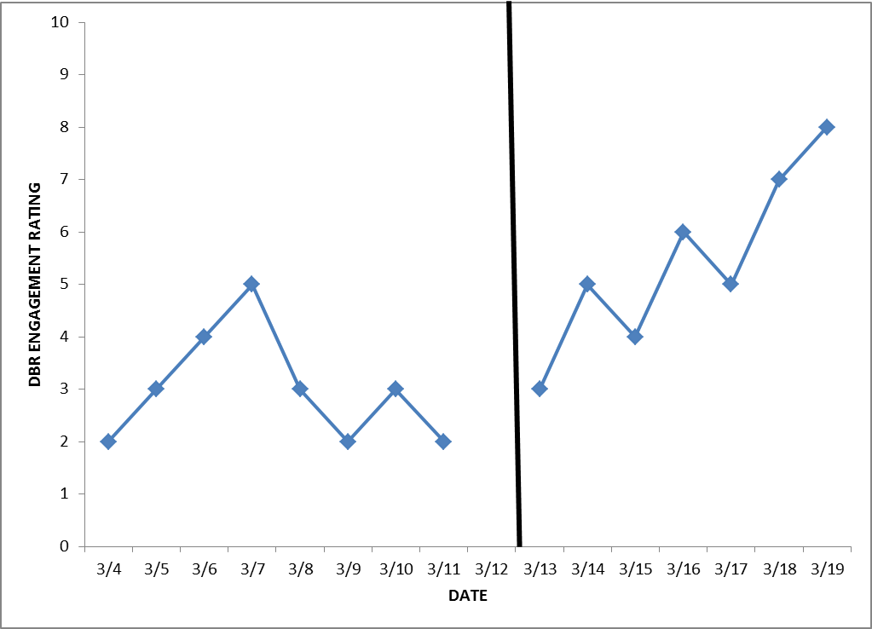
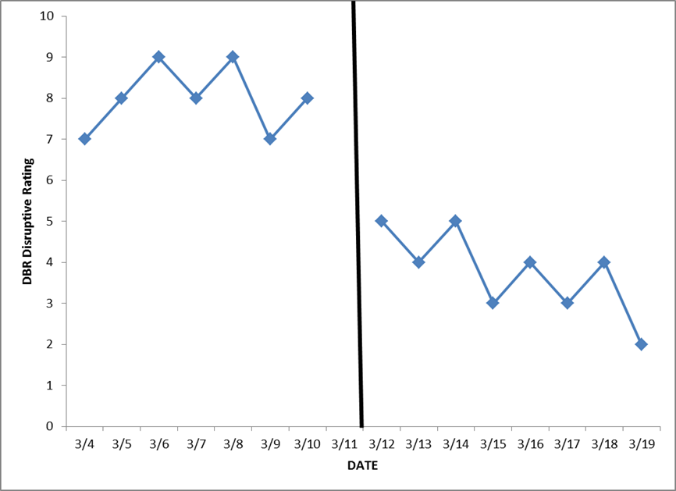
Pattern: Improved Behavior
After Intervention Change
Notes:
Let’s look at some data to see if our intervention is working. There are two different graphs displayed (point to each graph) that show data collection over time. The solid black line shows when an intervention was started. Keep in mind that it is important to collect baseline data so we can make sure the intervention is working.
Study the two graphs on the slide. What are the data telling you?
We sometimes want our target behavior to decrease (see the graph on the right). We sometimes want our target behavior to increase (see the graph on the left).

Slide 29
Interpreting Improved Behavior
After Intervention Change
Situation: The student’s response improves after an intervention change (direction depends on target behavior).
Analysis: No change in intervention is needed at this time. Continue monitoring until a change is needed or the goal is met.
Notes:
Discuss the situation and analysis on the slide.
Based on the graphs on the previous slide, the behavior improved after the intervention.

Slide 30
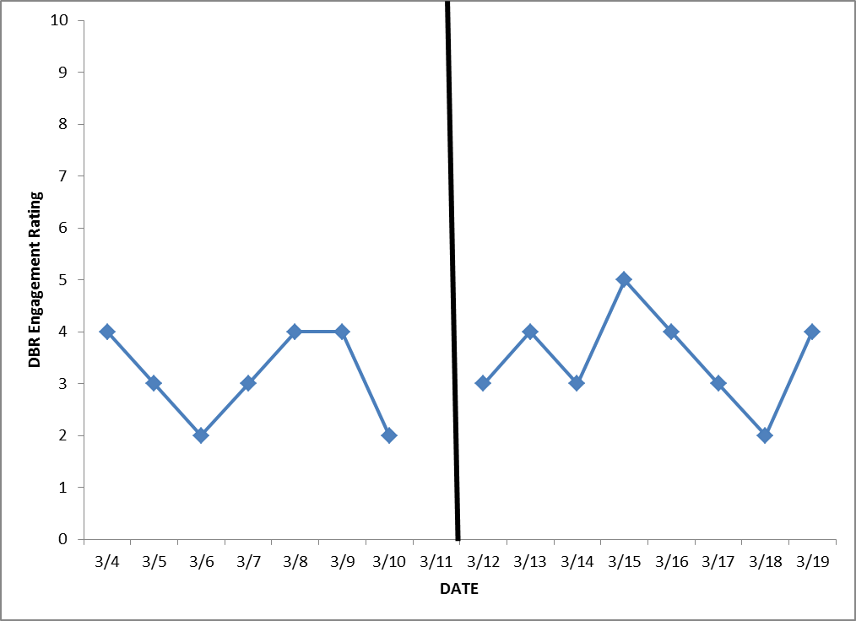
Pattern: No Change in Behavior
Notes:
Study the graph on this slide. What is it telling you? Discuss with your neighbor.
No change looks very similar for both academics and behavior.

Slide 31
Interpreting No Change
Situation: The data are similar before and after the change in intervention.
Possible interpretations:
  The student is not responding to the intervention.
  The student has not received the intervention with fidelity.
  The progress monitoring tool is not sensitive to change for this behavior.
  The intervention is not an appropriate match for the student’s needs.
  The intervention is not addressing the function of the behavior.
Notes:
Give participants time to read the slide and discuss the possible interpretations listed on the slide.

Slide 32
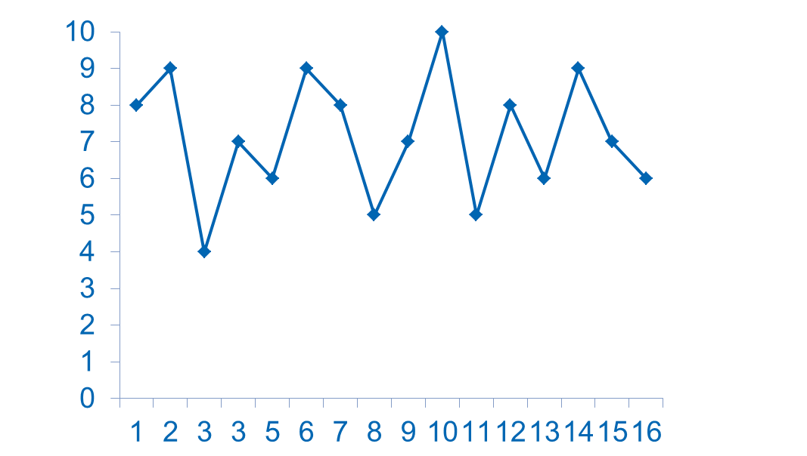
Pattern: Highly Variable Data
Disruptive Behavior Rating
Number of School Days
Notes:
Study the graph on this slide. What is it telling you? Discuss with a partner.

Slide 33
Interpreting Highly Variable Data
Situation: Data are inconsistent.
Possible explanations:
  The progress monitoring tool is not reliable for this behavior.
  The administration of the assessment is inconsistent.
  The behavior is as variable as the data suggest. Look for patterns in the setting, time of day, day of week, etc.
Notes:
Based on the previous slide:
Review the situation and possible explanations on the slide and discuss.

Slide 34
Daily Data Used for Decision Making for Steve
Steve’s “Check In Check Out” Performance
2010-2012
Notes:
For this example, a student is participating in the supplemental intervention, Check In Check Out. For the intervention, the student sets a daily goal to earn points. The graph is showing the percentage of points that the student is earning across days.
What is this daily data telling you? Discuss with a partner.
What would your next steps be for this student?

Slide 35
Daily Data Used for Decision Making
Rachelle’s “Check In Check Out” Performance
2010-2012
Notes:
What is this daily data telling you? Discuss with a partner.
What would your next steps be for this student?

Slide 36
Key Questions to Ask Before Intensive Interventions
Has the student been taught using an evidence-based, supplemental intervention program (if available) that is appropriate for his or her needs?
Has the program been implemented with fidelity?
  Content
  Dosage/schedule
  Group size
Has the program been implemented for a sufficient amount of time to determine the response?
Notes:
In most cases, we would not determine that a student requires intensive intervention until we have evidence that she or he is not responding to supplemental intervention. Key questions in reviewing this evidence include:
Has the student been taught using an evidence-based supplemental intervention program (if available) that is appropriate for his or her needs? The supplemental intervention should match the student’s identified needs.
Has the program been implemented with fidelity? Fidelity addresses whether or not the intervention is being delivered as planned.
Content. Are all key components being delivered per the instructions?
Dosage/schedule. Has the intervention been delivered as intended in terms of frequency and length of sessions?
Group size. Is the group the size recommended by the intervention developer? You might also want to consider the group composition: Do these students have similar needs that match the intervention? Do any students have competing behavior issues?
Has the program been implemented for a sufficient amount of time to determine the response? Consider this question in terms of how long the intervention is intended to be implemented for, and consider whether there is enough data to detect a change in performance.

Slide 37
Distinction Between Supplemental Intervention and Intensive Interventions
 | Supplemental | Intensive
Instruction | Follow standardized, evidence-based programs as designed | Use standardized, evidence-based programs as a platform, but adapt instruction based on student data
Duration and Timeframe | Use the duration and timeframe defined by the developer | Increase the frequency and/or duration to meet student needs
Group Size | Use the group size defined by the developer | Decrease group size to meet student needs
Progress Monitoring | At least once per month | Weekly
Population Served | At-risk (typically 15% of the student population) | Significant and persistent learning and/or behavior needs (3-5% of the student population)
Notes:
We have now looked at different graphs together and analyzed data. For some students, supplemental interventions will demonstrate positive changes for student behavior. But, there will be times when a supplemental intervention may not be sufficient for a student, suggesting that an intensive intervention is needed. It is always important to analyze the data and respond accordingly before layering on intensified supports for students.
Read and study the slide to gain a better understanding of the difference between supplemental and intensive interventions. Give participants time to read the slide and then discuss together.

Slide 38
Resources to Locate Evidence-Based Practices
What Works Clearing House
- http://ies.ed.go/ncee/wwc/
Promising Practices Network
- http://www.promisingpractices.net/
Current Practices Alert
- http://www.teachingld.org/Id_resources/alerts/
Evidence Based Interventions Network
-http://ebi.missouri.edu/
IRIS Center
    - http://iris.peabody.vanderbilt.edu
Florida’s Positive Behavior Support Project
- http://flpbs.fmhi.usf.edu/index.cfm
Notes:
This slide lists websites for resources that are evidence-based.
Activity: Website Share
Click on each link and show features of the resources to the audience.

Slide 39
In Summary
Supplemental interventions should
Be evidence-based and implemented with fidelity
Help students be successful, both academically and behaviorally
Set the foundation for intensive intervention, if necessary
Notes:
In summary, implementing effective supplemental interventions is crucial for schools to establish a foundation for intensive intervention. When supplemental interventions are evidence-based and implemented with fidelity, schools are able to meet the needs of most at-risk students and obtain a clearer sense of which students require intensive intervention. Furthermore, the way supplemental interventions are implemented has important implications for identifying students. IDEA regulations for identifying students with specific learning disabilities no longer require the use of the discrepancy model, and they allow schools to identify students using a process based on the child’s response to scientific, research-based intervention. With this in mind, it is crucial for schools to have effective systems for evidence-based supplemental interventions in place, as a child’s responsiveness to these interventions has a large impact on their identification and future services. As a leader, you set the tone for how systems are facilitated at your school – remember to use data-based decision-making for both behaviors and academics.

