Slide 1

Disciplinary Literacy
Collaboration for Effective Educator Development, Accountability and Reform
H325A120003

Slide 2
Every teacher a reading teacher?
Shift away from every teacher a reading teacher
Explore the overlay of generic content and discipline-dependent literacy practices
GOAL: Every teacher teaches literacy skills essential to their discipline

Slide 3
Objectives:
After participating in this PD, you will be able to:
Define disciplinary literacy
Note how the CCSS address disciplinary literacy
Discern unique literacy skills utilized in:
  History
  Mathematics
  Science & Technical Subjects
  Literary Genres
Model how to think aloud to teach close reading of disciplinary literacy
Plan effective, evidence-based scaffolds for students with learning difficulties

Slide 4
Common Core State Standards
Instructional Shifts
Emphasis on increased
reading of complex informational text
knowledge of disciplines
reliance on evidence from text
critical & analytical writing
academic vocabulary
Source: Adapted from www.engageNY.org, Instructional Shifts for the Common Core

Slide 5
Why Are Disciplinary Texts Difficult for Students?
Students may lack:
Experience reading lengthy expository text
Content-specific vocabulary
3. Decoding skills
4. Comprehension strategies
5. Background knowledge and
interest in the content

Slide 6
Disciplinary Literacy Standards
Activity
  Form pairs of partners A & B
  A’s move to the right and partner with another A
  B’s move to the left and partner with another B
  Materials Needed:
  The Common Core State Standards
  for your discipline
  (or your state standards)

Slide 7
What are Students Expected to Know about Disciplinary Literacy?
Partner A:
  6-12 ELA Standards for Informational Text & Writing pg. 39-47
Partner B:
  CCSS for Literacy in History/Social Studies, Science and Technical Subjects pg. 60-66
  NOTE: New insights and challenges

Slide 8
Partner Insights
On chart paper, write 2-3 insights
Post
You have 3 minutes

Slide 9
What is Disciplinary Literacy?
Knowledge of the unique protocols for each discipline
Historians, scientists, mathematicians, poets, musicians, artists–all approach text from unique perspectives

Slide 10
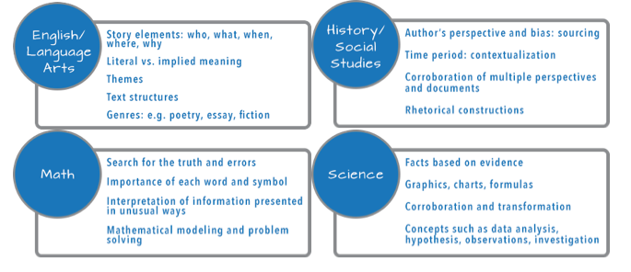
Successful reading in various disciplines involves:

Slide 11
Disciplinary Literacy Instruction
Refers to the specialized ways of knowing and communicating in the different disciplines to make meaning
Encompasses the idea that students need to be taught specialized routines
(Jetton & Shanahan, 2012)

Slide 12
Activity: Examine Your Text
What about the text is unique to your discipline?
What might be difficult for students?
What are examples of academic vocabulary specific to your discipline?
Select parts to model.

Slide 13
Model: Talking to the Text
Partner A: Annotations
Partner B: Strategies
All: Anticipated challenges for your students
Watch Student Reading Reflections
Notes:
https://vimeo.com/79984939

Slide 14
Your Turn to Talk to the Text
Partner B: Read and talk to the text
Partner A: Scribe
At the end of the second stanza, switch roles.
What strategies did you use?

Slide 15
What About These Strategies?
1. KWL and KWHL
2. Anticipation guides
3. Semantic feature analysis
4. Text structure analysis
5. Graphic organizers
6. Other

Slide 16
The Increasing Specialization of Literacy Development
Intermediate Literacy
Comprehension, word meanings, fluency
Disciplinary Literacy
Specialized literacy skills
Basic Literacy

Slide 17
Reflections of a Researcher
Let’s listen to Tim Shanahan, a researcher in this field from the University of Illinois at Chicago.
Listen to Dr. Shanahan's comments
Notes:
https://vimeo.com/76217730

Slide 18
Dr. Shanahan’s Comments
…disciplinary literacy is engaging students “in not just learning about the discipline, but actually in using reading and writing in the same way the historian or scientist does.”

Slide 19
10 Strategies to Read Complex
Texts in the Disciplines
Start with easier texts; build complexity
Start with small chunks of text & increase
Celebrate when students read longer text
Model struggling with text; honor the struggle
Teach students to pay attention to important parts of the text (graphic organizers, annotation)

Slide 20
Strategies (continued)
Set authentic purposes for reading
Model working carefully through text
Before teaching, determine the key ideas & significant details; plan supports
Teach students to collaborate with peers
Talk less; listen more. Allow students to figure out the text & answer their own questions

Slide 21
Partner Activity
Choose 2 strategies (not #3, 9, or 10)
Plan how to apply the strategies with your students
Be specific
Be prepared to share
Notes:
New slide #21 speaker notes: With your partner, select 2 of these teaching strategies (not #3,9 or 10). Pick two that you feel you need to apply more often. Using your text, plan with your partner how you would apply the two strategies with your students.

Slide 22
Close Reading
The standards focus on students reading closely to draw evidence and knowledge from the text.
Close reading and gathering knowledge from specific texts should be at the heart of classroom activities.
Coleman & Pimentel (2012) p. 1 & 9.

Slide 23
Components of Close Reading
Read and reread for different purposes
Be an active reader—annotate
Summarize
Self-explain, ask and answer questions
Determine the significance of ideas and information
Hinchman & Moore (2013), adapted

Slide 24
Why Reread?
1st reading: What are the main ideas of this text? (basic comprehension)
2nd reading: How does this text work? (devices used by the author, word choice, quality of evidence, how data was presented)

Slide 25
Leading to Deep Comprehension
3rd reading: What does this text mean? (critical analysis, connect to other texts and to me)
After reading, students engage in high-level discourse to further analyze the text
Shanahan, T. (June, 2013). Shanahan on Literacy.

Slide 26
Discipline-Specific Strategies for Previewing Text
Model previewing literature:
  What is the significance of the title?
  Who is the author?
  What is the genre?

Slide 27
Discipline-Specific Strategies for Previewing Text
With a partner teaching the same subject, list what students should attend to when previewing a piece of text (pre-reading strategies).
Write the critical points on chart paper.

Slide 28
Previewing Mathematics
  Skim the chapter for an overview.
  Read the chapter introduction, section titles, and section summaries.
  Note (and mark) unknown terms.

Slide 29
Previewing History
  Who is the author?
  When was it written?
  What is the topic?

Slide 30
Previewing Science
  What is the problem or phenomenon?
  What do I know about this topic?
  What do I predict about this problem or phenomenon?

Slide 31
Let’s Try It!
Read an article by Thomas Paine.
Be prepared to tell me the main idea.

Slide 32
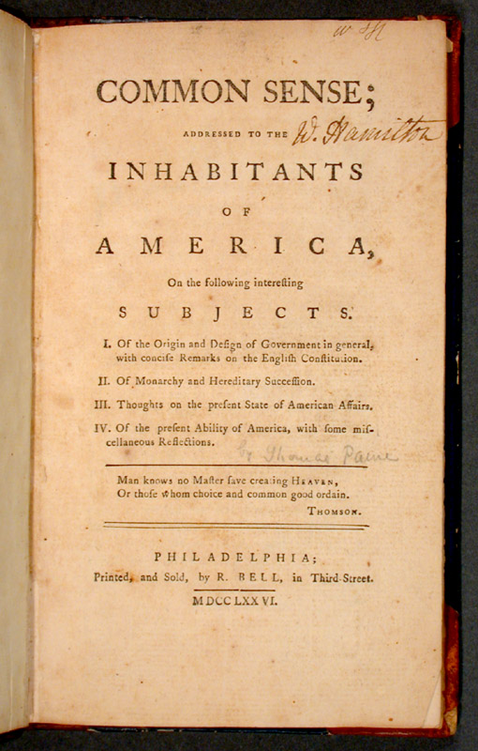
Common Sense

Slide 33
Model: Think Aloud
What strategies does this teacher model that help solve comprehension problems?
Watch “A Better Example”

Slide 34
Practice Think Alouds
Partner A reads and thinks aloud while solving comprehension problems
Partner B scribes A’s think alouds
Switch roles
Compare strategies used

Slide 35
Strategies Good Readers Use
With your partner, list the strategies you used
Add to the class poster of effective strategies
Circle the strategies that pertain to the discipline
Underline generic strategies

Slide 36
CCSS & Students with Disabilities
“The Standards allow for the widest possible range of students to participate fully from the outset and with appropriate accommodations to ensure maximum participation of students with special education needs.”
Source: Common Core State Standards, p 9.

Slide 37
Scaffolding Instruction
Increase opportunities to practice skills
Provide instruction in small groups
  Preteach
  Smaller tasks
  Specific strategies
Require reading of less text
Provide more time
Provide intensive interventions as needed

Slide 38
Returning to Paine…
With your partner, consider how you would modify this lesson to ensure ALL students have access to the learning.
Consider students who:
  Are struggling readers
  Have a learning disability
  Are English Language Learners

Slide 39
To be continued…
3 questions you have
2 things you learned
1 thing you’ll use
Remember, I am modeling activities you can use with your students! This is an exit card activity.

