Slide 1

Disciplinary Literacy
Collaboration for Effective Educator Development, Accountability and Reform
H325A120003

Slide 2
Every teacher a reading teacher?
Shift away from every teacher a reading teacher
Explore the overlay of generic content and discipline-dependent literacy practices
GOAL: Every teacher teaches literacy skills essential to their discipline

Slide 3
Objectives:
After participating in this PD, you will be able to:
Define disciplinary literacy
Note how the CCSS address disciplinary literacy
Explain why disciplinary literacy is important for all students
Articulate what teachers and students need to know and be able to do
Apply the components of close reading

Slide 4
Objectives (continued)
Discern unique literacy skills utilized in:
  History
  Mathematics
  Science & Technical Subjects
  Literary Genres
Model how to think aloud to teach close reading of disciplinary literacy
Plan effective, evidence-based scaffolds for students with learning difficulties

Slide 5
Common Core State Standards
Instructional Shifts
Emphasis on increased
reading of complex informational text
knowledge of disciplines
reliance on evidence from text
critical & analytical writing
academic vocabulary
Source: Adapted from www.engageNY.org, Instructional Shifts for the Common Core

Slide 6
Why Are Disciplinary Texts Difficult for Students?
Students may lack:
Experience reading lengthy expository text
Content-specific vocabulary
3. Decoding skills
4. Comprehension strategies
5. Background knowledge and
interest in the content

Slide 7
Teachers Expected to Know
CAEP
1.1 Teacher candidates and completers know subject matter (including pedagogical content knowledge) and pedagogy
CEC
3.1 Beginning special education professionals understand the central concepts, structures of the discipline, and tools of inquiry of the content areas they teach , and can organize this knowledge, integrate cross-disciplinary skills, and develop meaningful learning progressions for individuals with exceptionalities
CCSS
CCSS.ELA-Literacy.RH.9-10.6 Compare the point of view of two or more authors for how they treat the same or similar topics, including which details they include and emphasize in their respective accounts

Slide 8
What is Disciplinary Literacy?
Knowledge of the unique protocols for each discipline
Historians, scientists, mathematicians, poets, musicians, artists–all approach text from unique perspectives

Slide 9
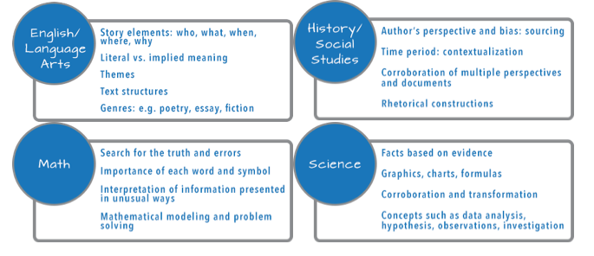
Successful reading in various disciplines involves:

Slide 10
Disciplinary Literacy Instruction
Refers to the specialized ways of knowing and communicating in the different disciplines to make meaning
Encompasses the idea that students need to be taught specialized routines
(Jetton & Shanahan, 2012)

Slide 11
Disciplinary Literacy is NOT:
Another term for content area reading
A method to work with poor readers
A generalized approach to literacy
across disciplines
Limited to study skills

Slide 12
What About These Strategies?
1. KWL and KWHL
2. Anticipation guides
3. Semantic feature analysis
4. Text structure analysis
5. Graphic organizers
6. Other

Slide 13
The Increasing Specialization of Literacy Development
Intermediate Literacy
Comprehension, word meanings, fluency
Disciplinary Literacy
Specialized literacy skills
Basic Literacy

Slide 14
10 Strategies to Read Complex
Texts in the Disciplines
Start with easier texts; build complexity
Start with small chunks of text & increase
Celebrate when students read longer text
Model struggling with text; honor the struggle
Teach students to pay attention to important parts of the text (graphic organizers, annotation)

Slide 15
Strategies (continued)
Set authentic purposes for reading
Model working carefully through text
Before teaching, determine the key ideas & significant details; plan supports
Teach students to collaborate with peers
Talk less; listen more. Allow students to figure out the text & answer their own questions

Slide 16
Close Reading
The standards focus on students reading closely to draw evidence and knowledge from the text.
Close reading and gathering knowledge from specific texts should be at the heart of classroom activities.
Coleman & Pimentel (2012) p. 1 & 9.

Slide 17
Why Reread?
1st reading: What are the main ideas of this text? (basic comprehension)
2nd reading: How does this text work? (devices used by the author, word choice, quality of evidence, how data was presented)

Slide 18
Leading to Deep Comprehension
3rd reading: What does this text mean? (critical analysis, connect to other texts and to me)
After reading, students engage in high-level discourse to further analyze the text
Shanahan, T. (June, 2013). Shanahan on Literacy.

Slide 19
Modeling Close Reading of Complex Disciplinary Text
Don’t commit “assumicide”
Students need explicit instruction
Remember to
Model
Model
Model
Model
Model
Model
Model…
your thinking as a historian, a scientist, a mathematician, a literary expert!

Slide 20
Let’s Try It!
Read an article by Thomas Paine.
Be prepared to tell me the main idea.

Slide 21
POP QUIZ!
Who was Thomas Paine?
To whom did he write?
Why did he write this?
What is the main idea?
Write a five-paragraph essay explaining why you agree or disagree with the author.
THIS IS A NONEXAMPLE! THIS IS NOT BEST PRACTICE! DO NOT DO THIS!

Slide 22
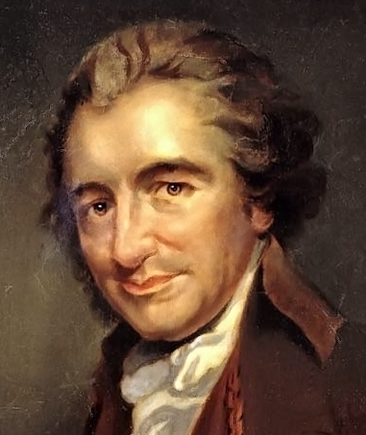
Thomas Paine, 1737–1809

Slide 23
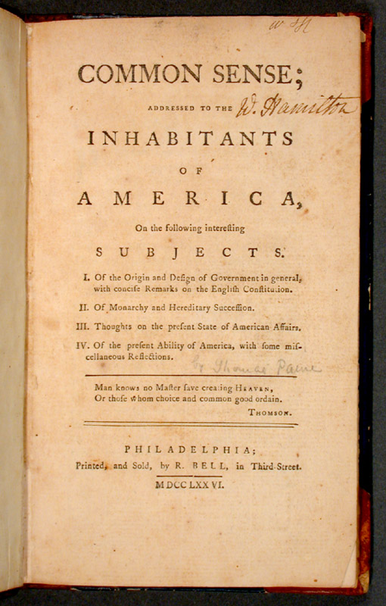
Common Sense

Slide 24
Model: Think Aloud
What strategies does this teacher model that help solve comprehension problems?
Watch “A Better Example”

Slide 25
Practice Think Alouds
Partner A reads and thinks aloud while solving comprehension problems
Partner B scribes A’s think alouds
Switch roles
Compare strategies used

Slide 26
Strategies Good Readers Use
With your partner, list the strategies you used
Add to the class poster of effective strategies
Circle the strategies that pertain to the discipline
Underline generic strategies

Slide 27
Metacognitive Thoughts Illustrate…
Accessing of prior knowledge
Awareness of rhetorical devices
Use of imagery and visualization
Linking of information with prior knowledge (also text to text)
Use of context clues to find word meaning

Slide 28
Metacognitive Thoughts Illustrate continued…
Accessing vocabulary knowledge
Monitoring understanding (infer text and fix-up)
Identifying unknown vocabulary

Slide 29
Scaffolding Instruction
Increase opportunities to practice skills
Provide instruction in small groups
  Preteach
  Smaller tasks
  Specific strategies
Require reading of less text
Provide more time
Provide intensive interventions as needed

Slide 30
Returning to Paine…
With your partner, consider how you would modify this lesson to ensure ALL students have access to the learning.
Consider students who:
  Are struggling readers
  Have a learning disability
  Are English Language Learners

Slide 31
In Conclusion….
  Quick Write: List strategies you should observe in classrooms studying disciplinary text:
  Used by teachers
  Used by students
Notes:
Final slide for DL Leadership CEM

