Slide 1

Culturally Relevant Education:
Cultivating Learning for All

Slide 2
Objectives
After participating in this professional learning opportunity, participants will be able to:
Understand the influence of culture and identity on teaching and learning.
Have knowledge of teacher and student demographics.
Be able to discuss the integration of culture and other frameworks to improve outcomes for diverse learners.
Have a common understanding of culture and culturally relevant education.
Begin developing action plans for culturally responsive education (CRE).
Notes:
Underlying questions posed in Milner (2010/2013, p. 2): (1) How do we design learning environments that build on the many talents and strengths that all P-12 students bring into the classroom? (2)Why do some teachers and students succeed while others do not?

Slide 3
Overview
The U.S. student population continues to diversify racially and culturally.
The U.S. teaching population remains predominately White, middle class, and female.
All teachers need to have self-awareness and preparation to provide learning opportunities that take into account student backgrounds, including diverse race, culture, and ability.

Slide 4
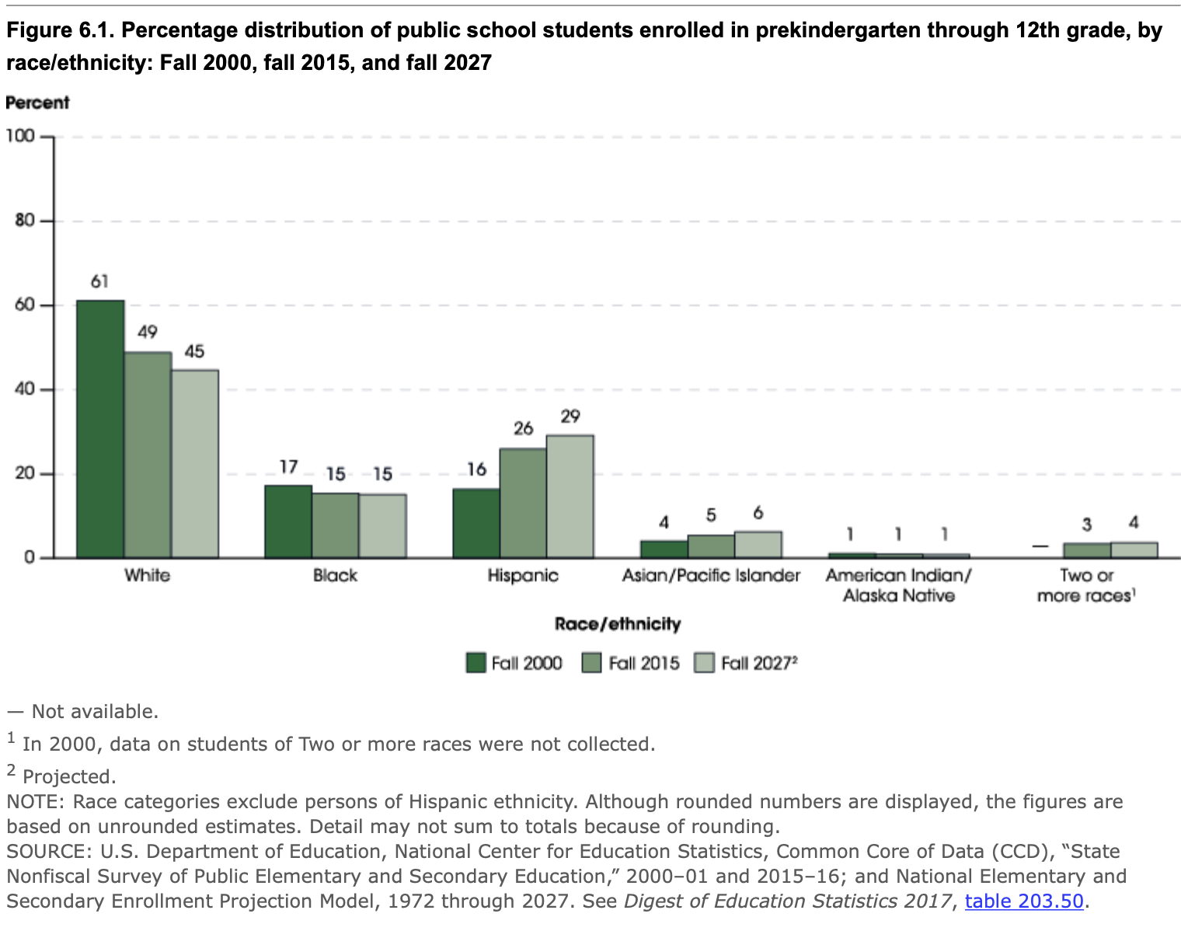
Notes:
If teachers and leaders are not prepared and held accountable for meeting the needs of all learners, disproportionality will continue to be a problem for racially and culturally diverse learners.

Slide 5
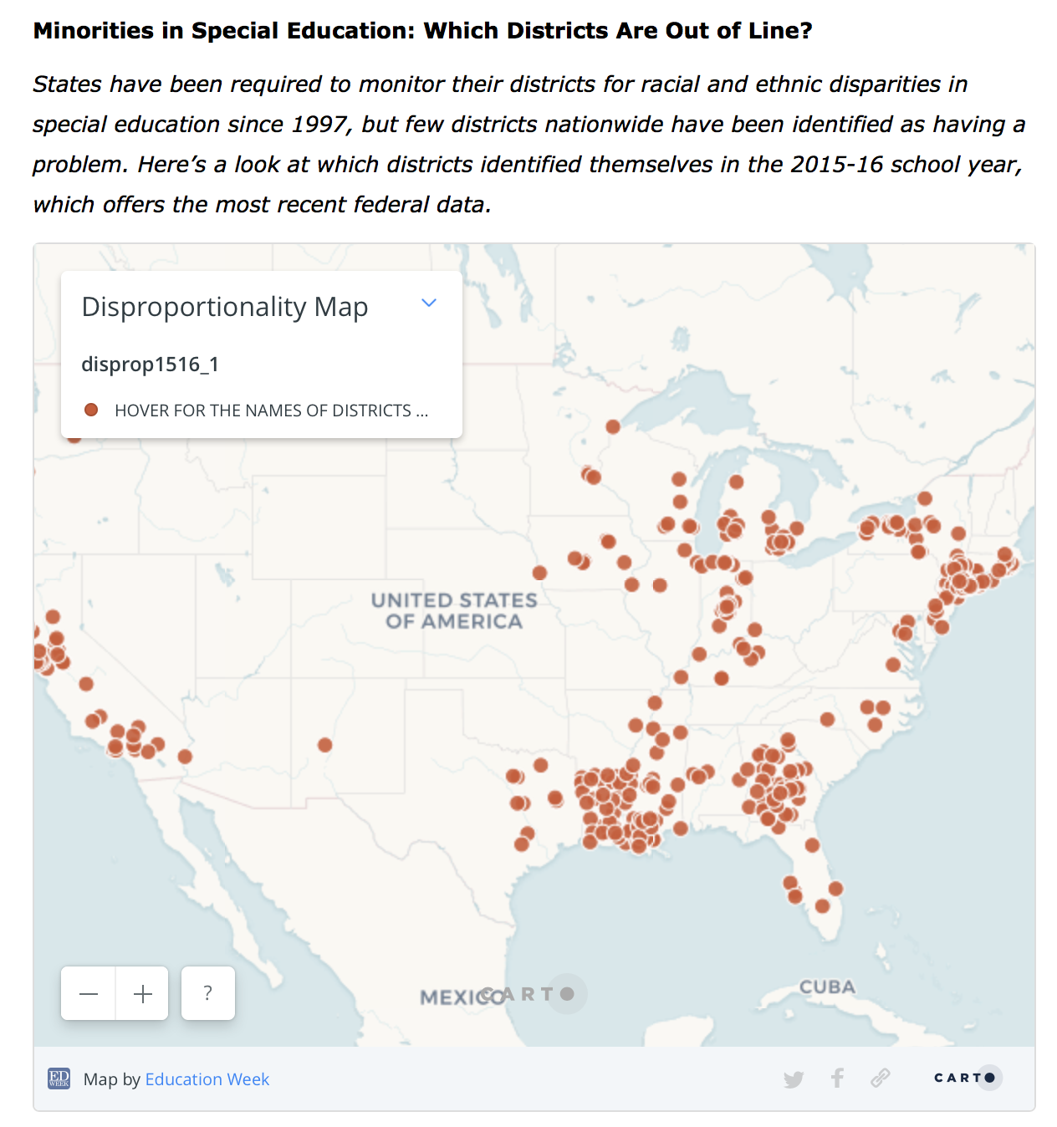
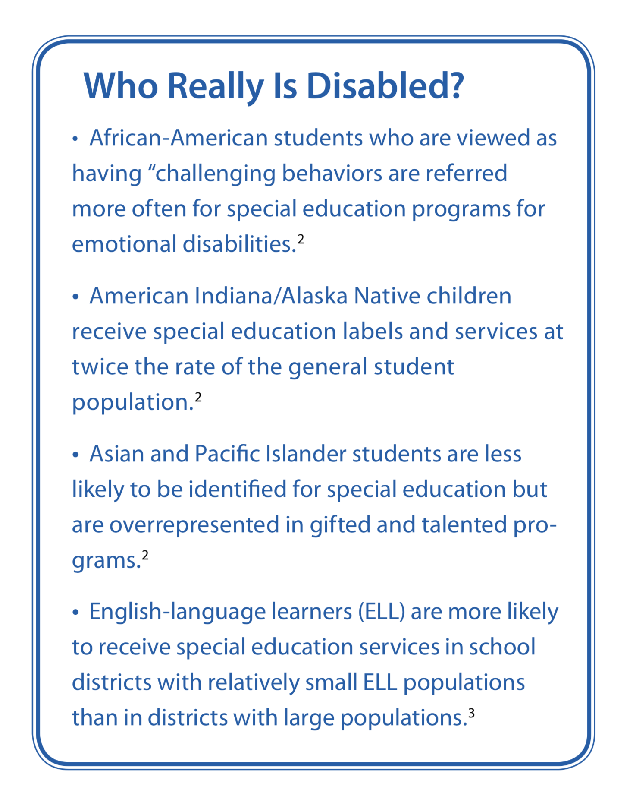
1.7
1.5
1.4
1.4
0.9
0.9
0.5
Notes:
On 1/25/18, EdWeek published an article including an interactive map, Map: Minorities in special education: Which districts are out of line?
https://www.edweek.org/ew/section/multimedia/map-minorities-in-special-education-which-districts.html
According to the 39th Annual Report to Congress on the Implementation of the Individuals with Disabilities Education Act (U.S. Department of Education, 2017), the risk ratios for receiving special education services were as follows: American Indian/Alaska Native, 1.7; Native Hawaiian/Pacific Islander, 1.5; Black/African American and Hispanic/Latino, 1.4; White and two or more races, 0.9; and Asian, 0.5.

Slide 6
Student ethno-racial demographics
SOURCE: U.S. Department of Education, National Center for Education Statistics, Common Core of Data (CCD), "Public Elementary/Secondary School Universe Survey", 2015-16, Version 1a; and "Local Education Agency Universe Survey", 2015-16, Version 1a; and "State Nonfiscal Survey of Public Elementary/Secondary Education", 2015-16, Version 1a.
Notes:
Student demographics continue to diversify. Hispanic/Latino ethnic groups are increasing at rates greater than all racial groups. Ethno-racial as a term acknowledges the complexities of race as a social construct and how it can converge with and diverge from ethnic and cultural identities.

Slide 7
Teacher workforce
SOURCE: U.S. Department of Education, National Center for Education Statistics, Schools and Staffing Survey (SASS), "Public School Teacher Data File," 1987-88 through 2011-12; "Private School Teacher Data File," 1987-88 through 2011-12; and "Charter School Teacher Data File," 1999-2000; and National Teacher and Principal Survey (NTPS), “Public School Teacher Data File,” 2015-16. (This table was prepared September 2017.)
Notes:
The workforce remains primarily White, middle class, and female.

Slide 8

Who are you?
Complete the cultural identity wheel diagram to reflect aspects of your cultural identity make-up.
Use words and illustrations as appropriate to make it uniquely you.
Be prepared to share your diagram with others.

Slide 9
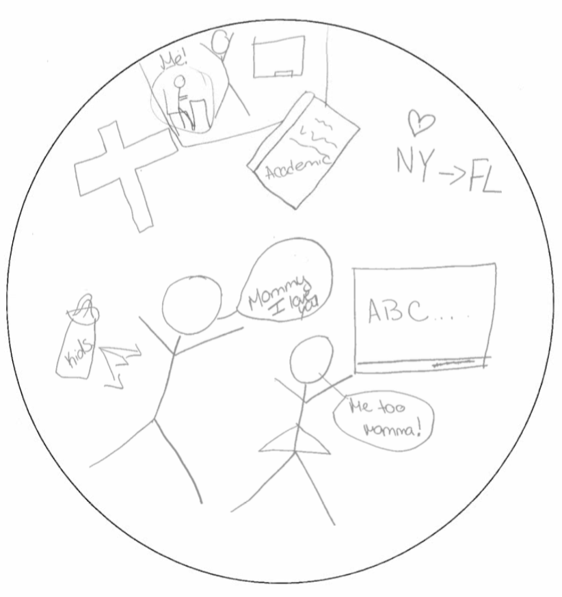
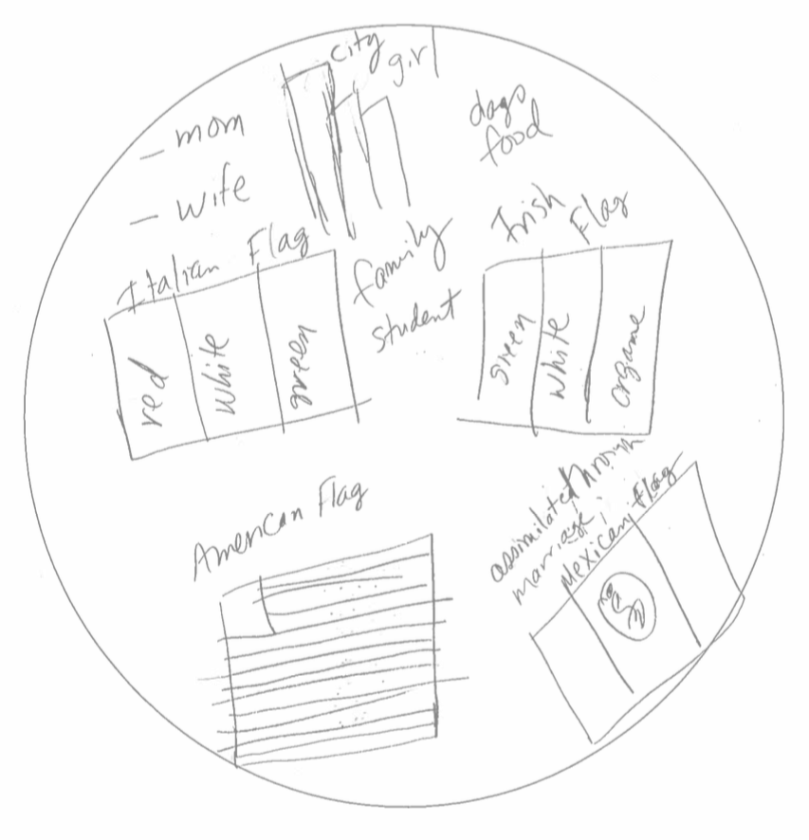
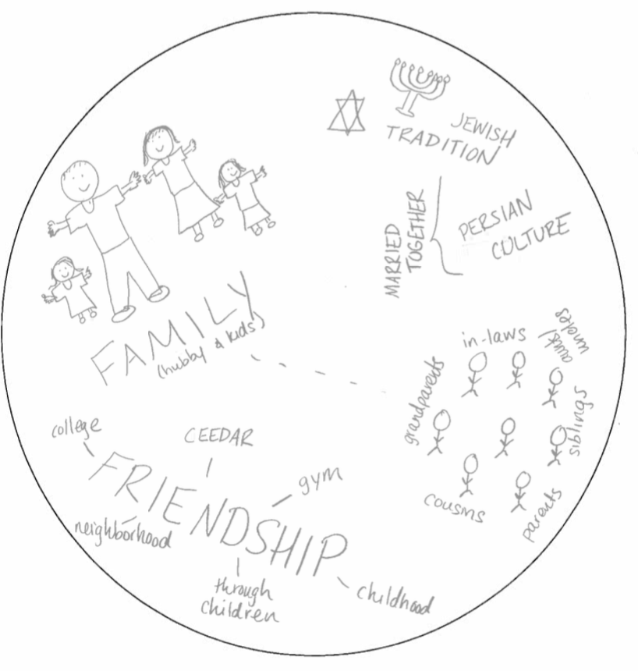
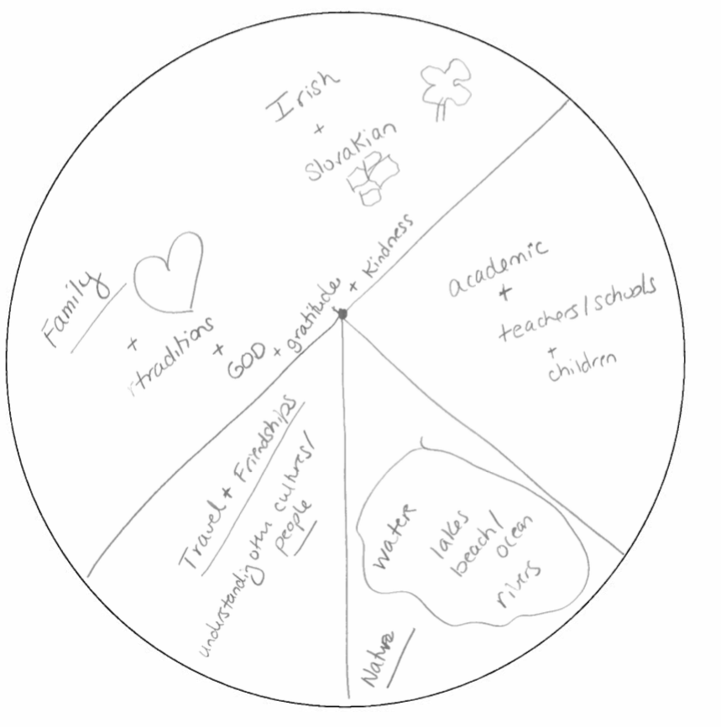
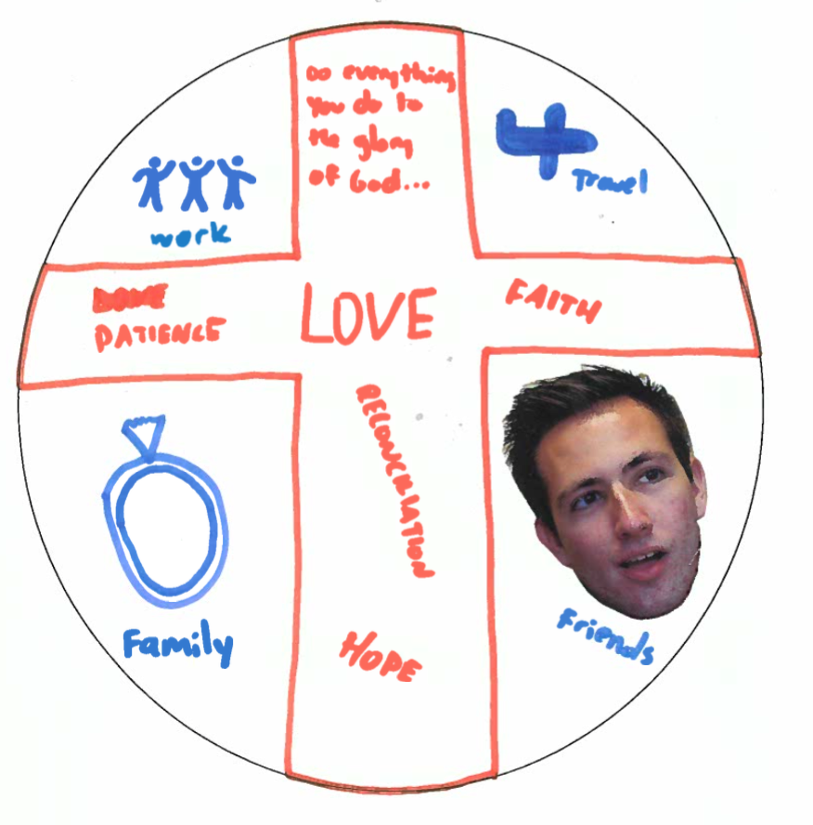
Some examples
Notes:
What are the commonalities?
What are the differences?

Slide 10

Conceptions of Culture
A blueprint for perception, evaluation, behavior, feeling, thinking.
Culture is in us, around us, like the air we breathe.
What appears to be natural and “how things are.”
A framework that guides and bounds life practices . . . a set of possibilities from which to choose.
(Hall, 1976; White,1959)
Notes:
Everyone has a culture. Many different people and researchers have looked at culture and defined it differently (Hall, 1976; White).
Culture used to mean refined ways of the elite and powerful: opera, art, fine wine, and food. Now we have better definitions.
Learning about our own culture as individuals and as professionals in special education will begin our journey to cultural competence and help to avoid some of the unfortunate experiences for children in our country. We will begin learning about multicultural education and ourselves this week.
Culture used to mean refined ways of the elite and powerful: opera, art, fine wine, and food. Now, we have better definitions.
Learning about our own culture as individuals and as professionals in special education will begin our journey to cultural competence and help to avoid some of the unfortunate experiences for children in our country. We will begin learning about multicultural education and ourselves this week.

Slide 11
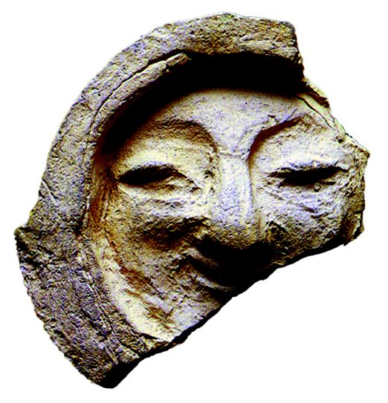
Culture is dynamic . . .
Glenn (1989) warned that "we need an approach to education that takes seriously the lived culture of children and their families, not the fiestas and folklores that had meaning for their grandparents but are not part of the lives of families coming to terms with the losses and gains of immigration" (p. 779).

Slide 12

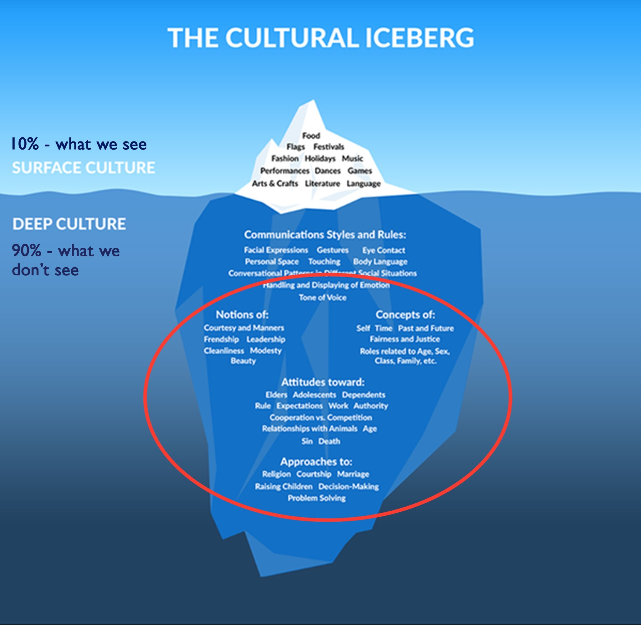
Culture is . . .
food
clothing
What Can Easily Be Seen
music
homes
holidays
traditions
attitudes
values
beliefs
relationships
What Remains Hidden From View
world view
Notes:
Edward T. Hall’s (1976) iceberg model continues to be popular in all of its variations. The point is that aspects and differences of culture are visible and obvious while other elements are hidden from limited observation but no less important. These below-the-surface values and characteristics can help us understand the depth of human individuality.

Slide 13
How your “who” affects your “do”
Notes:
An important point for you and your students to know is that we all have a cultural identity—not just ethnically/linguistically diverse groups, but all groups have a cultural identity. You have to be aware of your identity to understand and value another group's identity. By creating culturally inclusive lessons, you will show your students that you value who they are and where they come from, which goes a long way toward curtailing behavior problems and building strong relationships with your students. As the saying, "Physician heal thyself” goes, so should "Teachers know thyself so that you can know your students." Model appreciation for different cultures and languages for your students and teach them how to appropriately ask others about their cultures without offending.

Slide 14

The teacher
The U.S. educator workforce lacks the diversity of the student population.
Recent research shows the importance of having a diverse workforce, those individuals who bring unique funds of knowledge and represent the backgrounds of students.
How could your “who” affect your “do”?
Notes:
Let’s revisit our cultural identity wheels: How do the attributes/values on your wheel provide potential for dis/connect with students?

Slide 15
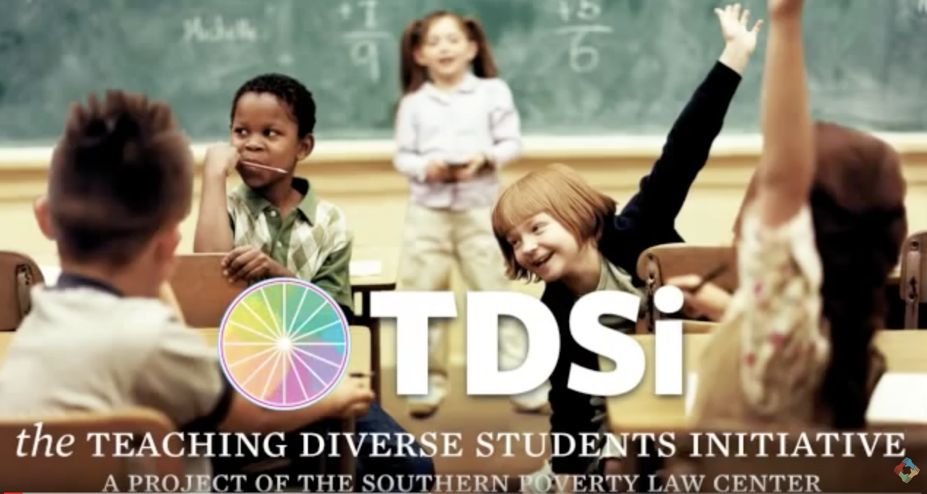
Culturally responsive & relevant pedagogy
As you watch this short video, jot down…
3 actionable steps you can take
2 questions you have
1 “aha” or insight
Notes:
Video: https://youtu.be/nGTVjJuRaZ8

Slide 16

Culturally relevant pedagogy
Educators enacting culturally relevant pedagogy . . .
Emphasize preparing students for lifelong learning through interactions that lead to individual and collective academic achievement and empowerment.
Focus on cultural competence and equip students to navigate systems not designed to enable their success.
Develop sociopolitical consciousness, identify root causes of injustice, increase self-awareness, and incorporate these issues in instruction from an informed stance so that students are able to understand and critique systems and society.
(Howard 2012; Ladson-Billings, 1995;)

Slide 17
Culturally responsive teaching
Culturally responsive teachers . . .
Empower students socially and academically by setting high expectations and demonstrating commitment to students’ success.
Engage cultural knowledge, experiences, contributions, and perspectives.
Use students’ cultural capital and funds of knowledge to build on strengths to develop/enhance curricula and provide instruction.
(continued on next slide)

Slide 18

Culturally responsive teaching
Seek to see, acknowledge, and teach the whole child socially, emotionally, and politically.
Transform schools and societies through student-centered approaches to curriculum, instruction, and assessment.
Explicitly engage students in critical thinking, reflection, and action to spur emancipation and liberation for the community through the students.
(Gay 2002, 2010; Villegas & Lucas, 2002)

Slide 19
Culturally sustaining pedagogy
Educators enacting culturally sustaining pedagogy . . .
Seek to “perpetuate and foster—to sustain—linguistic, literate, and cultural pluralism as part of the democratic project of schooling” (Paris, 2012, p. 93).
Seek to sustain “heritage and community” language, literacy, and cultural ways of knowing and being and offer “access to dominant cultural competence” (p. 95) while embracing the fluidity of culture and community.

Slide 20
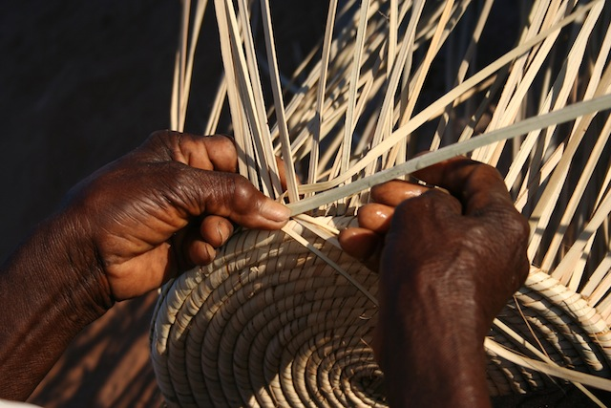
Culturally Relevant Education: Relevant, responsive, and sustaining
What are common elements across these terms or frameworks?
Notes:
The three unifying elements include intentional attention to academic achievement, awareness of and sensitivity to self and others, and critical analysis of systems and society.

Slide 21

What is culturally relevant education?
Captures the interconnectedness of culturally relevant pedagogy to inform culturally relevant teaching, delineating how “teaching affects competence and practice whereas pedagogy affects attitude and disposition” (Aronson & Laughter, 2016, p. 167).
Seeks to sustain cultural knowledge that students bring to the classroom, fostering cultural pluralism in all its fluidity.
Notes:
Your “who” affects what you “do.”

Slide 22
Providing CRE includes intentional . . .
Environment
Curriculum
Instruction
(see Aronson & Laughter, 2016)
Notes:
Take 5 minutes to quickly brainstorm/jot down strategies for implementing CRE in environment, instruction, and curriculum.

Slide 23
Culturally relevant education:
CURRICULUM
Curriculum
Content, materials, and lesson plans reflect the diversity of students, families, and global community.
The hidden curriculum is exposed so that students are equipped to navigate various systems.
Students are empowered and taught to think critically about what is taught and why.
Notes:
Work with a partner/small group (preferably someone you don’t usually work with) to place your strategy in one of these areas. Can you identify an additional strategy area that you don’t see listed? Place a star by it to share with the group.
See Anyon (1980) for a deeper discussion of the hidden curriculum and the implications for student outcomes.

Slide 24
Reshaping the Curriculum
The curriculum should be integrated, interdisciplinary, and meaningful.
The curriculum should include topics related to the students’ background and culture.
The curriculum should challenge the students to develop higher-order thinking skills.
(Villegas, 1991)

Slide 25
Reshaping the Curriculum
Teacher Practices
Use resources other than textbooks for learning
  Allow students to interview people and research topics in their community
Develop activities that foster the students’ cultural differences
  Allow students the choice working alone or in groups
Develop integrated units around universal themes
(Padron, Waxman, & Rivera, 2002)

Slide 26

Considering Curriculum
In what ways does your current curricula reflect the diversity of your school, community, and society at large?
In what ways do you/could you make the curriculum and learning opportunities more culturally relevant?

Slide 27
Culturally relevant education:
INSTRUCTION
Instruction
Learning opportunities are designed to tap students’ funds of knowledge and are student-centered and focused on long-term gain.
Teachers vary instructional moves to meet the needs of learners in the class.
Assessments serve to inform instruction and adjustments to instruction.
Lessons incorporate students to substantiate an informed stance and connection to their lived experiences.
Notes:
Work with a partner/small group (preferably someone you don’t usually work with) to place your strategy in one of these areas. Can you identify an additional strategy area that you don’t see listed? Place a star by it to share with the group.
For more on funds of knowledge, see Gonzalez, Moll, & Amanti (2005), who conceptualize funds of knowledge: People are competent, they have knowledge, and their life experiences have given them that knowledge (p. ix-x).

Slide 28

Reflection
Reflect on your own K-12 learning experience. Did you have experiences with teachers from cultures other than your own? Consider how your experience has shaped your perspective and may impact your interactions with culturally and linguistically diverse students (CLD).
Notes:
Self-awareness activity. The objective of this reflection is to allow students to be aware of their own learning experience and how it has shaped their perspective. Most teachers teach the way teachers taught them. Being aware of the worldview we bring to the classroom and considering how it may hinder our ability to connect with an learn from students is important.

Slide 29
High-Leverage Practices: Definition and Rationale

Slide 30

High-leverage practices
Practices that
  Focus on instructional practice.
  Occur with high frequency in teaching.
  Are research based and known to foster student engagement and learning.
  Are broadly applicable and usable in any content area or approach to teaching.
  Are skillfully executed for effective teaching.
Why are they important to have in one’s “toolbox”?
Notes:
Read slide
High-leverage practices (HLPs) are not constrained by content or grade level like evidence-based practices (EBPs) are. HLPs are cross-cutting practices that all teachers use to deliver EBPs. HLPs are about how teachers deliver instruction
(McLeskey & Brownell, 2015).
Both research and professional wisdom note how important this practice is — not just any type of practice, but aspects of practice that are critical to success. Additionally, research also supports that practices combined with feedback and emphasis on the critical components of a practice ARE most important in ensuring teachers gaining mastery and expertise over time
(McLeskey & Brownell, 2015).

Slide 31
Why do we need HLPs and CRE delivered together?

Slide 32
Why Students with Disabilities need HLPs with CRE
Students with disabilities are CLD (intersectionality).
CRE targets the historically disadvantaged.
CRE benefits exist despite systemic inequalities (Orosco, 2017).
Taken together, CRE and HLPs can improve outcomes for the lowest performing students.
Teachers need to know both HLPs and CRE.
(Gay, 2002; Klingner & Edwards, 2006; Orosco, 2017; Piazza, Rao & Protacio, 2015)
Notes:
CRE can help teachers and schools overcome the historic underachievement and underappreciation of culturally and linguistically diverse (CLD) students AND students with disabilities.
While larger structural forces substantially inhibit student achievement, CRE is one way teachers and schools can better support CLD students with disabilities, despite current limitations of the sociopolitical, educational, and economic systems.
This study examines culturally responsive pedagogy across the fields of special education, multicultural literacy education, and teaching English language learners (ELLs). A systematic review of recommendations identified culturally responsive practices in five key areas: dialogue, collaboration, visual representation, explicit instruction, and inquiry.
Culturally responsive literacy practices are vital for the academic achievement of sociocultural diverse learners (Au, 2011; Gay, 2000, 2002; Ladson-Billings, 2011; Tatum, 2005) and learners with specific learning disabilities (LD) in inclusive settings (Gay, 2002; Klingner & Edwards, 2006),

Slide 33
Culturally Responsive Teaching EBP
Notes:
In the CEEDAR CRT IC, authors Aceves and Orosco (2014) found six general CRE themes (i.e., instructional engagement; culture, language, and racial identity; multicultural awareness; high expectations; critical thinking; and social justice); four CRE practices (i.e., collaborative teaching, responsive feedback, modeling, and instructional scaffolding) that were considered emerging EBPs; two recommended teaching approaches (i.e., problem solving and child-centered instruction); and two instructional considerations (i.e., assessment and materials). The CRE literature supports our findings (see Table 1; Aceves & Orosco, 2014, pg. 9).
The review was restricted to empirical studies that included at least 50% of CLD students. Authors reviewed studies that examined instructional practices with K-12 student outcomes.
Using ESSA/CEEDAR evidence standards, authors categorized practices found in the literature shown here:
4 levels of evidence
Strong
Moderate
Limited
Emerging
http://ceedar.education.ufl.edu/wp-content/uploads/2014/08/Evidence-Based-Practices-guide.pdf

Slide 34
Activity
Take a look at the CRE essential elements presented.
Compare these to the HLPs for special education.
Using the handout, note the similarities and differences you see between the two lists.
HANDOUT
Notes:
Read slide. Refer to Activity 2 on the handout to complete this activity.

Slide 35
High leverage and culturally responsive practices
High-leverage practices (From Teaching Works) | High-leverage instructional practices (From CEC/CEEDAR work group) | CRE themes and practices
Explaining and modeling content, practices, and strategies | Use explicit instruction | Modeling
 | Teach cognitive and metacognitive strategies to support learning and independence | Child-Centered Instruction Critical Thinking
Diagnosing particular common patterns of student thinking and development in a subject-matter domain | Systematically design instruction toward a specific learning goal | Assessment Responsive Feedback Problem-Solving Approach
 | Adapt curriculum tasks and materials for specific learning goals | Assessment Materials
Coordinating and adjusting instruction during a lesson | Scaffold instruction | Instructional Scaffolding
Setting up and managing small group work | Use flexible grouping | Child-Centered Instruction
 | Use strategies to promote active student engagement | Instructional Engagement Cultural, Language, and Racial Identity
Specifying and reinforcing productive student behavior | Provide positive and constructive feedback to guide students’ learning and behavior | Responsive Feedback
Notes:
Provide this as an “answer key” to Activity 2. Looking across the rows, discuss the overlap in these practices.

Slide 36

4 Emerging Practices
Collaborative teaching
Responsive feedback
Modeling
Instructional scaffolding
Notes:
Research during the past few decades has developed the foundation for EBP that supports teaching for students who struggle with learning basic academic skills. However, despite this research, CLD learners continue to underachieve in United States public schools. This underachievement has led researchers and educators to examine research on the development of EBPs with CRE methods. Although empirical research investigating EBPs for diverse students with learning difficulties has increased, a scant research base in this area remains (Aceves et al., 2014).

Slide 37

Collaborative Teaching
Differentiated
Small group
Notes:
Collaborative teaching is an umbrella term for instructional methods (e.g., cooperative learning, differentiated instruction, peer teaching, reciprocal teaching) that involve joint intellectual effort (i.e., requiring individual accountability, positive interdependence, and strong interpersonal skills) between students and teachers (Klingner & Vaughn, 1996, 1999; O’Connor & Vadasy, 2011; Vaughn et al., 2011).
Research indicates that practitioners who use direct and explicit collaborative-based approaches to learning to reinforce students’ background knowledge (e.g., interdependence, sharing, collaboration) improve student literacy engagement and motivation (e.g., Au, 2011; Genesee & Riches, 2006).
In collaborative-based instruction, teachers provide a common introduction to lessons and then distribute learning assignments based on students’ academic skills (e.g., reading language level).
Although all students learn about the same topic, the assignments may vary according to student ability.
If learning challenges persist, teachers may need to reciprocate and teach specific skills for student understanding. For example, several studies (e.g., Calhoon, Al Otaiba, Greenberg, King, & Avalos, 2006; Klingner & Vaughn, 1996; Sáenz, Fuchs, & Fuchs, 2005) have used collaborative-based learning approaches to engage CLD students in small groups in content-related strategic discussion to assist students in understanding concepts, deriving the main ideas, asking and answering questions, and relating what they are learning to their own cultural backgrounds.

Slide 38

HLP/CRE: Responsive Feedback
Frequent
Immediate
Multiple opportunities to give feedback
Notes:
Culturally responsive feedback is provided when teachers offer critical, ongoing, and immediate feedback regarding students' responses and participation. Through culturally responsive feedback, teachers supply individualized support about performance in a manner sensitive to students’ individual and cultural preferences. This strategy includes incorporating students’ responses, ideas, languages, and experiences into the feedback that is provided (Gersten & Geva, 2003) while inviting students to construct new understandings regarding what they are learning (McIntyre & Hulan, 2013).
Providing responsive feedback is an instructional strategy recommended as a necessary practice in effective instruction with students experiencing academic difficulty (Fuchs & Vaughn, 2012). Responsive feedback has also been implemented as an important strategy within studies involving ELLs (Carlo et al., 2004; Gerber et al., 2004; Kamps et al., 2007; Vaughn et al., 2006).
To engage in this critical feedback exchange, teachers must create multiple opportunities for students to respond and fluidly dialogue throughout the day.
As a culturally responsive practice, modeling involves explicit discussion of instructional expectations while providing examples based on students’ cultural, linguistic, and lived experiences. Culturally responsive modeling requires teachers to exemplify learning outcomes of CRE, which include strategy use, content learning, metacognitive and critical thinking, and interest and respect for cultural and linguistic diversity.
Research has established the modeling of skills, strategies, and new content as an essential and effective method for teaching English learners (Gerber et al., 2004; Gersten & Geva 2003; Kamps et al., 2007; Vaughn et al., 2006).

Slide 39


HLP/CRE: Modeling
Notes:
Teacher modeling has long been viewed as an essential component of effective teaching.
As a culturally responsive practice, modeling involves explicit discussion of instructional expectations while providing examples based on students’ cultural, linguistic, and lived experiences. Culturally responsive modeling requires teachers to exemplify learning outcomes of CRE, which include strategy use, content learning, metacognitive and critical thinking, and interest and respect for cultural and linguistic diversity.
Research has established the modeling of skills, strategies, and new content as an essential and effective method for teaching English learners (Gerber et al., 2004; Gersten & Geva 2003; Kamps et al., 2007; Vaughn et al., 2006).

Slide 40

HLP/CRE: Scaffolding
Notes:
Culturally responsive instructional scaffolding occurs when teachers control for task difficulty and promote a deeper level of understanding using students' contributions and their cultural and linguistic backgrounds. Scaffolding skills include using different types of questions (e.g., open-ended questions, analytic questions); providing appropriate wait time and taking turns; extending and acknowledging students’ responses; and using supporting instructional materials (e.g., visual organizers, story maps; Jiménez & Gersten, 1999).
Researchers have integrated scaffolding methods in studies involving students experiencing academic difficulty, including students who speak a second language (Gerber et al., 2004; Goldenberg, 2013; Vaughn et al., 2006). For instance, scaffolding may include reference to ELLs’ primary languages or cultures.

Slide 41

Activity: Lesson Analysis with CRE in Mind
Consider a lesson that you are planning or have recently implemented.
Annotate places where you might integrate two to three of the CRE instructional strategies.
Notes:
Participants should bring a lesson plan to review. This activity will give them an opportunity to intentionally integrate CRE strategies.

Slide 42
Culturally relevant education:
ENVIRONMENT
Environment
School and classroom reflects and affirms the diversity of students, families, and community.
School and classroom culture and climate affirm and sustain globally diverse ways of knowing and being.
Student-teacher and student-student engagement demonstrate high expectations.
Students and teachers share responsibility and accountability for knowledge and socio-political consciousness.
Notes:
Work with a partner/small group (preferably someone you don’t usually work with) to place your strategy in one of these areas. Can you identify an additional strategy area that you do not see listed? Place a star by it to share with the group.

Slide 43
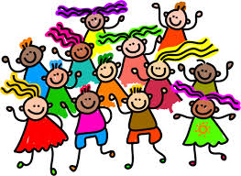
Who are our students? How are they diverse?
(Parker & Beck, 2017)
Race, ethnicity, and culture
Social class and religion
Language and dialect
Sex/gender
Sexual orientation
Learning differences
Notes:
Would you add any group to this list? If so, which group is missing? How many of these different groups are represented in your classrooms? How? How do these groups impact how your manage your classroom?

Slide 44

Activity: Thinking, Feeling, Saying, Doing
Brainstorm what you would be thinking, feeling, saying, and doing about working with the diverse students in your school and classroom.
Create a heading for each: thinking, feeling, saying, and doing, and then brainstorm your thoughts, words, actions, etc. on separate post-its. Place your post-its underneath the appropriate heading.
Be prepared to share your brainstorm with the group.
Notes:
Each group should have a different heading. For example, Group 1 (thinking), Group 2 (feeling), Group 3 (saying), Group 4 (doing). If you have more than four groups, repeat headings until each group has one. Give each group post-its on which to write their brainstorm thoughts, and then have them place their post-its on their poster and hang the posters on the wall around the room. Then, the participants will complete a walk-about of all of the posters. They will pull post-its to take back to their seats that they feel they need to discuss further. Facilitate a whole-group discussion of brainstorms through participants sharing the post-its that they brought back to their seats.

Slide 45

School-wide Strategies: PBIS
Positive Behavioral Interventions & Supports (PBIS): PBIS improves social, emotional, and academic outcomes for all students, including students with disabilities and students from underrepresented groups. The broad purpose of PBIS is to improve the effectiveness, efficiency, and equity of schools and other agencies (PBIS Center).
Notes:
Key point: Focus is not just on academic outcomes, but also on social and emotional outcomes. How and why is this focus beneficial to the students? How is Positive Behavioral Interventions & Support (PBIS) an equitable practice based on the definition and purpose of PBIS?

Slide 46
School-wide Strategies: PBIS
PBIS is an approach designed to prevent inappropriate behavior and teach appropriate behavior systematically (Metropolitan Center for Urban Education, 2008).
PBIS offers a method for identifying the environmental events, circumstances, and interactions that trigger problem behavior; developing strategy prevention; and teaching new skills (Metropolitan Center for Urban Education, 2008).
Notes:
Many factors within students’ environments can impact his or her behavior in the classroom. Knowing these factors allows the teacher to prevent certain behaviors by knowing triggers while allowing the teacher to teach students new skills to control their own behavior. Another key is to systematically teach these skills in a very specific manner.

Slide 47

School-wide Strategies: PBIS
PBIS includes all students and staff, including teachers, administrators, cafeteria workers, bus drivers, and custodians, and is applied consistently throughout the school—in classrooms, hallways, cafeterias, bathrooms, playgrounds, and the school bus (Metropolitan Center for Urban Education, 2008).
Notes:
This practice brief provides information on PBIS in the classroom: https://www.pbis.org/Common/Cms/files/Forum15_Presentations/RDQ%204%20Brief%20-%20Classroom.pdf

Slide 48
Potential of PBIS: Multicultural Perspective
Understand that cultural expectations influence perceptions of behavioral appropriateness. In other words, what people perceive as inappropriate varies across cultures, and behaviors occur within larger social and cultural contexts.
Connect with students in ways that convey respect and caring.
Explicitly teach rules and expected behaviors within a culture of care.
Notes:
Example of cultural appropriateness or inappropriateness: You expect students to participate in a lesson in which they question what you are telling them. You chastise the students for not asking questions when their culture teaches them that they do not question the teacher in school.
Example 2: You indirectly suggest that students should consider adding an illustration to their writing with the expectation that they will, but several of your students of color do not add the illustration. You penalize them for not adding the illustration when they felt that they did not have to add the illustration because you did not explicitly state that you wanted them to add an illustration.
Both are examples of cultural expectations (i.e., respect for the teacher by not questioning and expecting explicit directions versus an indirect message).

Slide 49

School-wide Strategies: Restorative Justice
Restorative Justice (RJ): RJ is a powerful approach to discipline that focuses on repairing harm through inclusive processes that engage all stakeholders. Implemented well, RJ shifts the focus of discipline from punishment to learning and from the individual to the community. However, it is often misperceived and misapplied (Centre for Justice and Reconciliation).

Slide 50
Potential of Restorative Justice: Multicultural Perspective
Understand the interconnectedness of individual behavior and group expectations and implications.
Use correction as a form of care with opportunities for relationship repair.
Empower students, professionals, and families to build community across contexts.

Slide 51
Restorative Justice Video (Rethinking Schools)
Restorative Welcome and Reentry Circle
Notes:
Notice the number of people who are in this group to support the student’s return to school. Knowing that he has this many people in his corner helps him positively transition back to school and alleviates potential behavior problems that could occur.
https://www.youtube.com/watch?v=HiLtFVHR8Q0

Slide 52
Classroom Strategies
(Weinstein, Curran, & Tomlinson-Clarke, 2003; Hambacher, 2015)
Develop caring and inclusive classroom strategies.
Organize the physical environment in a way that supports cultural diversity.
Establish clear expectations for behavior at the beginning of the school year.
After you share your expectations, continually and consistently remind students of them all year.
Communicate in culturally relevant/consistent ways with students and their parents (know the students’ ways of communicating and what’s effective).
Collaborate with families in culturally appropriate ways.
Use humor.
Know your students’ cultural backgrounds.
Notes:
Here are some general strategies to structure the environment and shape classroom culture. We’ll dig in to a few of these in more detail.

Slide 53
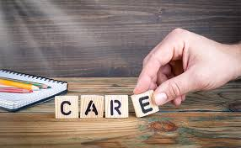
Classroom Strategies
Build caring and inclusive classroom strategies
  Greet students with a smile and a warm, welcoming comment.
  Greet second-language learners with a phrase from their culture.
  Shares stories about your life outside of school and let students share their interests and activities outside of school.
  Allow students to make choices and decisions about class activities and listen to their concerns or opinions.
  Deliberately model your respect for diversity by expressing admiration for students’ bilingual ability, praising the different languages represented in the classroom, and including examples of and content from a variety of cultures in your teaching.
  Communicate high expectations for all students and hold them accountable for high-quality academic work.
  Create a sense of community: illustrate to students how they are similar and different and engage students in morning meetings and cooperative learning activities.

Slide 54
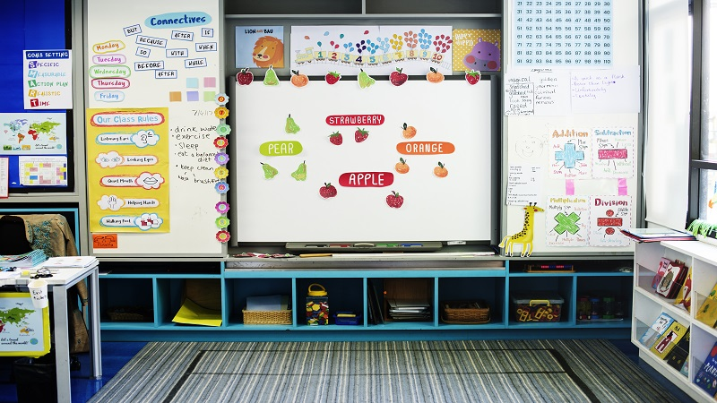
Classroom Strategies
Organize your physical environment in a way that supports cultural diversity
    Use a map of the world to highlight students’ countries of origin.
    Welcome students with a sign or banner in the different languages that they speak.
    Use posters to depict people of various cultural groups (be sure to stay away from stereotypical images).
    Mount children’s individual pictures on posters to create a jigsaw puzzle to reinforce that everyone comes together to make the whole.
    Display in your classroom library books that promote themes of diversity, tolerance, and community.
    Arrange desks in clusters to encourage students to work together.
    Reinforce kindness and tolerance by having students drop kindness notes in the Kindness Box (randomly read notes aloud) and creating a bulletin board display that encourages students to commit “Random Acts of Kindness.”
Notes:
Think about the ways in which you can strategically use the environment to communicate respect for diversity, reaffirm connectedness and community, and avoid marginalizing and disparaging students.

Slide 55

Classroom Strategies
Communicate in culturally relevant/consistent ways with students and their parents (know the students’ ways of communicating and what’s effective)
  Be aware that differences in discourse style can have a direct effect on students’ behavior. For example, African American children and children from working-class families are used to straight-forward communication from authority figures versus the indirect discourse strategies that middle-class White teachers use (Delpit, 1995).
  Teachers may need to modify their discourse style to be consistent with the cultural backgrounds of their students.
  Use parents and guardians as resources to determine the type of discourse or communication style that will work best with students (stern/direct vs. positive reinforcement/compliments/encouragement).

Slide 56
Classroom Strategies
Collaborate with families
  Be aware that culturally responsive classroom managers understand that a lack of direct involvement reflects a differing perspective about parental responsibility rather than a lack of commitment to their children’s education (e.g., Asian American and Latinos value education but view education as the responsibility of the school).
  Be aware that teachers and parents may have different expectations about what constitutes appropriate school behavior (e.g., teacher expects students to ask questions and debate and discuss, but parents from other cultures expect students to be quiet and obedient and not contradict their teacher and ask questions).
  Engage in genuine, meaningful two-way communication (e.g., ask parents for their feedback about how you can be effective with their child).
  Greet parents before you begin a conference, give parents time to think about how to respond to you to show sensitivity to cultural differences in communication styles.

Slide 57
Implications for student outcomes
Students receive an equitable education.
CRCM furthers social justice education.
One size does not fit all when disciplining students from culturally diverse backgrounds.
Being culturally responsive in our management practices leads to fewer discipline referrals for students of color.
Not being culturally responsive in our management practices leads to a disproportionate number of discipline referrals for students of color.
Notes:
What is social justice education? Teach your students about making positive change in the world by connecting with them, discussing real-world problems and multiple perspectives, creating classroom community, and including authentic assessment.

Slide 58

Discussion: Student outcomes
Why should teachers be aware of the student outcomes for implementing effective culturally responsive classroom management?
How do these outcomes positively impact your students and classroom environment?

Slide 59
Implications for teacher outcomes
How do your classroom management decisions promote or obstruct students’ access to learning?
Understand that culturally responsive classroom management is a frame of mind as much as a set of strategies or practices.
Culturally responsive classroom managers recognize their own biases/values and how they affect their interactions with students.

Slide 60
Implications for teacher outcomes
Culturally responsive classroom managers ask themselves hard questions about how they treat students based on their cultural background.
Culturally responsive classroom managers work to know the cultures and communities of their students.
Culturally responsive classroom managers explicitly teach their students mainstream ways without making them feel that these ways are better than their own cultural ways.

Slide 61

Discussion: Teacher outcomes
Rank order the teacher outcomes from least to most important, and then justify your ranking.
Think of these in terms of the impact on students and how you interact with them.

Slide 62
CRE Action Plan
Which part of your curriculum will you reshape to incorporate more CRE practices?
Which CRE instructional approaches will you implement to cultivate learning for all?
In what ways will you ensure your class/school environment is affirming of all students and their families?
How will you get support and feedback about your process?

Slide 63
DISCLAIMER
This content was produced under U.S. Department of Education, Office of Special Education Programs, Award No. H325A120003. David Guardino serve as the project officer. The views expressed herein do not necessarily represent the positions or polices of the U.S. Department of Education. No official endorsement by the U.S. Department of Education of any product, commodity, service, or enterprise mentioned in this website is intended or should be inferred.

