Slide 1
High Leverage Practices (HLP) Webinar 4:
The Gift of Feedback and Guidance
to Support Student Learning
Notes:
Day We would like to welcome you to the fourth installment of our High leverage practices webinar developed by the GA HLP team. If this is your first time, thank you for joining us! If you are a returning participant, welcome back. We are glad that you are joining us for another engaging discussion.
In this webinar we will focus on High Leverage practice 8 which considers the importance of feedback as a tool to guide students’ academic and social behavior.<CLICK>
(CLICK)

Slide 2
Disclaimer
This content was produced under U.S. Department of Education, Office of Special Education Programs, Award No. H325A170003. David Guardino serves as the project officer. The views expressed herein do not necessarily represent the positions or polices of the U.S. Department of Education. No official endorsement by the U.S. Department of Education of any product, commodity, service, or enterprise mentioned in this website is intended or should be inferred.
Notes:
Day Before we proceed, I'd like to offer the disclaimer that this work is produced under an Award sponsored by the US Department of Education and the project officer is David Guardino. Now, let's introduce the team <CLICK>
(CLICK)

Slide 3
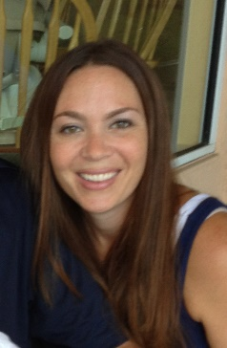
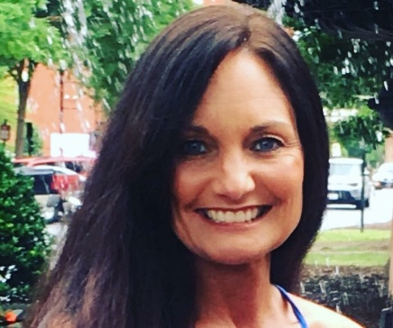
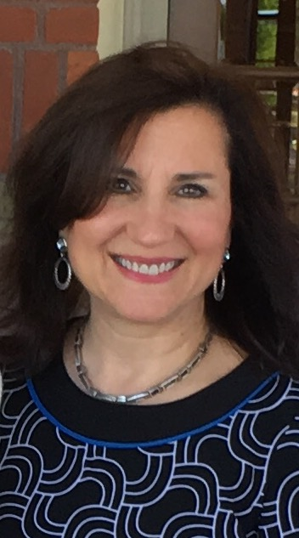
Facilitator Introductions
Melissa K. Driver, Ph.D.
DaShaunda Patterson, Ph.D.
Kate Zimmer, Ph.D. Pam Wetherington, Ed.D.
Carla Tanguay, Ph. D.
Notes:
Pam: Good afternoon everyone! My name is Pam Wetherington, and prior to working at Columbus State University, I taught 4th grade at New Mountain Hill Elementary School. Currently, I’m an assistant professor in Columbus State University’s Elementary Education Program in addition to serving all of our teacher preparation programs as the edTPA Coordinator and Asst Dept Chair. Although I teach graduate courses, my primary work and research is focused on ensuring pre-service teachers are indeed ready to be recommended for certification and their induction years of teaching.
Pam: Two of our HLP Team members, Melissa Driver and Kate Zimmer, are attending a conference this week and are not able to be with us in today’s webinar but have certainly supported this development of this webinar and the resources to support your work related top HLP 8 Providing positive and constructive feedback to guide students’ learning and behavior
Melissa: Hi my name is Melissa Driver, and I am an assistant professor of special education at Kennesaw State University. I taught in inclusive settings in both elementary and middle school and have also worked as an instructional coach for multiple school sites. My current teaching and research focuses on preparing special and general education teacher candidates to effectively support all learners.
Kate: hello, my name is Kate Zimmer and I am an associate professor of special education at Kennesaw State University. I taught in a multi-age classroom at the elementary level for many years. My teaching, research, and community engagement efforts focus on teacher preparation with a focus on high leverage practices, early intervention, and autism.
Day: Hello! My name is DaShaunda Patterson. I am a clinical assistant professor of special education at Georgia State University. I have taught in general education and special education environments in elementary schools. Currently, I support pre-service and in-service teachers who are earning certification or graduate degrees in special education.
Carla: Carla Tanguay was a former elementary school teacher and is currently a clinical assistant professor in the Department of Early Childhood and Elementary Education at Georgia State University and the Associate to the Dean for Clinical Practice, supporting all initial teacher preparation programs in the areas of teacher performance assessment and clinical practice. Joining Georgia State University in 2007, Dr. Tanguay continues to serve as the program coordinator for the bachelor of science in education in elementary education degree program with concentrations in English to Speakers of Other Languages (ESOL) and special education. She serves on the Georgia edTPA Policy and Implementation Advisory Committee and is the chair of the College of Education & Human Development’s Assessment and Accreditation Committee. Her scholarly interests include teacher development, teacher induction and retention, assessment, program evaluation and educational policy.
(Click)

Slide 4
Poll Time!
Select the option that best describes your role:
Educator Preparation Provider
P-12 Teacher
Instructional/Academic Coach or Teacher Leader
School or District Leader
State or National Policy Maker
State Education Agency Representative
Other (please indicate in chat box)
Notes:
Pam: So, let’s see who is joining us this afternoon, please click on the role that best describes you.
Review responses.
(CLICK)

Slide 5
Webinar Roadmap
Why are we here?
What high leverage practices will we focus on today?
What is feedback?
Why types of feedback are associated with positive outcomes?
How can stakeholders effectively use feedback in their settings?
What resources are available for these HLPs?
What’s next?
Notes:
Day
1. As we mentioned in our previous webinars, our goal is provide an overview of the High Leverage practices in a way that is meaningful and accessible to our stakeholders. This includes: P-12 teachers, instructional and academic coaches, building administrators and central office leaders. The last time we connected, we provided a general overview of the high leverage practices in the of engaging all learners through active classroom experiences.
2. Today, we are going to focus in on assessments and data based decisions in the context of a collaborative environment. For this work, we will focus on HLPs 1 and 4.
3. While the team offers you suggestions on how to effectively utilize these HLPs , we will also share resources that we have procured and developed that can help use and disseminate these HLPs within your settings.
5. Finally, we will close by giving you a heads up for what you can expect next time in HLP webinar 4.
<CLICK>

Slide 6
Our Mission & Partners
Notes:
Day: Before we continue, we want to acknowledge and thank our partners in this work: the CEEDAR center, the Ga Department of Education, the Ga Professional Standards Commission and the Board of Regents. WE appreciate your support as we move forward with this important work.
<CLICK>

Slide 7
Which high leverage practice will we focus on today?
Notes:
Day : Each of these webinars take a closer look at 1-2 HLPs across the areas of…
<CLICK>

Slide 8
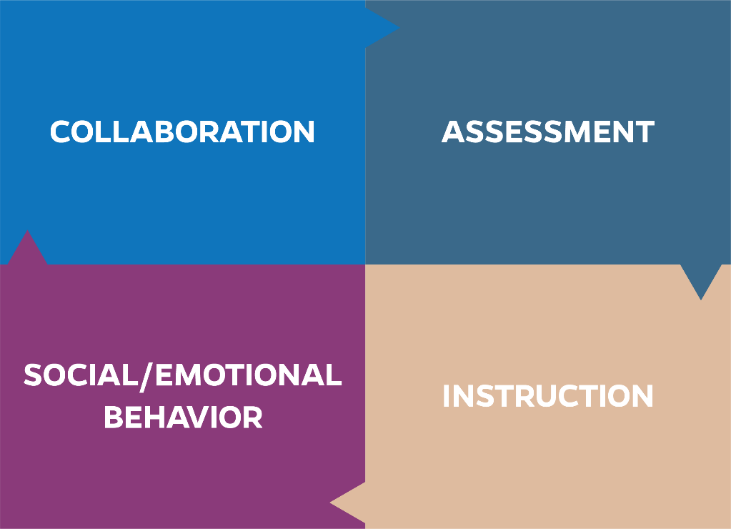
High Leverage Practices
HLPs are identified as specific teacher practices that are likely to result in improved student outcomes.
Notes:
Day: Collaboration, assessment, instruction, and social/emotional behavior.
<CLICK>
As a reminder, high leverage practices, or HLPs as they are commonly referred to, are identified teacher practices likely to result in improved student outcomes. HLPs are comprised of evidence-based strategies backed by decades of research. They are based on the premise that our students need teachers who are well-equipped in each of these areas. Effective educator practices often span across more than one of these areas. Today we will discuss the role of feedback specifically as it relates to supporting leaners’ access and use to information. ***Add explicit statement for social emotional and connection to today’s instruction domain.
<CLICK>

Slide 9
For Today
Social/Emotional/Behavioral Domain
HLP #8- Providing positive and constructive feedback to guide students’ learning and behavior
Instruction Domain
HLP #22- Providing positive and constructive feedback to guide students’ learning and behavior
Notes:
Day Specifically, we will focus in on HLP #8- Providing positive and constructive feedback to guide students’ learning and behavior. You will also notice that we address HLP # 22- Provide positive and constructive feedback to guide students’ learning and behavior. AS we have mentioned in previous webinars, the HLPs often overlap with one another. This session will be a great example of what that looks like from the perspective of feedback.
<CLICK>
Resource From the Book if needed:
#8 The purpose of feedback is to guide student learning and behavior and increase student motivation, engagement, and independence, leading to improved student learning and behavior. Effective feedback must be strategically delivered and goal directed; feedback is most effective when the learner has a goal and the feedback informs the learner regarding areas needing improvement and ways to improve performance. Feedback may be verbal, nonverbal, or written, and should be timely, contingent, genuine, meaningful, age appropriate, and at rates commensurate with task and phase of learning (i.e., acquisition, fluency, maintenance). Teachers should provide ongoing feedback until learners reach their established learning goals.
HLP # 22- Provide positive and constructive feedback to guide students’ learning and behavior.
The purpose of feedback is to guide student learning and behavior and increase student motivation, engagement, and independence, leading to improved student learning and behavior. Effective feedback must be strategically delivered and goal directed; feedback is most effective when the learner has a goal and the feedback informs the learner regarding areas needing improvement and ways to improve performance. Feedback may be verbal, nonverbal, or written, and should be timely, contingent, genuine, meaningful, age appropriate, and at rates commensurate with task and phase of learning (i.e., acquisition, fluency, maintenance). Teachers should provide ongoing feedback until learners reach their established learning goals.
(CLICK)

Slide 10
Organizing Classroom Spaces
Collaborative Inquiry Into Teaching
Interns
PSTs
Coaching Teacher
Leaders
Partners
Children
Hodges, 2018
Notes:
Day: As we consider ideas around feedback, we'd like to share this model offered by Dr. Hodges at the Professional Development Schools Southeastern Region vision for excellence conference. This model considers all of the potential stakeholders who occupy instructional space. These include Teachers, interns, Administrators, Preservice teachers etc.
Feedback regarding the impact of practice is available from all of these sources. It is important to consider all of the perspectives that are available when considering the impact of instructional practices and the feedback that is available from and for each stakeholder.
For example, What feedback can teachers get from students about their instruction. The level of participation that students demonstrate could indicate that the instruction is engaging, interesting or interactive. When students do not participate, what kind of feedback or information might that present?
For co-teaching relationships, if one teacher’s voice is heard most often while the second teacher is less active, what kind of feedback could that reflect?
How are all the sources of feedback leveraged in your spaces?
(CLICK)

Slide 11
High Leverage Practices Crosswalk
Eliciting & Interpreting individual students’ thinking #3 AND
Providing oral and written feedback #18
Providing positive and constructive feedback to guide students’ learning and behavior #8 & #22
High-Leverage Practices in
Special Education
High-Leverage Practices
Student
Learning
Notes:
Day: As we continue the discussion on feedback, we'd like to offer you two lenses. As you know, there are two sets of HLPs that specifically target general education and special education contexts. Since the HLPs are considered to be effective practices that teachers demonstrate, it would make sense that the practices identified for each context would overlap. Here is a great example of how that occurs. As we consider HLPs 8 and 22 from the special education context, we can see who this overlap almost perfectly with HLPs 3 and 18 in the general education context.
(CLICK)

Slide 12
Goals for Today
Feedback Defined
Types of Effective Feedback
Stakeholders’ Use of Feedback
Assessment Reform
Notes:
Carla: Good afternoon everyone, today we will define feedback, discuss types of effective and least effective feedback, share how various stakeholder use feedback to improve student learning and behavior, and finally, consider opportunities for assessment reform.
(CLICK)

Slide 13
“When a teacher teaches, no matter how well he or she might design a lesson, what a child learns is unpredictable. Children do not always learn what we teach. That is why the most important assessment does not happen at the end of learning – it happens during the learning, when there is still time to do something with the information.”
–Dylan Wiliam, 2011
Notes:
Carla: Dylan Wiliam (2011) helps us think about the criticality of providing feedback not only at the end of the lesson but also during instruction, when the teacher and the students can act upon the information. He states, “When a teacher teaches, no matter how well he or she might design a lesson, what a child learns is unpredictable. Children do not always learn what we teach. That is why the most important assessment does not happen at the end of learning – it happens during the learning, when there is still time to do something with the information.”
(CLICK)

Slide 14
What is Feedback?
Notes:
Carla: So, What is feedback? Let’s explore this further.
(CLICK)

Slide 15
High Leverage Practice #8 & #22: Providing Positive and Constructive Feedback to Guide Students’ Learning and Behavior
Feedback is…
information on a person’s actual versus ideal performance (Wiggins, 1998, p. 46);
provided by an agent (e.g., teacher, peer, book, parent, self, experience) (Hattie & Timperley, 2007, p. 81);
takes on new forms of instruction (Hattie & Timperley, 2007, p. 81); and
has a dual implication as it is included in the instruction (academic) and social/emotional/behavioral high leverage practices domains.
Notes:
Carla: Feedback is…information on a person’s actual versus ideal performance; it is provided by an agent, such as a teacher, peer, book, parent, oneself, or an experience; it takes on new forms of instruction (e.g., students may have opportunities to revise and resubmit their work or represent their work in a new way); and, feedback has a dual implication as it is included in the instruction (academic) and social/emotional/behavioral high leverage practices domains, focused on learning and behavior. Therefore, HLPs #8 and #22 explain that the purpose of feedback is to guide student learning and behavior to increase student motivation, engagement, and independence, leading to improved student learning and behavior outcomes.
(CLICK)

Slide 16
Feedback Cycle
PLANNING
Rubric 1
PLANNING
Rubric 5
INSTRUCTION
Rubric 8
ASSESSMENT
Rubric 12
ASSESSMENT
Rubric 13
Fales, H., & Norris, A. (2018). There is no failure, only feedback:
Supporting candidates to plan, implement, and evaluate feedback
to learners. TPA National Conference, San Jose, CA.
Notes:
Carla: Since feedback should occur not only at the end of the lesson but also during instruction as part of the assessment process, we may consider the following feedback cycle or loop as aligned to edTPA rubrics and state standards. It is important, then, that teachers/teacher candidates begin thinking during the planning phase about how they will create sequential lessons that build and connect ideas for learners, considering higher-order thinking questions and opportunities for learners to receive feedback during each lesson. Additionally, planning formative assessments to monitor student learning is another important step in the planning process. Then moving to the next phase, instruction, teachers/candidates enact their teaching where they elicit responses from their learners and provide feedback to their learners during instruction in order to deepen learning. Finally, the last phase of the cycle, assessment, teachers/candidates have the opportunity to provide feedback to their learners, by highlighting learners’ strengths and needs and by providing a strategy for their learners to extend or to improve learning. Last but not least, teachers/candidates have a responsibility to provide opportunities for their learners to respond to the feedback given either during the lesson/learning segment or at a later time.
(CLICK)

Slide 17
Planning: edTPA Rubric 1
Rubric 1: Planning for Learning
TAPS 2: Instructional Planning
Information taken from the edTPA Elementary Education Assessment Handbook
Copyright 2017 Board of Trustees of the Leland Stanford Junior University
All rights reserved.
Notes:
Let’s consider the first phase of the feedback cycle: Planning for Learning. As you can see Planning for Learning is aligned to edTPA Rubric 1 and TAPS 2 Instructional Planning. The edTPA and TAPs 2 criteria both focus on: (1) Developing plans that are clear, logical, sequential, and integrated across the curriculum (e.g., long-term goals, lesson plans, and syllabi), and (2) Analyzing and using student learning data from assessments to inform planning.
(CLICK)

Slide 18
Planning: edTPA Rubric 5
Rubric 5: Planning Assessments to Monitor and Support Student Learning
TAPS 5: Assessment Strategies
Information taken from the edTPA Elementary Education Assessment Handbook
Copyright 2017 Board of Trustees of the Leland Stanford Junior University
All rights reserved.
Notes:
Still considering the Planning phase, Planning Assessments to Monitor and Support Student Learning, edTPA Rubric 5 and TAPS 5 – Assessment Strategies, include criteria focused on strategically designing assessments to allow individual learners or groups with specific needs to demonstrate their learning.
(CLICK)

Slide 19
Instruction: edTPA Rubric 8
Rubric 8: Deepening Student Learning
TAPS 8: Academically Challenging Environment
Information taken from the edTPA Elementary Education Assessment Handbook
Copyright 2017 Board of Trustees of the Leland Stanford Junior University
All rights reserved.
Notes:
Moving to the second phase of the feedback cycle, Instruction, we will focus on edTPA Rubric 8 and TAPS 8. Deepening Student Learning and creating an Academically Challenging Environment, which include criteria emphasizing critical and creative thinking, questioning and providing feedback in order to push learners to achieve their goals. Teachers/candidates have opportunities to elicit and build on students’ responses to explicitly portray, extend, or clarify strategies and skills. Additionally, teachers/candidates facilitate interactions among students so they can assess their own abilities to deepen learning and to become self-regulating.
(CLICK)

Slide 20
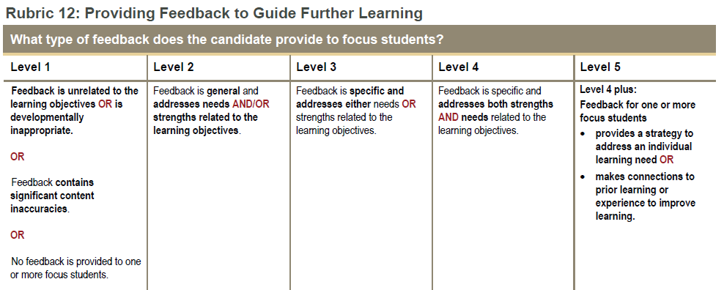
Assessment: edTPA Rubric 12
Rubric 12: Providing Feedback to Guide Further Learning
TAPS 6: Assessment Uses
Information taken from the edTPA Elementary Education Assessment Handbook
Copyright 2017 Board of Trustees of the Leland Stanford Junior University
All rights reserved.
Notes:
Finally, the last phase of the feedback cycle, Assessment, includes two main points of emphasis. First, I will discuss edTPA Rubric 12 and TAPS 6 – Assessment Uses which highlight the teacher’s/candidate’s provision of feedback to learners on their strengths and needs, and include a strategy to improve or to extend learning. Sharing accurate results of student progress with students, parents, and key school personnel is important for students to progress toward their learning goals.
(CLICK)

Slide 21
Assessment: edTPA Rubric 13
Rubric 13: Student Understanding and Use of Feedback
TAPS 6: Assessment Uses
Information taken from the edTPA Elementary Education Assessment Handbook
Copyright 2017 Board of Trustees of the Leland Stanford Junior University
All rights reserved.
Notes:
As part of the last phase of the feedback cycle pertaining to Assessment, the second point of emphasis is aligned to edTPA Rubric 13 and TAPS 6 – Assessment Uses – which highlight the criticality of opportunities for students to understand and to use the feedback provided. By providing opportunities for students to use feedback, teacher/candidates have help students make progress toward their goals AND teach them how to self-assess and use strategies to improve their own learning. This brings us back to the beginning of the feedback cycle/loop where we see alignment to TAPS 6 – Assessment Uses: teachers/candidates have the opportunity to use assessment tools for both formative and summative purposes to inform, guide, and adjust instruction and to systematically analyze and use data to measure student progress, to design appropriate interventions, and to inform long- and short-term instructional decisions.
(CLICK)

Slide 22
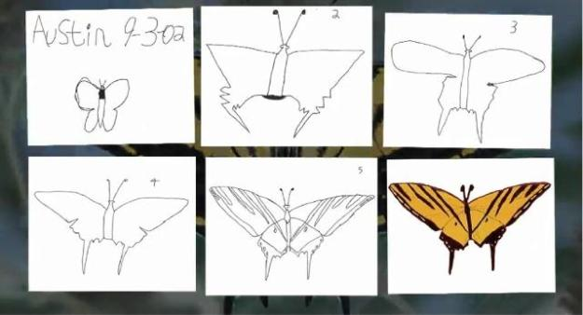
The Power of the Feedback Cycle
Austin’s Butterfly Video: https://www.youtube.com/watch?v=hqh1MRWZjms
Notes:
Day:
(CLICK)

Slide 23
Quick Chat! Power of the Feedback Cycle
Have you had a similar experience like the one Austin and his teacher experienced?
AND/OR
If you’ve seen Austin’s Butterfly video before, what was your initial reaction?
Austin’s Butterfly Video: https://vimeo.com/38247060
Notes:
Pam: Considering the power of the feedback cycle, have you had a similar experience that you’d like to share?
Or, maybe you’ve shown Austin’s Butterfly video before. How did your colleagues or pre-service teachers respond to the feedback cycle?
(CLICK)

Slide 24
Types of Feedback
What types of feedback are associated with effectiveness and why?
Notes:
Day So, you might be thinking, what types of feedback are most effective and why?
(CLICK)

Slide 25
Types of Feedback Associated with Effectiveness
Most Effective Feedback | Least Effective Feedback
Feedback is goal directed. AFFIRM WHAT THEY DID WELL & WHERE THEY ARE GOING | Feedback is not directed toward attainment of goals.
Feedback provides information on the correct response. Feedback on the Task – FT CORRECT & DIRECT | Feedback focuses on the incorrect response increasing the likelihood that it will be remembered.
Feedback is simple and age appropriate, rather than complex. Feedback on the Task – FT AIM FOR AGE-APPROPRIATE FEEDBACK | Feedback is too complex.
*Feedback builds on changes from previous trials– ways to improve.. Feedback on the Process – FP - more effective than FT POINT OUT THE PROCESS | Feedback does not include strategies to achieve goals that will promote student commitment and deeper learning.
Meaningful feedback is verbal, non-verbal, or written and goes beyond marks/scores/grades. Feedback on the Process – FP | Feedback focuses only on marks/scores/grades.
Feedback is meaningful, positive, and timely (i.e., immediate or delayed) based on the phase of learning (McLeskey, et al. 2017). Feedback on the Process – FP AIM FOR MEANINGFUL, POSITIVE, AND TIMELY FEEDBACK | Feedback is not timely. Praise, rather than meaningful feedback, directs attention away from the task to focus on self or the person, threatening self-esteem. Feedback About Self – FS
Feedback is the catalyst for helping learners create their own feedback and cognitive routines. Feedback about Self-regulation – FR ENCOURAGE SELF-REGULATION | Students are not provided opportunities to self-assess and critique their own work.
Hattie & Timperley (2007)
Notes:
Carla: The following slide provides information pertaining to most effective and least effective types of feedback. First, effective feedback must be strategically delivered and goal directed. Feedback is most effective when the learner has a goal and the feedback informs the learner regarding areas needing improvement and ways to improve performance. Hattie and Timperley (2007) highlight three kinds of feedback: Feedback on the Task, Feedback on the Process, and Feedback about Self-regulation. Providing Feedback on the Task, teachers/candidates provide information on the correct response, rather than the incorrect, in order to increases chances that the learner will remember the desired response. Effective feedback is simple, rather than complex, and is age-appropriate. Considering Feedback on the Process, which is more effective than Feedback on the Task, teachers/candidates provide feedback that builds on changes from learners’ previous trials, including ways to improve. Meaningful feedback is verbal, nonverbal, or written and goes beyond marks/scores/grades. Meaningful feedback is positive, and timely (i.e. immediate or delayed) based upon the phase of learning. Feedback that is not timely is not helpful to learners. Praise, rather than meaningful feedback, directions attention away from the task to focus on self or the person. We call this type of feedback, which is least effective, Feedback about Self. This type of feedback, if directed in a negative way, may threaten a learner’s self-esteem and impede progress. Finally, Feedback about Self-regulation is a catalyst for helping learners create their own feedback and cognitive routines, increasing their self-regulation. Students benefit when they are provided opportunities to self-assess and critique their own work.
(CLICK)

Slide 26
Quick Chat!
What type(s) of feedback do you find most effective or have observed being most effective?
Notes:
Pam: As you reflect on the types of feedback you provide to students or have observed being provided to students, which type(s) have you found to be most effective?
(CLICK)

Slide 27
Stakeholders Use of Feedback in their Settings
What kinds of strategies support students’ use of feedback to enhance learning?
Notes:
Day
(CLICK)

Slide 28
Strategies to Support the Use of Feedback to Enhance Learning
Assist students in answering the following questions:
Where am I going?
How am I going?
Where to next?
(Hattie & Timperley, 2007)
Use models with feedback to provide opportunities for students to use feedback (Wiggins, 1998)
Model
Practice
Perform
Feedback
Perform
Use models
with feedback
Notes:
Carla: Using strategies to support students’ use of feedback to enhance their learning is as important as providing learners with feedback. The following strategies are ways that teachers/candidates can provide opportunities for their students to use feedback: (1) Assist students in answering their own questions – where am I going? How am I doing? Where to next? (2) Model how to use feedback (e.g. thinking aloud and demonstrating); practice with learners as they try to use feedback; allow learners chances to perform as individuals; provide more feedback; and, follow-up with another opportunity for learners to respond.
(CLICK)

Slide 29
Quality Feedback & Assessment Reform
Why is quality feedback a critical component of assessment reform?
Notes:
Day
(CLICK)

Slide 30
Quality Feedback – a Critical Component of Assessment Reform
We can strive for reform by…
Let’s move past the status quo where…
Assessment tasks are aimed at measuring students’ levels of proficiency only (i.e., concern for adequacy of scores/grades).
Designing engaging, authentic assessment tasks that will provide students with information to understand the gap between their current performance and the learning goal.
Providing feedback about the task (FT), about the processes or strategies to understand the task (FP), or about self-regulation (FR).
Giving students opportunities to interpret and use the feedback promoting self-efficacy about learning which leads to further learning.
Hattie & Timperley (2007); Wiggins, (1998)
Notes:
Day MTSS connection
(CLICK)

Slide 31
Implications for ALL Stakeholders in Varied Settings
How does the gift of feedback and students’ use inform stakeholders in varied settings?
Notes:
Day
(CLICK)

Slide 32
Considerations for Educator Preparation Providers
In the university/school-based class setting
Model effective ways of giving feedback about the tasks, about the processes, and about self-regulation.
Provide opportunities for teacher candidates to use the feedback as applied to their own coursework and field experiences.
Encourage peer feedback and self-assessment in the university classroom.
Connect coursework with clinical experiences by embedding ongoing opportunities for teacher candidates to complete tasks with their students requiring their attention to feedback and student use of feedback.
Notes:
Carla:
(CLICK)

Slide 33
Considerations for Teachers
In the classroom
Design authentic, meaningful assessment tasks for students aligned to learning goals.
Model effective ways of giving feedback about the tasks, about the processes, and about self-regulation.
Provide opportunities for students to use the feedback as applied to their work.
Encourage peer feedback and self-assessment.
Notes:
Carla:
(CLICK)

Slide 34
Considerations for School Leaders
In the school and district
Evaluate the assessment process (i.e., beyond data analysis, including how to use data).
Identify feedback opportunities during observations.
Create a common time for teachers to determine how to use their data to improve instruction.
Notes:
Carla:
(CLICK)

Slide 35
Quick Chat!
Moving forward, how do you anticipate providing feedback in your setting?
OR
How do you anticipate supporting your teachers (pre-service or in-service) to provide effective feedback?
Notes:
Pam: As you move forward, perhaps you’ve considered adopting a new approach for providing feedback. If that’s the case, how do you anticipate providing feedback in your setting? Or, how do you anticipate supporting your teachers (pre-service or in-service) to provide effective feedback?
(CLICK)

Slide 36
What resources are available?
Notes:
Pam: Let’s take a closer look at the resources that are available for HLP 8 and past HLP webinars.
<CLICK>

Slide 37
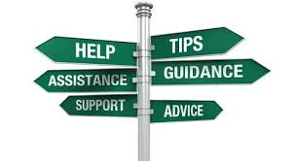
Resources
Video for HLPs #8 and #22: Provide Positive and Constructive Feedback to Guide Students’ Learning and Behavior https://highleveragepractices.org/701-2-3/
Professional Learning Opportunity for HLP 8
Discussion Guide for HLP 8, Austin’s Butterfly (video for Austin’s Butterfly can be found at https://www.youtube.com/watch?v=hqh1MRWZjms)
Recorded Past HLP Webinars and Resources- http://ceedar.education.ufl.edu/georgia-hlp-webinar-series/
Notes:
Pam: The first resource for HLP 8 is a fantastic video developed by CEEDAR. This video highlights both HLPs 8 and 22 in terms of the types of feedback and the effects of constructive feedback. The link to find the video is listed for you.
The second resource is a professional learning opportunity for HLP 8. This resource is to be used in conjunction with the video CEEDAR developed that I just referred to. The professional learning opportunity allows educators to watch the video, stop at various points throughout the video, and respond to reflective prompts/questions.
The third resource is a discussion guide regarding Austin’s Butterfly. We showed the progression of Austin’s butterfly when we discussed the power of the feedback loop. If you haven’t had the opportunity to see the effects of feedback for first grader, Austin, you will definitely want to check this out!
Finally, if you weren’t able to join the past HLP webinars 1 – 3 or you were able to join but would like to refer back to them, the webinars have been recorded for you. Furthermore, the HLP has developed and acquired resources to be used for each webinar- All of which have been uploaded onto CEEDAR’s site. The link to find the recorded webinars and resources is listed here for you.
<CLICK>

Slide 38
References
Notes:
Pam—we have also included the references that were used in Carla’s talk today if you would like to follow up on any of the information included in the slides.
(CLICK)

Slide 39
What’s Next?
Notes:
PAM: Now, let’s see what’s coming up…
(CLICK)

Slide 40
HLP Webinar #5
When: January, 23rd 3:30- 4:30pm
What: HLP #18, Using Strategies to Promote Active Student Engagement, through the lens of culturally responsive pedagogy, led by Dr. Neporcha Cone
To register: http://ceedar.education.ufl.edu/georgia-hlp-webinar-series/
Notes:
PAM: On January 23rd at 3:30 p.m., our fifth HLP webinar will focus on HLP #18 –and our keynote speaker will be Dr. Neporcha Cone from Kennesaw State University.
The link to register for the fifth webinar is listed for you but will also be sent in an invitation e-mail next week. As an FYI- when you register for the fifth webinar, you are automatically registering for the subsequent webinars and will receive information regarding the webinars.
(CLICK)

Slide 41
Any…
Notes:
PAM: Before we conclude, do you have any final questions and/or thoughts? If so, please use the chat box or raise your hand, and we’ll unmute you.
(CLICK)

Slide 42
Contact: pamela_wetherington@columbusstate.edu
Notes:
PAM: Please feel free to contact me if you have any questions.
Have a great week everyone! We will look forward to ‘seeing you’ (virtually) at the next HLP webinar on January 23 at 3:30 p.m.

