Slide 1
High Leverage Practices (HLP) Webinar 2: Reimagining Classroom Experiences to Maximize Student Engagement
Notes:
Day: (perhaps begin with welcoming them back or thanking them for participating for the first time)
Welcome to the second High leverage practices webinar developed by the GA HLP team. If this is your first time, thank you for joining us! If you are a returning participant, welcome back. We are glad that you are joining us for another awesome discussion.
In this webinar we will focus on engaging all learners through active classroom experiences. Participants will learn a variety of strategies to build relationships with students, create a learning environment that encourages active participation, and check for student understanding - all of which maximize student outcomes. We will discuss informal and deliberate methods to assess what students are learning during instruction to collect data and make informed decisions. Specifically we will focus on high leverage practices #18 and 4.

Slide 2
Disclaimer
This content was produced under U.S. Department of Education, Office of Special Education Programs, Award No. H325A120003. David Guardino serves as the project officer. The views expressed herein do not necessarily represent the positions or polices of the U.S. Department of Education. No official endorsement by the U.S. Department of Education of any product, commodity, service, or enterprise mentioned in this website is intended or should be inferred.
Notes:
Before we proceed, I'd like to offer the disclaimer that this work is produced under an Award sponsored by the USDOE and the project officer is David Guardino. Now, let's introduce the team.

Slide 3
Facilitator Introductions
Melissa K. Driver, Ph.D.
DaShaunda Patterson, Ph.D.
Kate Zimmer, Ph.D.
Pam Wetherington, Ed.D.
Notes:
All: Clockwise
Pam: will be Chat/Poll Girl
Melissa: Hi my name is Melissa Driver, and I am an assistant professor of special education at Kennesaw State University. I taught in inclusive settings in both elementary and middle school and have also worked as an instructional coach for multiple school sites. My current teaching and research focuses on preparing special and general education teacher candidates to effectively support all learners.
Kate: hello, my name is Kate Zimmer and I am an associate professor of special education at Kennesaw State University. I taught in a multi-age classroom at the elementary level for many years. My teaching, research, and community engagement efforts focus on teacher preparation with a focus on high leverage practices, early intervention, and autism.
Pam: My name is Pam Wetherington, and prior to working at Columbus State University, I taught 4th grade at New Mountain Hill Elementary School. Currently, I’m an assistant professor in Columbus State University’s Elementary Education Program in addition to serving all of our teacher preparation programs as the edTPA Coordinator and Asst Dept Chair. Although I teach graduate courses, my primary work and research is focused on ensuring pre-service teachers are indeed ready to be recommended for certification and their induction years of teaching.
Day: Hello! My name is DaShaunda Patterson. I am a clinical assistant professor of special education at Georgia State University. I have taught in general education and special education environments in elementary schools. Currently, I support pre-service and in-service teachers who are earning certification or graduate degrees in special education. CLICK

Slide 4
Poll Time!
Select the option that best describes your role:
Educator Preparation Provider
P-12 Teacher
Instructional/Academic Coach or Teacher Leader
School or District Leader
State or National Policy Maker
Other (please indicate in chat box)
Notes:
PAM: To allow us all to get a sense for who is joining us this afternoon, please click on the role that best describes you.
Review responses.

Slide 5
Webinar Roadmap
Why are we here?
What high leverage practices will we focus on today?
What instructional and behavioral strategies support active student engagement and learning?
What resources are available for these HLPs?
What’s next?
Notes:
Day: Include a quick recap of Webinar 1 in the why are we here.
1. As we mentioned in webinar 1, our goal is provide an overview of the High Leverage practices in a way that is meaningful and accessible to stakeholders including P-12 teachers, instructional and academic coaches, building administrators and central office leaders. The last time we connected, we provided a general overview of the high leverage practices in the context a multi-tiered system of support.
2. Today, we are going to start addressing specific practices that will be useful in fostering or supporting actively engaged classrooms. For this work, we will focus on HLP 4 and 18.
3. As we do our work together today, we want to share some instructional and behavioral strategies that are effective in engaging active student learning. And we also want to invite you reflect and share the practices that you use or see used that support this important goal.
4. While the team offers you suggestions on the tools, we will also share resources that we have procured and developed that can help you consider active engagement in your settings.
5. Finally, we will close by giving you a heads up for what you can expect next time in HLP webinar 3.

Slide 6
Our Mission & Partners
Notes:
Day:
Before we continue, we want to acknolwedge and thank our partners in this work: the CEEDAR center, the Ga Department of Education, the Ga Professional Standards Commission and the Board of Regents. WE appreciate your support as we move forward with this important work.

Slide 7
Georgia's Systems of Continuous Improvement Framework
Notes:
Day:
Quickly, I'd like to offer the GA Systems of continuous improvement framework. This framework operates with the whole child at the center of consideration as decisions are made about identifying and implementing evidence based practices and interventions, including High leverage practices. One component that is necessary to consider when thinking of ways for students to be ready to learn is the coherence of instruction. Today's focus on High leverage practices 18 and 4 will allow us to discuss active engagement through the use of multiple sources of information which will support coherent instruction.
\

Slide 8
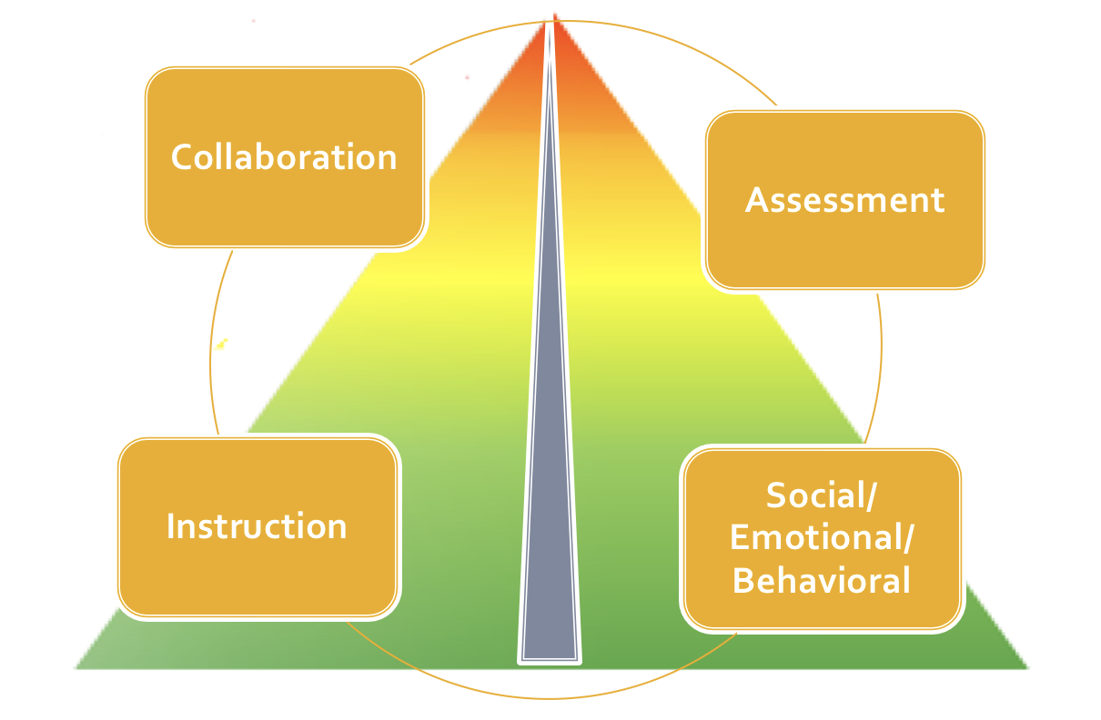
MTSS & HLPs
Notes:
Day:In the context of Georgia's tiered systems of supports, HLPs 18 and 4 are valuable practices that will make instruction accessible for ALL learners . And these practices can certainly be considered effective and sustainable and can typically be well sustained by the structures available in most systems.

Slide 9
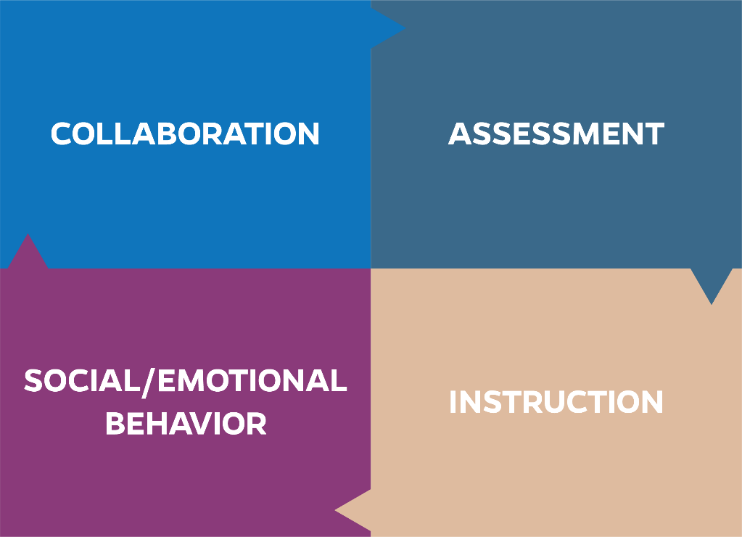
High Leverage Practices
HLPs are identified as specific teacher practices that are likely to result in improved student outcomes.
Notes:
Melissa: As a reminder, high leverage practices, or HLPs as they are commonly referred to, are identified teacher practices likely to result in improved student outcomes. HLPs are comprised of evidence-based strategies backed by decades of research. They are based on the premise that our students need teachers who are well-equipped in each of the areas of collaboration, assessment, social/emotional/behavior support, and instruction. <CLICK>

Slide 10
What high leverage practices will we focus on today?
Notes:
Melissa: As you saw on the previous graphics, high leverage practices are interconnected. Today, we will be focusing in on two HLPs in the areas of instruction and assessment. We will spend some time unpacking each and then discuss what it might look like to support pre and inservice teacher learning and implementation. <CLICK>

Slide 11
For Today
HLP #18 - Use strategies to promote active student engagement.
HLP #4 - Use multiple sources of information to develop a comprehensive understanding of a student’s strengths and needs.
Notes:
Melissa: Specifically, we will focus in on HLP 18 – using strategies to promote active student engagement and consider how this relates to HLP 4 – using multiple sources of information to develop understanding of student strengths and needs. We will focus specifically on the role of questioning and checks for understanding for both HLP 18 and 4. <CLICK>
Resource From the Book if needed:
#18 Use strategies to promote active student engagement: Teachers use a variety of instructional strategies that result in active student responding. Active student engagement is critical to academic success. Teachers must initially build positive student–teacher relationships to foster engagement and motivate reluctant learners. They promote engagement by connecting learning to students’ lives (e. g., knowing students’ academic and cultural backgrounds) and using a variety of teacher-led (e.g., choral responding and response cards), peer-assisted (e. g., cooperative learning and peer tutoring), student-regulated (e.g., self-management), and technologysupported strategies shown empirically to increase student engagement. They monitor student engagement and provide positive and constructive feedback to sustain performance. HLP19 Use assistive and
#4 Use multiple sources of information to develop a comprehensive understanding of a student’s strengths and needs: To develop a deep understanding of a student’s learning needs, special educators compile a comprehensive learner profile through the use of a variety of assessment measures and other sources (e.g., information from parents, general educators, other stakeholders) that are sensitive to language and culture, to (a) analyze and describe students’ strengths and needs and (b) analyze the schoolbased learning environments to determine potential supports and barriers to students’ academic progress. Teachers should collect, aggregate, and interpret data from multiple sources (e.g., informal and formal observations, work samples, curriculum-based measures, functional behavior assessment [FBA], school files, analysis of curriculum, information from families, other data sources). This information is used to create an individualized profile of the student’s strengths and needs.

Slide 12
What to Consider
Is it introduced?
Is it practiced?
Is it applied in the field?
How do pre- and inservice teachers demonstrate their knowledge, skills, and dispositions?
Notes:
Melissa – As we dive into these HLPs, we want you to think about this material in your own context, whether you are an educator preparation provider, a classroom teacher, teacher leader, school/district administrator, or policy maker. Regardless of your role, consider what must happen as pre- and in-service teachers learn new knowledge and skills. First, the content must be presented in a meaningful and authentic way. Next, pre- and in-teachers should practice in a safe context with feedback. We believe that this practice should occur before practicing in the field with students. This step often gets skipped, however, incorporating this practice helps ensure that our students are getting the best version of their teacher’s new skill when it is applied in the field. And this is the final step, taking what candidates have learned and practiced then putting it into action where it counts. <CLICK>

Slide 13
Quick Share!
What active engagement strategies have you found to be most helpful for students?
Notes:
Pam: Before we explore various strategies that support students’ active engagement, let’s hear from you. Using the chat box (or as a reminder, you can raise your hand and we’ll unmute you so you can speak to the group), please list the strategies that you have found to be most helpful to support students’ active engagement.
Read strategies in chat box.
Thank you for sharing your active engagement strategies that you have found to be successful! Now, let’s hear from my colleagues in regard to strategies that promote and sustain active student engagement.

Slide 14
What strategies support active student engagement and learning?
Is it introduced?
Is it practiced?
Is it applied in the field?
Notes:
KATE: Active student engagement is critical to academic success. In order to actively engage the learner, it is important that educators link student’s prior knowledge to the new knowledge that is being introduced (this can be based on the student personal, cultural, and community background knowledge). Thinking back to your own context…have you introduced this concept of active student engagement? If so, how did you introduce this concept? CLICK

Slide 15
HLP #18
Is it introduced?
Is it applied in the field?
Is it practiced?
Use strategies to promote active student engagement.
Notes:
KATE: One way to introduce strategies that support active engagement is through High Leverage Practice #18.This HLP is when teachers use a variety of instructional strategies that result in active student engagement. CLICK

Slide 16
HLP #18
Is it introduced?
Is it applied in the field?
Is it practiced?
Use strategies to promote active student engagement.
TeachingWorks/General Education HLP Alignment
Leading group discussions, #1
Notes:
Kate Another way to introduce active engagement is through the general education HLP #1: Leading a group discussion. A reminder: we provided a great resource that aligns all Special education and general education HLPs. You can find this on the CEEDAR and Georgia Department of Education website CLICK

Slide 17
HLP #18
Is it introduced?
Is it applied in the field?
Is it practiced?
Use strategies to promote active student engagement.
TeachingWorks/General Education HLP Alignment
Leading group discussions, #1
Leaders:
evidence-based approaches to instruction and assessment are implemented with integrity and are adapted to local needs
Notes:
Kate And within that alignment resource it also highlights what Leaders can do to support to the roll out of these HLPS and Ensure that evidence-based approaches to instruction and assessment are implemented with integrity and are adapted to the local needs CLICK

Slide 18
How do teachers actively engage?
Active Student Engagement
Teachers must build positive teacher-student relationships
Teachers should use a variety of strategies to ensure engagement in lesson
Teachers actively monitor for engagement & provide ongoing, specific feedback
Kennedy, Peeples, Romig, Mathews, & Rodgers (2018).
Notes:
Kate So, how do teachers actively engage? First, Teachers must build a positive teacher-student relationship. Second, teachers should use a variety of strategies to ensure engagement in lesson. And third, teachers actively need to monitor for engagement & provide ongoing, specific feedback
In other words we need our teachers to explicitly connecting new learning to previously learned material. Teachers use a variety of informal but deliberate methods to assess what students are learning during and between lessons. These frequent checks provide information about students’ current level of competence and help the teacher adjust instruction during a single lesson or from one lesson to the next. They may include, for example, simple questioning, short performance tasks, oral gestures, journal or notebook entries, and using technology such as clickers…... Over the next couple of slides we will provide some additional examples of how this can be done. CLICK

Slide 19
HLP #18
Is it introduced?
Is it applied in the field?
Is it practiced?
Teachers must build positive teacher-student relationships
Notes:
Kate: As stated in the previous slide, it is important to remember that teachers must initially build positive student–teacher relationships to foster engagement and motivate reluctant learners. We will go into more details on specific strategies on how to build those meaningful relationship in future webinars but for today we will highlight a few ways to start building those important relationships. CLICK

Slide 20
HLP #18
Teachers must build positive teacher-student relationships
Talk to your students
Notes:
Kate: Talk to your students. Greet them when they enter your classroom or building, and tell them goodbye when they leave. This may seem small and redundant, but it shows the students that you notice and enjoy their presence in your class and/or school. CLICK

Slide 21
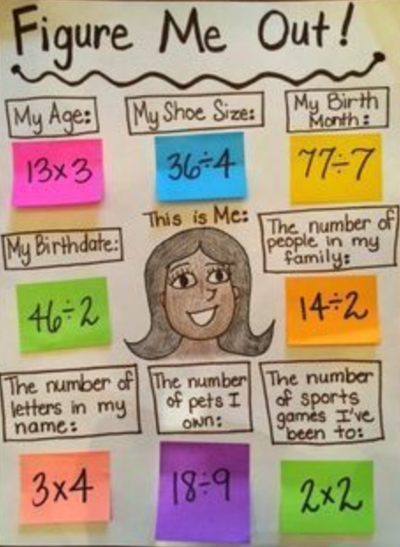
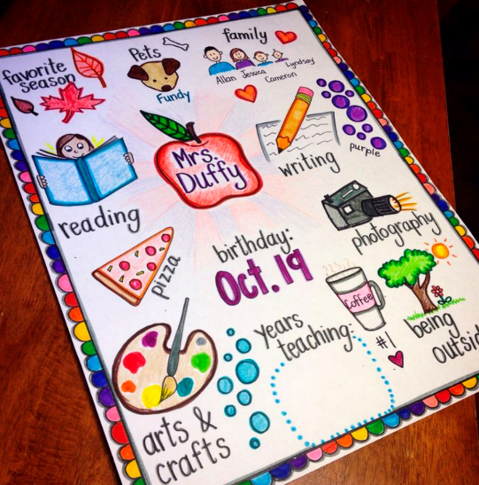
HLP #18
Teachers must build positive teacher-student relationships
Talk to your students
Share information about yourself
Notes:
Kate: Share some relevant yet age-appropriate information about yourself. Let the students get to know you too. They will have a deeper understanding for you, may change their judgments, or better understand your reasoning. It’s also a good way to show students the real world implications for the curriculum. CLICK

Slide 22
HLP #18
Teachers must build positive teacher-student relationships
Talk to your students
Share information about yourself
Attend some extracurricular activities
Notes:
Kate: If possible try to attend some extracurricular activities that your students are part of. This shows the student’s that you appreciate their interest and support them. CLICK

Slide 23
HLP #18
Teachers increase engagement when they have positive teacher-student relationships
Notes:
Kate: Teachers increase the likelihood that students will engage and persist in school when they establish positive, individual relationships with them. Techniques for doing this include greeting students positively every day, having frequent, brief, “check-in” conversations with students to demonstrate care and interest, and following up with students who are experiencing difficult or special personal situations. CLICK

Slide 24
Quick Share!
What strategies would you recommend to create meaningful teacher-student relationships?
Notes:
Pam- In our profession, we all recognize the importance of creating and sustaining meaningful student-teacher and student-student relationships. We’d love to hear ways in which you develop a classroom community with your students. What activities and/or strategies have you found to help create and sustain meaningful relationships in your classroom or school?
Or perhaps you’re an administrator, what are some of the ways your teachers develop meaningful relationships?
Read chats and share.
To continue this conversation, my colleagues will share some of their ideas related to creating and sustaining meaningful relationships with students.

Slide 25
HLP #18
Teachers should use a variety of strategies to ensure engagement in lesson
SPED HLP #16:
SPED HLP #17:
SPED HLP #19:
Use explicit instruction
Use flexible groups
Use assistive & instructional technology
Notes:
Kate Let’s continue to dive deeper into HLP #18 engagement. To ensure engagement in lessons, teachers should use a variety of strategies. This graphic highlights how high leverage practices are not to be used isolation, but rather how they are intertwined are should be used together. When teachers use a variety of strategies they are using explicit instruction; flexible grouping, and embedding technology throughout. The following slides we will provided additional engaging strategies… CLICK

Slide 26
HLP #18
Peer - assisted strategies
Cooperative learning & peer tutoring
Notes:
KATE: Peer-assisted strategies, such as cooperative learning and peer tutoring are great strategies to use with the classroom to actively engage students. In our resources for this webinar we provide 2 articles that provide guidelines for how to effectively implement class wide peer tutoring and how to train students to use peer assisted learning strategies. CLICK

Slide 27
HLP #18
Voice & Choice
student-regulated
differentiated instruction
strengthen teacher-student relationship
Notes:
KATE: Another engaging strategy to use is voice and choice. When students have opportunity to express “voice & choice” on important matters, it increases student buy in and engagement. In addition, student voice promotes student regulation, self-management, and differentiated instruction. Providing choices allows students to share there personal passions and experiences, which strengthens that teacher-student relationship. Some examples of voice and choice would be: allowing students to create topics to study, create questions asked, provide voice in text and resources used, input on products to create, voice and choice on time frame, and input on rubrics… CLICK

Slide 28
HLP #18
Technology- supported strategies
Engaging videos
Clickers
Social Media
Notes:
Kate: Another way to increase active engagement in students is to use Technology- supported strategies. Technology- supported strategies monitor student engagement and provide positive and constructive feedback to sustain performance. Think about engaging videos, virtual field trips, guest speakers, clickers, and social media CLICK

Slide 29
HLP #18
Students can share their opinions on issues or any open questions using Twitter.
We encourage you all to tweet what you have been learning using the hashtag #GaHLPs
Notes:
Kate: An example of using social media, could be having students share their opinions on issues or any open questions using Twitter. We encourage you all to tweet what you have been learning using the hashtag #GaHLPs CLICK

Slide 30
Sample Lesson Discussion
sample lesson plan for analysis
Notes:
Pam- One of the resources the HLP team included for this webinar was a sample lesson plan. This lesson plan was developed by a pre-service teacher early in her teacher preparation program as she began to learn about HLPs and ways in which to include them in lesson plans. We’ll be using this sample lesson plan as a point of reference at various points throughout our webinar and hope you find ways through the lesson plan discussion to support the integration of HLPs.

Slide 31
Sample Lesson Discussion
What evidence of HLP #18 (engagement) do you see in this lesson?
Notes:
Pam- One of the ways teachers, academic coaches, administrators, mentors of pre-service teachers, and teacher educators can use this resource is to identify evidence of HLP #18. So, let’s take a moment to review the lesson plan. Then, using the chat box, please list ways in which this pre-service teacher intentionally included HLP #18, engaging students in learning.
Read chat and share.
Dr. Driver will now discuss the structure of this lesson plan.

Slide 32
Lesson Structure
Notes:
Melissa: If the structure of that lesson plan looked familiar- that’s because it’s modeled from explicit instruction. Explicit instruction is systematic, direct, engaging, and success oriented—and has been shown to promote achievement for all students. It is also its own HLP, number 16 to be exact. We will be devoting an entire webinar to explicit instruction later in this series. We want to briefly highlight it here however, because the format of this instructional approach encourages active student participation and engagement. Explicit instruction also gradually releases responsibility to the students, so that they are able to be successful at all stages of the lesson. <CLICK>

Slide 33
HLP #18
Teachers actively monitor for engagement & provide ongoing, specific feedback
Notes:
Melissa:
A key part of engagement is being able to read the room and know that your students are with you. This is most often done through questioning and providing feedback to students to guide their thinking. Questioning blends between instruction and assessment on our graphic here, and we will spend a few minutes talking about this through the lens of HLP 4. <CLICK>

Slide 34
HLP #4
Is it introduced?
Is it applied in the field?
Is it practiced?
Use multiple sources of information to develop a comprehensive understanding of a student’s strengths and needs
TeachingWorks/General Education HLP Alignment
Eliciting and interpreting individual students’ thinking, #3
Checking student understanding during and at the conclusion of lessons, #15
Selecting and designing formal assessments of student learning, #16
Notes:
Melissa: HLP 4 is about using multiple sources of information to drive instructional decisions. In order to use information, you must first collect it. In today’s webinar we will focus on collecting data through formative assessments. In our October webinar, we will focus on analyzing data and using it to make data-based decisions. HLP 4 is aligned with several of the TeachingWorks HLPs related to checks for student understanding. <CLICK>
Resources if needed:
3) Teachers pose questions or tasks that provoke or allow students to share their thinking about specific academic content in order to evaluate student understanding, guide instructional decisions, and surface ideas that will benefit other students. To do this effectively, a teacher draws out a student’s thinking through carefully-chosen questions and tasks and considers and checks alternative interpretations of the student’s ideas and methods.
15) Teachers use a variety of informal but deliberate methods to assess what students are learning during and between lessons. These frequent checks provide information about students’ current level of competence and help the teacher adjust instruction during a single lesson or from one lesson to the next. They may include, for example, simple questioning, short performance tasks, or journal or notebook entries.
16) Effective summative assessments provide teachers with rich information about what students have learned and where they are struggling in relation to specific learning goals. In composing and selecting assessments, teachers consider validity, fairness, and efficiency. Effective summative assessments provide both students and teachers with useful information and help teachers evaluate and design further instruction.

Slide 35
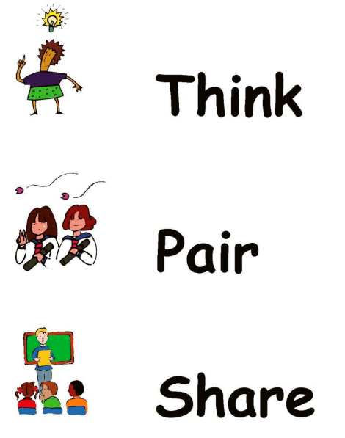
Diagnostic Assessments
Notes:
Melissa: When we think of collecting data to increase student engagement, we want our teachers to first think about diagnostic or pre-assessments. This can be anything from a formal standardized assessment report, unit pre-test, to a simple think-pair-share at the start of a lesson. The point is that we want our students to be successful in each and every lesson, and this means we need our instruction to be accessible from wherever their starting point is. Using diagnostic assessments allows teachers to build on learners’ prior knowledge and experiences, anticipate sticking points, and provide strategic opportunities for students to respond in the lesson. <CLICK>

Slide 36
Questioning
Notes:
Melissa – And this brings us to questioning, the most common way teachers check student understanding during and at the conclusion of instruction. <CLICK>

Slide 37
Poll Time!
What dominates the majority of instructional time?
Teacher talk
Teacher questions
Student talk
Student questions
Notes:
Pam: When we consider GA’s classrooms, which of the following (teacher talk, teacher questions, student talk, or student questions) do you believe dominates the majority of instructional time?
Review the poll.
There is research to indicate teachers talk between 70-80% during instructional time. Additionally, it has been found that only 5-10% of teacher talk results in student discourse. As such, it has been recommended that teachers should speak 20-30% during instructional time, which includes posing questions to deepen students’ learning.
Now, let’s identify ways in which questioning can be used to deepen students’ learning.

Slide 38
Questioning
Notes:
Melissa – Questioning serves a variety of purposes. In terms of student engagement, it provides students opportunities to respond. These opportunities should be meaningful and frequent. <CLICK>

Slide 39
Questioning
Notes:
Melissa – Questioning also allows teachers to gauge student understanding at key points throughout the lesson. Often we see novice teachers barreling through a lesson, perhaps asking questions, but not really using this strategy to inform their next move. They get to the end of the lesson, and the students are lost or confused. Questioning should be a safeguard, one that teachers use to determine if students are ready to practice in groups and independently, or if they are ready to tackle a more complex problem. <CLICK>

Slide 40
Questioning
Notes:
Melissa – Questioning also provides natural opportunities for teachers to provide specific feedback and reinforce correct student understandings. Specific feedback is key here. When asking a student to point to a picture of a triangle, a teacher might say “great job Anna”. This reinforces her effort but doesn’t add much to the overall understanding of the class. In the same scenario the teacher could say “great job Anna. You’re right, this is a triangle because it has three sides”. The additional few seconds taken here just reinforced why Anna was correct, therefore praising effort and reinforcing content. <CLICK>

Slide 41
Questioning
Notes:
Melissa – We also want to see both questions and feedback that deepens students level of critical thinking and encourages connections between content and their lives. Questions should be strategically scaffolded to appropriately challenge all learners and keep them active in the lesson. <CLICK>

Slide 42
Scaffold Questioning
From the start to finish of a lesson
For an incorrect answer
For increasing levels of difficulty
Notes:
Melissa: Scaffolding is a process through which a teacher adds supports for students in order to enhance learning and aid in the mastery of tasks. The teacher systematically builds on students’ experiences and knowledge as they are learning new skills. <CLICK>

Slide 43
Consider…
The types of questions you ask
How you ask students to respond
When you ask in the lesson cycle
Notes:
Melissa – As teachers develop questions and seek to scaffold support, they should consider the types of questions asked, how students are responding, and when each question is asked. <CLICK>

Slide 44
Question Types
DOK 1
Recall & Reproduction
Recall a fact, term, principle; perform a routine procedure
DOK 2
Basic Application of Skills/Concepts
Use information, conceptual knowledge; select appropriate procedure for task; perform 2 or more steps with decisions points along the way; solve routine problems; organize or display data; interpret or use simple graph
DOK 3
Strategic Thinking
Reason or develop a plan to approach a problem, employ some decision-making and justifications; solve abstract, complex, or non-routine problems, complex (often allow more than one possible answer)
DOK 4
Extended Thinking
Perform investigations or apply concepts and skills to the real world that require time to research, problem solve, and process multiple conditions of the problem or task; perform non-routine manipulations across disciplines, content areas or multiple sources.
Notes:
Kate Here are the 4 levels of DOK. Students learn skills and acquire knowledge more readily when they can transfer their learning to new or more complex situations. Having a variety of DOK questions within your lesson can help to articulate how deeply students must understand the related content to complete the necessary tasks. CLICK

Slide 45
Depth of Knowledge
Notes:
Kate: Here is a screen shot of the supplemental materials that came with this module. Continually cycling through the DOK levels, will support and scaffold learning to help students to extend their thinking. CLICK
IF PEOPLE ASK: A new model of rigor, depth of knowledge Depth of Knowledge (DOK) was created and ties more closely to the depth of content understanding and the purpose of the learning task from beginning to end. The level is not determined by the task’s verb, rather the task that follows the verb.

Slide 46
Sample Lesson Discussion
Create a Level 3 or 4 question and/or learning experience for this lesson.
Notes:
Pam- With Depth of Knowledge in mind and as we analyze the lesson plan that was developed by a former pre-service teacher, can you think of ways you could mentor the pre-service teacher or an induction teacher to include level 3 or 4 questions and/or learning experiences. We’ll take a moment to go back to the DOK chart so you’ll be reminded of DOK’s levels 3 and 4. Matt…
Spend a few minutes reviewing the chart (then, come back to this slide).
We’ll give you a few moments to refresh your memory of this lesson. And then, using the chat box, please list level 3 or 4 questions or learning experiences that could strengthen the engagement of students.
***Be prepared to share a level 3 or 4 question and/or learning experience

Slide 47
Multiple Ways to Respond
Notes:
Melissa – Once you’ve developed the types of questions to be asked, we want to also consider how we are asking students to respond. Maximizing participation and incorporating variety is a great way to keep students engaged. Teachers can individually call on students or ask a question for a whole class choral response. <CLICK>

Slide 48
Multiple Ways to Respond
Notes:
Melissa – Students can also share their thinking with a peer, which encourages all students to share out in a slightly safer environment than in front of the whole class. . <CLICK>

Slide 49
Multiple Ways to Respond
Notes:
Melissa – Students might write their thinking down, and this provides additional time for individual analysis and reflection. <CLICK>

Slide 50
Multiple Ways to Respond
Notes:
Melissa – Students might also write their response down on a whiteboard <CLICK>

Slide 51
Multiple Ways to Respond
Notes:
Melissa - or use a response card in order to encourage all students to think through the answer and give the teacher a visual whole class snapshot of student learning. <CLICK>

Slide 52
Multiple Ways to Respond
Notes:
Melissa - Or use student clickers to achieve the same result. These whole class strategies are typically best for questions that don’t require a lot of thinking time. Regardless of the approach teachers choose, we want them to be very strategic for why. The how is just as important as the what when it comes to questioning. <CLICK>

Slide 53
Quick Share!
How do teachers check for whole group and individual student understanding? What additional strategies would you like to see or use?
Notes:
Pam- In your mentoring roles and/or in your own classrooms, what are some effective strategies you’ve used or have seen used that check for students’ understanding (whole group, small groups, and individual students)? Are there any strategies that you’ve heard about and would like to try, or are there strategies for checking for students’ understanding that you’d like to see being used by your pre-service teachers, student teachers, teachers?
Please use the chat box to share your strategies.
Read chats and share.
Dr. Driver…

Slide 54
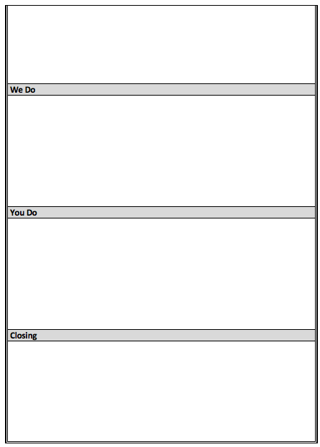
When and Where to Ask
Notes:
Melissa – Finally we want teachers to strategically decide when they will ask each question throughout the lesson. A common trend we see with our preservice teachers is that they want to save all their Level 2-4 DOK questions for the You Do, when students are practicing independently. Depending on how they have scaffolded the learning experiences throughout the lesson, students may or may not be ready to grapple at higher levels independently if all of the high quality questions are saved for last. In addition, they might have missed out on some great peer interaction earlier in the lesson cycle. <CLICK>

Slide 55
When and Where to Ask
Notes:
Melissa – The questions asked throughout should prepare students for and build towards the assessment for the lesson, whatever that might be <CLICK>

Slide 56
When and Where to Ask
Notes:
Melissa – Questions at varying DOK levels, with multiple opportunities for how students respond, should occur at all phases of the lesson cycle. To maximize student engagement, teachers can think of key “gateway” questions to ask before moving from the I Do, to guided practice, and finally to independent practice. What knowledge, skills, and understandings should a student be able to demonstrate in order to know they are ready for the next stage of the lesson? <CLICK>

Slide 57
Sample Lesson Discussion
What could this preservice teacher ask in the “We Do” section to know his/her students are ready for independent practice?
Notes:
Pam- As a mentor of a pre-service teacher or possibly as a mentor for an induction teacher, what questions would you recommend be posed to students in the ‘We do’ section of this lesson to make sure students are ready to independently create new examples for the physical characteristics of the Everglades?
Read chat box and share.

Slide 58
What strategies support active student engagement and learning?
Is it introduced?
Is it practiced?
Is it applied in the field?
Notes:
Melissa
So now that we have introduced strategies to support active student engagement and learning, let’s talk about what this practice piece might look like. <CLICK>

Slide 59
Preparing for the Field
Strategies should be introduced & practiced before the field!
Check teacher’s understanding and readiness.
Notes:
Melissa – There are several ways to provide practice before the field. This is a key time to check for teacher understanding and readiness in the same ways we just discussed. This can be done through group discussions, case studies, and simulated classroom experiences to name a few <CLICK>

Slide 60
Prompts for Planning
Think about the following questions when creating a lesson:
When you teach do you make an effort to build on your student’s prior knowledge and experiences?
Do you know your students well enough to be able to activate this prior knowledge?
What ways could you get to know individual student interest?
How will you check student understanding before, during, and after instruction?
Notes:
Kate: Providing planning prompts is a great way to encourage practice and solicit feedback prior to the field. Think about the following questions when creating a lesson: When you teach do you make an effort to build on your student’s prior knowledge and experiences? ; Do you know your students well enough to be able to activate this prior knowledge? ; What ways could you get to know individual student interest?; How will you check student understanding before, during, and after instruction? CLICK

Slide 61
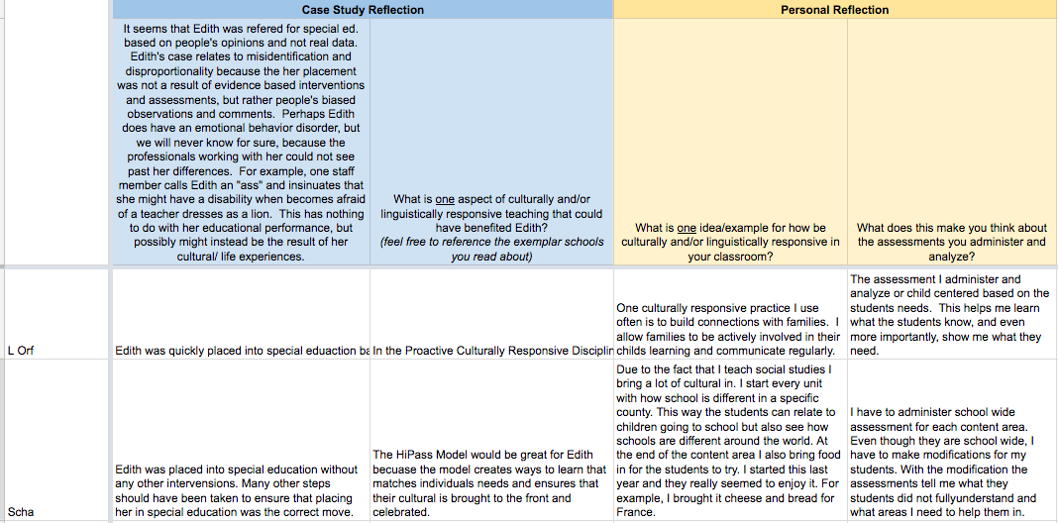
Are My Teachers Ready?
Notes:
Melissa - Just like with students, purposeful practice includes checks for understanding and feedback. Does the teacher demonstrate the knowledge, skills, and dispositions needed to successfully implement what they’ve learned? If not, what additional experiences are needed. For the majority of teaching strategies, having the opportunity to practice delivering instruction before going “live” is an invaluable experience. <CLICK>

Slide 62
What strategies support active student engagement and learning?
Is it introduced?
Is it practiced?
Is it applied in the field?
Notes:
KATE: So how do we know if these strategies are applied in the field? CLICK

Slide 63
Observation & Reflection
Notes:
Kate: While in the field we can observation our teachers and our teachers self reflect…. CLICK

Slide 64
Quick Share!
How do you identify if the active engagement strategies are occurring in the field and/or classroom?
How are you measuring or could measure the implementation of the strategies?
How do you or could you provide feedback and monitor change?
Notes:
Pam- Since we are moving towards the end of our time, we’d like for you to just choose one of the questions to respond to in the chat box based on what’s most pressing to you and your context. If you’d like to raise your hand, we can unmute you so you can share with the whole group.
Read questions and allow time for responses.

Slide 65
What resources are available for these HLPs?
Notes:
Day
With all of the great information presented today, we'd like to direct you to some tools that will be helpful for you as you consider ways to enhance and support active engagemen in your learning environment.

Slide 66
Available Resources
Webinar #1 Recording
Lesson Plan Activity/Case
Everglades Physical Characteristics Lesson Plan
Articles
Classwide Peer Tutoring
OSEP Research Institute: Bridging Research and Practice
Depth of Knowledge Guides
Levels
Question Stems
Professional Learning Opportunity for HLP 18
Notes:
Day- the description of for these resources are
Webinar #1 recording (Introduction to High Leverage Practices through a Multi-Tiered System of Supports) can be found on CEEDAR’s site and was also distributed to webinar 1’s registered participants.
Classwide Peer Tutoring- This article provides examples and strategies for how to promote effective student-student tutoring and collaboration in the classroom in an effort to engage all students.
OSEP Research Institute: Bridging Research and Practice- This article provides examples and strategies for how to engage all students for mathematics learning through peer-assistance.
Depth of Knowledge Levels- The chart lists the sequencing of steps in order to deepen students' content knowledge.
Depth of Knowledge Question Stems- The list provides examples of various question stems that represent each DOK level.
Everglades Physical Characteristics Lesson Plan- The lesson plan was developed by one of GA's pre-service teachers that intentionally includes supports and strategies to actively engage all students.
Professional Learning Opportunity for HLP 18- Mentors of pre-service and novice teachers seek to find ways to engage their mentees in professional learning opportunities. This resource is used in conjunction with CEEDAR's HLP #18 video (video can be found at https://highleveragepractices.org/701-2-5/). The Professional Learning Opportunity resource includes reflective, probing questions that can promote rich conversations with mentors and mentees for how to actively engage all students.

Slide 67
HLPs in Action
Notes:
Day
https://highleveragepractices.org/701-2-5/

Slide 68
Sample Lesson Discussion
How might you use this resource with your pre/in-service teachers?
Notes:
Pam- In the chat box, let’s share some ideas for how the former pre-service teacher’s Everglades lesson can be used as a resource with your pre and/or in-service teachers.

Slide 69
What’s Next?
Notes:
Pam: As we continue our HLP webinar series, let’s share what’s next.

Slide 70
Webinar III
When: October 24th 3:30- 4:30pm
What:
Use multiple sources of information to develop a comprehensive understanding of a student’s strengths and needs, HLP #4
AND
Collaborate with professionals to increase student success, HLP #1
Notes:
Pam: On Oct. 24 from 3:30 – 4:30 p.m., we will facilitate the third webinar in our HLP webinar series. In this webinar, we will investigate HLP #4, using multiple sources of information to develop an in-depth understanding of students’ strengths and needs in addition to HLP #1, collaborating with professionals to increase student success. For we know when teachers collaborate with others in regard to sharing what they’ve learned about their students’ strengths and needs, specific and individualized supports and enrichment activities can be developed.

Slide 71
Any…
Notes:
Pam: Before we conclude today, do you have any questions or thoughts? Please use the chat box if so. Or, if you’d like to raise your hand, we’ll unmute you to you can ask your question and/or share your thoughts.
Respond to questions and/or thoughts.
The HLP Team would like to thank you for participating in today’s webinar. If you have additional questions or thoughts, please feel free to contact me. (CLICK for next slide)

Slide 72
Contact: pamela_wetherington@columbusstate.edu
Notes:
Pam: We hope you have a fantastic afternoon and look forward to hearing how you are actively engaging students!

