Slide 1
Giving Them A Strong Start: Strategies and Resources for Supporting Early Career Special Educators Kerry Haag, Meg Kamman, Donna Wilder Moderator: Rob O’Neill
OSEP Project Directors’ Conference
Monday, July 23, 2018
Arlington, VA

Slide 2
Purpose of CFDA 84.325
The purposes of OSEP’s Personnel Development to Improve Services and Results for Children with Disabilities program are to:
help address State-identified needs for personnel preparation in special education, related services, early intervention, and regular education to work with children, including infants and toddlers, with disabilities; and
ensure that those personnel have the necessary skills and knowledge, derived from practices that have been determined through scientifically based research and experience, to be successful in serving those children.

Slide 3
Strategic Investments in PDP
Across the Career of Educators
Interest in Field
Personnel Preparation
Hiring
Mentoring / Induction
Ongoing Professional Learning

Slide 4
Shortages
Nearly every state reports shortages of special education teachers and early intervention providers
48 states and the District of Columbia report shortages of special education teachers
42 states report shortages of early intervention providers

Slide 5
Why Should We Be Concerned?
Certain students are more likely to be affected than others
Remote rural and urban areas have the worst shortages
Students served in special schools are more likely to have less prepared teachers

Slide 6
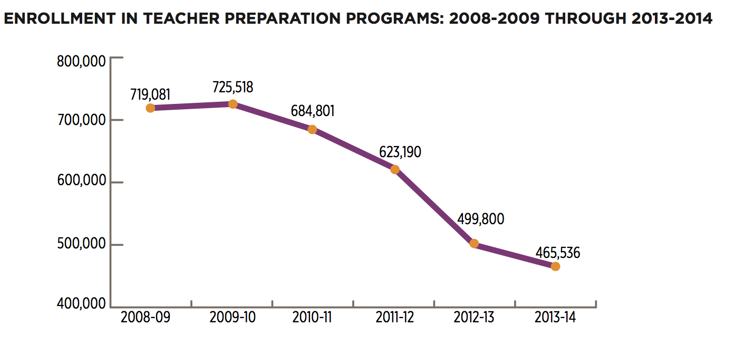
New Teacher Pipeline is Shrinking

Slide 7
Why Should We Be Concerned?
These shortages will likely result in shortcuts to the classroom, which could have deleterious effects.

Slide 8
Being Prepared Matters
Special education teachers with a certificate from a preparation program or 30 hours of credit completion are more effective in reading and math
Fully prepared special education teachers demonstrate more effective practice than those teachers with little preparation
Notes:
Feng & Sass, 2013
Nougaret, Scruggs, & Mastropieri, 2005

Slide 9
Experience Matters
Experience has been linked to the effectiveness of special education teachers and early childhood teachers
Having experienced and effective peers as colleagues influences retention in an environment and teacher effectiveness
Notes:
Teachers certified in special education are more likely to stay in special education teaching
Certification status has been found to be the strongest predictor of leaving
Boe, Cook, & Sunderland, 2006; Ingersoll, Merrill, & May, 2014; Miller, Brownell, & Smith, 1999;
Ronfeldt, Loeb, & Wyckoff, 2013; Sin, Loeb, & Grissom, 2017

Slide 10
Ultimately we need a Talent Management Framework
What should we do?
Recruitment
Preparation
Retention
Notes:
From the State Department, Universities and Local districts.

Slide 11
Kerry Haag
Assistant Director of Special Education, & Title Services
Learning Services Division
Kansas State Department of Education
Notes:
Image: Kansas Early Career Special Educator Mentoring including TASN (Kansas Technical Assistance System Network) logo with sunflower

Slide 12
Kansas loses more than 10% of special education teachers annually
Source: https://www.ksde.org/Agency/Division-of-Learning-Services/Early-Childhood-Special-Education-and-Title-Services/Special-Education/Special-Education-Fiscal-Resources/Categorical-Aid
Notes:
Image: Graph depicting percentage of Special Education, Math, and Science teachers Kansas loses yearly from 2013-2017
Special Education (9.7% in 2013, 10.3% in 2014, 11.8% in 2015, 12.7% in 2016, and 13.5% in 2017)
Math (6.7% in 2013, 6.4% in 2014, 7.1% in 2015, 7% in 2016, and 7.3% in 2017)
Science (7.2% in 2014, 7.3% in 2015, 7.6% in 2016, and 8.6% in 2017)

Slide 13
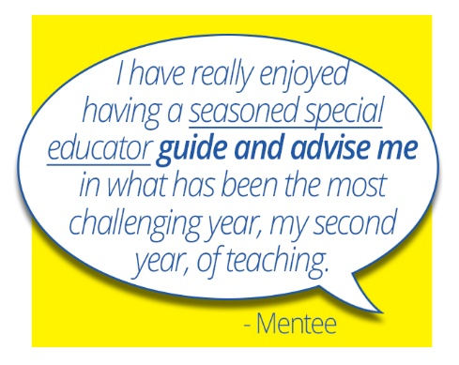
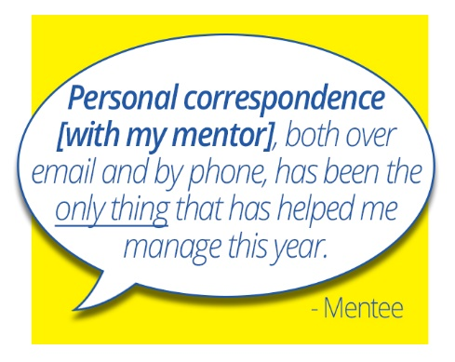
Aim: To Retain Highly Qualified Special Education Teachers in Kansas Schools
Notes:
Image 1: Quote from a mentee: I have really enjoyed having a seasoned special educator guide and advise me in what has been the most challenging year, my second year, of teaching.
Image 2: Middle aged man smirking wearing a tie with an oversized apple on his head
Image 3: Quote from a mentee: Personal correspondence [with my mentor], both over email and by phone, has been the only thing that has helped me manage this year.

Slide 14
The Kansas Recruitment and Retention project provides support to Kansas districts, schools and educators through the Kansas Education Employment Board (KEEB) and to early career special education staff through the Kansas e-Mentoring for Student Success (eMSS) effort.
Notes:
Image: Kansas Early Career Special Educator Mentoring including TASN (Kansas Technical Assistance System Network) logo with sunflower

Slide 15
Snapshot of Outcomes
Short-Term | Intermediate | Long-Term | Sustainability
Increased knowledge of effective instructional practices and effective classroom management practice | Increased implementation of effective instructional practices and effective classroom management practices | Increased student engagement | Increased special education teacher retention
Increased teacher competence | Increased job-related self-efficacy | Improved cooperation within educational systems | Intra and inter-school collaboration
Fidelity to mentoring professional development plan | Cadre of highly skilled KS mentors | Data-based mentoring to continually improve instructional practices that impact student outcomes | Sustainable system of mentoring available statewide to meet the needs of early career teachers
Increased knowledge of effective mentoring techniques | More effective mentoring through content enhancement, including family engagement | Increased family engagement | Increased special education teacher retention

Slide 16
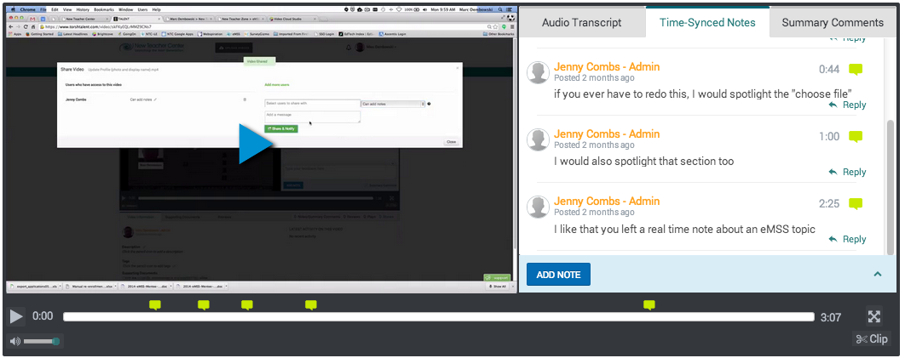
Mentoring Components
Video Observations
Notes:
Image 1: Two colorful computer generated images representing people grouped together with text “Our Place”
Image 2: Five colorful computer generated images representing people grouped together with text “Explorations”
Image 3: Multiple groups of colorful computer generated images representing people surrounding an image of the United States of America with text “National Community”
Image 4: Screenshot of Swivl video observation online tool with text “Video Observations”

Slide 17
Additional Supports
TASN Face-to-Face PD
Resources
Video Observation Tools
Notes:
Image 1: Classroom with adult learners facing forward at the presenter and the presenter screen
Image 2: Three books (Discipline in the Secondary Classroom, How to Reach and Teach Children with Challenging Behavior, Explicit Instruction), a Swivl observation device, and a tablet

Slide 18
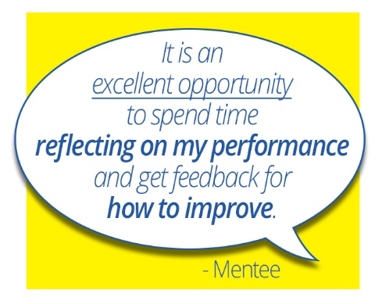
Expectations for Mentees
Communicate with your mentor 2 times per week.
Participate in a goal setting process with your mentor.
Complete 1 Exploration per year (allowed up to 3).
Participate in 3 video observation cycles during the school year (including pre-conference, video, post-conference with your mentor).
Notes:
Image: Quote from a mentee: It is an excellent opportunity to spend time reflecting on my performance and get feedback for how to improve.

Slide 19
Explorations Completed in 2017-18

Slide 20
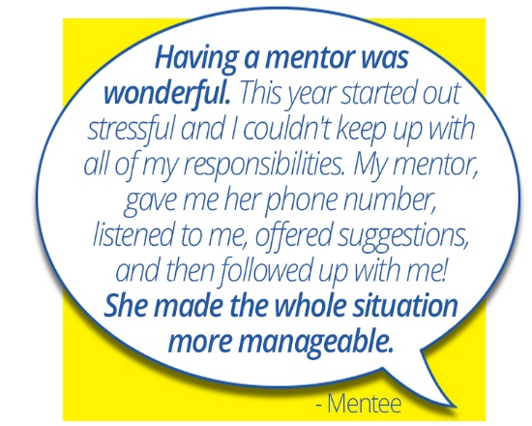
Mentee Satisfaction
Percentage of mentees that agreed or strongly agreed with each statement
My mentor was a great source of moral support | 96%
My mentor had a positive affect on my instructional practice | 93%
My mentor was a great content resource | 89%
Mentoring helped me grow professionally/develop my skills in my current role | 88%
eMSS provided me with mentoring support that would otherwise be unavailable to me | 80%
Notes:
Image: Quote from mentee: Having a mentor was wonderful. This year started out stressful and I couldn't keep up with all of my responsibilities. My mentor, gave me her phone number and listened to me, offered suggestions, and then followed up with me! She made the whole situation more manageable.

Slide 21
Mentee Reflection
Instruction, Administrative Support, and Job Satisfaction
Notes:
Graph: Percentage of Mentees Who Agreed with the Following Statements
87.7% agree with the statement: I am given the support I need to teach students with disabilities.
93.0% agree with the statement: My students are engaged in the lessons that I teach.
87.7% agree with the statement: I am able to meet the learning needs of all my students.
96.6% agree with the statement: I regularly communicate with parents regarding the academic progress of their child.
94.8% agree with the statement: I regularly communicate with parents regarding the behavioral progress of their child.
85.7% agree with the statement: I am generally satisfied with being a teacher at this school.

Slide 22
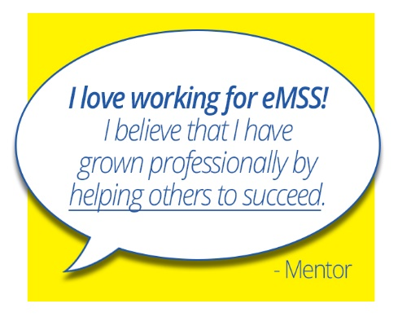
Mentor Rating of Mentee Proficiency
Notes:
Graph: Mentor Ratings of Mentees (Percentage of Proficient or Somewhat Proficient ratings)
98% rated “Plan instruction based on learning and developmental levels of all students” as proficient or somewhat proficient
98% rated “Establishes a classroom environment conducive to learning” as proficient or somewhat proficient
100% rated “Uses methods and techniques that are effective in meeting student needs” as proficient or somewhat proficient
Image: Quote from a mentor: I love working for eMSS! I believe that I have grown professionally by helping others to succeed.

Slide 23
Local Level Impact (Retention 2 Years After Mentoring)
Notes:
Image 1: Text “99% of mentees continue teaching 2 years after participating in mentoring” with a graphic of Kansas with 99% of the state colored dark blue while 1% of the state is colored light blue
Image 2: Pie graph depicting the Current Teaching Roles of 2015-16 Mentoring Participants (87% Special Educators, 70; 12% Other Educators, 10; 1% No Longer Educators, 1; Includes 1 mentee that moved out of Kansas but is still teaching special education and Does not include 5 mentees whose current teaching roles are unknown)

Slide 24
Statewide Implementation
In the past six years, 491 early career special educators in 87 Kansas school districts have successfully completed at least one year of e-mentoring.
Notes:
Image: Map depicting the districts or related organizations impacted by E-Mentoring between 2012-18 (Districts include: 260, 273, 305, 308, 336, 345, 353, 407, 457, 458, 475, 480, 489, 497, 605, 609, 610, 611, 616, 619, 620, 638, as well as service centers and special education cooperatives)

Slide 25
Kansas Lessons Learned
Aligned and coherent systems
Clearly convey expectations
Be responsive yet steadfast

Slide 26
Briefs Available
Briefs available for download at:
TASN Provider Evaluation Briefs

Slide 27
Kerry Haag
Kansas State Department of Education
khaag@ksde.org
www.ksdetasn.org
Handout Located at: TASN Provider Evaluation Briefs
Notes:
Image: Kansas Early Career Special Educator Mentoring including TASN (Kansas Technical Assistance System Network) logo with sunflower

Slide 28
Building Capacity of Novice Educators Using Performance Data and Authentic Coaching
Donna B. Wilder
Supervisor of Professional Learning

Slide 29
Outcomes
Gain clarity to better understand the functions and intentions of those who mentor novice educators.
Understand the role of data to support educator growth during authentic coaching conversations.
Notes:
30 seconds
Read independently.
What: Identification of the learning targets for this segment.
Why: Outcomes create interest and establish context for learning.
How: Allow time for participants to read the outcomes, then emphasize that the data collected will have a role in the focus of today’s learning.

Slide 30
Role versus Function
Every person has multiple roles to play in life. Every role requires a different set of functions and responsibilities.
“My role is mentor, but I support the new teacher by functioning as a coach, collaborator, and consultant.”
Mentor
Veteran Teacher
Wife
Parent
Mentee
New Teacher
Son
Athlete
Notes:
30 seconds
What: Clarification of a role versus a Function
Why: Understanding of the difference allows the mentor to make strategic decisions that best support the novice educator.
How: Explore the support functions (next slide) that mentors develop skill in navigating.
Invite participants to think about role vs. function as we focus on mentors and how they supports a new teachers.
Reveal quote and read to the group.

Slide 31
Coaching
Collaborating
Consulting
Presumes the teacher has resources to reflect on practice and plan for instruction.
Is teacher-focused
Is driven by the thinking of the teacher.
Supports self-directed assessment, thinking and learning.
Creates shared focus and thinking.
Is driven by the thinking and contributions of both parties.
Promotes valued collaboration.
Can lead to dependency by the teacher.
Is focused on thinking and knowledge of the mentor who gives advice, options, etc.
Is driven by the ideas offered to the teacher by the mentor.
Leads to dependency by the teacher.
“Just tell me what to do.”
Notes:
3 minutes
What: An opportunity to compare each of these three support functions and consider why it is important that mentors understand the difference and when each should be used.
Why: Without clarity, mentors and others who intend to be growth producers who empower, default to what they know best, and give all of their thoughts, rather than building upon the thinking of the teacher.
How: Identify when each function is most appropriate and why the order of these functions is an important consideration.
Transition from the three support functions by focusing on the use of feedback as an energy source (Hattie 2003) and how a mentor who collects relevant data and uses it skillfully (free from subjective interpretation, judgments)
can activate self-evaluation, self-analysis, and self-modification as the novice educator surfaces their own judgments, personal observations, and inferences. (Wiggins 2014, & Costa, A., and Garmston, r., (2016)

Slide 32
Five Types of Feedback
Judgments
Personal Observations
Inferences
Data
Mediative Questions
Outstanding
A+
Your attitude was poor.
F
I like your classroom.
I didn’t like the strategy used.
I liked the group activities.
You’re a model teacher.
Your classroom runs beautifully.
You’re going to struggle fitting in.
You called on 8 girls and 3 boys during the lesson.
Here is a script of all 20 questions you asked.
Your paragraph is a 3 of 4 on the rubric.
What are you noticing about your data?
How do these compare to your expectations?
How might you refine your paragraph?
Costa, A., and R. Garmston 2016. Cognitive Coaching. 3rd ed.
Notes:
3 Minutes
What: Five different types of feedback.
Why: Understanding the feedback we give and its impact informs the decisions a mentor makes to build capacity of the novice educator.
How: Explore the differences in the feedback we give and apply these differences as a real example is shared (next slide).
Judgments and Evaluations: Shifts focus from the thoughts of the novice educator to the evaluative thinking of the mentor. Can erode trust and ultimately undermine a safe learning environment for the novice educator.
Personal Observations and Preferences: Reflects the personal thoughts, perspectives and points of view of the mentor. Opens the door to dependency from the novice educator in wanting to please the mentor.
Inferences, Causality, and Interpretations: These statements come from the mentor’s point of view and interpretations.
Nonjudgmental Data: When educators identify and request data that would support their personal goals for a lesson, they are provided the opportunity to make meaning of day and to surface new learning and thinking that can be applied to future learning situations.
Mediative Questions: Questions that invite the novice educator to reflect on their own observations and data, support self-assessment and self-modification. The ultimate goal is for novice educators to become self-directed learners and thinkers who are able to self-manage, self-modify, and self-modify.
Mediative questions, combined with non-judgmental data provide the greatest opportunity for novice educators to clarify their own thinking and practice, and form their own judgments, personal observations and inferences.
After providing the types and examples of feedback for each type, transition to the next slide by saying, “So, what might this look and sound like as a mentor works with the novice educator?”

Slide 33
Growth Producing Feedback
Judgments
Personal Observations
Inferences
Data
Mediative Questions
As you listen to each of these scenarios, be thinking about how the feedback and its use is an essential skill for mentors.
Costa, A. and R. Garmston 2016. Cognitive Coaching. 3rd ed.
Notes:
What: Two authentic scenarios where performance data was incorporated in an authentic reflective coaching conversation with a new educator.
Why: Provides an opportunity for participants to envision how a coach can impact the educator’s ability to self-assess and modify practice.
How: Listen as presenter shares two examples that bring clarity to the role of data and how it is inserted into a reflective conversation with the educator.
Scenarios
First year middle school math teacher example with script of all questions asked during the lesson.
Use of short video clips to capture independent group work as the teacher provided small group to five students in the class.

Slide 34
Growth Producing Feedback (Cont’d)
Judgments
Personal Observations
Inferences
Data
Mediative Questions
Coaching
to support
self-directed
thinking
Evaluative
from the observer’s
perspective.
Costa, A. and R. Garmston 2016. Cognitive Coaching. 3rd ed.
Notes:
1 minutes
What: Clarification between evaluative feedback and feedback combined with coaching as growth-producing feedback..
Why: Provides an opportunity for participants consider the feedback they give and the potential impact on thinking and practice.
How: Draw connections from the scenarios provided and the potential for impacting self-directed learning and thinking with the novice educator.

Slide 35
There is only one you in all time.
Martha Graham
When we give our advice, we open the door to be blamed for failure. Blame evokes defensiveness, defensiveness reduces awareness.
No two human minds or bodies are the same. How can I tell you how to use yours best? Only you can discover how with your awareness.
John Whitmore (2010)
Notes:
1 minutes
Personal Story:
What: A quote to support and extend thinking of participants.
Why: Personal connections are important in supporting and even challenging the thinking of others.
How: Read and reflect upon the quote.
Listen to a personal story and share at tables how this quote and story connects to your personal experiences.

Slide 36
National Technical Assistance
CEEDAR
NCIPP

Slide 37
Systems Approach
State Department
Universities
Districts

Slide 38
West Virginia Example

Slide 39
West Virginia Goal
To reduce unwanted teacher turnover by creating an induction program aimed at ensuring a committed high quality special education teacher force by:
building instructional quality
increasing student achievement
retaining effective teachers

Slide 40
West Virginia Plan
Strategy to Achieve Goals, Ameliorate Roadblocks
Effective Special Education Teacher
National Board Certification
Professional Development
E-Mentoring

Slide 41
National Board Certification
Goal:
Encourage Experts in Special Education
Build Strong Cadre of Mentors
Take One!
Standards-based approach for improving teaching practice and links student learning to effective instruction
Paid for by State

Slide 42
E-Mentoring Plans- WV Connect
Establish Statewide cadre of low-incidence mentors
Online Platform decision/collaborate with IHEs
Pilot mentor assignment for most rural areas, open invitation

Slide 43
Professional Development
Monthly professional development sessions
Mentor and beginning teacher attend
Follow up activities, materials, suggestions

Slide 44
Georgia Example

Slide 45
High-Leverage Practices
The Georgia Department of Education
The University System of Georgia
The Georgia Professional Standards Commission
CEEDAR Center
School Districts

Slide 46
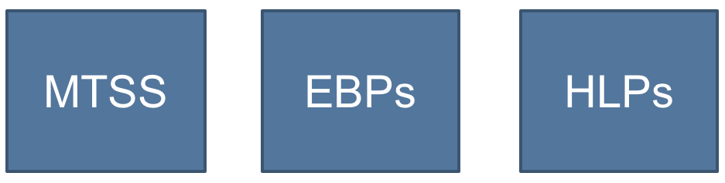
Empower educators to maximize P-20 student success using High-Leverage Practices within a Multi-tiered System of Supports(MTSS)

Slide 47
High-Leverage Practices (HLPs)
“A set of practices that are fundamental to support…student learning, and that can be taught, learned, and implemented by those entering the profession.” (Windschitl, Thompson, Braaten, & Stroupe, 2012, p. 880)
HLPs are HOW teachers deliver instruction. All teachers should have deep knowledge in a core set of effective instructional practices. (McLeskey & Brownell, 2015)
Notes:
(McLeskey & Brownell, 2015)
A “high-leverage practice” is an action or task central to teaching. Carried out skillfully, these practices increase the likelihood that teaching will be effective for students’ learning. They are useful across a broad range of subject areas, grade levels, and teaching contexts, and are helpful in using and managing differences among students. The set of high-leverage practices is intended as a common framework for teaching that will provide a core “curriculum” for an educator preparation program.

Slide 48
What about Evidence-Based Practices?
Are content specific
Developmentally appropriate
Learner dependent
Are taught using HLPs
Notes:
EBPs and HLPs are similar in that they are both grounded in strong research, however have some distinct differences. (read slide)
HLPs are how evidence based practices are delivered.

Slide 49
Key Stakeholders
Universities- University System
Embed HLP in coursework and field experiences in teacher and leader preparation
School Districts
Provide opportunities for practice in general education, special education and leadership supports
DOE
Provide infrastructure for supports, P-20 collaboratives, RESAs, State TA support
PSC
Considerations for Policy
CEEDAR
IHEs
LEAs
DOE
PSC

Slide 50
Resource Roundup
NCIPP.org
Mentor handbook
District Induction Manual
Briefs
CEEDAR.org
HLP
EBP
Course Enhancement Modules
Practice Based Opportunities

Slide 51
If we truly care about students with disabilities we will:
Commit to increasing the number of fully prepared staff
Put in place programs and policies that recruit and retain more well prepared and fully certified staff
Leverage federal, state, and district programs to create a more comprehensive talent management approach

Slide 52
Questions

