Slide 1
High Leverage Practices: Where Do We Go from Here?
Larry Maheady, PhD
Exceptional Education Department
SUNY Buffalo State
maheadlj@buffalostate.edu
June 20, 2018
HLP/MTSS Summit West Georgia State University Macon, GA

Slide 2
Bring clarity to the similarities & differences among HLPs, EBPs, RBPs, PPs, and PBTE within the context of MTSS such as RtI & SWPBIS

Slide 3
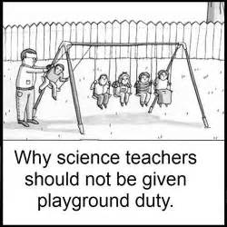
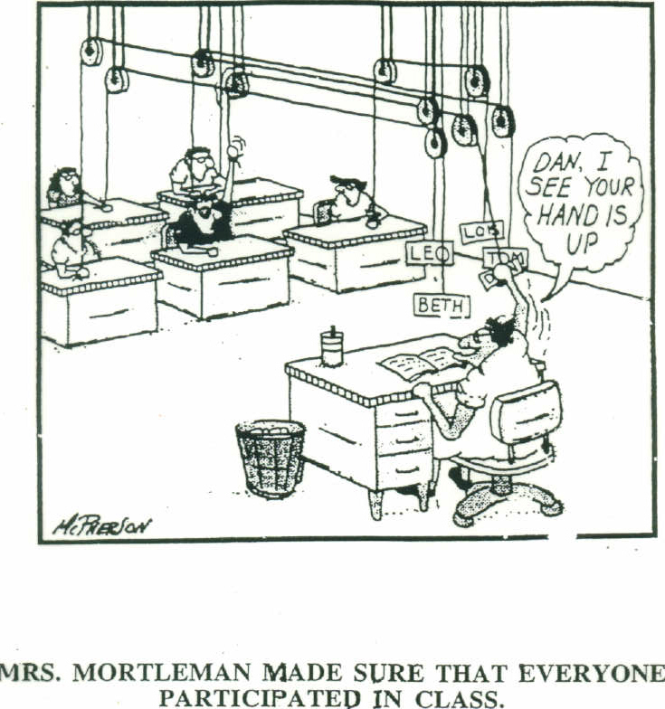
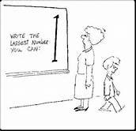
Answers to Other Important Questions

Slide 4
Agenda
Describe HLPs/EBPs in general & special education & how they are linked to MTSS
Provide three examples of how they can be infused into University coursework & P-12 schools
Describe some opportunities to respond to challenges associated with identifying & implementing them

Slide 5
High Leverage Practices
“A set of practices that are fundamental to support student learning, and that can be taught, learned, and implemented by those entering the profession” (Windschitl, Thompson, Braaten, & Stroupe, 2012, p. 880).
Limited number of teaching practices that are….
Used frequently in classroom
Broadly applicable across age/grade levels & content areas
Research-based & foster improved student outcomes

Slide 6
High Leverage Practices (N= 19; Teaching Works, 2013)
Lead guided reading lesson(s)
Teach lessons or lesson segments
Implement organizational routines, procedures, and strategies to support a learning environment
Set up and manage small group work
Establish norms and routines for classroom discourse in subject matter
Select and use specific methods to check understanding and monitor pupil progress
Provide oral and written feedback on student work
Communicate about students with parents or guardians
Analyze instruction for the purpose of improving it

Slide 7
High Leverage Practices in Special Education (N = 22; CEC, 2016)
Collaboration (3)
Collaborate with other professionals to increase student success
Assessment (3)
Use assessment data, analyze instructional practices, & make adjustments to improve student outcomes
Social/Emotional/Behavioral (4)
Establish consistent, organized, and respectful learning environments
Instruction (12)
Use strategies to promote student engagement
Use flexible grouping
Notes:
THESE ARE FROM CEC HLPs for SPE teachers—but relate strongly to what all teachers should be able to do in inclusive general education classrooms.
Collaboration—think co-teaching
Assessment—think formative assessment
Social/Emotional/Behavioral—basic classroom management

Slide 8
How are HLPs used?
Adopt HLPs & components to be taught in relevant coursework
Teach systematically to mastery in college classes, simulated, and natural (classroom) settings
Integrate practices in P-12 classrooms with coaching to develop fluency
Produce teachers with a foundation of critical skills when they enter the classroom

Slide 9
19 GE
22 SE
41 HLPs
Signature Set of Practices

Slide 10
“Signature Set” of High-Leverage Practices
Work collaboratively with others to improve student outcomes (HLPs # 1 & 3)
Use formative assessment to monitor student performance (HLP# 6)
Use strategies that actively engage all students (HLP#18)
Provide effective academic and behavioral feedback (HLPs# 8 & #22)
Create consistent, organized, & respectful learning environments (HLP #7)
Use small/flexible grouping effectively (HLP#17)

Slide 11
Evidence-Based Practice(s)

Slide 12
Evidence-Based Practice(s) (EBPs)
Defined in two ways in education
1. Set or list of teaching practices validated by rigorous research reviews
What Works Clearinghouse
Best Evidence Encyclopedia
Hattie or Marzano “Meta-analyses”
2. Decision-making process informed by
Best available evidence
Professional wisdom
Student needs

Slide 13
Formative evaluation = .90
Feedback = .73
Spaced practice = .71

Slide 14
Essential or Core Practices
Providing formative evaluation | 0.90
Feedback | 0.73
Spaced versus massed practice | 0.71
Meta-cognitive strategies | 0.69
Self-verbalization/self-questioning | 0.64
Concept maps | 0.57
Worked examples | 0.57
Peer tutoring | 0.55

Slide 15
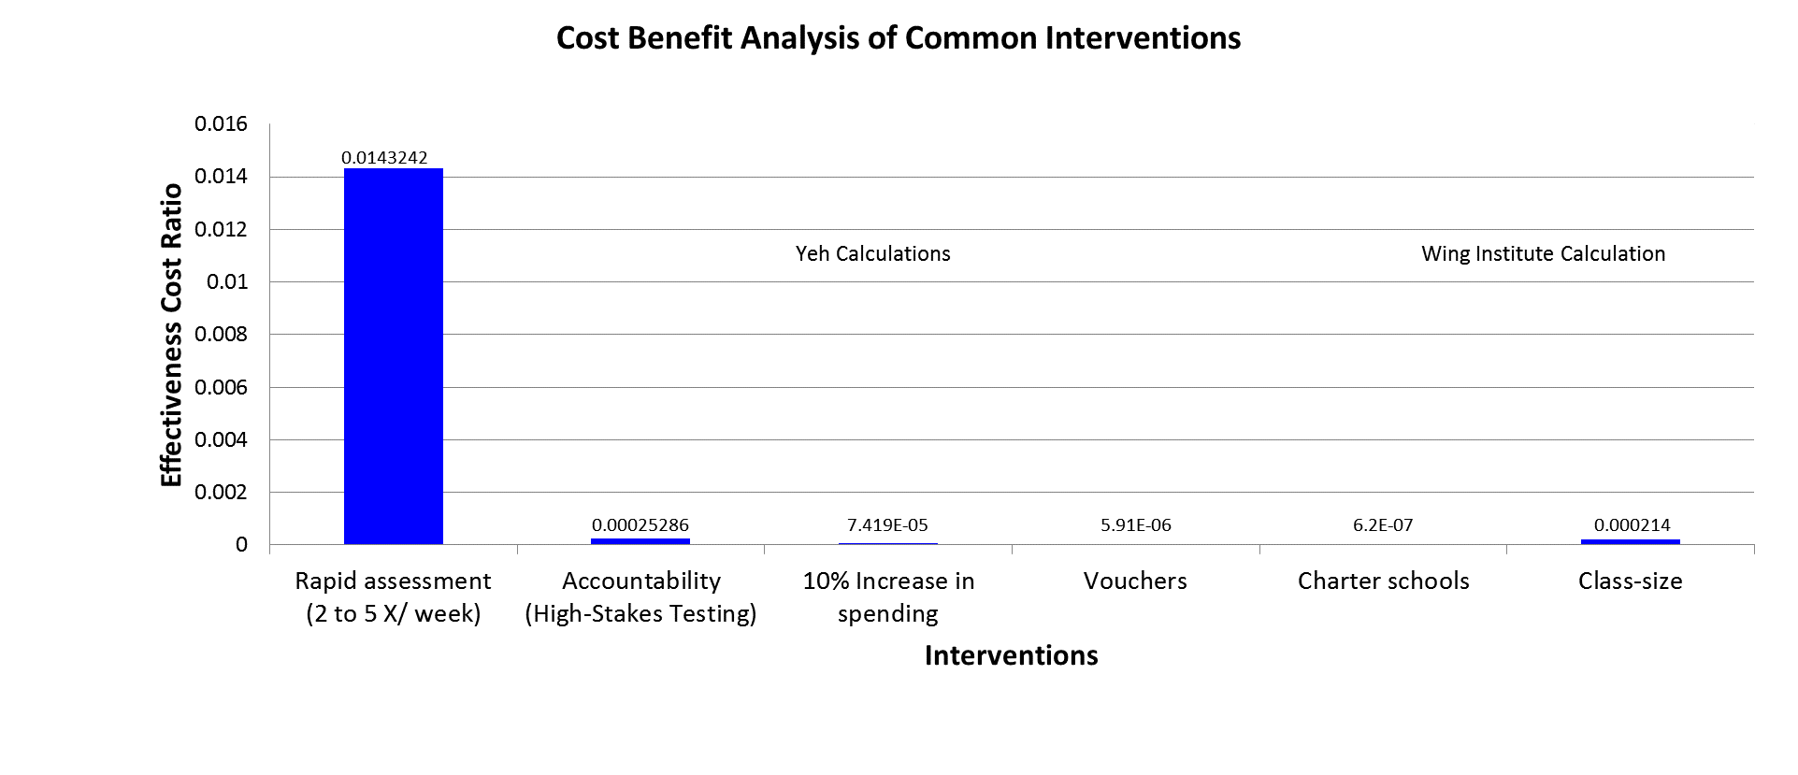
Effectiveness Cost Ratio = Effect Size/Cost Per Student

Slide 16
EBP as a Decision-Making Process

Slide 17
Challenge for Leaders & Practitioners
Solve specific problems for specific students in specific context.
Evidence base may be…...
abundant to non-existent
more or less relevant
What should leaders & practitioners do? decisions must be made…
Use the best available evidence OR make decisions without relying on evidence at all
Even if EBPs are implemented well, impact on students must still be evaluated
Progress monitoring = practice-based evidence

Slide 18
Evidence-based Practice as Decision-Making Process
Professional Wisdom
Best available evidence
Student Needs
Best Available Evidence
Sackett et al (2000)
Professional Wisdom
EBP is a decision-making approach that places emphasis on evidence to:
guide decisions about which interventions to use;
evaluate the effects of any intervention.
Detrich (2008)
Student Needs

Slide 19
Which HLPs/EBPs should YOU implement in our classrooms and programs & support in policy?

Slide 20
Infusing HLPs/EBPs in University Coursework & P-12 Schools

Slide 21
Instructional Assistants Program

Slide 22
Instructional Assistants Program
8- to 10-week clinical experience; linked to required foundation course & developed with P-12 schools
Candidates assigned in pairs; (twice per week; 3 hours per day)
Teaching/Learning Contracts defined daily instructional roles
Taught two formal lessons
Pre- & post-test lessons
Graphed results for whole class, small groups, & one target student
Use simple EBP with fidelity in one lesson

Slide 23
High Leverage Practice Contracts
High Leverage Practice(s) | Very Important | Somewhat Important | Less Important
#1. Collaborate with professionals to increase student success. | X
#6. Use student assessment data, analyze teaching practice & adjust to improve student outcomes. | X
#8. Provide positive & constructive feedback | X
#14. Teach cognitive & metacognitive strategies. | X
#17. Use flexible grouping. | X

Slide 24
Descriptive Study (Maheady et al., 2007)
422 pre-service general educators over 4 semesters
Almost 17,000 hours of in class assistance (15 years)
78% in high need schools
Taught over 800 formal lessons & implemented simple EBP with fidelity
Students made marginal and noticeable gains in 83% of sampled lessons
Students & teachers provided positive evaluations of program and EBP
Lessons Learned
Candidates can use “simple” EBP as intended & helped students
In-service teachers used IA primarily for instructional purposes
School-university partnership has persisted for over 25 years

Slide 25
How might this type of clinical experience “fit” into YOUR programs & schools?

Slide 26
Pair Tutoring Program

Slide 27
Peer Tutoring Program
After-School Tutoring Program
Linked to Introduction to Special Education course
8- to 10-week tutoring program for SWDs & ELLs
2:1 instructional arrangement
Candidates alternated roles (i.e., teaching, observing, & data collection)
Collected data on fidelity of practice use
Monitored student performance on brief, end-of-session assessments
On campus, worked in small cooperative learning groups
Used Jigsaw
Modeled content enhancements & incentive systems

Slide 28
High Leverage Practice Contracts
High Leverage Practice(s) | Very Important | Somewhat Important | Less Important
1. Collaborate with professionals to increase student success. | X
6. Use formative assessment data to improve student outcomes. | X
8. Provide positive & constructive feedback. | X
11,12, & 13. Co-plan, co-teach & adapt lessons. | X
16 & 20. Use explicit and/or intensive instruction. | X

Slide 29
Peer Coaching Study
Randomly selected 3 tutor pairs
Taught them to use adapted version of PALS
Examined effects of coaching on
How well candidates coached
How well they used PALS
What happened to P-12 students’ ORF & comprehension
Lessons Learned
Candidates learned to coach but not well
Coaching improved candidate’ accuracy in using PALS
Improved accuracy produced better P-12 student outcomes
Teachers, candidates, & P-12 students rated program favorably
Pair Tutoring Program sustained for 26 years

Slide 30
How might a tutoring program “fit” into YOUR programs & schools?

Slide 31
Graduate Research Sequence

Slide 32
Graduate Research Sequence
6-hour TE research sequence
First course, candidates……
Identify important PRACTICE-BASED problems
Complete illustrative literature reviews
Design research-to-practice studies
Research-to-practice studies
Targeted important problems in P-12 settings
Conducted study under “existing” conditions
Compare student performance under existing (baseline) versus intervention conditions

Slide 33
Teaching/Learning Contracts
Roles & Responsibilities | Very Important | Somewhat Important | Less Important
1. Collaborate with other professionals | X
2. Use assessment data to make decisions | X
3. Analyze instruction for the purpose of improving it | X
4. Administer and score academic/behavioral assessments | X
5. (Insert other preferred instructional assistance)

Slide 34
Julie’s 5th Grade Inclusion Class
Participants and Settings
22 students 20 C; 1 His. & 1 AA in small, suburban setting
5 students with IEPs; 1 with 504 plan
Problem
High rates of disruptive behavior
Loud occasionally chaotic sessions
Goals
Reduce disruptive behaviors by at least 50%
Increase active student participation (i.e., asking & answering questions)
Instructional Practices
Three Jars vs. Existing Practice

Slide 35
Target Behavior & Criteria
Target students
Contingent Rewards
What?
Who?
Wow!

Slide 36
What outcomes/behaviors would you like to improve?
Non-compliance = 1
Out of seat = 1
All behaviors = 66
WHAT?
Inappropriate touching = 1
Non-compliance = 1
Out of seat = 1

Slide 37
Interdependent group contingencies:
All group members are rewarded based upon their collective performance (Litow & Pumroy, 1975)
Entire class
Dependent group contingencies:
All group members rewarded based on performance of one or few rmembers
WHO ?
Row 3
Row 2
Row 1
Sara
Bradley
Kristin

Slide 38
What are some preferred items and activities for your students?
5 min early dismissal
Teacher dresses up!
No work dots
No homework coupon
WOW!
Mystery Motivator
P

Slide 39
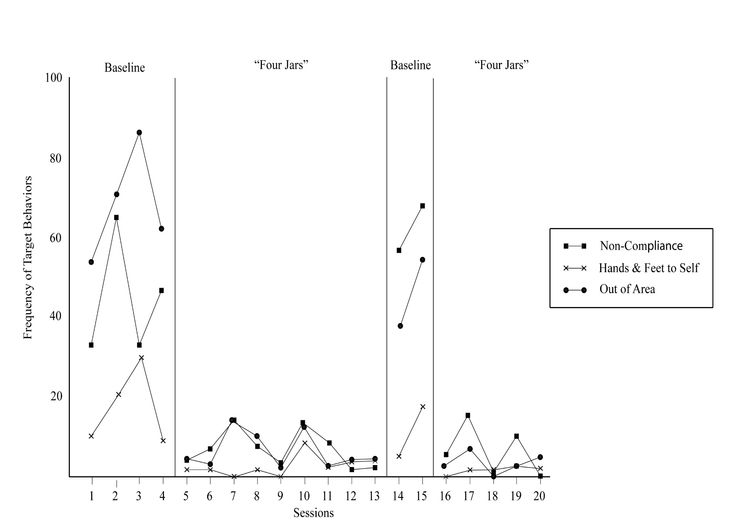
What happened when Jars was put back into effect?
What decision would you make about use of Jars?

Slide 40
How might research-to-practice studies “fit” into YOUR program?

Slide 41
Opportunities to Respond to Challenges of HLP Implementation

Slide 42
P-12 Teachers can….
Identify & prioritize areas of academic/behavioral need
Select HLPs/EBPs that are relevant, acceptable, & most likely to be effective
Guide when and where core practices are delivered
During regularly scheduled instruction, after-school……?
Tell us how to help them in implementing and making data-based decisions about HLPs/EBPs

Slide 43
School Leaders can……
Adopt, implement, and support mutually agreed upon HLPs
Identify & prioritize common areas of need
Work collaboratively with universities to identify important and relevant practices.
Encourage & support teacher use of signature set of practices & appropriate progress monitoring
Use PD that is evidence-based, linked directly to improved student needs, & feasible to implement and sustain
Use implementation & improvement science to guide efforts

Slide 44
Teacher Educators can….
Define the nature & scope of clinical experiences
Link P-12 teacher and student needs with evidence-based, relevant, and acceptable HLPs
Monitor implementation & impact on important candidate & P-12 student outcomes
Write professionally about how all of this was done

Slide 45
SEA professionals can…..
Promote policies that support use of HLP/EBP
policies that create systems and frameworks for implementation across all levels of the educational system
Encourage use of “enlightened PD” to help teachers use practices (e.g., coaching & induction models)
Support accountability policies and procedures that focus on student and teacher improvement over evaluation

Slide 46
Reason for Optimism
We are in midst of a practice-based movement in teacher education
We can expect more clinical experiences, strengthening partnerships among universities & P-12 schools, & policies that support and foster these changes
This is a good thing for P-12 students, teachers & school leaders, teacher candidates, university faculty & leaders, & families and communities

Slide 47
GA Accomplishments
Linked CEEDAR resources to multiple state initiatives
Adopted a sustainability approach supported by implementation science research
Taken initial steps to infuse practices with empirical support into teacher and leader preparation programs across general & special education
Assembled this summit to share, motivate, and support GA educators in providing the best educational services for students with and without disabilities

Slide 48
"We can, whenever and wherever we choose, successfully teach all children whose schooling is of interest to us. We already know more than we need to in order to do that. Whether or not we do it must finally depend upon how we feel about the fact that we haven't so far.'
Ron Edmonds (1979)

Slide 49
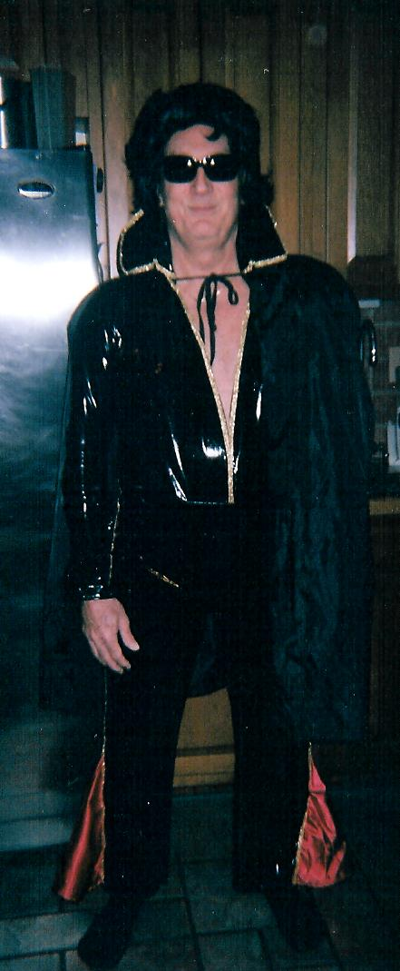
Thank ya, ….. thank ya, …thank ya very much

Slide 50
References
Council for Exceptional Children (2017). High Leverage Practices for K-12 special education teachers. Arlington, VA: Author.
Hattie, J. (2009). Visible learning: A synthesis of over 800 meta-analyses relating to achievement. New York: Taylor & Francis.
Maheady, L., Jabot, M., Rey, J., & Michelli-Pendl, J. (2007). An early field based experience and its effects on pre-service teachers’ practice and student learning. Teacher Education and Special Education 30, 24-33.
Mallette, B., Maheady, L., & Harper, G. F. (1999).The effects of reciprocal peer coaching on pre-service general educators' instruction
University of Michigan. (n.d.). Teachingworks: High leverage practices. Retrieved from: http://www.teaching works.org/work-of-teaching/high-leverage-practices
Yeh, S. S. (2007). The cost-effectiveness of five policies for improving student achievement. American Journal of Evaluation, 28(4), 416-436.

