Slide 1
Lesson study: A practice-based approach for increasing preservice teachers’ instructional and collaborative skill for inclusive teaching

Slide 2
Presenters
Mary Brownell, Director, CEEDAR Center, University of FL
Amber Benedict, Assistant Visiting Professor, University of FL
Sally Drew, Associate Professor, Central Connecticut State University
Joan Nicoll-Senft, Professor and Chairperson, Central Connecticut State University

Slide 3
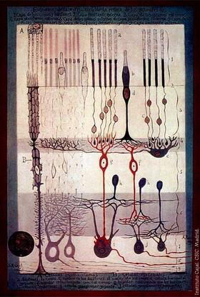

Why is practice important?
Allows for the development
of fluent performance and
situated knowledge
Notes:
I liked this picture of neurons and their synapses as it made me think about the acquisition of knowledge.
But the type of knowledge effective teachers and other experts need is not just acquired through learning from a book. It is acquired by applying in those settings and situations where we will ultimately be asked to use it.
Practice is what allows an expert to almost seem as if they are making decisions that are intuitive.

Slide 4
What Characterizes Effective Practice?

Slide 5



Essential Features of Deliberate Practice
MODELING
Demonstrates what is involved in effective performance
SPACED LEARNING
Provides sustained & repeated opportunities to practice knowledge over a period of time.
VARIED LEARNING
Provides opportunities to practice knowledge and skills across varying contexts, with a diverse range of student learners.

Slide 6



Essential Features of Deliberate Practice
COACHING AND FEEDBACK
Provides explicit feedback on practice attempts
ANALYZING AND REFLECTING
Engages in analysis and reflection of practice to deepen knowledge and expertise.
SCAFFOLDING
Provides opportunities to practice that gradually increase in complexity over time.

Slide 7
Lesson Study
A practice-based approach that incorporates many of the features of effective practice
Notes:
By planning and watching instruction, teachers have opportunities to see models of instruction. During phase two, they have opportunities to receive feedback and analyze one’s own performance. As teachers work through the lesson study process, they potentially have multiple to scaffold each others’ learning.

Slide 8
A Preservice and Inservice Example

Slide 9
DISCLAIMER
This content was produced under U.S. Department of Education, Office of Special Education Programs, Award No. H325A120003. Bonnie Jones and David Guardino serve as the project officers. The views expressed herein do not necessarily represent the positions or polices of the U.S. Department of Education. No official endorsement by the U.S. Department of Education of any product, commodity, service, or enterprise mentioned in this website is intended or should be inferred.

