Slide 1
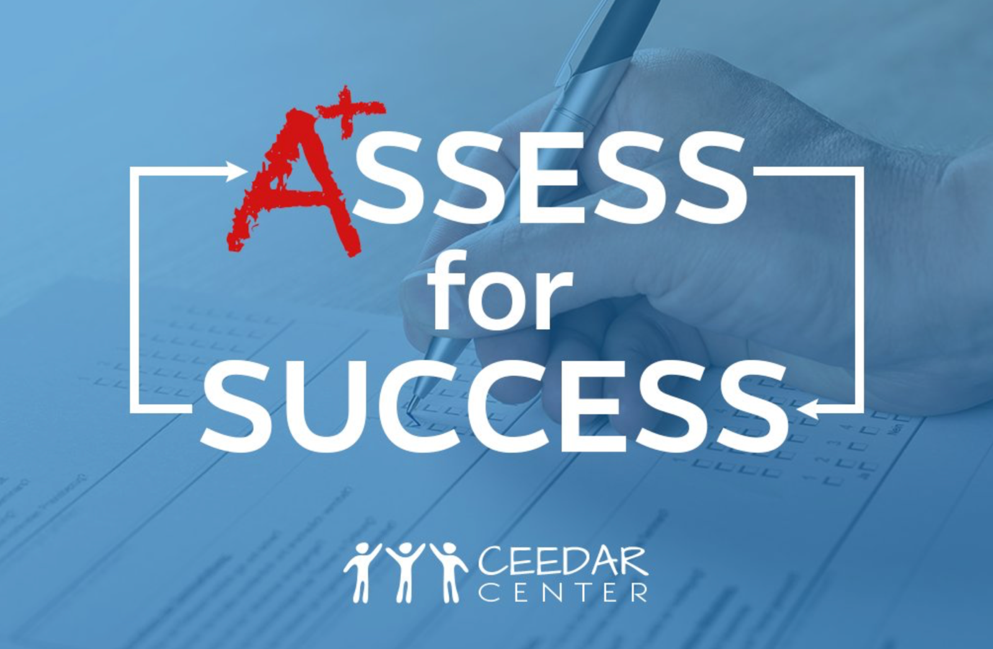
High-Leverage Practices in Special Education:
Assessment
ceedar.org
U.S. Department of Education, H325A120003

Slide 2
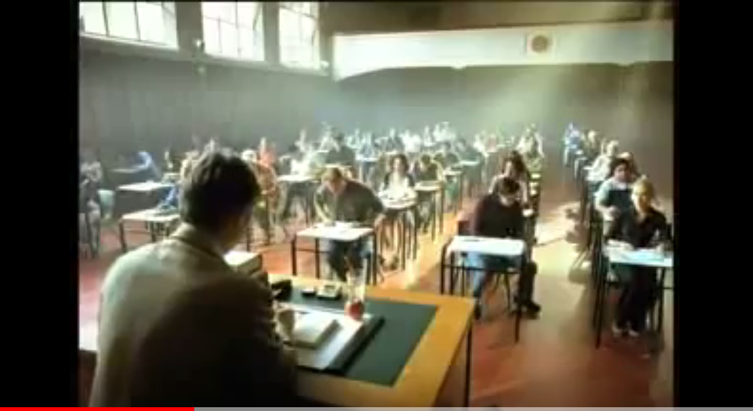
“When a teacher teaches, no matter how well he or she might design a lesson, what a child learns is unpredictable. Children do not always learn what we teach. That is why the most important assessment does not happen at the end of learning – it happens during the learning, when there is still time to do something with the information.”
–Dylan Wiliam, 2011
Notes:
https://www.youtube.com/watch?v=9zFmHeUcHXE&feature=youtu.be
Many people have a negative view of assessment. They think of assessment is taking a test. Given the current climate in many locations, assessment for teachers provides anxiety, sometimes for students, but assessment is really a good thing. It is a critical part of ensuring that as educators we are leveraging student strengths and meeting student needs.

Slide 3
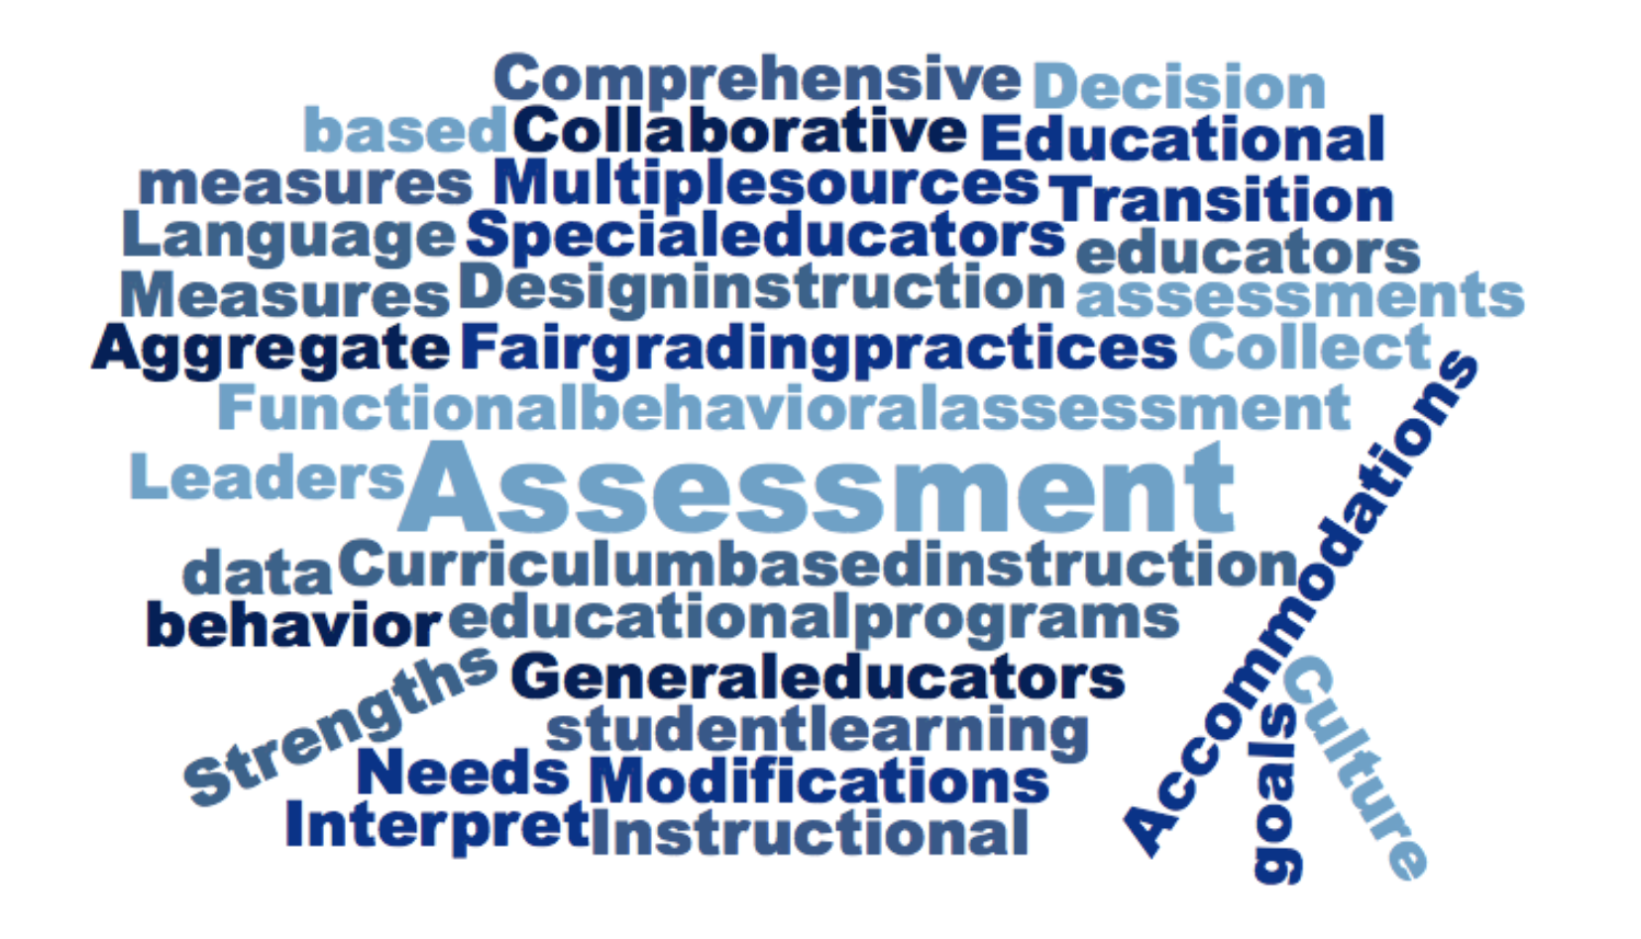
Notes:
Assessment is complex and because it guides educational plans, instruction and student learning- so we want to make sure we get it right.

Slide 4
HLPs: Assessment
Collect Information
Analyze data to create a learner profile
Interpret and communicate
Collaboratively create an educational plan
Ongoing adjustments to implementation
Notes:
Assessment is also not a one and done event. Assessment is a process, that is ongoing. Many teacher candidates come into their programs and field experiences with experiences about assessment that are not aligned with the idea of a process. It is our job to help our teacher and leader candidates have experiences in using assessment to guide educational programing and student learning

Slide 5
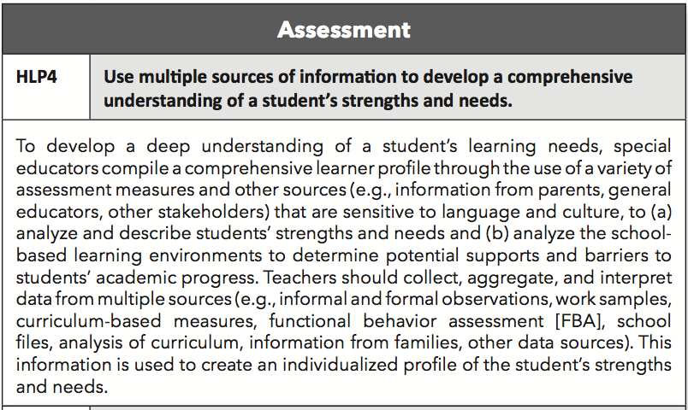
Sample activities and experiences:
Identify appropriate measures from multiple sources
Analyze real student data related to the creation of a lesson or unit
Use real and simulated case studies of students to create learner profiles using assessment data
Use Examples and Non-Examples to reflect culture and language challenges
Notes:
Beginning teachers have likely had many personal experiences with assessment, but often do not have enough opportunities to learn about what is appropriate assessment data and how to analyze that data to create student learning profiles. General educators aren’t often taught their role in assessments that are appropriate for all their students, including diverse learners and students with disabilities. Special education teachers often do not learn how to use multiple sources of data to better understand student strengths and needs. Finally, parents often do not understand how they can contribute to the data that is used for student learning profiles.

Slide 6
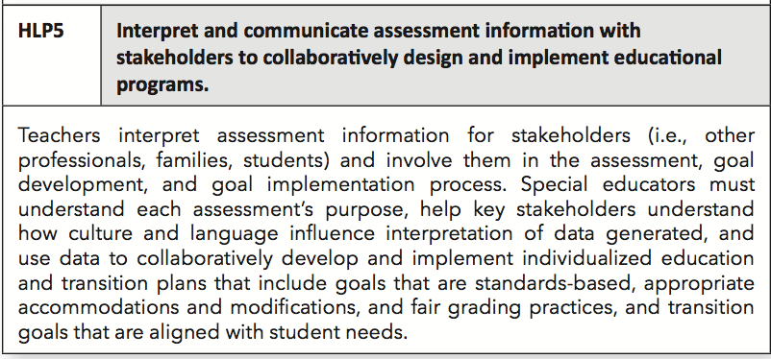
Sample activities and experiences:
Observe IEP meetings where data is discussed
Role play the interpretation of assessment information with different stakeholders
Generate questions parents or other key stakeholders may ask
Create a case study of 3 different families from different backgrounds and how culture and language changes a meeting
Notes:
When we get the multiple sources of data and it has been analyzed, communicating and interpreting results for key stakeholders is critical. All too often, meetings are held and assessment is either not talked about at all, or it discussed in a cursery way. It might include numbers of scores for different assessments. Often parents and teachers in meetings do not feel like they can ask for further clarification, and so the team is not fully informed when making decisions about educational plans. Having everyone understanding the data together is imperative so that the most effective plans for students with disabilities can be created.

Slide 7
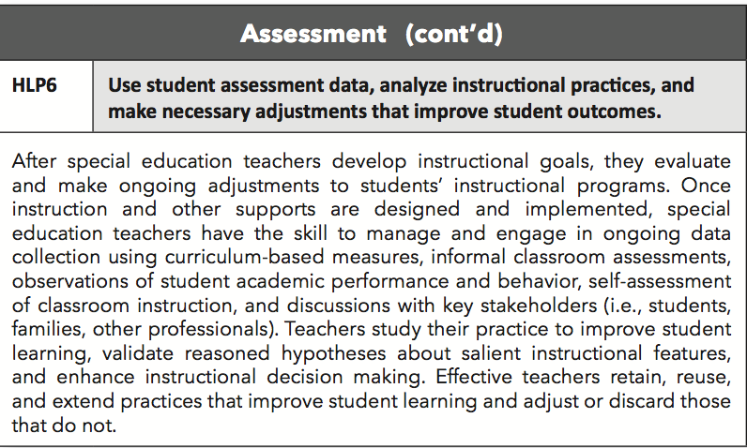
Sample activities and experiences:
Identify learning goals that are being met and not met
Create lessons using student data
Generate opportunities for ongoing assessment
Notes:
Even when the assessments are complete and then plan made, we are still not done. Helping teacher candidates understand and practice using assessments on an ongoing basis to adjust student instruction. Too often meetings on students with disabilities reveal that progress in student learning was not made. Special and general education candidates need to learn and practice using assessment on a regular basis to adjust the instruction to make sure students are making progress on student learning goals.

Slide 8
Opportunities & Solutions
Use multiple sources to create comprehensive learner profiles
Facilitate meetings that provide an opportunity for ALL stakeholders to understand assessment information and contribute
Make assessment a regular part of informing instruction
Notes:
Thinking about this from a pre-service GE, SE, EL, related services perspective…
What opportunities do you take to look at data collaboratively? Do you have data teams?
What challenges or opportunities do you see for growth in candidates?
What works well in preparing them to become effective in using assessment?

Slide 9
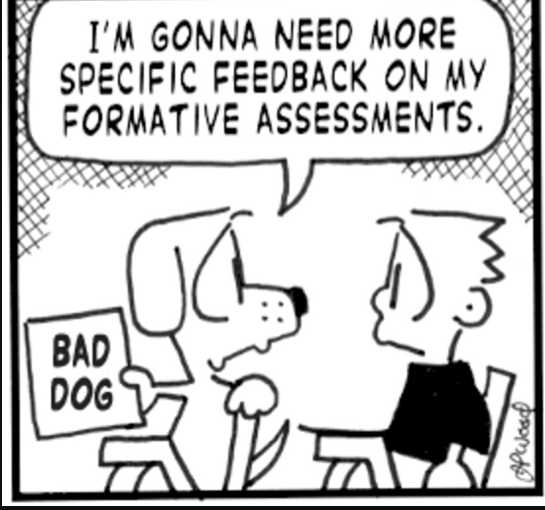
Notes:
I like this little comic because this little doggie wants to be a better dog, but he doesn’t know how. He needs more information and to understand the data on his actions.

Slide 11
Disclaimer
The contents of this webinar were developed under a cooperative agreement from the U.S. Department of Education, H325A120003. However, those contents do not necessarily
represent the policy of the U.S. Department of Education, and you should not assume endorsement by the federal government.

