Slide 1

Northern Michigan University
Joe Lubig
jlubig@nmu.edu
906-227-1880
www.nmu.edu/education

Slide 2

8
390.4
16,452
52
7
3%
320
240.9

Slide 3
16,452 square miles
3% of the population (311,361)
320 miles
7 ISDs
52 LEAs
8 Institutes of Higher Ed

Slide 4
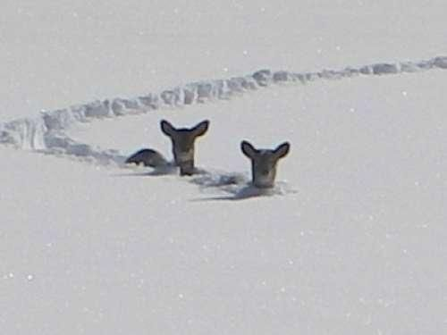
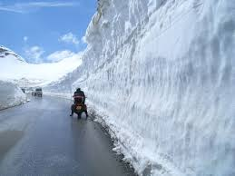

240.9 – 48 year average snow fall
390.4 – record snow fall

Slide 5
SISU in the Yoop
Heart
  Building Relationships with Students
  Passion for Engaged Learning
  Fostering authentic relationships built upon partners’ passions and strengths
Grit
  Building Relationships with Community Partners
  Time Commitment
  Foster trust between university program and Pre-K – 12 leadership
Bravery
  Trying Something that had Never Been Done Before In Program Form (based on case study research)
  Assuring that we use child assessment data in meaningful ways—do no harm!

Slide 6
U.P. Wide Collaborations
Upper Peninsula Center for Educational Development (UPCED)
Michigan Association of School Administrators Region I (MASA)
NMU Seaborg Math and Science Center
Teacher Education Advisory Committee (TEAC)

Slide 7
U.P. Wide Needs
Sustained Quality Professional Development for Teachers and Administrators
Internet Access
Teacher Shortage
Dual/Concurrent Enrollment
Quality of Candidates Entering the Profession

Slide 8
Barriers
State testing fear and the effect it will have on school rating (Went to co-teaching into two parts for student teaching ; Residency I they go 3 days a week and Residency II can be same classroom for traditional student teaching)
  Teacher evaluation system and disruption in the spring for testing (shifted to year-long student teaching)
  How to navigate the non-traditional student if we do year long residencies
  Over saturation of IHEs in a geographic area and those that have no IHEs in their area
  Master teachers want student teachers, but it is about building relationships so as to centralize the system and master teachers apply to mentor
  Limitation on student/teacher candidate finances (paid internships at instructional aide rate paid by school district)

Slide 9
Opportunities or Why Teachers are Willing to Work with Us

Slide 10
Interdisciplinary Middle School Teaching Experience
Week-long experience
7th grade
Four core areas, PE, music, and art
Special education
Defined roles
  Teacher candidates
  7th grade students
  Faculty
  Teachers
  Instructional Aides
  Administrators

Slide 11
Student Interest-driven Literacy Tutoring
Graveraet Elementary School and NMU
1st and 2nd Grade Students
1. Elementary students will have a positive literacy learning experience and grow in their literacy skills/knowledge.
2. Teacher candidates will have a positive teaching experience and grow in their literacy assessment, instructional knowledge, and professional communication.

Slide 12
Teacher Candidates Negotiate Relationships with Key Stakeholders
Teacher candidates engaged in ongoing professional interactions with key stakeholders, such as school specialists, students’ caregivers, mentors, and an instructional leader/evaluator (course professor).
Program Administration Negotiations
Use of inquiry to establish priorities and to increase the capacity of our program to the benefit of our teacher candidates, clinical partners, and every Pre-K – 12 student with whom we work.

Slide 13
What’s Next?
Develop a shared vision as to how these partnerships benefits children in the context of a compelling written case
Define a predictable financial support system to sustain the partnerships
Implement parent and child feedback loops to inform effectiveness of pre-service practice
Develop case study methodology to track teacher to parent & child conferencing effectiveness

Slide 14
Northern Michigan University
Joe Lubig
jlubig@nmu.edu
906-227-1880
www.nmu.edu/education

